Slide 1


Slide 2




Unit 15
OUR
HEALTH
Lesson 2 – Period 3

Slide 3









Table of Contents
Warm-up and Review
Activity 1: Look, listen and repeat.
Activity 2: Listen, point and say.
Activity 3: Let’s talk.
Fun corner and Wrap-up

Slide 4


01
Warm-up and Review

Slide 5


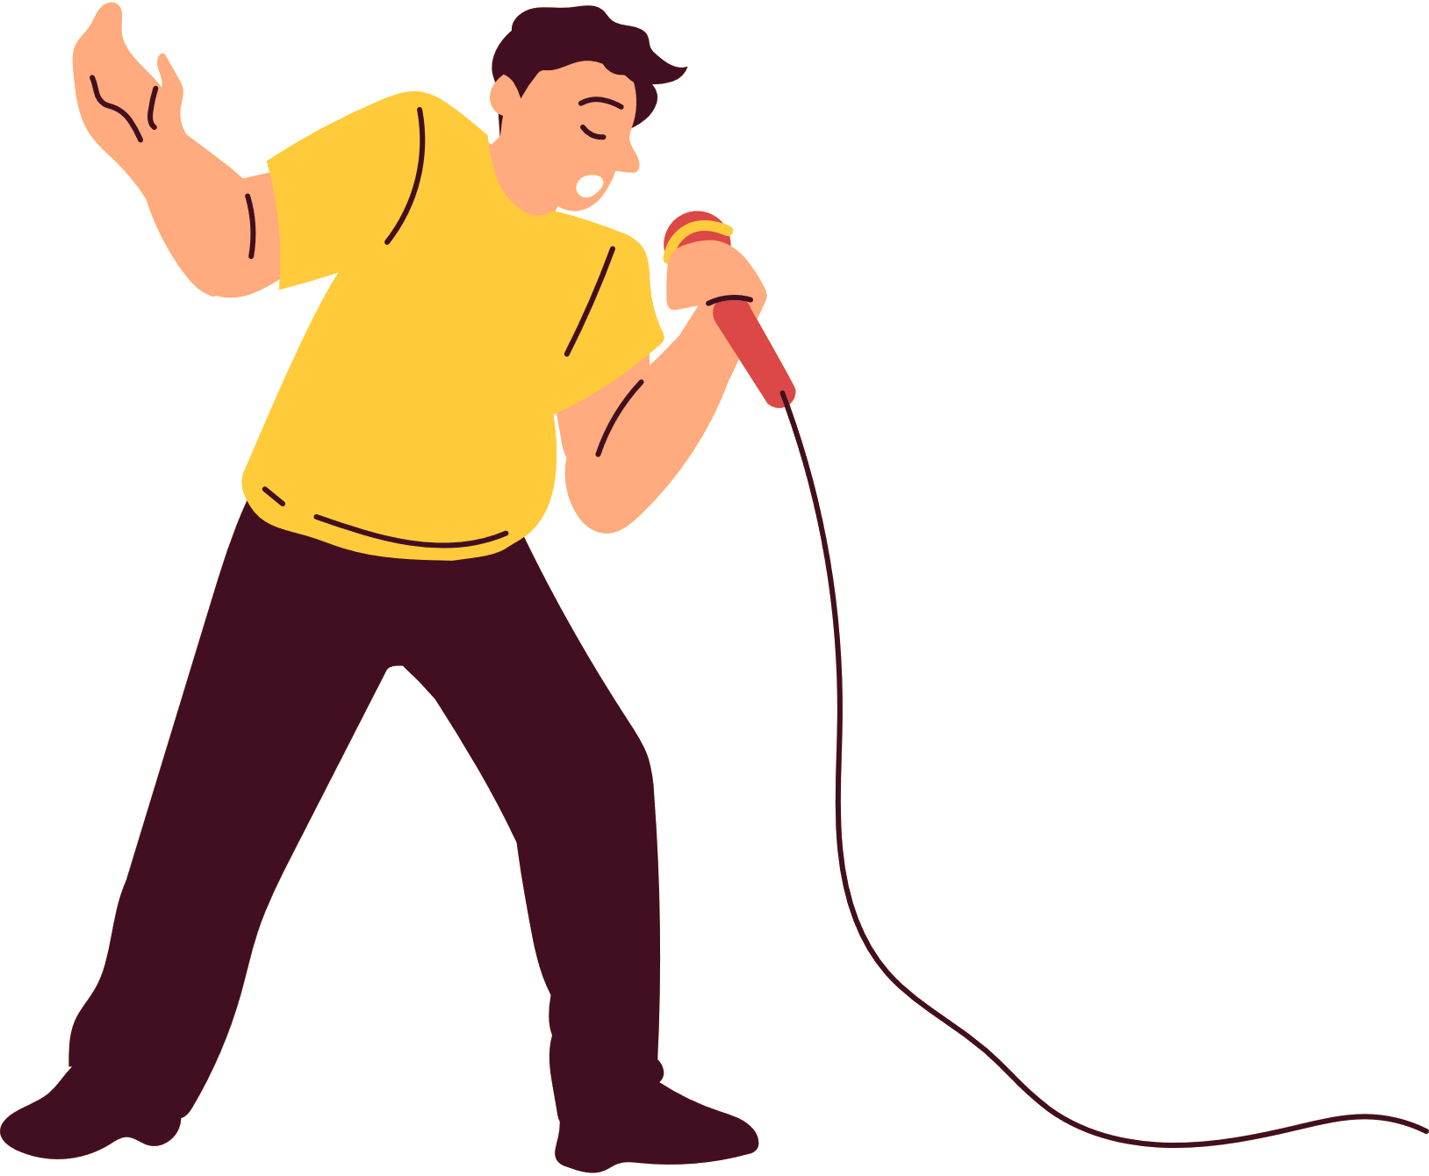
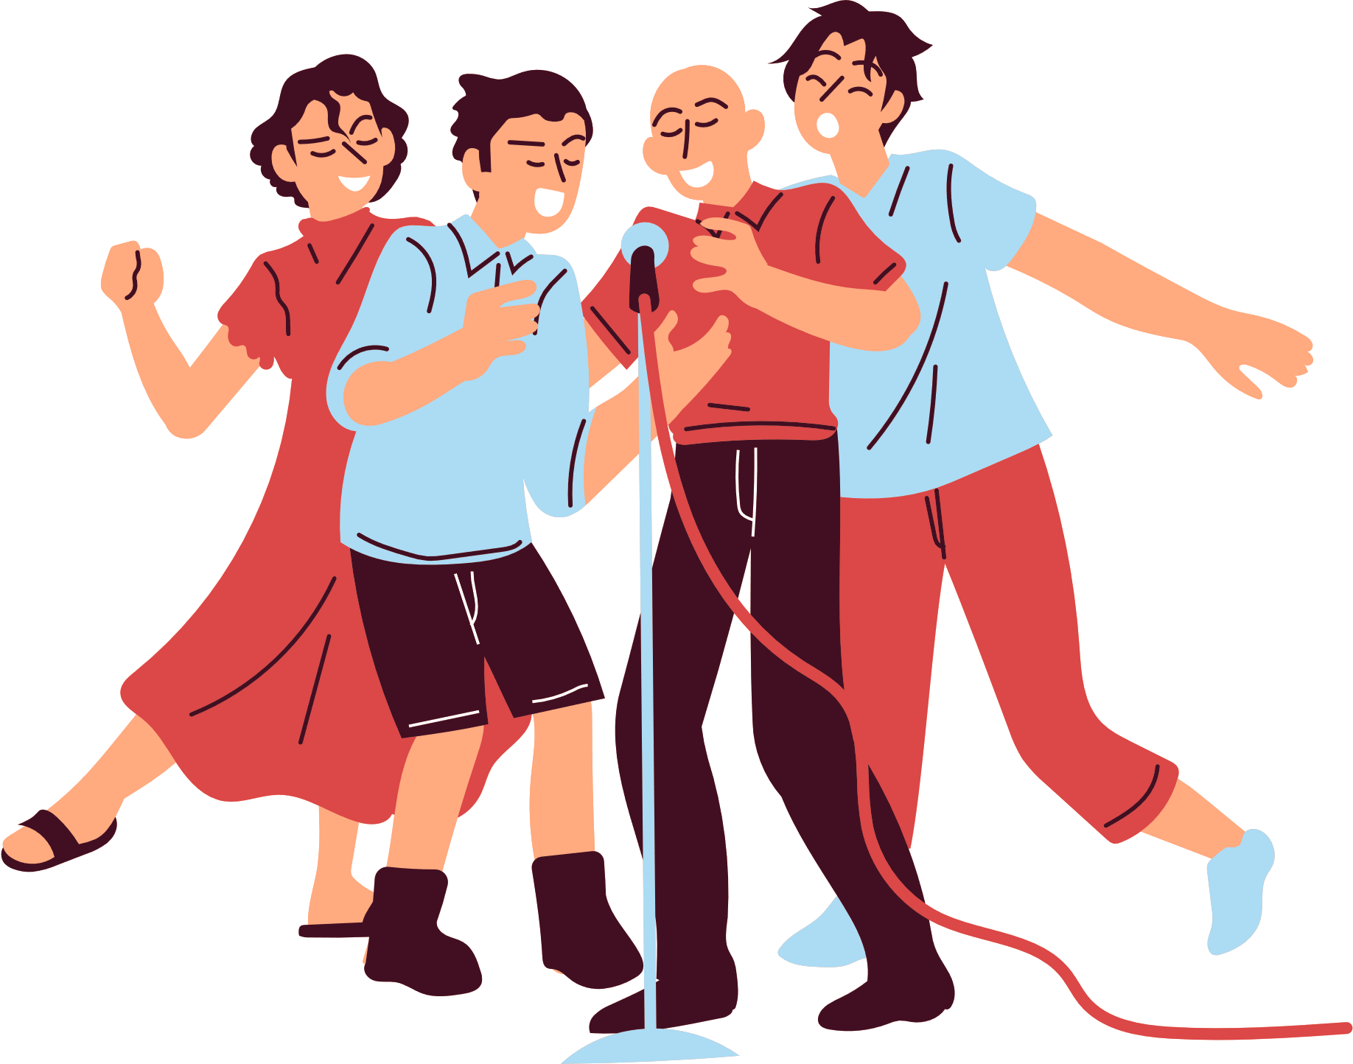
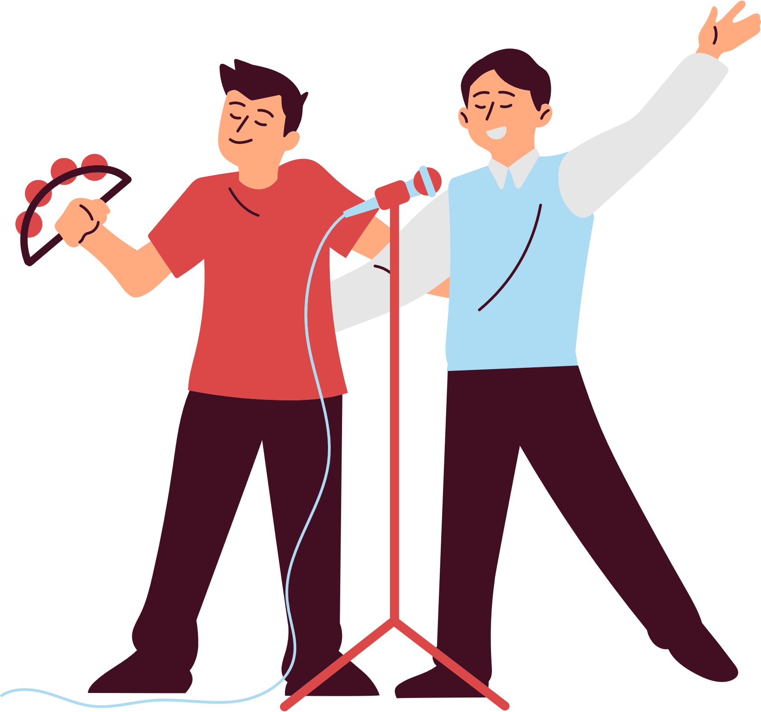
KARAOKE SHOW

Slide 6
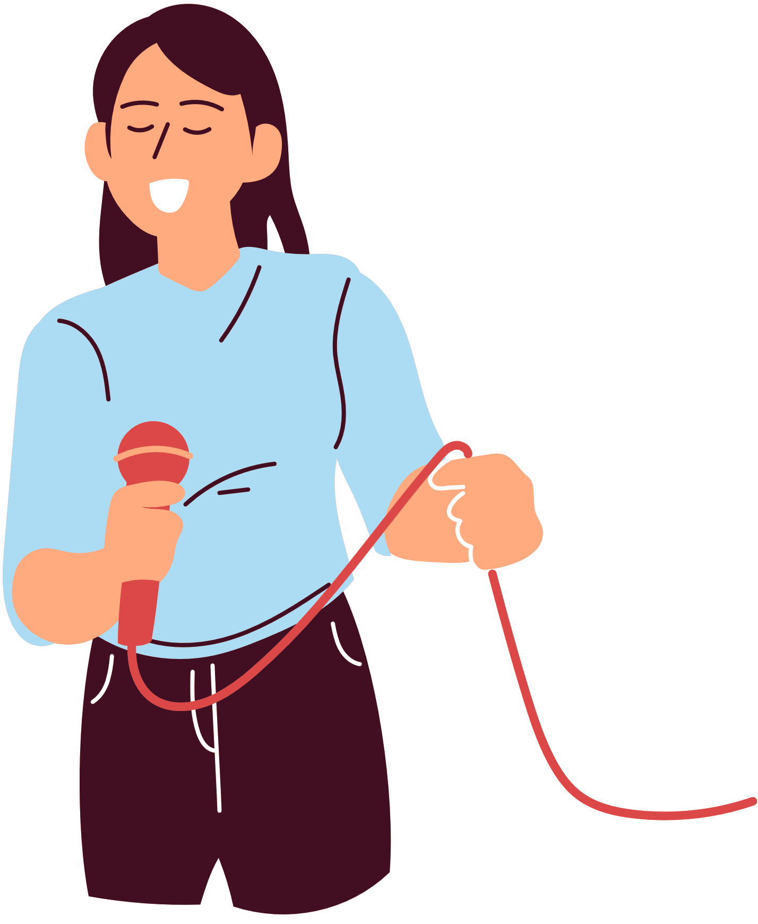
WHAT’S THE MATTER?
Let’s go out and play.
I’m sorry. I can’t.
Why? What’s the (1) ________?
I’m not very well.
I have a (2) ___________.
Notes:
Pupils guess what the missing words are.

Slide 7
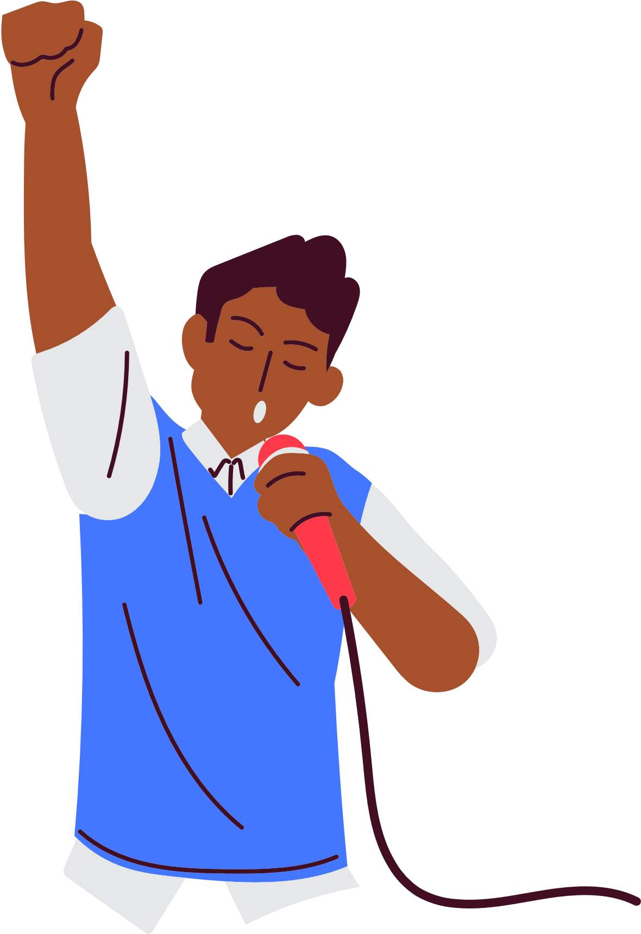
WHAT’S THE MATTER?
Let’s play and (3) __________.
I’m sorry. I can’t.
Why? What’s the matter?
I don’t feel well.
I have a (4) ______________.
Notes:
Pupils guess what the missing words are.

Slide 8

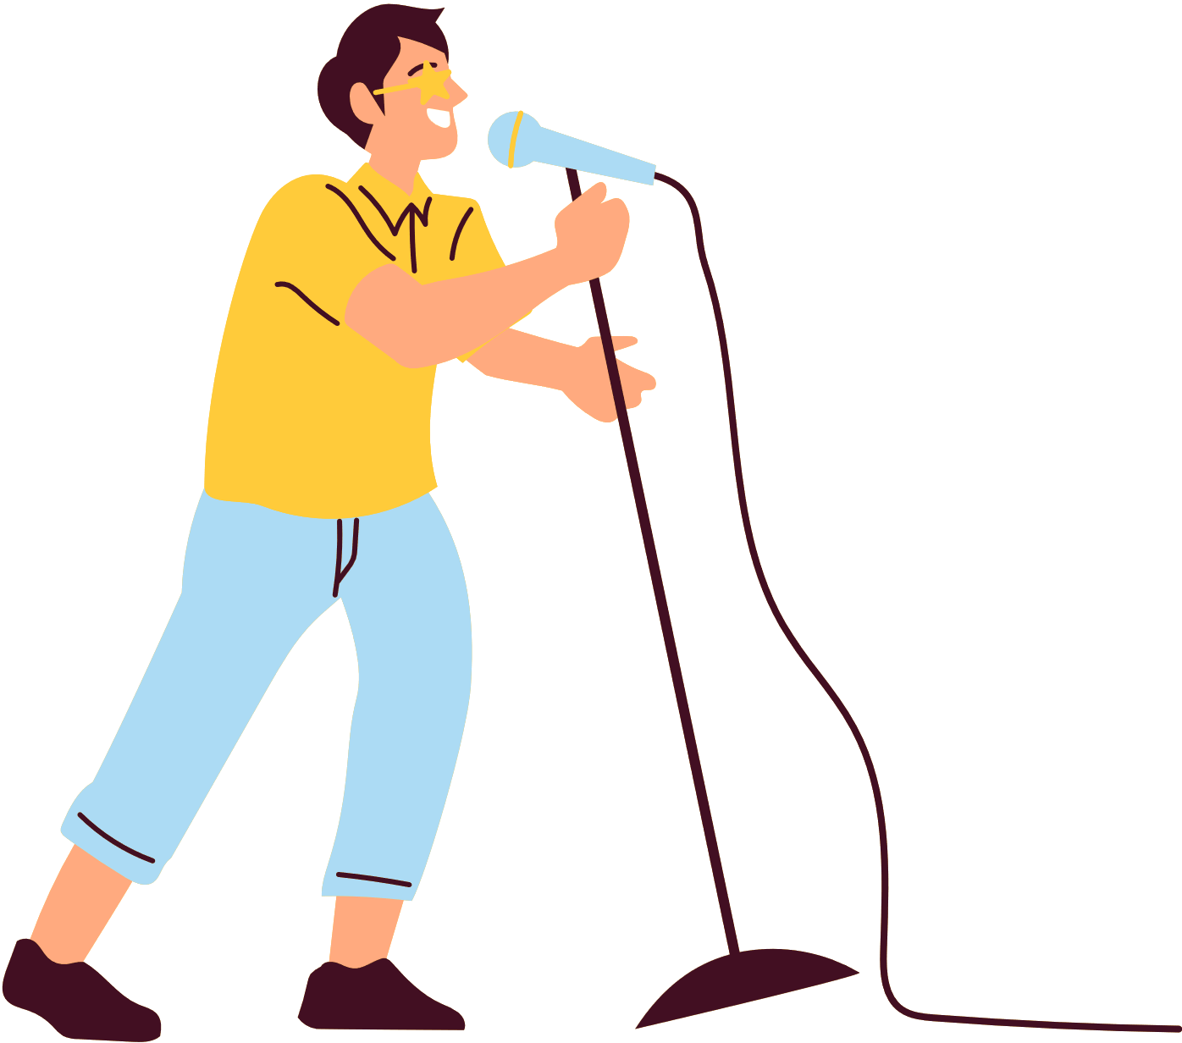
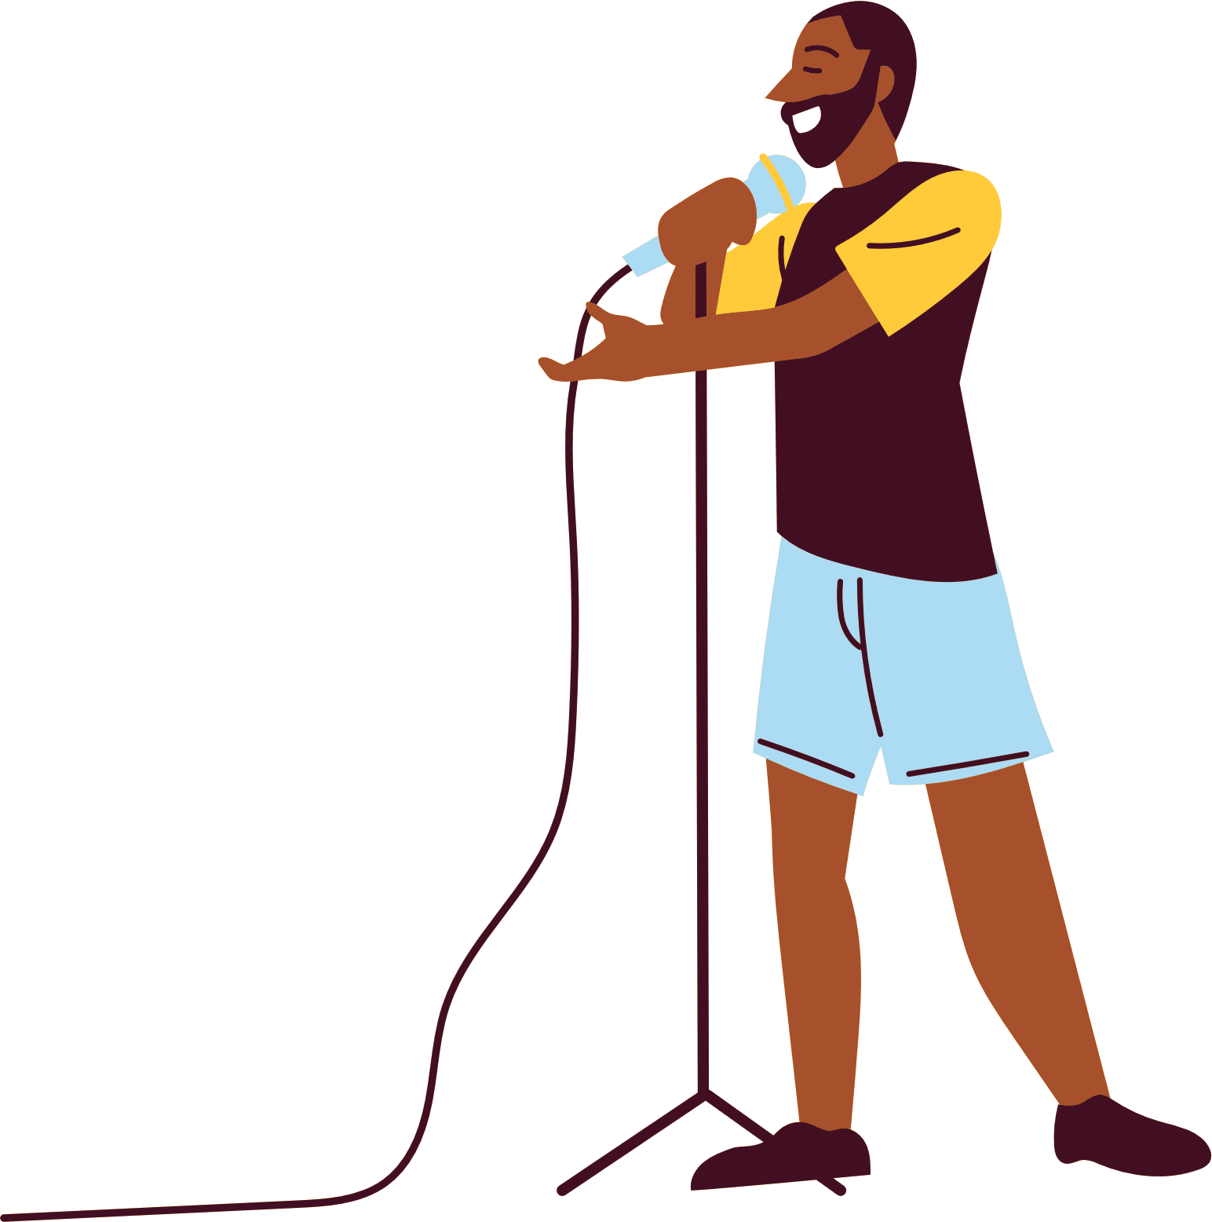
Listen and sing.
WHAT’S THE MATTER?
Let’s go out and play.
I’m sorry. I can’t.
Why? What’s the (1) ________?
I’m not very well.
I have a (2) ___________.
matter
headache
Notes:
- Have pupils listen to the song and fill in the gaps. Play the recording of the gapped sentences twice for pupils to fill in. Then check the answers as the class.

Slide 9

Listen and sing.
WHAT’S THE MATTER?
Let’s play and (3) __________.
I’m sorry. I can’t.
Why? What’s the matter?
I don’t feel well.
I have a (4) ______________.
sing
sore throat
Notes:
- Have pupils listen to the song and fill in the gaps. Play the recording of the gapped sentences twice for pupils to fill in. Then check the answers as the class.

Slide 10

Sing and clap.
WHAT’S THE MATTER?
Let’s go out and play.
I’m sorry. I can’t.
Why? What’s the (1) _____?
I’m not very well.
I have a (2) ___________.
Let’s play and (3) ________.
I’m sorry. I can’t.
Why? What’s the matter?
I don’t feel well.
I have a (4) ___________.
Notes:
- Play the recording again and have pupils sing the whole song while clapping their hands.

Slide 11





Let’s sing altogether !!!!
Notes:
- Invite a few groups to the front of the class to sing the song. The class may sing along and clap to reinforce the activity.

Slide 12
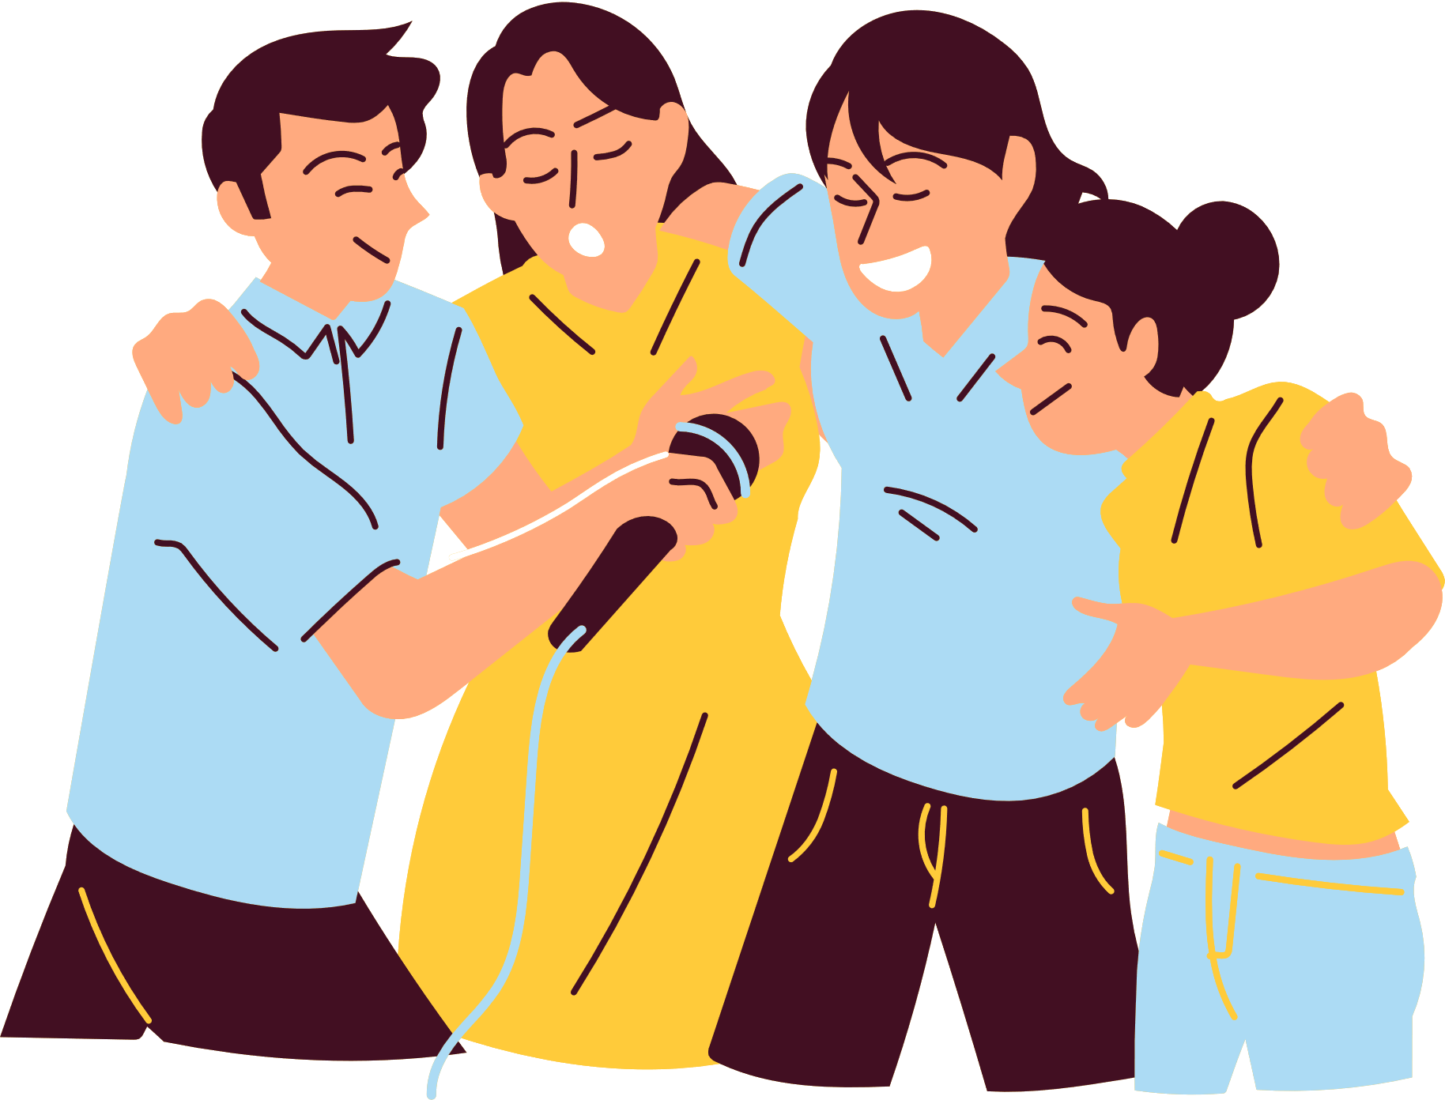
THANK YOU!
See you on the next karaoke show!

Slide 13
02
Activity 1
Look, listen and repeat.

Slide 14
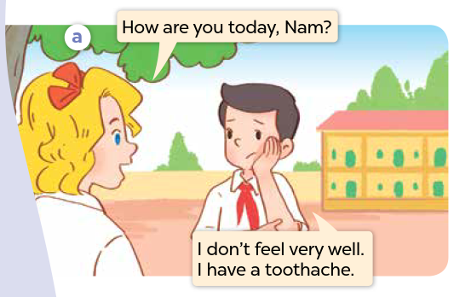
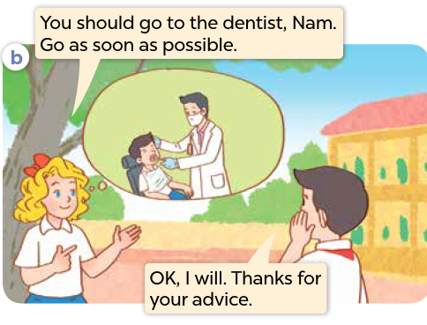

Look and say.
Notes:
Step 1: Ask pupils to look at Pictures a and b, and identify the characters in the pictures. Have them say what they can see in the thought bubbles.

Slide 15

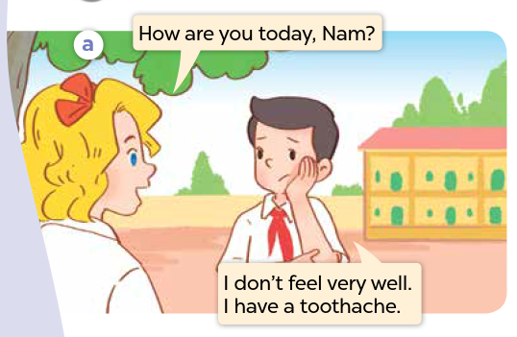
Listen and point.
Notes:
Step 2: Ask pupils to look at Picture a. Play the recording of two exchanges for them to listen to.
Step 3: Play the recording again, sentence by sentence, for pupils to listen and repeat individually and in chorus. Correct their pronunciation where necessary. Repeat the same procedure with Picture b.

Slide 16
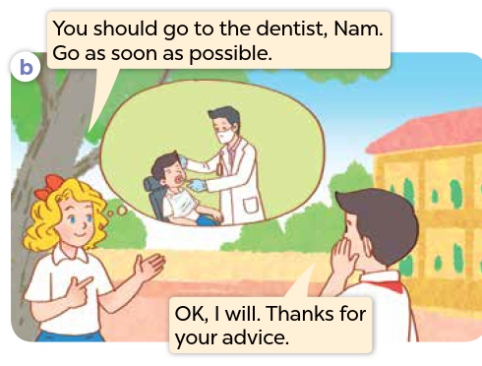
Listen and point.
Notes:
Step 2: Ask pupils to look at Picture a. Play the recording of two exchanges for them to listen to.
Step 3: Play the recording again, sentence by sentence, for pupils to listen and repeat individually and in chorus. Correct their pronunciation where necessary. Repeat the same procedure with Picture b.

Slide 17
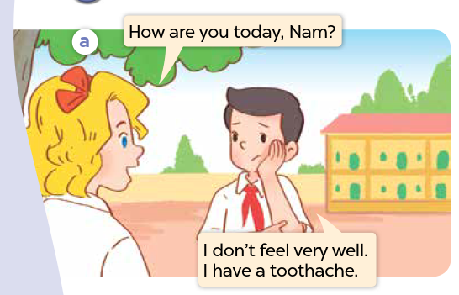
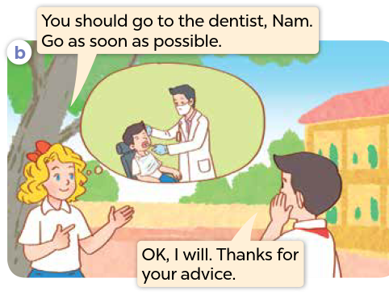
Listen and repeat.
Notes:
Step 4: Invite a few pairs to the front of the class to listen and repeat the sentences in the recording. Give corrections and feedback where necessary.
Step 5: Direct pupils’ attention to the advice You should go to the dentist? and the response Thanks for your advice. Tell pupils that they are advice and a response about health problems.

Slide 18





Slide 19
03
Activity 2
Listen, point and say.

Slide 20

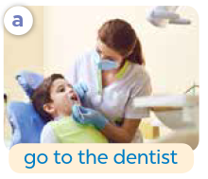
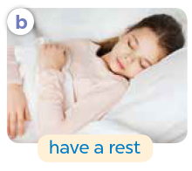
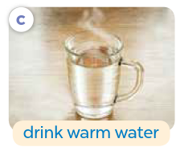
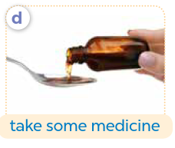
Look and say.
Notes:
Have pupils look at the pictures and say what they can see.

Slide 21
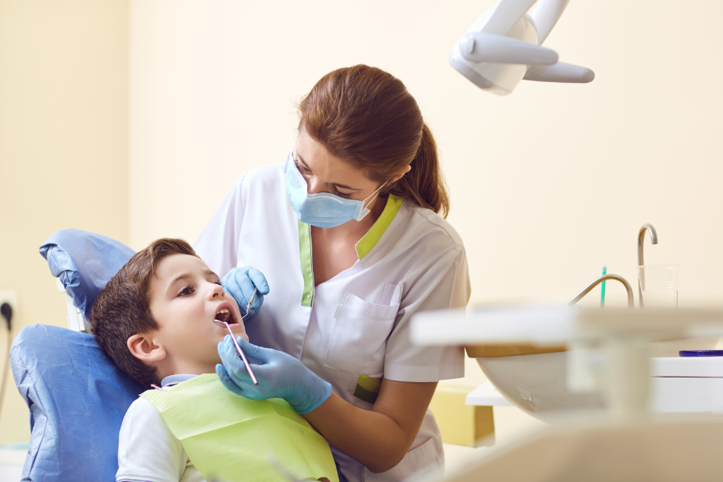
Listen and repeat.
a. go to the dentist
Notes:
Step 1: Have pupils point at Picture a, listen to the recording and repeat the phrase go to the dentist several times. Repeat the same procedure with Pictures b, c and d. Have the class repeat the phrases.

Slide 22

Listen and repeat.
b. have a rest
Notes:
Step 1: Have pupils point at Picture a, listen to the recording and repeat the phrase go to the dentist several times. Repeat the same procedure with Pictures b, c and d. Have the class repeat the phrases.

Slide 23

Listen and repeat.
c. drink warm water
Notes:
Step 1: Have pupils point at Picture a, listen to the recording and repeat the phrase go to the dentist several times. Repeat the same procedure with Pictures b, c and d. Have the class repeat the phrases.

Slide 24
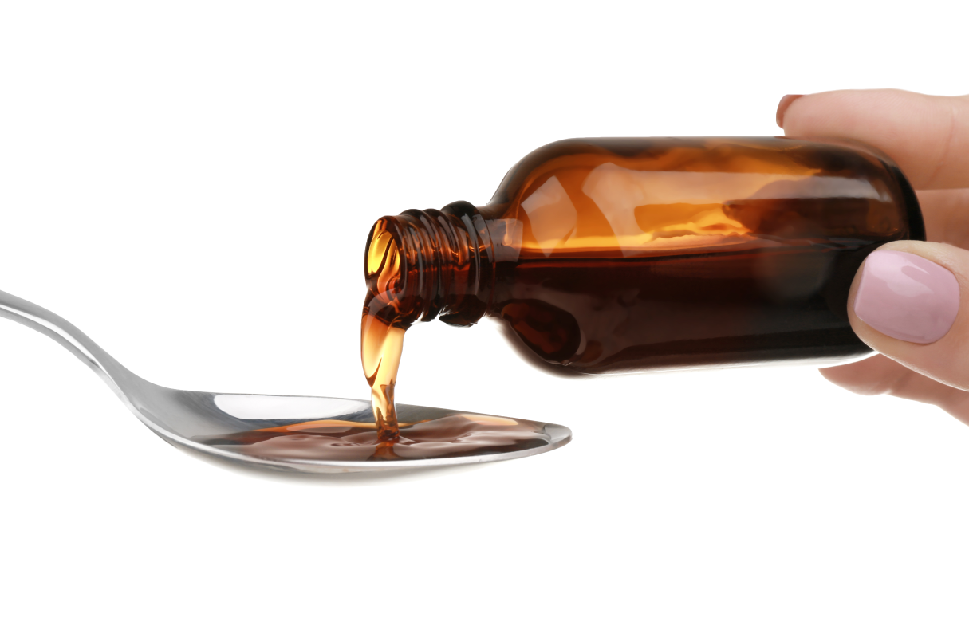
Listen and repeat.
d. take some medicine
Notes:
Step 1: Have pupils point at Picture a, listen to the recording and repeat the phrase go to the dentist several times. Repeat the same procedure with Pictures b, c and d. Have the class repeat the phrases.

Slide 25
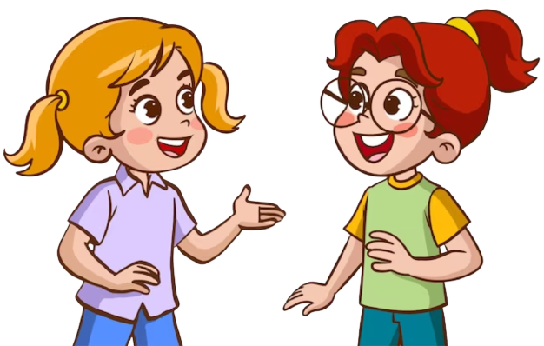
Listen and repeat.
You should …………………..
Thanks for
your advice.
Notes:
Step 2: Point at the advice pattern You should ____. Read it aloud and have pupils repeat it. Follow the same procedure with the response Thanks for your advice.

Slide 26
Listen and repeat.
You should go to the dentist.
Thanks for
your advice.
Notes:
Step 3: Point at Picture a and have pupils listen and repeat after the recording You should go to the dentist. - Thanks for your advice. Repeat the same procedure with Pictures b, c and d.

Slide 27
Listen and repeat.
You should have a rest.
Thanks for
your advice.
Notes:
Step 3: Point at Picture a and have pupils listen and repeat after the recording You should go to the dentist. - Thanks for your advice. Repeat the same procedure with Pictures b, c and d.

Slide 28
Listen and repeat.
You should drink warm water.
Thanks for
your advice.
Notes:
Step 3: Point at Picture a and have pupils listen and repeat after the recording You should go to the dentist. - Thanks for your advice. Repeat the same procedure with Pictures b, c and d.

Slide 29
Listen and repeat.
You should take some medicine.
Thanks for
your advice.
Notes:
Step 3: Point at Picture a and have pupils listen and repeat after the recording You should go to the dentist. - Thanks for your advice. Repeat the same procedure with Pictures b, c and d.

Slide 30



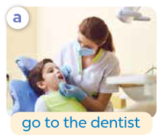
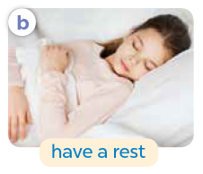

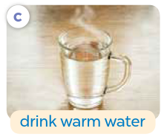
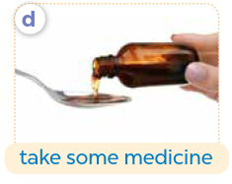
Look and say.
Notes:
Step 4: Divide the class into two groups to take turns repeating the advice and the responses for Pictures a - d until they feel confident.

Slide 31
Work in pairs.
Notes:
Step 5: Have pairs of pupils practise advising and responding to the advice with the pictures. Invite a few pairs to point at the pictures and say the questions and the answers in front of the class. Check their pronunciation, give corrections and feedback where necessary.

Slide 33
04
Activity 3
Let’s talk.

Slide 34
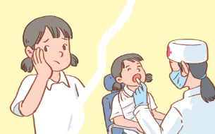
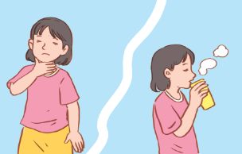
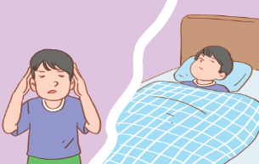
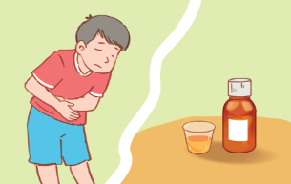
What’s the matter?
Look and say.
You should …….
………………
……………………..
Notes:
Step 1: Draw pupils’ attention to the pictures and guess the health problems that the characters have. Read the advice in the first speech bubble aloud and ask pupils to repeat it. Ask pupils to look at the second bubble and identify what the answer should be.

Slide 35

Look and say.
What’s the matter?
You should ……….
________.
Thanks for
your advice.
Notes:
Step 2: Have pairs of pupils practise advising and responding to the advice about health problems. Go around the class and provide support when necessary.

Slide 36
Look and say.
What’s the matter?
You should drink warm water.
I have a sore throat.
Thanks for
your advice.
Notes:
Step 3: Invite a few pairs to practise advising and responding to the advice about health problems. Give corrections and feedback where necessary.

Slide 37
Look and say.
What’s the matter?
You should take some medicine.
Thanks for
your advice.
I have a stomach ache.
Notes:
Step 3: Invite a few pairs to practise advising and responding to the advice about health problems. Give corrections and feedback where necessary.

Slide 38
Look and say.
What’s the matter?
You should go to the dentist.
Thanks for
your advice.
I have a toothache.
Notes:
Step 3: Invite a few pairs to practise advising and responding to the advice about health problems. Give corrections and feedback where necessary.

Slide 39
Look and say.
What’s the matter?
You should have a rest.
Thanks for
your advice.
I have a headache.
Notes:
Step 3: Invite a few pairs to practise advising and responding to the advice about health problems. Give corrections and feedback where necessary.

Slide 41
05
Fun corner and Wrap-up

Slide 42






QUIZ TIME
Let's Put Your Knowledge to The Test!

Slide 43




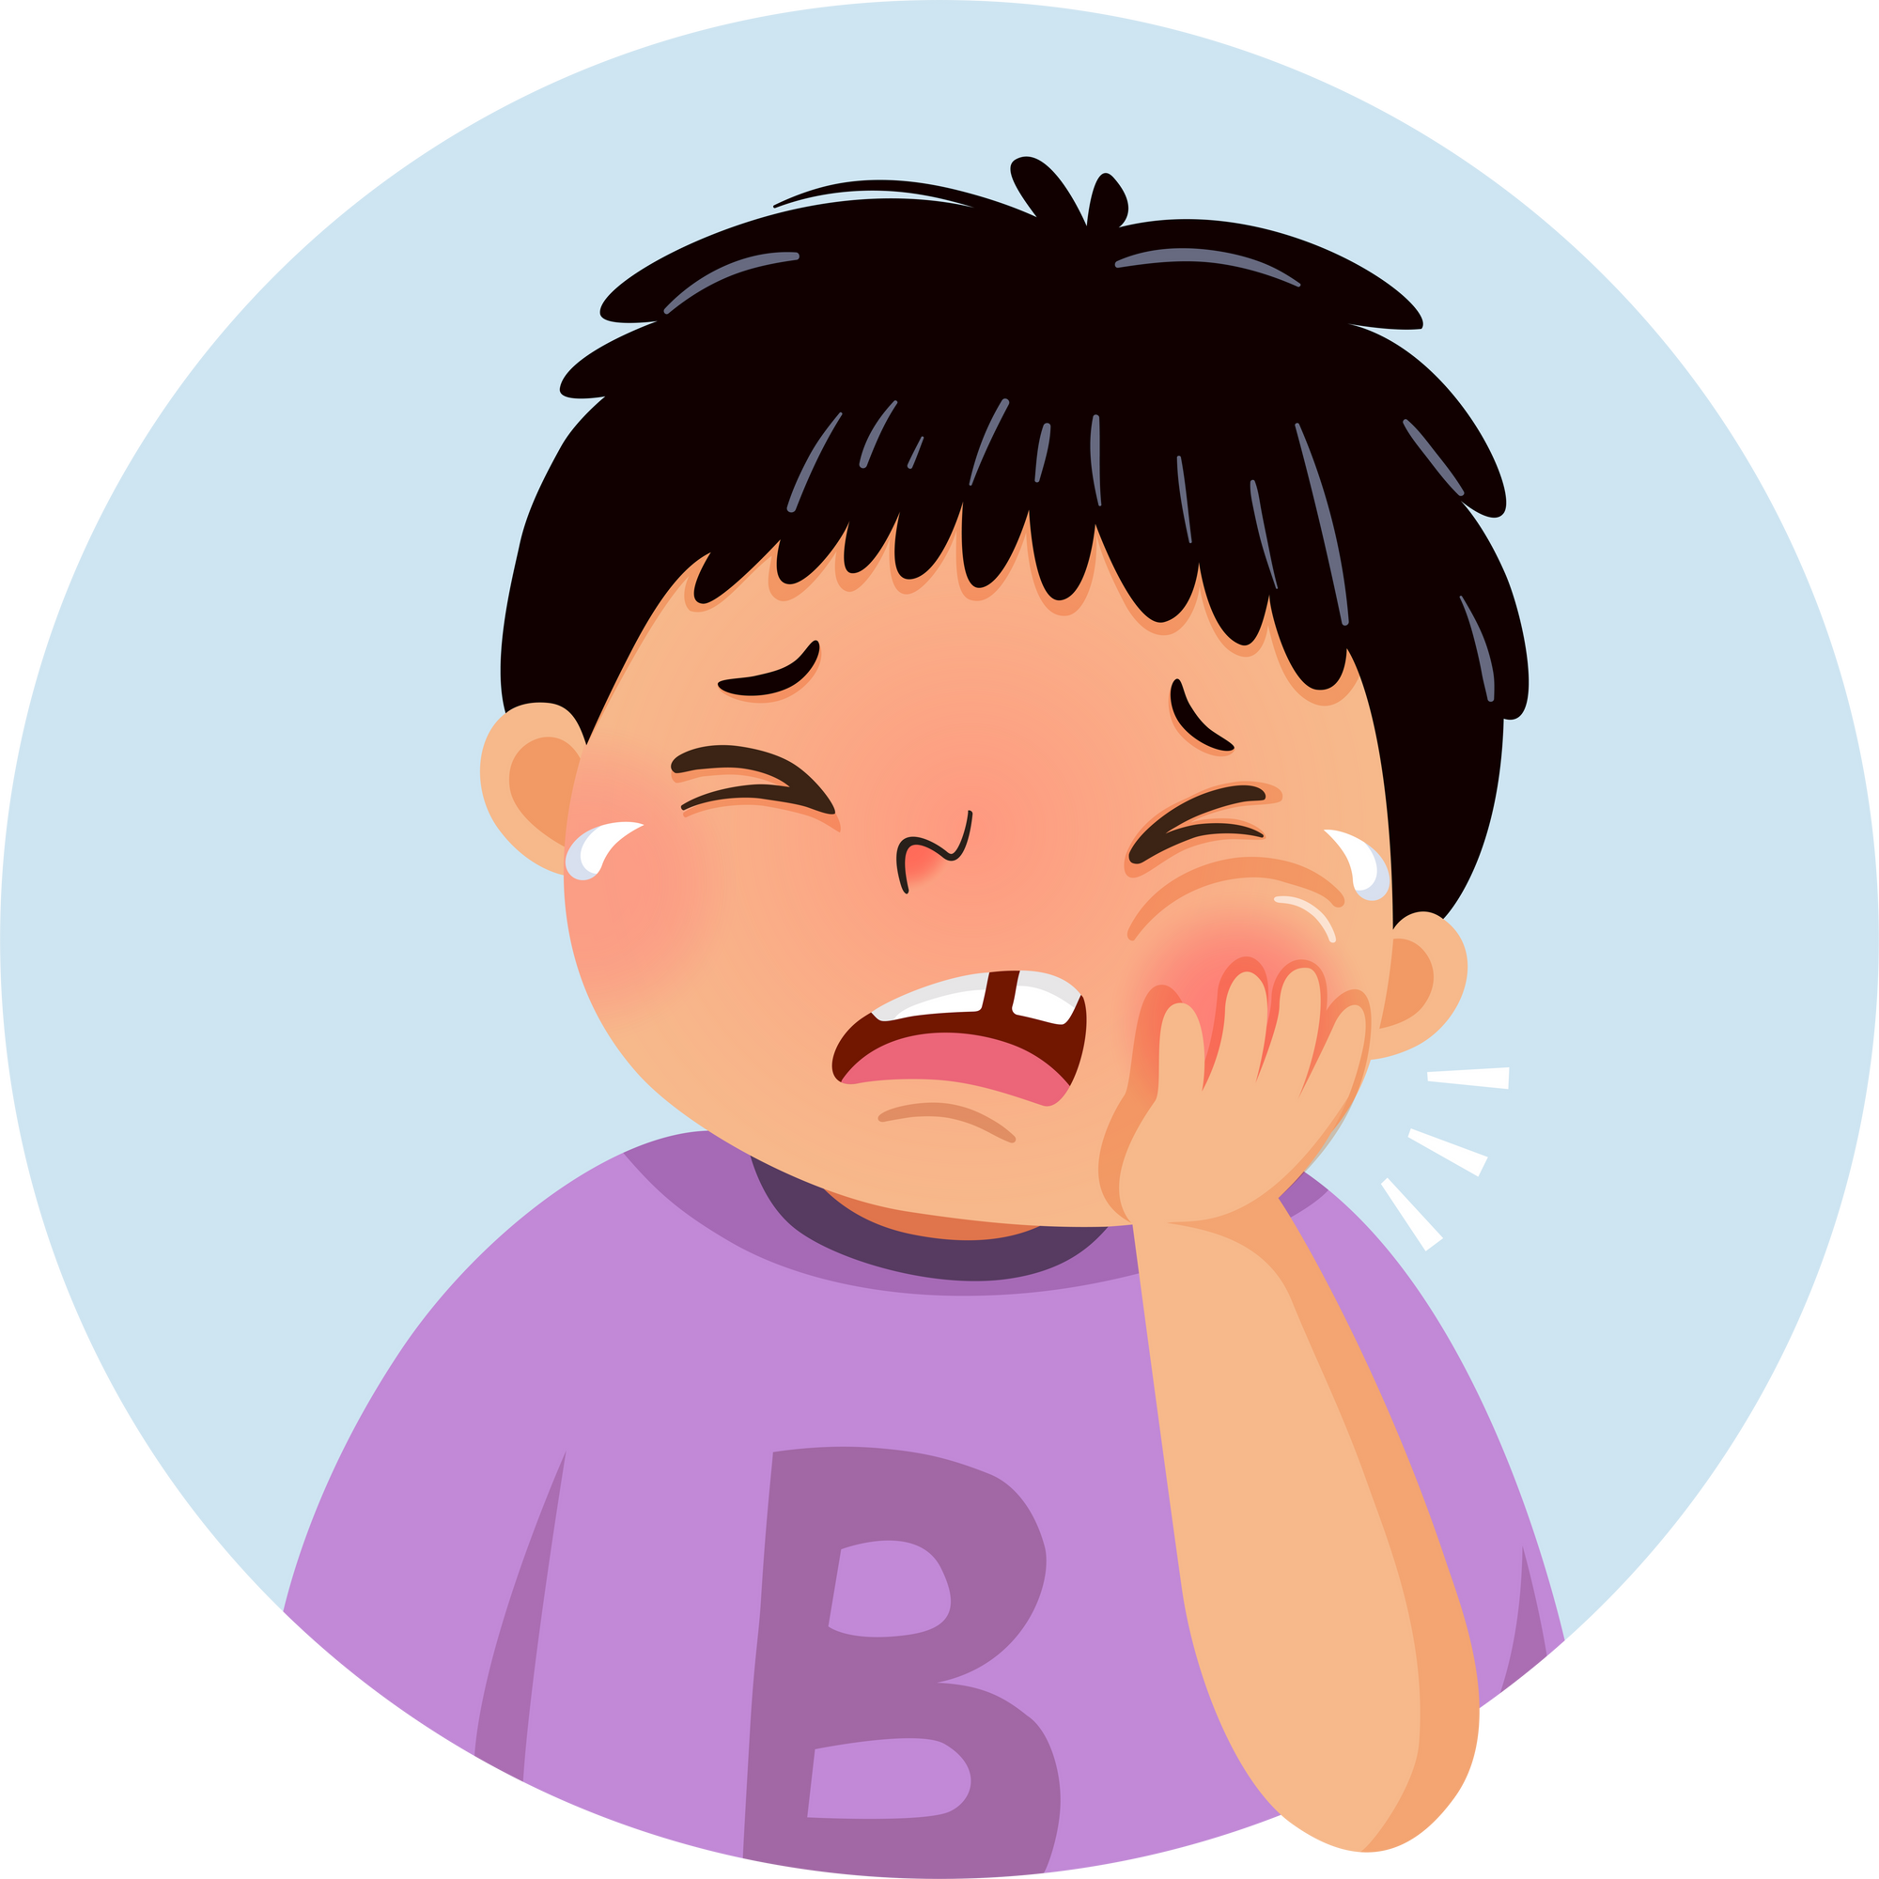


QUESTION
You should
play football.
watch TV.
go to the dentist.

Slide 44
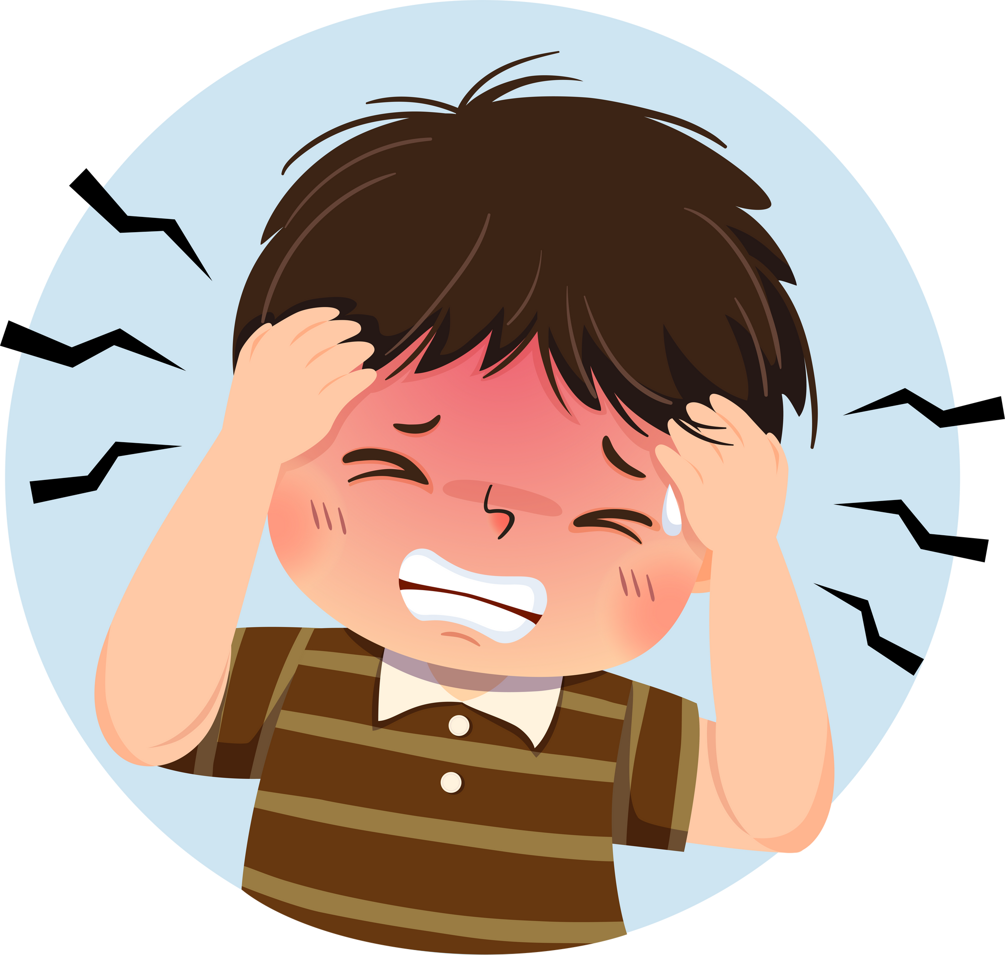
QUESTION
You should
go to the dentist.
have a rest.
play with friends.

Slide 45
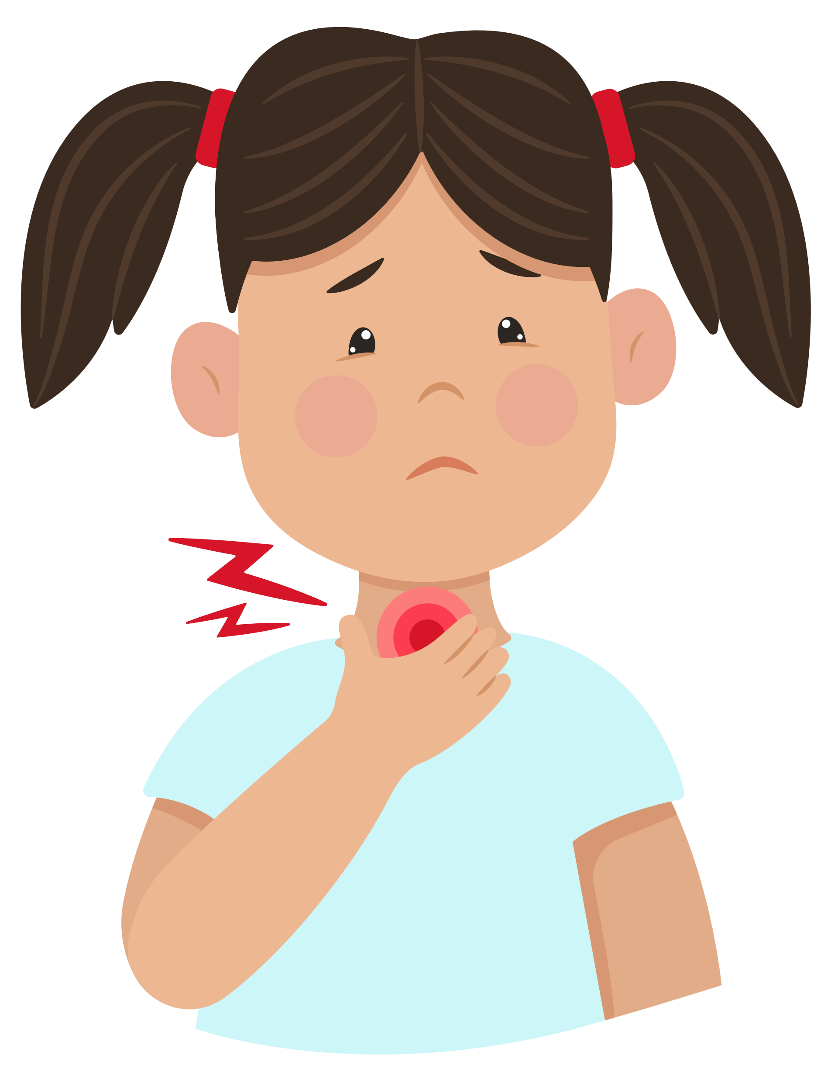
QUESTION
You should
drink warm water.
drink cold water.
eat some fries.

Slide 46
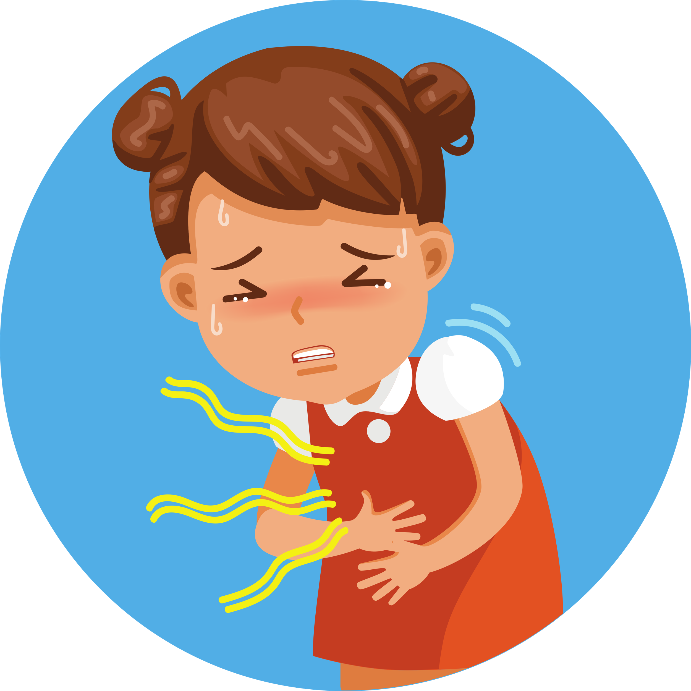
QUESTION
You should
eat more food.
take some medicine.
drink coke.

Slide 47




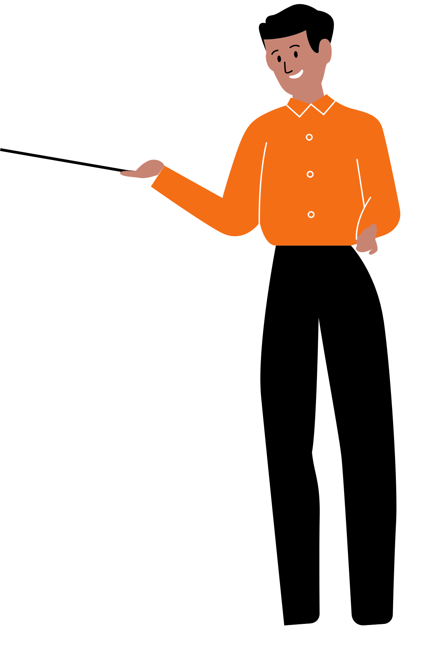


Good job!

Slide 48
Website: hoclieu.vn
Fanpage: https://www.facebook.com/tienganhglobalsuccess.vn/

