Slide 2






Unit 13:
In the maths class
Lesson 2

Slide 3









Table of Contents
Warm-up and review.
Listen and chant.
Listen and tick.
Write and say.
Fun corner and wrap-up.

Slide 4




Warm-up and Review.

Slide 5




MATHS QUIZ

Slide 6





+
?
=
A
B
✗
C
✗
✓
ten
nine
eight

Slide 7

+
=
?
A
✗
B
✗
C
✓
fifteen
fourteen
eleven

Slide 8





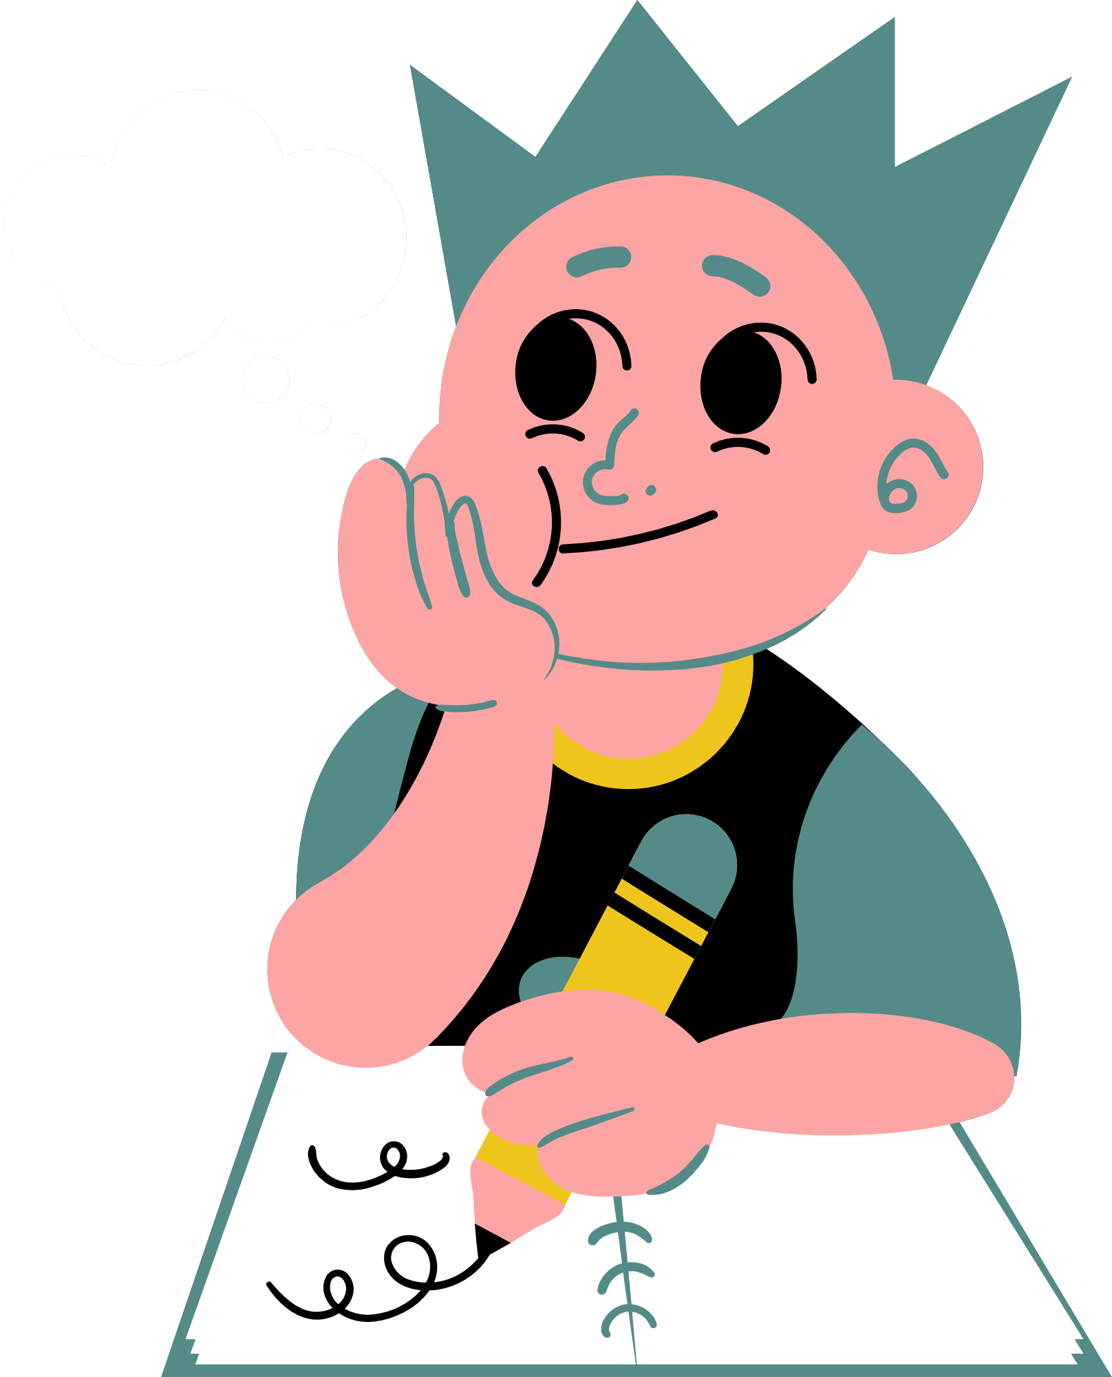
+
=
?
A
B
✗
C
✗
✓
fifteen
fourteen
thirteen

Slide 9



+
?
=
A
✗
B
✗
C
✓
fourteen
eleven
thirteen

Slide 10



+
?
=
A
✗
B
C
✗
✓
thirteen
fourteen
fifteen

Slide 11

Thank you for Playing!

Slide 12
Listen and chant.

Slide 13
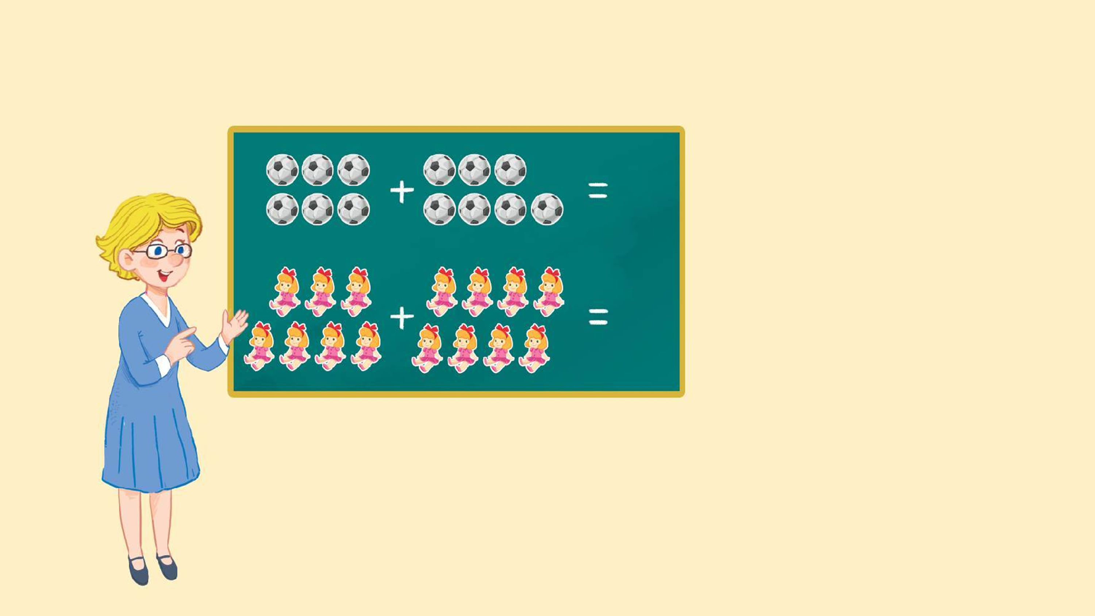
Look and say.
13
thirteen
15
fifteen

Slide 14


Watch a video.

Slide 15

3.Listen and chant.
N, n, eleven.
N, n, eleven.
N, n, eleven.
N, n, eleven.
N, n, thirteen.
N, n, thirteen.
N, n, thirteen.
N, n, thirteen.
How many balls?
How many balls?
How many balls?
How many balls?
Eleven or thirteen.
Eleven or thirteen.
Eleven or thirteen.
Eleven or thirteen.
N, n, fourteen.
N, n, fourteen.
N, n, fourteen.
N, n, fourteen.
N, n, fifteen.
N, n, fifteen.
N, n, fifteen.
N, n, fifteen.
How many dolls?
How many dolls?
How many dolls?
How many dolls?
Fourteen or fifteen.
Fourteen or fifteen.
Fourteen or fifteen.
Fourteen or fifteen.

Slide 16
Work in teams.
N, n, eleven.
N, n, thirteen.
How many balls?
Eleven or thirteen.
N, n, fourteen.
N, n, fifteen.
How many dolls?
Fourteen or fifteen.

Slide 17
Listen and tick.

Slide 18

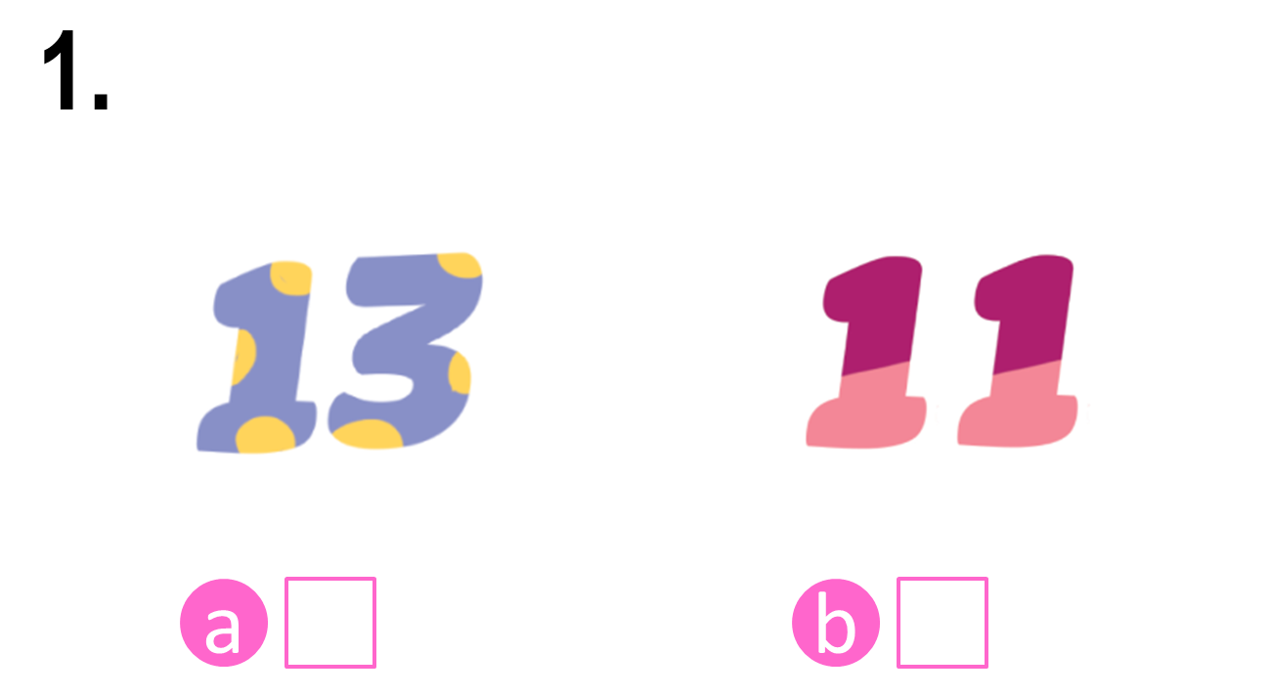
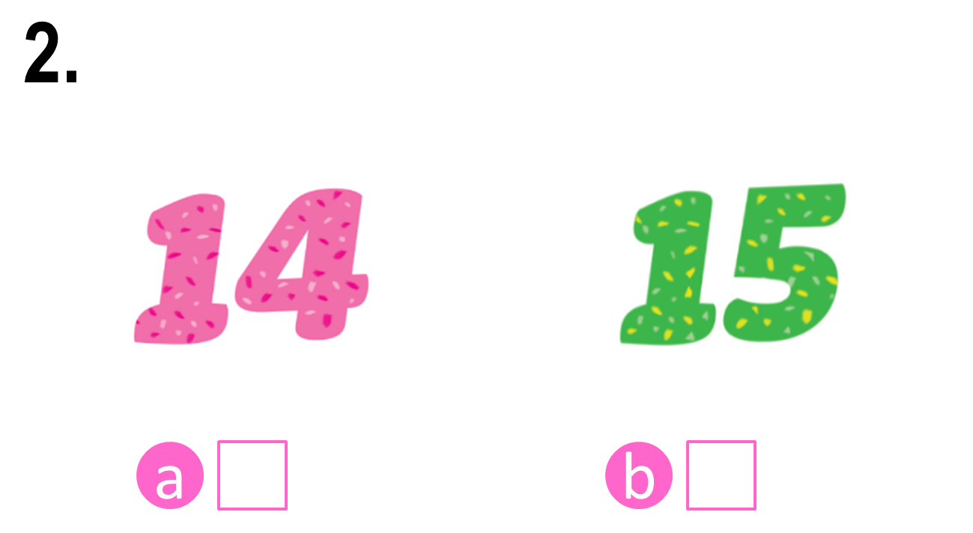


Look and say.

Slide 19
4. Listen and tick.

Slide 20
Check the answers.

Notes:
Step 3: Check the answers by asking “a or b?” When pupils answer correctly, confirm by saying “1a. Can you see the number thirteen?”/ “2b. Can you see the number fifteen?” and encourage them to repeat.

Slide 21
Check the answers.


Slide 22
Write and say.

Slide 23







Look and say.
eleve__
thirtee__
fourtee__
fiftee__

Slide 24
5. Write and say.
eleve__
thirtee__
fourtee__
fiftee__

Slide 25
Check the answers.
n
n
n
n
eleve__
thirtee__
fourtee__
fiftee__

Slide 26
Say the words.
n
n
n
n
eleve__
thirtee__
fourtee__
fiftee__

Slide 27
Fun corner and wrap-up.

Slide 28



Matching Game

Slide 29
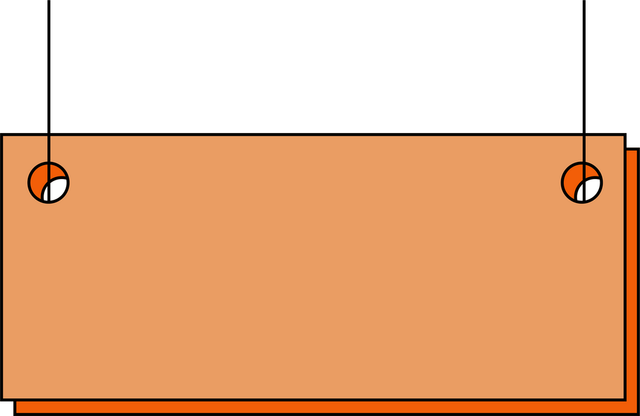





1
2
3
4
eleven
fourteen
fifteen
thirteen
A
B
C
D

Slide 30

Thank you
for
playing!

Slide 31
Website: hoclieu.vn
Fanpage: https://www.facebook.com/tienganhglobalsuccess.vn/

