Slide 2






Unit 13:
In the maths class
Lesson 3

Slide 3









Table of Contents
  Warm-up and review.
  Listen and repeat.
  Let’s talk.
  Let’s sing.
  Fun corner and wrap-up.

Slide 4




Warm-up and Review.

Slide 5









Game
MISSING LETTERS

Slide 6




What are missing letters?
F
O
_
_
T
E
E
N
I
R
A
R
U
R

Slide 7
What are missing letters?
_
_
F
T
E
E
N
F
I
T
I
S
I

Slide 8
What are missing letters?
T
_
_
R
T
E
E
N
K
I
H
I
R
I

Slide 9
What are missing letters?
E
L
E
V
_
_
E
L
E
M
E
N

Slide 10
THANK YOU
FOR
PLAYING!

Slide 11
Listen and repeat.

Slide 12

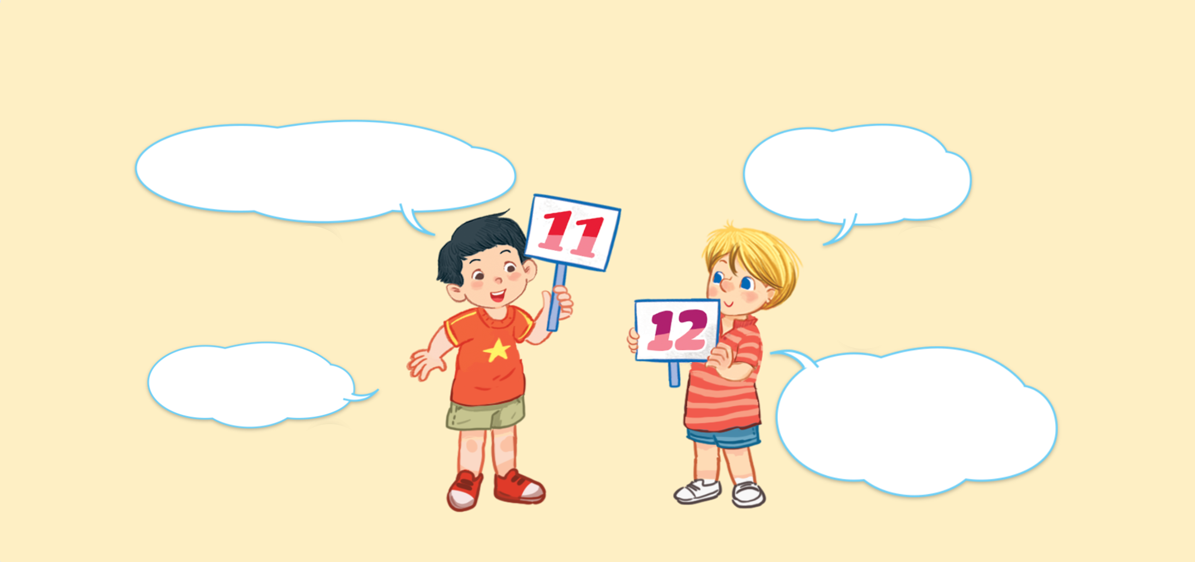


Look and say.
What number is it?
What number is it?
What number is it?
What number is it?
It’s eleven.
It’s eleven.
It’s eleven.
It’s eleven.
It’s twelve.
It’s twelve.
It’s twelve.
It’s twelve.
What number is it?
What number is it?
What number is it?
What number is it?

Slide 13

6. Listen and repeat.
What number is it?
What number is it?
What number is it?
What number is it?
It’s eleven.
It’s eleven.
It’s eleven.
It’s eleven.
It’s twelve.
It’s twelve.
It’s twelve.
It’s twelve.
What number is it?
What number is it?
What number is it?
What number is it?

Slide 14
Let’s talk.

Slide 15








Look and say
What number ______?
.
______.
a
b
c
d

Slide 16
7. Let’s talk.
What number ______?
.
______.
a
b
c
d

Slide 17
Work in pairs.
What number ______?
.
______.
a
b
c
d

Slide 18
Let’s sing.

Slide 19

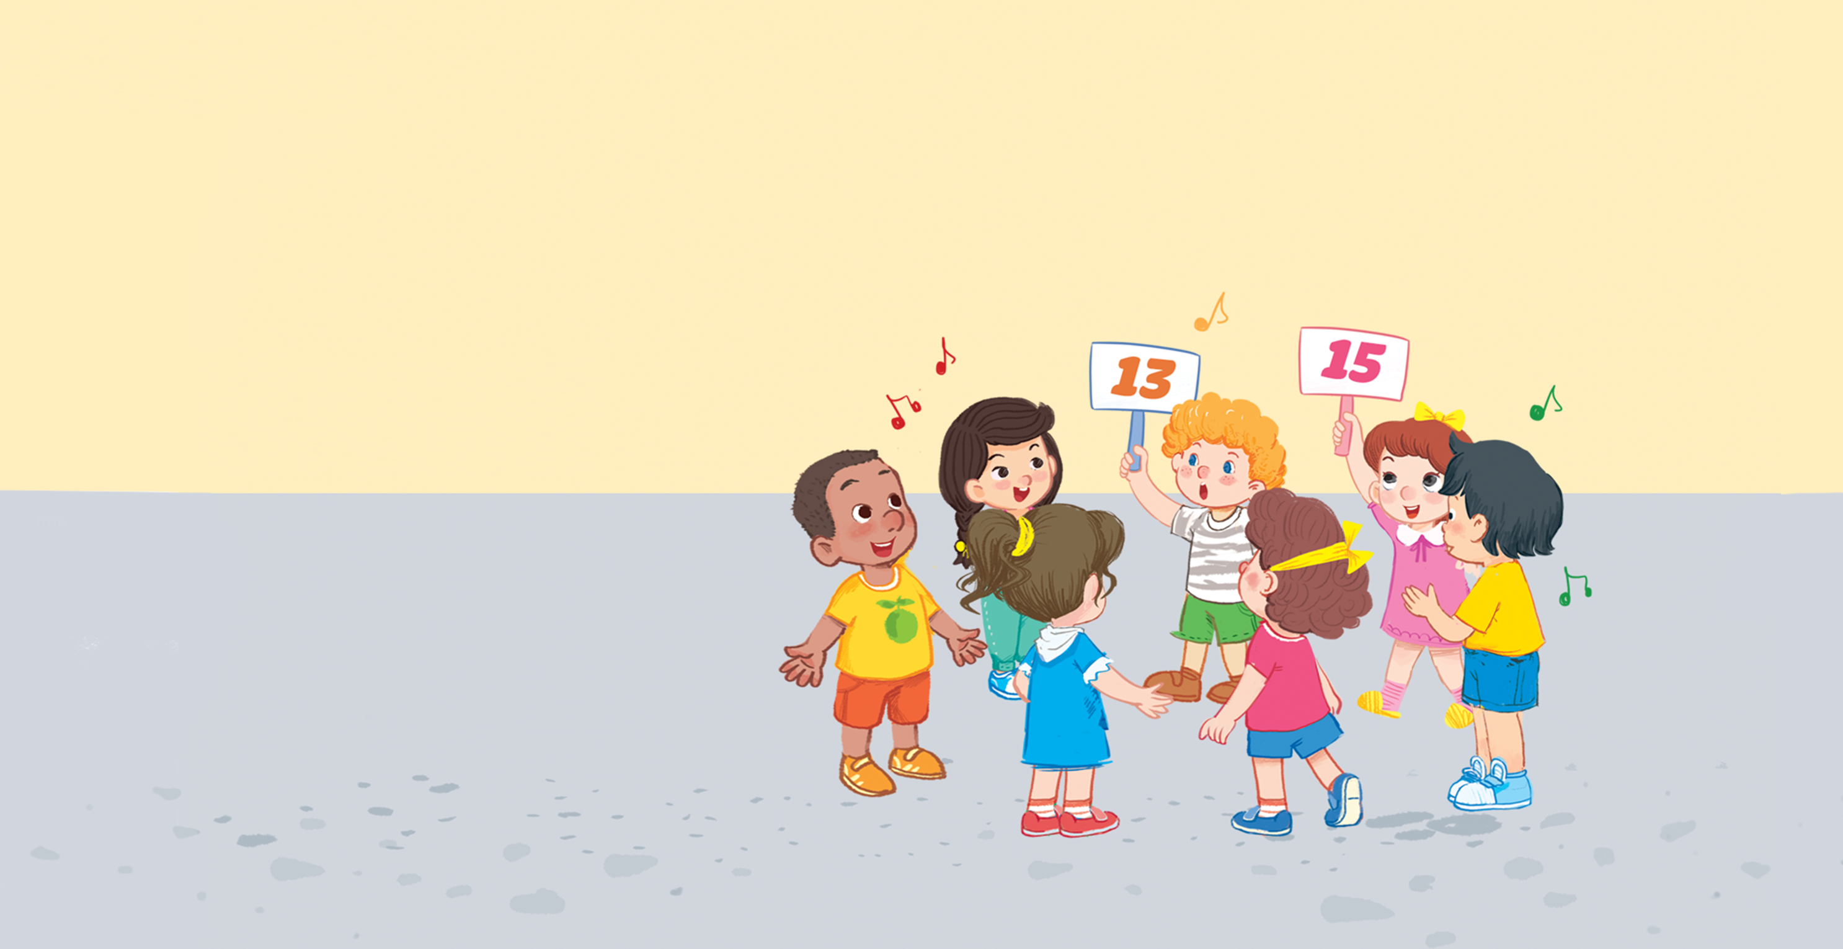


Look and say.

Slide 20
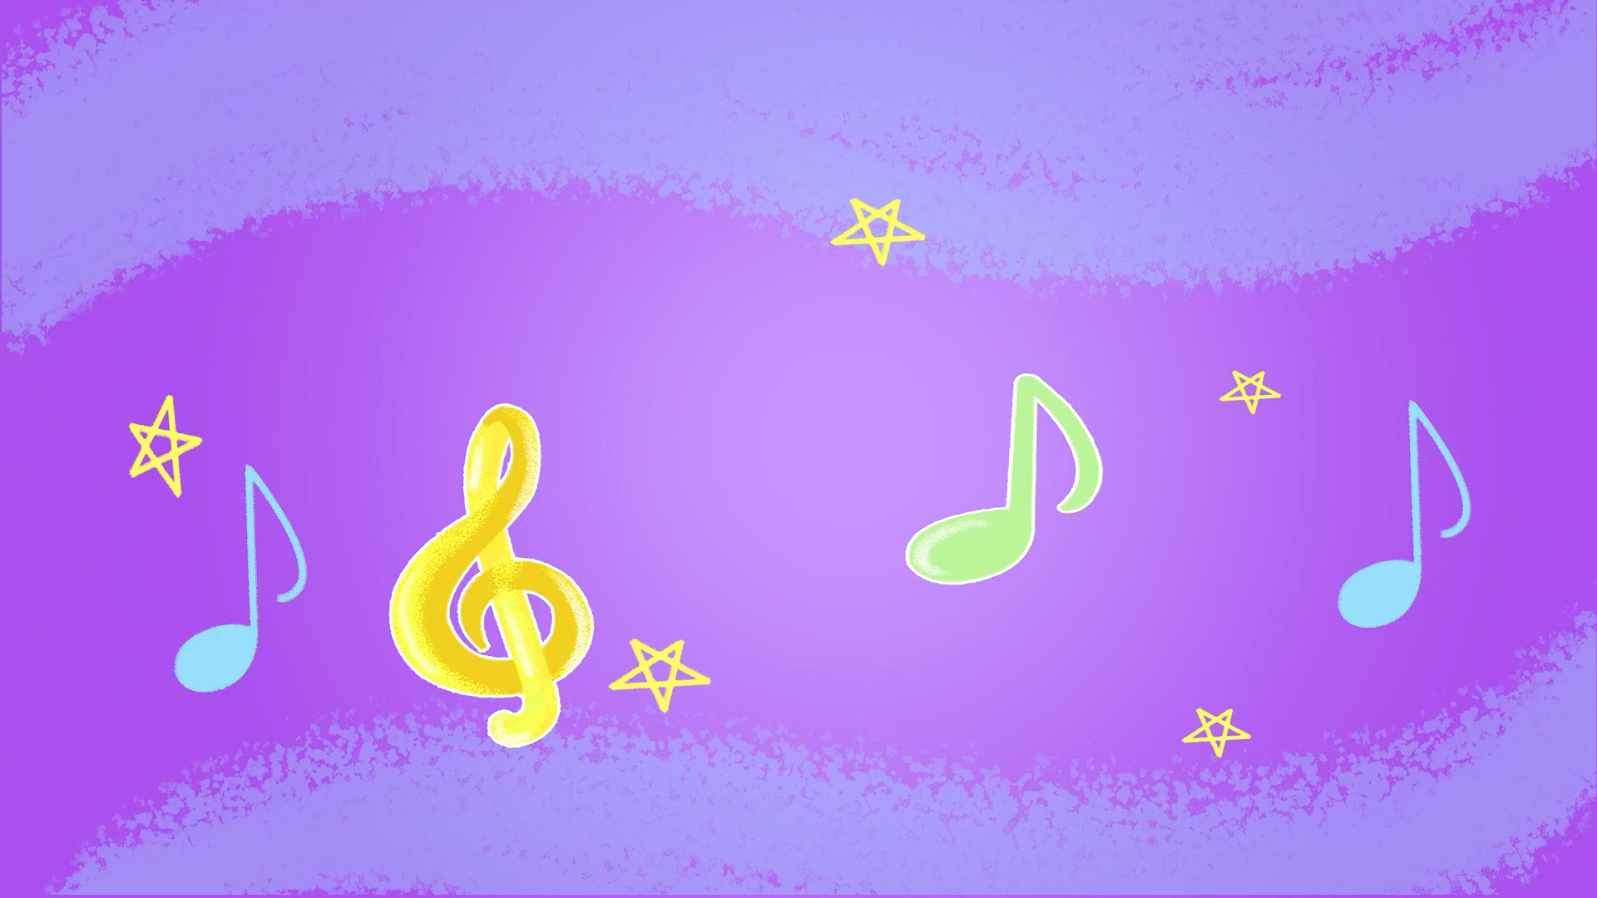
Watch a video song.
Notes:
Step 2: Play the recording of the song to familiarise pupils with the rhythm and melody (say “Listen.”).

Slide 21
8. Let’s sing.
What number is it?
What number is it?
What number is it?
What number is it?
Eleven, twelve or thirteen.
Eleven, twelve or thirteen.
Eleven, twelve or thirteen.
Eleven, twelve or thirteen.
It’s thirteen.
It’s thirteen.
It’s thirteen.
It’s thirteen.
What number is it?
What number is it?
What number is it?
What number is it?
Thirteen, fourteen or fifteen.
Thirteen, fourteen or fifteen.
Thirteen, fourteen or fifteen.
Thirteen, fourteen or fifteen.
It’s fifteen.
It’s fifteen.
It’s fifteen.
It’s fifteen.

Slide 22
Work in groups.
What number is it?
Eleven, twelve or thirteen.
It’s thirteen.
What number is it?
Thirteen, fourteen or fifteen.
It’s fifteen.
Notes:
Step 5: Have pupils work in groups to make up actions for the song. Invite a few groups to perform the song for the class.

Slide 23
Fun corner and wrap-up.

Slide 24



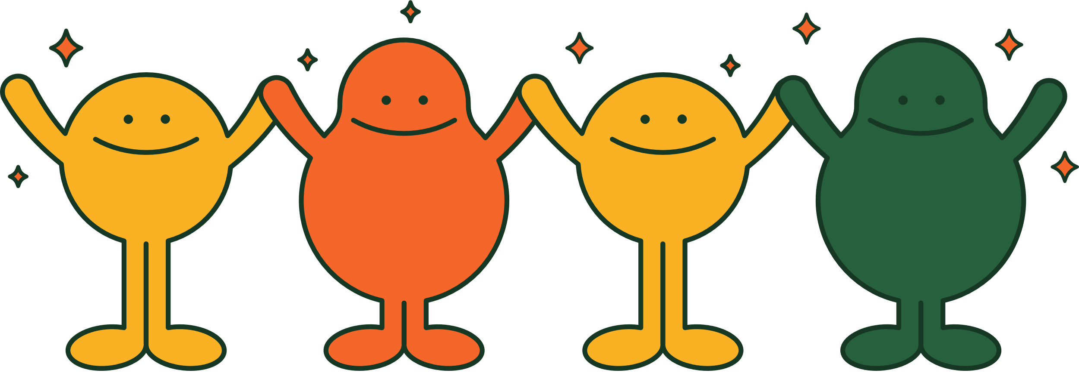
PLAY TIME
Bingo

Slide 25



B
I
N
G
O
11
1
7
✗
13
15
8
9
10
4

Slide 26

Thank You
For Playing!

Slide 27
Website: hoclieu.vn
Fanpage: https://www.facebook.com/tienganhglobalsuccess.vn/

