Slide 2







Unit 14
AT HOME
Lesson 1

Slide 3









Table of contents
Warm-up and review.
Listen and repeat.
Point and say.
Fun corner and wrap-up.

Slide 4







Warm-up and Review.

Slide 5










LET'S PLAY
FIND A WORD

Slide 6





FIND THE WORD
M
?
T
H
?
R

Slide 7
FIND THE WORD
The answer is ...
M
O
T
H
E
R

Slide 8

FIND THE WORD
?
A
T
H
E
?

Slide 9
FIND THE WORD
The answer is ...
F
A
T
H
E
R

Slide 10

FIND THE WORD
B
?
Y

Slide 11
FIND THE WORD
The answer is ...
B
O
Y

Slide 12

FIND THE WORD
G
?
R
L

Slide 13
FIND THE WORD
The answer is ...
G
I
R
L

Slide 14

CONGRATULATION!

Slide 15
Listen and repeat.

Slide 16
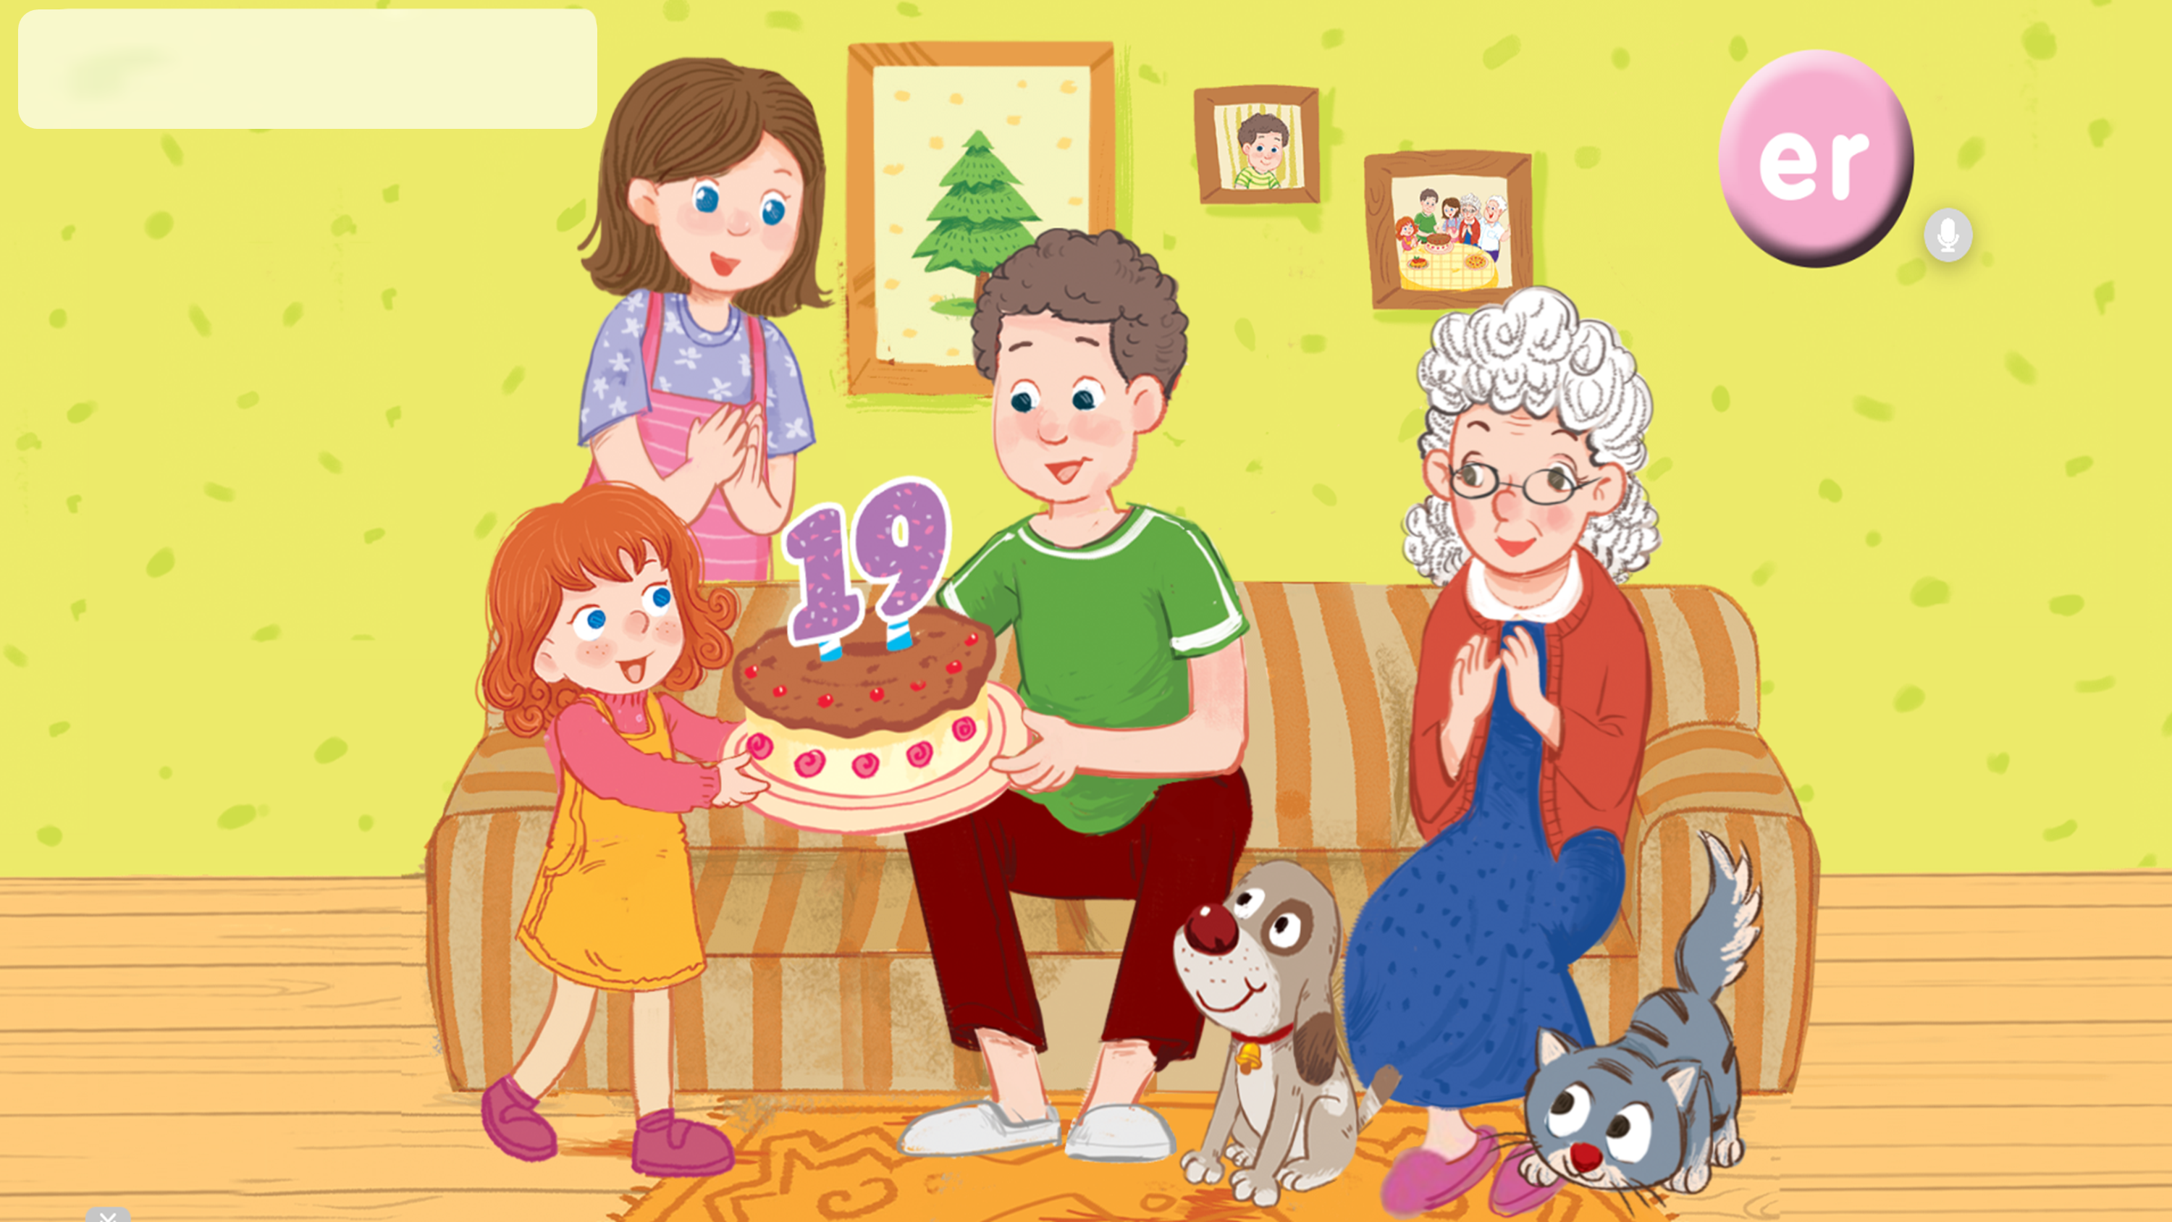


Look and say.

Slide 17
1. Listen and repeat.

Slide 18
1. Listen and repeat.
brother
sister
grandmother

Slide 19
1. Listen and repeat.
brother
sister
grandmother

Slide 20
Point and say.

Slide 21
Look and say.

Slide 22
2. Point and say.
brother
sister
grandmother

Slide 23
Work in pairs.
brother
sister
grandmother

Slide 24
Fun corner and wrap-up.

Slide 25







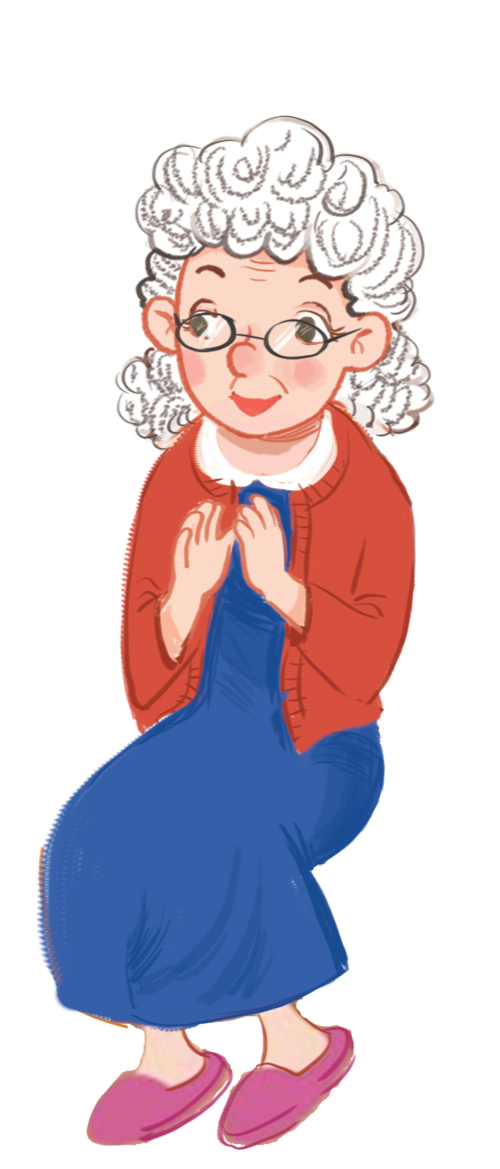

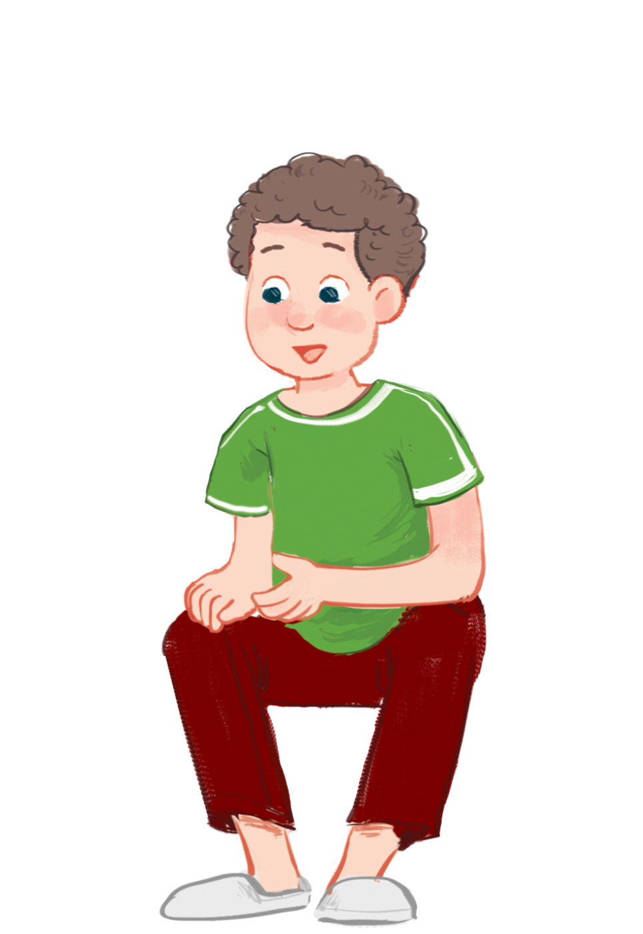




Game
What is it?

Slide 26
Website: hoclieu.vn
Fanpage: https://www.facebook.com/tienganhglobalsuccess.vn/

