Slide 2







Unit 14
AT HOME
Lesson 2

Slide 3










Table of contents
  Warm-up and review.
  Listen and chant.
  Listen and circle.
  Write and say.
  Fun corner and wrap-up.

Slide 4







Warm-up and Review.

Slide 5





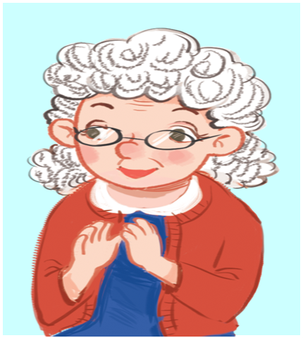
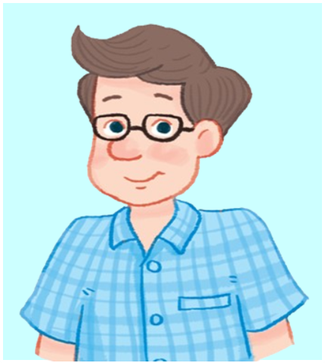

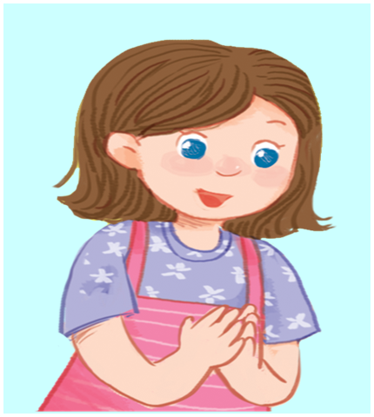
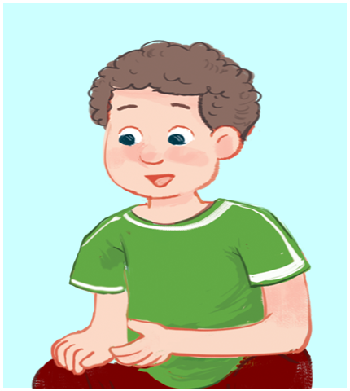

Review
grandmother
father
mother
sister
brother

Slide 6







What’s missing?
Game

Slide 7

What’s missing?
sister

Slide 8
What’s missing?
father

Slide 9
What’s missing?
brother

Slide 10
What’s missing?
grandmother

Slide 11
What’s missing?
mother

Slide 12



Thanks
for
playing!

Slide 13
Listen and chant.

Slide 14

Look and say.

Slide 15

Watch a video

Slide 16

3. Listen and chant.
Er, er, sister.
Er, er, sister.
Er, er, sister.
She’s my sister.
She’s my sister.
She’s my sister.
She’s sixteen.
She’s sixteen.
She’s sixteen.
Er, er, brother.
Er, er, brother.
Er, er, brother.
He’s my brother.
He’s my brother.
He’s my brother.
He’s nineteen.
He’s nineteen.
He’s nineteen.

Slide 17
It’s time to chant together
Er, er, sister.
Er, er, sister.
Er, er, sister.
She’s my sister.
She’s my sister.
She’s my sister.
She’s sixteen.
She’s sixteen.
She’s sixteen.
Er, er, brother.
Er, er, brother.
Er, er, brother.
He’s my brother.
He’s my brother.
He’s my brother.
He’s nineteen.
He’s nineteen.
He’s nineteen.

Slide 18
Listen and circle.

Slide 19




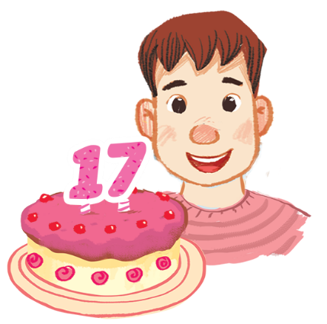
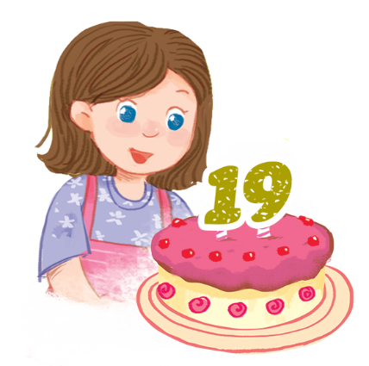
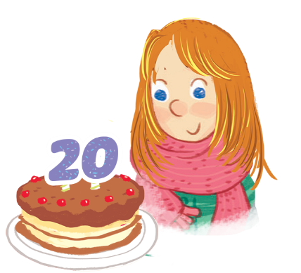


Look and say.
1
2
a
b
a
b
Notes:
Step 1: Have pupils look at the pictures and say the words (say “Point and say.”). When pupils answer correctly, confirm by saying “sixteen/seventeen/nineteen/twenty”.

Slide 20
4. Listen and circle.
1
2
a
b
a
b

Slide 21
Check the answer.
1
2
a
b
a
b

Slide 22
Write and say.

Slide 23


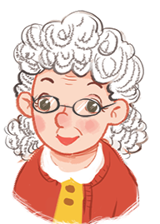
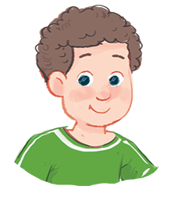
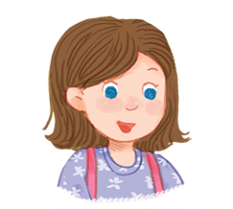


Look and say.
grandmoth__ __
broth__ __
sist__ __

Slide 24
5. Write and say.
grandmoth__ __
broth__ __
sist__ __

Slide 25
Check the answers.
grandmoth__ __
e
r
broth__ __
e
r
sist__ __
e
r

Slide 26
Say the words.
grandmoth__ __
e
r
broth__ __
e
r
sist__ __
e
r

Slide 27
Fun corner and wrap-up.

Slide 28









GAME

Slide 29




What number is it?
20
twenty

Slide 30
What number is it?
Who’s this?
grandmother

Slide 31
What number is it?
16
sixteen

Slide 32
What number is it?
Who’s this?
brother

Slide 33
What number is it?
17
seventeen

Slide 34
Who’s this?
sister

Slide 35
What number is it?
19
nineteen

Slide 36


Slide 37
Website: hoclieu.vn
Fanpage: https://www.facebook.com/tienganhglobalsuccess.vn/

