Slide 1

Welcome to our English class 4c
Teacher : NGO THI HANH
School: Nguyen Doc Tin Primary school

Slide 2







Unit 4
My Birthday
Party
Lesson 1 – P1,2,3
Teacher:Ngo Thi Hanh1

Slide 3


MsPham
0936082789
Warm-up

Slide 4


Slide 5
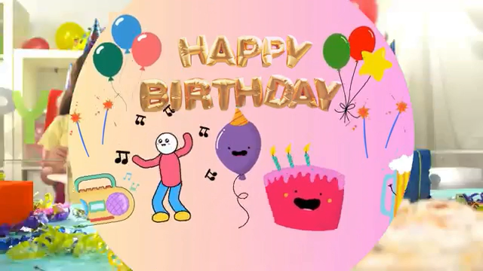
MsPham-9036082789

Slide 6
MsPham
0936082789
Vocabulary

Slide 7

January
Tháng 1
/ˈdʒænjuəri/

Slide 8

February
Tháng 2
/ˈfebruəri/

Slide 9

March
Tháng 3
/mɑːtʃ/

Slide 10

April
Tháng 4
/ˈeɪprəl/

Slide 11
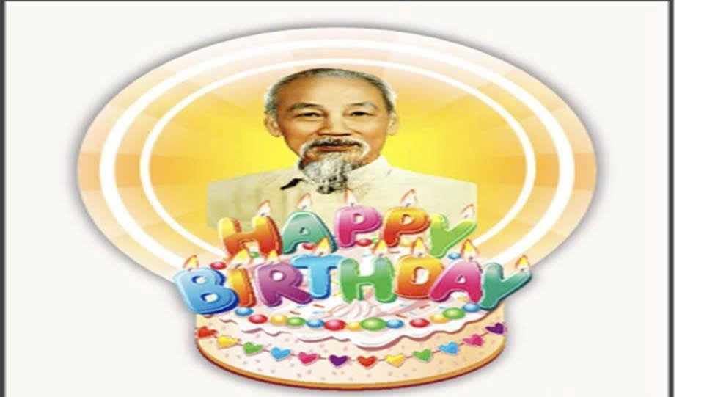
May
/meɪ/
Tháng 5

Slide 12

June
Tháng 6
/dʒuːn/

Slide 13
I. Vocabulary
January
: Tháng 1
February
: Tháng 2
March
: Tháng 3
April
: Tháng 4
May
: Tháng 5
June
: Tháng 6

Slide 14
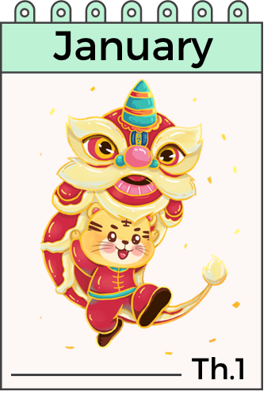



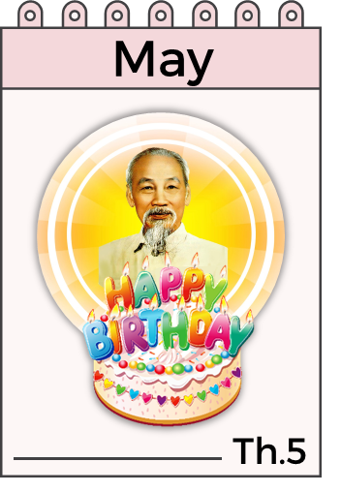

What is the month missing?

Slide 15

What is the month missing?

Slide 16

What is the month missing?

Slide 17
What is the month missing?

Slide 18
What is the month missing?

Slide 19
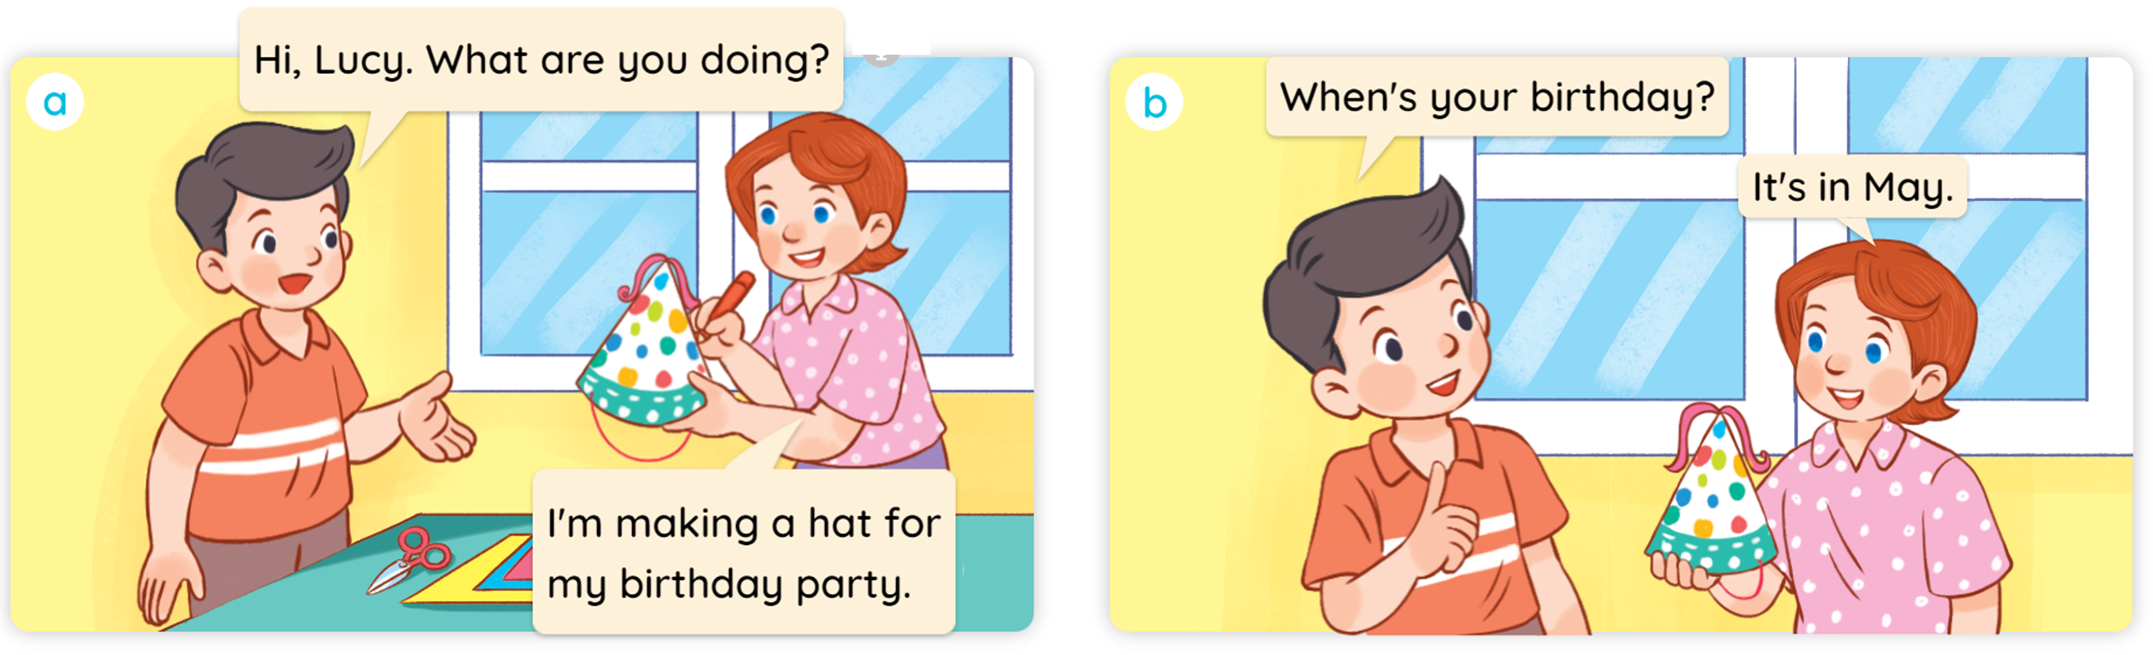

1
Look, listen and read.

Slide 20
MsPham
0936082789
Structure

Slide 21
1
Cách hỏi sinh nhật của bạn:
When’s your birthday?
(Khi nào là sinh nhật của bạn?)
It’s in _________.
(Vào tháng _____.)
(+ month)
Ex:
When’s your birthday?
It’s in June.

Slide 22
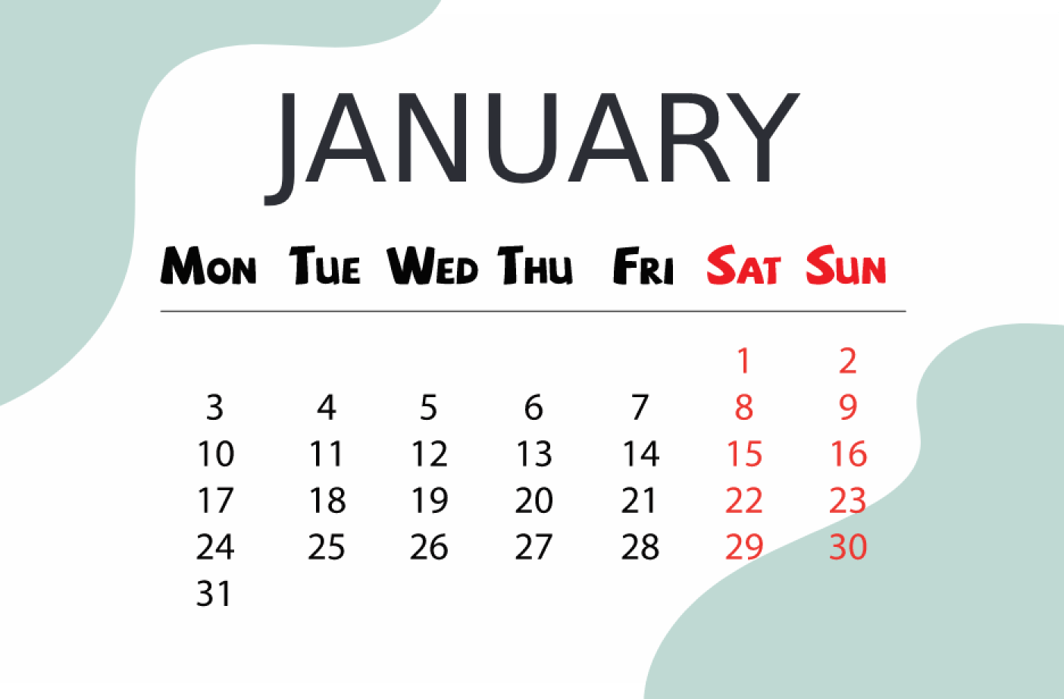
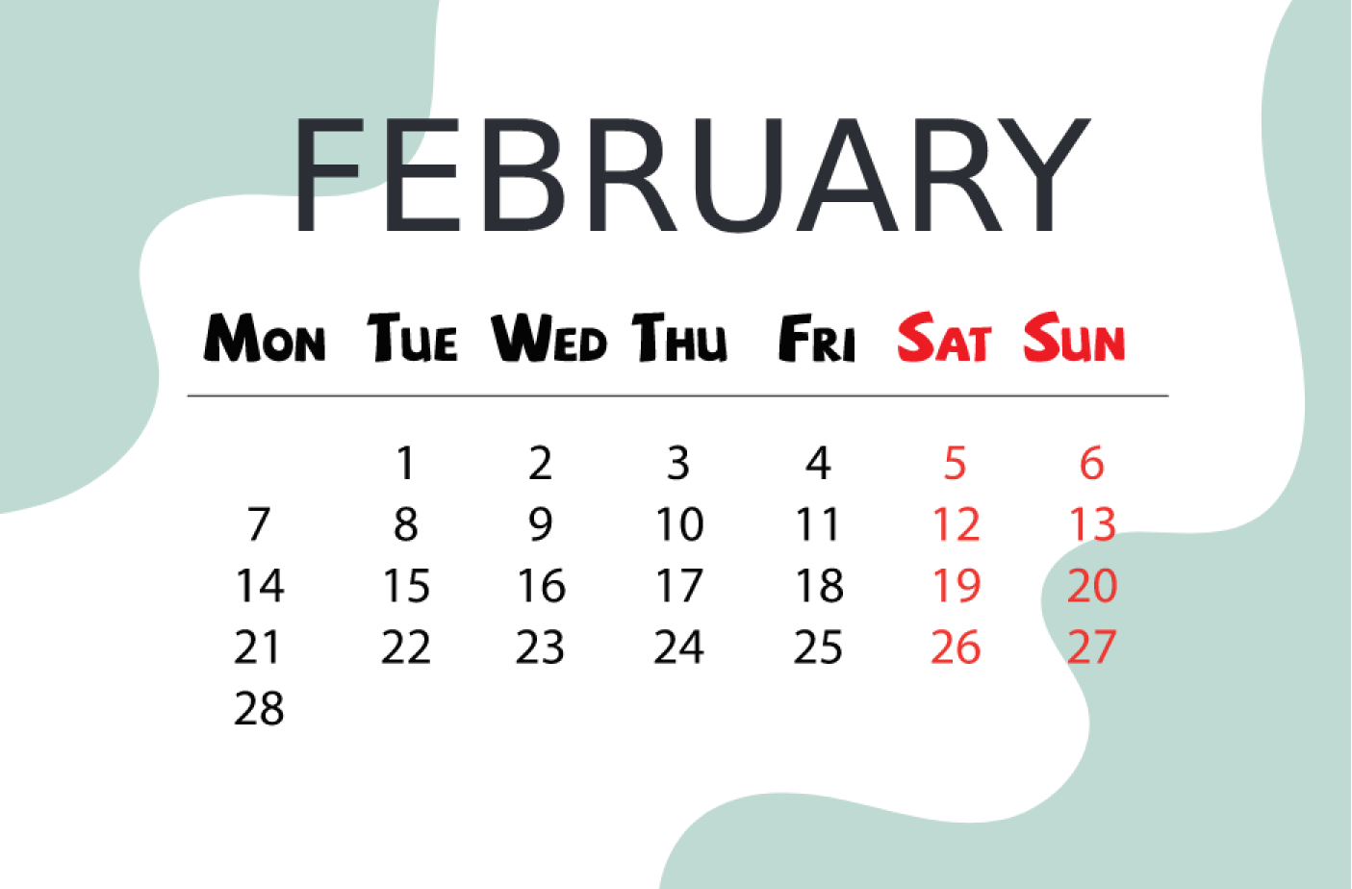
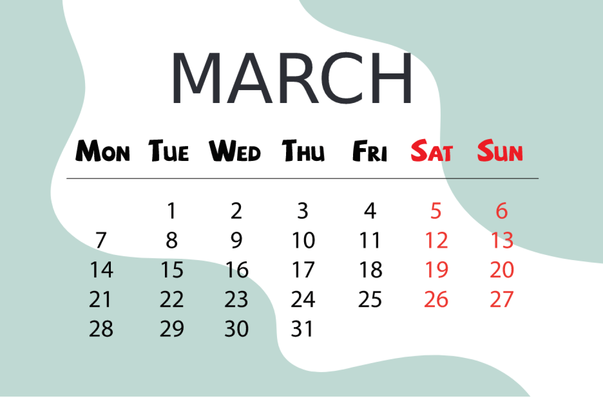
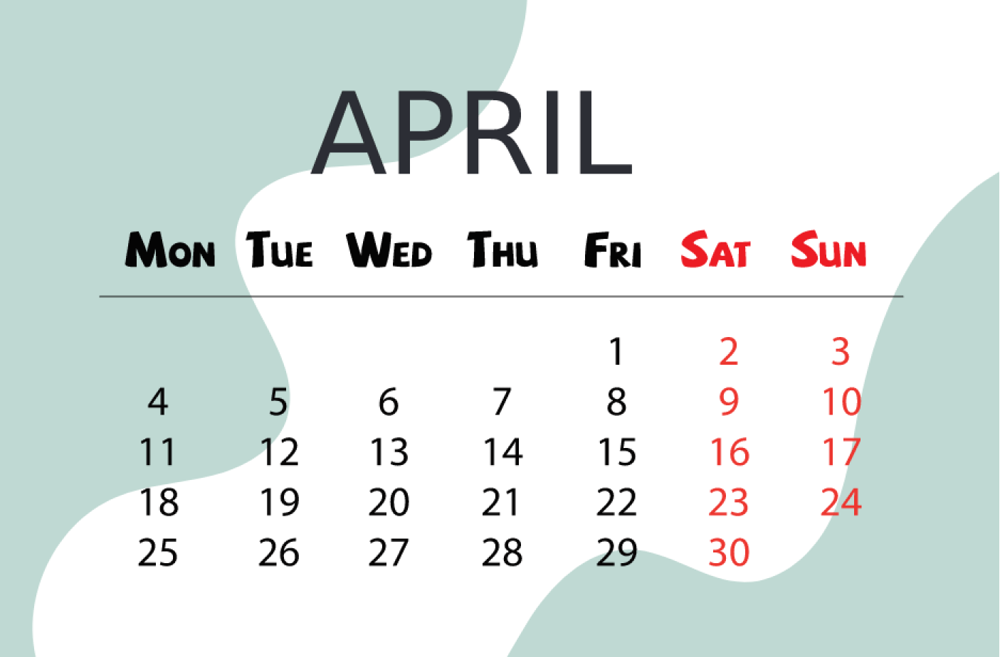
2
Listen, point and say.
When’s your birthday?
It’s _________.
a
January
b
February
MsPham
0936082789
c
d
March
April

Slide 23




Lucky circle
30
20
40
10
1
2
3
50
80
4
5
6
60
70
QUAY

Slide 24







A: When’s your birthday?
B:______________.
A. It’s in April
B. It’s in March
C. It’s in August
D. It’s in June
Home

Slide 25

A: ____ your birthday?
B: It’s in May.
A. What’s
B. When’s
C. Where’s
D. Who’s
Home

Slide 26
A: When’s your birthday?
B: _________________.
Câu hỏi
A. It’s in March
B. It’s in April
C. It’s in July
D. It’s in June
Home

Slide 27
A: When’s your ______?
B: It’s in January.
A. house
B. cake
C. birthday
D. mother
Home

Slide 28
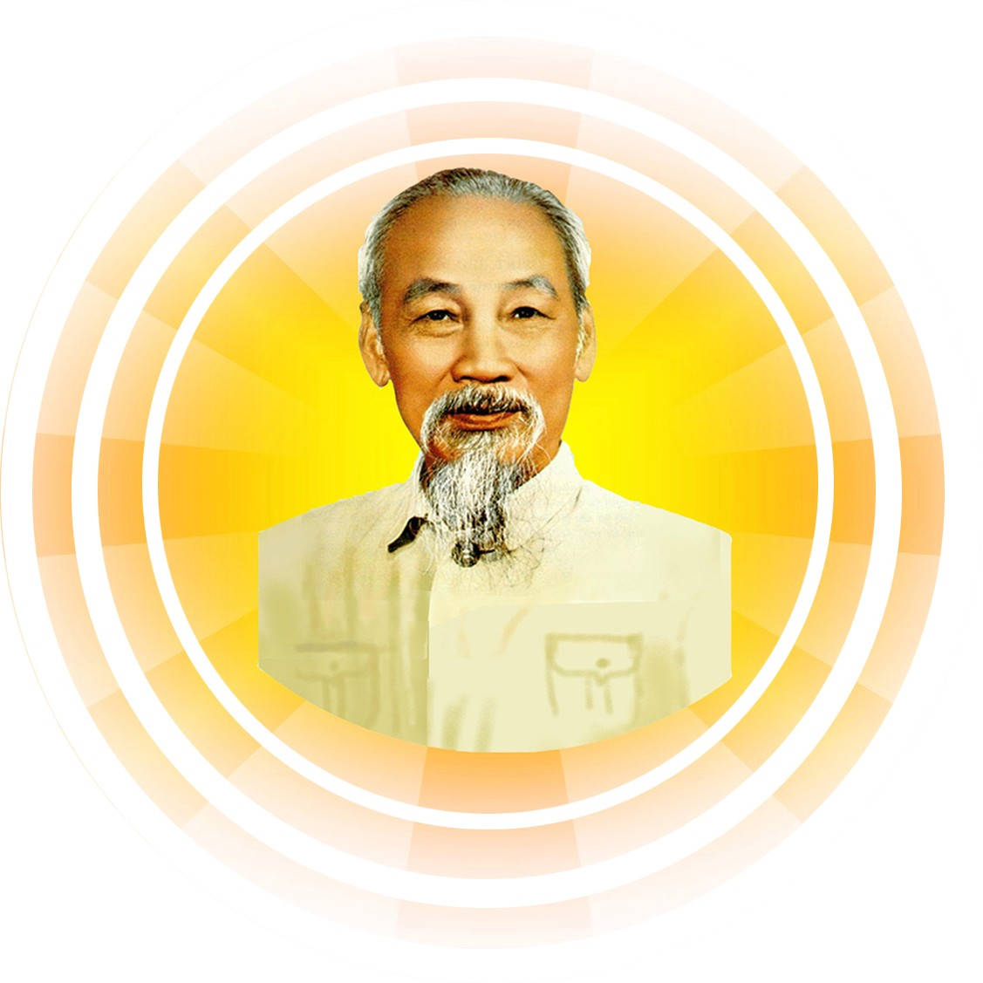

A: When’s your birthday?
B: _________________.
A. It’s in August
B. It’s in March
C. It’s in February
D. It’s in May
Home

Slide 29

A: When’s your birthday?
B: It’s________.
A. In May
B. In January
C. In September
D. In February
Home

Slide 30



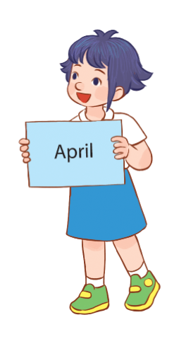
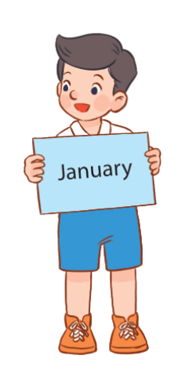
3
Let’s talk.
It’s in ___________.
When’s your birthday?

Slide 31
TEADY BEAR PASS

Slide 32
Thank you
for joining!

