Slide 1





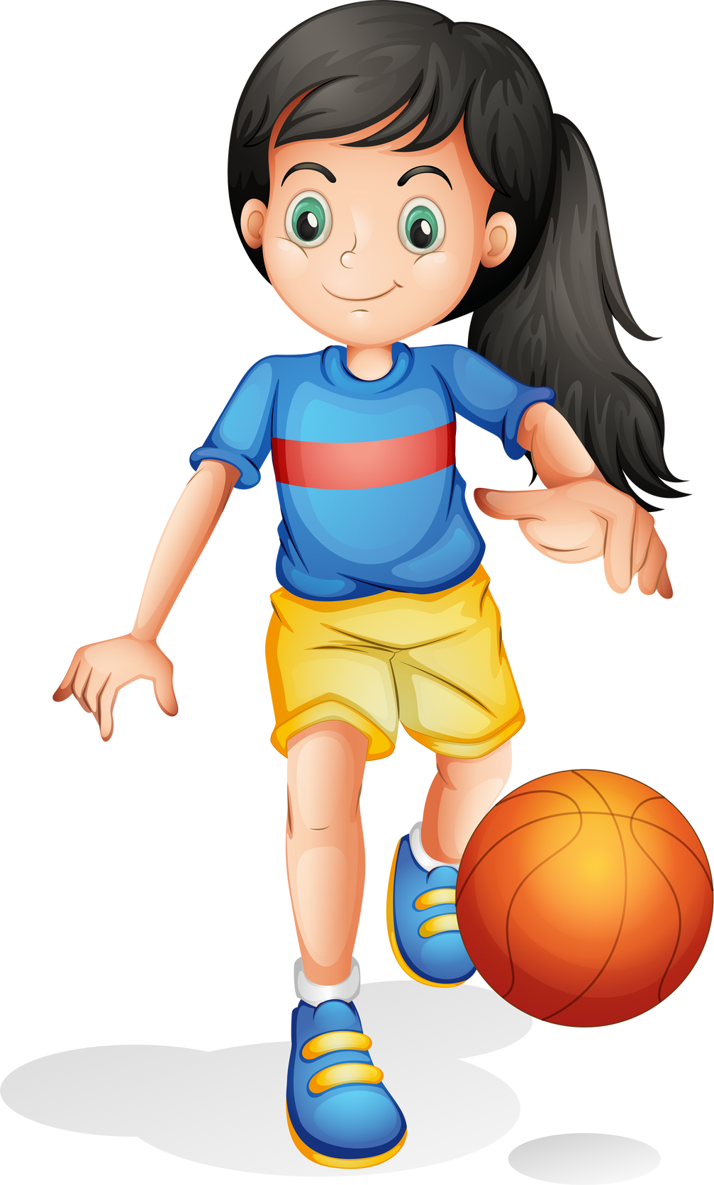

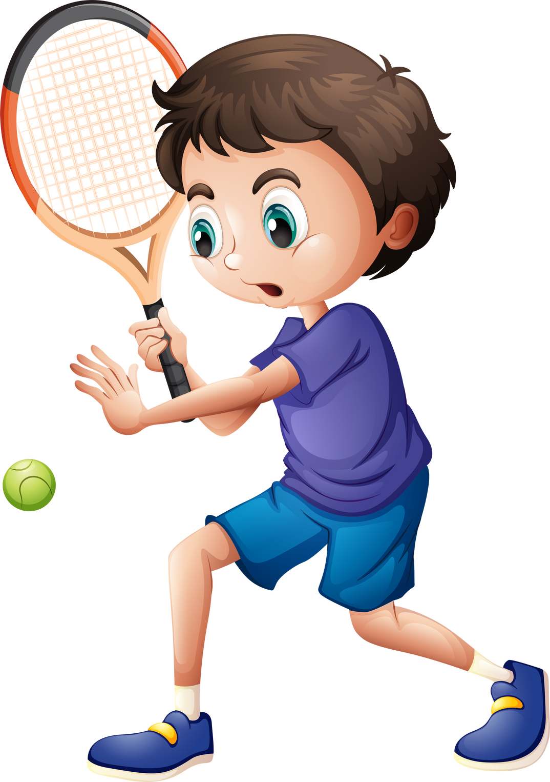
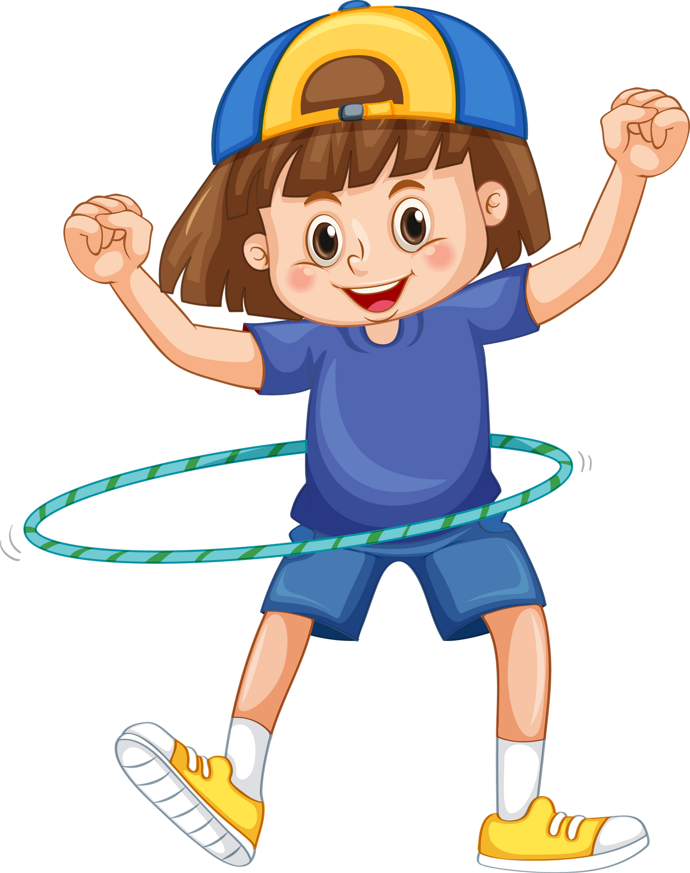
Unit 4
MsPham
0936082789
OUR FREE-TIME ACTIVITIES
Lesson 1 - Part 1, 2, 3
Teacher: Đặng Thị Thanh Thu
Class: 5D

Slide 2

MsPham
0936082789
1
Warm-up

Slide 3
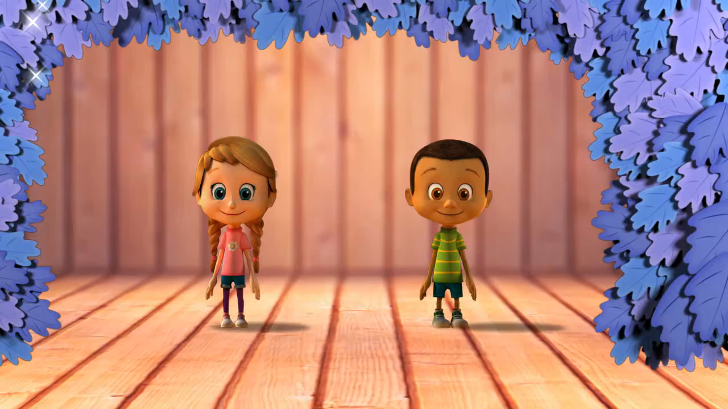
MsPham
0936082789

Slide 4
Unit 4
MsPham
0936082789
OUR FREE-TIME ACTIVITIES
Lesson 1 - Part 1, 2, 3

Slide 5

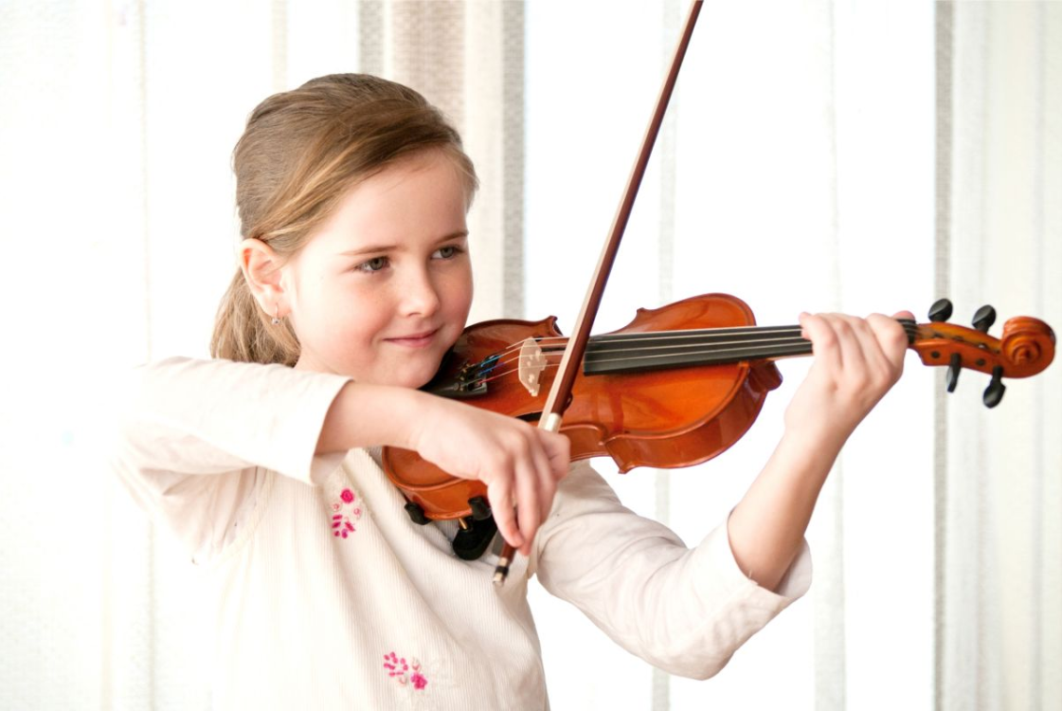
Vocabulary
play the violin
MsPham
0936082789
chơi đàn vi-ô-lông

Slide 6

Vocabulary
surf the Internet
MsPham
0936082789
lướt mạng
In-tơ-nét

Slide 7
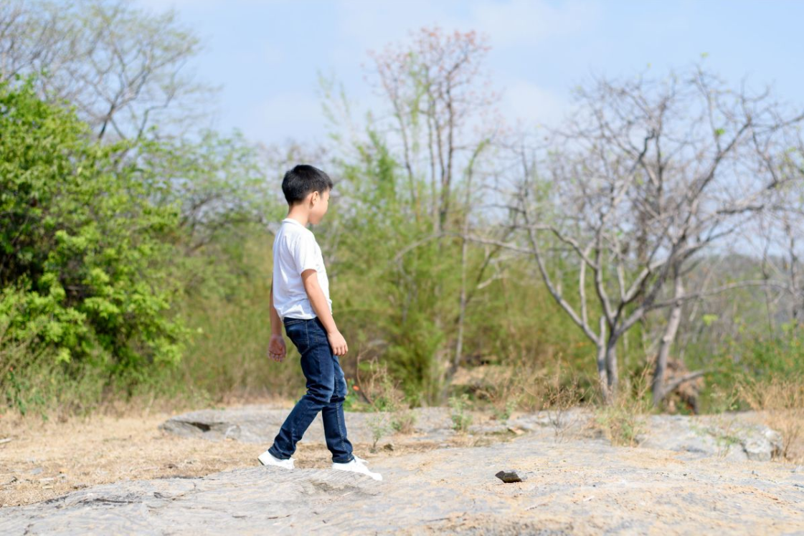
Vocabulary
go for a walk
MsPham
0936082789
đi dạo

Slide 8
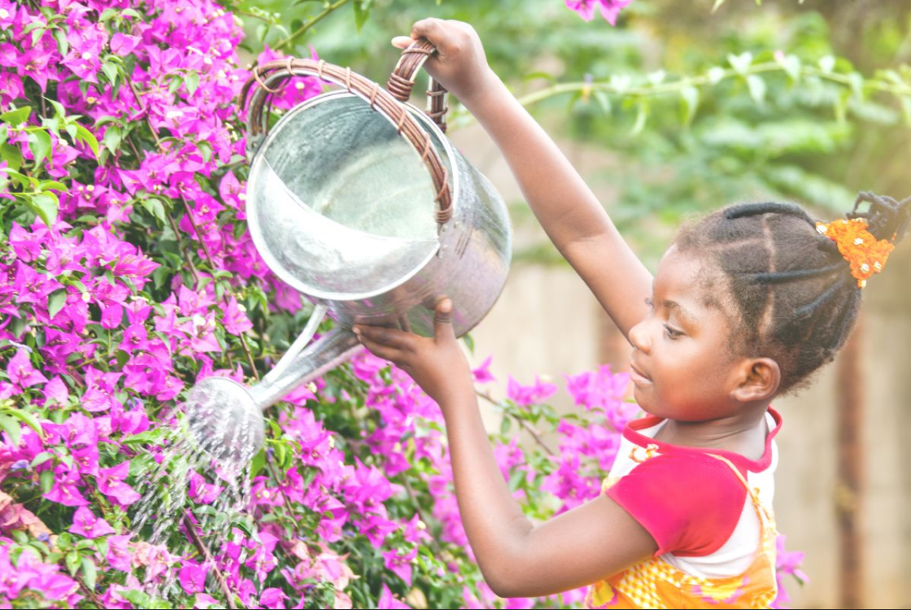
Vocabulary
water the flowers
MsPham
0936082789
tưới hoa

Slide 9
Vocabulary
play the violin
surf the Internet
go for a walk
water the flowers

Slide 10
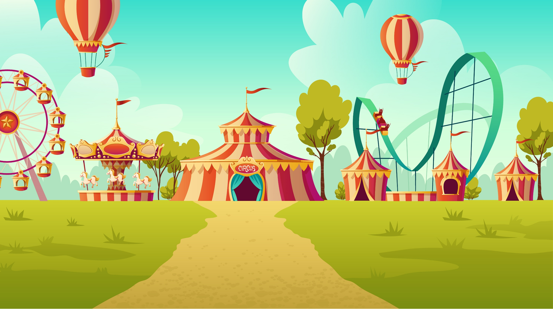


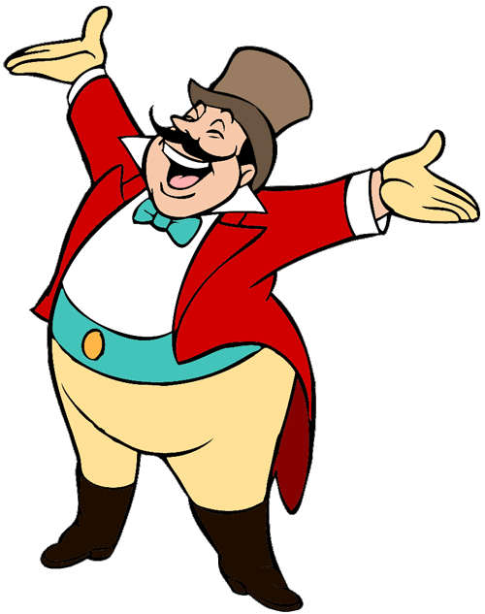
START

Slide 11



Look and choose
the best answer:
MsPham
0936082789
A
surf the Internet
B
water the flower
C
go for a walk

Slide 12
Look and choose
the best answer:
MsPham
0936082789
A
watch a cartoon
B
surf the Internet
C
play the violin

Slide 13

Listen and choose the best answer:
MsPham
0936082789
MsPham
0936082789
A
go for a walk
B
play the violin
C
water the flowers

Slide 14
Look and choose
the best answer:
MsPham
0936082789
A
go for a walk
B
watch a cartoon
C
play the violin

Slide 15
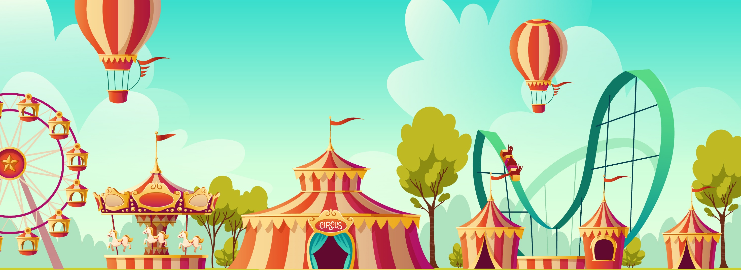




Slide 16
MsPham
0936082789
4
Let’s talk

Slide 17

MsPham
0936082789
5
Fun corner
and wrap-up

Slide 18
MsPham
0936082789
Thank you!
For joining!

