Slide 1









MsPham
0936082789
Warmly welcome our lesson today
Unit 5
My future job
MsPham
0936082789
Lesson 2 – Part 4, 5, 6
Class: 5D
Teacher: Đặng Thị Thanh Thu

Slide 2


MsPham
0936082789
1
MsPham
0936082789
Warm-up
and review
MsPham
0936082789

Slide 3



JOB IN THE FUTURE
What would you like to be in the future, in the future?
I’d like to be a teacher.
Why would you like to be a teacher?
Because I’d like to teach children
Why would you like to be a teacher?
Because I’d like to teach children.
What would you like to be in the future, in the future?
I’d like to be a writer.
Why would you like to be a writer?
Because I’d like to write stories.
Why would you like to be a writer?
Because I’d like to write stories.

Slide 4







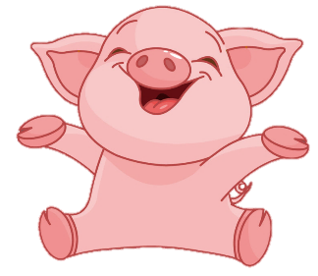


2
100
200
4
1
100
-200
3
5
6
+200
200
Notes:
Ms Huyền Phạm - 0936.082.789 – YOUTUBE: MsPham. Facebook: Dạy và học cùng công nghệ.

Slide 5




  a. a writer
Why would you like to be _________?
Because I'd like to teach children.
b. a teacher
  c. a doctor
Notes:
Ms Huyền Phạm - 0936.082.789 – YOUTUBE: MsPham. Facebook: Dạy và học cùng công nghệ.

Slide 6
a. a teacher
Why would you like to be _________?
Because I'd like to write stories.
  b. a doctor
  c. a writer
Notes:
Ms Huyền Phạm - 0936.082.789 – YOUTUBE: MsPham. Facebook: Dạy và học cùng công nghệ.

Slide 7
  a. a doctor
Why would you like to be _________?
Because I'd like to help sick people.
  b. a reporter
c. a teacher
Notes:
Ms Huyền Phạm - 0936.082.789 – YOUTUBE: MsPham. Facebook: Dạy và học cùng công nghệ.

Slide 8
  a. a gardener
Why would you like to be _________?
Because I'd like to report the news.
  b. a reporter
c. a nurse
Notes:
Ms Huyền Phạm - 0936.082.789 – YOUTUBE: MsPham. Facebook: Dạy và học cùng công nghệ.

Slide 9
a. a nurse
Why would you like to be _________?
Because I'd like to grow flowers.
b. a cook
  c. a gardener
Notes:
Ms Huyền Phạm - 0936.082.789 – YOUTUBE: MsPham. Facebook: Dạy và học cùng công nghệ.

Slide 10
a firefighter
Why would you like to be _________?
Because I'd like to take care sick people.
a nurse
  a writer
Notes:
Ms Huyền Phạm - 0936.082.789 – YOUTUBE: MsPham. Facebook: Dạy và học cùng công nghệ.

Slide 11
  a reporter
Why would you like to be _________?
Because I'd like to help people when there is a fire.
a cook
a firefighter
Notes:
Ms Huyền Phạm - 0936.082.789 – YOUTUBE: MsPham. Facebook: Dạy và học cùng công nghệ.

Slide 12
a. a cook
Why would you like to be _________?
Because I'd like to cook many delicious dishes.
b. a firefighter
  c. a gardener
Notes:
Ms Huyền Phạm - 0936.082.789 – YOUTUBE: MsPham. Facebook: Dạy và học cùng công nghệ.

Slide 13
MsPham
0936082789
5/37
MsPham
0936082789
MsPham
0936082789
Read and complete

Slide 14
MsPham
0936082789
6
MsPham
0936082789
MsPham
0936082789
Let’s play

Slide 15
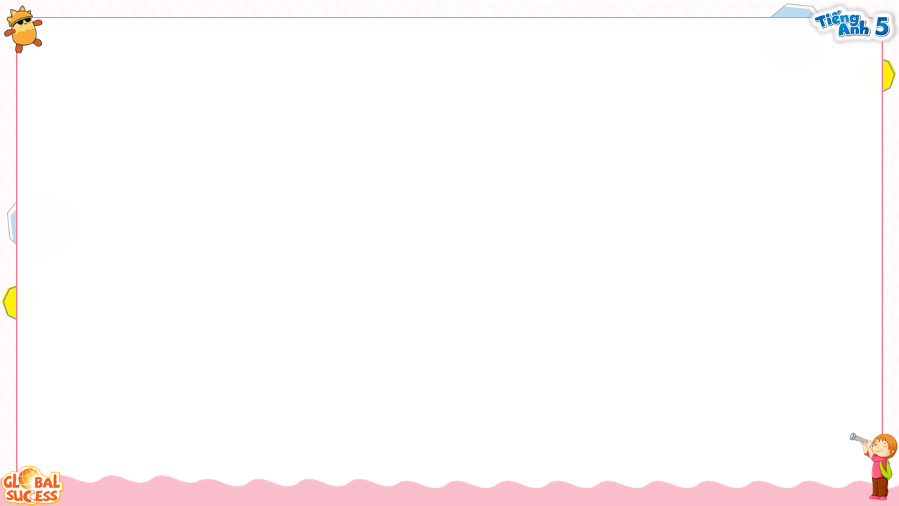
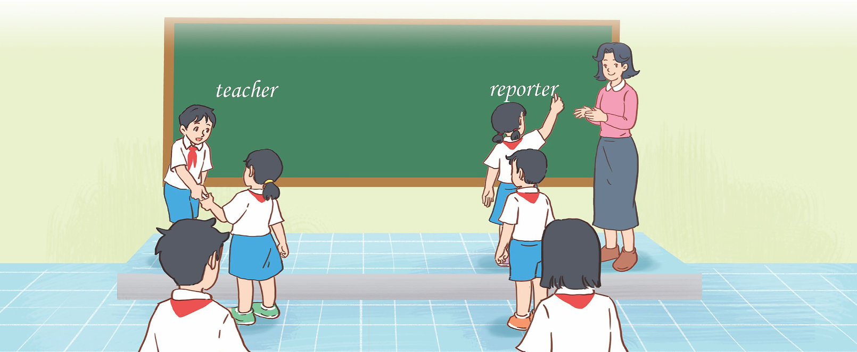
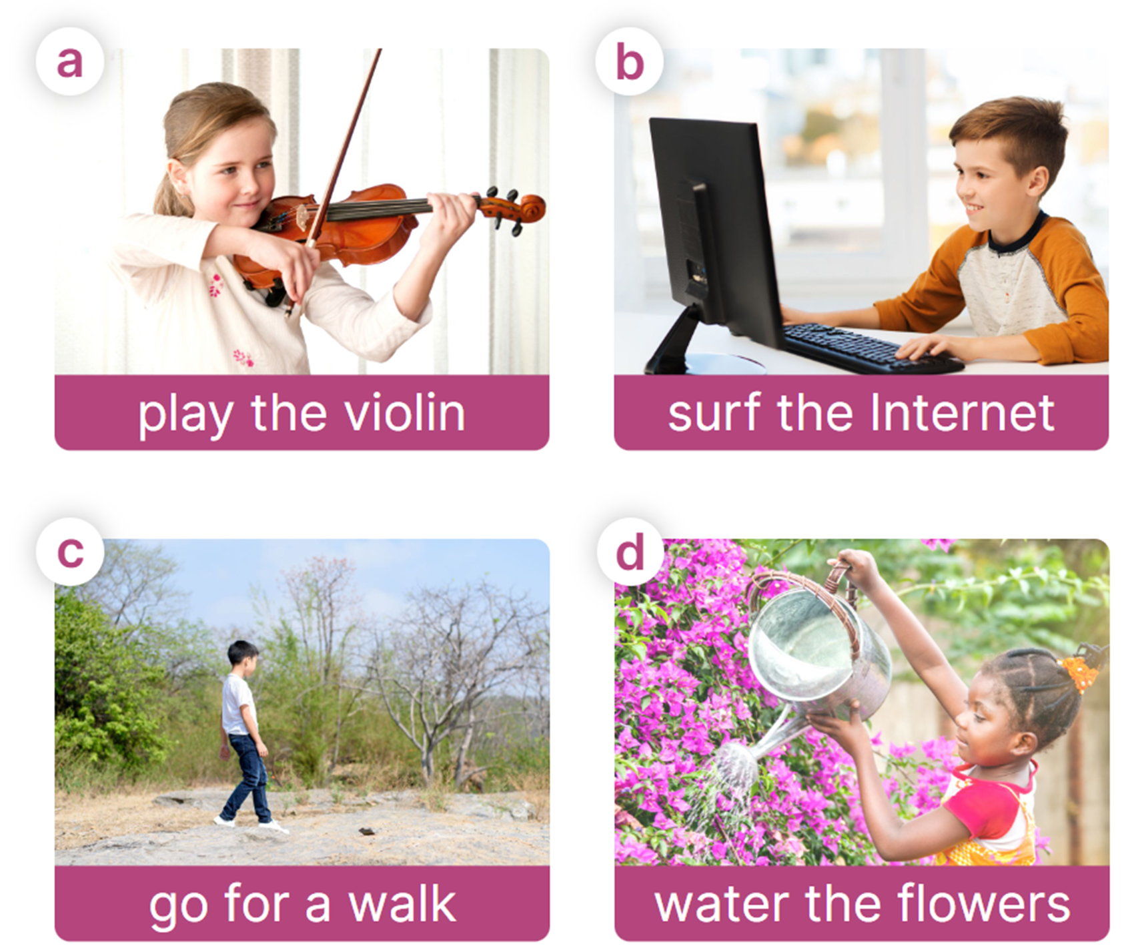
MsPham
0936082789
Jobs word bank
MsPham
0936082789
MsPham
0936082789

Slide 16
MsPham
0936082789
Thank you!
For joining!
Notes:
MsPham-0936082789

Slide 17
MsPham
0936082789
MsPham
0936082789
Fun corner
and wrap-up

Slide 18
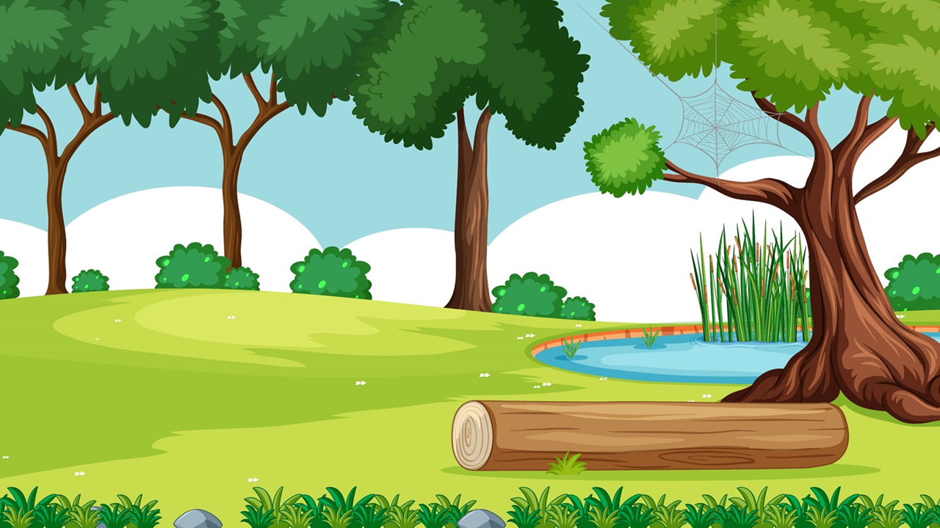

MsPham-0936082789
MsPham-0936082789
MsPham-0936082789
Start
MsPham-0936082789

Slide 19
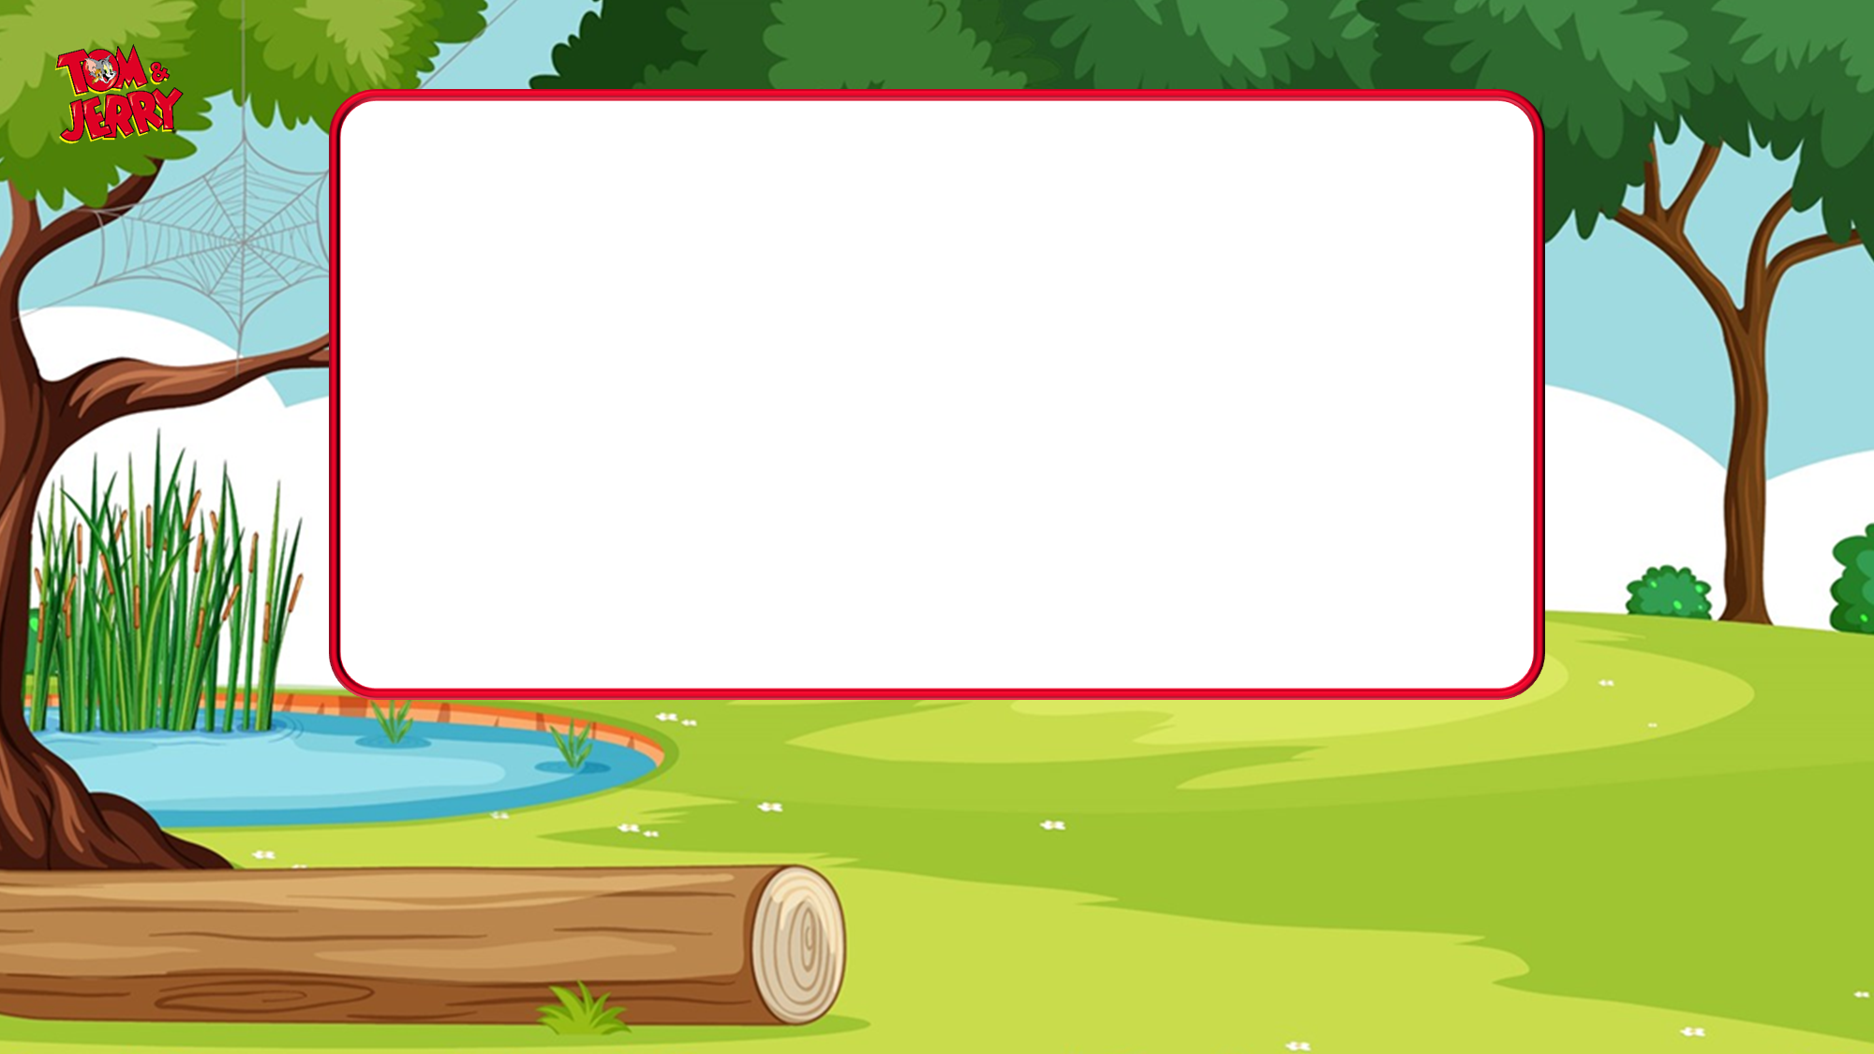
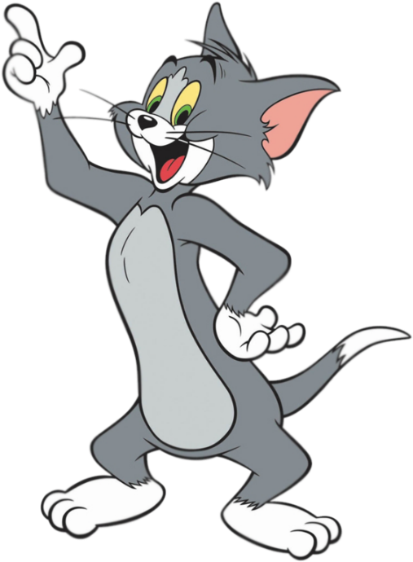
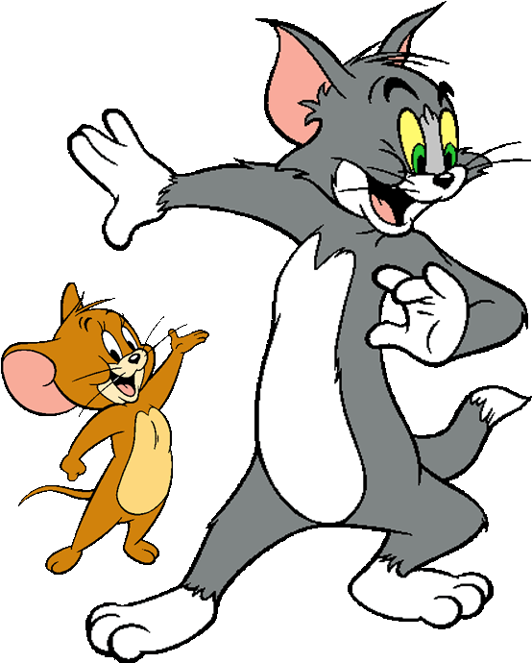


MsPham-0936082789
Why would you like to be a gardener?
Because I'd like to grow flowers.
MsPham-0936082789
MsPham-0936082789
True
False
Next
MsPham-0936082789

Slide 20
MsPham-0936082789
Why would you like to be a firefighter?
Because I'd like to help sick people.
MsPham-0936082789
MsPham-0936082789
True
False
Next
MsPham-0936082789

Slide 21
MsPham-0936082789
Why would you like to be a singer?
Because I'd like to cook many delicious dishes.
MsPham-0936082789
MsPham-0936082789
True
False
Next
MsPham-0936082789

Slide 22
MsPham-0936082789
Why would you like to be a reporter?
Because I'd like to report the news.
MsPham-0936082789
MsPham-0936082789
True
False
Next
MsPham-0936082789

Slide 23
MsPham-0936082789
Why would you like to be a farmer?
Because I'd like to take care sick people.
MsPham-0936082789
MsPham-0936082789
True
False
Next
MsPham-0936082789

Slide 24
MsPham-0936082789
Why would you like to be a writer?
Because I'd like to write stories.
MsPham-0936082789
MsPham-0936082789
True
False
Next
MsPham-0936082789

Slide 25
MsPham-0936082789
Why would you like to be a teacher?
Because I'd like to teach children.
MsPham-0936082789
MsPham-0936082789
True
False
Next
MsPham-0936082789

Slide 26
MsPham-0936082789
Why would you like to be a policeman?
Because I'd like to sing songs.
MsPham-0936082789
MsPham-0936082789
True
False
Next
MsPham-0936082789

Slide 27


MsPham-0936082789
MsPham-0936082789
To be continued…
MsPham-0936082789
End
MsPham-0936082789

Slide 28
MsPham
0936082789
Thank you!
For joining!
Notes:
MsPham-0936082789

