Slide 1
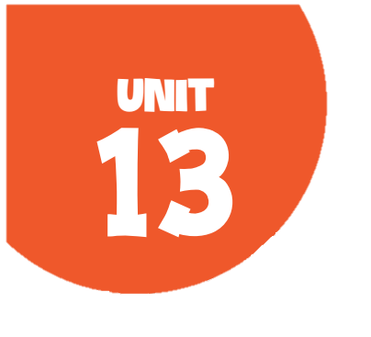
OUR SPECIAL DAYS
Lesson 1 - Period 1

Slide 2
Table of contents
1
2
3
4
Warm-up
Let's chant.
Activity 1
Look, listen and repeat.
Activity 2
Listen, point and say.
Activity 3
Let's talk.
Fun corner
5
Let's play.

Slide 3
01
Warm-up
Let's chant.

Slide 4
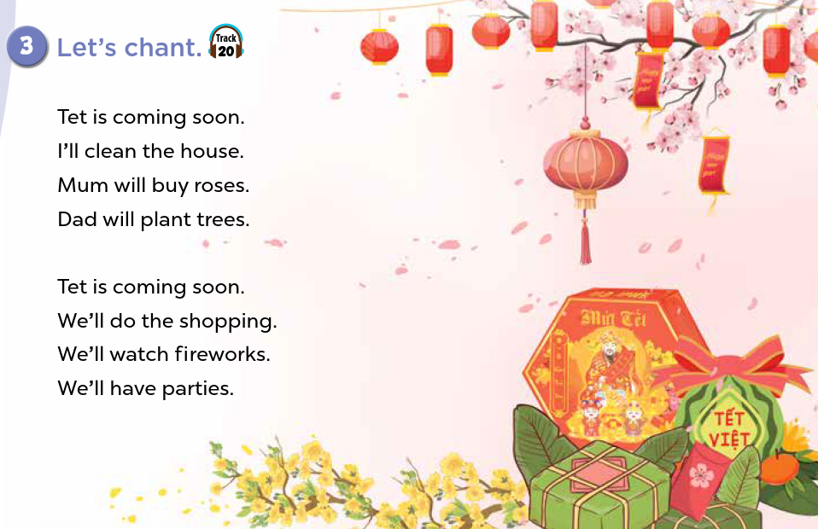


Slide 5
02
Activity 1
Look, listen and repeat.

Slide 6
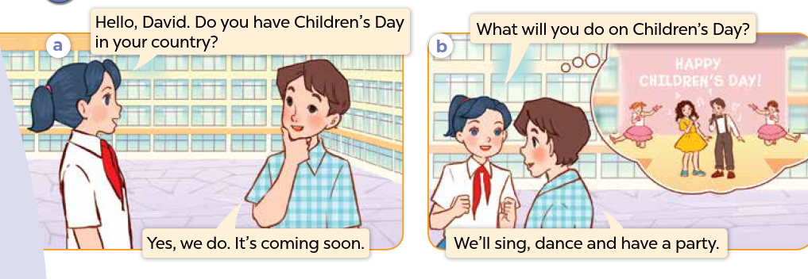
Who can you see? Where are they?
What are they talking about?

Slide 7
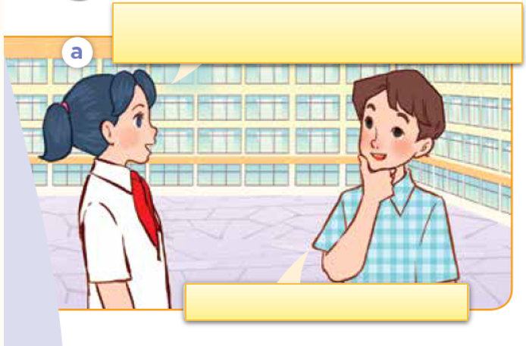
Look, listen and repeat.

Slide 8
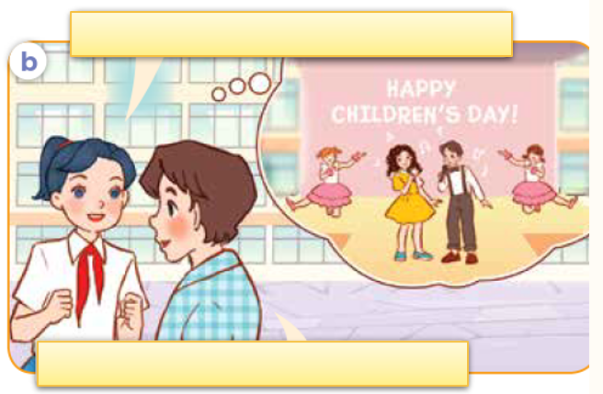
Look, listen and repeat.

Slide 9
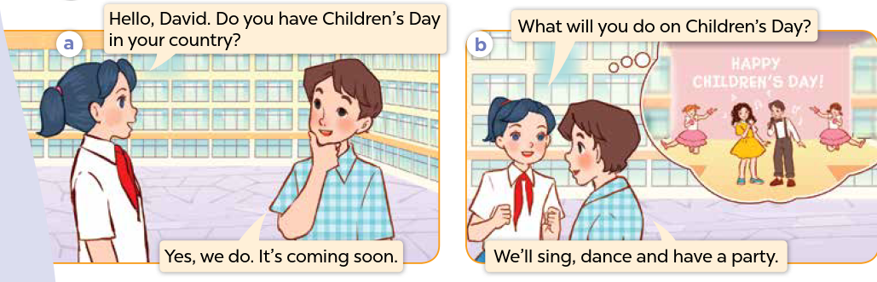
Look, listen, and repeat.

Slide 10
03
Activity 2
Listen, point and say.

Slide 11
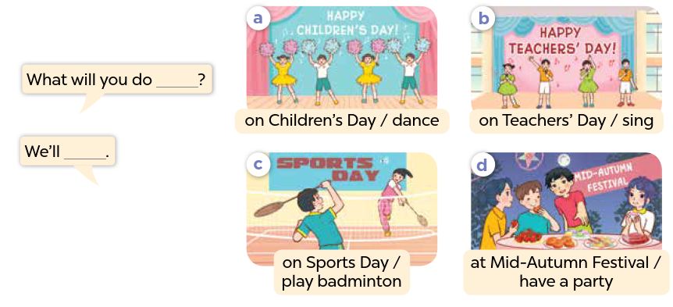

Slide 12
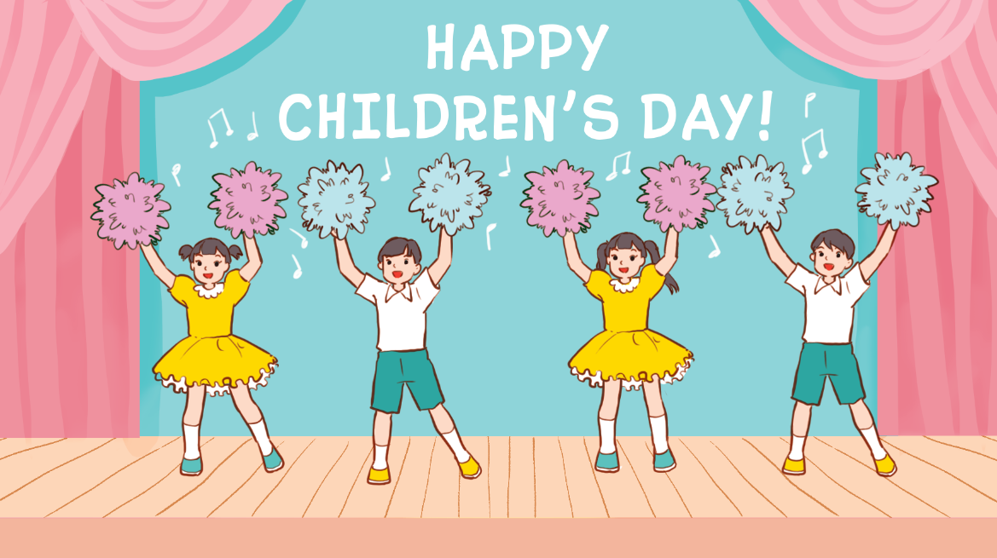
Listen, point and say.
a. On Children’s Day / dance

Slide 13
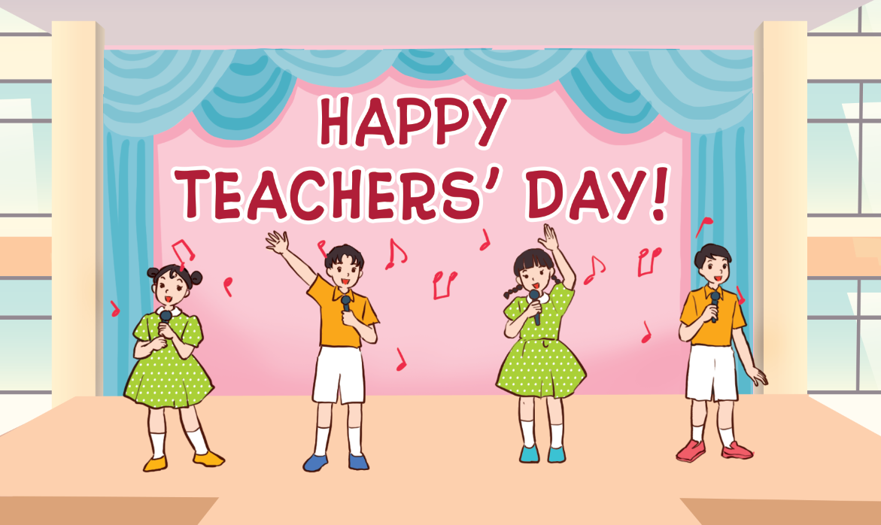
Listen, point and say.
b. on Teacher’s Day / sing

Slide 14
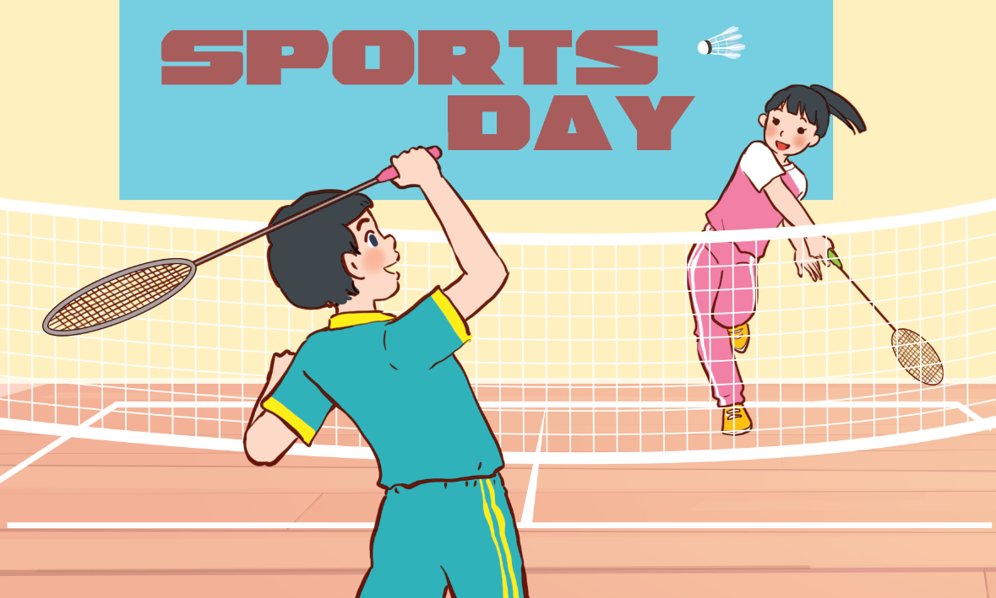
Listen, point and say.
c. on Sports Day / play badminton

Slide 15
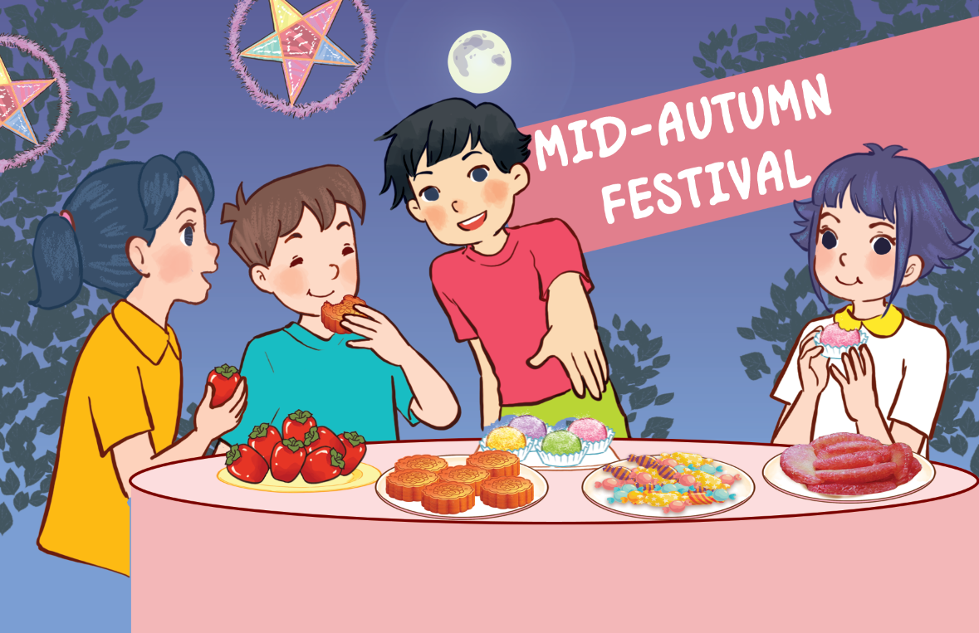
Listen, point and say.
d. at Mid-Autumn Festival / have a party

Slide 16
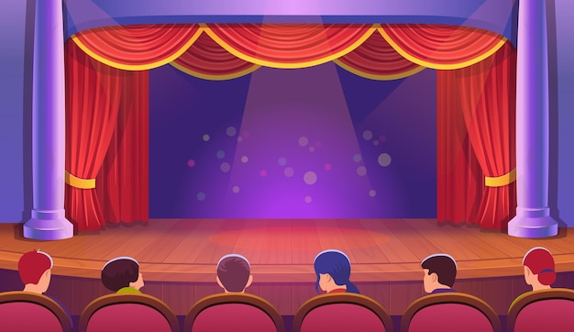
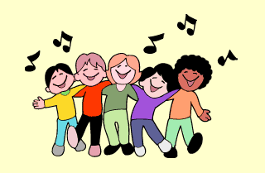
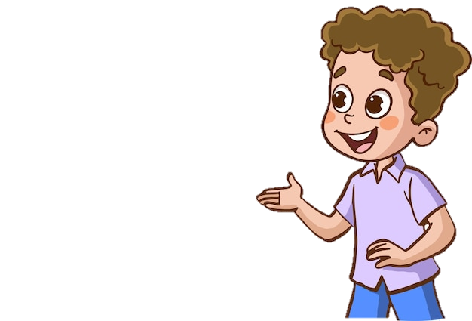
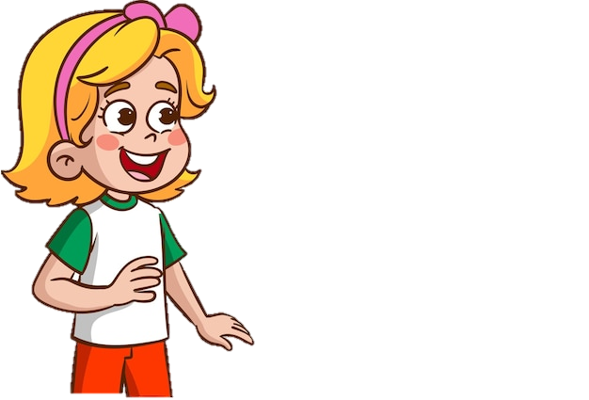
What will you do on Children's Day?
We'll sing.
HAPPY
CHILDREN'S DAY!

Slide 17
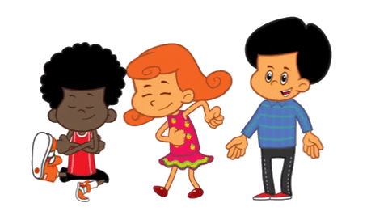
What will you do on Teachers' Day?
We'll dance.
HAPPY
TEACHERS' DAY!

Slide 18
What will you do ________?
We'll ____.

Slide 19
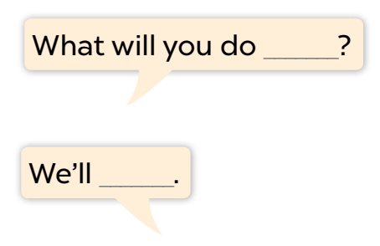
Listen, point and say.
a. On Children’s Day / dance

Slide 20
Listen, point and say.
b. on Teacher’s Day / sing

Slide 21
Listen, point and say.
c. on Sports Day / play badminton

Slide 22
Listen, point and say.
d. at Mid-Autumn Festival / have a party

Slide 23
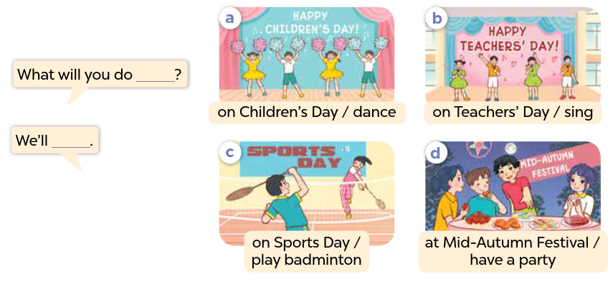
Work in pairs. Ask and answer.

Slide 24
Activity 3
04
Let's talk.

Slide 25
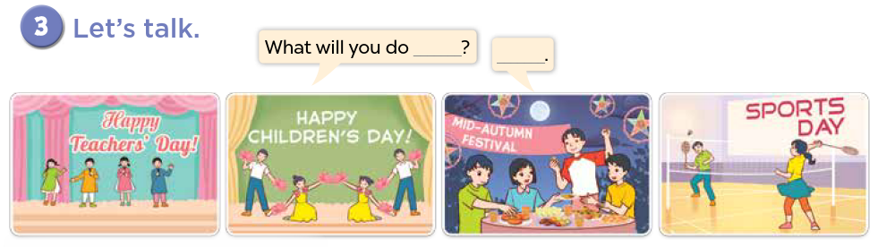

Slide 26
Fun Corner
05
SPIN THE WHEEL

Slide 27
Spin the wheel
3 JUMPING JACKS
1 STAR
5 STARS
3 STARS
SPIN AROUND
SAY AN ENGLISH WORD
Click here to spin
5 HIGH KNEES
NO STAR
-2 STARS
-5 STARS
3 SQUATS
10 STARS

Slide 28
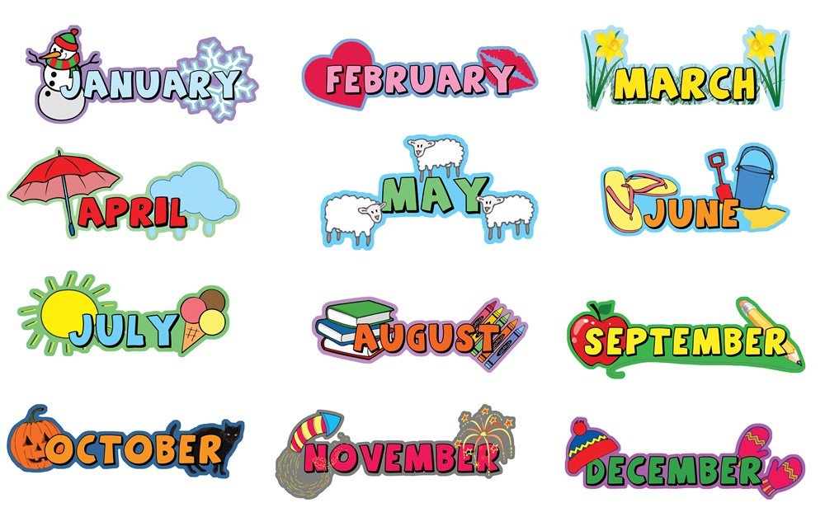
What's your favourite month?

Slide 29

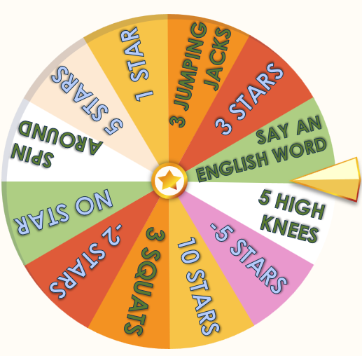
What day is June 1st?
It's Children's Day.

Slide 30

What day is November 20th?
It's Vietnamese Teachers' Day.

Slide 31
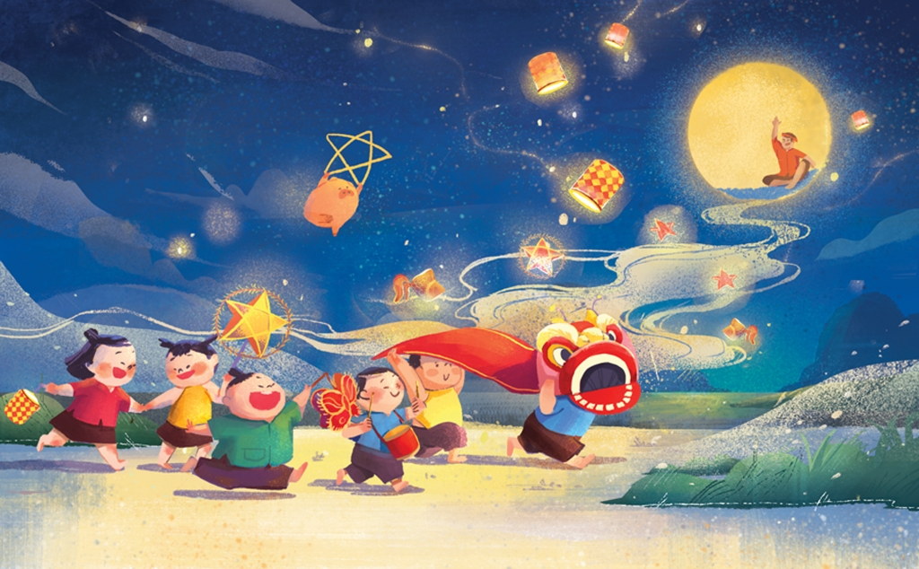
What festival is it?
It's Mid-Autumn Festival.

Slide 32
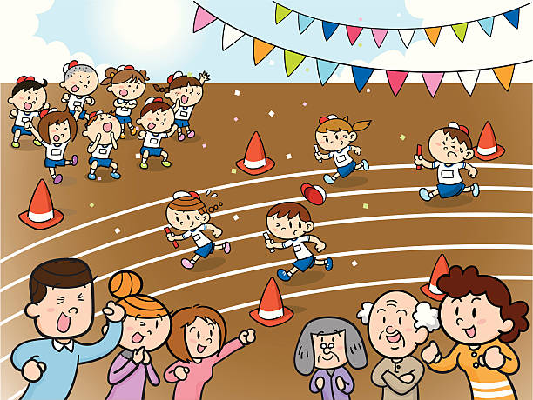
What day is it?
It's Sports Day.

Slide 33
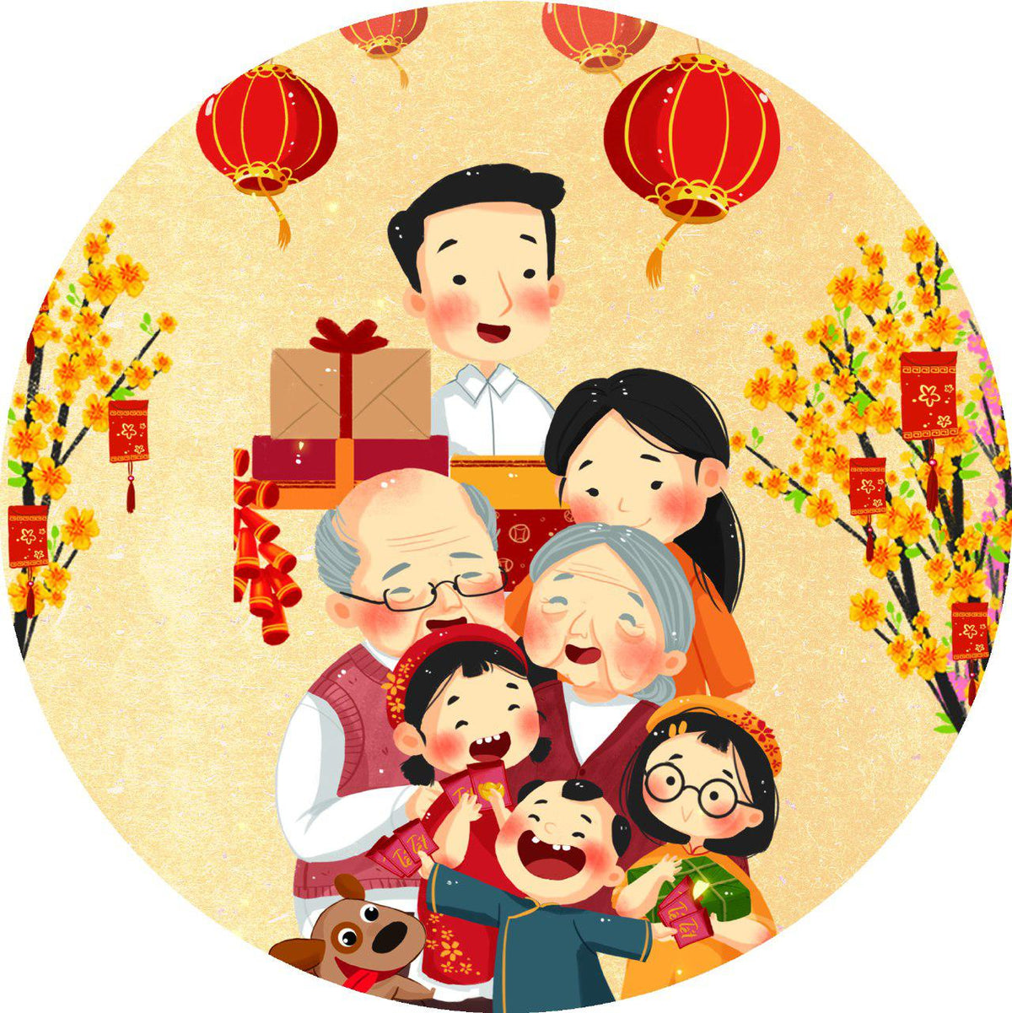
What festival is it?
It’s Tet Festival.
(Lunar New Year)

Slide 34
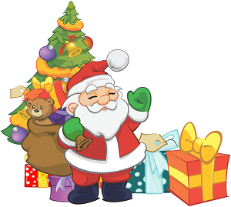
What day is it?
It's Christmas Day.

Slide 35
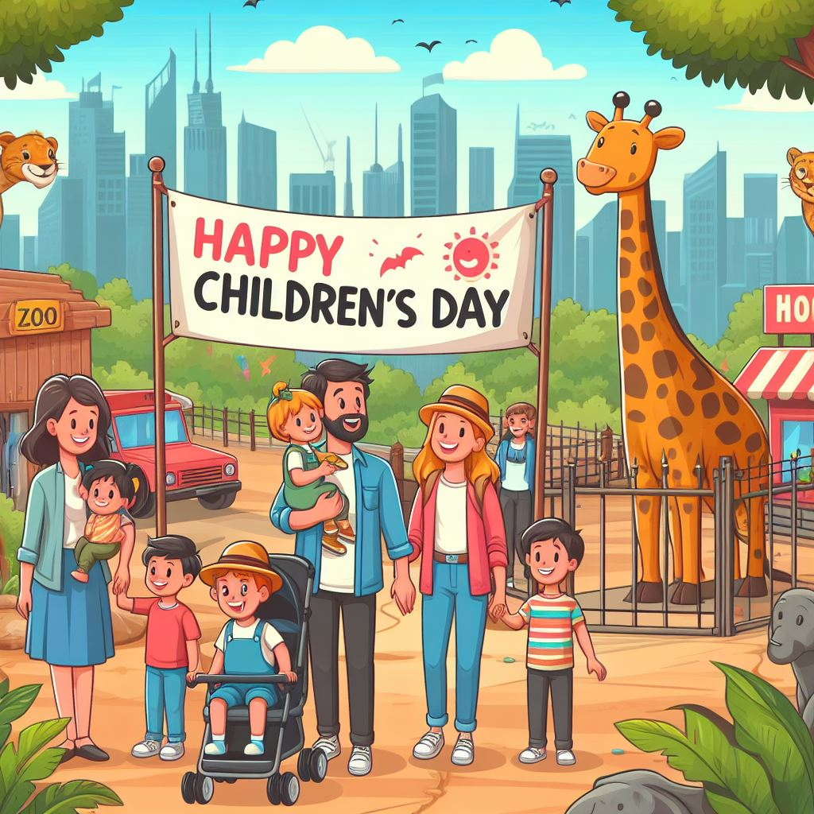
Ask and answer.
What will you do ___________?
on Children's Day
We'll ________.
go to the zoo

Slide 36
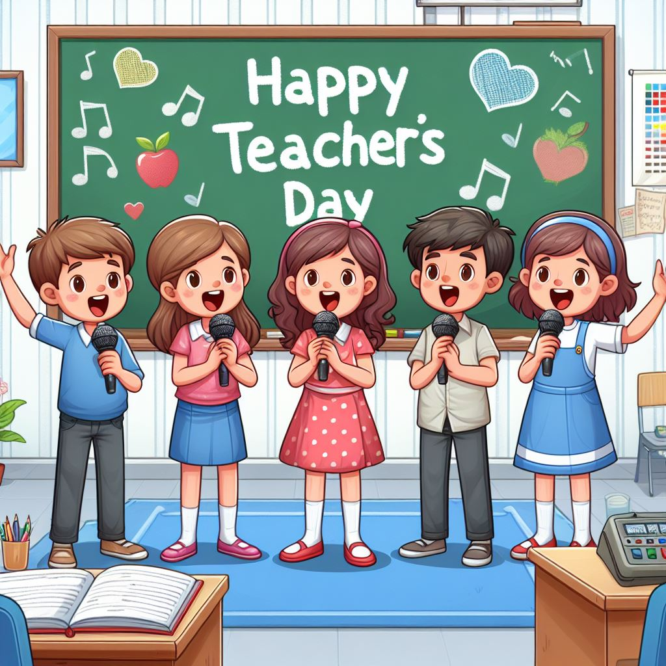
Ask and answer.
What will you do ___________?
'
on Teachers' Day
We'll _____.
sing

Slide 37
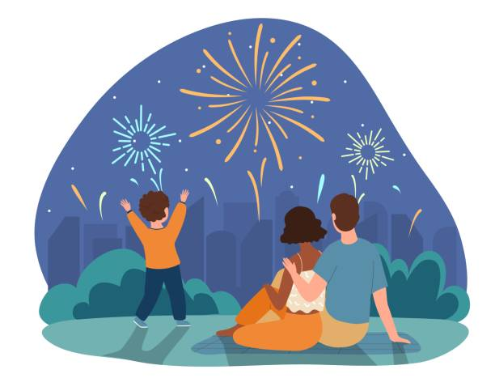
Ask and answer.
What will you do ___________?
at Tet Festival
___ watch _____.
We'll
fireworks

Slide 38
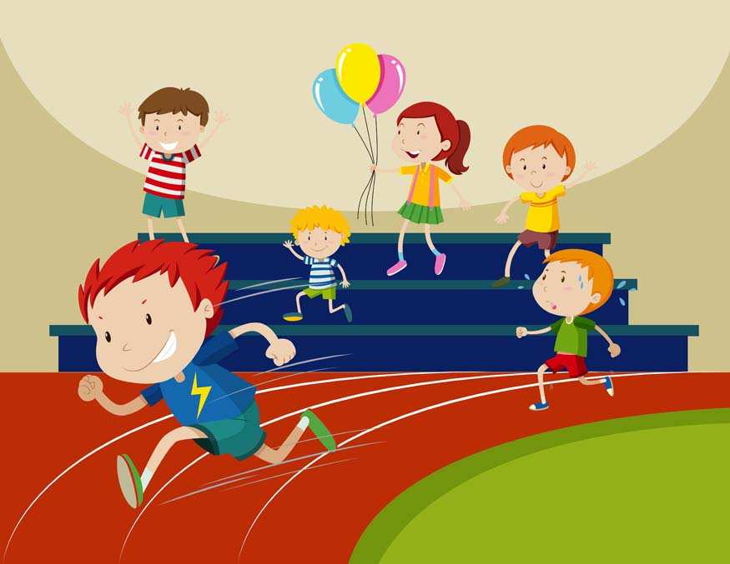
Ask and answer.
What will you do ___________?
on Sports Day
We'll _____.
run

Slide 39
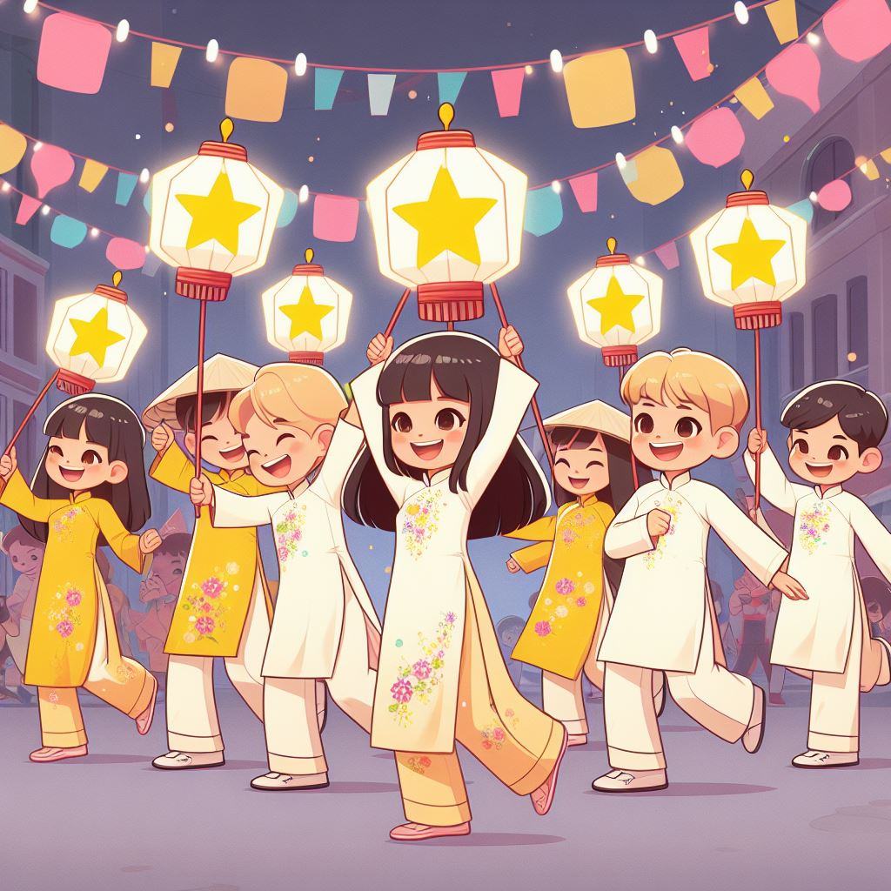
Ask and answer.
_________at Mid-Autumn Festival?
What will you do
______ dance and have fun.
We'll

Slide 40
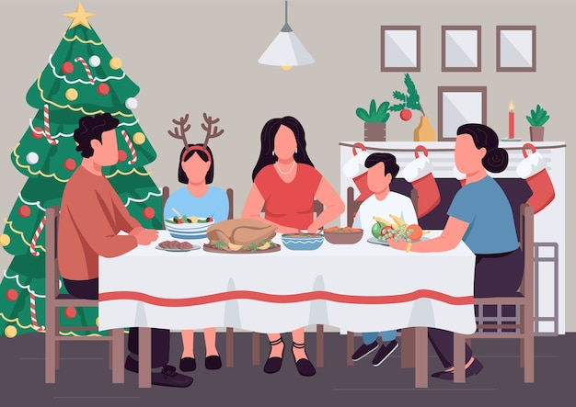
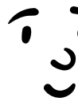




Ask and answer.
_________ on Christmas Day?
What will you do
___________.
We'll have a party

