Slide 1
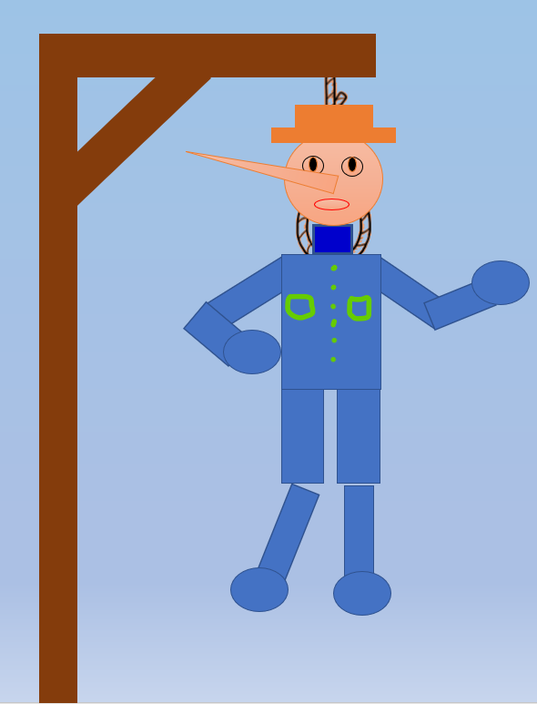

Warm-up
and review
HANGMAN GAME
0
1
2
3
4
5
6
7
8
0
9
1
2
3
4
5
6
7
8
0
9
1
2
3
4
5
6
7
8
GIRLS
9
0
1
2
3
4
5
6
7
8
0
9
1
2
3
4
5
6
7
8
0
9
1
2
3
4
5
6
7
8
BOYS
9
Notes:
- Divide the class into 2 teams.
- Have pupils guess the word letter by letter.
- Whenever a team guesses a letter, click that letter. If it belongs to the secret word, it will be filled in the blank, and the team will get one point. If not, parts of the hangman will appear.

Slide 2
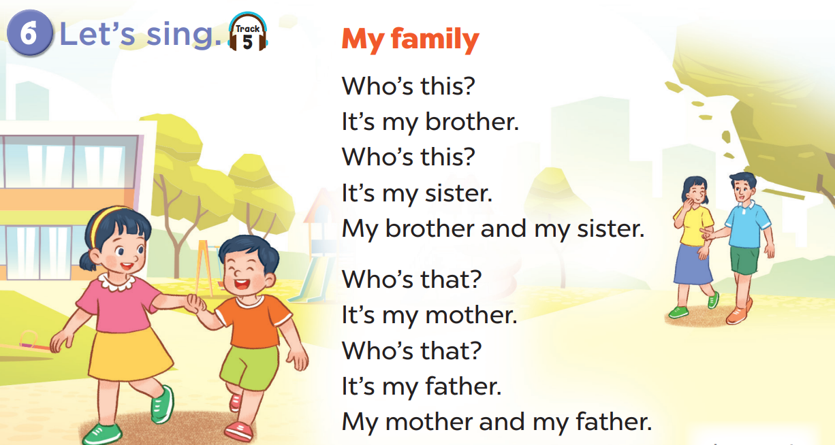


Slide 3








A
B
C
D
Notes:
Click on the headphone to play the recording.
Click on the gold piece to go back.

Slide 4




B
C
D
A
Notes:
Click on the headphone to play the recording.
Click on the gold piece to go back.

Slide 5
B
C
D
A
Notes:
Click on the headphone to play the recording.
Click on the gold piece to go back.

Slide 6
A
B
C
D
Notes:
Click on the headphone to play the recording.
Click on the gold piece to go back.

Slide 7

Website: hoclieu.vn
Fanpage: facebook.com/www.tienganhglobalsuccess.vn

