Slide 2

Warmly welcome all the teachers
WARMLY WELCOME
Nguyen Khuyen Primary School
Teacher: Vu Thi Hong Nhung
Grade 5

Slide 3
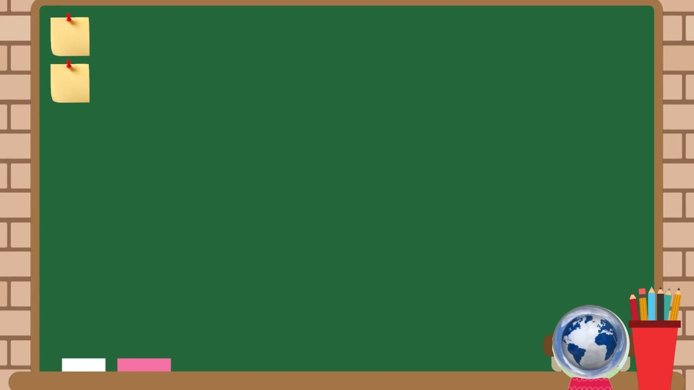
Thursday, April 10th 2025
Unit 17: Stories for children
Lesson 2 – Activity 4, 5, 6/P.40

Slide 4






UNIT 17
STORIES FOR CHILDREN
Lesson 2 – Period 4

Slide 5











Table of Contents
Warm-up and Review
Listen and circle.
Read and complete.
Listen, complete and sing.
Fun corner and Wrap-up

Slide 6


01
Warm-up and Review

Slide 7

What and Where
Notes:
- Tell pupils that they are going to say and write the words.

Slide 8
Game: WHAT and WHERE
work
sing
cook
run
Notes:
Ask pupils to read the words aloud. Delete the words in the circle one by one.
Click the word to disappear it.
Click the pink circles to make it appear.

Slide 9
Game: WHAT and WHERE
work
sing
cook
run
Notes:
Point to the empty circle and ask pupils to read it again.
Ask pupils to come to the board and rewrite the words with the correct places in the circles.
Check the answers as the class by clicking on the pink circle chosen.
Have pairs of pupils use these words to ask and answer questions about a character in a story.

Slide 10
Game: WHAT and WHERE
work
sing
cook
run

Slide 11
Game: WHAT and WHERE
work
sing
cook
run

Slide 12
Game: WHAT and WHERE
work
sing
cook
run
Notes:
Have pairs of pupils use these words to ask and answer questions about a character in a story.

Slide 13



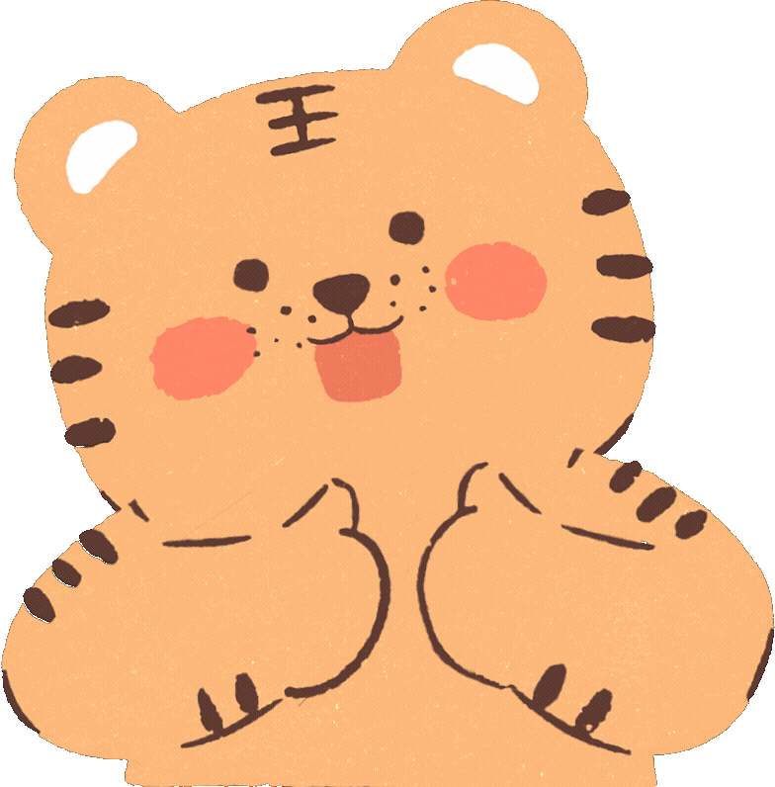



Slide 14
02
Listen and circle.

Slide 15


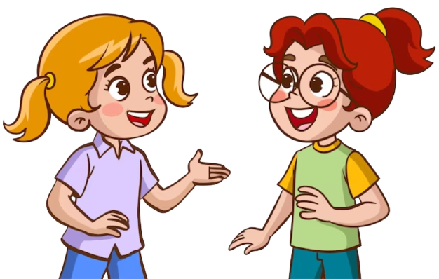
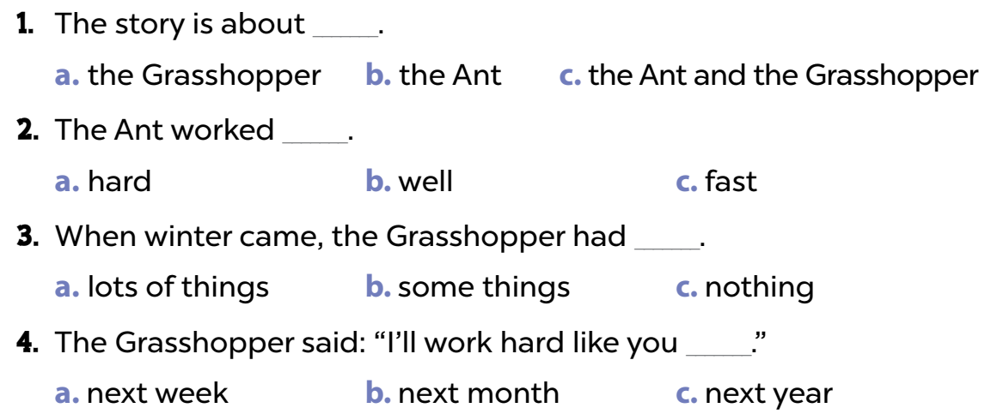
Read and guess the answers.
1. The story is about _______.
a. a grasshopper b. an ant c. an ant and a grasshopper
2. The ant worked _______.
a. hard b. well c. fast
3. When winter came, the grasshopper did not have any _______.
a. water b. friends c. food
4. The grasshopper said: “I’ll work hard like you _______.”
a. next week b. next month c. next year

Slide 16
Listen.
1. The story is about _______.
a. a grasshopper b. an ant c. an ant and a grasshopper
2. The ant worked _______.
a. hard b. well c. fast
3. When winter came, the grasshopper did not have any _______.
a. water b. friends c. food
4. The grasshopper said: “I’ll work hard like you _______.”
a. next week b. next month c. next year

Slide 17
Listen and circle.
1. The story is about _______.
a. a grasshopper b. an ant c. an ant and a grasshopper
2. The ant worked _______.
a. hard b. well c. fast
3. When winter came, the grasshopper did not have any _______.
a. water b. friends c. food
4. The grasshopper said: “I’ll work hard like you _______.”
a. next week b. next month c. next year

Slide 18
Work in pairs to check your answers.

Slide 19
Let’s check the answers.
1. The story is about _______.
a. a grasshopper b. an ant c. an ant and a grasshopper
2. The ant worked _______.
a. hard b. well c. fast
3. When winter came, the grasshopper did not have any _______.
a. water b. friends c. food
4. The grasshopper said: “I’ll work hard like you _______.”
a. next week b. next month c. next year

Slide 21
03
Read and complete.

Slide 22
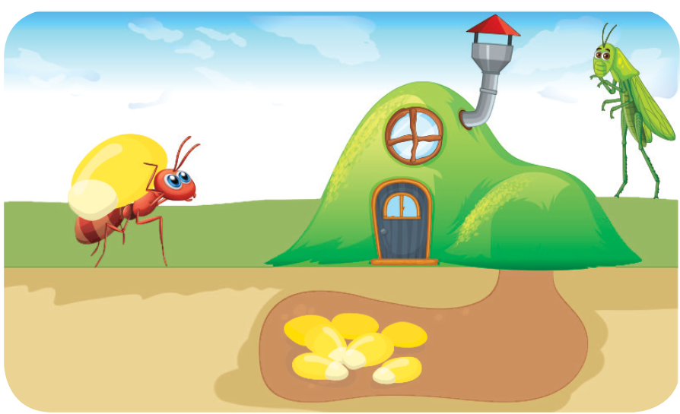
Look and answer.
1. Who are the main characters in this story?
2. How did they work?

Slide 23

Look and answer.
A: Who are the main
characters in the story?
B: They’re the ant and the
_____________ .
A: _______ did the ant work?
B: He worked __________ to
gather food for the winter.
grasshopper
How
hard

Slide 24
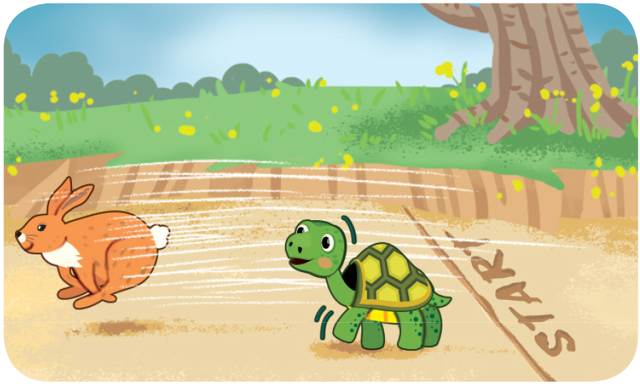
Look and answer.
1. Who are the main characters in this story?
2. How did they run?

Slide 25

Look and answer.
A: How did the hare run?
B: He ran _____ .
A: _______ he win the race?
B: No, he didn’t. He stopped
and fell asleep. The tortoise
won the race.
fast
Did

Slide 26
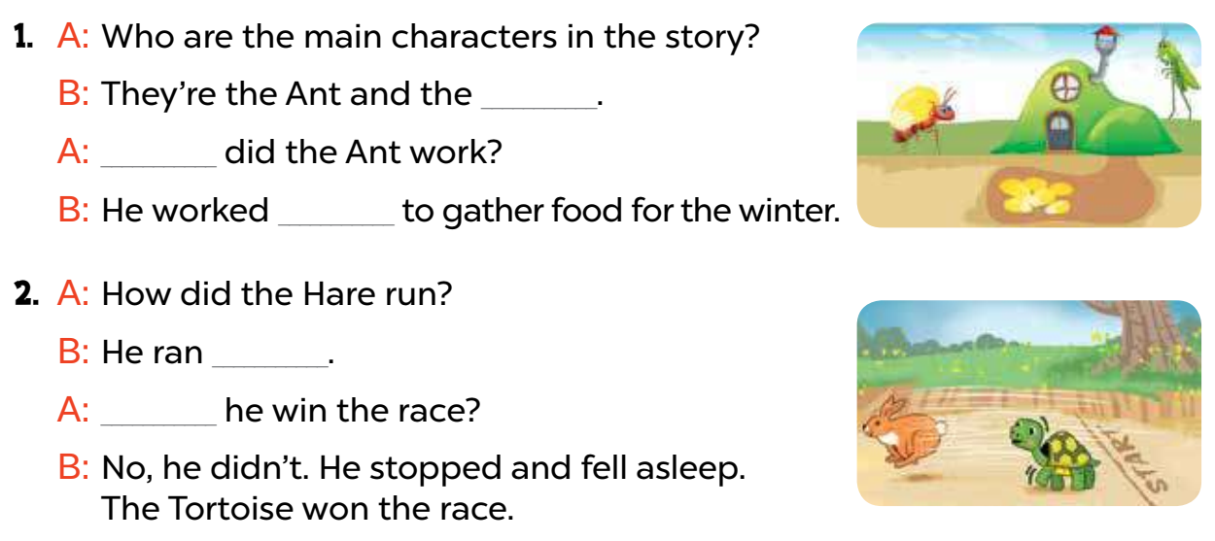
Swap your books and check your answers.
1. A: Who are the main characters in the story?
B: They’re the ant and the _______________.
A: ______ did the ant work?
B: He worked ______ to gather food for the winter.
2. A: How did the hare run?
B: He ran ______.
A: _____ he win the race?
B: No, he didn’t. He stopped and fell asleep.
The tortoise won the race.
grasshopper
How
hard
fast
Did

Slide 27


True or False

Slide 28

False
The main characters
in the story 1 are the ant and the hare.
True

Slide 29
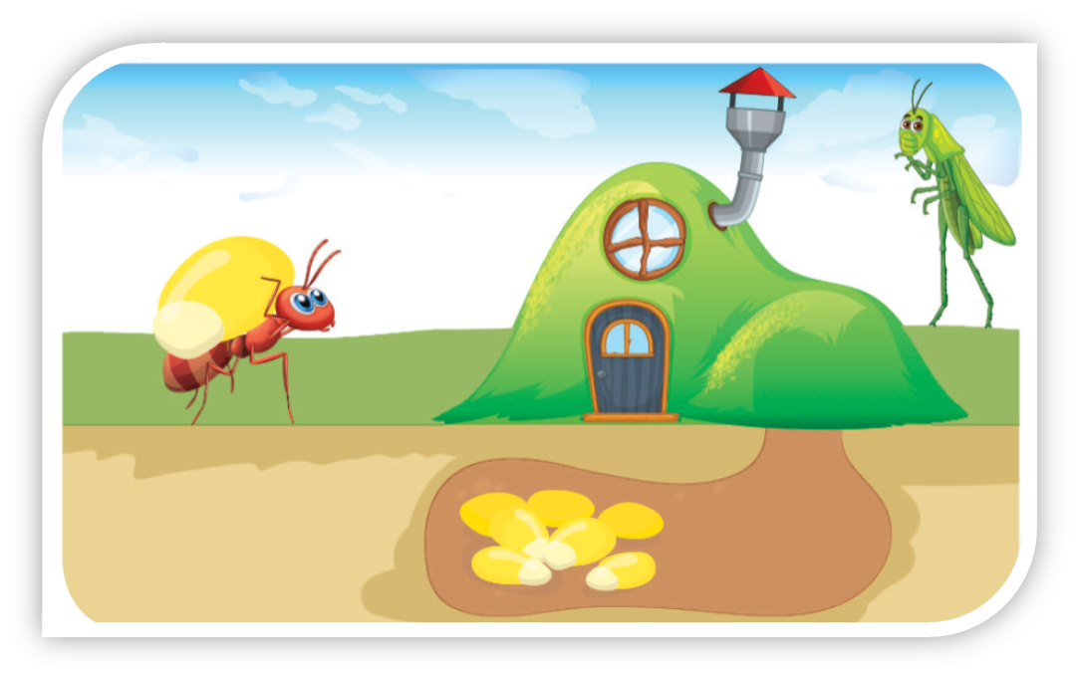
False
They are the ant and the grasshopper.

Slide 30

False
The ant worked very hard to gather food for the winter.
True

Slide 31
True

Slide 32

False
The hare ran fast, and
he won the race.
True

Slide 33
False
He ran fast but he didn’t win the race.

Slide 34

The tortoise won the race finally.
True
False

Slide 35
True

Slide 36

Great Job!

Slide 37
04
Listen, complete and sing.

Slide 38


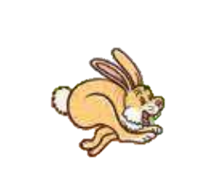
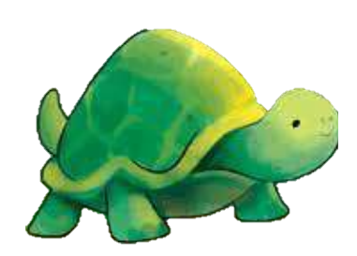
Listen to the teacher carefully.
The tortoise and the hare
The hare said to the tortoise
“Let’s go, go, go!”
The hare ran (1) _________.
But the tortoise was slow.
The (2) _________ was near the finish line.
He stopped, stopped, stopped.
The hare fell asleep.
And the (3) _________ won the race.

Slide 39
Read and guess.
The tortoise and the hare
The hare said to the tortoise
“Let’s go, go, go!”
The hare ran (1) _________.
But the tortoise was slow.
The (2) _________ was near the finish line.
He stopped, stopped, stopped.
The hare fell asleep.
And the (3) _________ won the race.

Slide 40
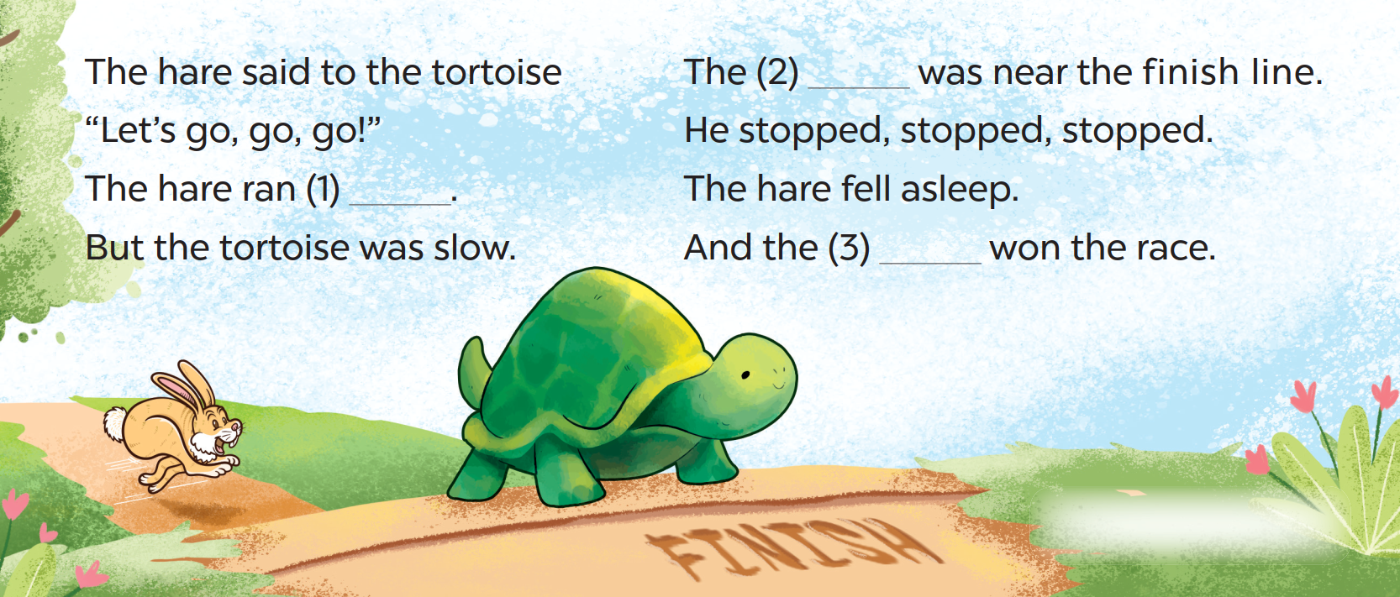
Read and guess.
The tortoise and the hare

Slide 41
Listen and complete.
The tortoise and the hare
The hare said to the tortoise
“Let’s go, go, go!”
The hare ran (1) _________.
But the tortoise was slow.
The (2) _________ was near the finish line.
He stopped, stopped, stopped.
The hare fell asleep.
And the (3) _________ won the race.

Slide 42
Listen and sing along.
The tortoise and the hare
The hare said to the tortoise
“Let’s go, go, go!”
fast
The hare ran (1) ______ .
But the tortoise was slow.

Slide 43
Listen and sing along.
The tortoise and the hare
hare
The (2) _______ was near the finish line.
He stopped, stopped, stopped.
The hare fell asleep.
tortoise
And the (3) __________ won the race.

Slide 44
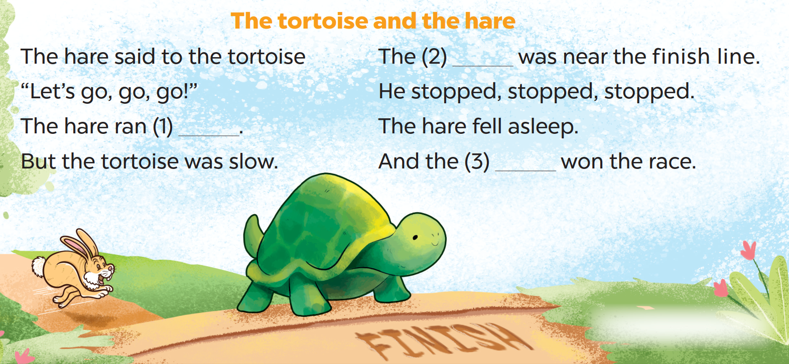
Listen, sing and clap.

Slide 46
05
Fun corner and Wrap-up

Slide 47




Board
Game

Slide 48
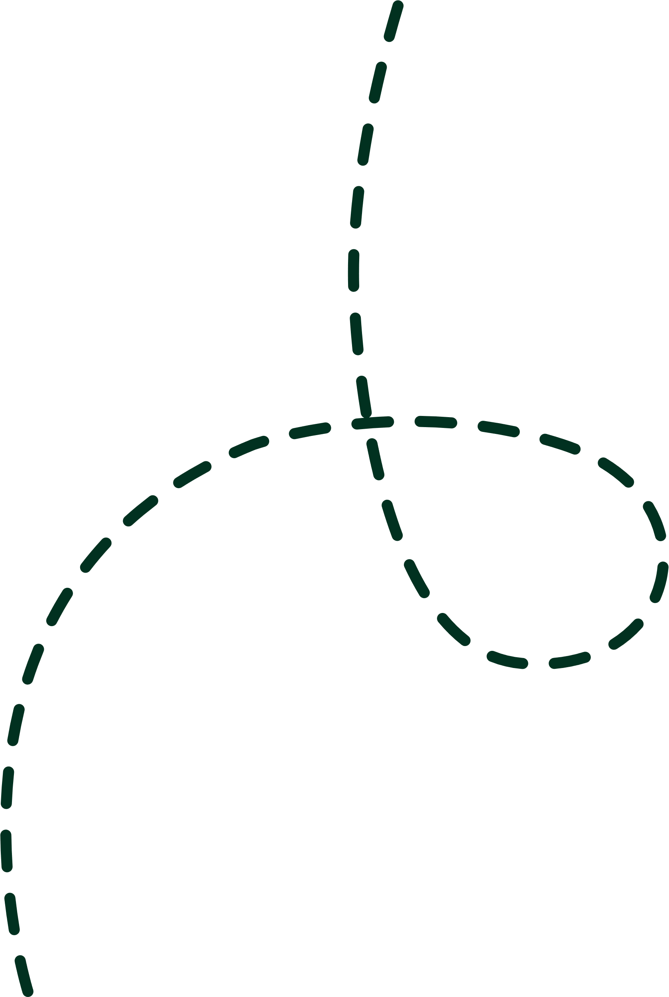

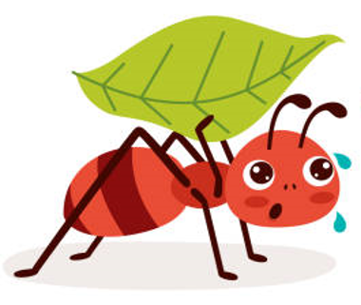
A: How did the ant work?
B: He worked very hard.

Slide 49
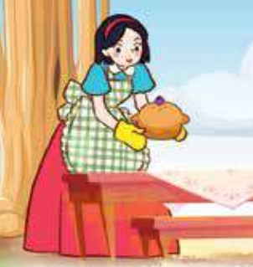
B: She cooked very well.
A: How did Snow White cook?

Slide 50
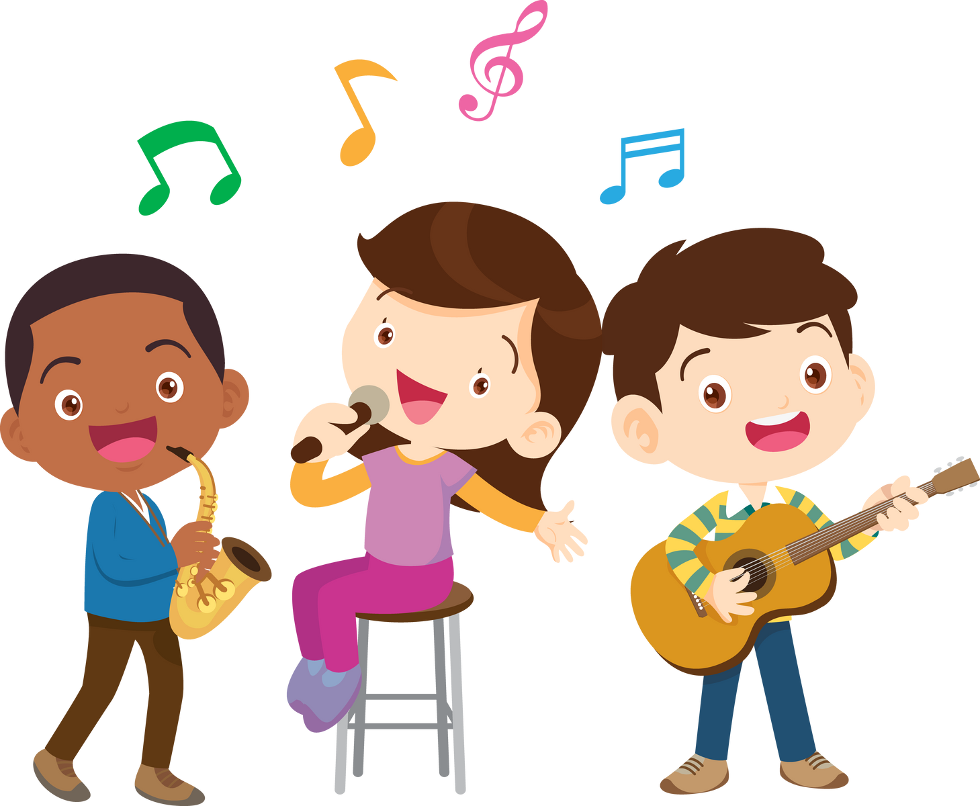
A: How did the students sing?
B: They sang well. /
They sang beautifully.

Slide 51
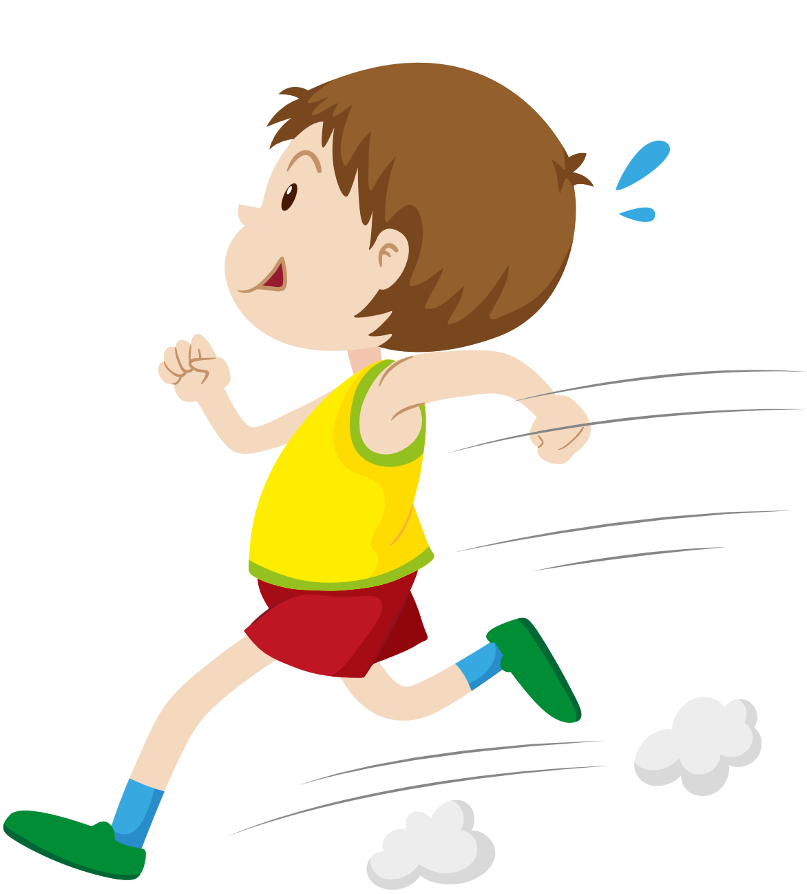
A: How did the boy run?
B: He ran quickly. /
He ran fast.

Slide 52

A: How did the man work?
B: He worked very hard.

Slide 53


You did a good job!

