Slide 1








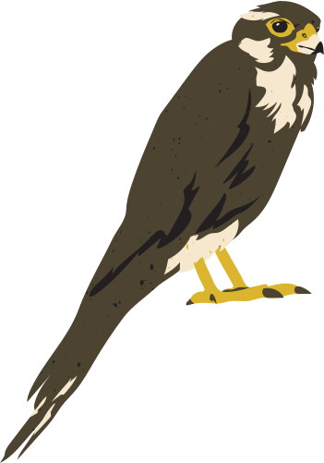
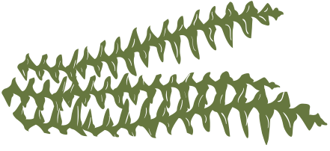
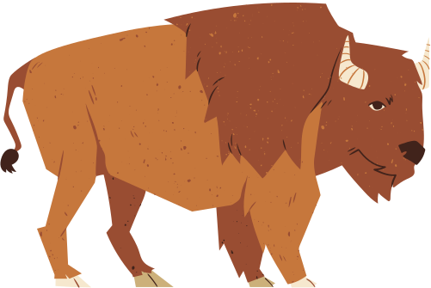
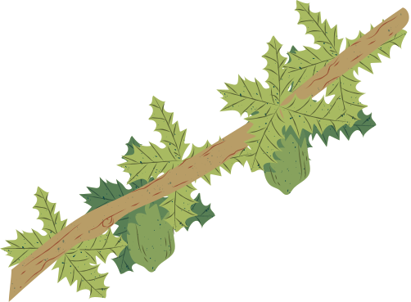

GUESS THE ANIMAL

Slide 2



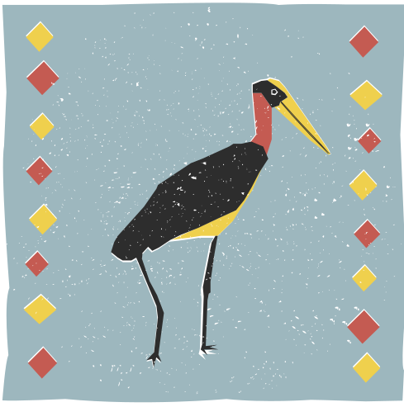


LÍTEN TO THIS SOUND AND GUESS...
ANIMAL 1

Slide 3
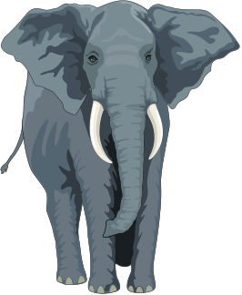
LÍTEN TO THIS SOUND AND GUESS...
ELEPHANT

Slide 4
LÍTEN TO THIS SOUND AND GUESS...
ANIMAL 2

Slide 5


LÍTEN TO THIS SOUND AND GUESS...
TIGER

Slide 6
LÍTEN TO THIS SOUND AND GUESS...
ANIMAL 3

Slide 7
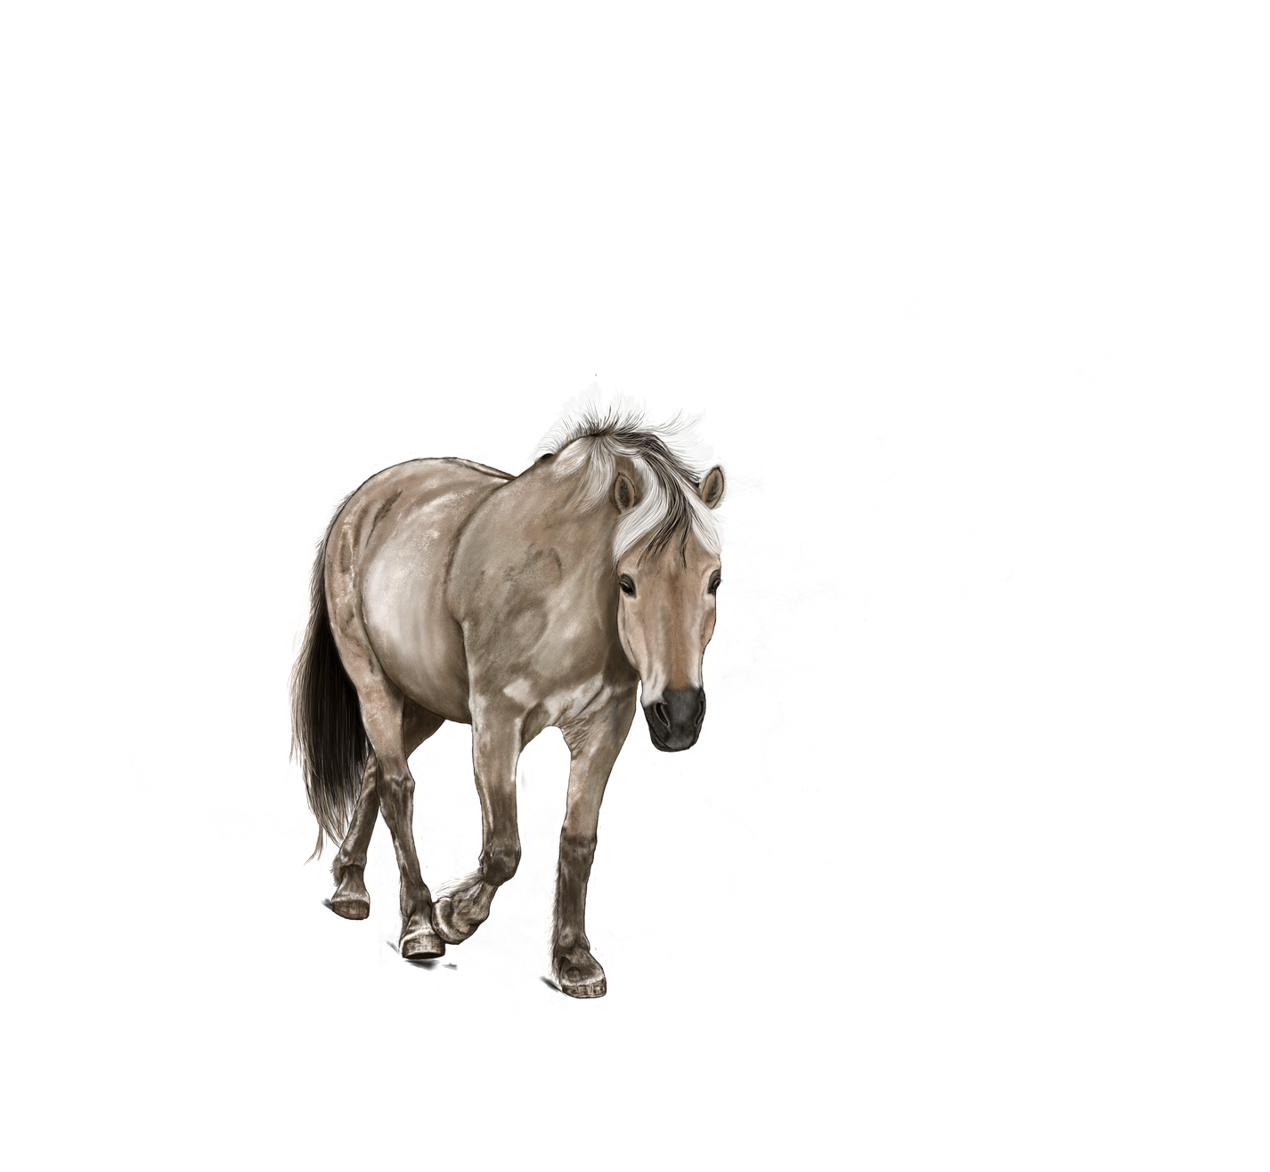
LÍTEN TO THIS SOUND AND GUESS...
HORSE

Slide 8
LÍTEN TO THIS SOUND AND GUESS...
ANIMAL 4

Slide 9
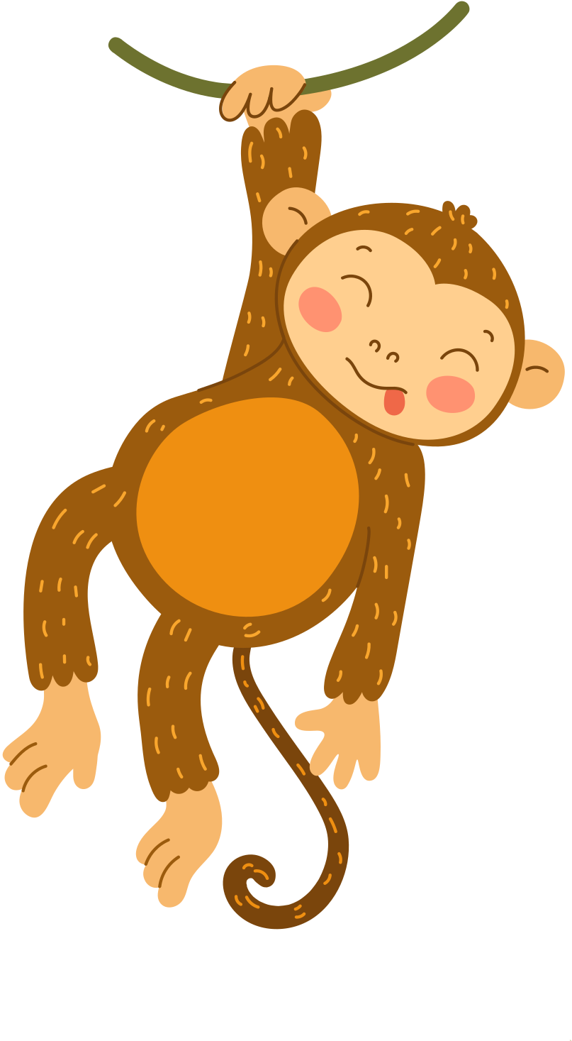
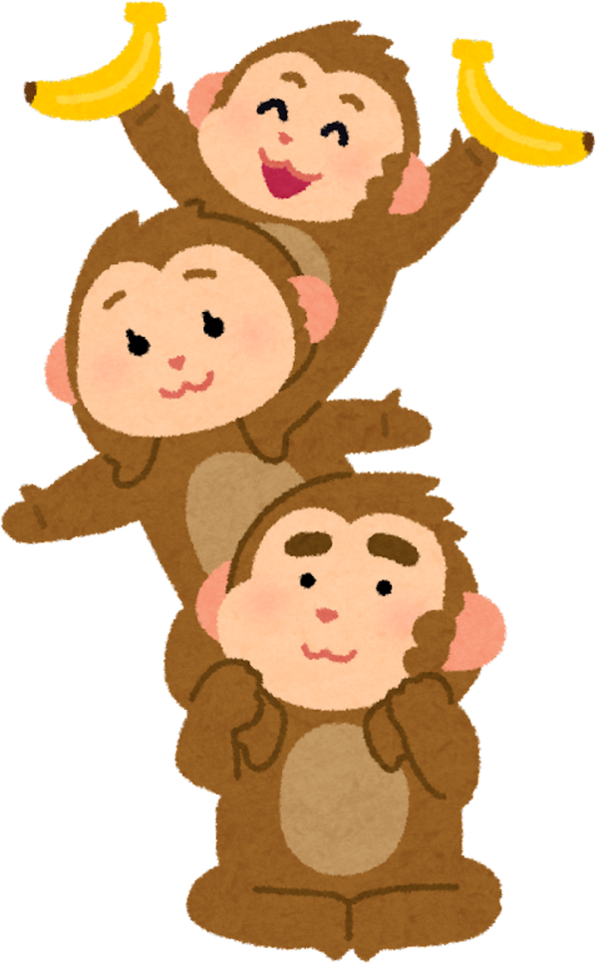
LÍTEN TO THIS SOUND AND GUESS...
MONKEY

Slide 10
LÍTEN TO THIS SOUND AND GUESS...
ANIMAL 5

Slide 11
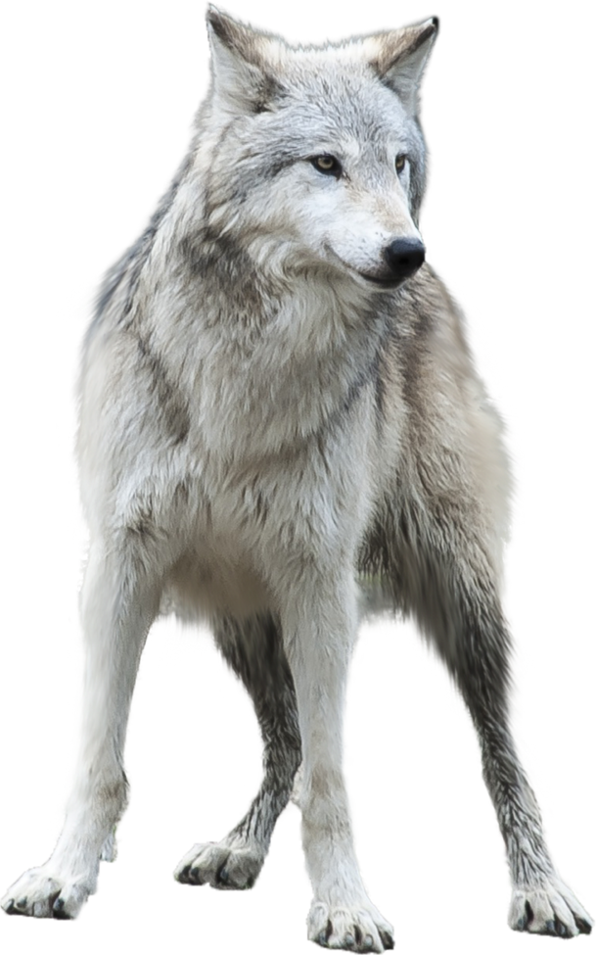
LÍTEN TO THIS SOUND AND GUESS...
WOLF

Slide 12
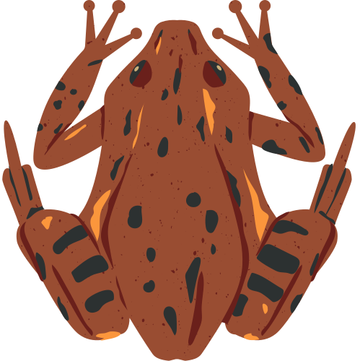
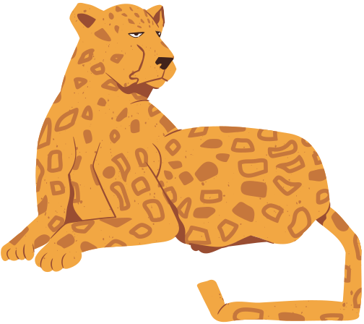
UNIT 8: WILDLIFE CONSERVATION
LESSON 1:
GETTING STARTED

Slide 13


VOCABULARY

Slide 14





1
Guess the word: 12 letters

Slide 15



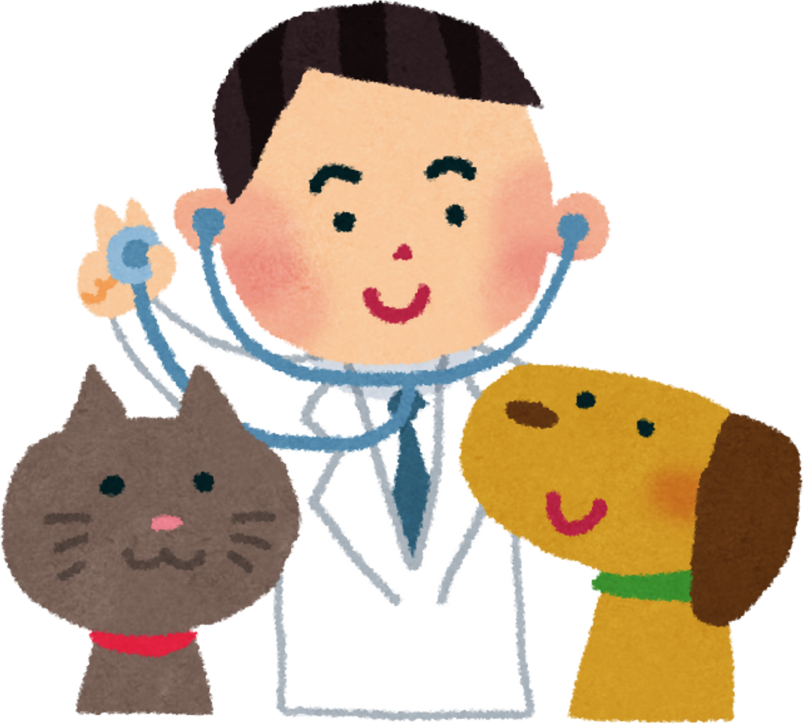
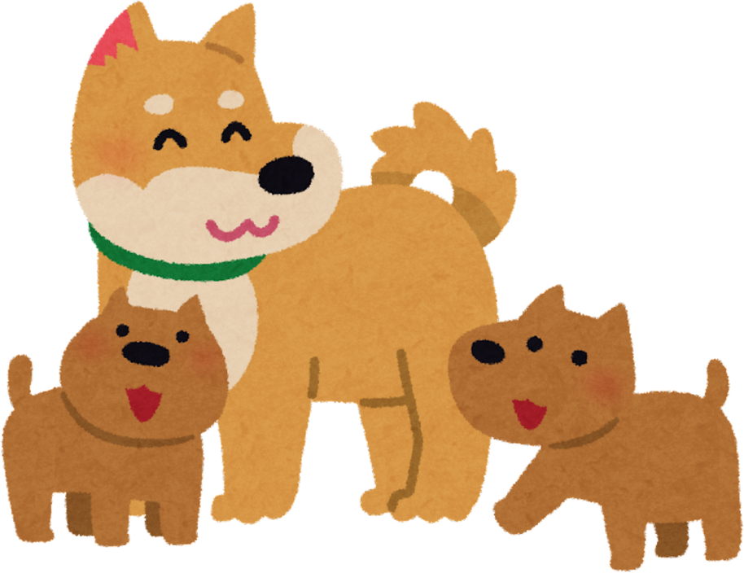
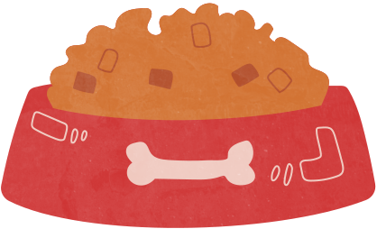
Guess the word : 12 letters
_ _ _ _ _ _ _ _ _ _ _ _ (N)
“Relating to a person”

Slide 16
Guess the word : 12 letters
Veterinarian (n)
/ˌvetərɪˈneəriən/
“Ex:Consult your veterinarian if your cat is still not eating.”

Slide 17
2
Watch the video and guess the word: 7 letters

Slide 18

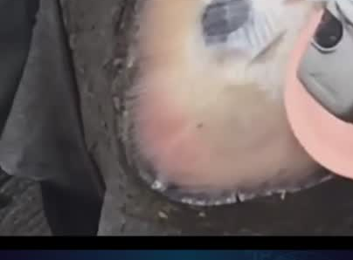
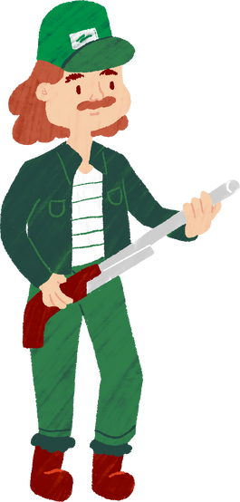
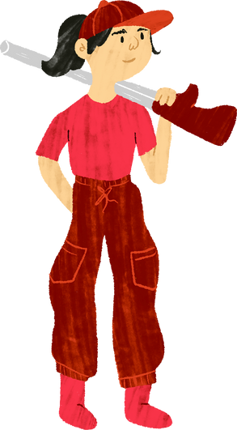
Watch the video and guess the word: 7 letters
_ _ _ _ _ _ _ (N)
“Relating to a person ”

Slide 19

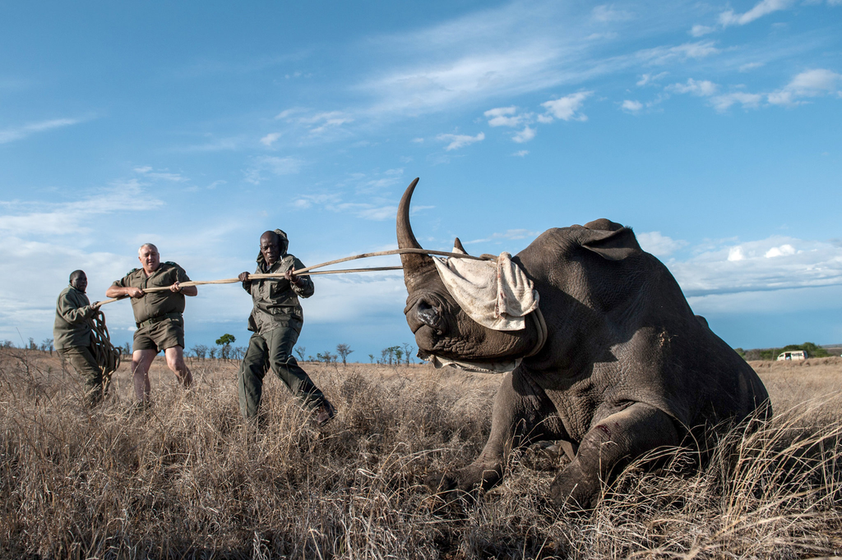
Watch the video and guess the word: 7 letters
Poacher (n)
/ˈpəʊtʃə(r)/
“Ex:Poachers hunt and kill the rhinos for their horns”

Slide 20
3
Listen and guess the word: 7 letters

Slide 21



Listen and guess the word : 7 letters
_ _ _ _ _ _ _ (V)

Slide 22




Listen and guess the word: 7 letters
Monitor (v)
/ˈmɒnɪtə(r)/
“Ex:The patient is carefully monitored.”

Slide 23
4
Guess the word: 7 letters

Slide 24

Guess the word : 7 letters
_ _ _ _ _ _ _ (ADJ)
Synonymous: unlawful, wrongful, undue,...

Slide 25




Guess the word : 7 letters
illegal (adj)
/ɪˈliːɡl/
“Ex:These proposals are unethical and possibly illegal.”

Slide 26
5
Guess the word: 10 letters

Slide 27
Guess the word : 10 letters
_ _ _ _ _ _ _ _ _ _ (ADJ)
“Expressing a threat of harm or violence”

Slide 28

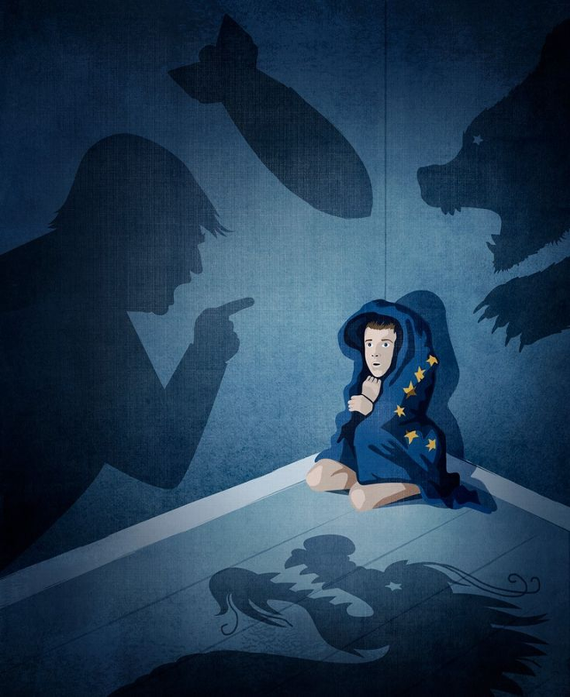

Guess the word : 10 letters
Threatened (adj)
/ˈθretnd/
“Ex:Gibbons are the smallest of the apes, and all seven species are regarded as threatened”

Slide 29
6
Guess the word: 6 letters

Slide 30
Guess the word : 6 letters
A/A/M/L/M/M (N)
“Relating to animals”

Slide 31

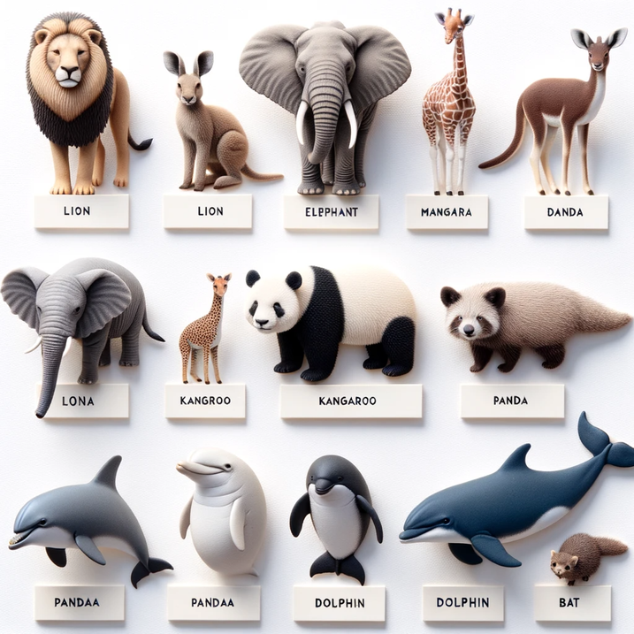


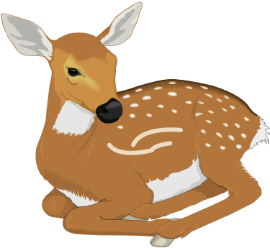
Guess the word : 6 letters
Mammal (n)
/ˈmæml/
“Ex:Cows, humans and whales are all mammals.”

Slide 32
FORM | PRONUNCIATION | MEANING | VIETNAMESE
veterinarian (n) | /ˌvetərɪˈneəriən/ | a person trained in the medical treatment of animals | Bác sĩ thú y
poacher (n) | /ˈpəʊtʃə(r)/ | someone who catches and kills animals illegally | Kẻ săn trộm
monitor(v) | /ˈmɒnɪtə(r)/ | to watch and check something over a period of time in order to see how it develops | Giám sát
threatened (adj) | /ˈθretnd/ | in danger, or likely to stop existing | Bị đe dọa
mammal(n) | /ˈmæml/ | any animal of which the female feeds her young on milk from her own body | Động vật có vú
illegal (adj) | /ɪˈliːɡl/ | not allowed by law | Bất hợp pháp

Slide 33
EXERCISE 1

Slide 34


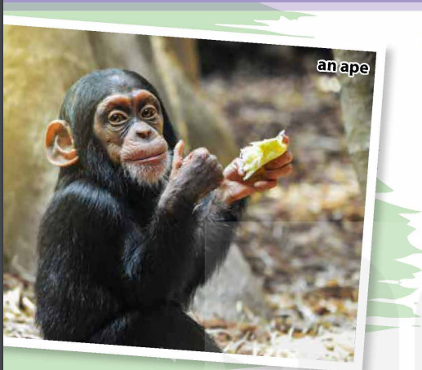
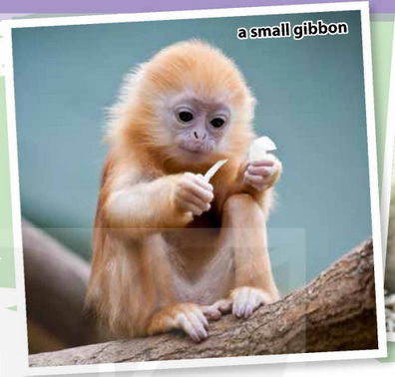
Exercise 1: Listen and read:
Ms Smith: Welcome to the Endangered Primate Rescue Centre! If you have any questions during the tour, don't hesitate to ask me.
Mark: I've just seen a monkey in the enclosure. So are primates just monkeys, Ms Smith?
Ms Smith: No, primates are a group of mammals that includes not just monkeys, but also humans and apes.
Mark: What's the difference between apes and monkeys?
Ms Smith: Well, apes don't have tails and are larger than monkeys. Their brains are also larger. They're as good at using tools as they're at learning sign language.
Mai: So how many primates live here?
Ms Smith: The centre is home to more than 170 primates representing 14 species. They're housed in large enclosures.
Mark: I can hear some sounds. Is someone singing?
Ms Smith: We're close to the gibbons' enclosure, and the male and female gibbons are singing. Gibbons are the smallest of the apes, and all seven species are regarded as threatened. In fact, five of them are listed as critically endangered.
Mai: What is the main threat to gibbons?
Ms Smith: It's habitat loss due to deforestation and illegal hunting. Poachers make a big profit out of selling gibbons as pets and for making traditional medicine and food.
Mai: So we can help gibbons if we stop keeping them as pets.
Ms Smith: That's right. Now let me show you Derek, the gibbon we rescued last week. He was locked in a cage for two years as an illegal pet.
Mai: Oh no, he's so thin.
Ms Smith: Yes. Gibbons can become ill or weak unless they're fed the right type of food. After examining Derek, our veterinarian also found head injuries. So we'll give him a suitable diet and monitor him for several weeks before we release him into the national park.

Slide 35
EXERCISE 2

Slide 36
Exercise 2: Read and conversation again and decide whether the statements are true(T) or false(F):
 | T | F
1. Humans belong to the same group of mammals as apes and monkeys.
2. Apes can learn sign language, but can’t use tool.
3. Gibbons are endangered because they are the smallest of the apes.
4. Derek’s owner kept him in a cage and gave him the wrong type of food.

Slide 37

Exercise 2: Read and conversation again and decide whether the statements are true(T) or false(F):
 | T | F
1. Humans belong to the same group of mammals as apes and monkeys.
2. Apes can learn sign language, but can’t use tool.
3. Gibbons are endangered because they are the smallest of the apes.
4. Derek’s owner kept him in a cage and gave him the wrong type of food.

Slide 38

Exercise 2: Read and conversation again and decide whether the statements are true(T) or false(F):
“Ms Smith: No, primates are a group of mammals that includes not just monkeys, but also humans and apes”
 | T | F
1. Humans belong to the same group of mammals as apes and monkeys.
2. Apes can learn sign language, but can’t use tool.
3. Gibbons are endangered because they are the smallest of the apes.
4. Derek’s owner kept him in a cage and gave him the wrong type of food.

Slide 39
Exercise 2: Read and conversation again and decide whether the statements are true(T) or false(F):
 | T | F
1. Humans belong to the same group of mammals as apes and monkeys.
2. Apes can learn sign language, but can’t use tool.
3. Gibbons are endangered because they are the smallest of the apes.
4. Derek’s owner kept him in a cage and gave him the wrong type of food.

Slide 40

Exercise 2: Read and conversation again and decide whether the statements are true(T) or false(F):
 | T | F
1. Humans belong to the same group of mammals as apes and monkeys.
2. Apes can learn sign language, but can’t use tool.
3. Gibbons are endangered because they are the smallest of the apes.
4. Derek’s owner kept him in a cage and gave him the wrong type of food.

Slide 41
Exercise 2: Read and conversation again and decide whether the statements are true(T) or false(F):
Ms Smith: “.... They're as good at using tools as they're at learning sign language.”
 | T | F
1. Humans belong to the same group of mammals as apes and monkeys.
2. Apes can learn sign language, but can’t use tool.
3. Gibbons are endangered because they are the smallest of the apes.
4. Derek’s owner kept him in a cage and gave him the wrong type of food.

Slide 42
Exercise 2: Read and conversation again and decide whether the statements are true(T) or false(F):
 | T | F
1. Humans belong to the same group of mammals as apes and monkeys.
2. Apes can learn sign language, but can’t use tool.
3. Gibbons are endangered because they are the smallest of the apes.
4. Derek’s owner kept him in a cage and gave him the wrong type of food.

Slide 43
Exercise 2: Read and conversation again and decide whether the statements are true(T) or false(F):
 | T | F
1. Humans belong to the same group of mammals as apes and monkeys.
2. Apes can learn sign language, but can’t use tool.
3. Gibbons are endangered because they are the smallest of the apes.
4. Derek’s owner kept him in a cage and gave him the wrong type of food.

Slide 44
Exercise 2: Read and conversation again and decide whether the statements are true(T) or false(F):
 | T | F
1. Humans belong to the same group of mammals as apes and monkeys.
2. Apes can learn sign language, but can’t use tool.
3. Gibbons are endangered because they are the smallest of the apes.
4. Derek’s owner kept him in a cage and gave him the wrong type of food.
Ms Smith: “... Gibbons are the smallest of the apes, and all seven species are regarded as threatened. In fact, five of them are listed as critically endangered.”

Slide 45
Exercise 2: Read and conversation again and decide whether the statements are true(T) or false(F):
 | T | F
1. Humans belong to the same group of mammals as apes and monkeys.
2. Apes can learn sign language, but can’t use tool.
3. Gibbons are endangered because they are the smallest of the apes.
4. Derek’s owner kept him in a cage and gave him the wrong type of food.

Slide 46
Exercise 2: Read and conversation again and decide whether the statements are true(T) or false(F):
 | T | F
1. Humans belong to the same group of mammals as apes and monkeys.
2. Apes can learn sign language, but can’t use tool.
3. Gibbons are endangered because they are the smallest of the apes.
4. Derek’s owner kept him in a cage and gave him the wrong type of food.

Slide 47
Exercise 2: Read and conversation again and decide whether the statements are true(T) or false(F):
 | T | F
1. Humans belong to the same group of mammals as apes and monkeys.
2. Apes can learn sign language, but can’t use tool.
3. Gibbons are endangered because they are the smallest of the apes.
4. Derek’s owner kept him in a cage and gave him the wrong type of food.
Ms Smith:” .... He was locked in a cage for two years as an illegal pet...
Gibbons can become ill or weak unless they're fed the right type of food.”.

Slide 48
EXERCISE 3

Slide 49


Exercise 3: Match the words and phrases with their meanings
1. threatened species
a. to watch and check something carefully over a period of time
2. critically endangered species
b. plants and animals that are in danger of disappearing
c. to let someone go free after having kept them somewhere
3. monitor
d. plants and animals that are likely to become endangered in the near future
4. release

Slide 50
EXERCISE 4

Slide 51
Exercise 4: Complete the following the sentences using the informationfrom 1
  ______, don’t hesitate to ask.
=> If you have any questions during the tour, don’t hesitate to ask.
2. Aps are as good at using tools ______ .
=> Apes are as good at using tools as they’re at learning sign language.
3. We can help Gibbons ______.
=> We can help gibbons if we stop keeping them as pets.
4. ______ unless they’re fed the right type of food.
=> Gibbons can become ill or weak unless they’re fed the right type of food.

Slide 52
GAME

Slide 53
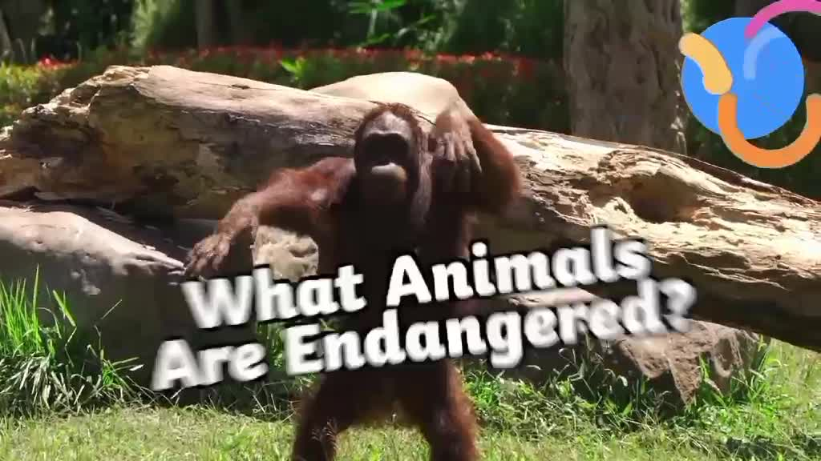
Watch the following video and list the names and solutions to protect endangered animals.

Slide 54
Check the answer:
-
Names of endangered animals:
- Orangutans
- Polar bears
- Sea turtles
- Red squirrels
- Giant otters
- Mountain gorillas
- Giant pandas
- Sumatran tigers
- Kiwis
Solution:
- We need to study the species and where it lives.
- We must protect them by breeding more animals in captivity and releasing them back into the wild.
- Protect through creating nature reserves and making laws to make hunting illegal.

Slide 55
HOMEWORK
LEARN VOCABULARY BY HEART.
PREPARE FOR THE NEXT LESSON.

