Slide 1


Slide 2
Unit
8
BECOMING INDEPENDENT
Unit
FAMILY LIFE
LESSON 2
LANGUAGE

Slide 3
LESSON 2
LANGUAGE
WARM-UP
Watch a video
Task 1: Listen and repeat.
Task 2: Read the sentences out loud.
PRONUNCIATION
Task 1: Match each word with their meanings.
Task 2: Complete the sentences.
VOCABULARY
Task 1: Rewrite the sentences.
Task 2. Ask and answer questions
GRAMMAR
Wrap-up
Homework
CONSOLIDATION

Slide 4
WARM-UP
WATCH A VIDEO
Work in 4 groups.
Watch the video and list out what to do to become independent.
Stick the paper on the boards.
The group with the most correct answers is the winner.

Slide 5
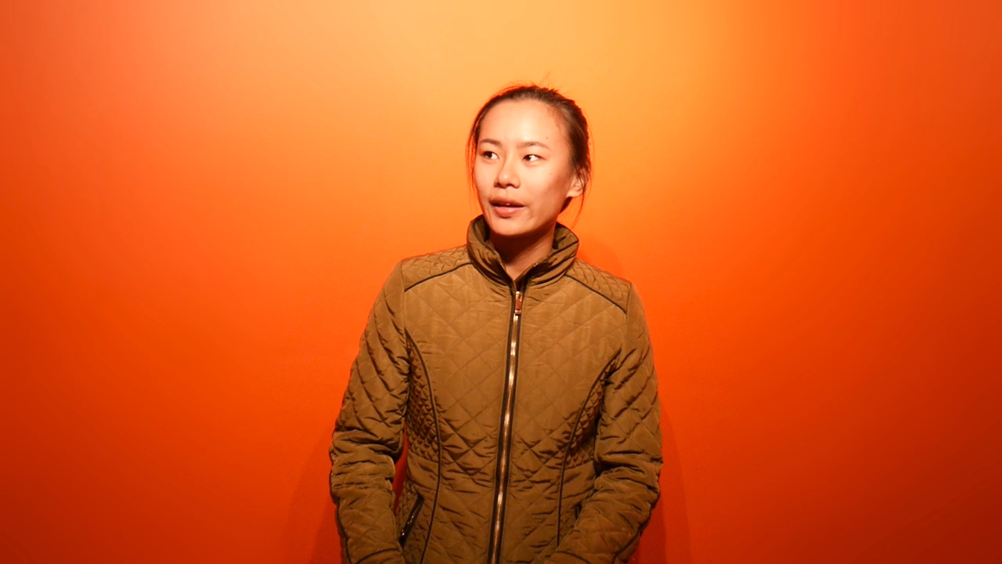
WARM-UP
WATCH A VIDEO

Slide 6

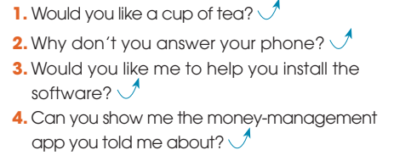
PRONUNCIATION
1
Listen and repeat. Pay attention to the fall-rise intonation in the following sentences.

Slide 7
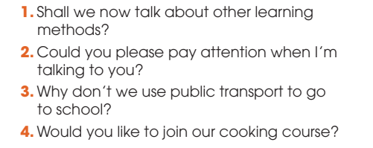
PRONUNCIATION
2
Listen and pay attention to the fall-rise intonation in the following sentences. Then practice saying them in pairs.

Slide 8
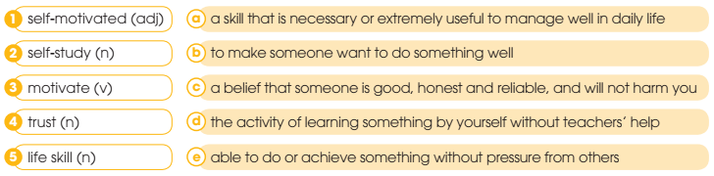
VOCABULARY
1
Match the words with their meanings.
1. e 2. d 3. b 4. c 5. a

Slide 9
VOCABULARY
2
Complete the sentences using the correct forms of the words in 1.
1. We have great ________ in our parents and teachers.
2. Teenagers should learn basic ________, such as cooking a meal and using a washing machine.
3. My brother signed up for a _________ computer course.
trust
life skills
self-study

Slide 10
VOCABULARY
2
Complete the sentences using the correct forms of the words in 1.
4. A good teacher can ________ her students to take responsibility for their own learning.
5. His parents don’t have to force him to study hard as he is highly ______________.
motivate
self-motivated

Slide 11
GRAMMAR
1
Rewrite the sentences.
1. John is saving his pocket money to buy a new phone.
→ It ______________________________________ to buy a new phone.
2. He gets 20 dollars every week by doing chores around the house.
→ It ________________________________ by doing chores around the house.
is John that/who is saving his pocket money
is 20 dollars that he gets every week
1. is John who is saving his pocket money
2. is 20 dollars that he gets every week by
3. was last weekend that John earned
4. was gifts for friends and family members that
5. is by taking part-time jobs that teenagers

Slide 12
GRAMMAR
1
Rewrite the sentences
3. John earned more pocket money by helping his grandpa last weekend.
→ It ________________________________ more pocket money by helping his grandpa.
4. He bought gifts for his friends and family members with his pocket money.
→ It _______________________________________ he bought with his pocket money.
was last weekend that John earned
was gifts for friends and family members that
1. is John who is saving his pocket money
2. is 20 dollars that he gets every week by
3. was last weekend that John earned
4. was gifts for friends and family members that
5. is by taking part-time jobs that teenagers

Slide 13
GRAMMAR
1
Rewrite the sentences
5. Parents can motivate children to do household chores by doing these chores with them.
It _____________________________________ ____________ can motivate them to do these chores.
Is by doing household chores with children that parents

Slide 14

GRAMMAR
2
Ask and answer questions about the chores you and your family members do at home. Use cleft sentences.

Slide 15
CONSOLIDATION
1
Wrap-up
What have you learnt today?
Some lexical items about becoming independent
The fall-rise intonation in a sentence
Cleft sentences

Slide 16
CONSOLIDATION
2
Homework
Do exercises in the workbook.
Prepare for Lesson 3 - Unit 8.

Slide 17

Website: hoclieu.vn
Fanpage: facebook.com/www.tienganhglobalsuccess.vn

