Slide 1
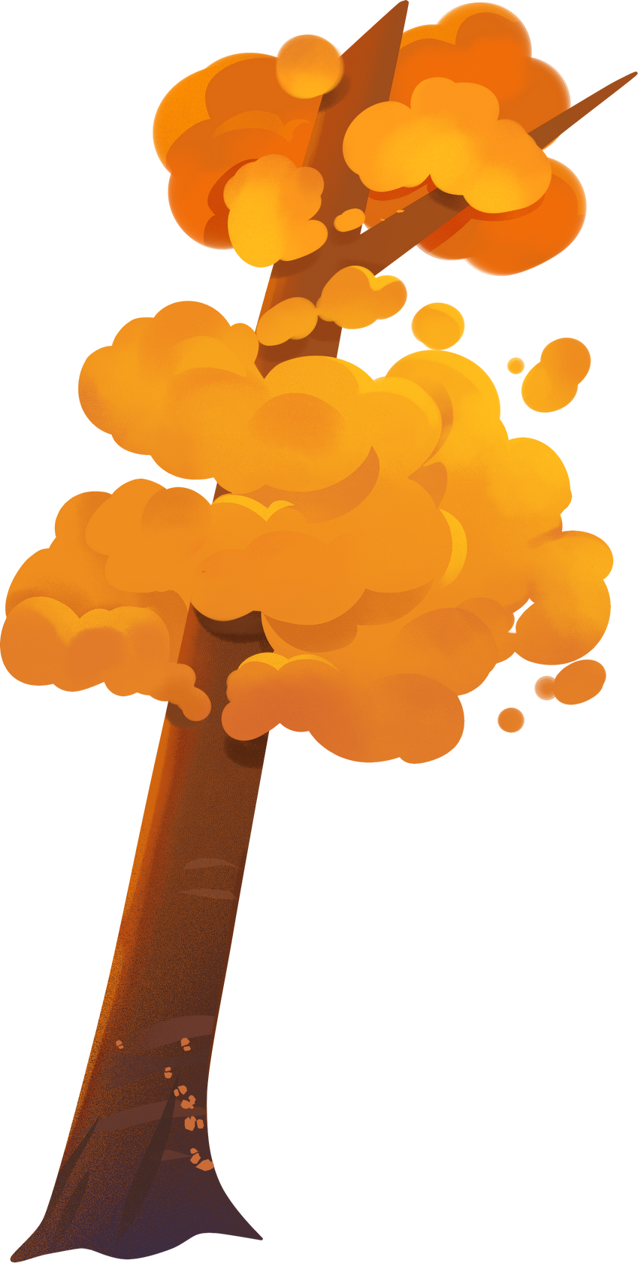


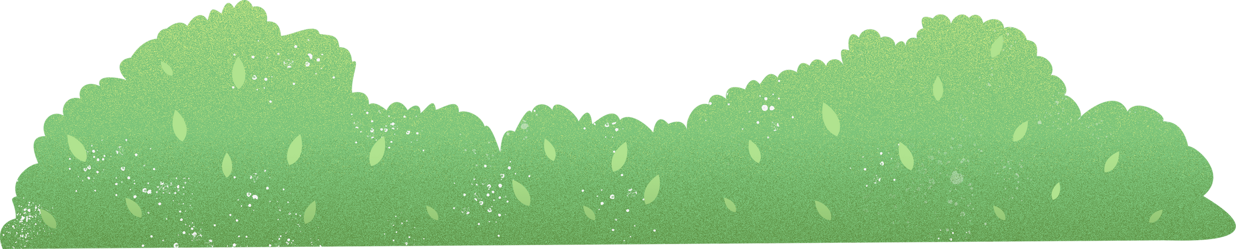
UNIT 10: THE ECOSYSTEM
LESSON 1: GETTING STARTED

Slide 2
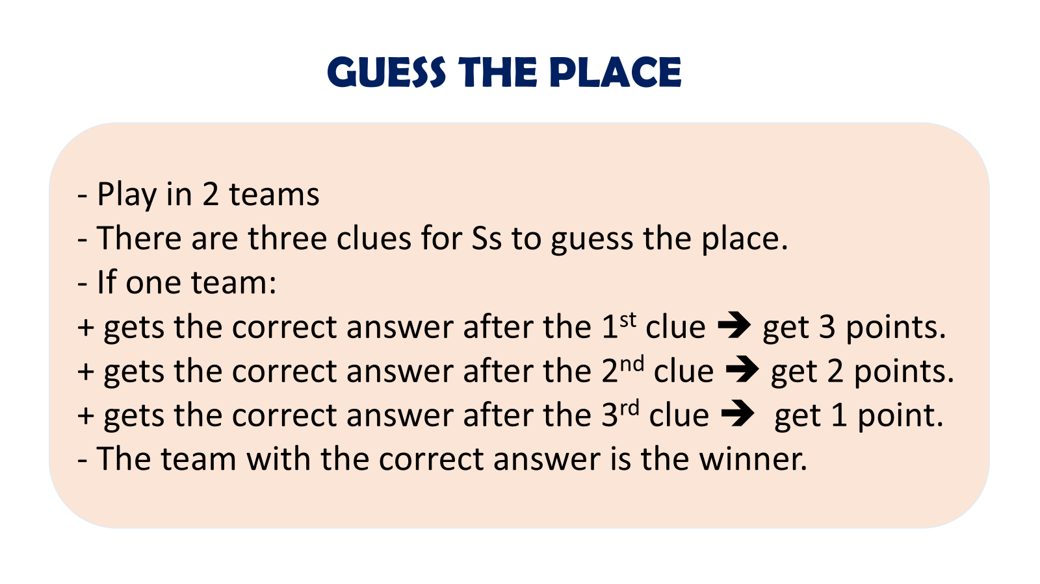

Slide 3
CLUE 1
This landscape forms the habitat for some of Asia’s rarest animal and plant species.

Slide 4
CLUE 2
Visitors in April and May have the chance to see thousands of vibrant butterflies.

Slide 5
CLUE 3
This place is located 120 km southwest of Hanoi, and nestled between the provinces of NinhBinh, ThanhHoa and HoaBinh.

Slide 6
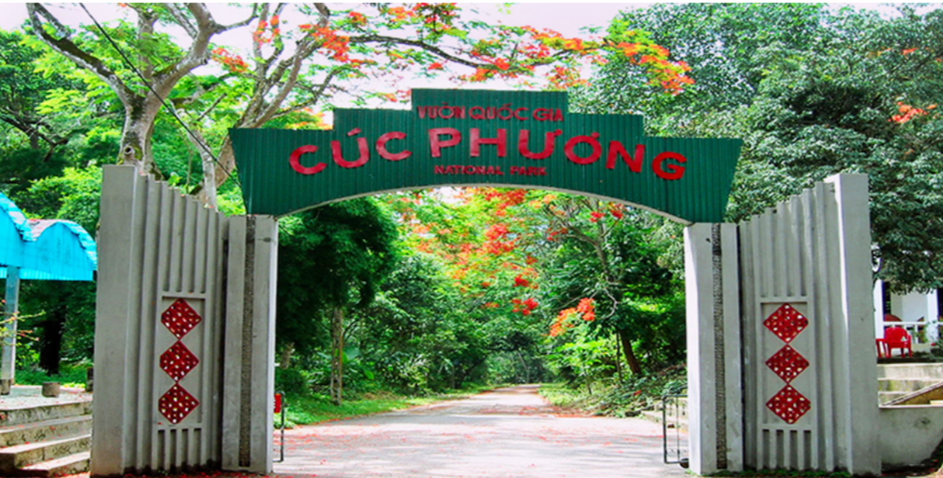
Cuc Phuong National Park

Slide 7
VOCABULARY

Slide 8
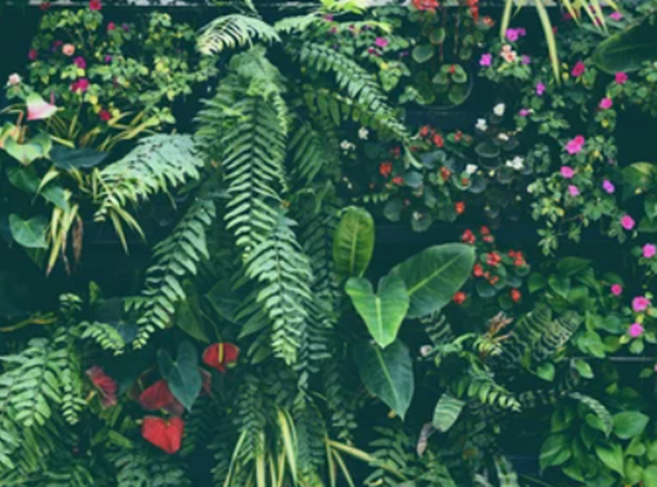

Guess the word: 6 letters
the plants of a particular area, type of environment or period of time
_ _ _ _ _ _ (n)
flora (n) /ˈflɔːrə/

Slide 9
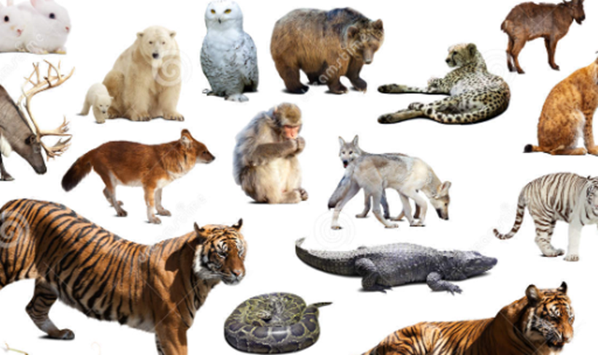

Guess the word: 5 letters
all the animals living in an area or in a particular period of history
_ _ _ _ _ (n)
fauna (n) /ˈfɔːnə/

Slide 10
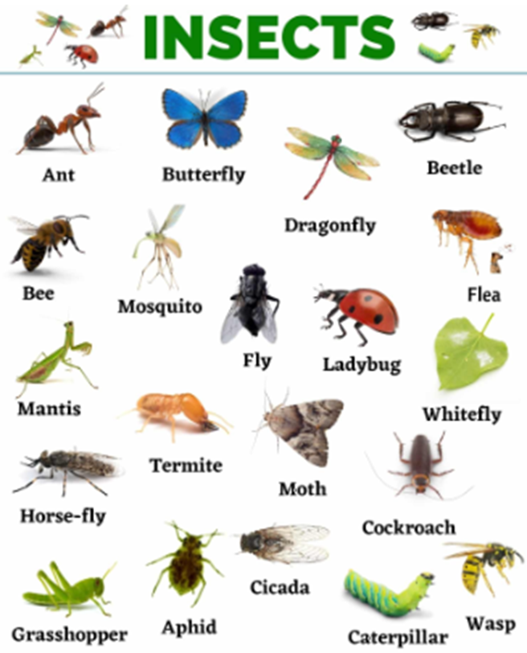

Guess the word: 6 letters
any small creature with six legs and a body divided into three parts. Insects usually also have wings. Ants, bees and flies are all insects.
_ _ _ _ _ _ (N)
insect (N) /ˈɪnsekt/

Slide 11
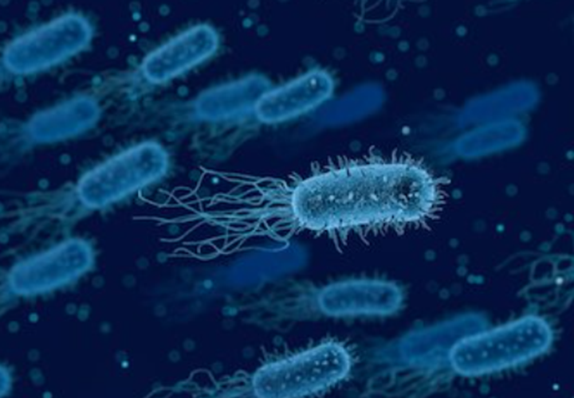

Guess the word: 8 letters
a living thing, especially one that is extremely small
_ _ _ _ _ _ _ _ (N)
organism (n)
/ˈɔːɡənɪzəm/

Slide 12
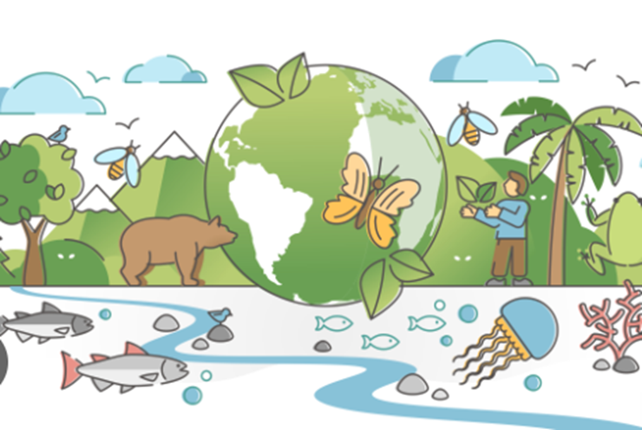
Guess the word: 12 letters
the existence of a large number of different kinds of animals and plants which make a balanced environment
------------ (n)
biodiversity (n)/ˌbaɪəʊdaɪˈvɜːsəti/

Slide 13
Form | Pronunciation | Meaning | Vietnamese meaning
flora (n) | /ˈflɔːrə/ | the plants of a particular area, type of environment or period of time | Thực vật
fauna (n) | /ˈfɔːnə/ | all the animals living in an area or in a particular period of history | Động vật
insect (n) | /ˈɪnsekt/ | any small creature with six legs and a body divided into three parts. Insects usually also have wings. Ants, bees and flies are all insects. | Côn trùng
organism (n) | /ˈɔːɡənɪzəm/ | a living thing, especially one that is extremely small | Sinh vật
biodiversity (n) | /ˌbaɪəʊdaɪˈvɜːsəti/ | the existence of a large number of different kinds of animals and plants which make a balanced environment | Đa dạng sinh học
6. ecosystem (n) | /ˈiː.kəʊˌsɪs.təm/ | all the living things in an area and the way they affect each other and the environment | Hệ sinh thái

Slide 14
Exercise 1: Listen and read
Ms Hoa: Nam, you went to Cuc Phuong National Park last weekend, didn‘t you?
Nam: Yes, that’s right. It was an amazing trip. This old forest is home to thousands of different kind of plants, insects, and animals. I really liked the colourful butterflies and the thousand-year-old tree.
Ms Hoa: Yes, Cuc Phuong National Park has a very rich ecosystem.
Mai: What's an ecosystem, Ms Hoa?
Ms Hoa: It's a community that has living things, like flora and fauna. Flora refers to plants and fauna refers to animals, including tiny organisms, like bacteria. Ecosystems also include non-living things, like sunlight, air, soil, and water.
Nam: How important are ecosystems to life on our planet, Ms Hoa?
Ms Hoa: Healthy ecosystems are essential for human health and survival because they provide us with goods such as food, energy, raw materials, clean water, and air.
Mai: So we should protect our ecosystems, shouldn't we?
Ms Hoa: That's right. Unfortunately, many ecosystems around the world are being lost, damaged, or destroyed because of climate change, pollution, and overuse of natural resources. It’s very important to protect and restore them for future generations. We don't want our planet to lose even more biodiversity, do we?

Slide 15

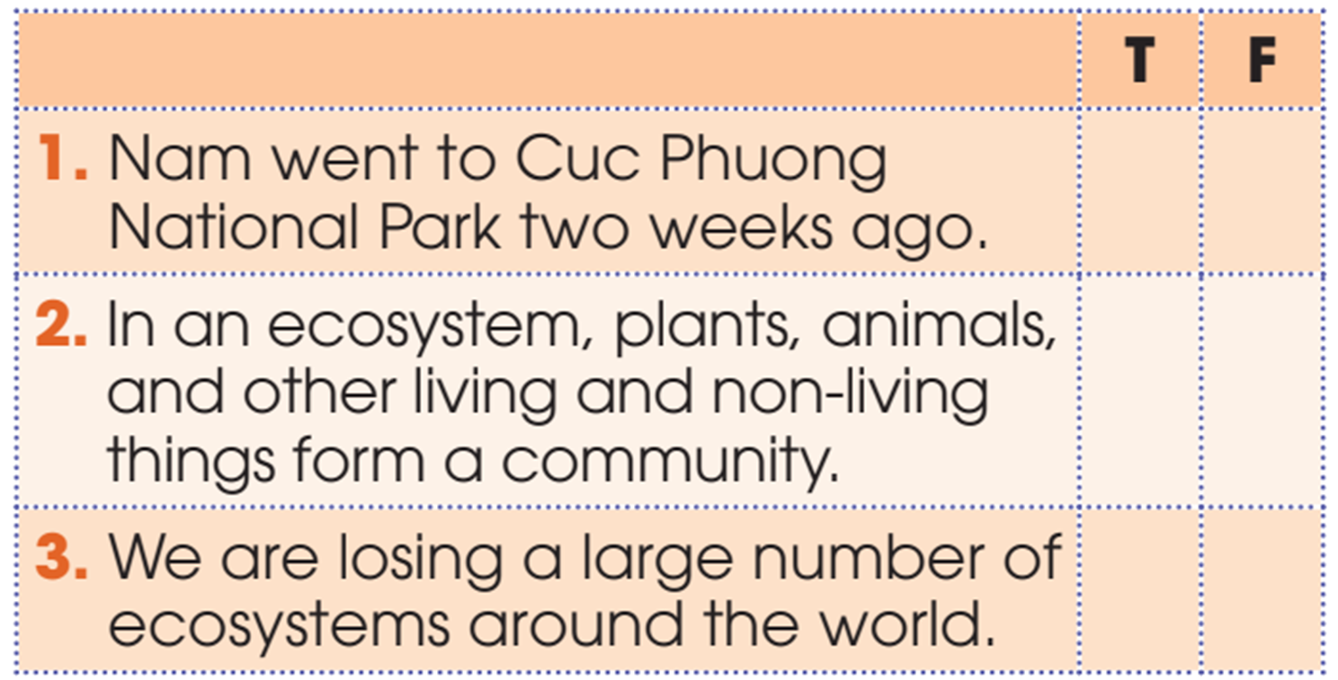


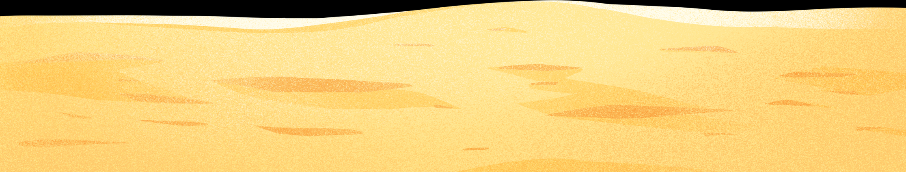
Exercise 2: Read the conversation and decide whether these statements are True or False.
Ms Hoa: Nam, you went to Cuc Phuong National Park last weekend, didn‘t you?
Nam: Yes, that’s right.

Slide 16
Exercise 2: Read the conversation and decide whether these statements are True or False.
Mai: What's an ecosystem, Ms Hoa?
Ms Hoa: It's a community that has living things, like flora and fauna. Flora refers to plants and fauna refers to animals, including tiny organisms, like bacteria. Ecosystems also include non-living things, like sunlight, air, soil, and water.

Slide 17
Exercise 2: Read the conversation and decide whether these statements are True or False.
Unfortunately, many ecosystems around the world are being lost, damaged, or destroyed because of climate change, pollution, and overuse of natural resources.

Slide 18
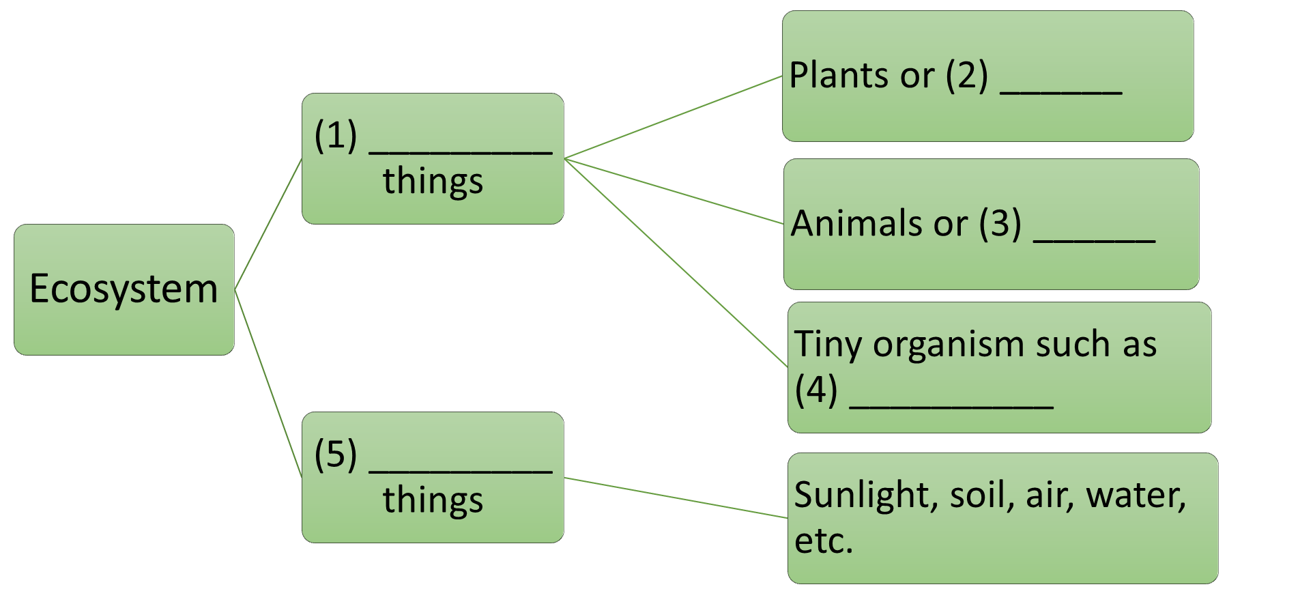
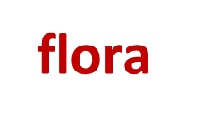

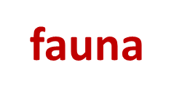


Exercise 3: Complete the diagram with words and phrases in Task 1

Slide 19
Exercise 4: Use the words in the box to form compound nouns mentioned in Task 1. Match them with the meaning below.
1. a change in the earth’sweather conditions.
2. things that exist in nature and can be used by people
3. land protected by the government because of its natural beauty of special history
4. basic materials used to make products
climate change
natural resources
national park
raw materials
Nội dung đoạn văn bản của bạn

Slide 20
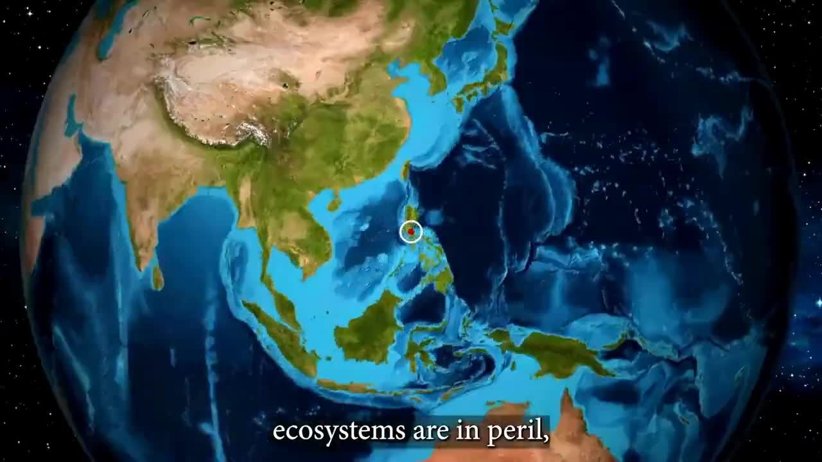
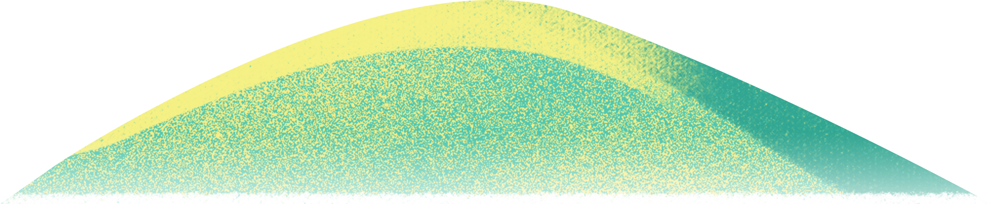
Watch the following video and list the names and solutions to protect endangered animals.

Slide 21

Check the answer:
SOLUTION TO PROTECT THE ECOSYSTEM:
Ecosystem restoration has a variety of techniques:
Planting trees
Restoring wetlands
Cleaning up polluted areas
BENEFITS OF PROTECTING ECOSYSTEM:
Create healthier habitats for wildlife
Restore natural water cycles and improve water quality of the region
Provide new opportunities for ecotourism, create job in restoration and maintenance
The restoration of lowest plateau has reduced erosion and improve the productivity of farmland
Provide other benefits to environment
Provide essential benefits local communities and economies

Slide 22
HOMEWORK
LEARN VOCABULARY BY HEART.
PREPARE FOR THE NEXT LESSON.

