Slide 1









UNIT 7
EDUCATION OPTIONS FOR SCHOOL LEAVER
LESSON 8: LOOKING BACK AND PROJECT
TEACHER : BUI THUY TRANG
TRAN TAT VAN HIGH SCHOOL
Notes:
"Good morning, class!welcoming the teacher attending our class today.
Before we start today’s lesson, let’s play a fun guessing game.
I will devided you into 3big group. This is group 1,...and look at screen I will show you pictures of five famous universities in Vietnam, and your task is to guess their names. You will work in groups, and The fastest team will give the answer and get the point with correct answer.
- The first team with more correct answers will be the winner.
. This activity will help us get into the topic of today’s lesson: education options for school leavers. Ok, are you clear that.
Ok.Let’s begin!"

Slide 2



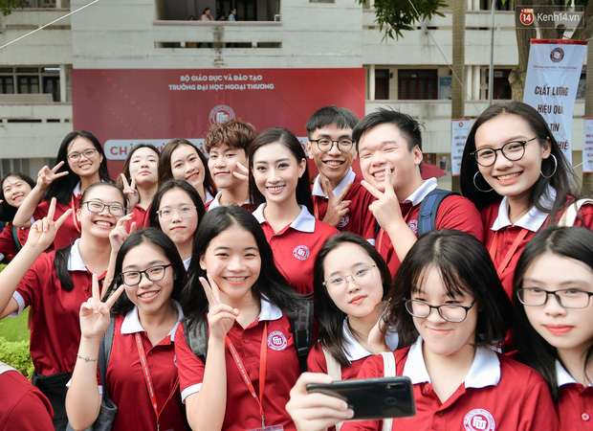
GUESSING GAME
Foreign Trade University
Notes:
"Can you guess which university this is? Yes, it’s [University Name]!"

Slide 3

GUESSING GAME
University of Languages and International Studies
Notes:
"Can you guess which university this is? Yes, it’s [University Name]!"

Slide 4

GUESSING GAME
National Economics University
Notes:
"Can you guess which university this is? Yes, it’s [University Name]!"

Slide 5
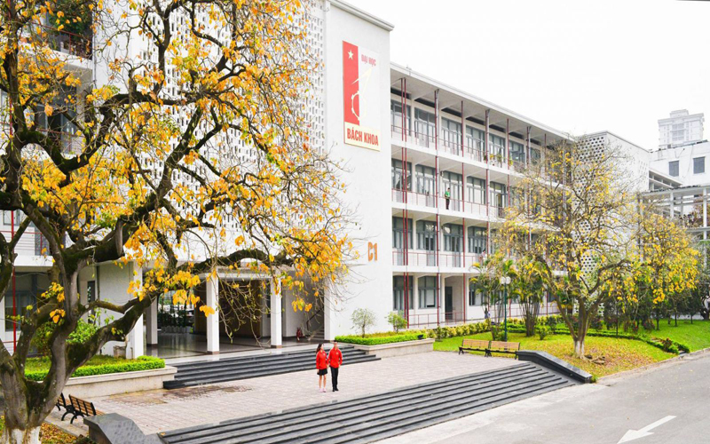
GUESSING GAME
"Can you guess which university this is? Yes, it’s [University Name]!"
Hanoi University of Science and Technology
Notes:
"Can you guess which university this is? Yes, it’s [University Name]!"

Slide 6

GUESSING GAME
University of Trade
Notes:
"Can you guess which university this is? Yes, it’s [University Name]!"

Slide 7
UNIT 7
EDUCATION OPTIONS FOR SCHOOL LEAVER
Lesson 8: Looking back and Project

Slide 8

PRONUNCIATION
1
Listen and mark the intonation in these questions
Notes:
"Now, let’s review our pronunciation skills. We will watch an AI virtual video and listen to some questions. Your task is to mark whether they have rising or falling intonation.
Please open your book to page ... and listen carefully, paying close attention to the intonation.
Alright, let’s check together! The first sentence has rising intonation. Class, is that correct? Yes, I agree! And remember In Yes/No questions, the intonation usually rises.
Now, practice saying the sentences in pairs for 30 seconds. Focus on your intonation, as it helps convey meaning clearly and makes your speech sound more natural. Let’s begin!" 🚀

Slide 9


PRONUNCIATION
1
Listen and mark the intonation in these questions
1. Are you interested in studying at university? 2. How much is the fee for this cooking course? 3. Did you attend the education fair? 4. Who would like to train to become a tour guide?
Notes:
"Great job! Your pronunciation was clear, and you used the correct intonation. Well done! 👏 Remember to emphasize the rising or falling tone naturally. Let's have another volunteer to try!"
("Good effort! Your intonation was mostly correct, but try to make the rising tone a bit clearer at the end."
"Excellent! You used the right intonation and spoke fluently. Keep it up!"
"That was good, but don’t forget to make your falling intonation stronger in Wh-questions. Try again!"

Slide 10

VOCABULARY
2
Complete the text. Use the correct form of the words and phrase in the box.
school-leaver apprenticeship higher education graduation institution
Nowadays, there are educational opportunities available to all (1) _____________. If they want to earn an academic degree, they can continue their studies at (2) ______________ institutions. But if they want to gain practical and job-specific skills, then vocational education is the perfect choice for them. At vocational schools, they can also do (3) ______________ and learn from skilled people on the job. Having qualifications from good educational (4) __________ helps young people find jobs immediately after (5) _________.
school-leavers
higher education
apprenticeships
institutions
graduation
Notes:
"Next, let’s review the key vocabulary from this unit. You have a list of words and phrases that you learned. Your task is to complete the text using the correct words from the box within one minute. Then, I will read the text aloud, and whenever I say ‘Pink,’ you must quickly call out the correct word to fill in the gap. This game will test your memory and quick thinking. Let’s see who can complete the text correctly!"
"Great job, everyone! 🎉 You recalled the vocabulary well and responded quickly. Keep practicing, and you'll improve even more!

Slide 11

GRAMMAR
MINIGAME
LUCK BLIND BAG

Slide 12
INSTRUCTIONS
You can choose a lucky bag.
• Each question will appear on a new slide.
Read the question and select your answer.
• You have 30 seconds for each question.
Notes:
"For our final review activity, we’ll play an exciting game called Lucky Blind Bag Challenge! This will help us practice rewriting sentences using perfect gerunds and perfect participle clauses—a great way to express past actions more accurately.
📝 Game Rules:
✅ Work in groups and complete the task in 2 minutes. ✅ Each group takes turns picking a ‘Lucky Blind Bag.’ ✅ A sentence will appear on the screen. ✅ You have 30 seconds to rewrite it correctly. ✅ The group with the most correct answers wins!
Let’s see who can master this challenge! Ready? Let’s go!

Slide 13







LUCK BLIND BAG
2
1
3
4
5

Slide 14

After he finished school, my brother took a year off and travelled around the world.
→ ______________________________ took a year off and travelled around the world.
Having finished school, my brother

Slide 15
Congratulations!

Slide 16
3. My cousin didn’t ask anyone for advice, so she made the wrong decision about her education.
→ _______________________________________ made the wrong decision about her education.
Not having asked anyone for advice, my cousin

Slide 17
2. He did not remember that he had discussed his study options with his parents.
→ ___________________________________ his study options with his parents.
He did not remember having discussed

Slide 18
4. Lan won the first prize in the competition. This is something she’s very proud of.
→ _______________________________________ is something Lan is very proud of.
Having won the first prize in the competition
Notes:
Well done! This structure helps us rewrite sentences in a more advanced way using perfect participles and perfect gerunds."

Slide 19
PROJECT
CHOOSING THE PERFECT EDUCATIONAL INSTITUTION

Slide 20
PROJECT
3 GROUPS
Group 1: Present the options for students after graduation.
Group 2: One student plays the role of a university lecturer and another is a 12th-grade student. They will ask each other about the school the lecturer is advising.
Group 3: One student plays the role of a student attending a university and presents the advantages and disadvantages of the school.
Notes:
"Now, it’s time for our main project! You have been preparing for this throughout the unit, and today, you will present your final product. Each group has a different task:
✅ Group 1: Present different options for students after graduation. ✅ Group 2: Act out a conversation between a university lecturer and a 12th-grade student discussing school options. ✅ Group 3: Present the advantages and disadvantages of a specific university.

Slide 21
PROJECT
CHOOSING THE PERFECT EDUCATIONAL INSTITUTION
- What type of educational institution is it? Where is it? How big is it?
- What programme or training for that particular subject, trade, or job does it offer? How much is the fee?
- What facilities does it have? Are there any student activities or clubs?
- What job opportunities are there for its students after graduation?
Notes:
While presenting, make sure to include these key points: 📌 What type of educational institution is it? Where is it located? How big is it? 📌 What programmes or training does it offer for a particular subject, trade, or job? How much is the fee? 📌 What facilities does it have? Are there any student activities or clubs? 📌 What job opportunities are there for its students after graduation?
While presenting, remember to speak clearly and naturally, interact with the audience, and use visuals if possible After each presentation, your classmates will assess your work using a peer evaluation checklist.
Let’s give it our best effort! Good luck!
"And now, to make our project session even more exciting, I would like to one student to be our host for this part. DUONG, please come forward and guide us through the presentations!

Slide 22
Thank
You

