Slide 1
10th Grade
WELCOME TO OUR CLASS
Notes:
Welcome to our class today. Before starting the lesson, let’s do a warmup activity

Slide 2
Guessing game: Who Am I?
WARM UP
10th Grade
+ The hidden pictures will gradually be appeared.
+ The student who can guess the names of pictures first will get 1 point.
+ Raise your hands when you get the answers.
+ 1 POINT is given for 1 correct answer.

Slide 3
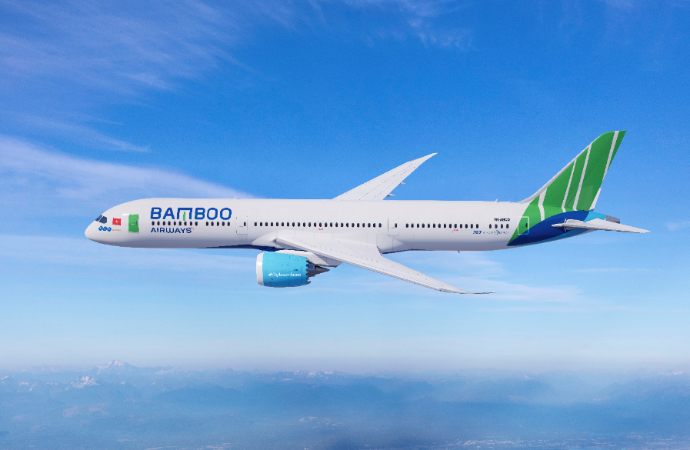
WARM UP

Slide 4
WARM UP

Slide 5
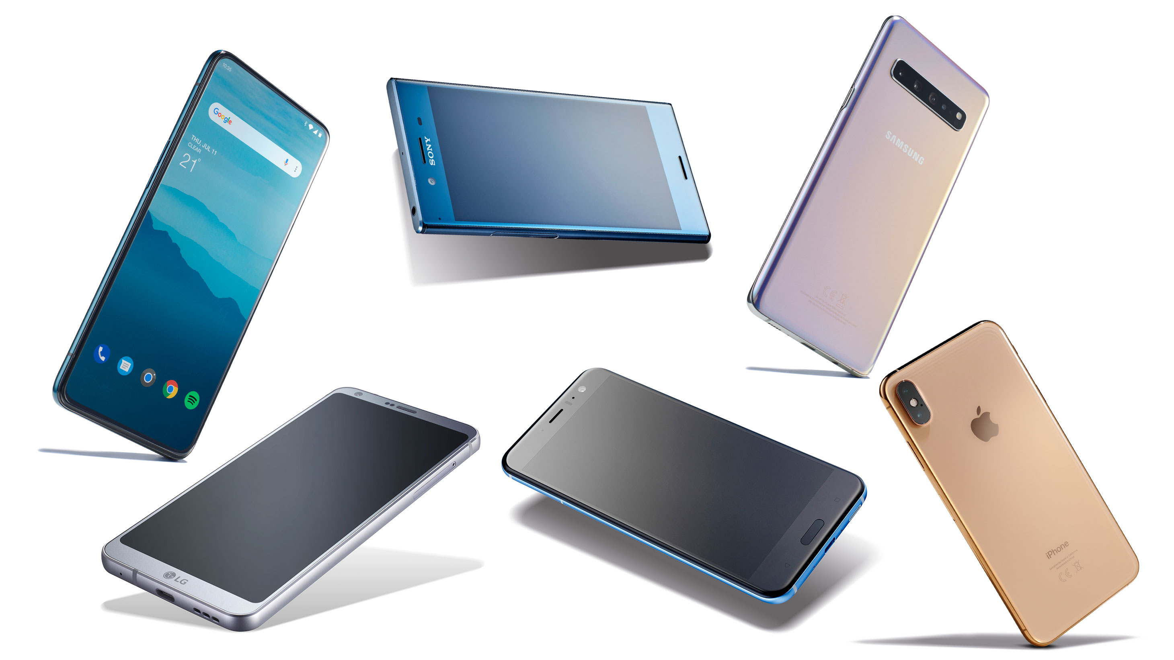
WARM UP

Slide 6
WARM UP

Slide 7
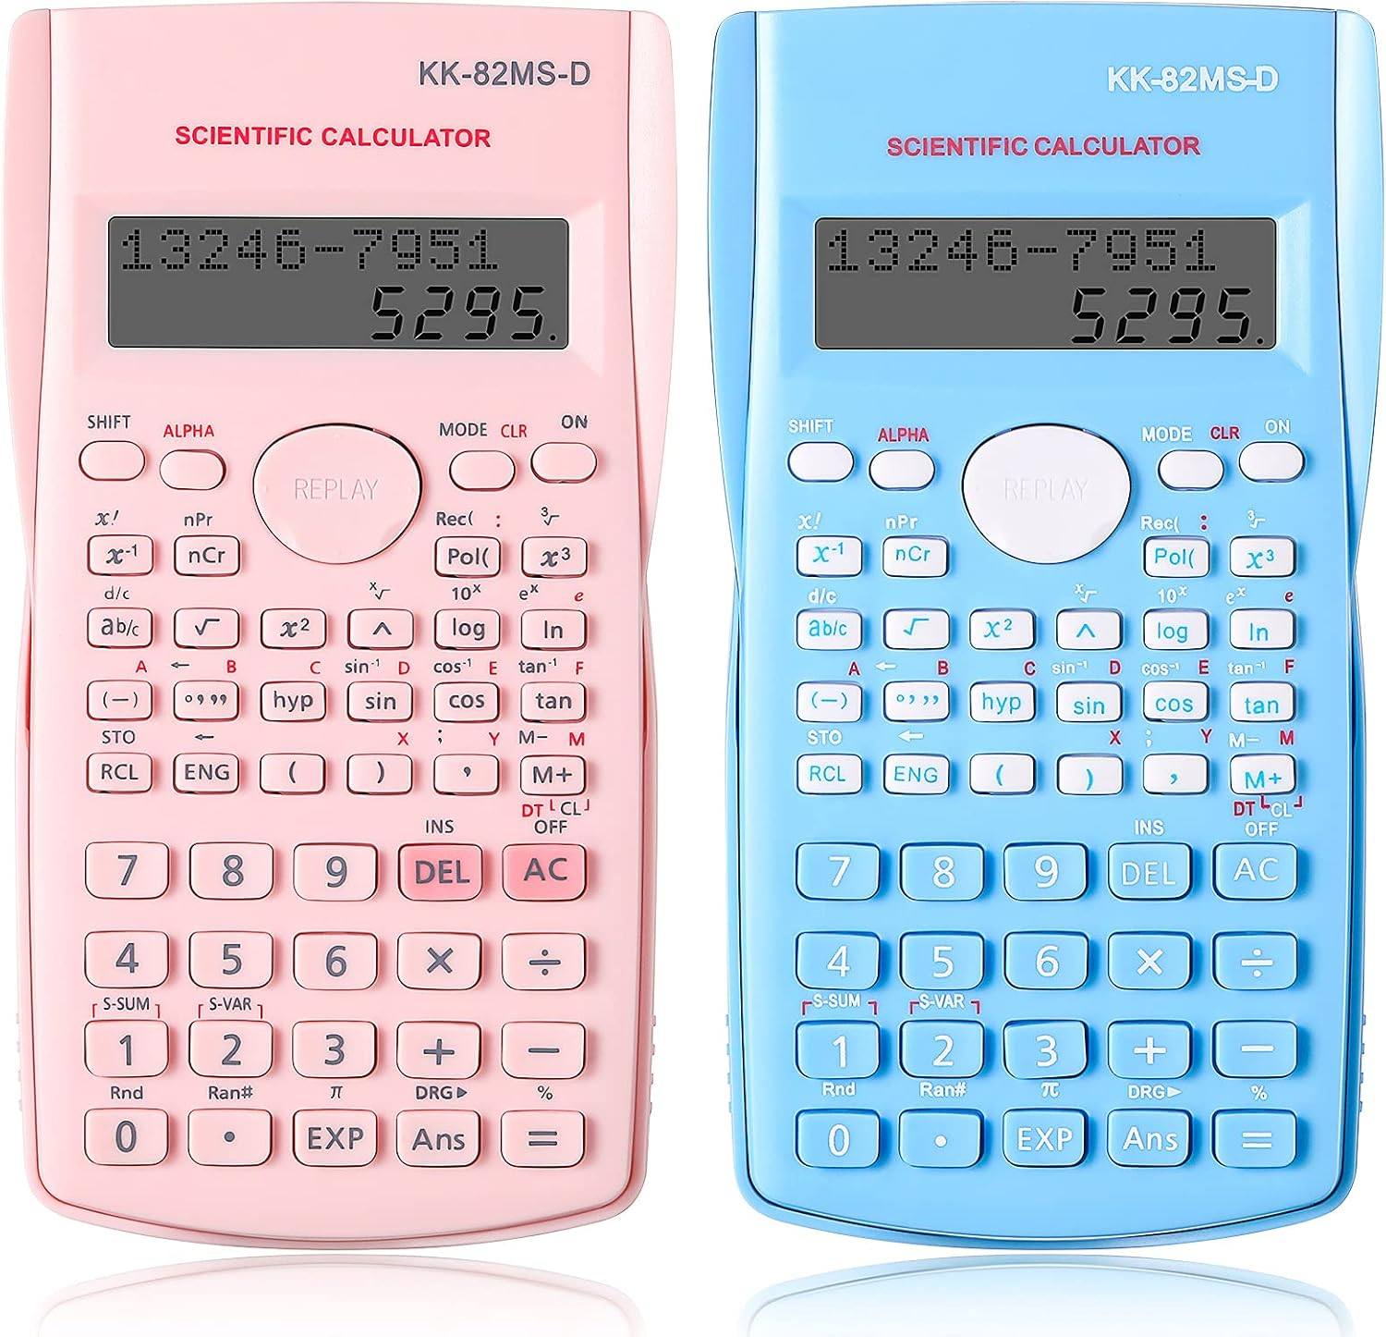
WARM UP

Slide 8
WARM UP

Slide 9

WARM UP

Slide 10
WARM UP

Slide 11

WARM UP

Slide 12
WARM UP

Slide 13

WARM UP

Slide 14
WARM UP

Slide 15
INVENTION

Slide 16
UNIT 5: INVENTION
LESSON 1: GETTING STARTED
Student Book – Page 52

Slide 17


VOCABULARY
invent (v)
/ɪnˈvent/
to produce or design something that has not existed before
Phát minh

Slide 18

VOCABULARY
improve (v)
/ɪmˈpruːv/
to become better than before; to make something/ somebody better than before
Cải thiện

Slide 19

VOCABULARY
suitable (adj)
/ˈsuːtəbl/
right or appropriate for a particular purpose or occasion
Phù hợp

Slide 20

VOCABULARY
app (n)
/æp/
a piece of software that you can download to a device such as a smartphone or tablet
Ứng dụng

Slide 21

VOCABULARY
convenient (adj)
/kənˈviːniənt/
useful, easy or quick to do; not causing problems
Thuận tiện

Slide 22
VOCABULARY
New words | Pronunciation | Meaning
1. invent (v) | /ɪnˈvent/ | to produce or design something that has not existed before (Phát minh)
2. improve (v) | /ɪmˈpruːv/ | ​to become better than before; to make something/somebody better than before (Cải thiện)
3. suitable (adj) | /ˈsuːtəbl/ or /ˈsjuːtəbl/ | right or appropriate for a particular purpose or occasion (Phù hợp)
4. app (n) | /æp/ | a piece of software that you can download to a device such as a smartphone or tablet (Ứng dụng)
5. convenient (adj) | /kənˈviːniənt/ | useful, easy or quick to do; not causing problems (Thuận tiện)

Slide 23

JUMBLED WORDS
Let’s solve all these jumbled words!
- Words are jumbled all the letters.
- Arrange all the letters in the correct order in 10 seconds.
- Say “Bingo” if you get the answer as fast as possible.
-1 POINT is given for 1 correct answer.

Slide 24

P | I | M | O | R | V | E
IMPROVE
Cải thiện

Slide 25
V | E | N | C | O | N | I | E | N | T
CONVENIENT
Thuận tiện

Slide 26
V | N | T | E | N | I
INVENT
Phát minh

Slide 27
P | A | P
APP
Ứng dụng

Slide 28
T | A | B | L | E | I | U | S
SUITABLE
Phù hợp

Slide 29
Inventions for Education
1. LISTEN AND READ
Phong: Dad, I’ve saved some money since Tet holiday. I think I’ll buy something new for my studies.
Dad: Good idea, Phong. What do you want to buy?
Phong: I’m not sure. It’s hard to choose between a smartphone and a laptop. They’re both useful and I’ve wanted either of them for a long time. What do you think, Dad?
Dad: Perhaps a laptop is a better choice. Since laptops were invented, they’ve allowed us to study better and work faster. They’ve completely changed our lives in the last 20 years.
Phong: That’s true, Dad. But smartphones have also improved the way we work and study.
Dad: Really? I didn’t know smartphones were suitable for learning.
Phong: Well, it’s actually a lot of fun to learn with educational apps. It’s also very convenient for learners to use them. Some of my classmates love using them on their smartphones. The apps allow them to communicate and learn at the same time.
Dad: I didn’t know that! There have been so many valuable inventions. Hmm … Perhaps you should ask your teacher. She may be able to help you decide.

Slide 30
PRESENTATION
2. READ AND ANSWER THE QUESTIONS.
1. What inventions are Phong and his dad talking about?
2. How useful are laptops?
3. How long have laptops changed our lives?
4. Have smartphones improved the way we work and study?
5. Why is it fun and convenient to learn with educational apps on smartphones?

Slide 31
“BLIND BAG”
PRESENTATION
- Work in 2 teams.
- Choose a number.
- Answer the question in each number and get 2 points for each correct question.
- With LUCKY BLIND BAG, you get the point without answering the question.

Slide 32

1
2
3
4
5
6
7
8

Slide 33

1
2
3
4
5
6
7
8

Slide 34
1
2
3
4
5
6
7
8

Slide 35
1
2
3
4
5
6
7
8

Slide 36
1
2
3
4
5
6
7
8

Slide 37
1
2
3
4
5
6
7
8

Slide 38
1
2
3
4
5
6
7
8

Slide 39
1
2
3
4
5
6
7
8

Slide 40
1
2
3
4
5
6
7
8

Slide 41
PRESENTATION
+5 points

Slide 42
PRESENTATION
What inventions are Phong and his dad talking about?
They are (talking about) laptops/ computers and smartphones.

Slide 43
PRESENTATION
Have smartphones improved the way we work and study?
Yes, they have.

Slide 44
PRESENTATION
+10 points

Slide 45
PRESENTATION
Why is it fun and convenient to learn with educational apps on smartphones?
Because you can use educational apps that allow you to communicate and learn at the same time.

Slide 46
PRESENTATION
+10 points

Slide 47
PRESENTATION
How long have laptops changed our lives?
They’ve changed our lives in the last 20 years.

Slide 48
PRESENTATION
How useful are laptops?
Laptops have allowed us to study better and work faster.

Slide 49
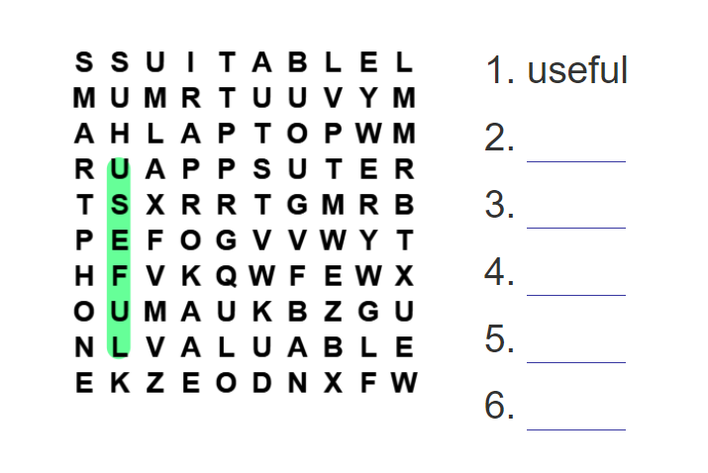
3. FIND 3 NOUNS & 3 ADJECTIVES.
PRESENTATION
smartphone
suitable
laptop
apps
valuable

Slide 50
In your opinion, which invention do you like most? Why?
PRODUCTION

Slide 51
CONSOLIDATION
Wrap – up
Gain an overview about the topic Inventions.
Memorize vocabulary to talk about Inventions.
2. Homework
Do exercise 4 – page 53.
Prepare Lesson 2 – Language.

Slide 52
THANK YOU!
Do you have any questions?
buithuytrag221097@gmail.com
0898.265.168
Please keep this slide for attribution

