Slide 1







1. VIETNAM
3. CAMBODIA
2. SINGAPORE
4. THAILAND
6. THE PHILIPPINES
5. LAOS

Slide 2
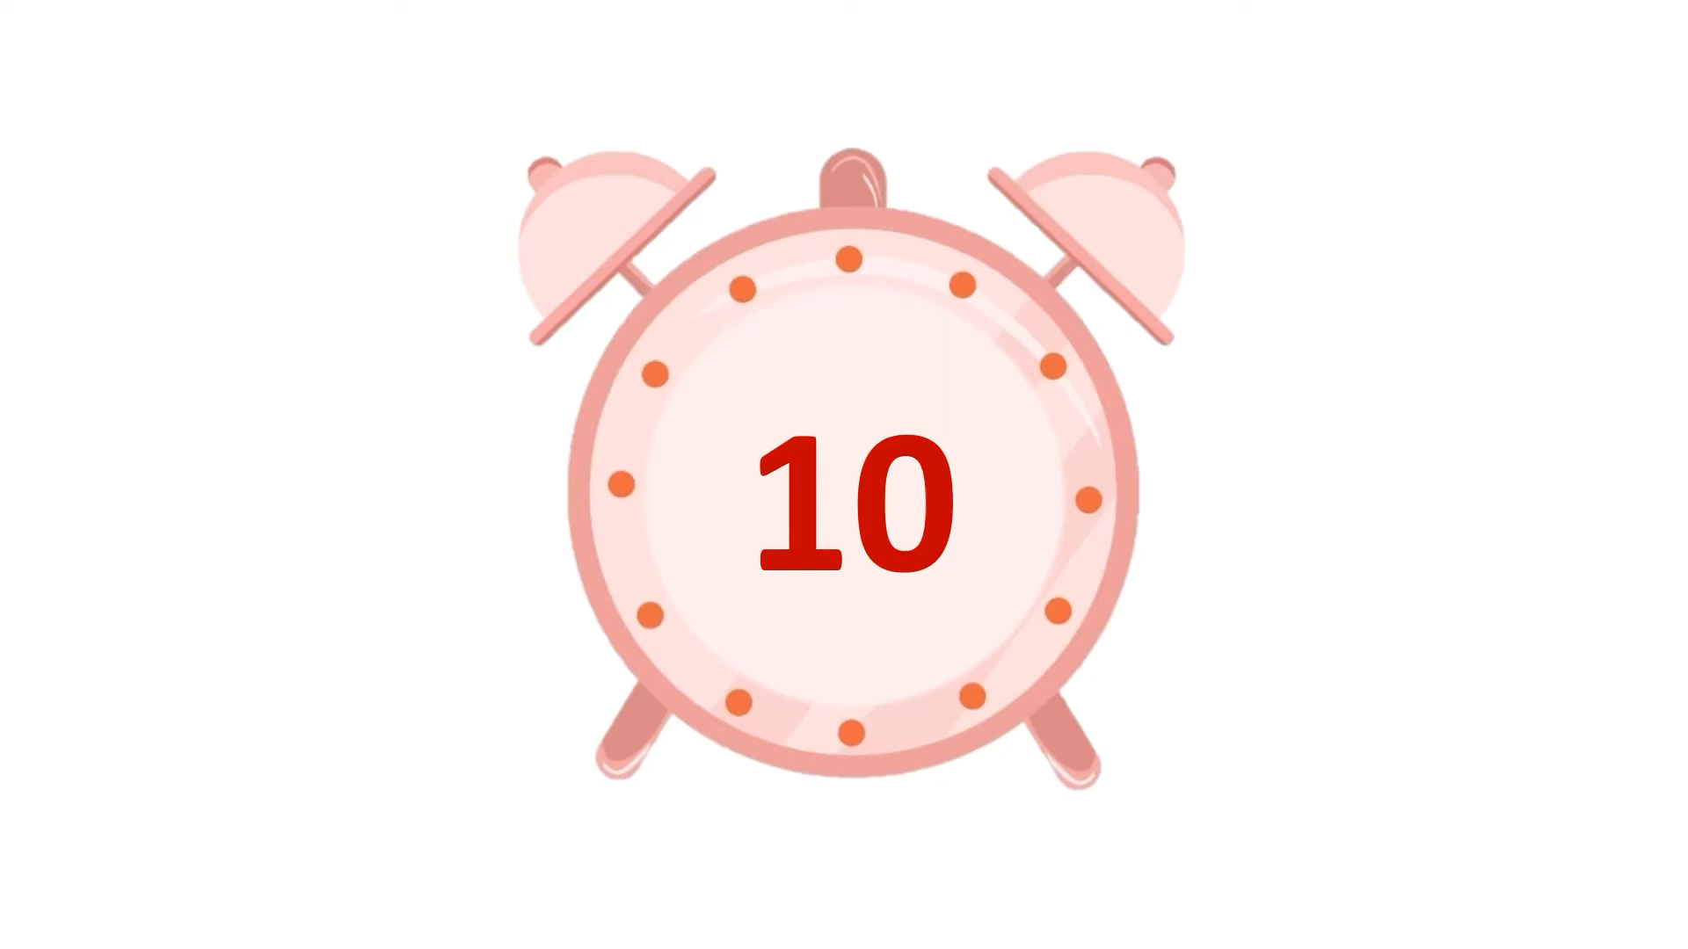

How long does the journey of the SSEAYP last?
A. 60 days
B. 50 days
C. 40 days

Slide 3
How many youths will take part in the program?
A. About 100
B. 0ver 200
C. Over 300

Slide 4
What is the main purpose of the SSEAYP program?
A. To promote business cooperation among ASEAN countries
B. To bring together young people for learning and cultural exchange
C. To train athletes for international competitions

Slide 5
What kinds of activities will participants join?
A. Sports competitions and music festivals
B. Cooking and language classes
C. Discussions, cultural exchanges, and leadership training

Slide 6
What does SSEAYP stand for?
A. Ship for Southeast Asian and Japanese Youth Programme.
B. Ship for Asian and Japanese Youth Programme.
C. Ship for Vietnamese and Japanese Youth Programme.

Slide 7
Where does the journey begin?
A. In Japan
B. In Vietnam
C. In Thailand

Slide 8


Slide 9


Controlled Practice

Slide 10
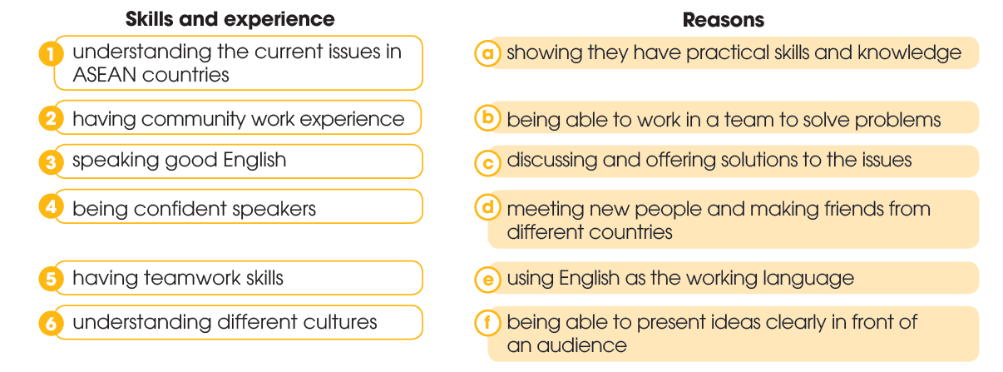
1c-2a-3e-4f-5b-6d
Controlled Practice

Slide 11

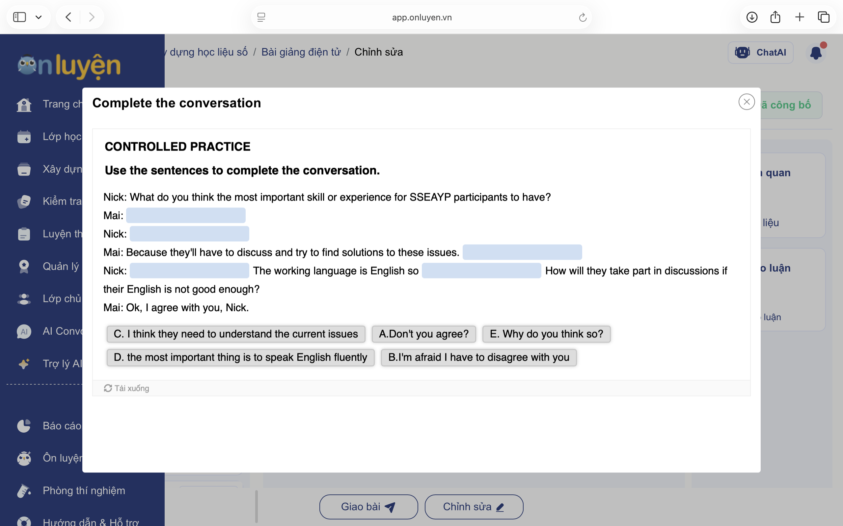

Controlled Practice

Slide 12

Controlled Practice

Slide 13
Nick: What do you think is the most important skill or experience for SSEAYP participants to have?
Mai: (1) C. I think they need to understand the current issues in ASEAN countries.
Nick: (2) E. Why do you think so?
Mai: Because they'll have to discuss and try to find solutions to these issues. (3) A. Don't you agree?
Nick: (4) B. I'm afraid I have to disagree with you. The working language is English so (5) D. the most important thing is to speak English fluently. How will they take part in discussions if their English is not good enough?
Mai: OK, I agree with you, Nick.

Slide 14
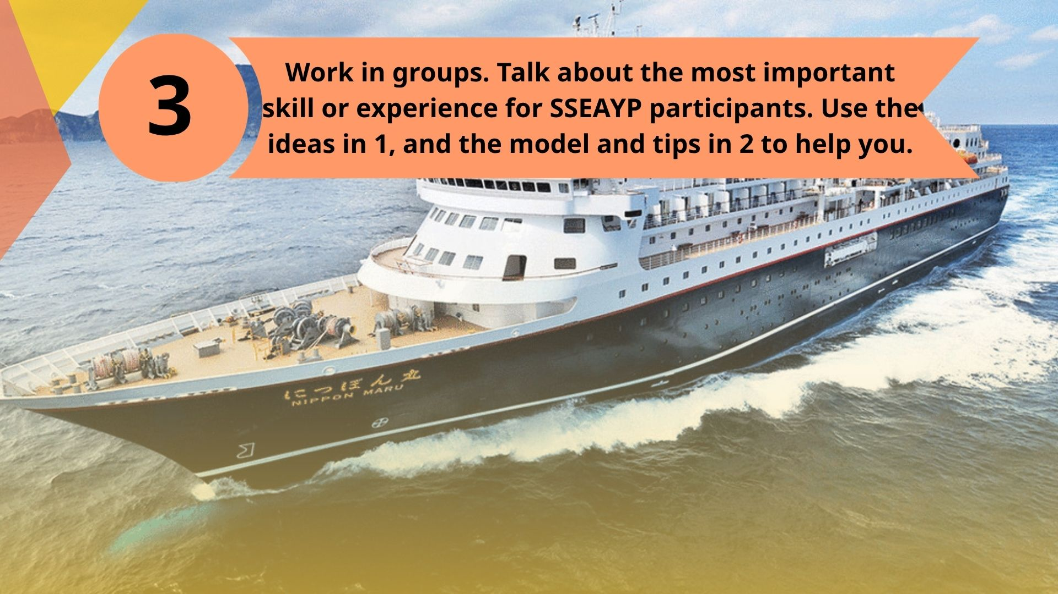
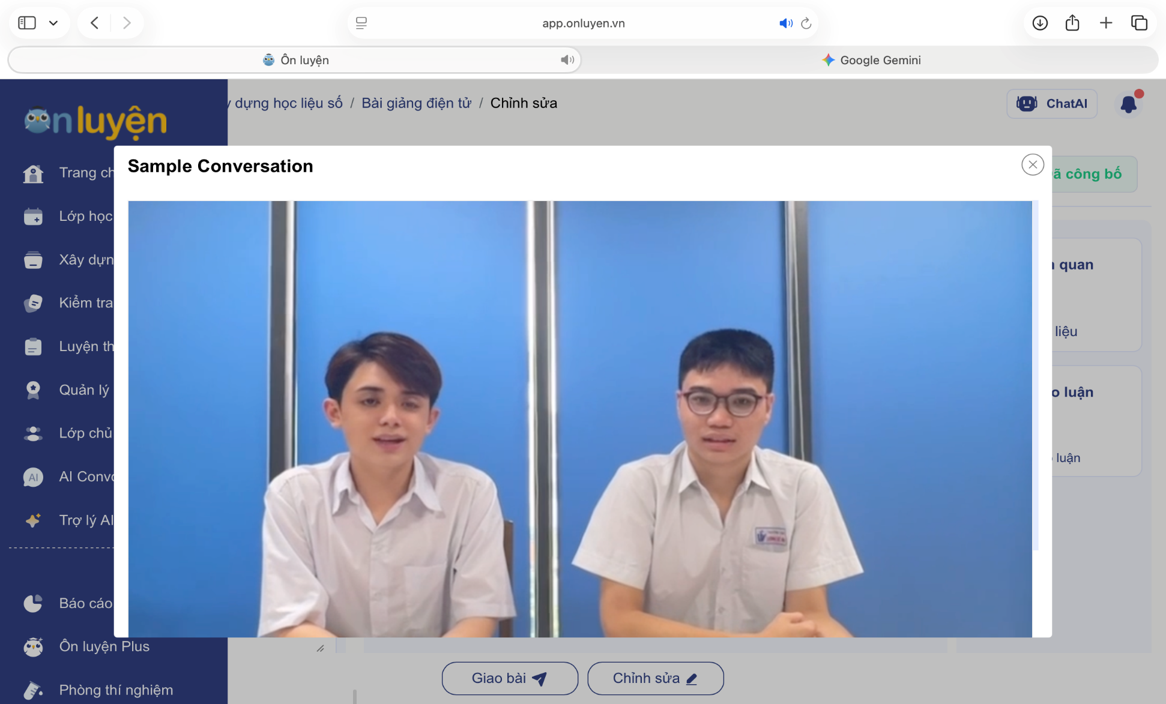
Controlled Practice

Slide 15
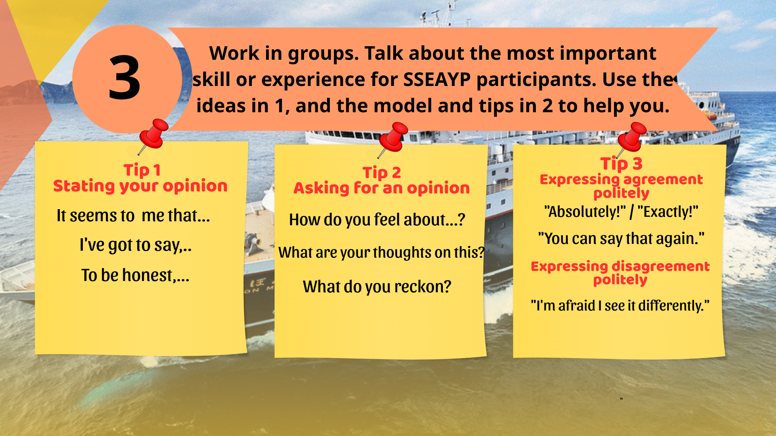
Controlled Practice
I think
What about you?
OK I definitely with you.
Sample Conversation
I’m afraid I can’t agree with you

Slide 16


Controlled Practice

Slide 17
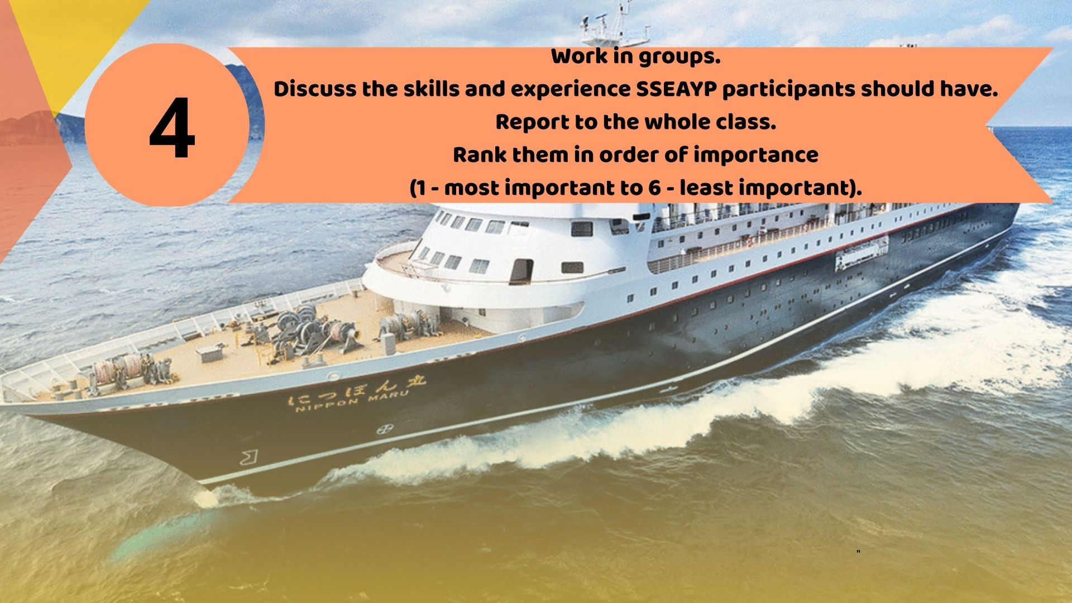


Wrap-up
Suggested Prompt:
Drawing a visual mind-map with “2/3/… “ branches about why ”skills/experience" are the most important with SSEAYP participants.
Consolidation

Slide 18


Wrap-up
Consolidation

Slide 19


Slide 20

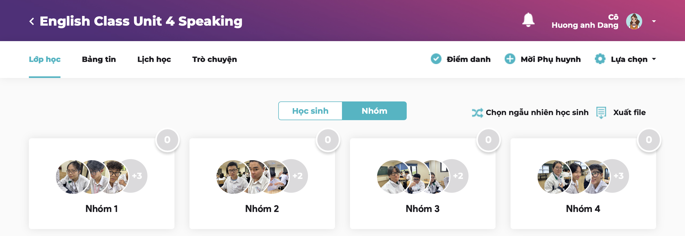
ClassClap app

Slide 21


