Slide 1
Unit 1
A long and healthy life

Slide 2
LESSON 5 : LISTENING
Food and health

Slide 3
LESSON 5 : LISTENING
WARM-UP
Let’s talk
PRE-LISTENING
Task 1. Choose the correct meaning of the underlined word and phrase.
Task 2. Circle the topic of the show.
Task 3. Listen again and tick the food which is recommended in the talk.
Task 4. Complete the sentences. Use ONE word for each answer.
WHILE-LISTENING
POST-LISTENING
Make a healthy meal plan for one day
CONSOLIDATION
Wrap-up
Homework

Slide 4
WARM UP

Slide 5
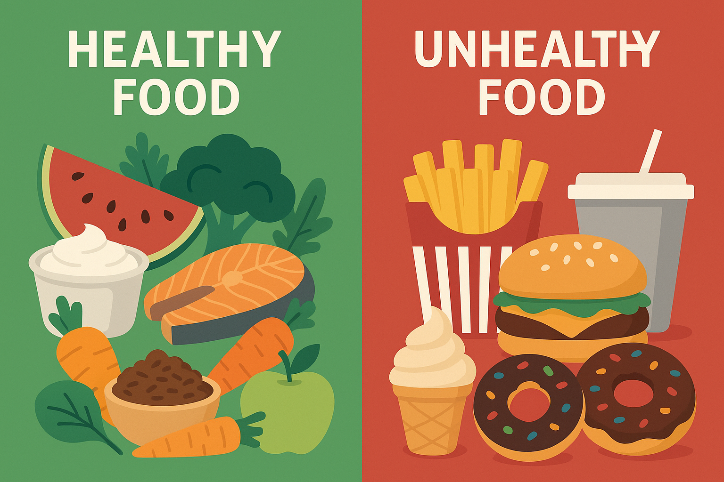
Let's talk about what we eat!
Warm-up Activity: Food and Health

Slide 6

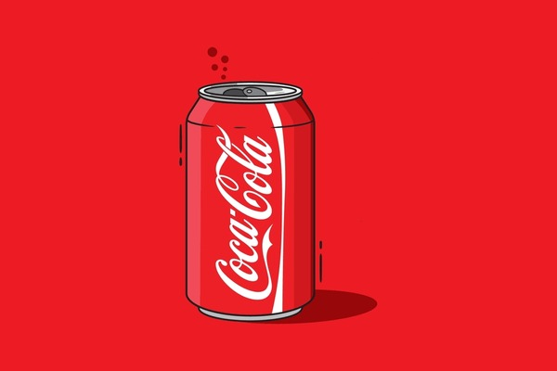

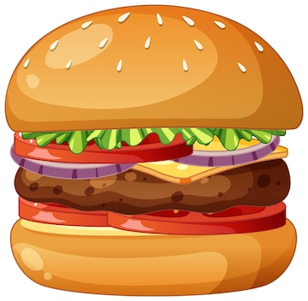

Brainstorming Question
Can you name 4 healthy foods and 4 unhealthy foods?
Instruction: Work in pairs. You have 1 minute!

Slide 7
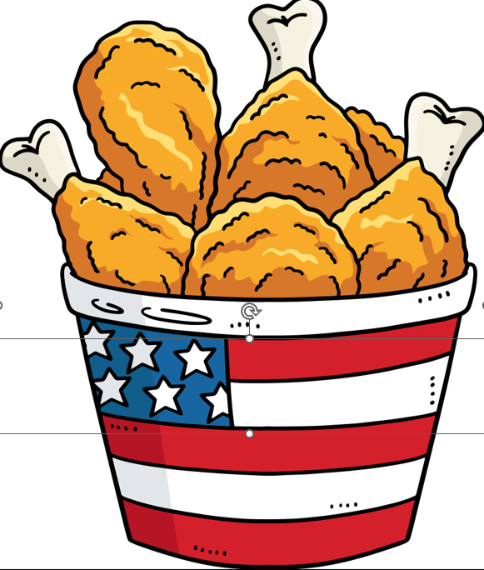
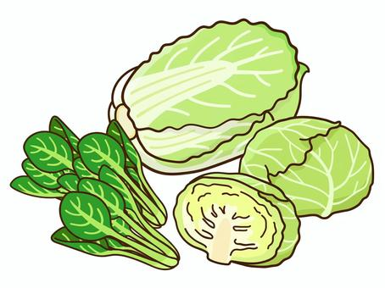
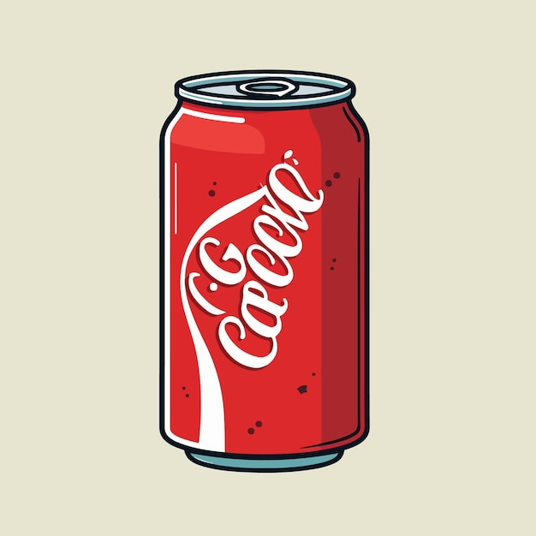
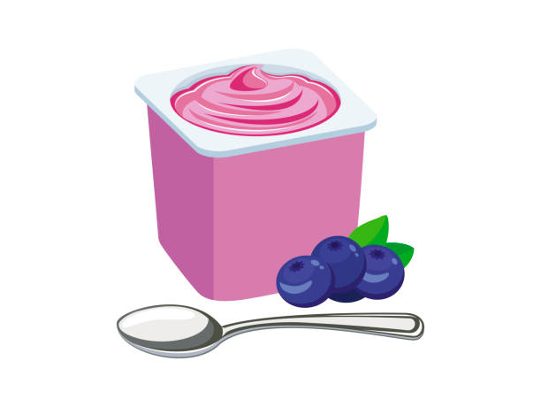

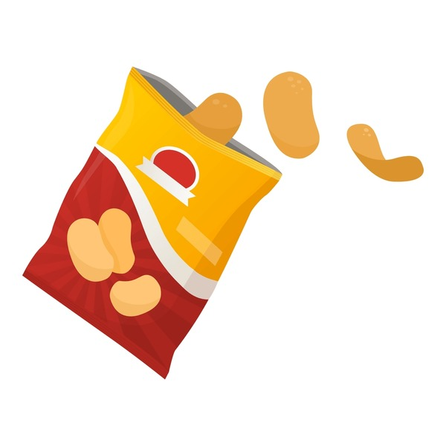
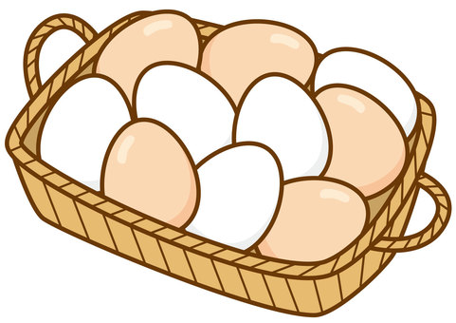
Healthy or Unhealthy?
Instruction: Look at the pictures. Decide if each food is healthy or unhealthy.
Raise your hand or use red/green cards

Slide 8
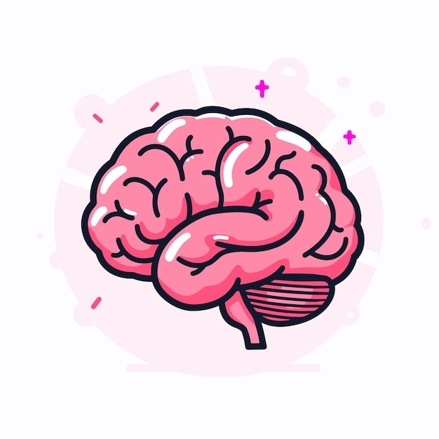
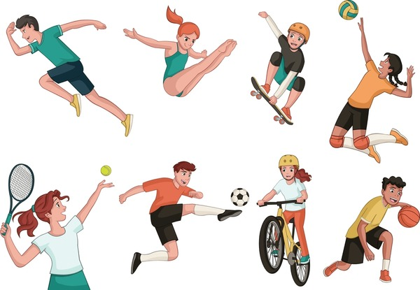

Think – Pair – Share activity
Why Eat Healthy?
Why do teenagers need to eat healthy food?

Slide 9
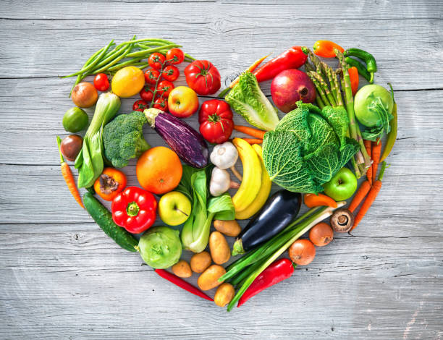
Lesson today
Listening – Food and Health Brief overview
- Learn about healthy food choices
- Practice listening for key information
- Talk about what makes a balanced die
Let’s discover how food helps our body and mind!

Slide 10
LISTENING

Slide 11
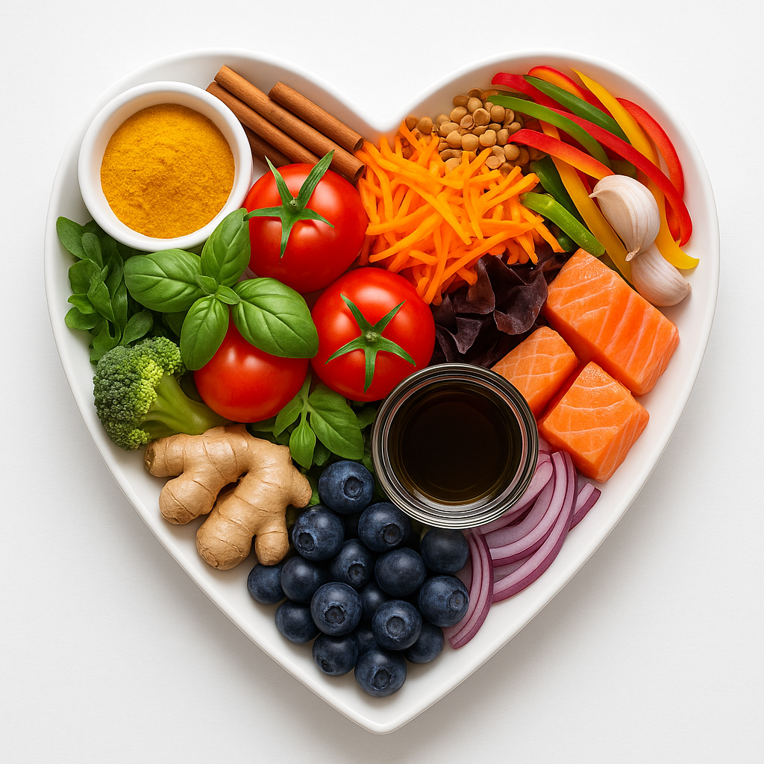
PRE-LISTENING
What is a balanced diet?
A diet that contains different kinds of foods in appropriate amounts to give our body the nutrients it needs

Slide 12

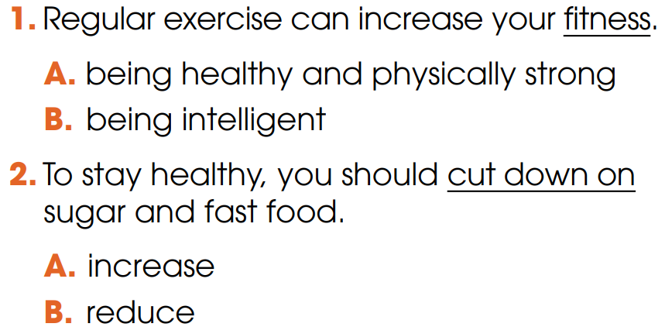
PRE-LISTENING
1
Choose the correct meaning of the underlined word and phrase

Slide 13
VOCABULARY

Slide 14

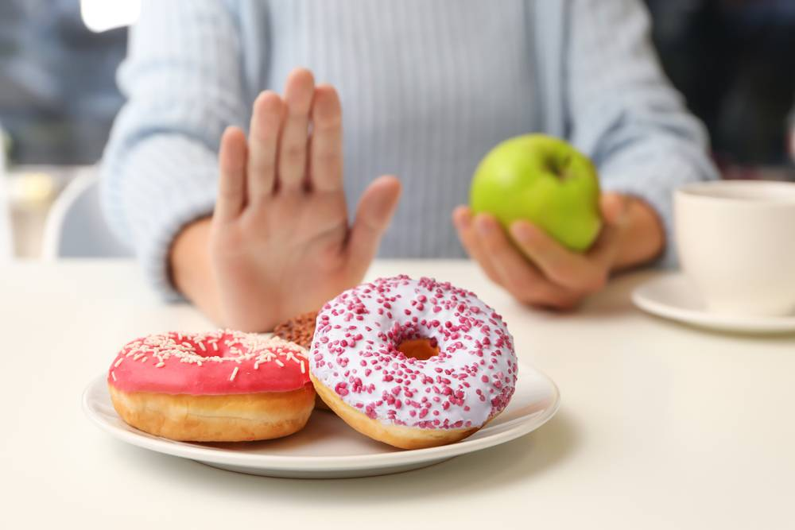
PRE-LISTENING
cut down on
/kʌt daʊn ɒn /
cắt giảm, giảm bớt
to reduce the size, amount or number of something
E.g. I will show you 5 tips to cut down on sugar.

Slide 15
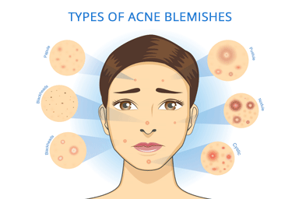
PRE-LISTENING
acne (n)
/ˈækni/
mụn trứng cá
a skin condition, common among young people, that produces many pimples (= spots), especially on the face and neck

Slide 16
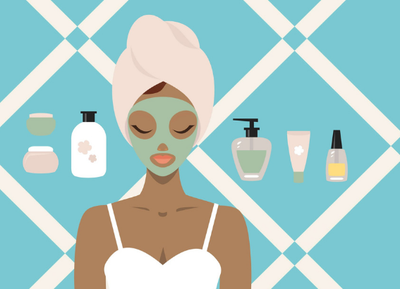
PRE-LISTENING
skincare (n)
/ˈskɪnkeə(r)/
việc chăm sóc da bằng kem và các sản phẩm chuyên dụng
the use of creams and special products to look after your skin

Slide 17
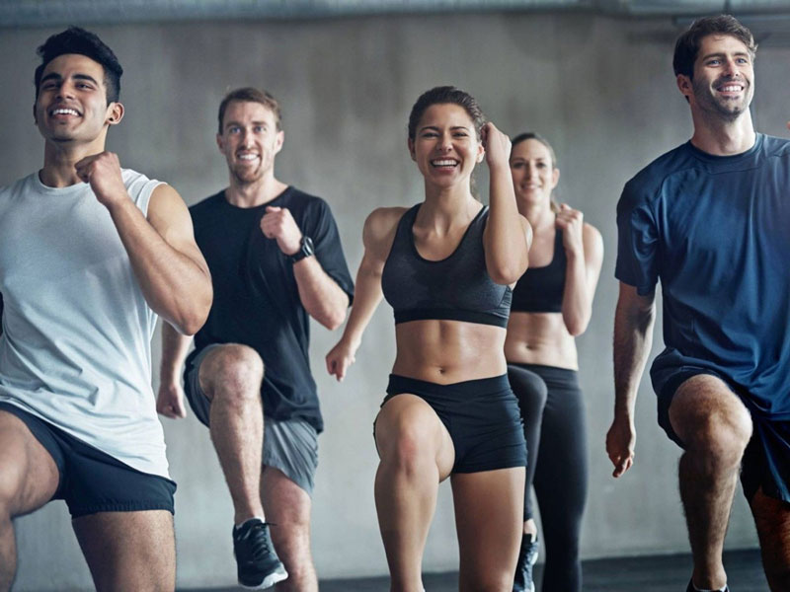
PRE-LISTENING
fitness (n)
/ˈfɪtnəs/
thể lực; tình trạng sức khỏe và sự dẻo dai của cơ thể
the state of being physically healthy and strong

Slide 18
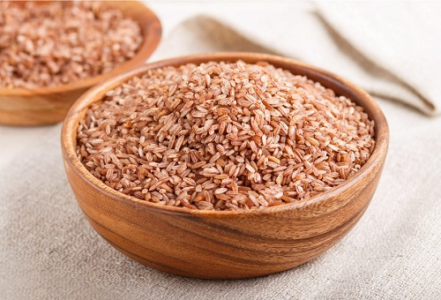
PRE-LISTENING
brown rice (n)
/ˌbraʊn ˈraɪs/
gạo lứt
rice that is light brown because it has not had all of its outside part removed

Slide 19
PRE-LISTENING
Form | Pronunciation | Meaning
1. cut down on | /kʌt daʊn ɒn / | to reduce the size, amount or number of something
2. acne (n) | /ˈækni/ | a skin condition, common among young people, that produces many pimples (= spots), especially on the face and neck
3. skincare (n) | /ˈskɪnkeə(r)/ | the use of creams and special products to look after your skin
4. fitness (n) | /ˈfɪtnəs/ | the state of being physically healthy and strong
5. brown rice (n) | /ˌbraʊn ˈraɪs/ | ​rice that is light brown because it has not had all of its outside part removed

Slide 20
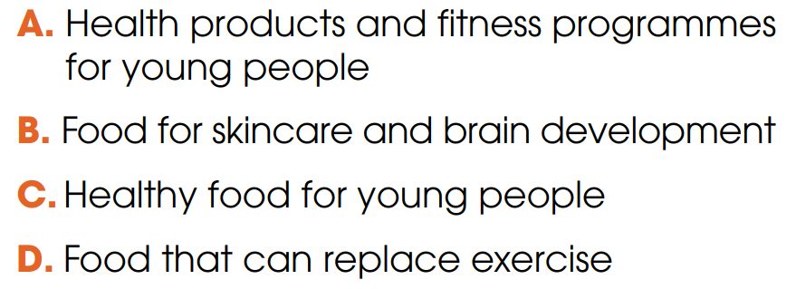
WHILE-LISTENING
2
Listen to a TV chat show about teen health. Circle the topic of the show.

Slide 21
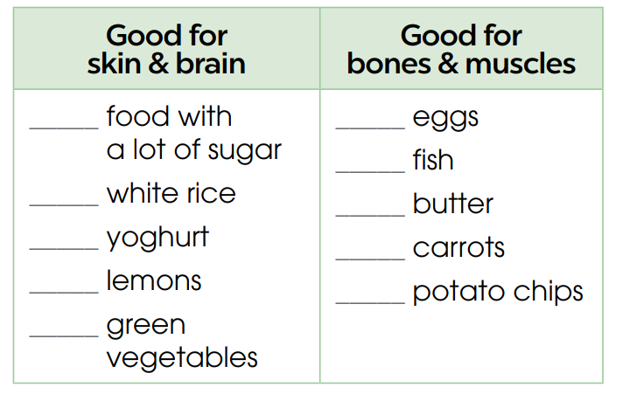

WHILE-LISTENING
3
Listen again and tick the food which is recommended in the talk.

Slide 22
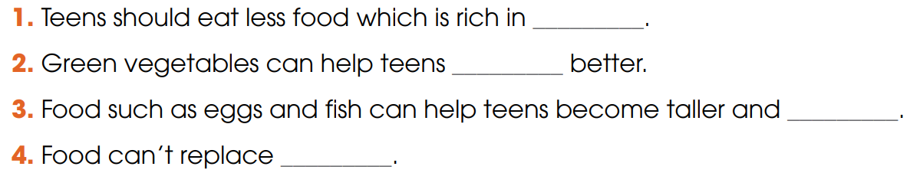
WHILE-LISTENING
4
Listen again and complete the sentences. Use ONE word for each answer.
sugar
concentrate
stronger
exercise

Slide 23
LISTENING TAPESCRIPT
TV host: Good evening! This is Oliver and this is ‘Teen Life’, where we answer questions from young people. This week we have received a lot of health questions, so today we have Katherine Jones, a food expert, to talk about healthy eating for teenagers and how food can affect their health. Welcome and thank you for joining us, Katherine.
Katherine Jones: Good evening and thank you for inviting me. Well, when people want to improve their health and fitness, they often think of expensive health products and fitness programmes. But in fact, we can solve many of our health problems if we just eat healthily. For example, a lot of teenagers suffer from acne, pimples or other skin issues, and often look for expensive skincare products. This is not necessary because they can simply change their diets for better skin. Food with a lot of sugar is not very good for your skin, so you should cut down on sugary desserts and drinks. By contrast, brown rice, yoghurt, watermelons, and green vegetables are great for healthy skin. Moreover, green vegetables can improve brain health and memory, and help teens concentrate better. Teenagers are still growing, so they also need food for building strong bones and muscles. Research shows that eggs, fish, butter, carrots, and sweet potatoes can help make them taller and stronger. Although food can’t replace exercise, eating a balanced diet, supplying all the nutrients you need, will definitely help improve your muscle strength.
TV host: I guess ‘you are what you eat’ after all. Thank you, Katherine.

Slide 24
REVIEW
GAME

Slide 25



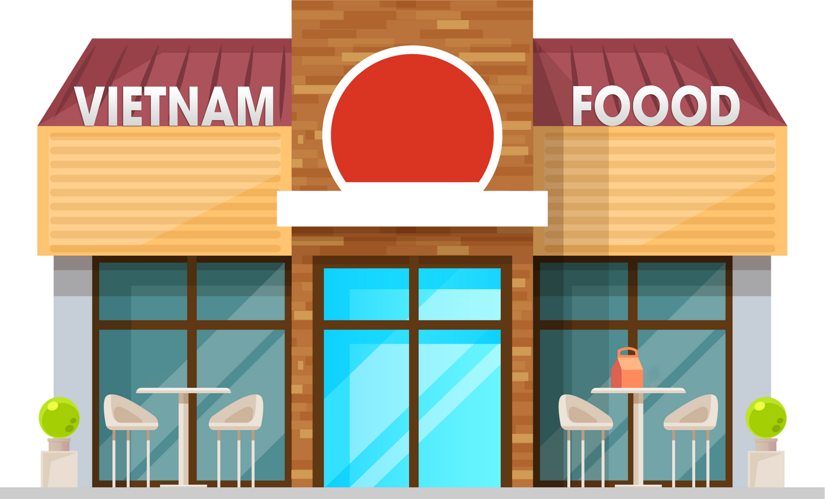
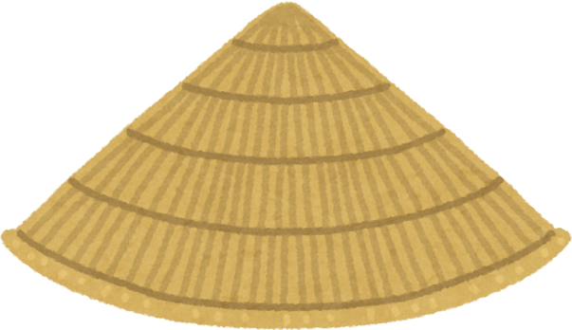

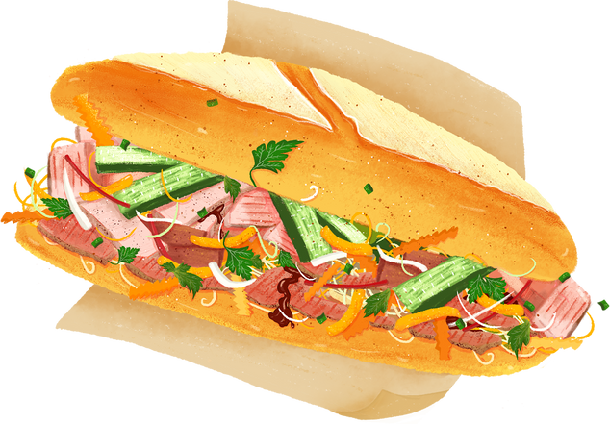


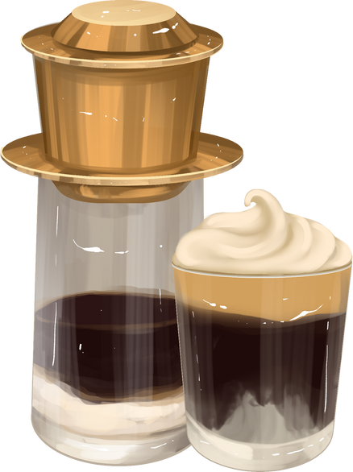

Slide 26
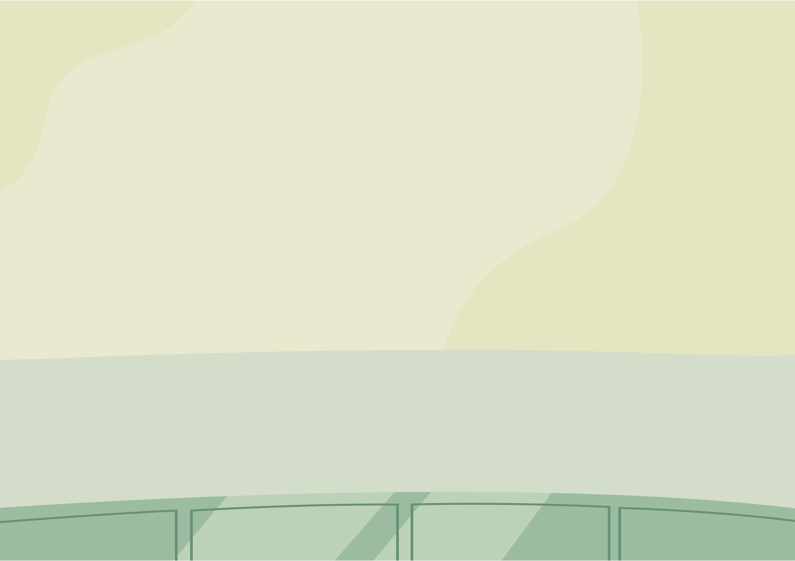


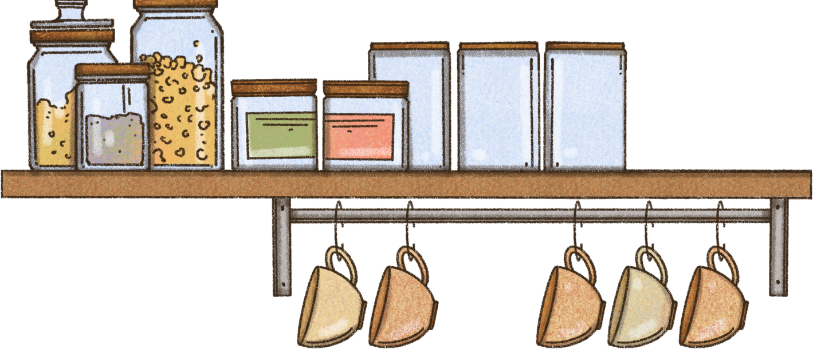

RULE
🍽️ Welcome to VIETNAM restaurant with many attractive dishes.
🧠 Your mission is to answer the questions correctly so the 👨‍🍳 chef can cook and serve the meals to the hungry customers.
Good luck and have fun! 🎉

Slide 27

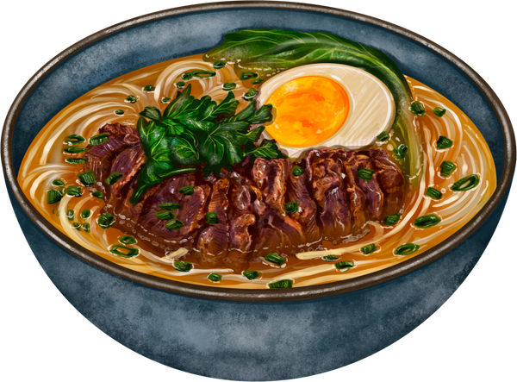

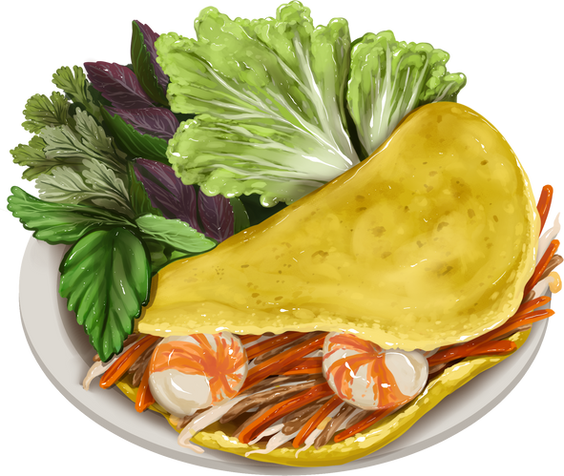
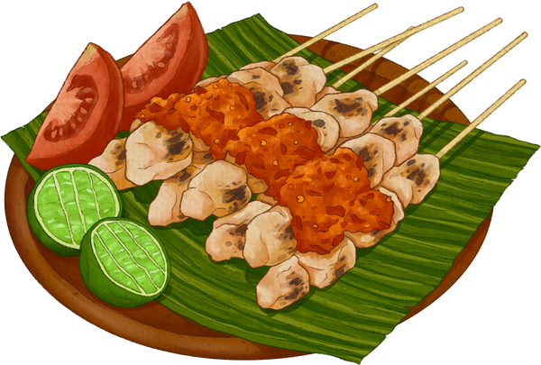

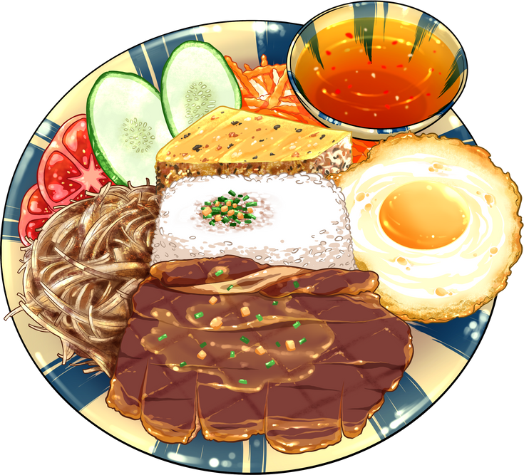
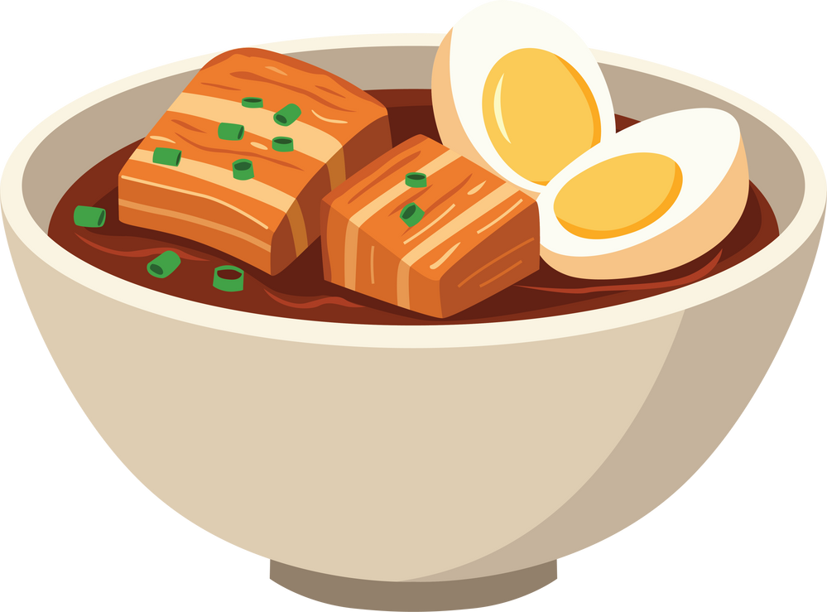
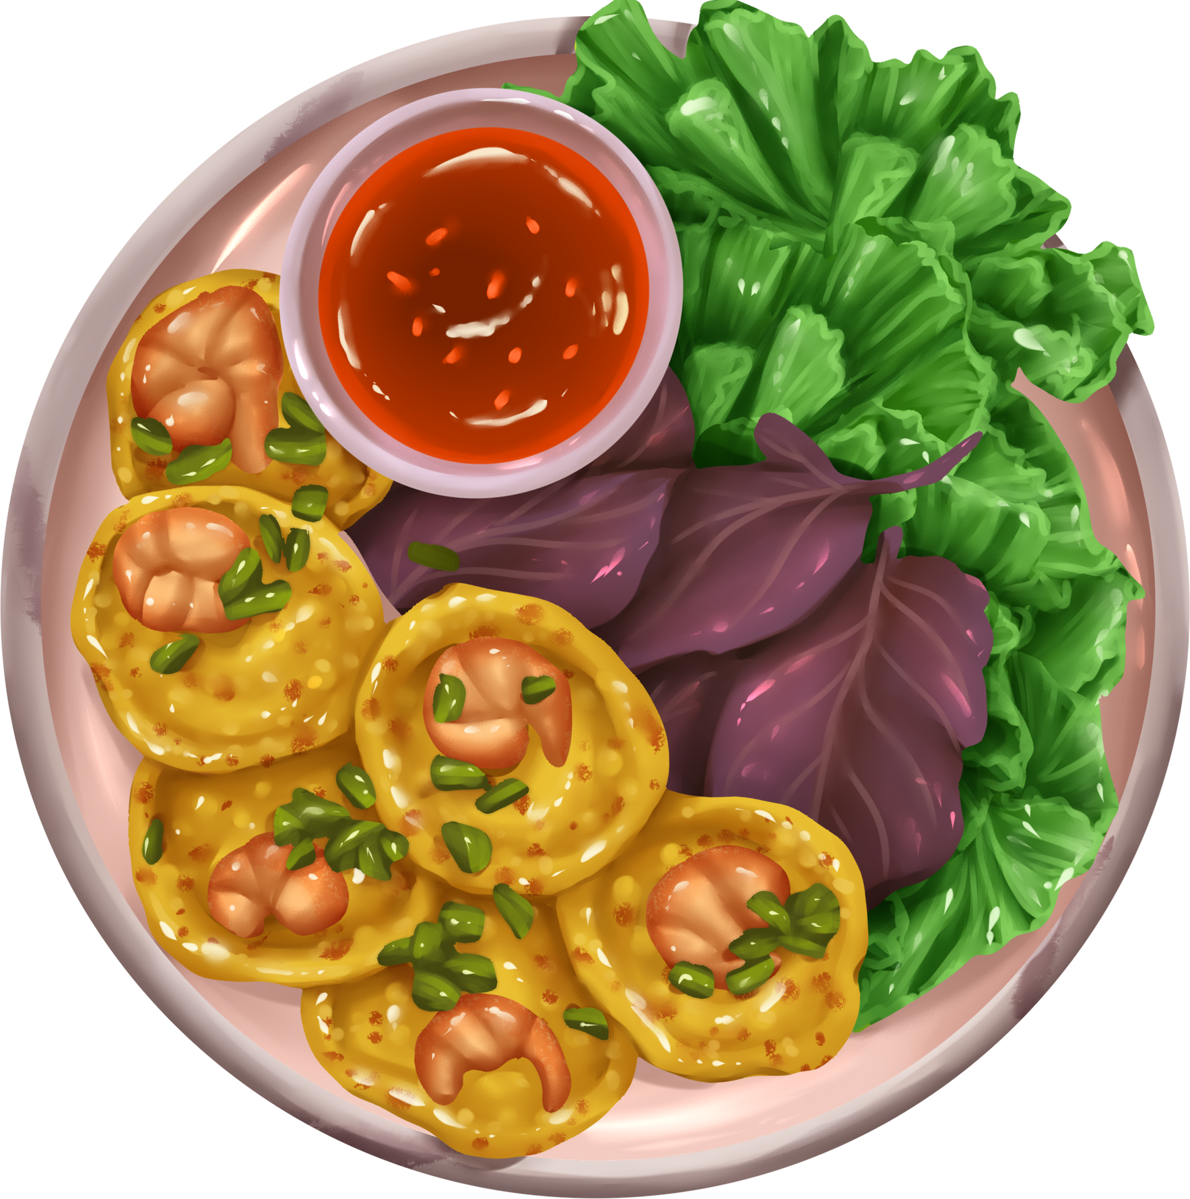
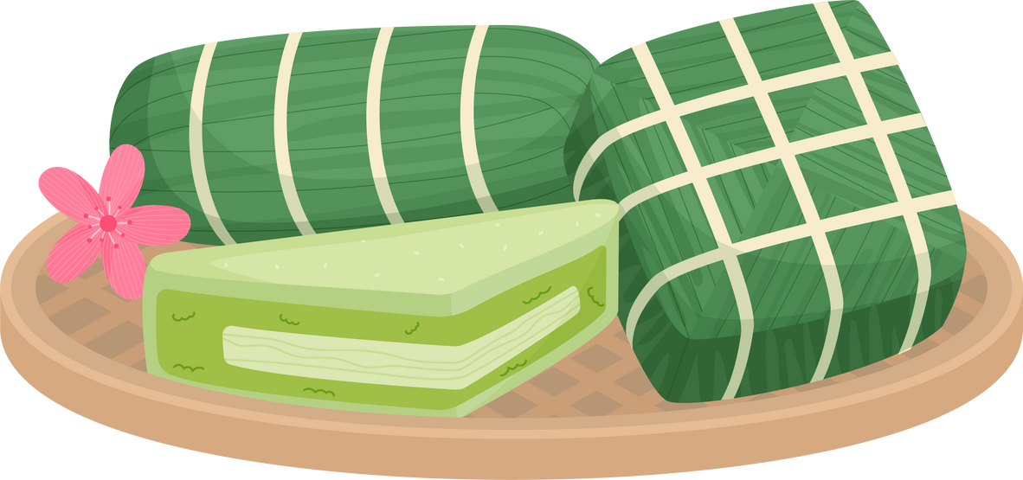

BANH MI
$4
PHO
$6
THIT NUONG
$5
BANH XEO
$7
THIT KHO HOT VIT
$6
COM SUON
$8
BANH CHUNG
BANH GIAY
$7
BANH KHOT
$9

Slide 28
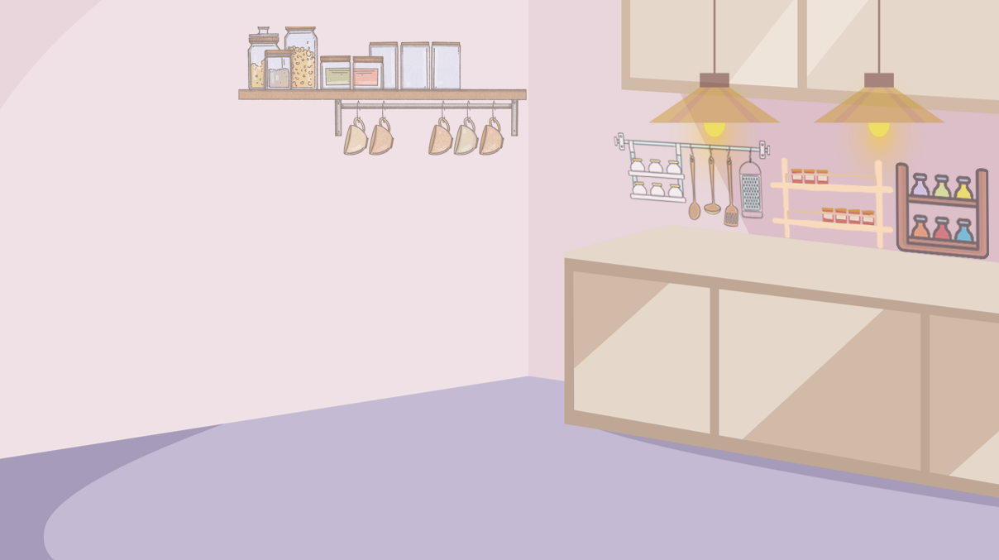



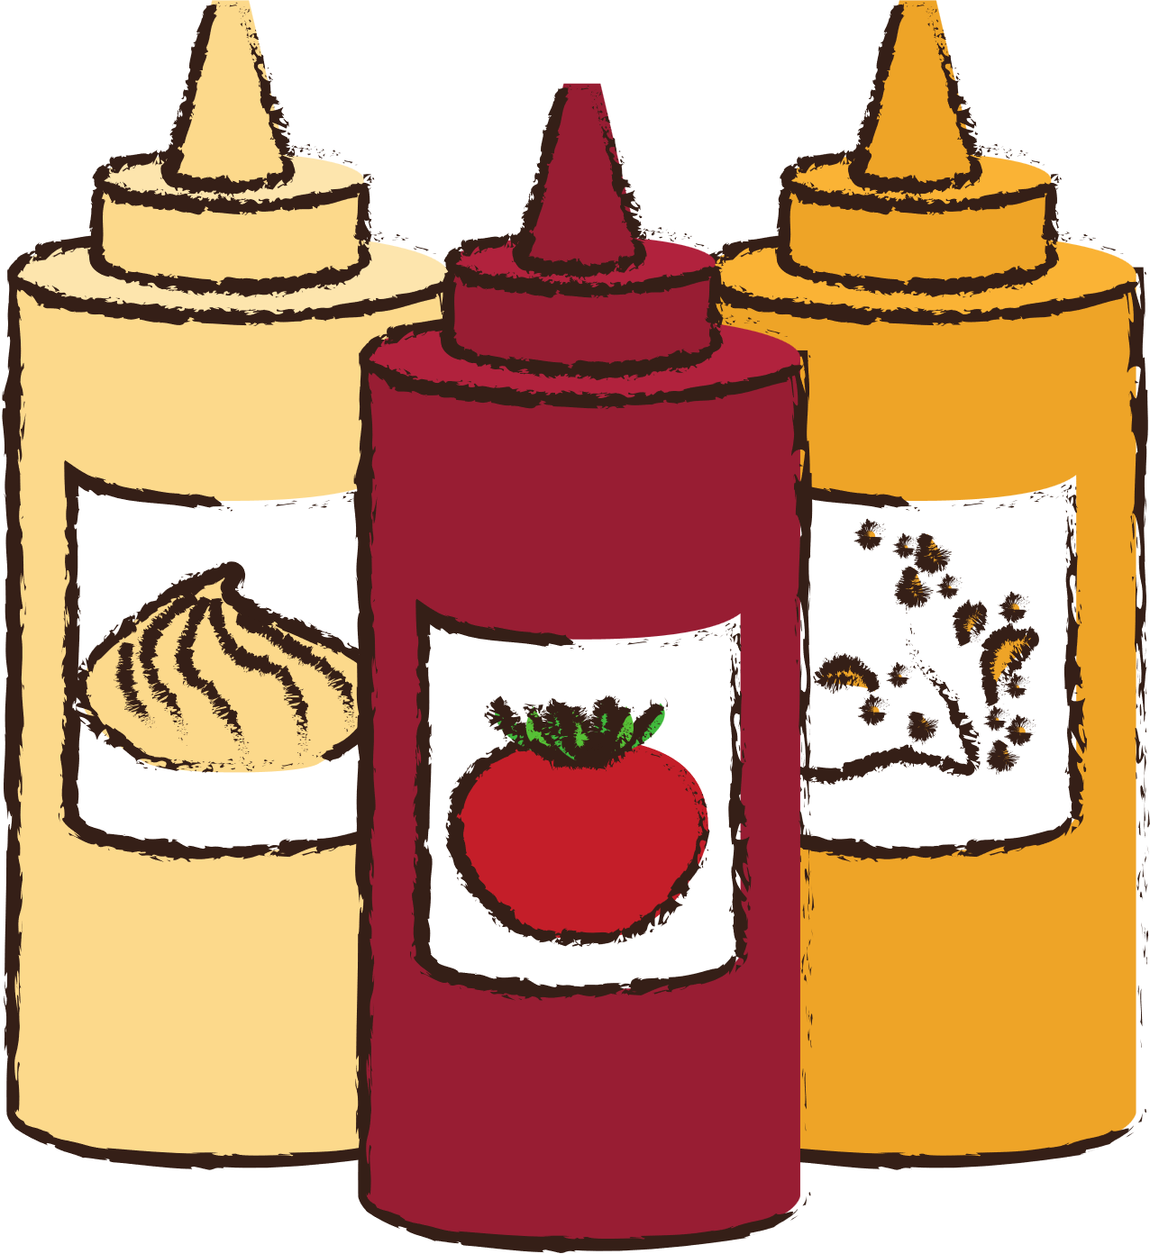
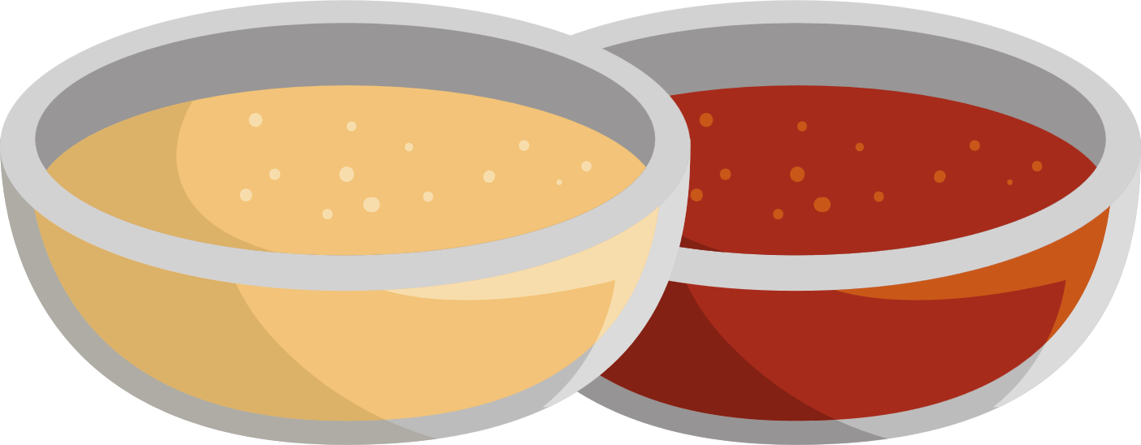
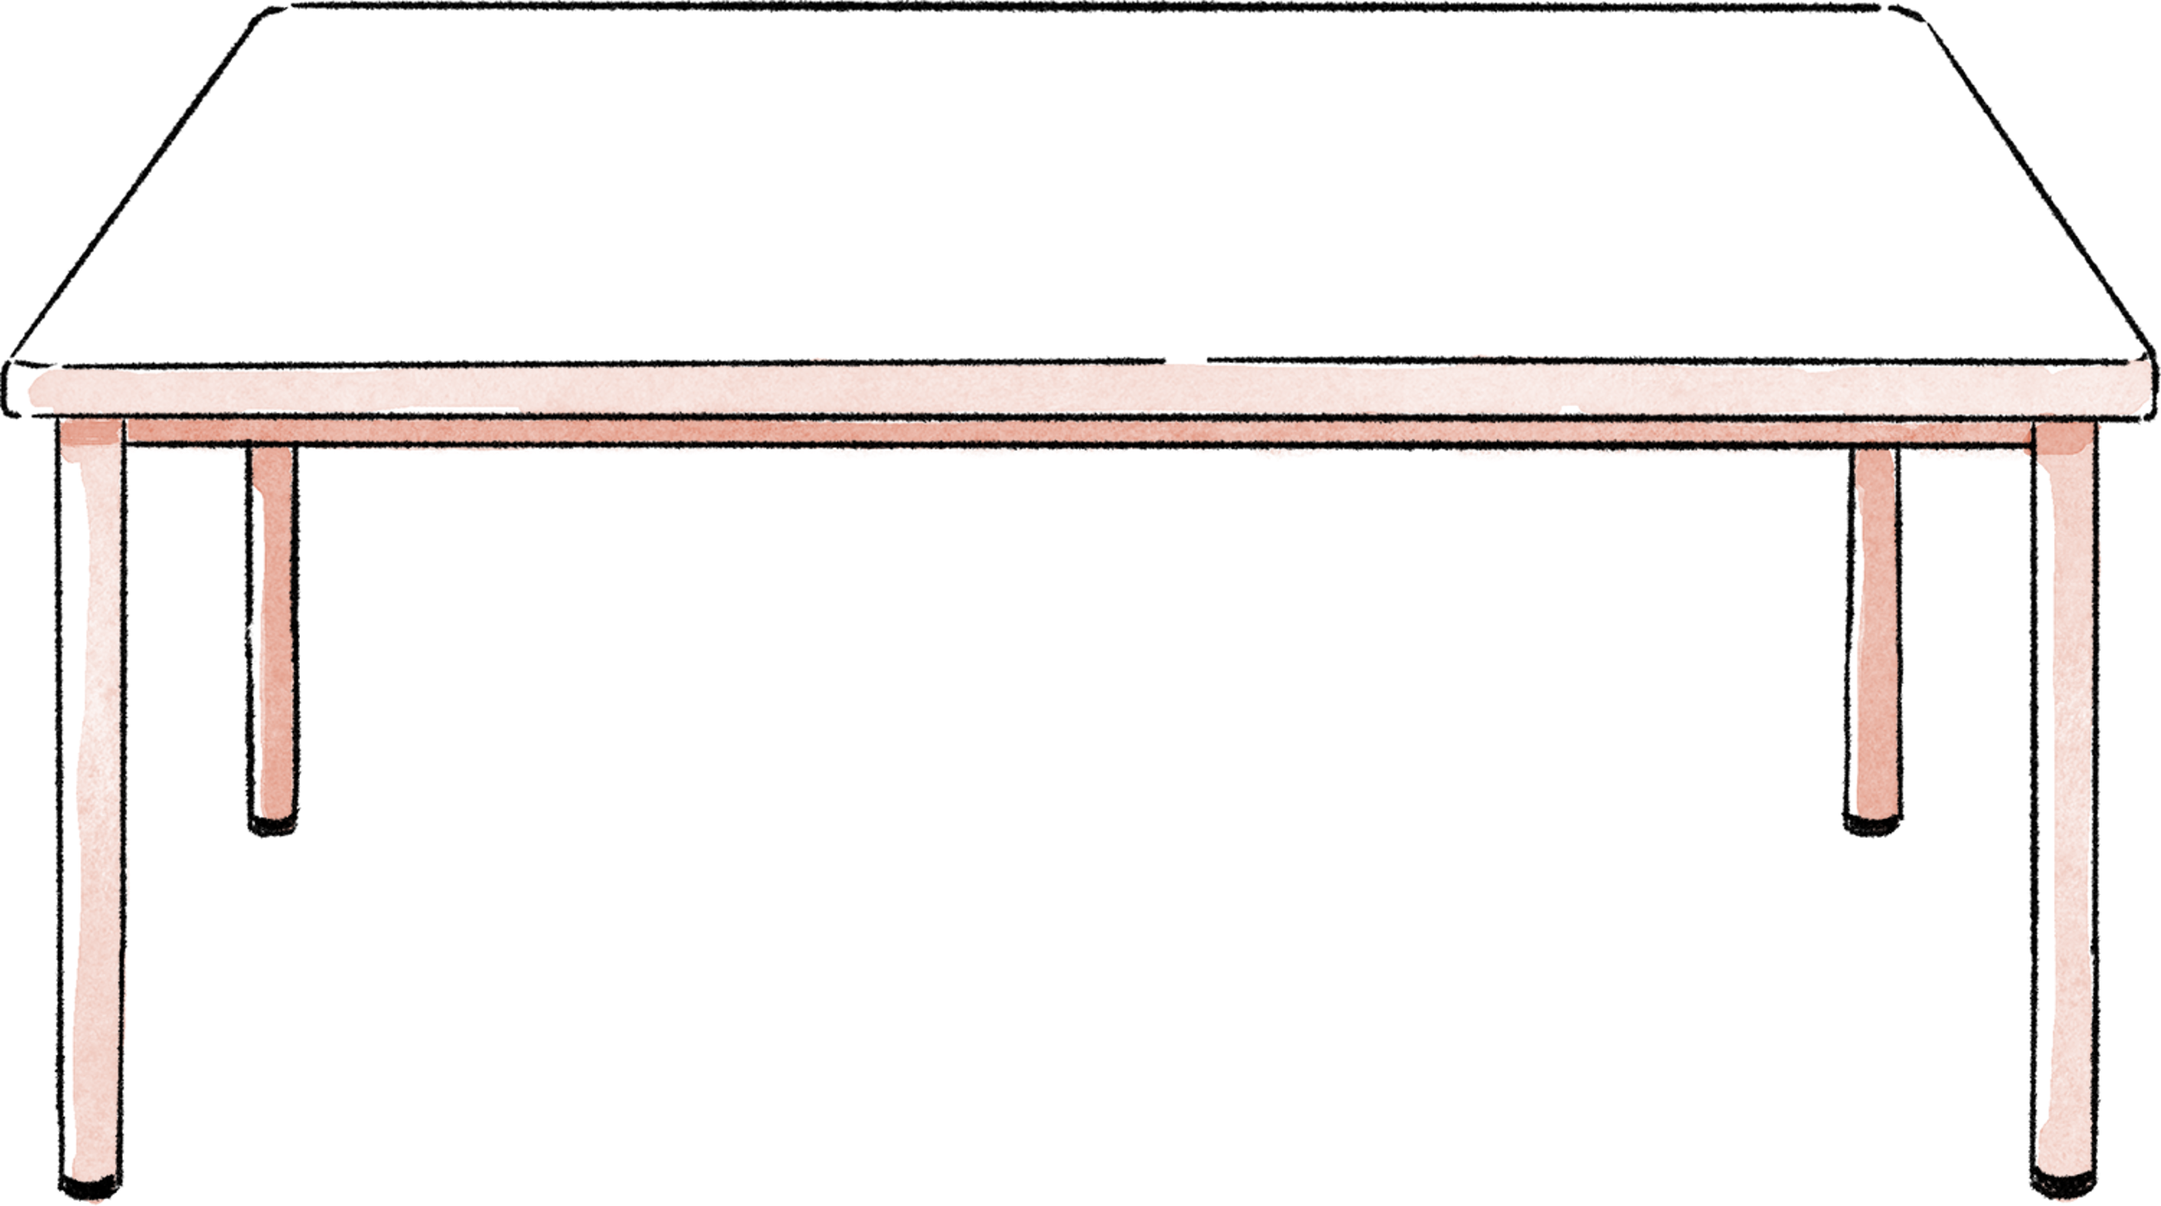

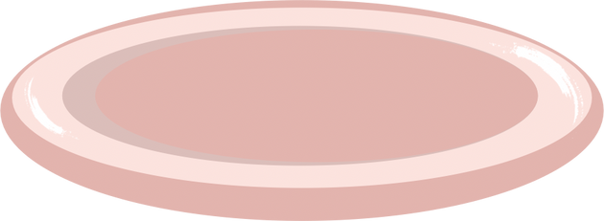


To reduce the size, amount or number of something.
A. expand
B. cut down on
C. develop

Slide 29
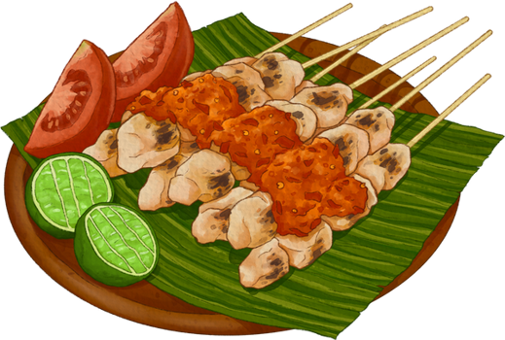
What is the main topic of the TV programme?
A. How to start an exercise routine for teens.
B. Why teenagers should avoid skincare products.
C. How teenagers can eat healthily to improve their health.

Slide 30
A skin condition, common among young people, that produces many pimples (= spots), especially on the face and neck.
A. allergy
B. acne
C. rash

Slide 31
According to Katherine, which of the following is NOT good for your skin?
A. sugary drinks
B. yoghurt
C. watermelon

Slide 32
Rice that is light brown because it has not had all of its outside part removed.
A. white rice
B. brown rice
C. fried rice

Slide 33
Which benefit of green vegetables is mentioned in the interview?
A. They support brain health and memory.
B. They improve skin colour.
C. They help with weight loss.

Slide 34
The state of being physically healthy and strong.
A. illness
B. fitness
C. weakness

Slide 35
Why does Katherine mention eggs, fish, and sweet potatoes?
A. They help teenagers sleep better.
B. They are good alternatives to meat.
C. They help teenagers grow taller and stronger.

Slide 36





Slide 37
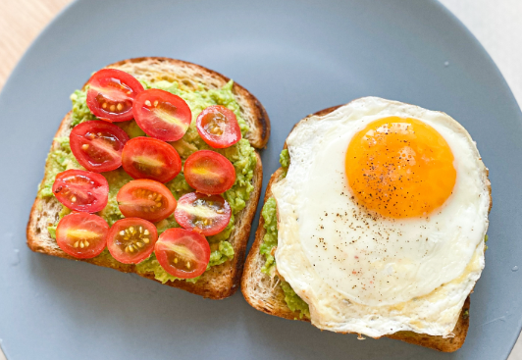
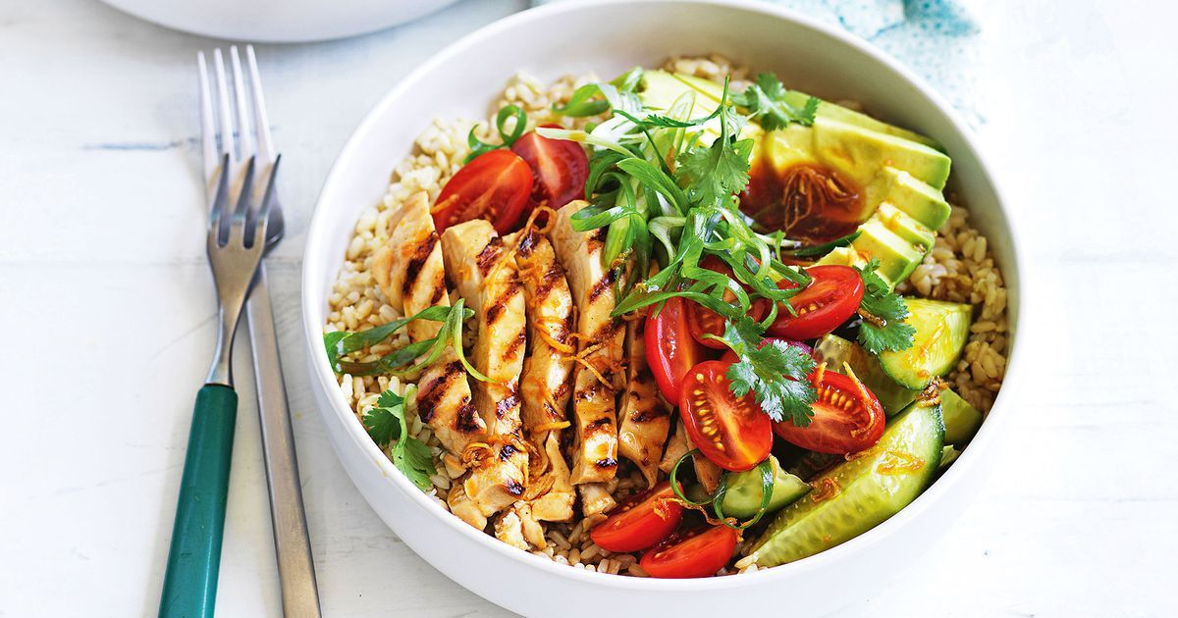
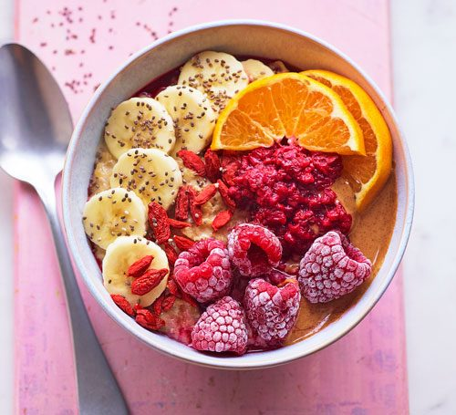
POST-LISTENING
5
Work in groups. Make a healthy meal plan for one day and explain why you have selected the food.

Slide 38
POST-LISTENING
5
Work in groups. Make a healthy meal plan for one day and explain why you have selected the food.
This is a plate with two slices of toasted bread. One slice is topped with mashed avocado and halved cherry tomatoes, while the other has mashed avocado and a sunny-side-up fried egg with some black pepper on top. The food looks fresh and healthy.

Slide 39
POST-LISTENING
5
Work in groups. Make a healthy meal plan for one day and explain why you have selected the food.
This is a colorful bowl of healthy breakfast. It contains sliced bananas, frozen raspberries, orange slices, and some red berries. There is also a sprinkle of chia seeds on top.

Slide 40
POST-LISTENING
5
Work in groups. Make a healthy meal plan for one day and explain why you have selected the food.
This is a healthy meal served in a white bowl. It contains grilled chicken slices, cherry tomatoes, avocado, cucumber, and brown rice. Fresh herbs and green onions are used as garnish.

Slide 41
CONSOLIDATION
1
Wrap-up
What have you learnt today?
Healthy food for teenagers
Listening for main ideas and specific information

Slide 42
CONSOLIDATION
2
Homework
Do exercises in the workbook.
Prepare for Lesson 6 - Unit 1.

Slide 43
THANK YOU

