Slide 2
Unit 3
GREEN LIVING
LESSON I
GETTING STARTED
Green Classroom Competition

Slide 3
LESSON I
GETTING STARTED
WARM-UP
Guessing
PRESENTATION
Vocabulary
Task 1: Listen and read.
Task 2: Read and tick
Task 3: Match each word with its definition.
Task 4: Complete the sentences.
PRACTICE
PRODUCTION
GW: making mind map
CONSOLIDATION
Wrap-up
Homework

Slide 4
WARM-UP

Slide 5


PRESENTATION
awareness
/əˈweənəs/
knowledge or understanding of a particular subject or situation

Slide 6

PRESENTATION
decompose
/ˌdiːkəmˈpəʊz/
decay or make something decay

Slide 7

PRESENTATION
reusable
/ˌriːˈjuː.zə.bəl /
able to be used more than once

Slide 8

PRESENTATION
carbon footprint
/ ˌkɑː.bən ˈfʊt.prɪnt /
a measurement of the amount of carbon dioxide that human activities produce

Slide 9
PRESENTATION
Form | Pronunciation | Meaning | Vietnamese equivalent
1. awareness | /əˈweənəs/ | knowledge or understanding of a particular subject or situation | Nhận thức
2. decompose | /ˌdiːkəmˈpəʊz/ | decay or make something decay | Phân hủy
3. reusable | /ˌriːˈjuː.zə.bəl / | able to be used more than once | Có thể tái sử dụng
4. Carbon footprint | / ˌkɑː.bən ˈfʊt.prɪnt / | a measurement of the amount of carbon dioxide that human activities produce | Lượng khí thải carbon

Slide 10
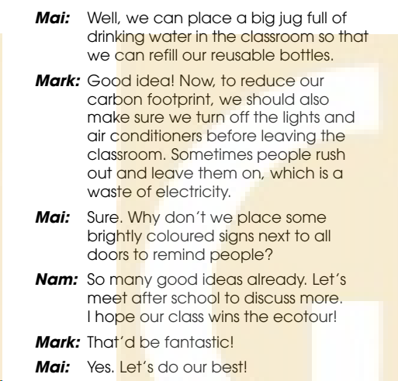
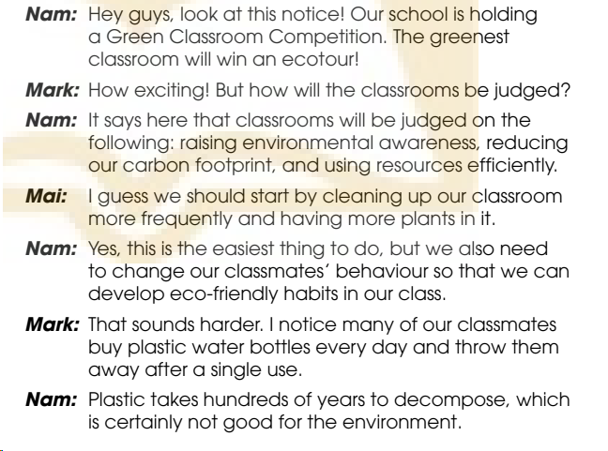
PRACTICE
1
Listen and read.

Slide 11
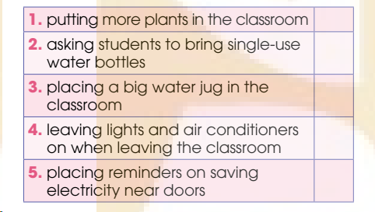
PRODUCTION
2
Read the conversation again and tick (✔) the green ideas mentioned in 1.
✔
✔
✔

Slide 12
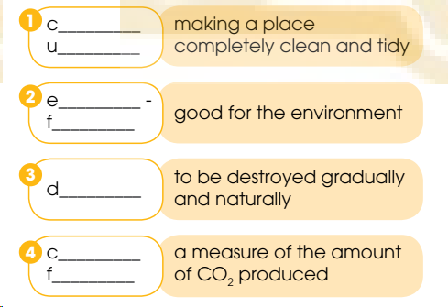
PRODUCTION
Find words and phrases in 1 with the following meanings.
3
lean
p
co
riendly
ecompose
arbon
ootprint

Slide 13
PRODUCTION
4
Complete the sentences with words from 1.
1. Many students throw (1) _________ plastic water bottles after a single use, (2) _________ is not good for the environment.
2. We need to turn (3) _________ the lights and air conditioners before leaving the classroom.
3. Some students leave them (4) _________ when they rush out, (5) _________ is a waste of electricity.
away
which
off
on
which

Slide 14
CONSOLIDATION
1
Wrap-up
What have you learnt today?
Some lexical items about green living
Reading for specific information
Verbs with prepositions

Slide 15
CONSOLIDATION
2
Homework
Do exercises in the workbook.
Make a mind map about ways to protect environment.
Prepare materials for the project in Lesson 8.

Slide 16
Website: hoclieu.vn
Fanpage: facebook.com/www.tienganhglobalsuccess.vn

