Slide 1
Unit 1
A long and healthy life

Slide 2
WARM UP

Slide 3


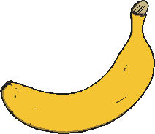

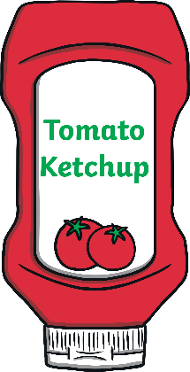
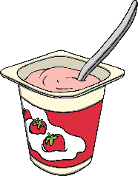
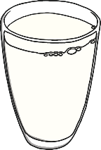
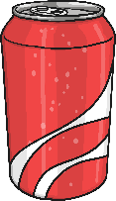
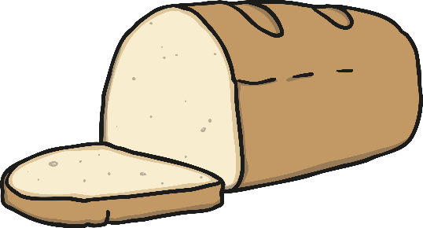
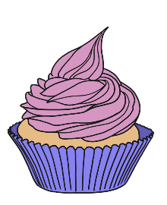
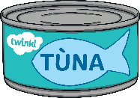

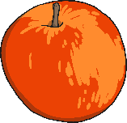

To help our bodies and minds stay healthy and well, we can eat a balance of lots of different types of foods. It is very important to keep our body hydrated with lots of water as well.
Look at all the foods here. Can you talk about how they taste and how they make your body feel when you eat them?

Slide 4

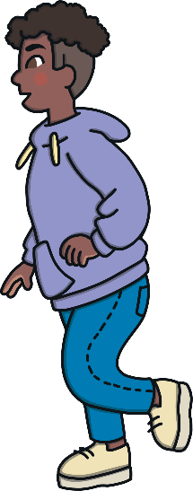
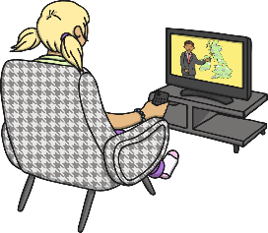
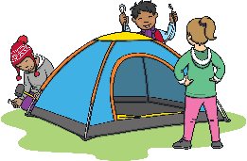
Look at the activities here. Talk to your partner about how your body and mind feel when you enjoy these different activities.
As well as getting a balance of different types of food, it is important that we do lots of different activities to help our bodies and minds stay healthy and well.

Slide 5
How will you do each of these?
Enjoy lots of physical activity.
Eat a healthy balance of different foods.
Talk about or express how you are feeling.
Make time to rest and relax.
Spend time with people you care about.
Drink lots of water.
There are lots of ways we can keep our bodies and minds healthy and well.
Spend time focusing on a new skill or hobby.

Slide 6
LESSON 1 : GETTING STARTED
A healthy lifestyle

Slide 7
LESSON 1 : GETTING STARTED
WARM-UP
GAME: Warm Up
PRESENTATION
Vocabulary
Role-play
PRACTICE
Task 1: Listen and read.
Task 2: True or False.
Task 3: Fill in the blanks to make phrases.
Task 4: Complete the text.
PRODUCTION
CONSOLIDATION
Wrap-up
Homework

Slide 8
VOCABULARY

Slide 9

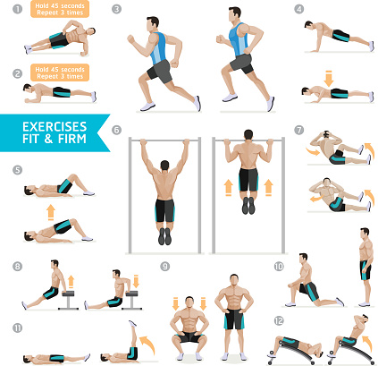
PRESENTATION
(to) work out
/wɜːk aʊt/
Tập luyện
to exercise in order to improve the
strength or appearance of your body

Slide 10
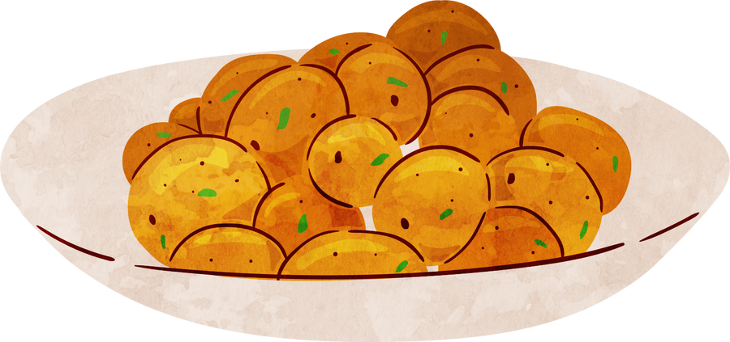
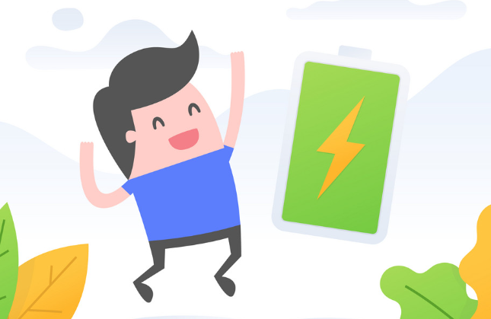
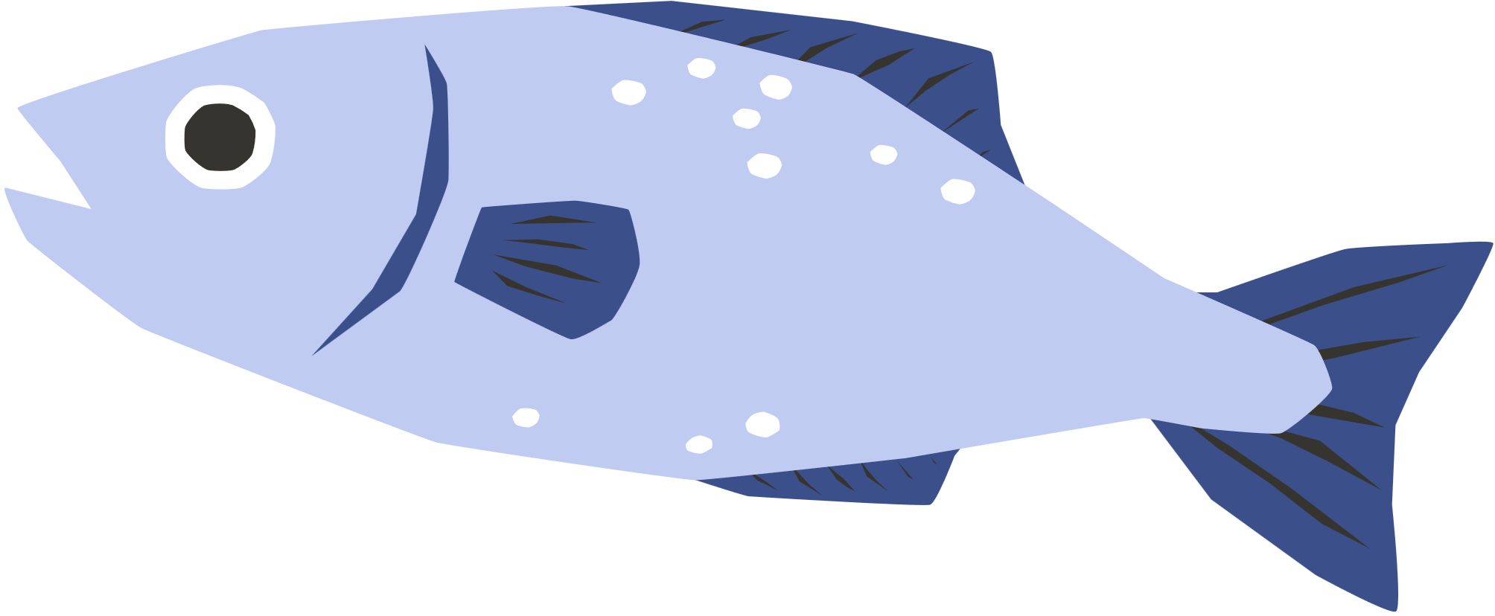
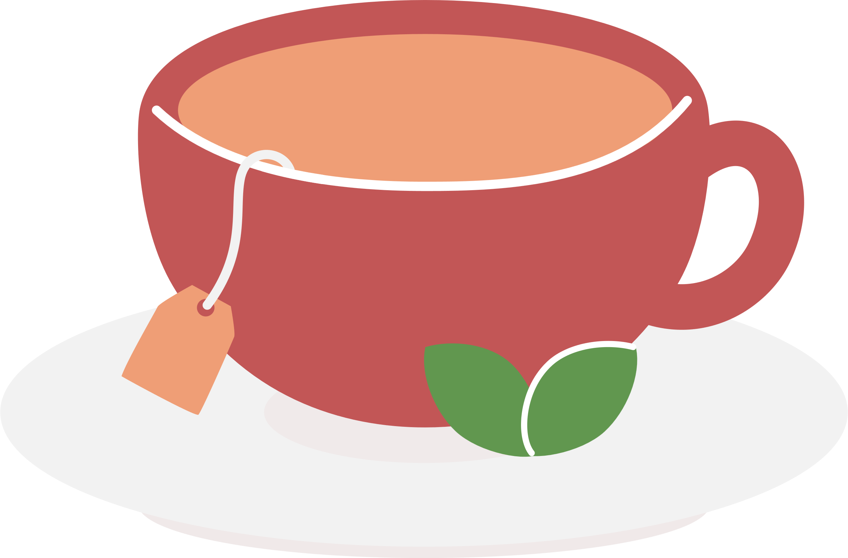


PRESENTATION
(be) full of
/fʊl əv/
Tràn đầy
containing a lot of something
E.g: You're always so full of energy.

Slide 11
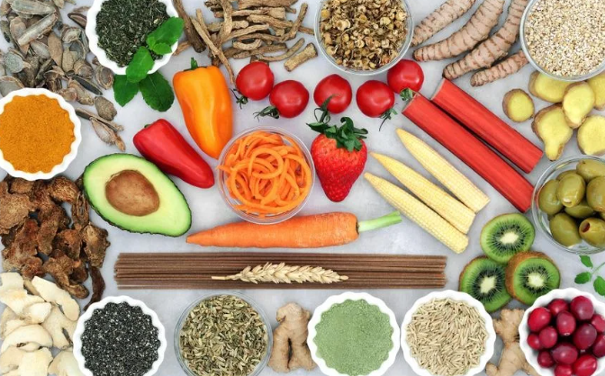
PRESENTATION
diet (n)
/ˈdaɪət/
Chế độ ăn uống
the food and drink usually eaten or
drunk by a person or group

Slide 12

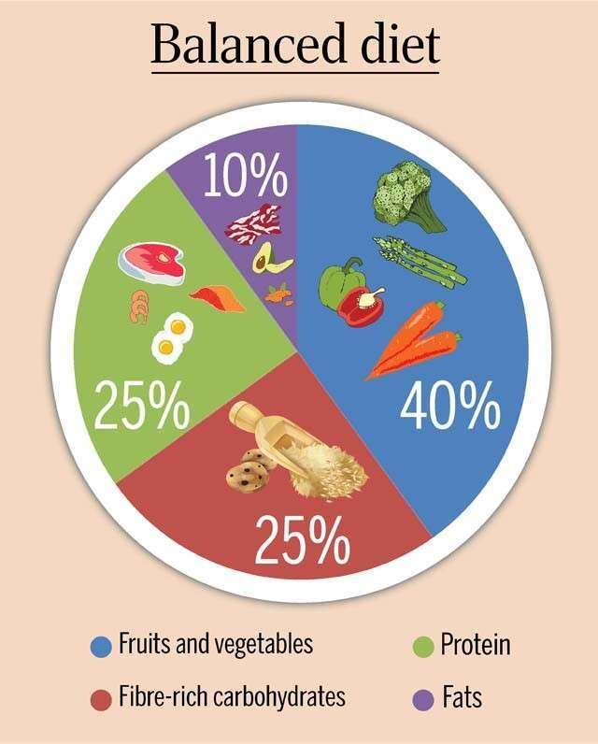

PRESENTATION
balanced (adj)
/ˈbælənst/
Cân bằng
A balanced diet is a combination of the correct types and amounts of food

Slide 13
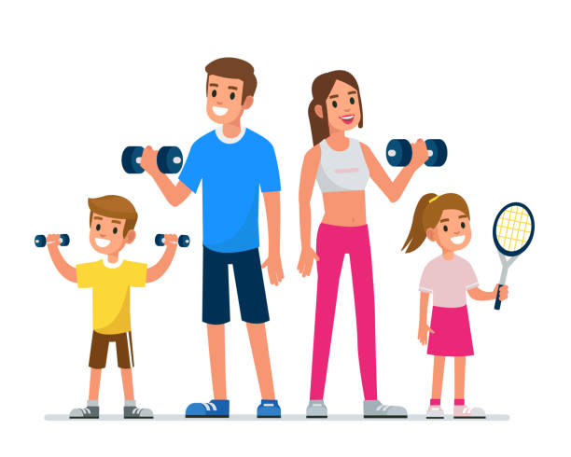
PRESENTATION
fit (adj)
/fɪt/
Cân đối
healthy and strong, especially as a result of exercise

Slide 14

PRESENTATION
Form | Pronunciation | Meaning | Vietnamese equivalent
1. (to) work out | /wɜːk aʊt/ | to exercise in order to improve the strength or appearance of your body | Tập luyện
2. (be) full of | /fʊl əv/ | containing a lot of something | Tràn đầy
3. diet (n) | /ˈdaɪ.ət/ | the food and drink usually eaten or drunk by a person or group | Chế độ ăn uống
4. balanced (adj) | /ˈbælənst/ | A balanced diet is a combination of the correct types and amounts of food. | Cân bằng
5. fit (adj) | /fɪt/ | healthy and strong, especially as a result of exercise | Cân đối

Slide 15
REVIEW
VOCABULARY

Slide 16
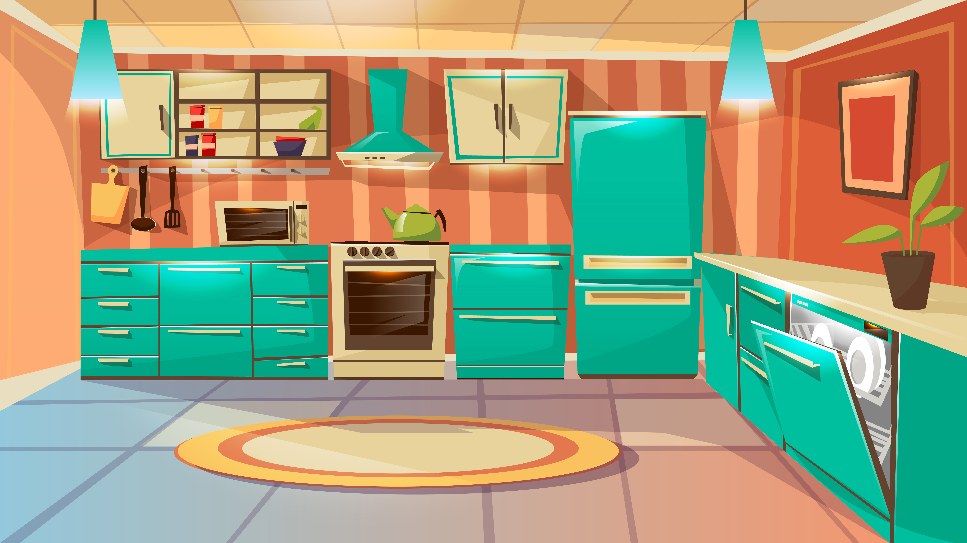
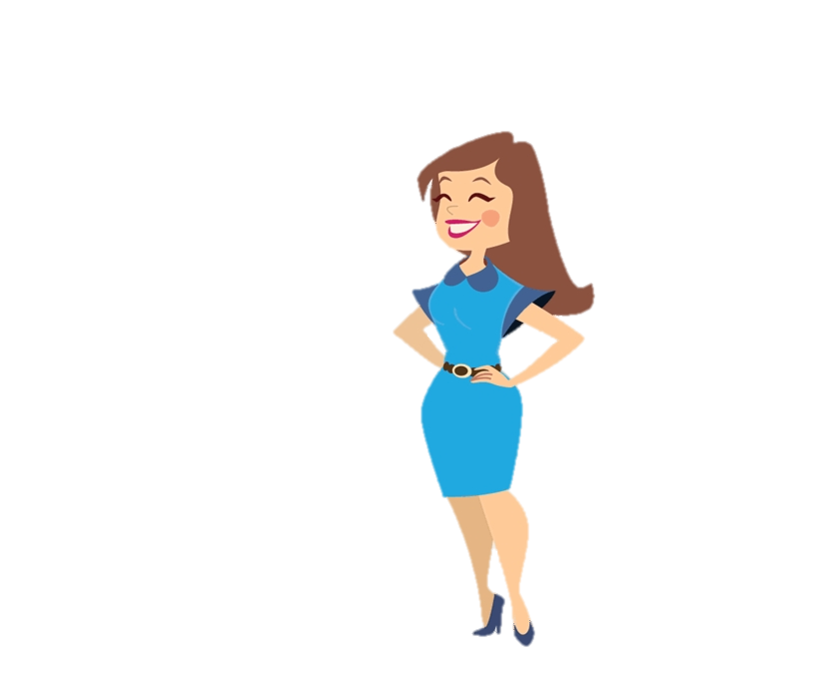
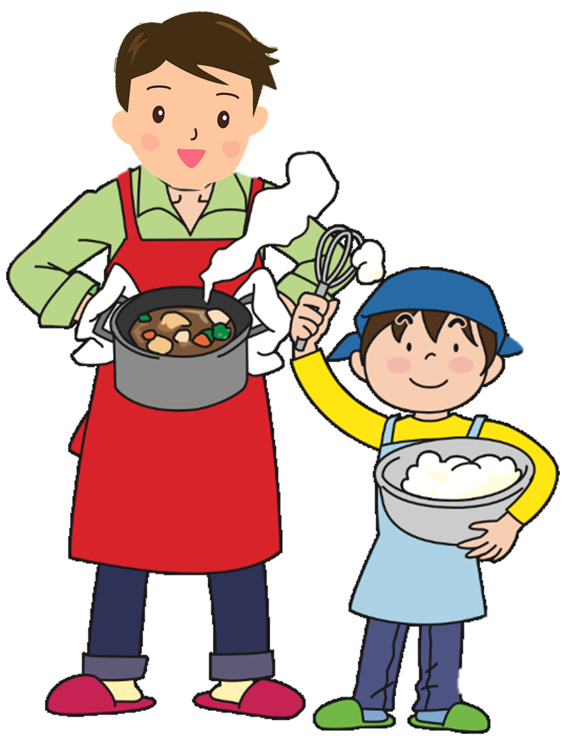



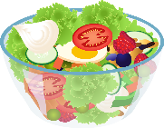
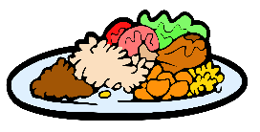

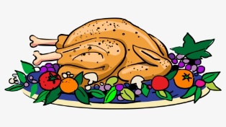

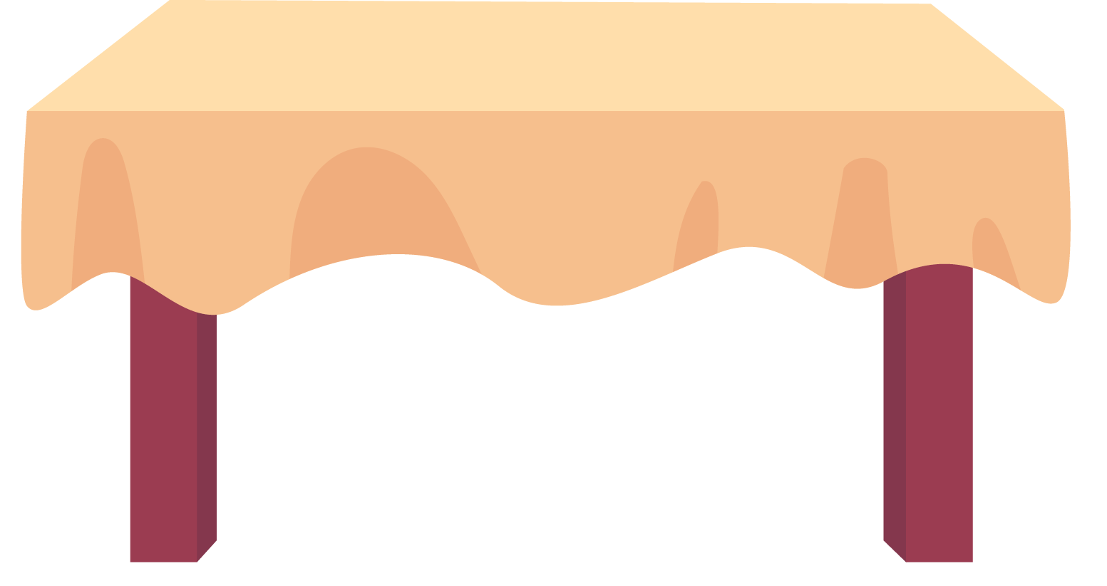


A SURPRISED DINNER

Slide 17
Let’s prepare a surprised dinner for your mom on the twentieth of October.
Yes, daddy.

Slide 18






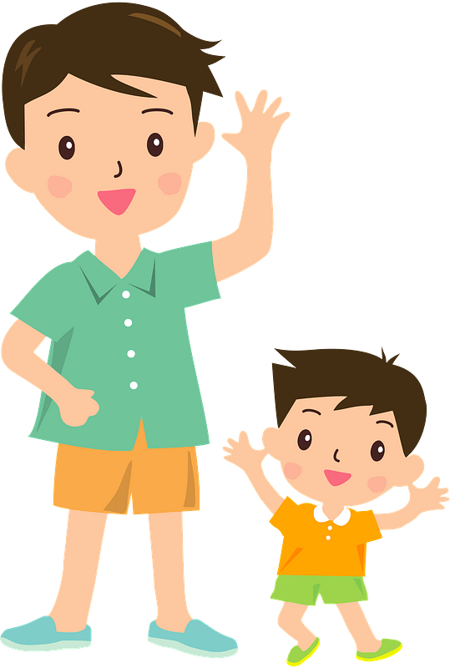

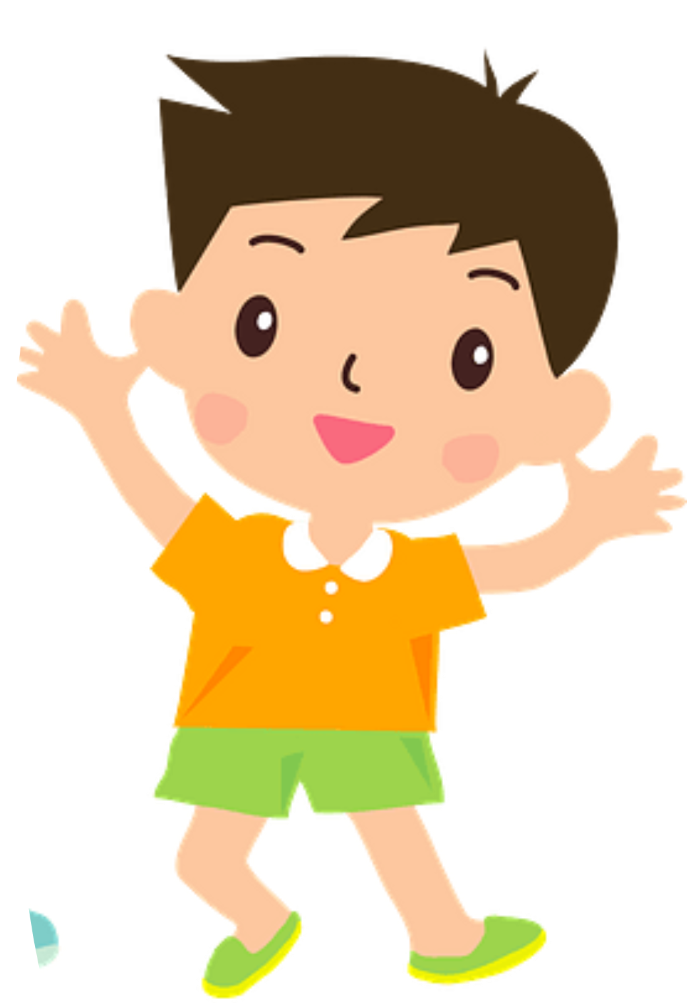

Happy Vietnam women's day ❤

Slide 19




To do exercises to make your body strong and healthy
A. diet
B. work out
C. fit
D. full of

Slide 20
To have a lot of something inside
A. diet
B. work out
C. balanced
D. full of

Slide 21
The food that a person usually eats
A. full of
B. balanced
C. diet
D. fit

Slide 22
Having the right mix of things (not too much, not too little)
A. balanced
B. full of
C. work out
D. fit

Slide 23
Strong and healthy because of regular exercise
A. diet
B. fit
C. work out
D. full of

Slide 24
READING

Slide 25
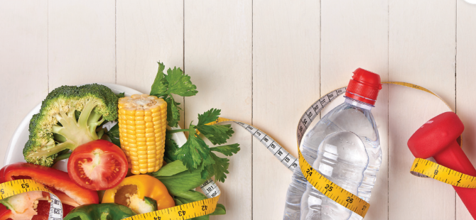
PRESENTATION
1
Listen and read.

Slide 26
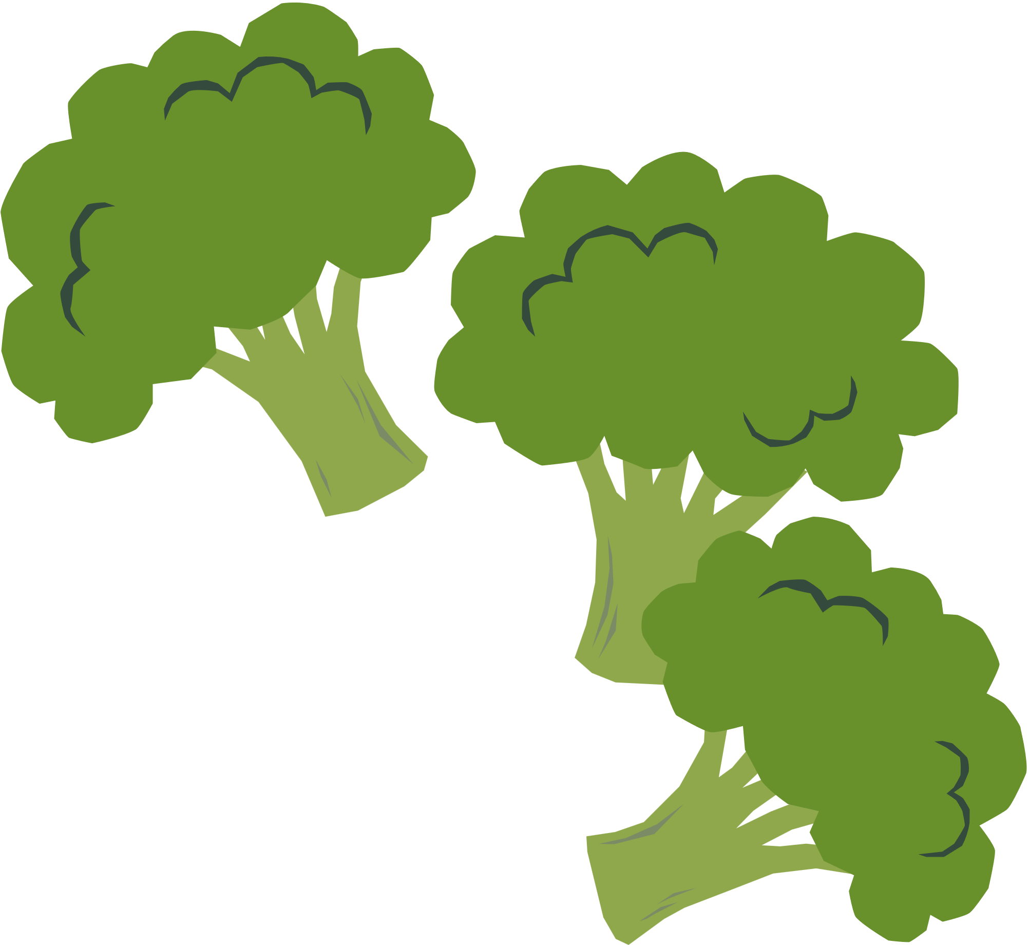
PRESENTATION
1
Listen and read.
Mark: Hi, Nam!
Nam: Hi, Mark! Long time no see. How are you?
Mark: I'm fine, thanks, but you look so fit and healthy! Have you started working out again?
Nam: Yes, I have. I've also stopped eating fast food and given up bad habits, such as staying up late.
Mark: I can't believe it! I thought you can't live without burgers and chips!
Nam: I know. I ate a lot of fast food, but now I prefer fresh fruits and vegetables.
Mark: So what happened?
Nam: Well, it was my grandfather. I visited him during my last summer holiday and have learnt a lot of important life lessons from him.
Mark: Really?
Nam: Yes. He's a wonderful person. He has just had his 90th birthday, but he’s still full of energy!
Mark: Amazing! How does he stay so active?
Nam: Well, he does exercise every morning, goes to bed early, and eats a lot of vegetables. We spent a lot of time together cooking, working in his garden, and walking in the parks. I've learnt from him that taking regular exercise and eating a balanced diet are the key to a long and healthy life.

Slide 27

PRACTICE
NEXT
2
Read the conversation again and decide whether the following statements are true (T) or false (F).
 | T | F
1. Nam has always had healthy habits.
2. He has learnt the importance of exercise and healthy food.
3. Nam’s grandfather goes to sleep early, exercises everyday and eats healthily.
✓
✓
✓

Slide 28
Mark: Hi, Nam!
Nam: Hi, Mark! Long time no see. How are you?
Mark: I'm fine, thanks, but you look so fit and healthy! Have you started working out again?
Nam: Yes, I have. I've also stopped eating fast food and given up bad habits, such as staying up late.
Mark: I can't believe it! I thought you can't live without burgers and chips!
Nam: I know. I ate a lot of fast food, but now I prefer fresh fruits and vegetables.
Mark: So what happened?
Nam: Well, it was my grandfather. I visited him during my last summer holiday and have learnt a lot of important life lessons from him.
Mark: Really?
Nam: Yes. He's a wonderful person. He has just had his 90th birthday, but he’s still full of energy!
Mark: Amazing! How does he stay so active?
Nam: Well, he does exercise every morning, goes to bed early, and eats a lot of vegetables. We spent a lot of time together cooking, working in his garden, and walking in the parks. I've learnt from him that taking regular exercise and eating a balanced diet are the key to a long and healthy life.
BACK

Slide 29
Mark: Hi, Nam!
Nam: Hi, Mark! Long time no see. How are you?
Mark: I'm fine, thanks, but you look so fit and healthy! Have you started working out again?
Nam: Yes, I have. I've also stopped eating fast food and given up bad habits, such as staying up late.
Mark: I can't believe it! I thought you can't live without burgers and chips!
Nam: I know. I ate a lot of fast food, but now I prefer fresh fruits and vegetables.
Mark: So what happened?
Nam: Well, it was my grandfather. I visited him during my last summer holiday and have learnt a lot of important life lessons from him.
Mark: Really?
Nam: Yes. He's a wonderful person. He has just had his 90th birthday, but he’s still full of energy!
Mark: Amazing! How does he stay so active?
Nam: Well, he does exercise every morning, goes to bed early, and eats a lot of vegetables. We spent a lot of time together cooking, working in his garden, and walking in the parks. I've learnt from him that taking regular exercise and eating a balanced diet are the key to a long and healthy life.
BACK

Slide 30
Mark: Hi, Nam!
Nam: Hi, Mark! Long time no see. How are you?
Mark: I'm fine, thanks, but you look so fit and healthy! Have you started working out again?
Nam: Yes, I have. I've also stopped eating fast food and given up bad habits, such as staying up late.
Mark: I can't believe it! I thought you can't live without burgers and chips!
Nam: I know. I ate a lot of fast food, but now I prefer fresh fruits and vegetables.
Mark: So what happened?
Nam: Well, it was my grandfather. I visited him during my last summer holiday and have learnt a lot of important life lessons from him.
Mark: Really?
Nam: Yes. He's a wonderful person. He has just had his 90th birthday, but he’s still full of energy!
Mark: Amazing! How does he stay so active?
Nam: Well, he does exercise every morning, goes to bed early, and eats a lot of vegetables. We spent a lot of time together cooking, working in his garden, and walking in the parks. I've learnt from him that taking regular exercise and eating a balanced diet are the key to a long and healthy life.
BACK

Slide 31
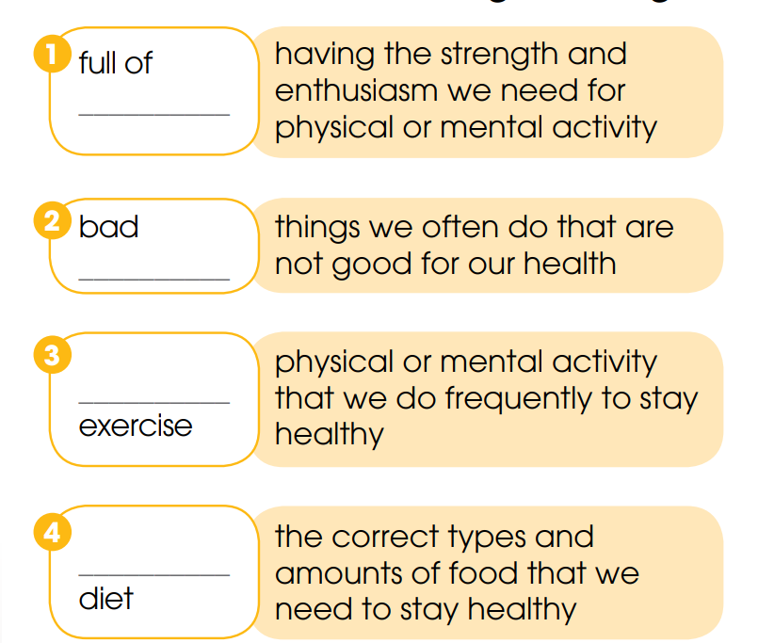
PRACTICE
3
Fill in the blanks to make phrases from Task 1 with the following meanings.
energy
habits
regular
balanced

Slide 32
PRACTICE
4
Complete the text based on the conversation in Task 1. Use the correct forms of the verbs in brackets.
In the past, Nam (1. eat) _______ fast food and often stayed up late. But he (2. start) ____________ eating healthy food and (3. give) ____________ up bad habits. He has changed his lifestyle since he (4. visit) _________ his grandfather, who (5. just celebrate) ___________________ his 90th birthday.
ate
has started
(has) given
visited
has just celebrated

Slide 33
REVIEW
READING

Slide 34


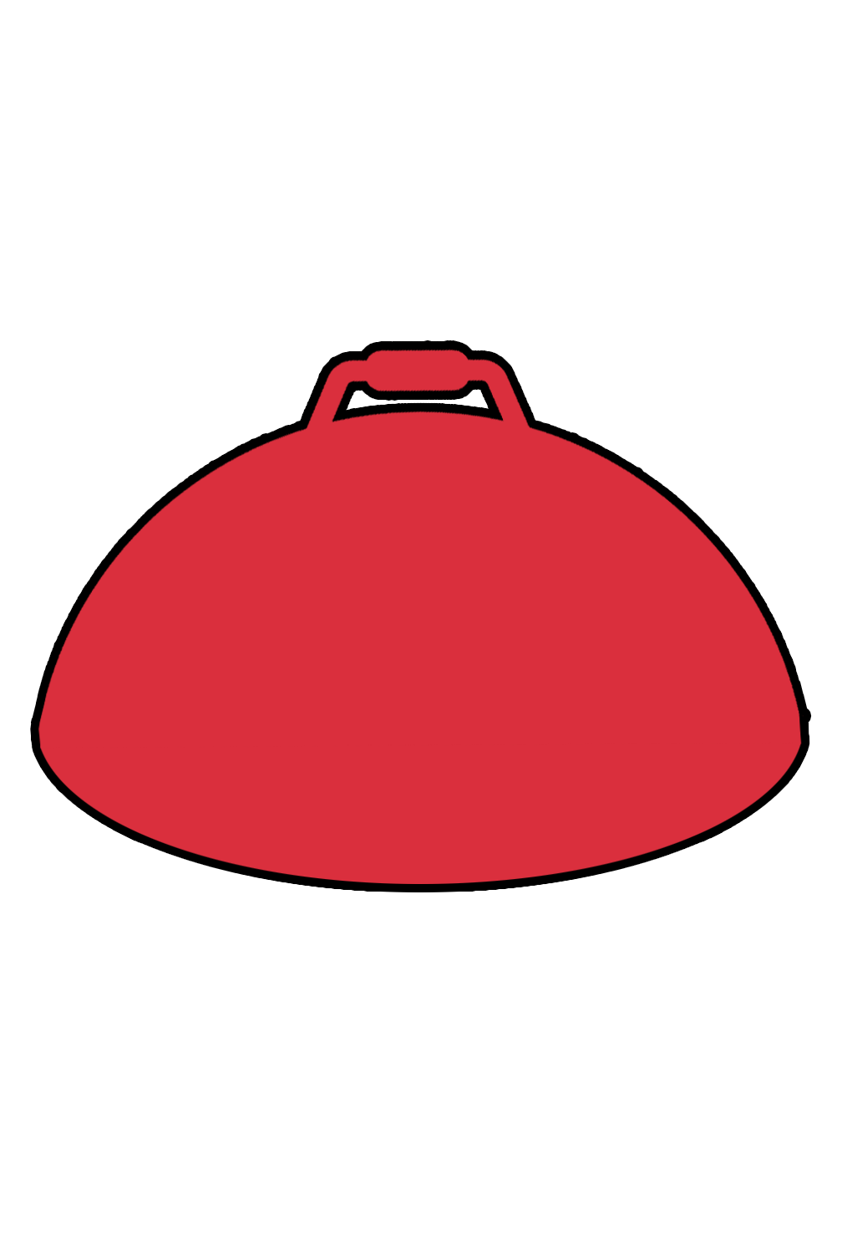
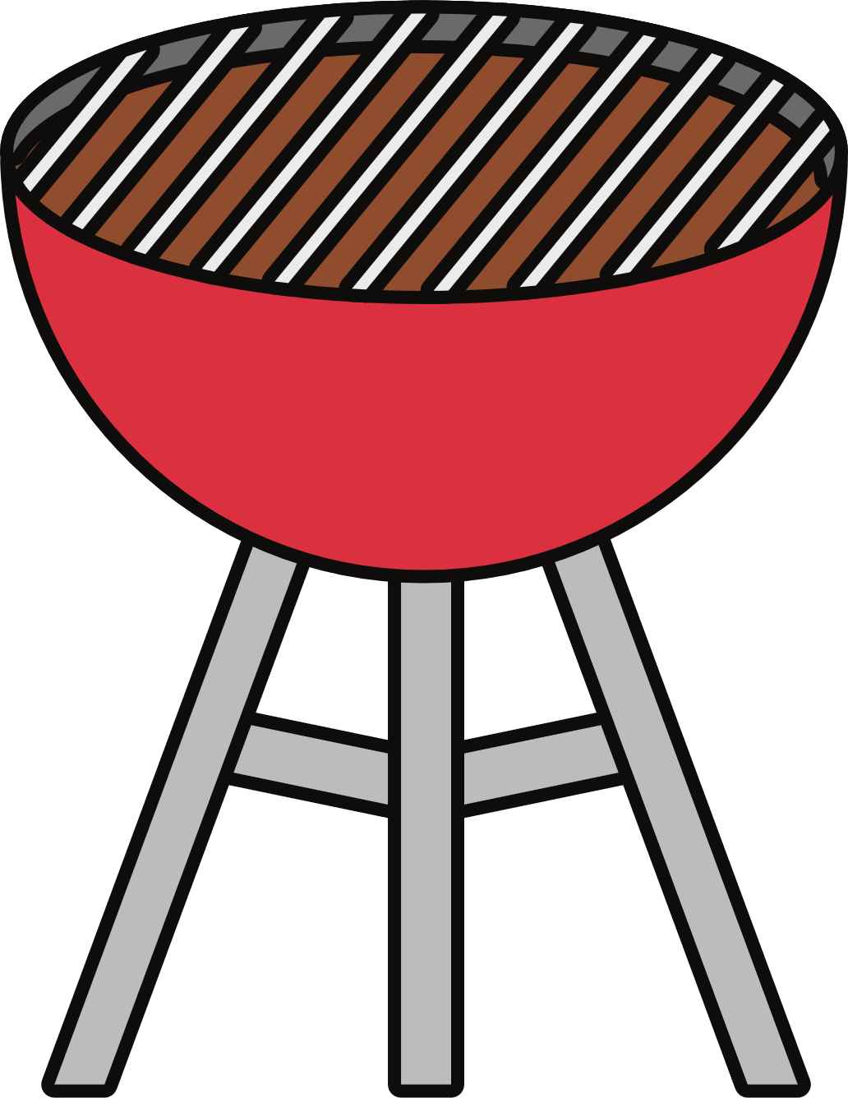
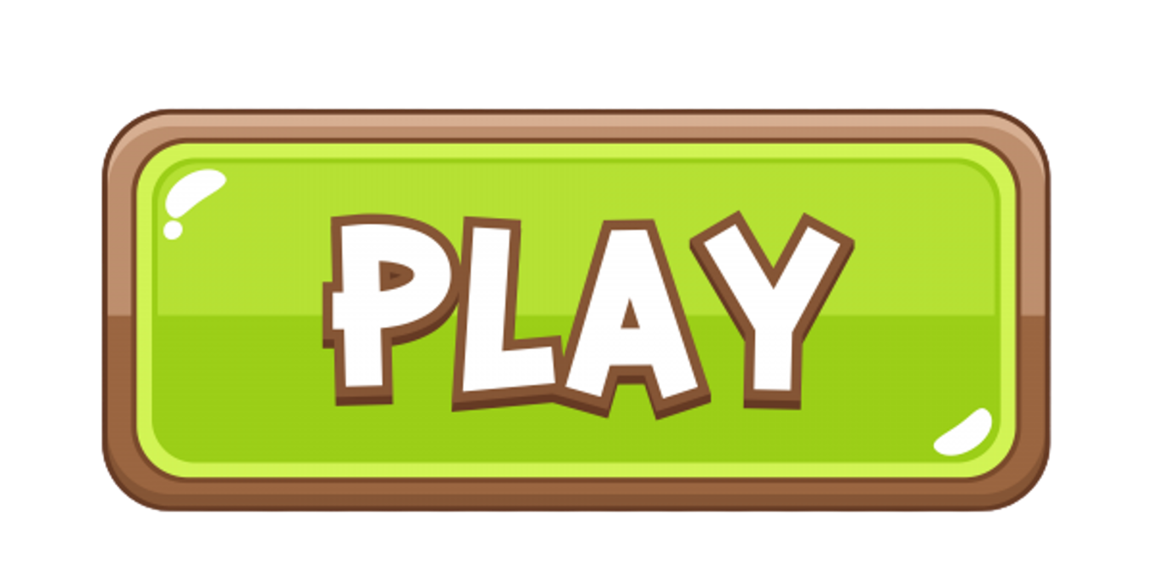
BAKE CAKE!!!

Slide 35

RULE
🎉 Chào mừng bạn đến với trò chơi hôm nay, cùng nhau nướng bánh.
👉 Tham gia bằng cách chọn một câu hỏi bất kỳ và tìm ra đáp án đúng.
🔙 Bấm mũi tên để quay về và hoàn thành món bánh thơm ngon. 🎂
🎮 Chúc các bạn chơi game vui vẻ. 😄✨
🎉 Welcome to today's game: Let's bake together! 🍰
👉 Join in by picking any question and finding the correct answer.
🔙 Tap the arrow to go back and finish making your delicious cake. 🎂
🎮 Have fun playing the game! 😄✨

Slide 36
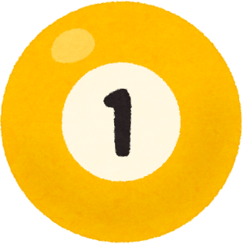
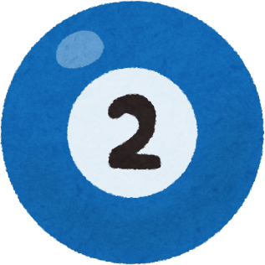
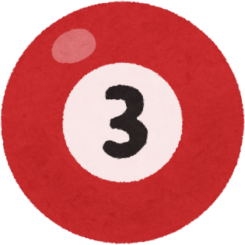
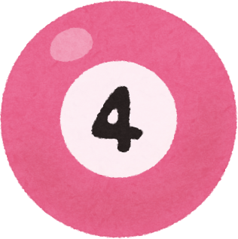
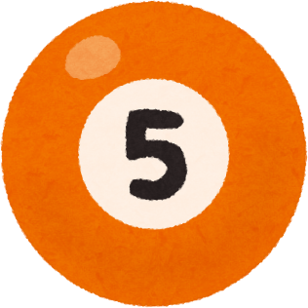
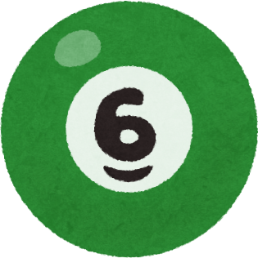

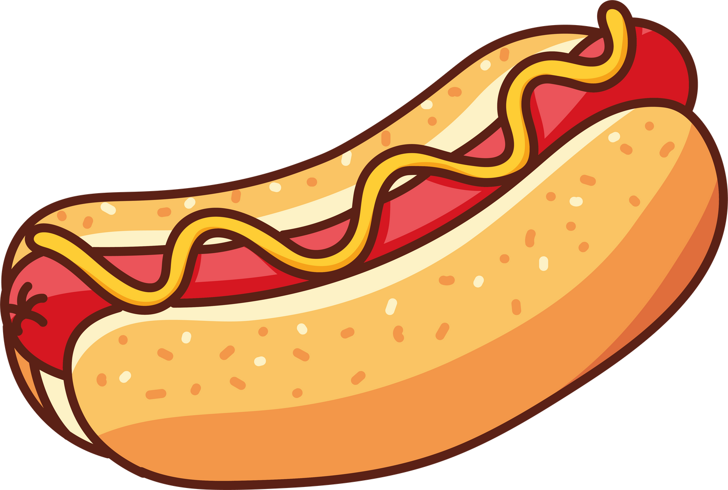
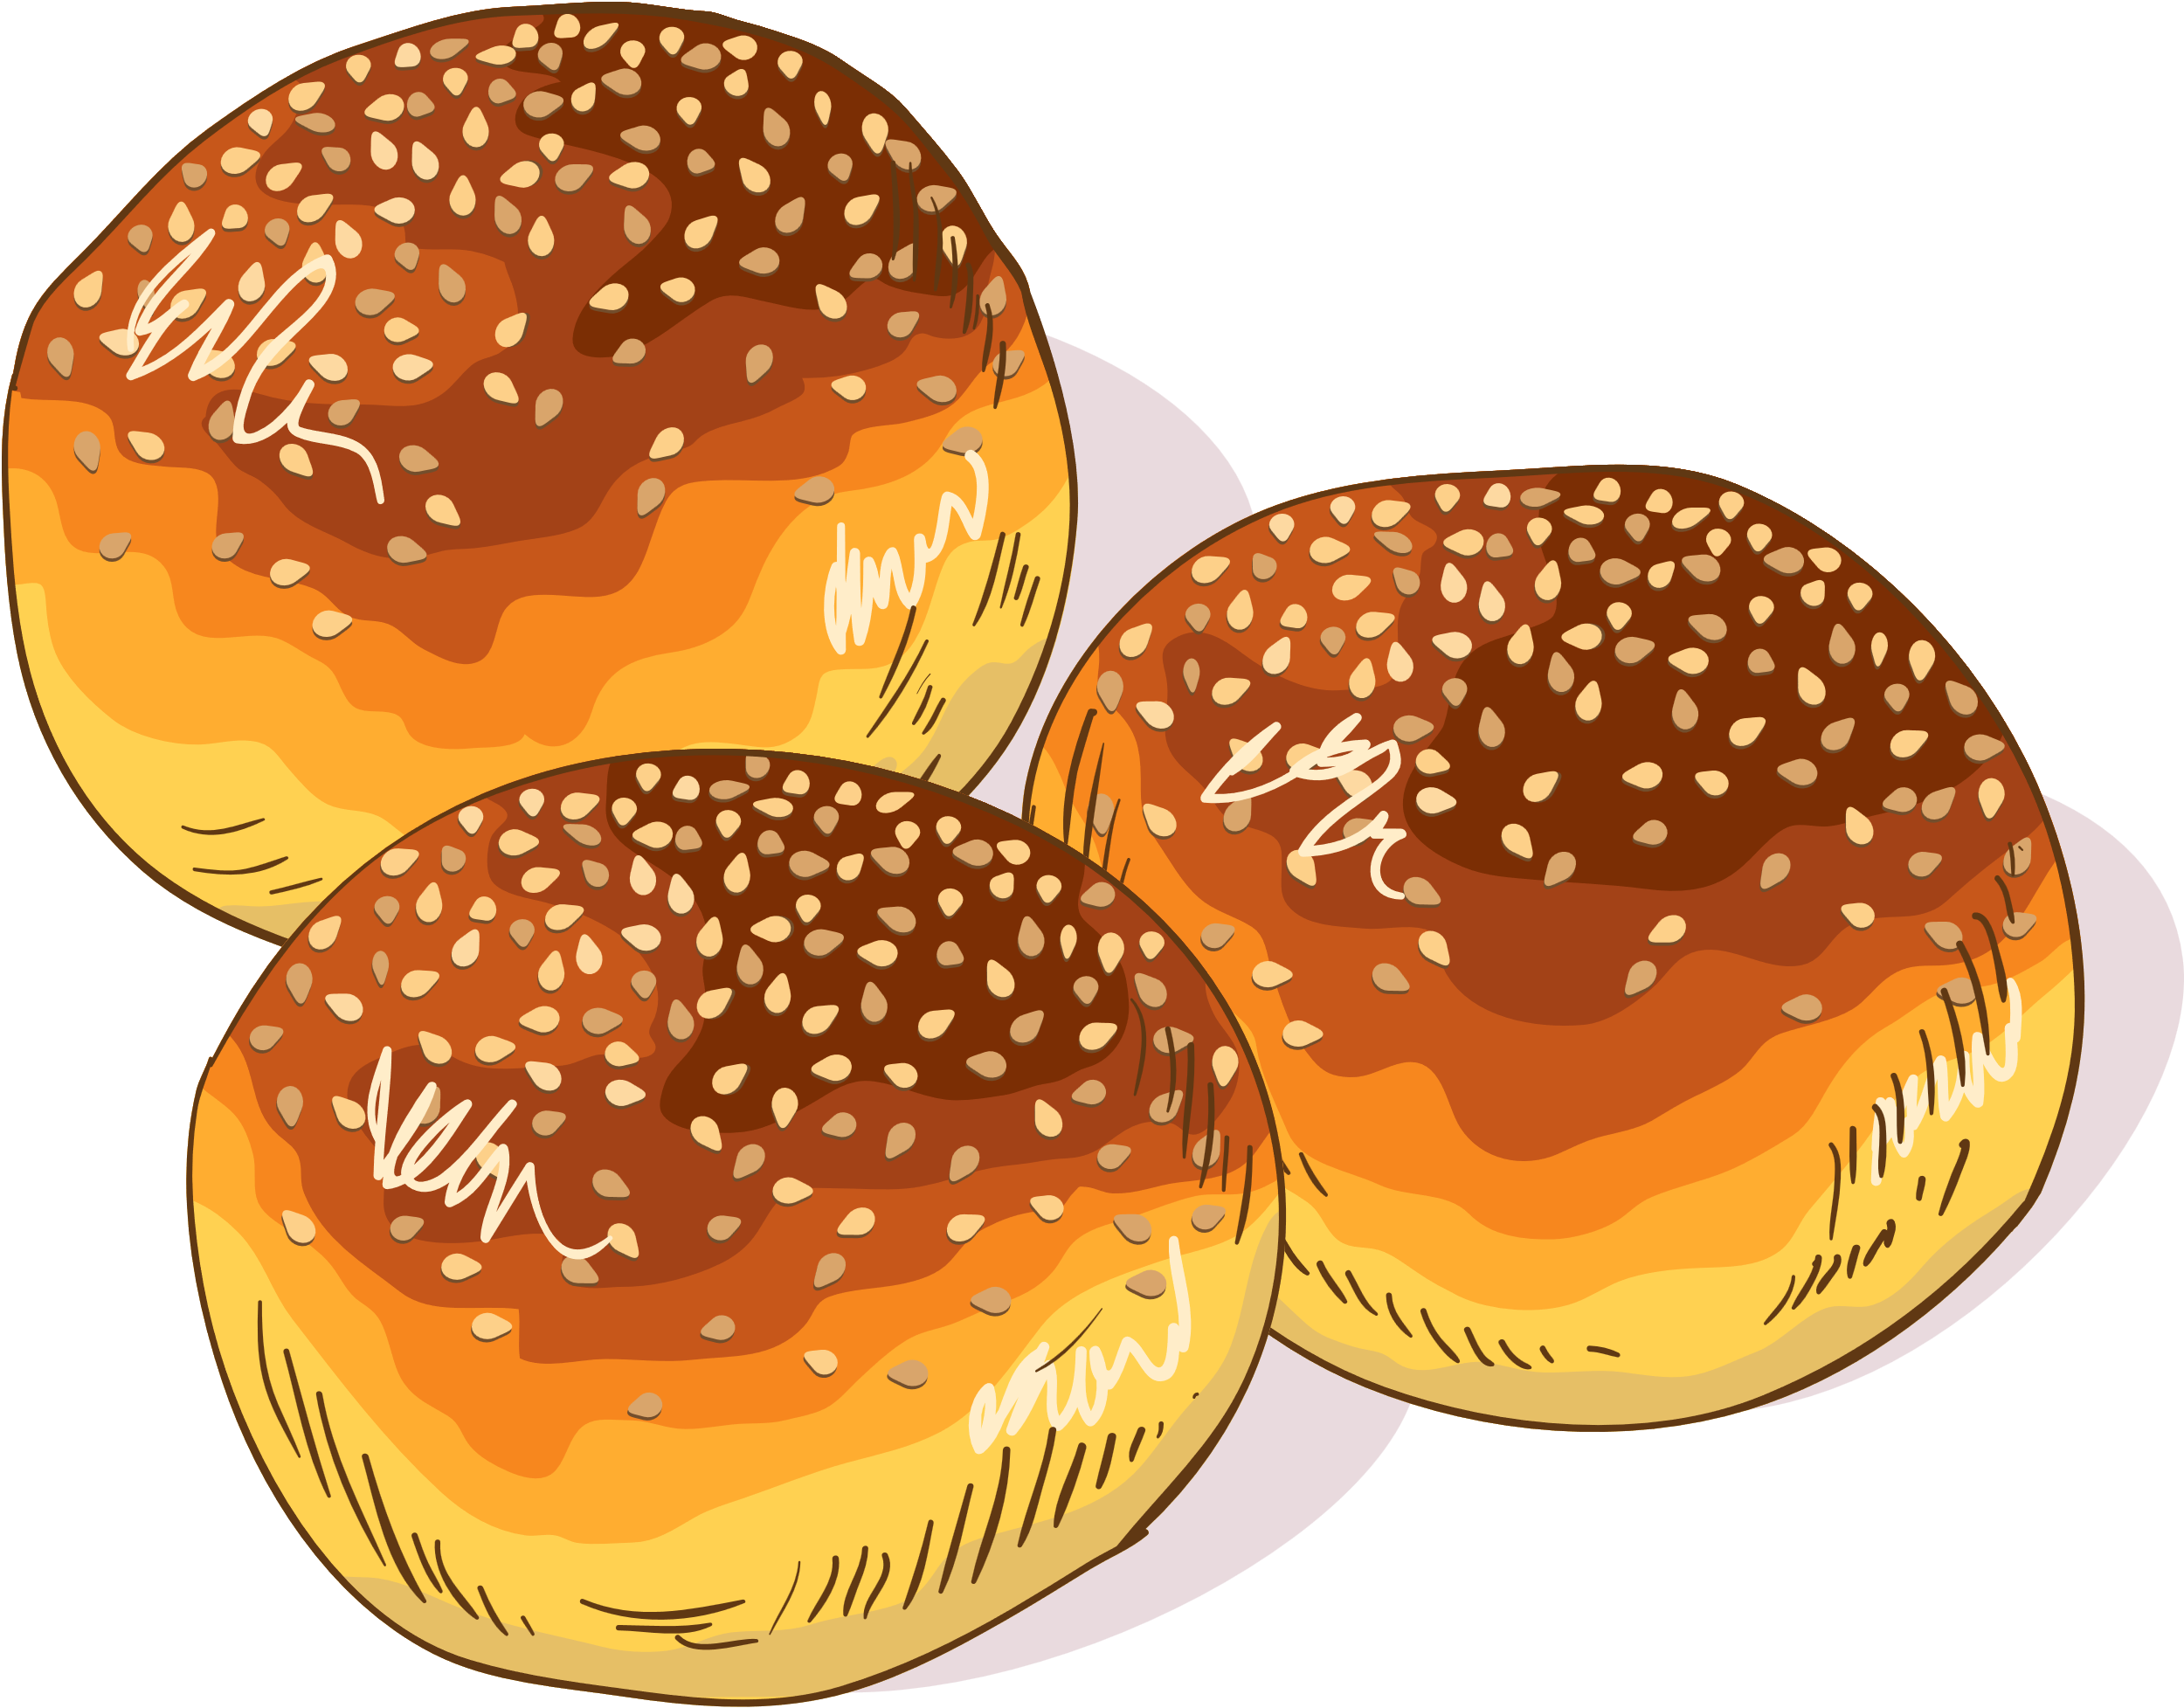

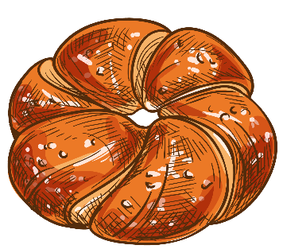
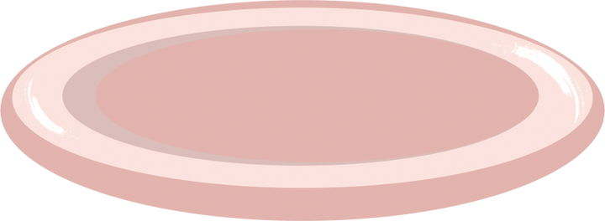
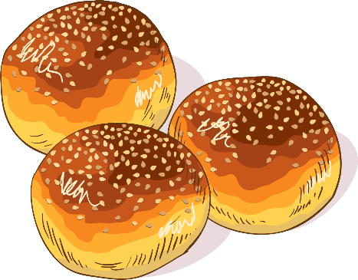

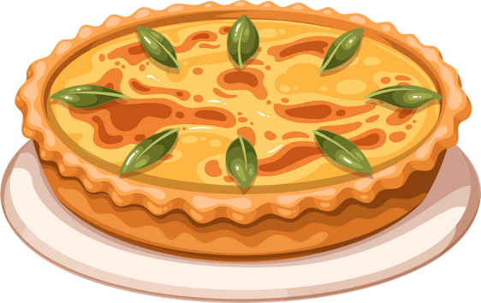
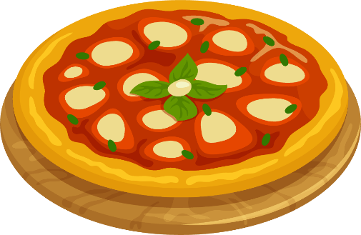
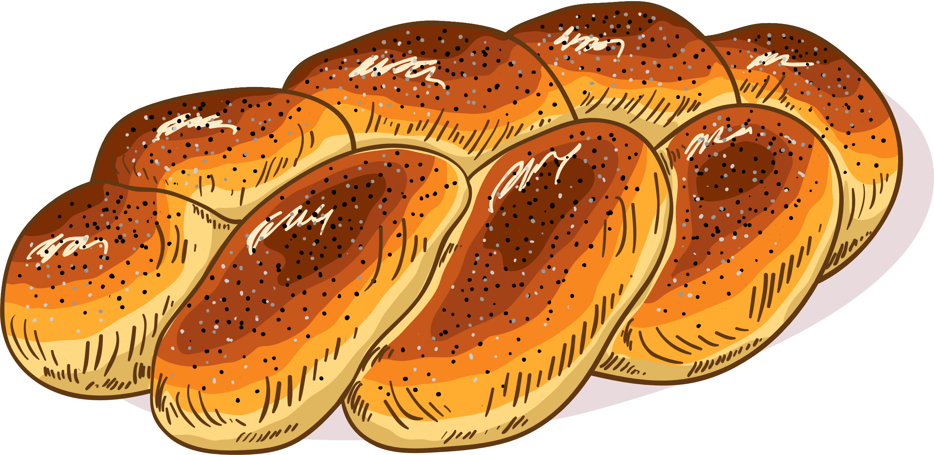




Slide 37


How does Mark feel when he sees Nam?
A. He thinks Nam looks unhealthy.
B. He thinks Nam looks tired.
C. He thinks Nam looks fit and healthy.

Slide 38
What has Nam stopped doing?
A. Working out.
B. Eating fast food and bad habits.
C. Visiting his grandfather.

Slide 39
What did Mark think about Nam’s eating habits before?
A. He thought Nam couldn’t live without burgers and chips.
B. He thought Nam ate only fresh fruits.
C. He thought Nam was a vegetarian.

Slide 40
Who inspired Nam to live healthily?
A. His mother
B. His friend
C. His grandfather

Slide 41
How old is Nam’s grandfather?
A. 70 years old
B. 90 years old
C. 50 years old

Slide 42
What habits help Nam’s grandfather stay healthy?
A. Taking regular exercise and eating a balanced diet.
B. Watching TV every day.
C. Eating fast food and staying up late.

Slide 43
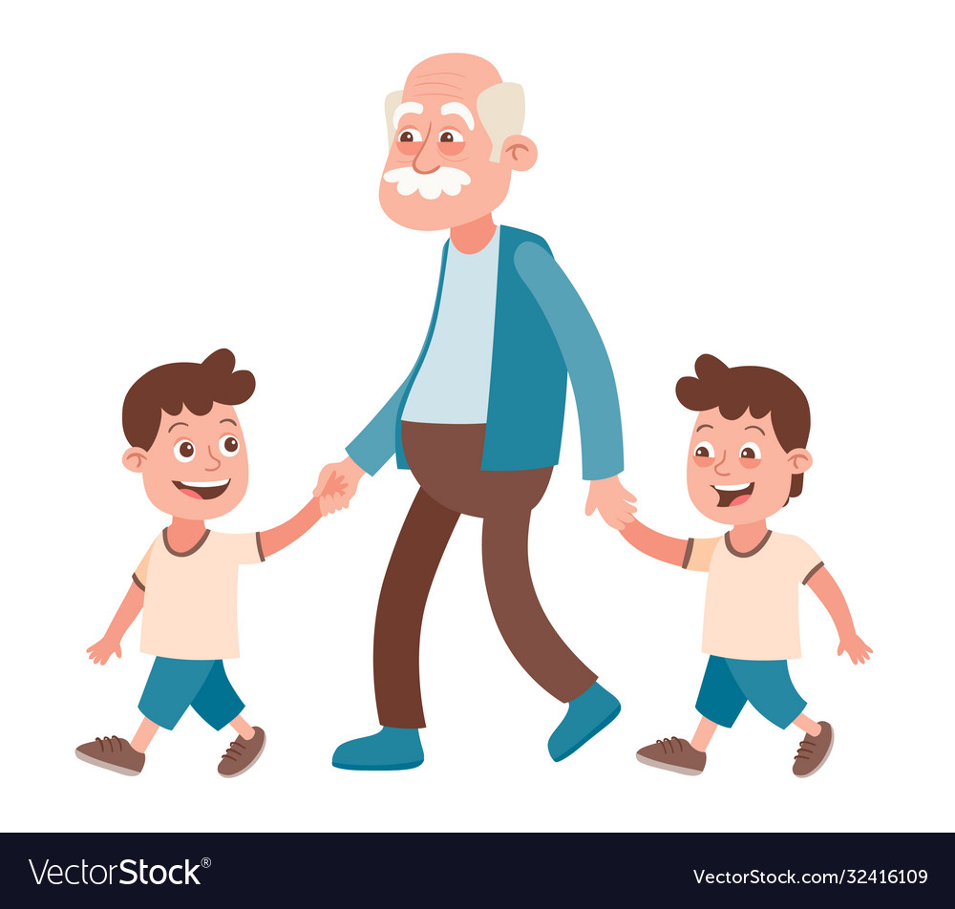
PRODUCTION
Role-play
- Ss work in groups of 4.
- In each group, one student plays the role of grandpa who is in his 90s and still very strong and healthy. Others are grandchildren.
- Grandpa gives advice on how to be healthy.
- 3 minutes to prepare for the role-play.
- 2 minutes for a performance.

Slide 44
CONSOLIDATION
1
Wrap-up
What have you learnt today?
Some lexical items about healthy lifestyle
Reading for specific information
Past simple and Present perfect tense

Slide 45
CONSOLIDATION
2
Homework
Do exercises in the workbook.
Write a short paragraph about how to keep fit and stay healthy.
Prepare materials for the project in Lesson 8.

Slide 46
THANK YOU

