Slide 1




8
Period 1
Teacher: Bui Thi Thu Trang
Quang Trung Primary School

Slide 2
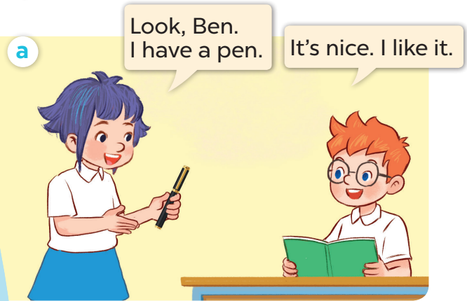
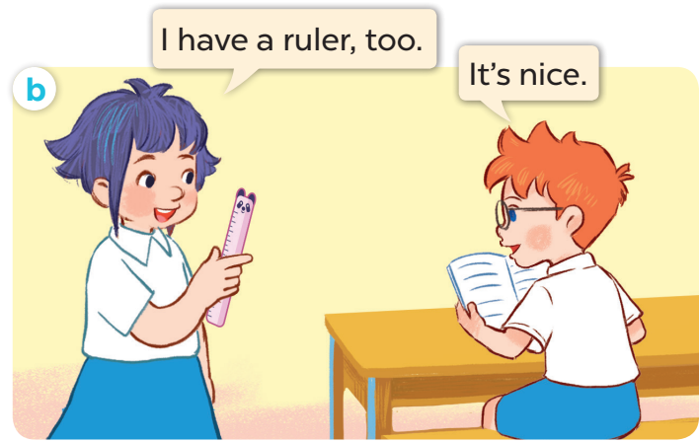
1. Look, listen and repeat.

Slide 3
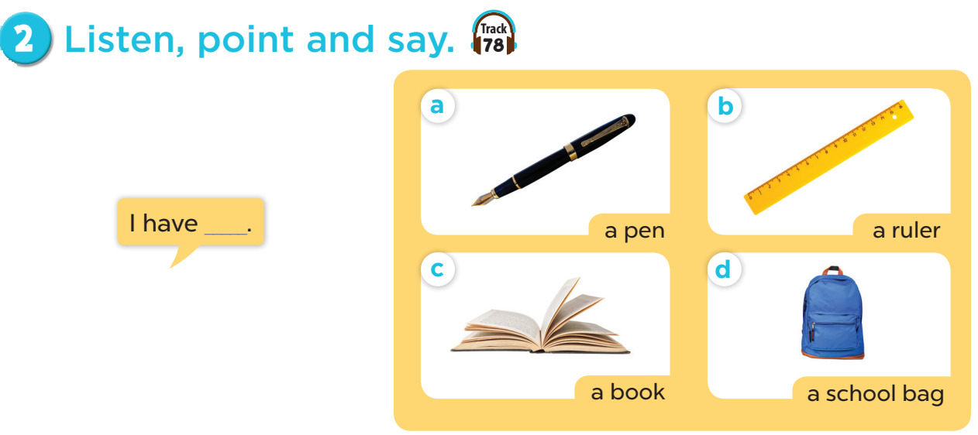

Slide 4

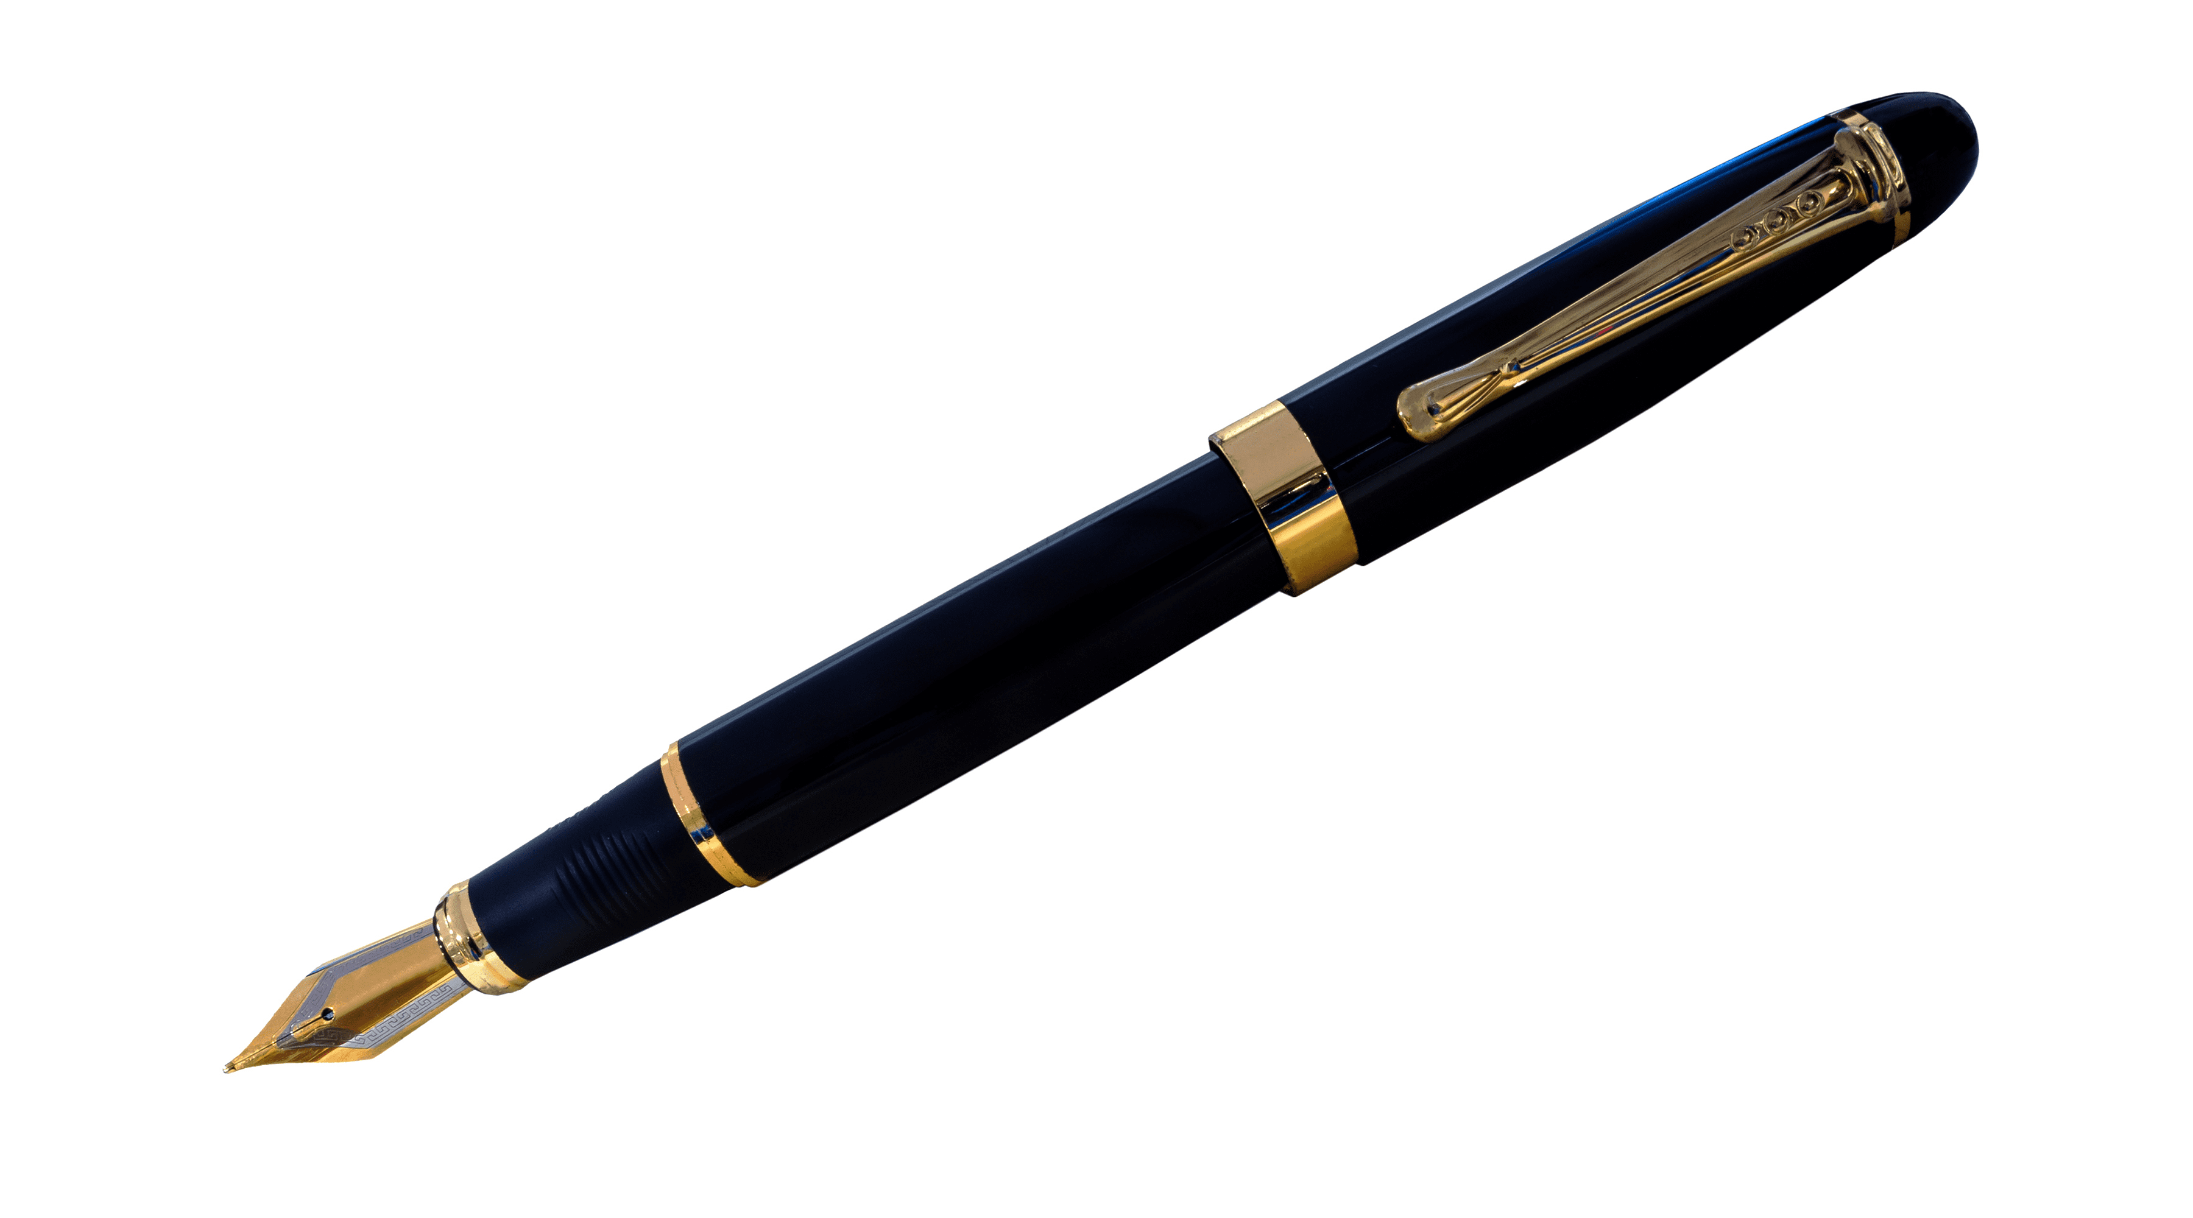
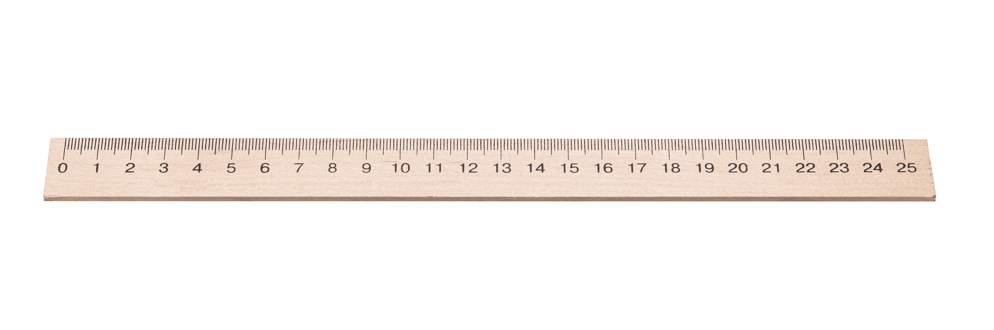
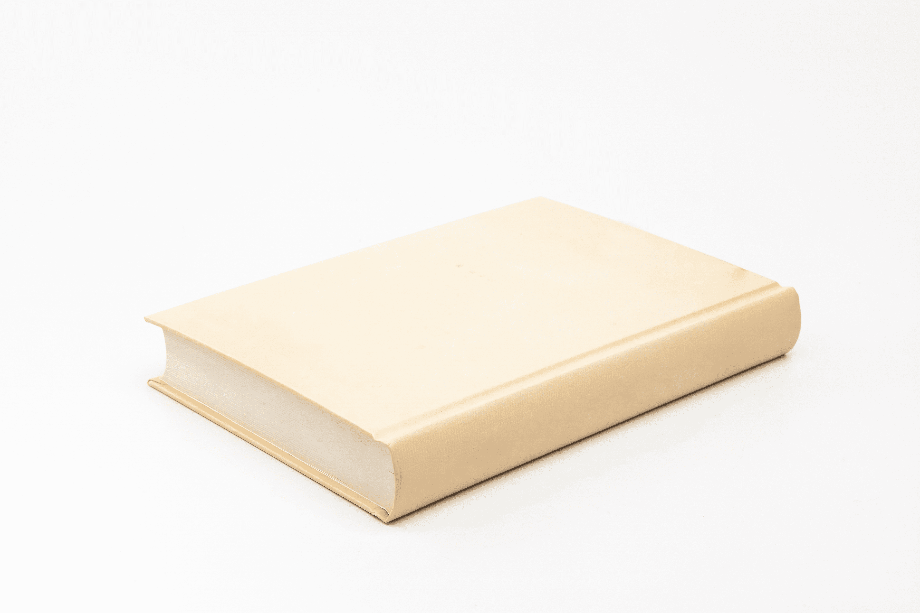
I have a ruler!
Game:
Notes:
Game: Slap the board.
- Divide the class into four teams.
- Stick the pictures of school things on the board.
- T says a sentence, a pupil from each team has to point/slap the right picture and says the sentence again. The faster pupil will get points for their team.

Slide 5
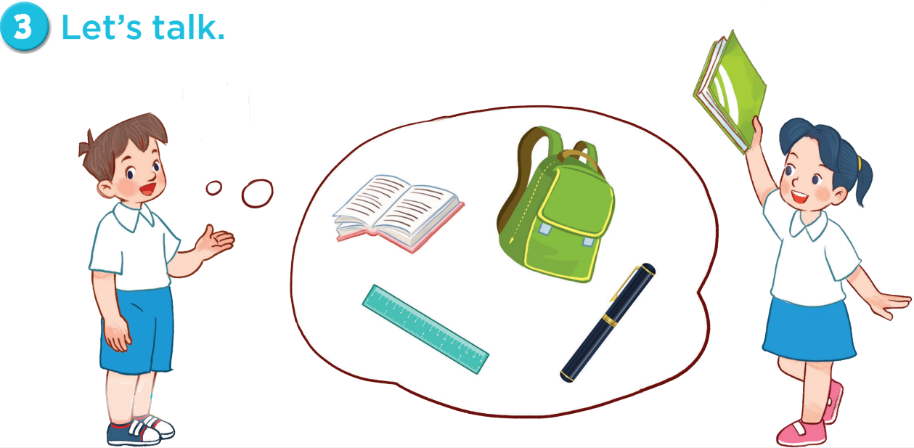

Slide 6
Game: Let’s move and say!

