Slide 1



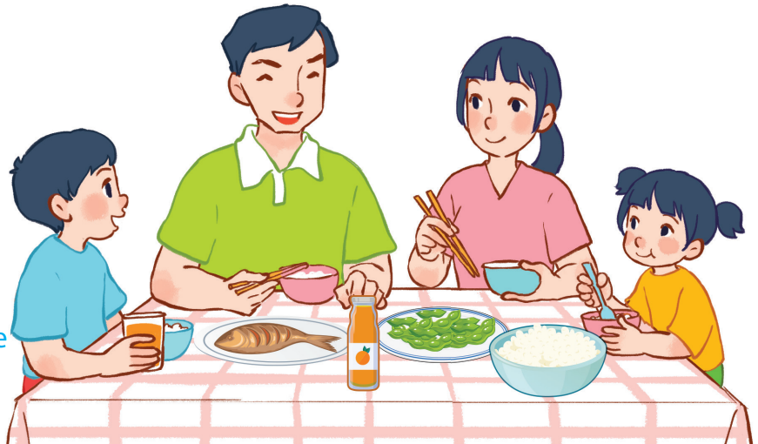
15
At the dining table
LESSON 1 – PERIOD 2
Quang Trung Primary School
Teacher: Bui Thi Thu Trang

Slide 2




FRUIT JUICE
Team A
Team B
Warm-up
and review
Notes:
Divide the class into 2 teams.
Each team chooses one jar mug of juice to go to the question. Have pupils look, read and choose the right option.
Click the score mug to get back to the menu for pupils to choose another question.
Pupils continue their turns until there is no mug left.

Slide 3


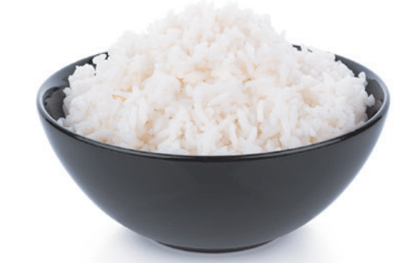


Would you like some ……………?
Yes, please.
40
bread
rice
cake

Slide 4

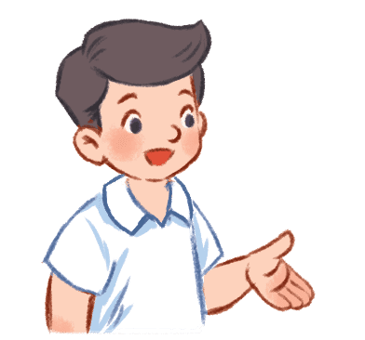
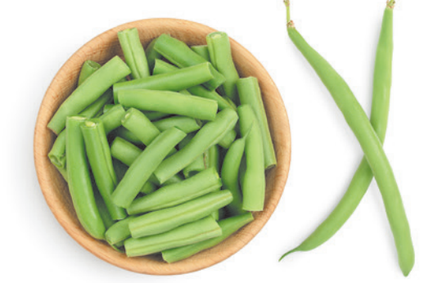
Would you like some ……………?
No, thanks.
30
beans
apples
pears

Slide 5

Would you like some ……………?
No, thanks.
20
beans
meat
fish

Slide 6


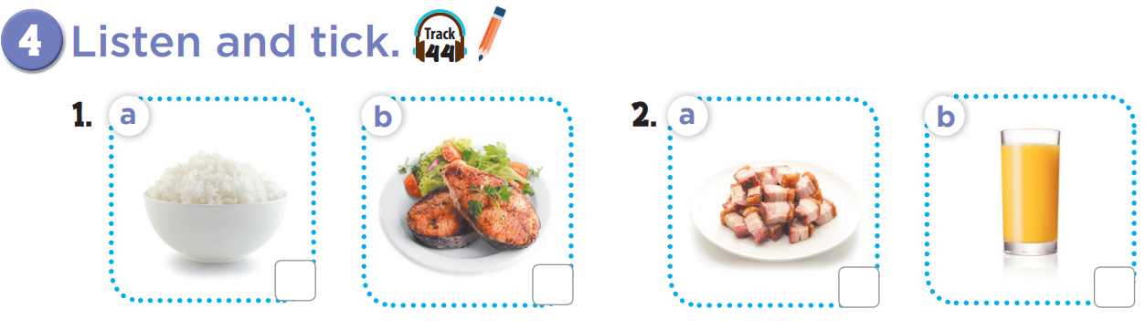

Slide 7
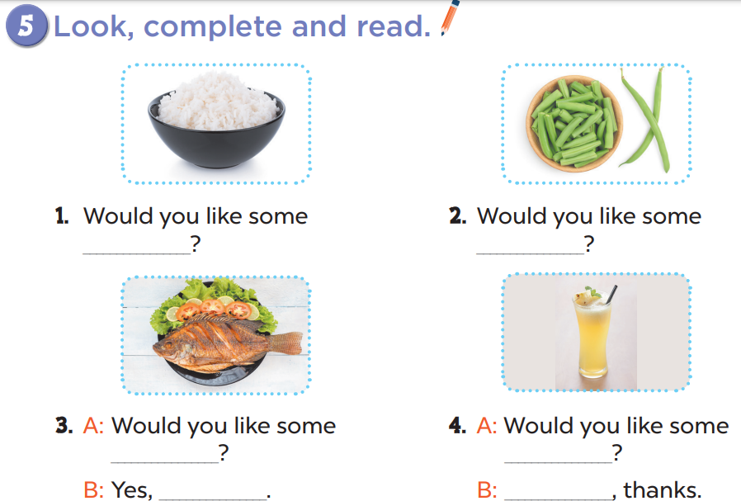
rice
beans
fish
juice
please
No

Slide 8
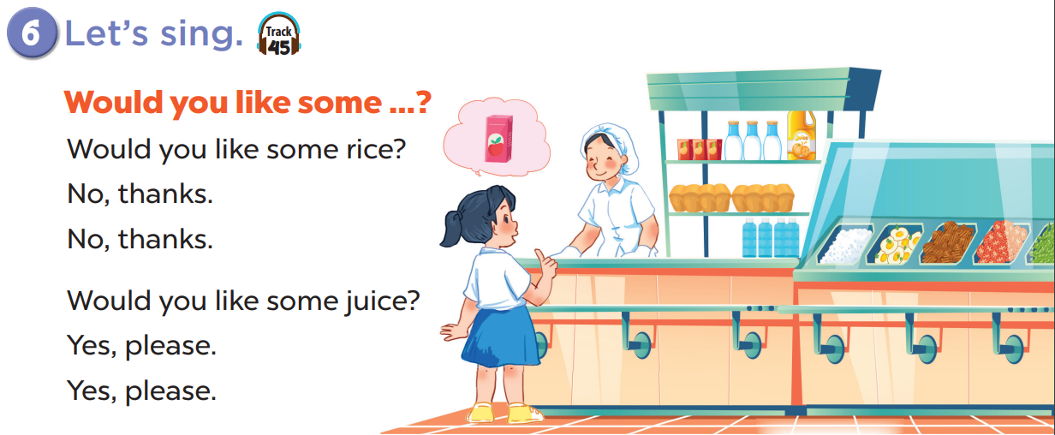

Slide 9
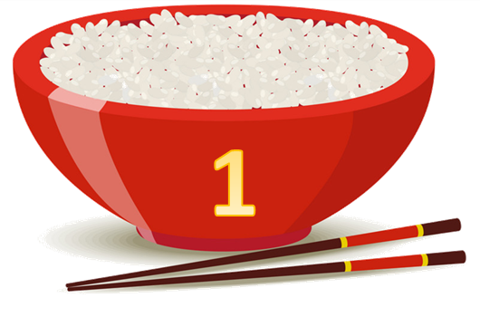
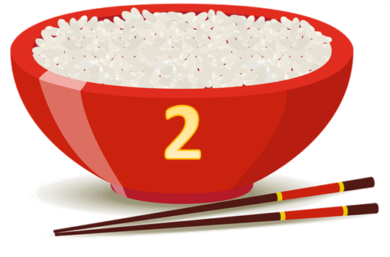






Yummy
Team A
Team B
Fun corner
and wrap-up
Notes:
Divide the class into 2 teams.
Each team chooses one bowl to go to the question. Have pupils look, read and choose the right option.
Click the ‘score’ bowl to get back to the menu for pupils to choose another question.
Pupils continue their turns until there is no bowl left.

Slide 10

Listen and choose.
60
apples
beans
pears
Notes:
Click the character on the left side to listen and choose the right options. Click the character on the right side to hear the answer.

Slide 11
Listen and choose.
30
rice
soup
noodles
Notes:
Click the characters to listen and choose the right options.

Slide 12
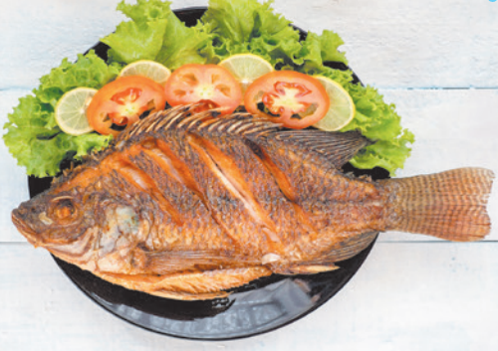
Listen and choose.
40
chicken
meat
fish
Notes:
Click the characters to listen and choose the right options.

