Slide 1



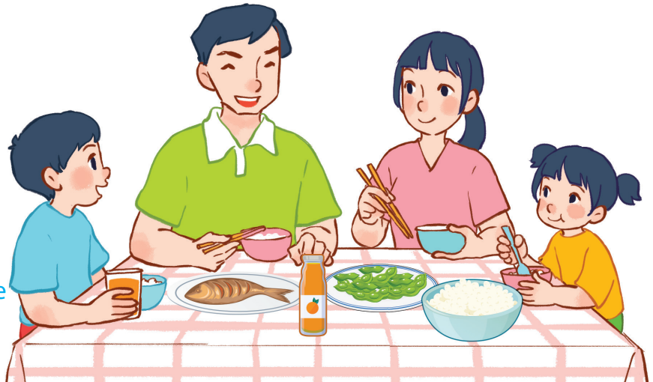
15
At the dining table
LESSON 2 – PERIOD 4
Quang Trung Primary School
Teacher: Bui Thi Thu Trang

Slide 2



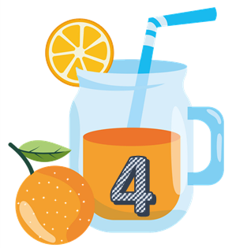
Team A
Team B
Warm-up
and review
Notes:
Divide the class into 2 teams..
Each team chooses one jar mug of juice to go to the question.
Have pupils look, read and choose the right option.
Click the ‘score’ mug to get back to the menu for pupils to choose another question.
Pupils continue their turns until there is no mug of juice left.
The team who gets the most points is the winner.

Slide 3











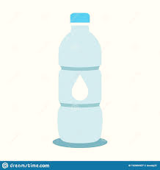
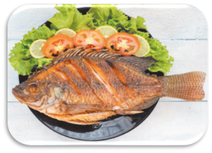
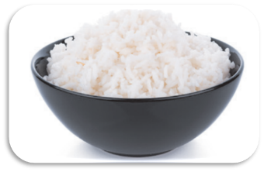
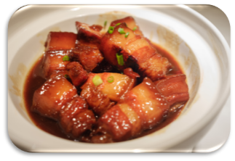
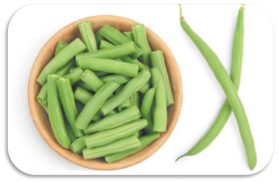
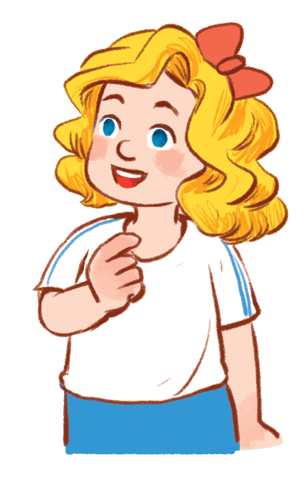
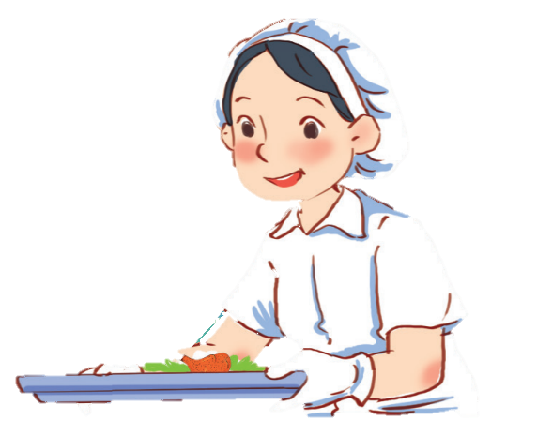
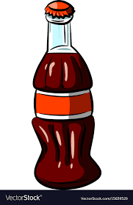
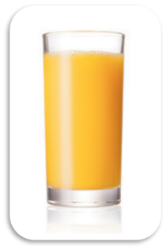
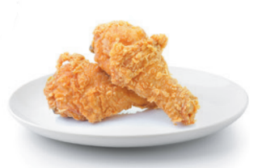
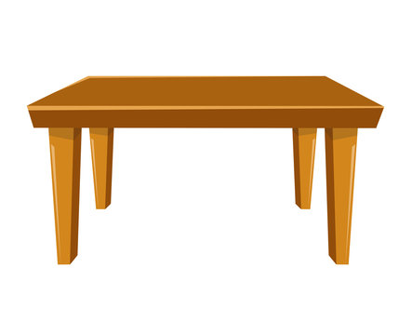
TIME
IS UP
What would you like to eat?
I’d like some meat.
40

Slide 4

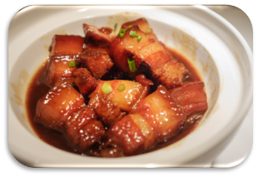
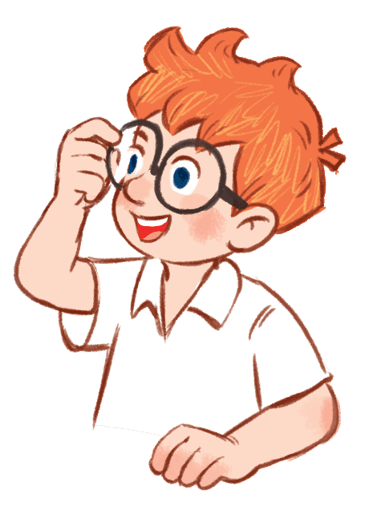


TIME
IS UP
I’d like some milk.
20
What would you like to drink?

Slide 5



TIME
IS UP
I’d like some chicken.
What would you like to eat?
30

Slide 6
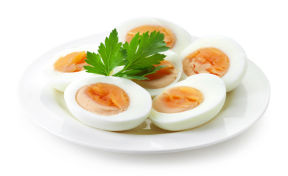
TIME
IS UP
I’d like some eggs.
What would you like to eat?
40

Slide 7

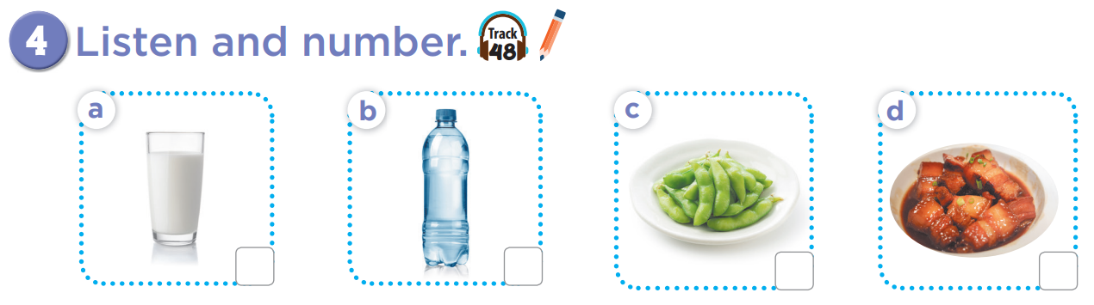


3
4
1
2

Slide 8
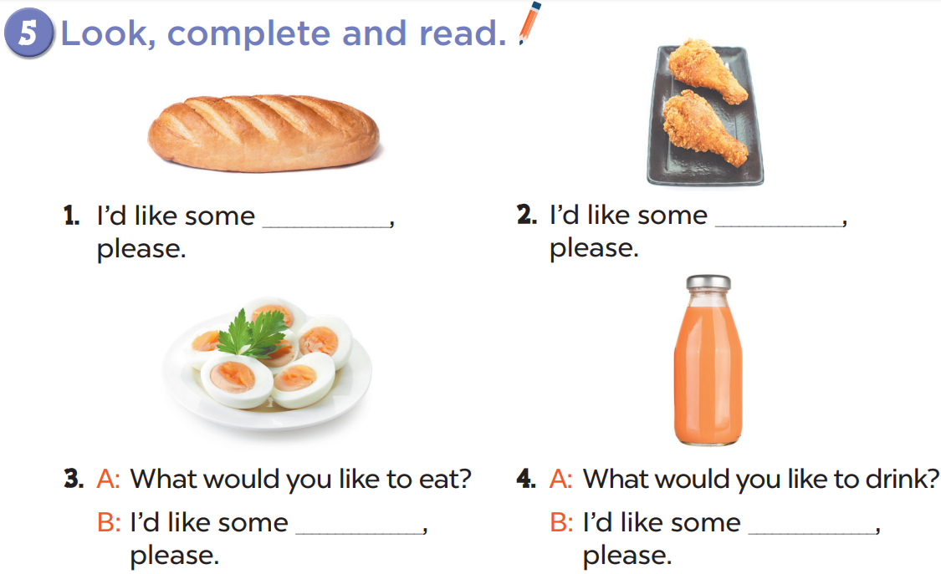
bread
chicken
eggs
juice

Slide 9
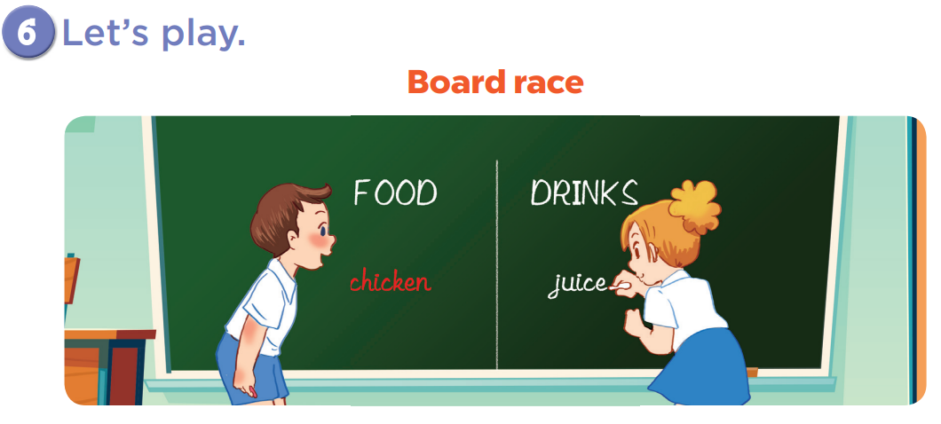

Slide 10
Fun corner
and wrap-up
FOOD MAZE
Notes:
Have pupils look, read and choose the correct picture to lead the food eater to the food or drink.
This game is just for fun.

Slide 11
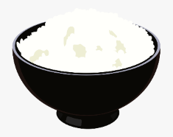
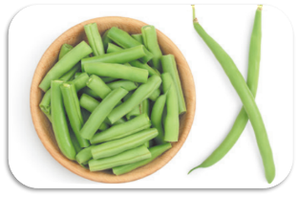





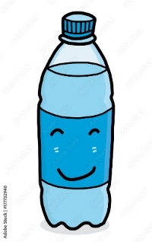
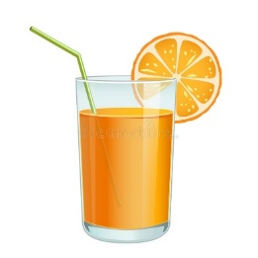
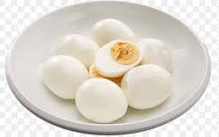
What would you like to eat and drink?
I would like some milk.
I would like some rice.
I would like some juice.
I would like some chicken.
I would like some bread.
I would like some eggs.
I would like some fish.
I would like some water.
I would like some beans.
Notes:
Look at the sentence then choose the right picture of the food or drinks.

