Slide 1



13
My house
LESSON 2 - PERIOD 3
Quang Trung Primary School
Teacher: Bui Thi Thu Trang

Slide 2
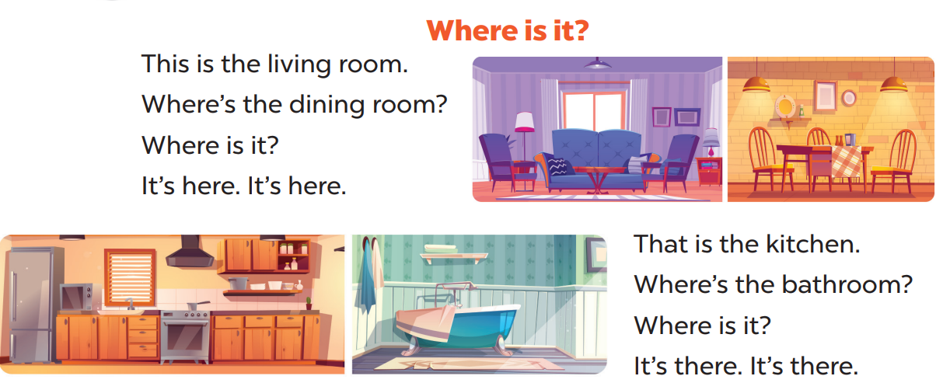

Sing a song
Option 1

Slide 3
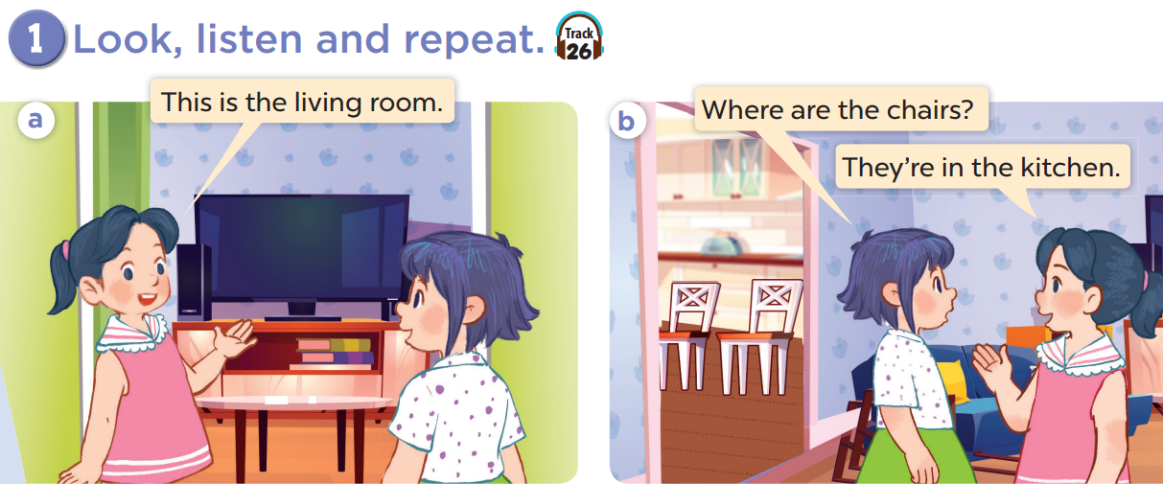

Slide 4
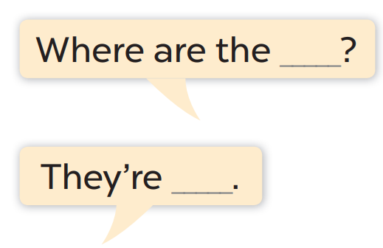
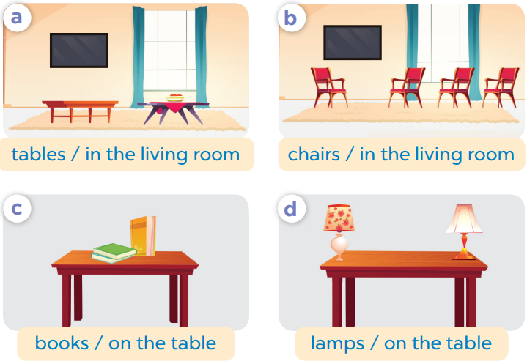
Work in pair, ask and answer.

Slide 5
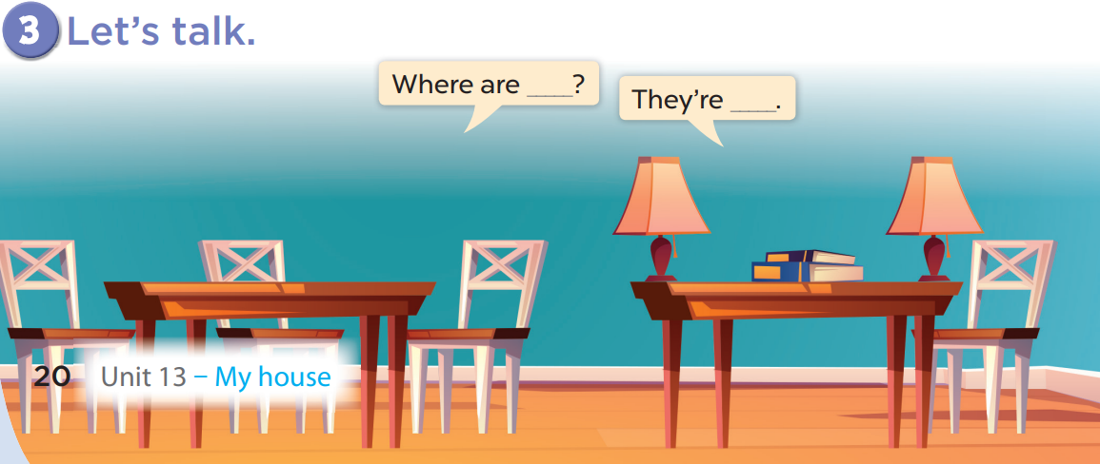
Work in pairs, ask and answer.

Slide 6



Lucky number
1
2
3
4
Notes:
Divide the class into 2 teams.
Each team takes turns choosing a number then answering the question.

Slide 7
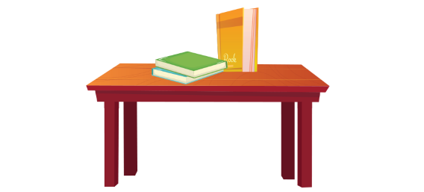





Where are the books?
They’re in the table.
They’re on the table.
Notes:
Click the home to go back.

Slide 8
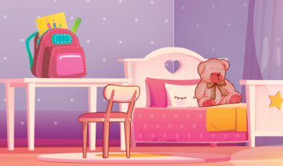

Where………………the teddy bear?
is
are
am
Notes:
Click the home to go back.

Slide 9
……….. is the bag?
What
How
Where
Notes:
Click the home to go back.

Slide 10

Where are the chairs?
They’re in the living room.
They’re on the living room.
Notes:
Click the home to go back.

