Slide 1
REVIEW 2.2
Teacher: Bui Thi Thu Trang
Quang Trung Primary School

Slide 2
Look and guess!

Slide 3
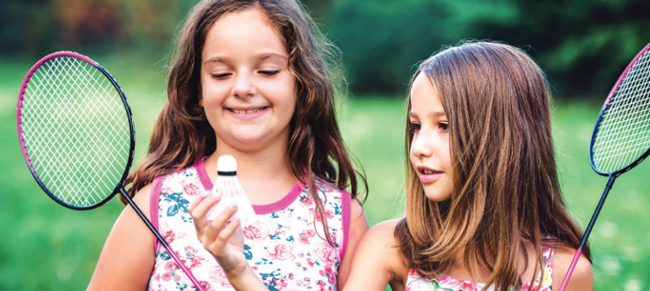

Slide 4
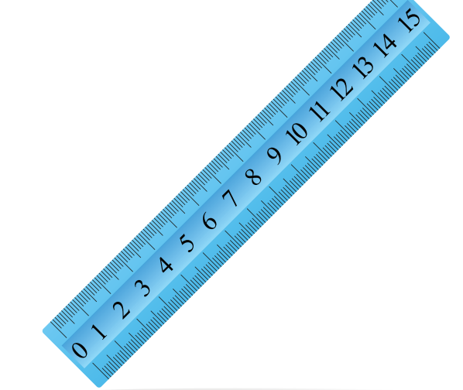

Slide 5
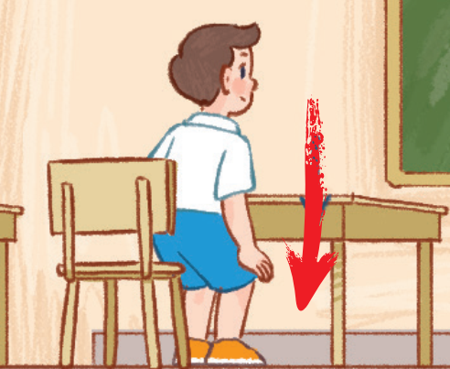

Slide 6
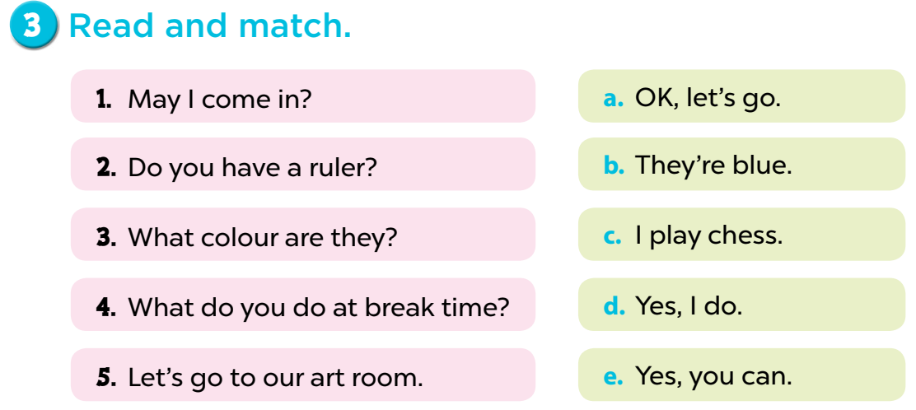

Slide 7
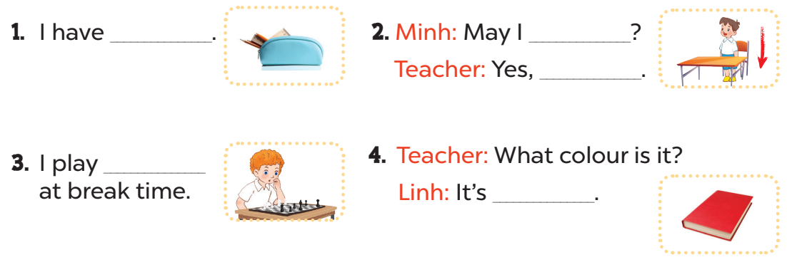
4. Look, complete and read.
a pencil case
sit down
you can
chess
red

Slide 8
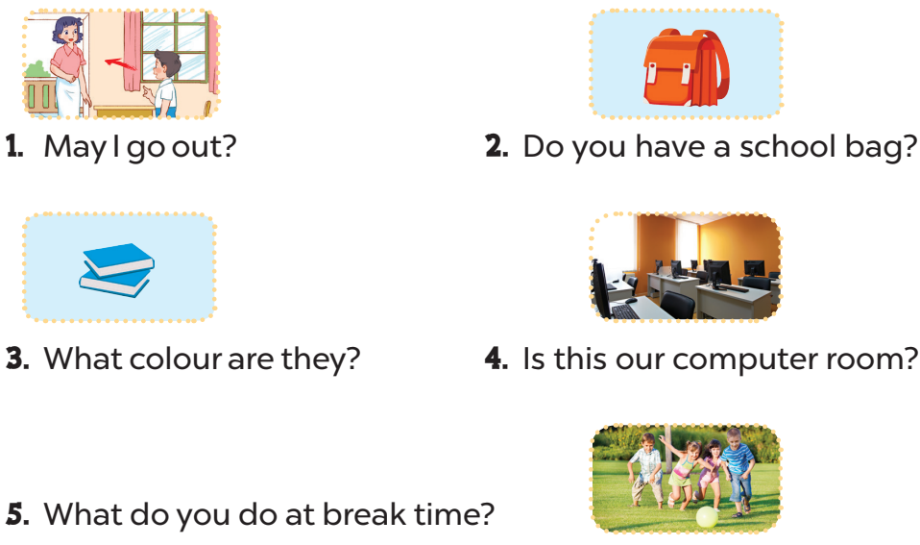
5. Ask and anwer.
Yes, you can/No, you can’t.
Yes, I do.
Ask and anwer.
They’re blue.
Yes, it is.
I play football.

Slide 9


Slide 10
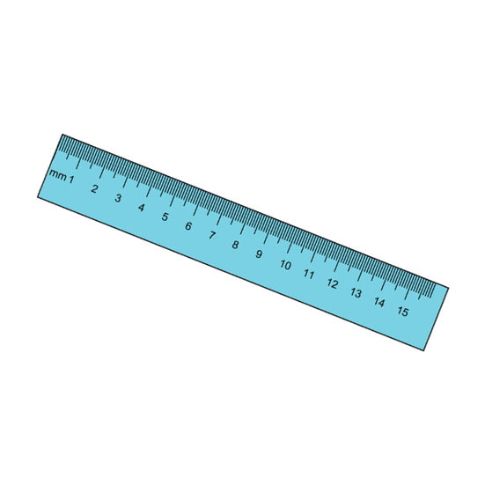

What colour is it?
+ 2 points
It’s blue.

Slide 11
What colour is it?
+ 5 points
It’s yellow.

Slide 12


What colour are they?
+ 3 points
They’re green.

Slide 13
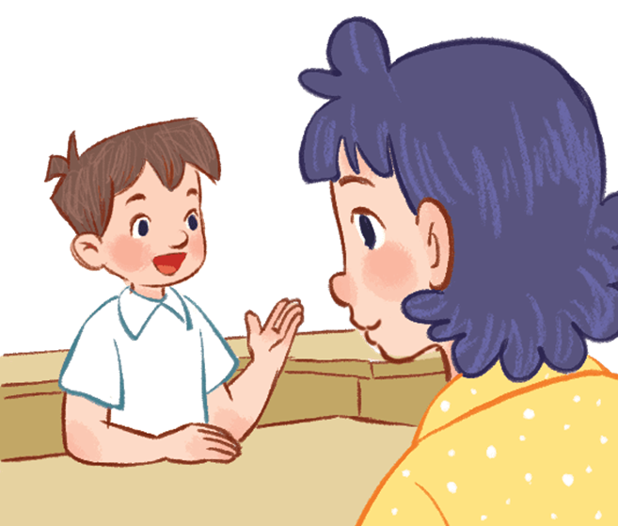
Vietnamese?
+ 10 points
May I speak Vietnamese?

