Slide 1




Our toys
17
LESSON 1
Period 2
Quang Trung Primary School
Teacher: Bui Thi Thu Trang

Slide 2

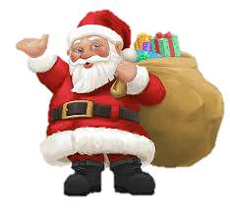



A Letter To The Santa Claus
Notes:
Step 1: Divide the class into 4 teams.
Step 2: Invite 1 pupil to go to the board, look at the picture, then say aloud what toy the boy wants for Christmas. The fastest pupil gets one points for his/her team.
Step 3: Encourage pupils to join in the game.
Step 4: Give points for pupils.

Slide 3
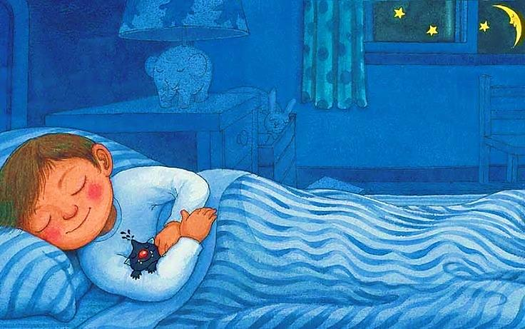

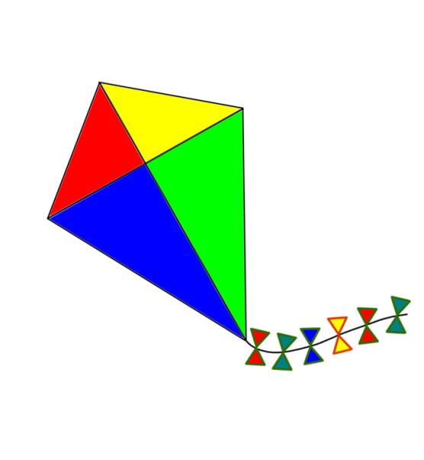
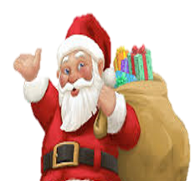


Click on the right letter
Dear Santa,
I want a
doll
Dear Santa,
I want a
train
Dear Santa,
I want a
kite
NEXT

Slide 4
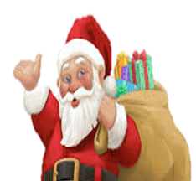

Click on the right letter
Dear Santa,
I want a
train
Dear Santa,
I want a
car
Dear Santa,
I want a
plane
NEXT

Slide 5

Click on the right letter
Dear Santa,
I want a
robot
Dear Santa,
I want a
plane
Dear Santa,
I want a
car
NEXT

Slide 6

Click on the right letter
Dear Santa,
I want a
train
Dear Santa,
I want a
kite
Dear Santa,
I want a
plane
NEXT

Slide 7
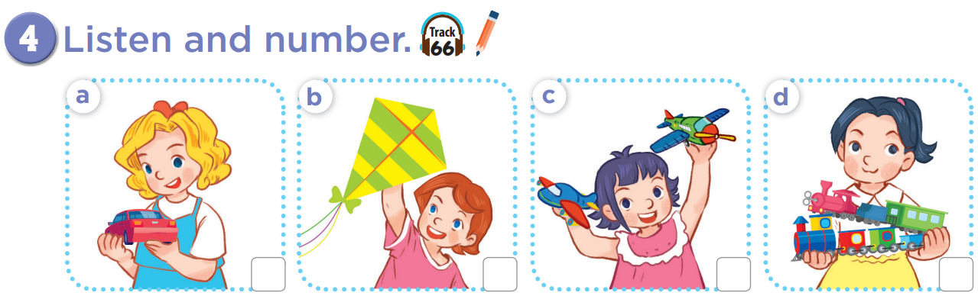


Slide 8
4
1
3
2

Slide 9
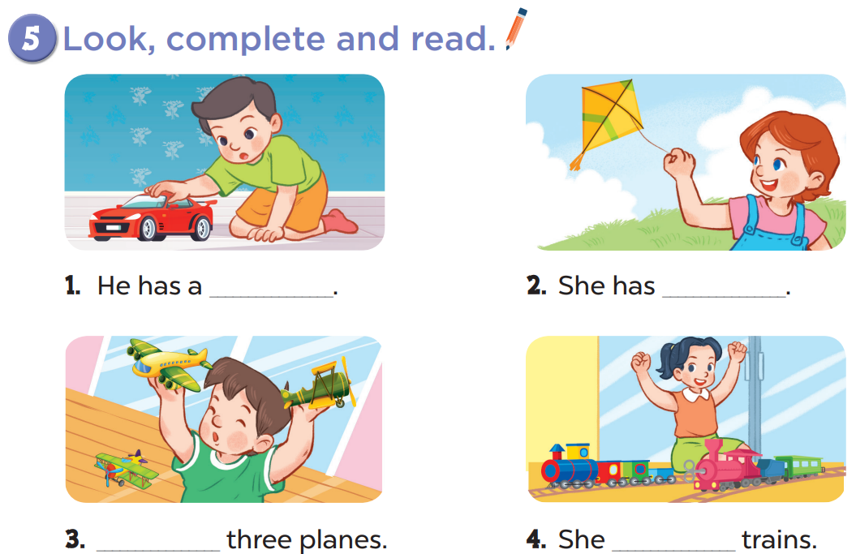

Slide 10
car
a kite
He has
has two

Slide 11
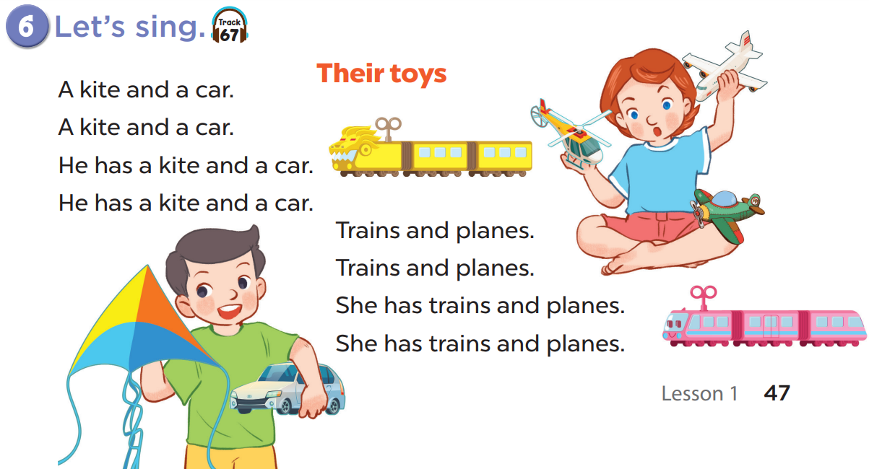

Slide 13
Game time!!!
Sentence Puzzle
Notes:
Step 1: Divide the class into 4 teams.
Step 2: Invite 1 pupil from each team to come to the front to look at the clues then rearrange the words in order to make a sentence. Then quickly say aloud the sentence. If it is correct, give points for that team.
Step 3: Encourage pupils to practice speaking English.
Step 4: Give points for pupils.

Slide 14

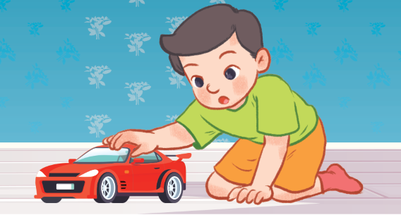

He
has
a car
+5
___ __ ____.
He has a car

Slide 15

She
has
two trains
+7
___ __ ________.
She has two trains

Slide 16

She
has
two planes
+10
___ ___ ________.
She has two planes

Slide 17
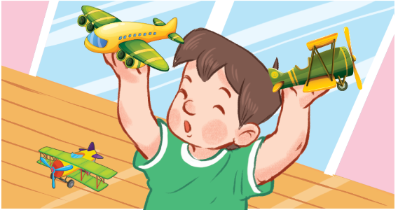
He
has
three planes
+6
___ __ _________.
He has three planes

