Slide 1

Gv: Võ Thị Loan

Slide 2
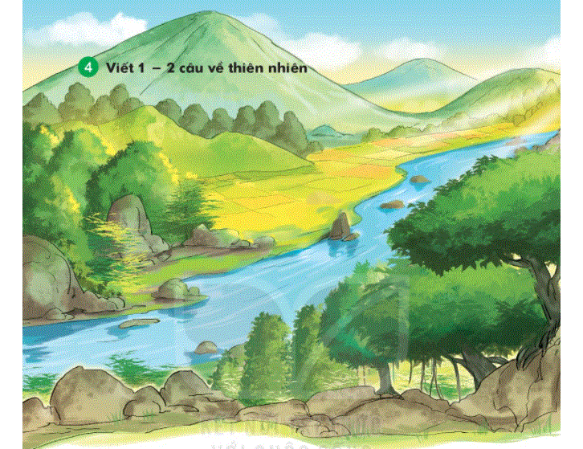

Slide 3


