Slide 1


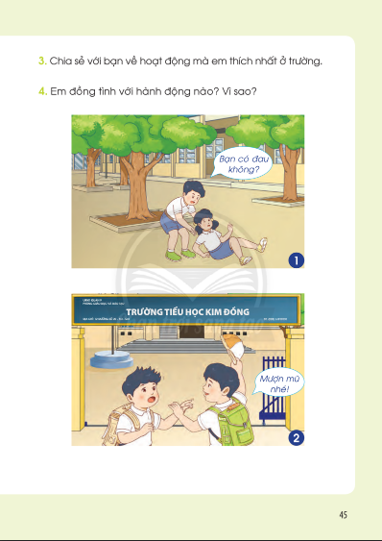
S/44

Slide 2
Bai 30 Phep tru so co hai chu so voi so co hai chu so t2

