Slide 1

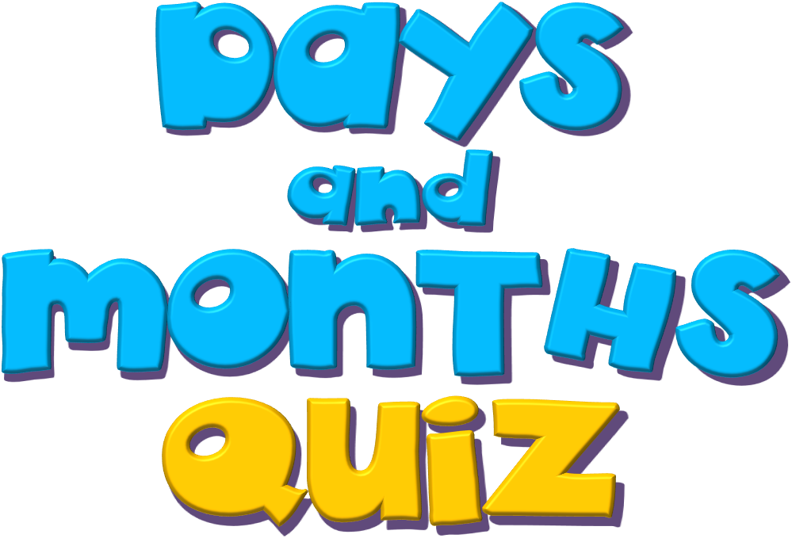

Slide 2

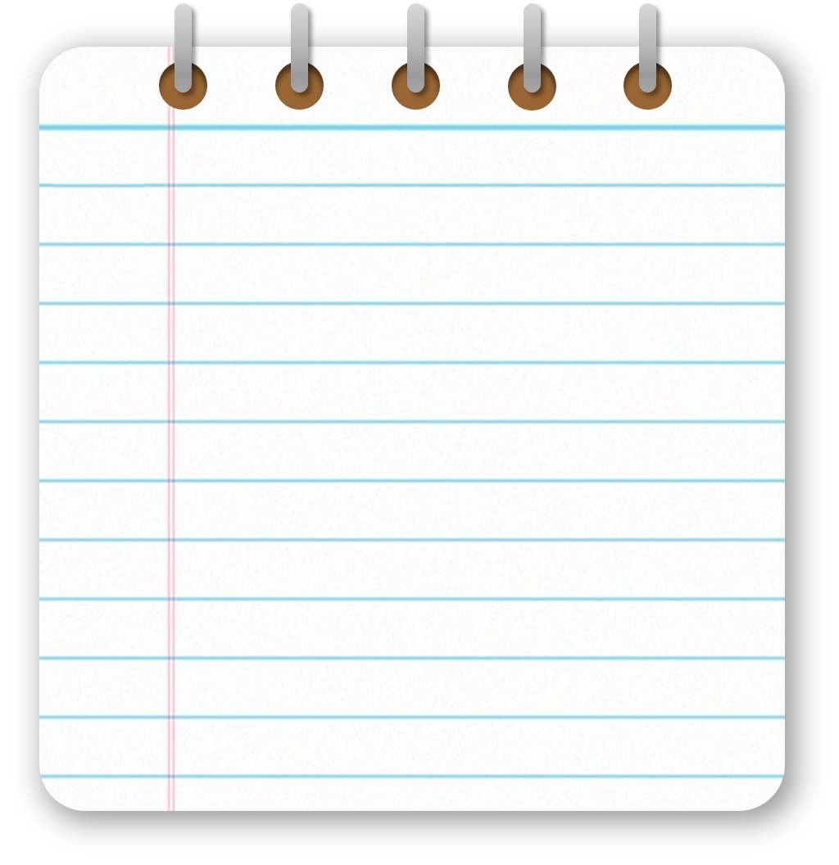



Days
of the
week

Slide 3

monday
friday
tuesday
saturday
wednesday
sunday
thursday

Slide 4
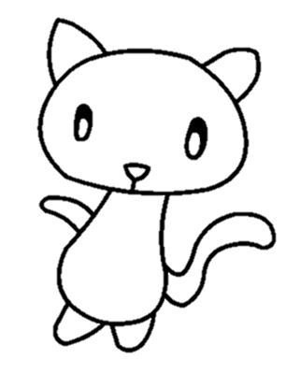
1/7
We don’t go to school this day.
sunday
monday
sunday
friday

Slide 5
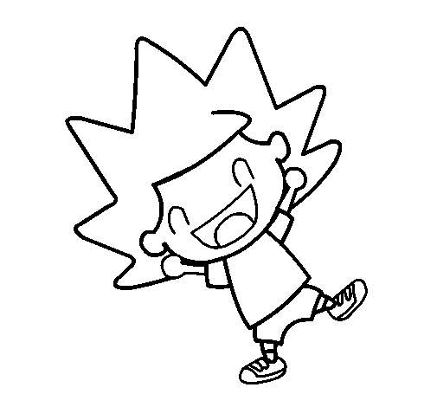
2/7
The day before thursday.
monday
wednesday
wednesday
saturday

Slide 6
3/7
The day before Saturday.
thursday
friday
friday
saturday

Slide 7
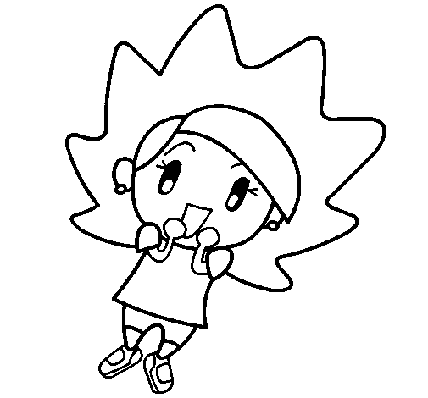
4/7
The day before friday.
thursday
monday
thursday
friday

Slide 8
5/7
The day after monday.
tuesday
wednesday
tuesday
friday

Slide 9
6/7
A day of the weekend.
monday
tuesday
saturday
saturday

Slide 10
7/7
The first day of the week.
sunday
tuesday
monday
monday

Slide 11
Months
of the
year

Slide 12
January
July
February
August
March
September
April
October
May
November
June
December

Slide 13

1/12
School starts.
April 4
February 3
January 7
January 7th

Slide 14

11/12
The month between October and December.
September
November
January
November

Slide 15
2/12
Charlie’s basketball competition.
October 6
January 7
October 6th
March 11

Slide 16

3/12
The month after July.
June
August
August 8th
September

Slide 17
4/12
Flo and Ella’s birthday.
December 12
December 9
December 12th
December 10

Slide 18

5/12
Aunti Daisy’s birthday
March 11
May 1
May 1st
June 5

Slide 19

6/12
Flo and Ella’s school trip to museum.
June 5
February 3
September 10
September 10th

Slide 20

7/12
Scgool trip to museum.
June 5
April 4
February 3
February 3rd

Slide 21

8/12
Luke’s birthday
July 2
April 4
April 4th
June 5

Slide 22
9/12
School holidays start
July 2
June 5
July 2nd
January 7

Slide 23
7/12
The month after January.
December
March
February
February

Slide 24
2/12
The month after of September.
October
August
October
November

Slide 25

10/12
School play
May 1
June 5
March 11
March 11th

Slide 26
11/12
Visit grandma and grandpa.
September 10
November 9
December 12
November 9th

Slide 27
8/12
The month before May
March
April
April
June

Slide 28
12/12
Poetry competition.
April 4
May 1
June 5
June 5th
EXIT

Slide 29
9/12
The month between June and August
July
May
July
September

