Slide 1




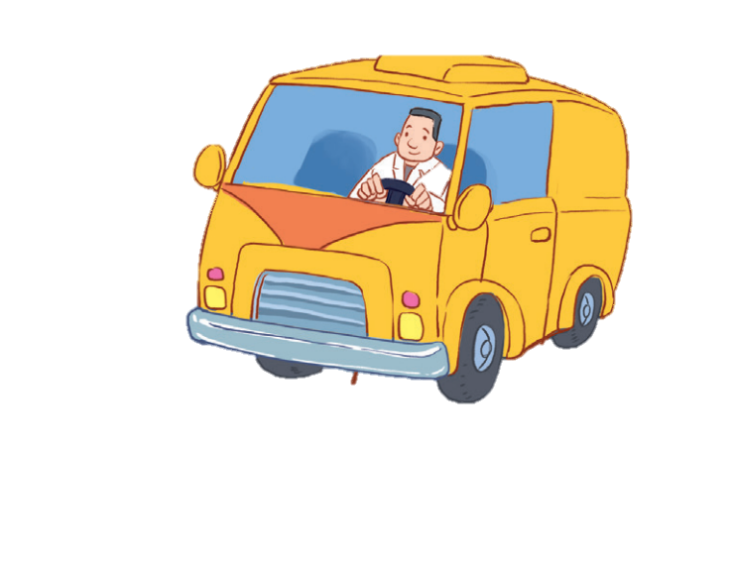


12
LESSON 2 – Period 4

Slide 2
Contents
Warm-up and review
Listen and number.
Look, complete and read.
Let’s play.
1
2
3
4
5
Fun corner and wrap-up

Slide 3
1
Warm-up and review

Slide 4

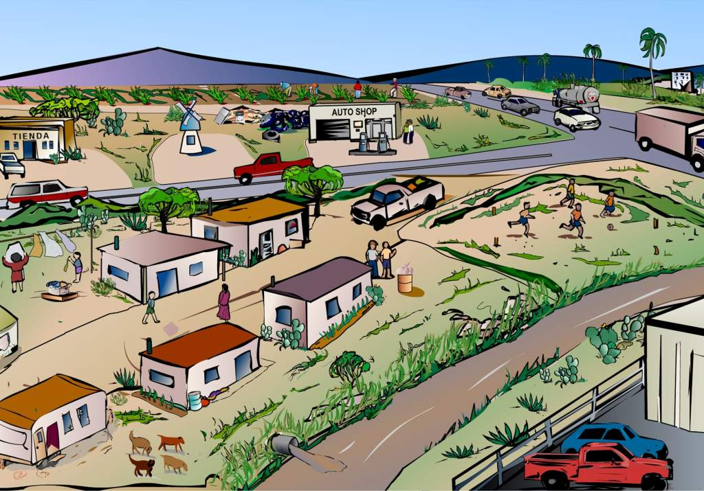

WHAT Do they do?
Notes:
Step 1: Divide the class into 4 teams.
Step 2: One pupil from each team will go to the front, look at the picture then answer the question. The fastest pupil will get points. After that, each of them has to say the word aloud 3 times.
Step 3: Encourage pupils to join in the game.
Step 4: Give points for pupils.

Slide 5


What’s her job?
GREAT
She’s a teacher.
She’s a nurse.
She’s a doctor.

Slide 6
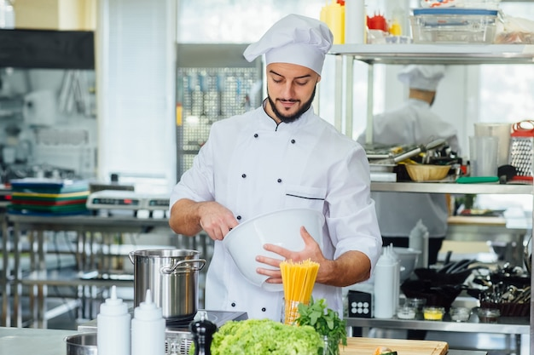

What’s his job?
GREAT
He’s a cook.
He’s a teacher.
He’s a farmer.

Slide 7


What’s her job?
GREAT
She’s a doctor.
She’s a nurse.
She’s a singer.

Slide 8

What’s his job?
GREAT
He’s a doctor.
He’s a cook.
He’s a worker.

Slide 9
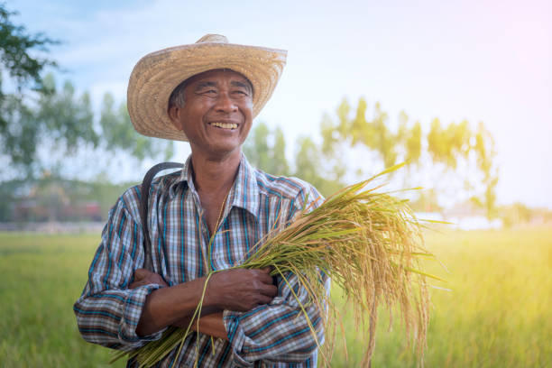

What’s his job?
GREAT
He’s a teacher.
He’s a farmer.
He’s a doctor.

Slide 10

What’s her job?
GREAT
She’s a teacher.
She’s a worker.
She’s a farmer.

Slide 11

What’s his job?
GREAT
He’s a doctor.
He’s a driver.
He’s a teacher.

Slide 12

What’s her job?
GREAT
She’s a doctor.
She’s a teacher.
She’s a driver.

Slide 13
2
Listen and number.

Slide 14


Notes:
Step 1: Have pupils look at the pictures. Point at each picture to elicit the job.
Play the recording twice so that pupils can do the task. Play the recording the third time to give pupils another listening opportunity.
Step 2: Check answers together as a class. Play the recording again for pupils to correct their answers.
Extension: If time allows, play the recording sentence by sentence for the class to listen and repeat in chorus. Correct their pronunciation if necessary.

Slide 15

3
2
4
1

Slide 16
3
Look, complete and read.

Slide 17
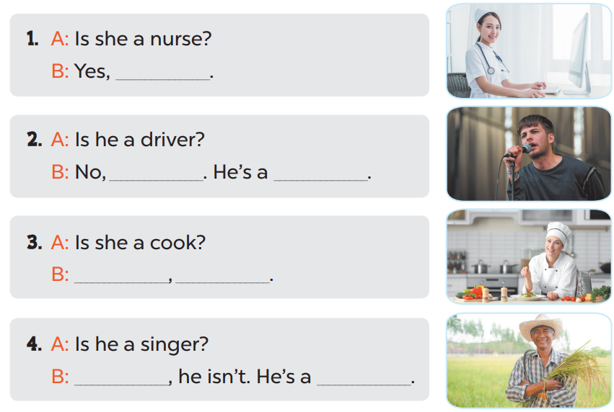

Slide 18
she is
he isn’t
singer
Yes
she is
No
farmer

Slide 19
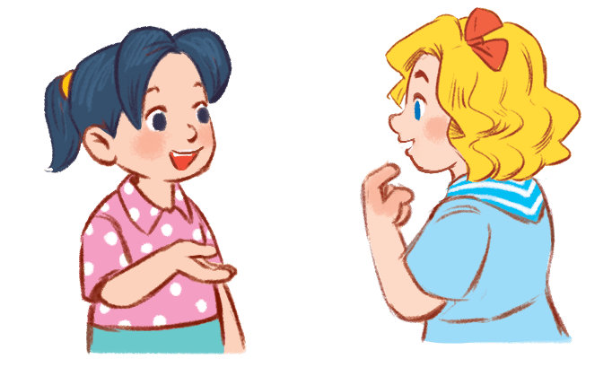
Game time!!!
Role play
Choose a number!
1
2
3
4
5
6
7
8
9
10
Next activity
Notes:
Step 1: Divide the class into 2 teams.
Step 2: Invite each pupil from each team to go to the board and practice “Is she/ he a _____? – yes, she/ he is. No, she/ he is.”
Step 3: Encourage pupils to practice speaking.
Step 4: Give points for pupils.

Slide 20
- Is she a farmer?
- No, she isn’t.
+10

Slide 21
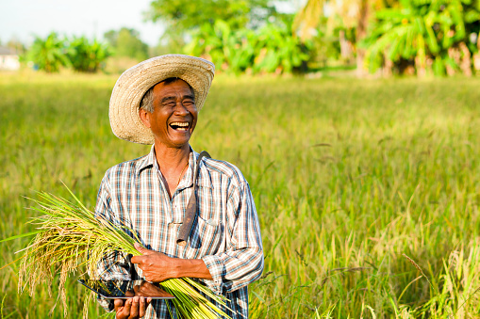
- Is he a farmer?
- Yes, he is.
+5

Slide 22
- Is he a cook?
- No, he isn’t.
+5

Slide 23

- Is he a teacher?
- Yes, he is.
+5

Slide 24

- Is she a doctor?
- Yes, she is.
+10

Slide 25
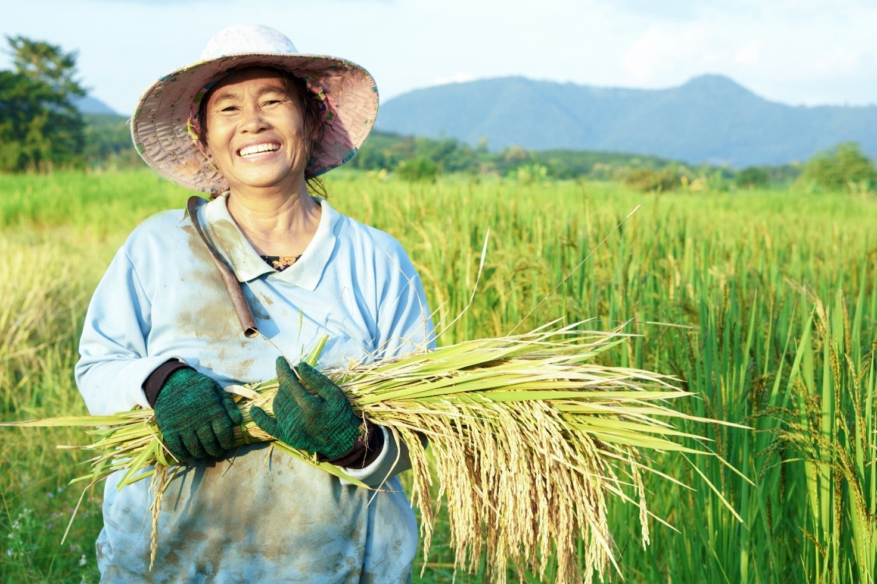
- Is she a driver?
- No, she isn’t.
+15

Slide 26

- Is she a singer?
- No, she isn’t.
+5

Slide 27

- Is he a singer?
- Yes, he is.
+5

Slide 28

- Is she a driver?
- Yes, she is.
+10

Slide 29
- Is he a driver?
- No, he isn’t.
+5

Slide 30
4
Let’s play.

Slide 31
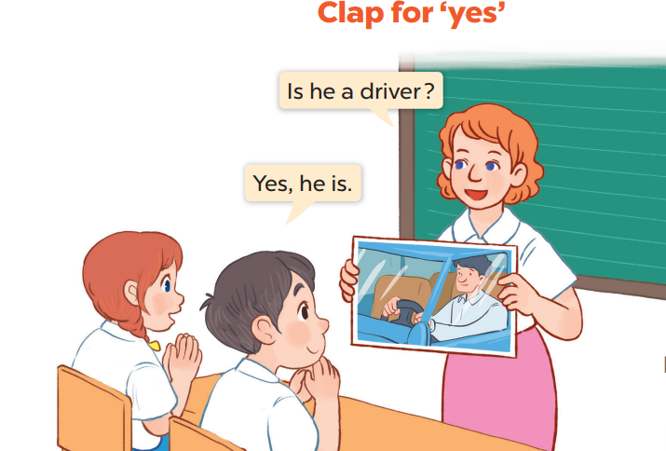

Slide 32
5
Fun corner and wrap-up

Slide 33
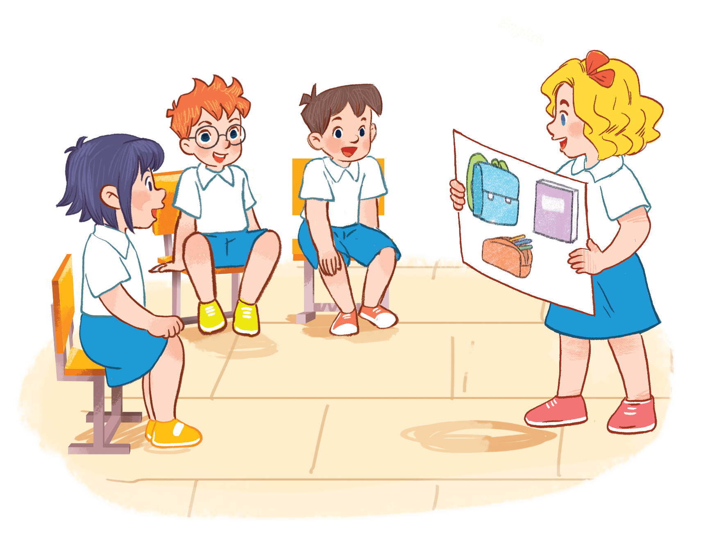

Guessing
- Is she a nurse?
- No, she isn’t.
Great job!
She’s a cook.
Notes:
Step 1: Ask pupils to sit in a circle.
Step 2: A pupil shows a flashcard for the whole class, then pupils will ask and answer “Is he/she ______? Yes, he/ she is. No, he/she isn’t.”
Step 3: Students who answer correctly will stand up and hold another flashcard. Encourage pupils to practice speaking English.

Slide 34
Game time!!!
Guessing
- Is he a driver?
- Yes, he is.
Excellent!

Slide 35
Game time!!!
Guessing
- Is she a teacher?
- No, she isn’t.
Bravo!
She’s a nurse.

Slide 36
Game time!!!
Guessing
- Is he a farmer?
- No, he isn’t.
He’s a teacher.
Great!

Slide 37
Game time!!!
Guessing
- Is he a worker?
- Yes, he is
Nice job!

Slide 38
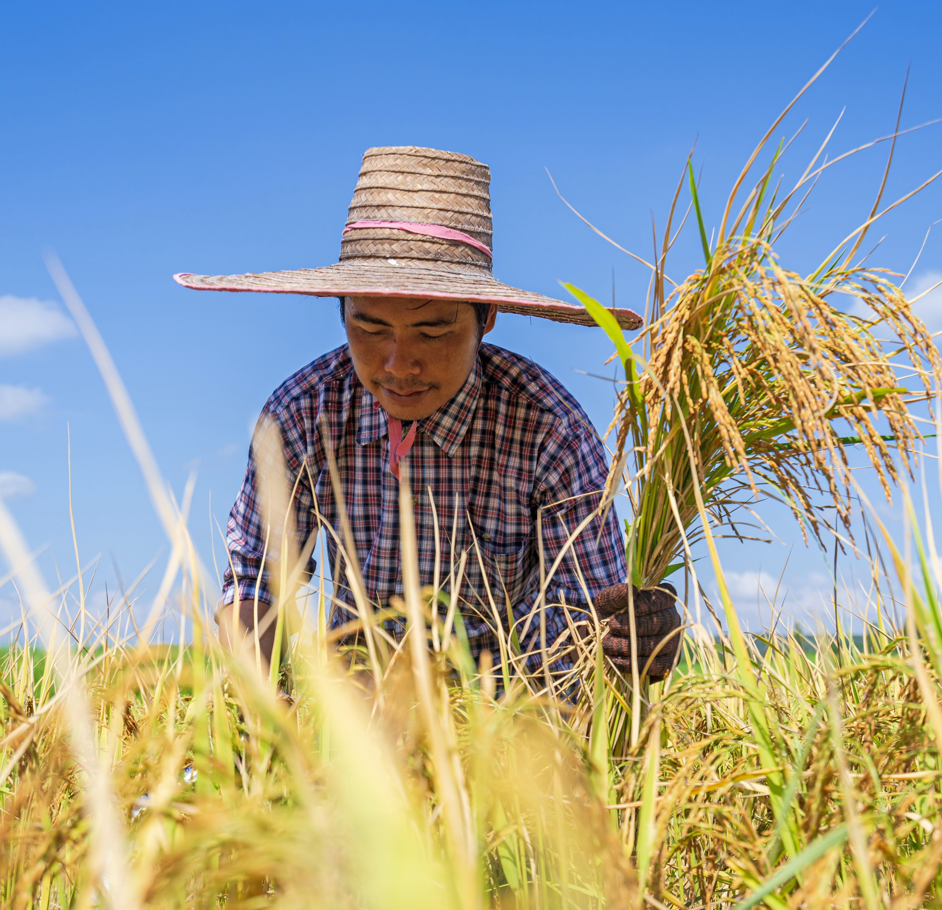
Game time!!!
Guessing
- Is he a cook?
- No, he isn’t.
Well done!
He’s a farmer.

