Slide 1




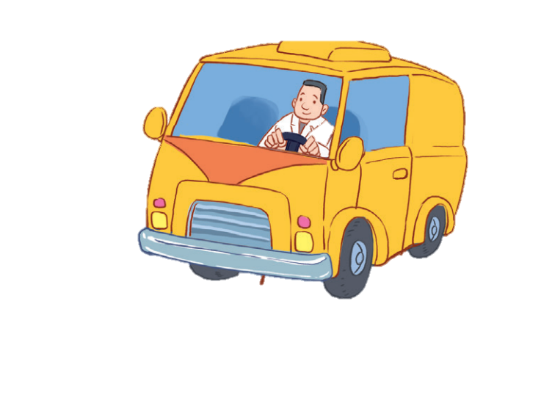


12
LESSON 3 – Period 6

Slide 2
Contents
Warm-up and review
Read and complete.
Let’s write.
Project
1
2
3
4
5
Fun corner and wrap-up

Slide 3
1
Warm-up and review

Slide 5
Choose a number.
1
2
3
4
5
6
7
8
Next activity
Notes:
Game: Guessing
Step 1: Divide the class into 4 teams.
Step 2: Look at the cards (1-8), there are pictures behind them. Let pupils guess the jobs in the pictures. (Spin the lucky wheel to get points.)
Step 3: Encourage pupils to take part in the game and practise speaking English.
Step 4: Give points to pupils.

Slide 6

teacher
What’s her job?
She’s a ____.
Get your present here!

Slide 7

driver
What’s his job?
He’s a ______.
Get your present here!

Slide 8

singer
What’s her job?
She’s a _____.
Get your present here!

Slide 9

farmer
What’s his job?
He’s a _____.
Get your present here!

Slide 10

doctor
What’s his job?
He’s a ______.
Get your present here!

Slide 11

worker
What’s his job?
He’s a ______.
Get your present here!

Slide 12

nurse
What’s her job?
She’s a _____.
Get your present here!

Slide 13

cook
What’s his job?
He’s a _____.
Get your present here!

Slide 14
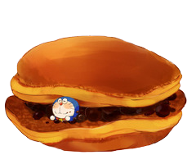

Slide 16
Exchange points with any team!

Slide 19
Steal 3 points from another team!

Slide 20




Slide 21
2
Read and complete.

Slide 22
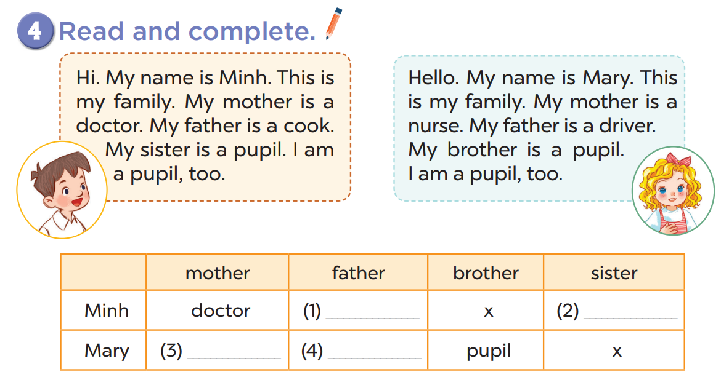

Slide 23
cook
pupil
nurse
driver

Slide 24
3
Let’s write.

Slide 25
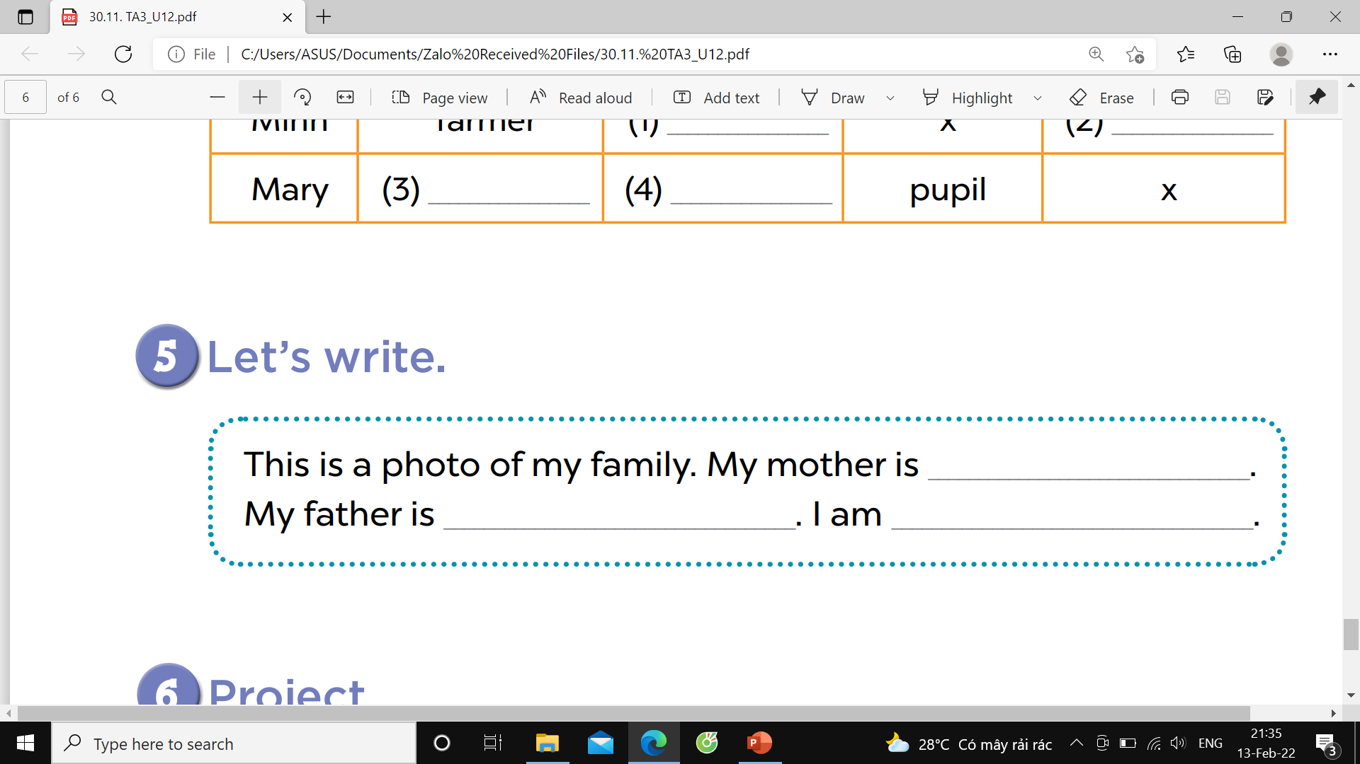

Slide 26

Presentation time!
Notes:
Step 1: Divide the class into four teams.
Step 2: Invite each pupil from each team to go to the board then talk about their parents’ jobs.
Step 3: Encourage pupils to take part in the game.
Step 4: Give points to pupils.

Slide 27

Presentation

Slide 28


Presentation

Slide 29


Presentation

Slide 30


Presentation

Slide 31

Presentation

Slide 32
4
Project

Slide 33
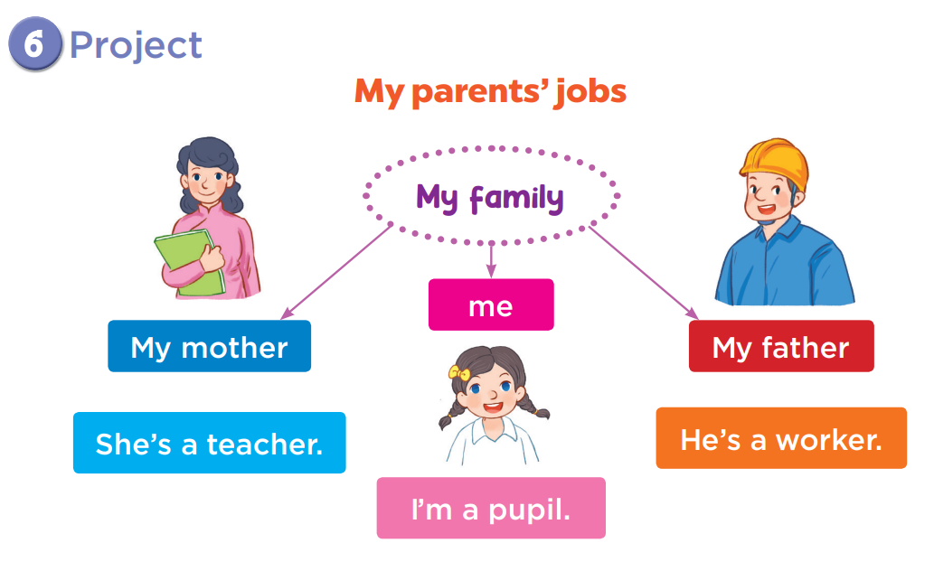

Slide 34
5
Fun corner and wrap-up
Notes:
Game: Guessing game
Step 1: Divide the class into 4 teams.
Step 2: Invite 1 pupil from each team to come to the board and do action about a job.
Step 3: Pupils from other teams will guess what the job is.
Step 4: Give points for the teams.

Slide 35

a teacher
Guessing
game

Slide 36

a driver
Guessing
game

Slide 37

a worker
Guessing
game

Slide 38

a nurse
Guessing
game

Slide 39

a farmer
Guessing
game

Slide 40

a cook
Guessing
game

Slide 41

a singer
Guessing
game

Slide 42

a doctor
Guessing
game

Slide 43

Website: hoclieu.vn
Fanpage: facebook.com/www.tienganhglobalsuccess.vn

