Slide 1


Slide 2

FUN TIME 3
Period 2

Slide 3

Table of contents
01
Warm-up and Review
02
Activity 3.Match and say.
03
Activity 4. Let’s play.
04
Fun corner and Wrap-up

Slide 4


01
Warm-up and Review

Slide 5


Stop The Bus!
GAME

Slide 6


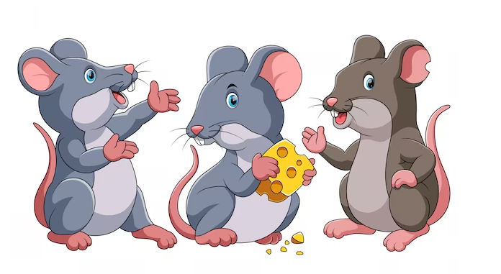

Notes:
Nháy vào hình ảnh bus stop lần 1 để dừng xe. Nháy lần 2 để hiện vỗ tay

Slide 7


Slide 8
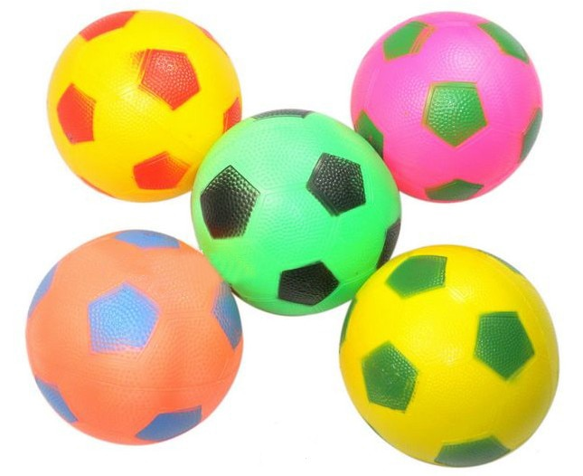

Slide 9


Slide 10


Slide 11
Very Good!

Slide 12
02
Activity 3. Match and say.

Slide 13




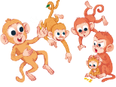
Match and say.
1.
five monkeys
a
2.
three clocks
b
3.
two locks
c
4.
four pots
d

Slide 14
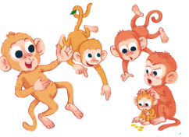
four pots
two locks
three clocks
five monkeys

Slide 15
03
Activity 4. Let’s play.

Slide 16

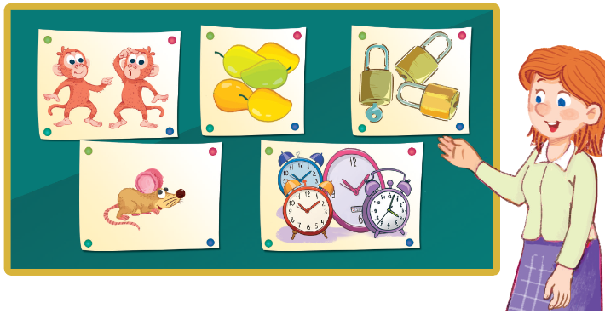
Let’s play.

Slide 17

Kim’s game

Slide 18

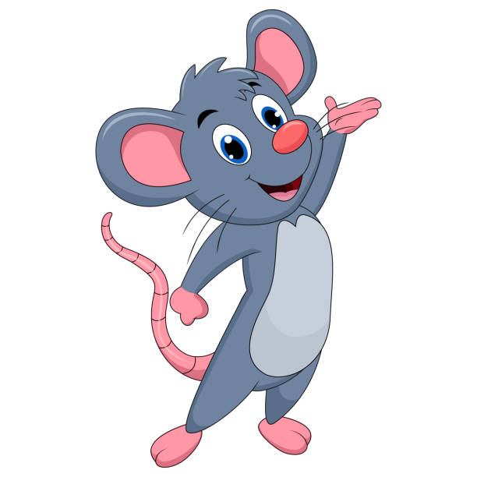
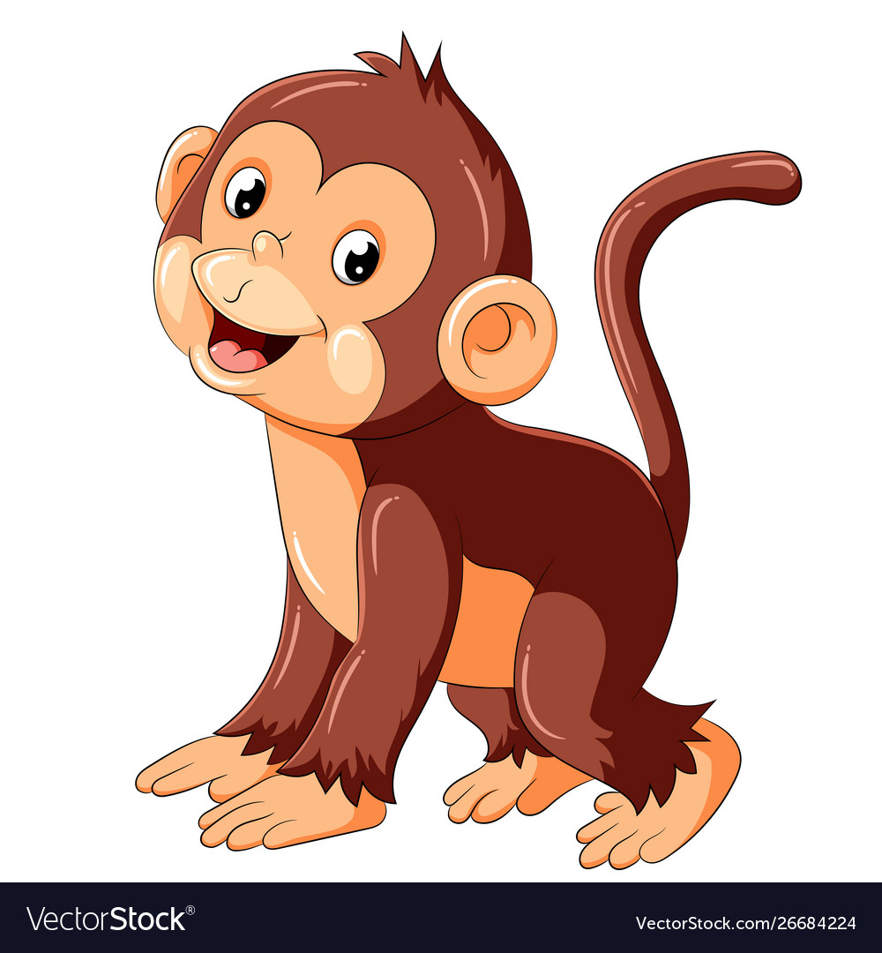
Kim’s game
Team Monkey
Team Mouse

Slide 19




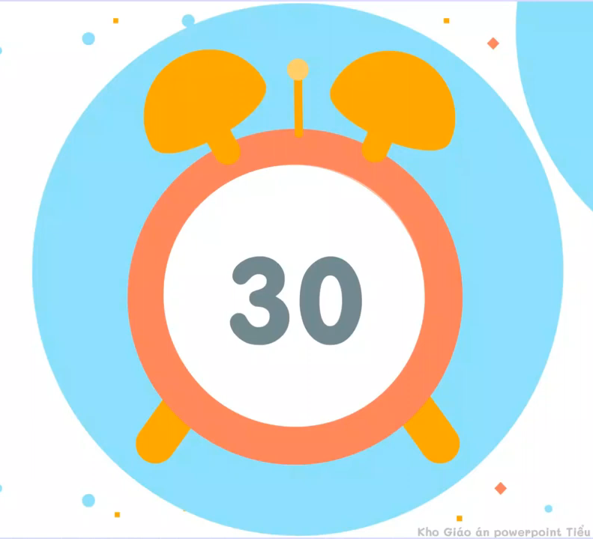
1
2
3
4
5
6
five mangos
Notes:
Sau khi hết 30 giây từ khoá xuất hiện, HS chọn 1 ô chữ, nếu chọn đúng ô chữ biến mất.

Slide 20
1
2
3
two monkeys
4
6
five mangos

Slide 21
1
3
two monkeys
three
locks
4
6
five mangos

Slide 22
1
two monkeys
three locks
four clocks
4
6
five mangos

Slide 23
four clocks
two monkeys
three locks
one mouse
4
6
five mangos

Slide 24
four clocks
two monkeys
three locks
one bus
6
one mouse
five mangos

Slide 25

Summary
Point
Point
Notes:
GV nháy vào biểu tượng của đội chơi để tính điểm cho các đội. Mỗi lần nháy 1 ngôi sao xuất hiện.

Slide 26

Win!

Slide 27

two monkeys
five mangos
three locks
one mouse
four clocks

Slide 28
04
Fun corner and Wrap-up

Slide 29



Answer the questions.
How many mangos?
Four mangos.

Slide 30

Answer the questions.
How many hats?
Five hats.

Slide 31

Answer the questions.
How many clocks?
One clock.

Slide 32

Answer the questions.
How many bags?
Two bags.

Slide 33

Answer the questions.
.
How many dogs?
Four dogs

Slide 34

Answer the questions.
How many fishs?
Three fish.

Slide 35
Very Good!

Slide 36
Website: hoclieu.vn
Fanpage: https://www.facebook.com/tienganhglobalsuccess.vn/

