Slide 1
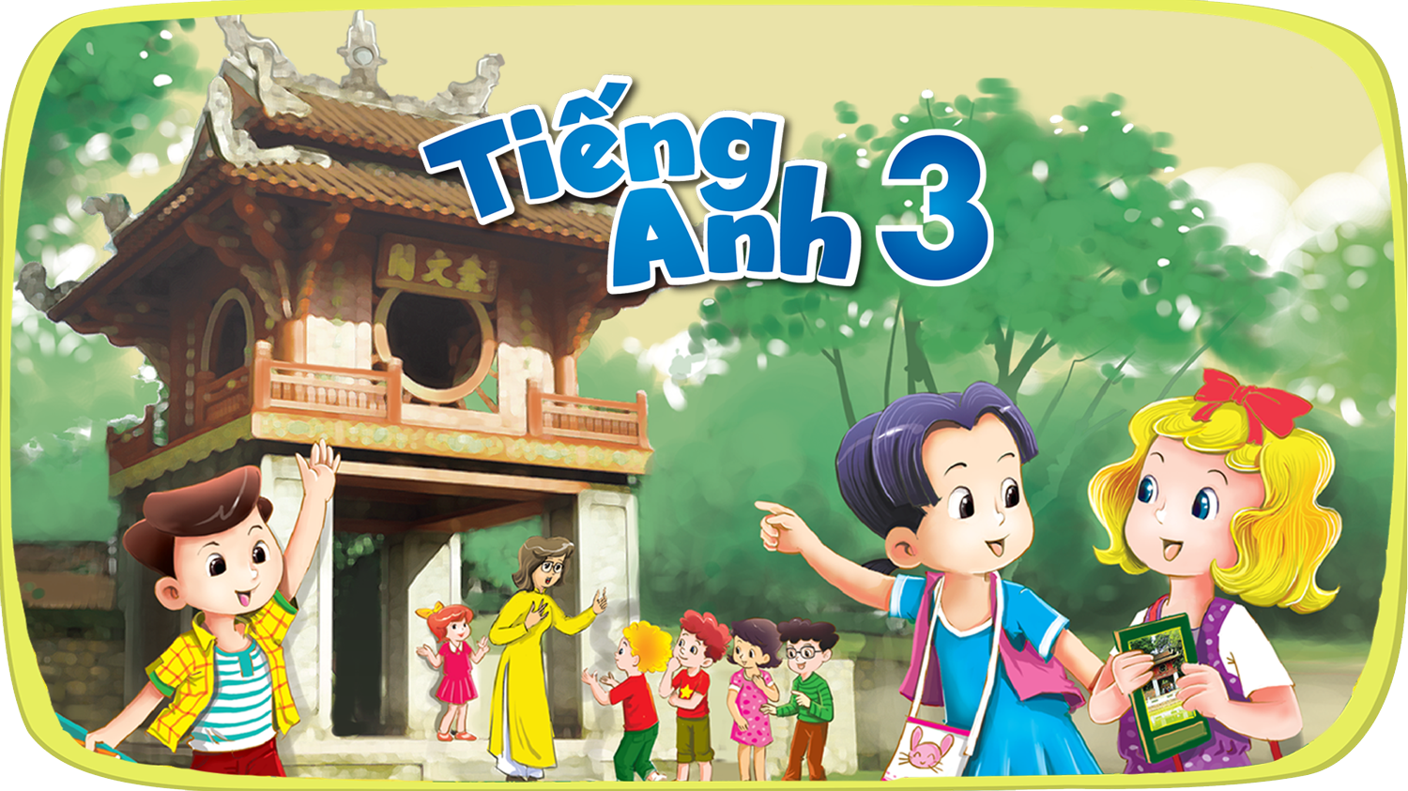




Slide 2
Unit 13
Appearance
Lesson 1 - Period 1

Slide 3
Table of contents
01
Warm-up and review
04
02
03
Let's talk.
Look, listen and repeat.
05
Fun corner and wrap-up
Listen, point and say.

Slide 4
Warm-up
01
Complete the family tree!
Options:
Easy
Advanced

Slide 5
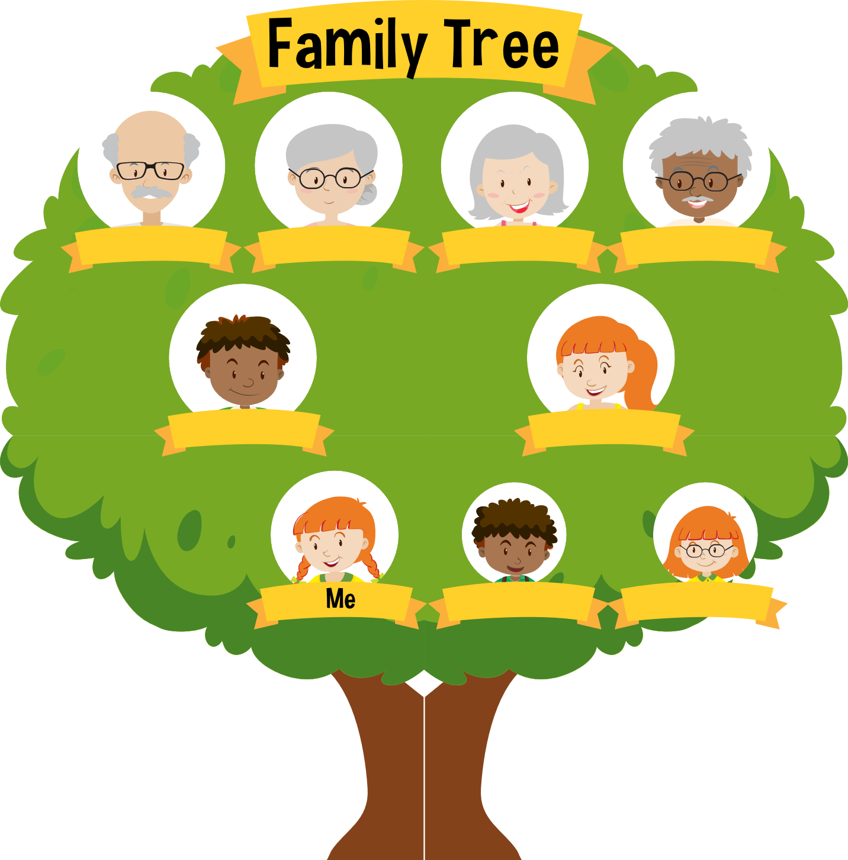
Grandfather
Grandmother
Grandmother
Grandfather
Father
Mother
Brother
Sister

Slide 6

Grandfather
Grandmother
Father
Mother
Uncle
Aunt
Sister
Brother
Cousin

Slide 7
02
Look, listen and repeat.

Slide 8

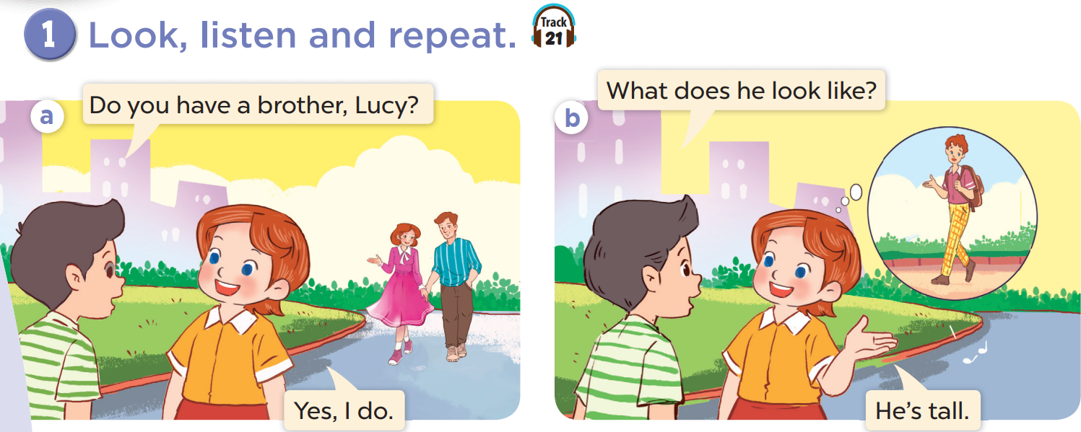
Who is he? Who is she?
Look at Lucy's brother. Is he tall or short?

Slide 9
Look, listen and repeat.

Slide 10
03
Listen, point and say.

Slide 11
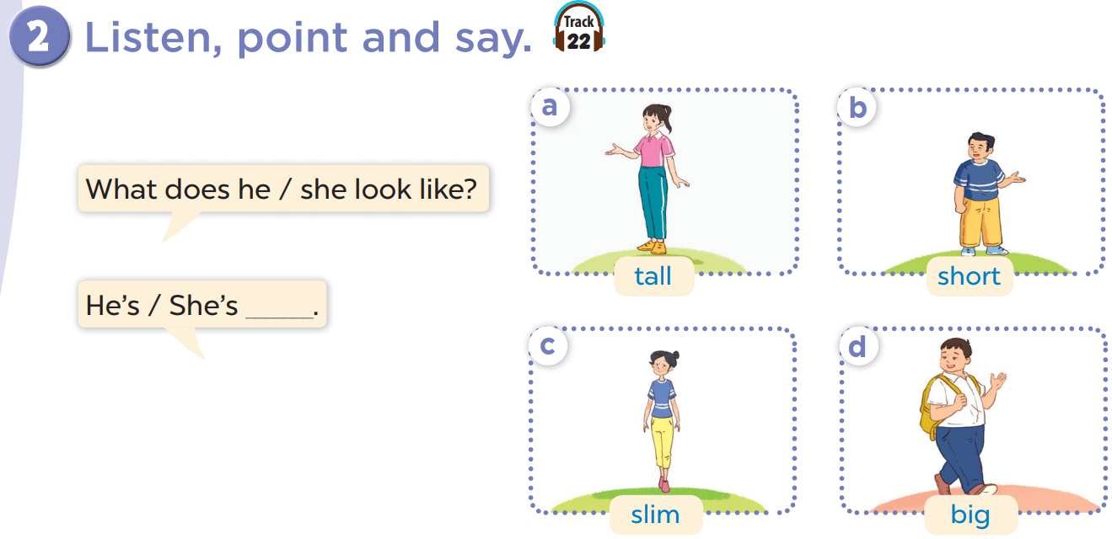
Listen, point and say.
Work in pairs. Practise.
Notes:
Click on the Speaker Icon to play the audio.

Slide 12
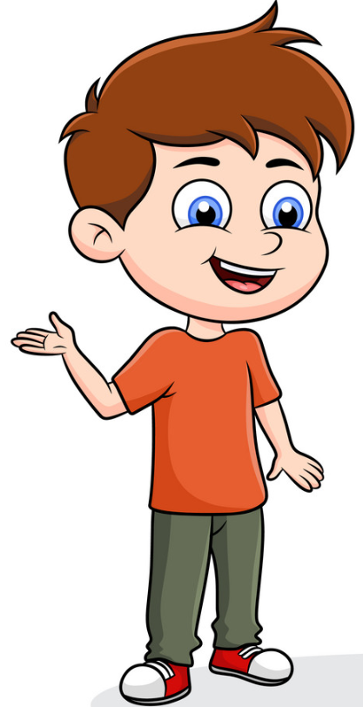


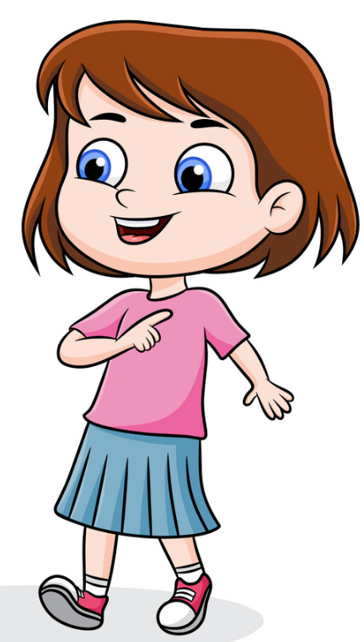
What does she look like?
She is slim.

Slide 13
What does he/she look like?
He/She is _____.

Slide 14
04
Let's talk.

Slide 15
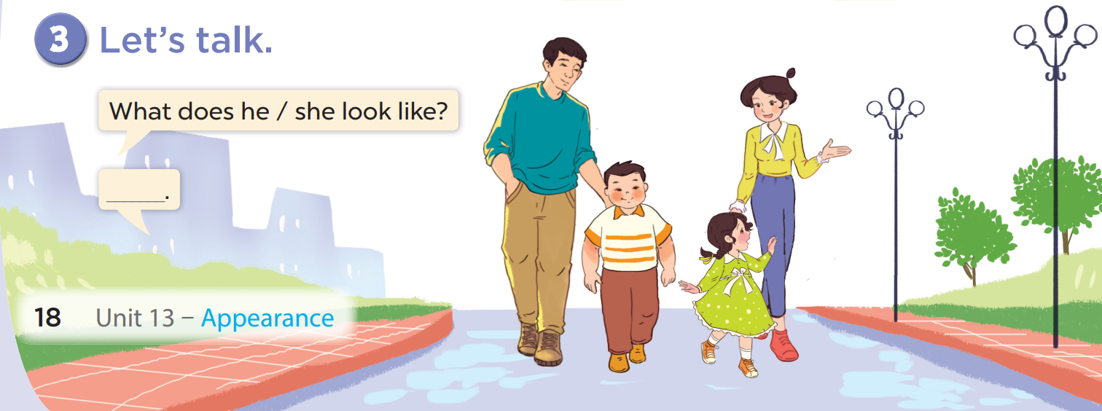

Slide 16
Fun corner and wrap-up
05

Slide 17

Choose a number and answer
Sound file is in me!
1.
2.
3.
4.
5.
6.
7.
8.
9.
10.
Notes:
Main question slide.

Slide 18

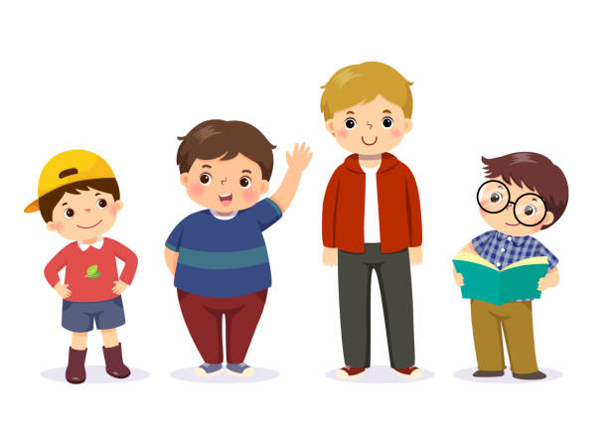

What does Tim look like?
Tim
Ben
He is tall.

Slide 19
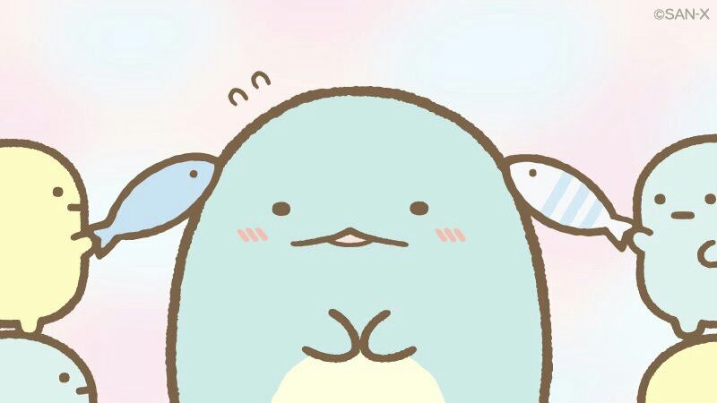





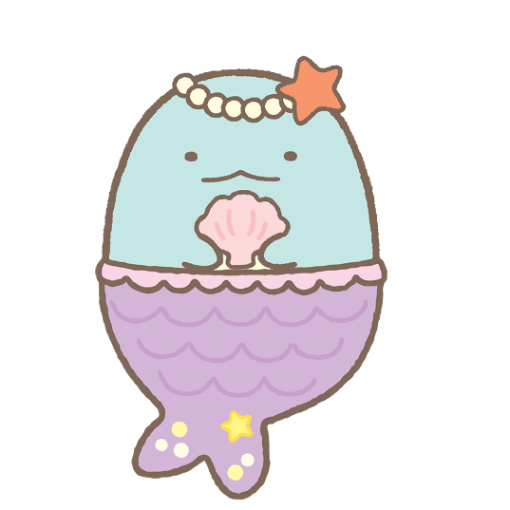



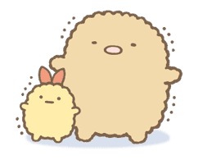



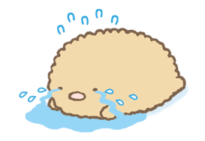
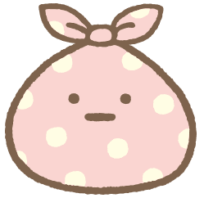
Sound file is in me!
1.
2.
Change points
+7
-3
+7
3.
4.
Notes:
Choice slide. Click on the character in the bottom right hand corner to go to the points counter.

Slide 20
What does Ben look like?
Tim
Ben
He is short.
Notes:
Question two.

Slide 21

Sound file is in me!
+3
Notes:
Click on the character in the bottom right hand corner to go to the points counter slide.

Slide 22
What does he look like?
He is big.
Notes:
Question three.

Slide 23

Sound file is in me!
+5
Notes:
Click on the character in the bottom right hand corner to go to the points counter slide.

Slide 24
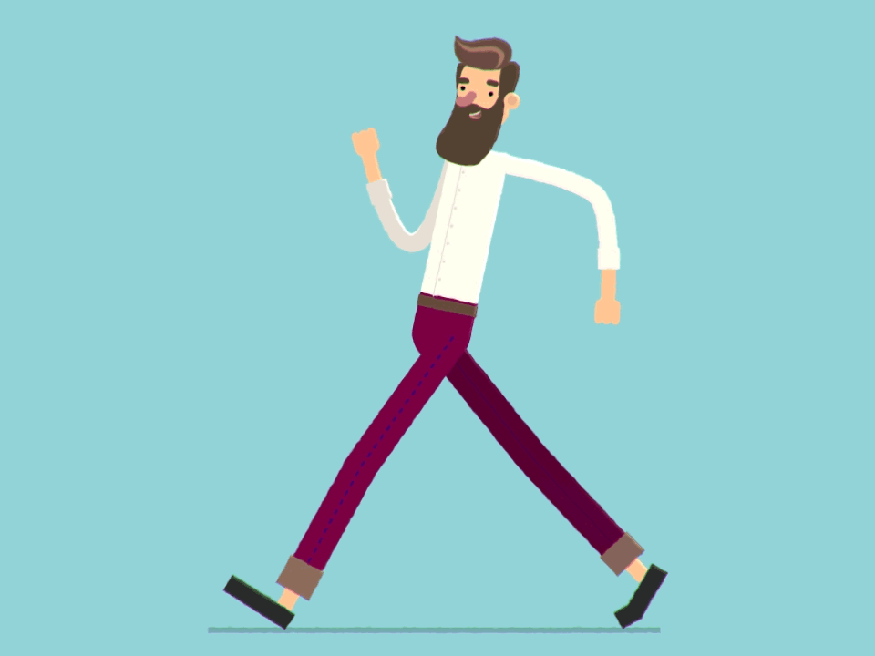
What does he look like?
He is tall and slim.
Notes:
The answers can vary: He is tall. / He is slim. / He is tall and slim.

Slide 25
Sound file is in me!
1.
2.
-3
Change points
+7
+7
3.
4.
Notes:
Choice slide. Click on the character in the bottom right hand corner to go to the points counter slide.

Slide 26
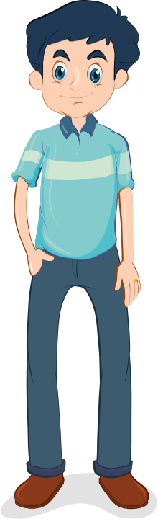
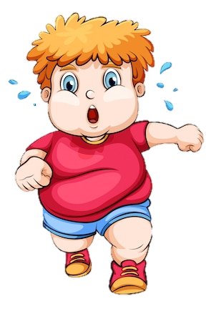
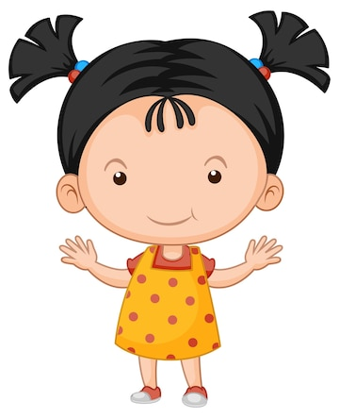
What does your father look like?
He is tall.
Notes:
Question five.

Slide 27
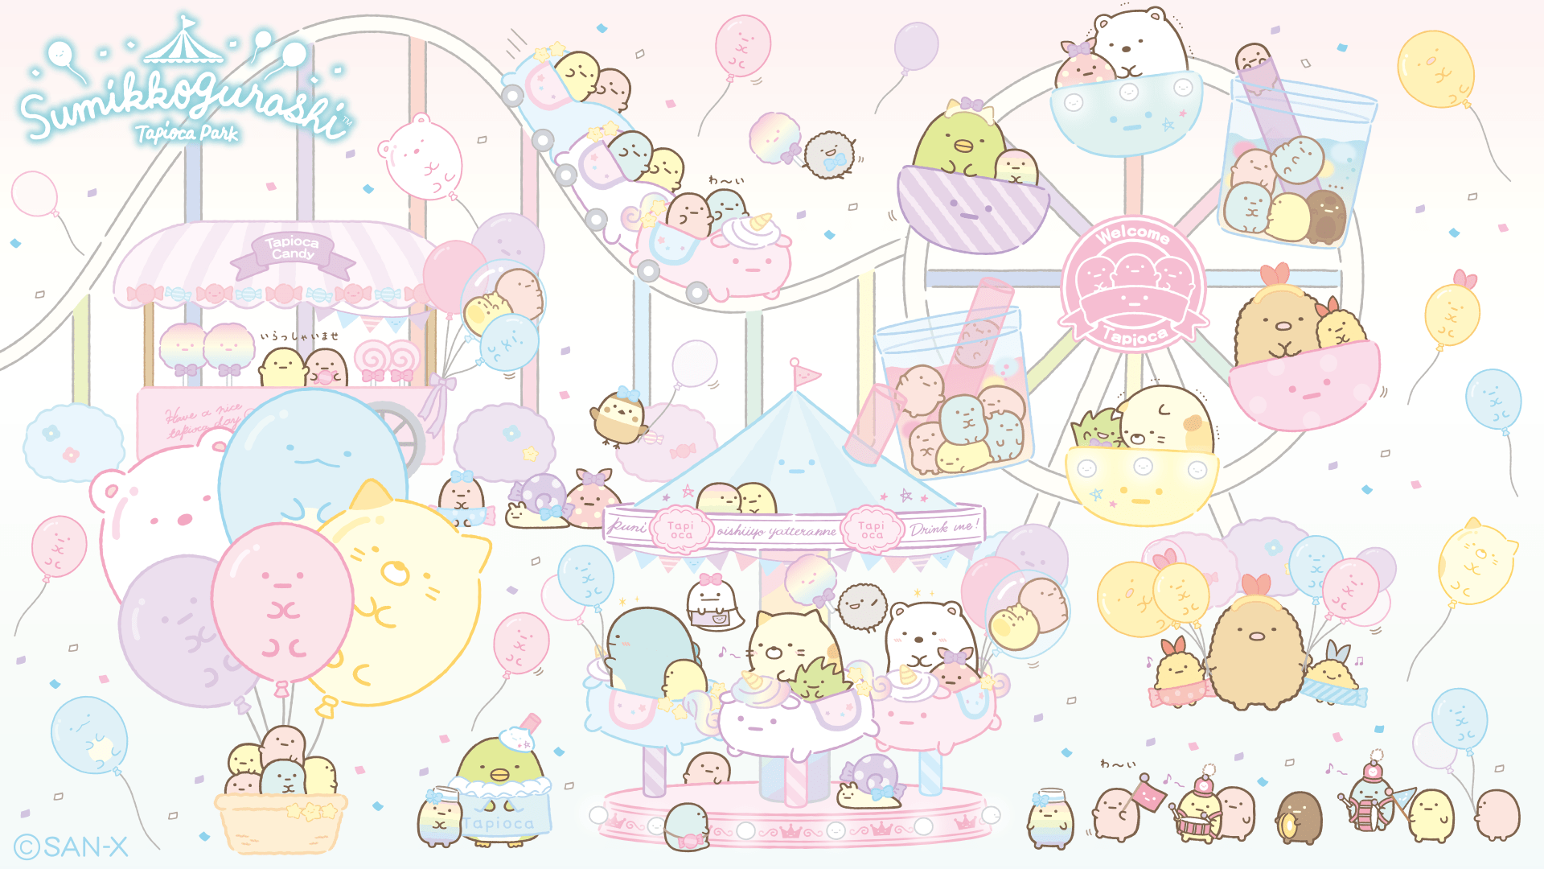

Sound file is in me!
-3
Notes:
Minus three points. Click on the crying cat to go to the points counter slide.

Slide 28
What does your mother look like?
She is slim.
Notes:
Question six.

Slide 29
Sound file is in me!
+7
Notes:
Click on the character in the bottom right hand corner to go to the points counter slide.

Slide 30
What does your brother look like?
He is big.
Notes:
Question seven.

Slide 31
Sound file is in me!
1.
2.
-3
+7
-3
+7
3.
4.
Notes:
Choice slide. Click on the character in the bottom right hand corner to go to the points counter slide.

Slide 32
What does your sister look like?
She is short.
Notes:
Question eight.

Slide 33
Sound file is in me!
+6
Notes:
Click on the character in the bottom right hand corner to go to the points counter slide.

Slide 34
What does he say?
.......................?
He is tall.
What does he look like?
Notes:
Question nine.

Slide 35
Sound file is in me!
+3
Notes:
Click on the character in the bottom right hand corner to go to the points counter slide.

Slide 36
What does he say?
.........your mother.......?
She is big.
What does your mother look like?
Notes:
Question ten.

Slide 37


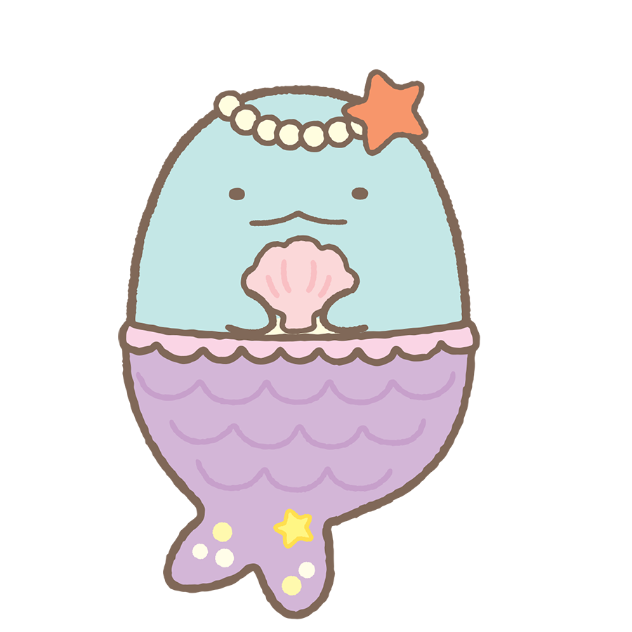
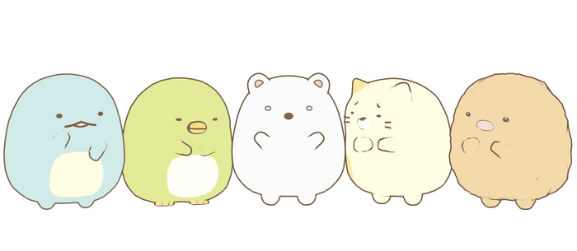
Sound file is in me!
Change points
Notes:
Change points. Click on the background to go back to the points counter slide.

Slide 38


Team one
Team two
9
8
7
5
6
4
0
1
0
1
2
9
8
7
6
5
3
4
2
3
9
8
7
5
6
4
0
1
9
8
7
5
6
4
1
3
0
2
3
2
Team three
Team four
9
8
7
5
6
4
0
1
9
8
7
6
5
4
3
2
1
0
9
8
7
6
5
4
0
1
9
8
7
6
5
4
3
2
1
3
3
0
2
2
Notes:
This is the points counter. Click on the character in the middle to go back to the main question slide. Let students change the team names and change the text as needed.

