Slide 1
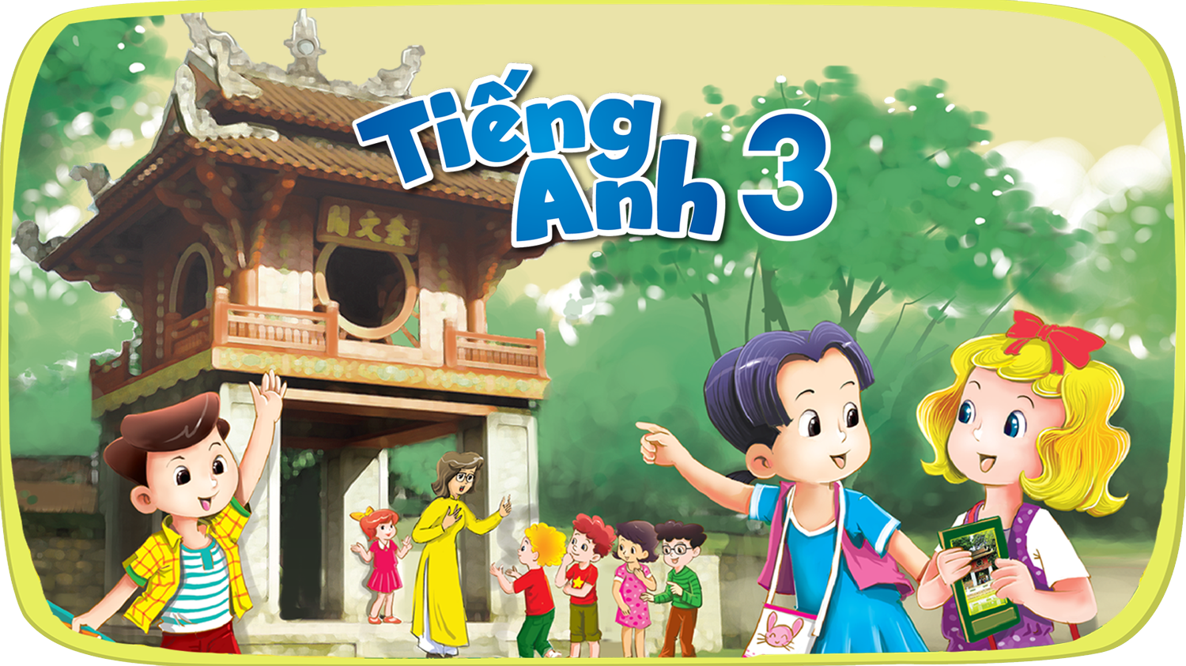




Slide 2
Unit 13
Appearance
Lesson 1 - Period 2

Slide 3
Table of contents
01
Warm-up and review
04
02
03
Listen, point and say.
Listen and tick.
05
Fun corner and wrap-up
Look, listen and repeat.

Slide 4

Slap the board
01
Choose the correct answer.

Slide 5
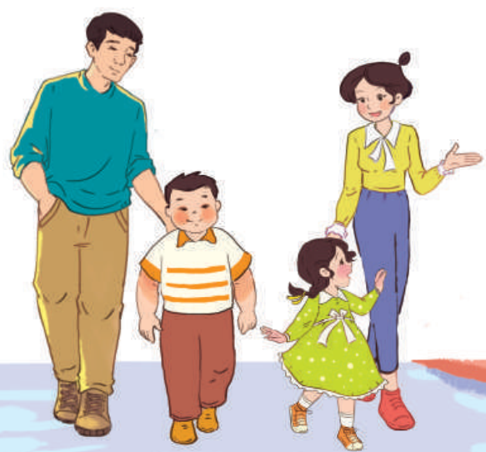
What's the missing letter?
SL_M
I
I
O
A
A
B
C

Slide 6
What's the missing letter?
TA_L
L
I
L
N
A
B
C

Slide 7
What's the missing letter?
BI_
G
Y
O
G
A
B
C

Slide 8
What are the missing letters?
SH_ _T
OR
AR
OR
ON
A
B
C

Slide 9
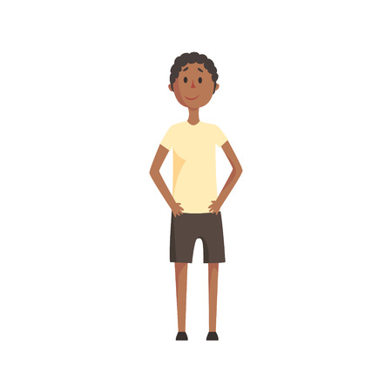


This is my brother. He is slim.
z
A
B
C

Slide 10
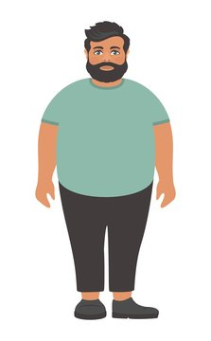

This is my mother. She is tall.
z
A
B
C

Slide 11
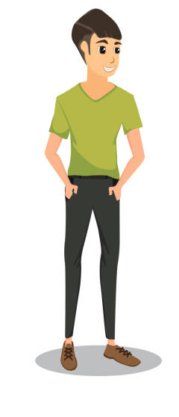
This is my father. He is big.
z
A
B
C

Slide 12
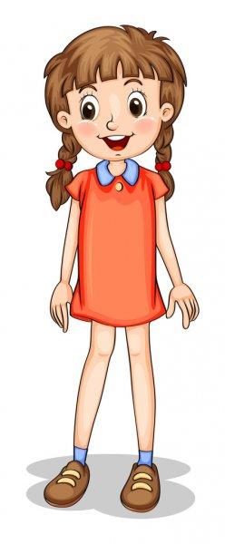

This is my sister. She is short.
z
A
B
C

Slide 13
02
Listen and tick.

Slide 14
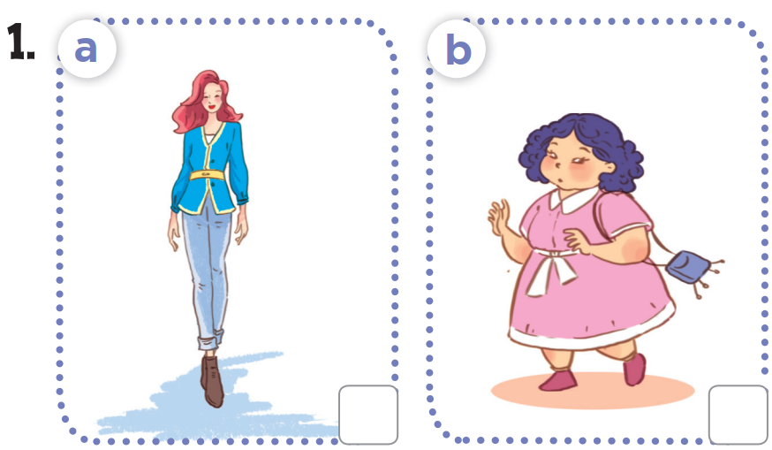
Look at the pictures.
What can you see in each picture?
How are they different?

Slide 15
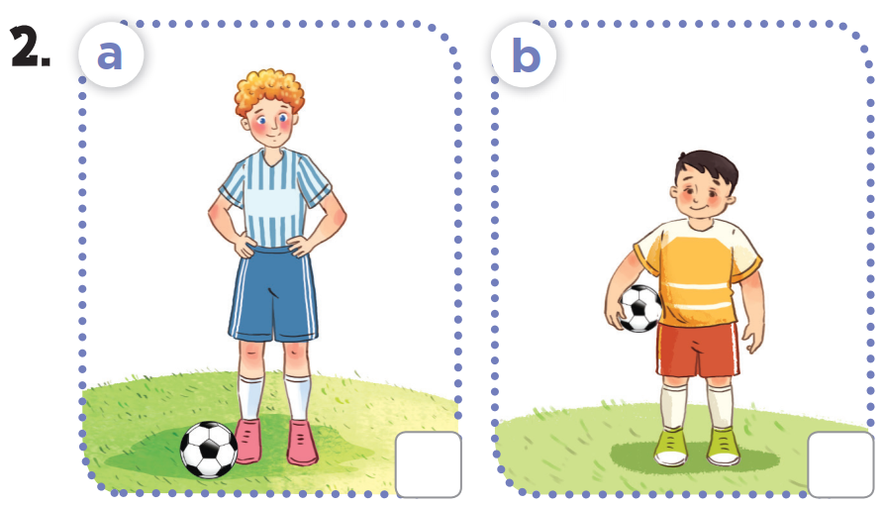
Now look at pictures 2a and 2b.
What can you see in each picture?
How are they different?
Notes:
suggested answer:
- I see two women. / I see two girls.
- One is slim/tall. The other is short/big.

Slide 16

Listen and tick.

Notes:
Click on the audio icon to listen again (if needed).

Slide 17
Listen and tick.

Notes:
Click on the audio icon to listen again (if needed).

Slide 18
03
Look, complete and read.

Slide 19
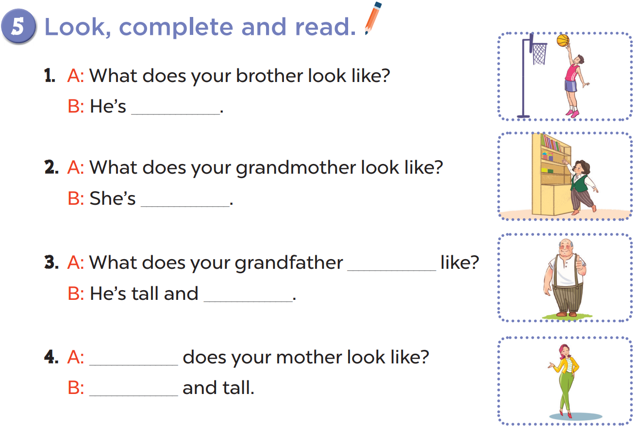
tall
short
look
big
What
She's slim

Slide 20
Practise in pairs.
tall
short
Act it out!
look
big
What
She's slim

Slide 21
04
Let's sing.

Slide 22
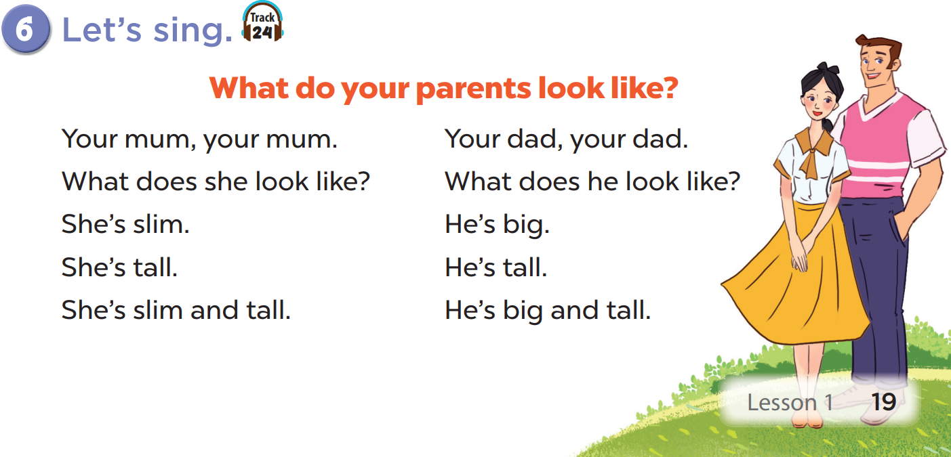
Read the lyrics

Slide 23
Listen.
Practise line by line.
Sing the song.

Slide 24
05
Fun corner and wrap-up
Learn more words - Then have fun!

Slide 25
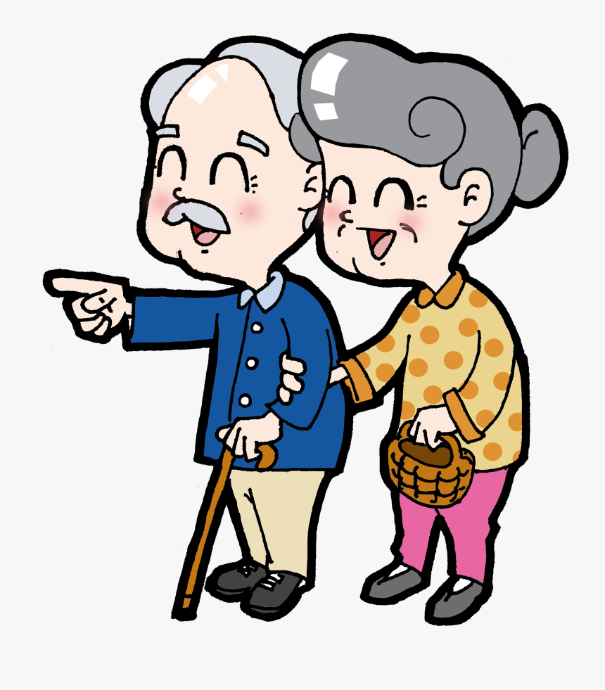
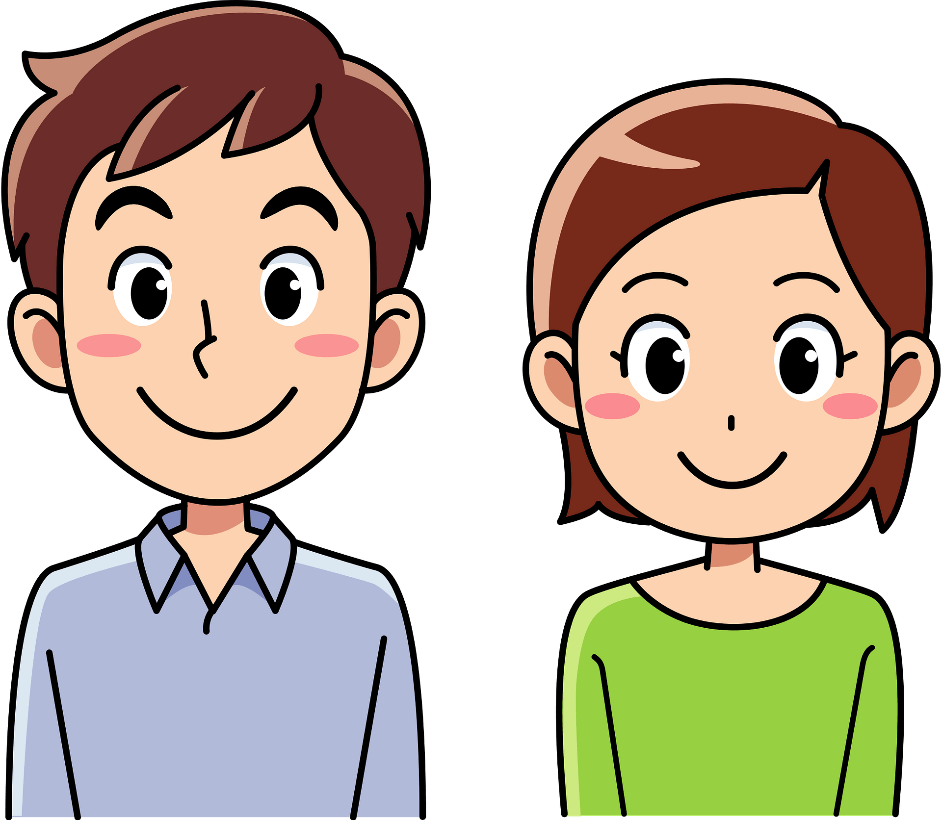
More words
young
old

Slide 26

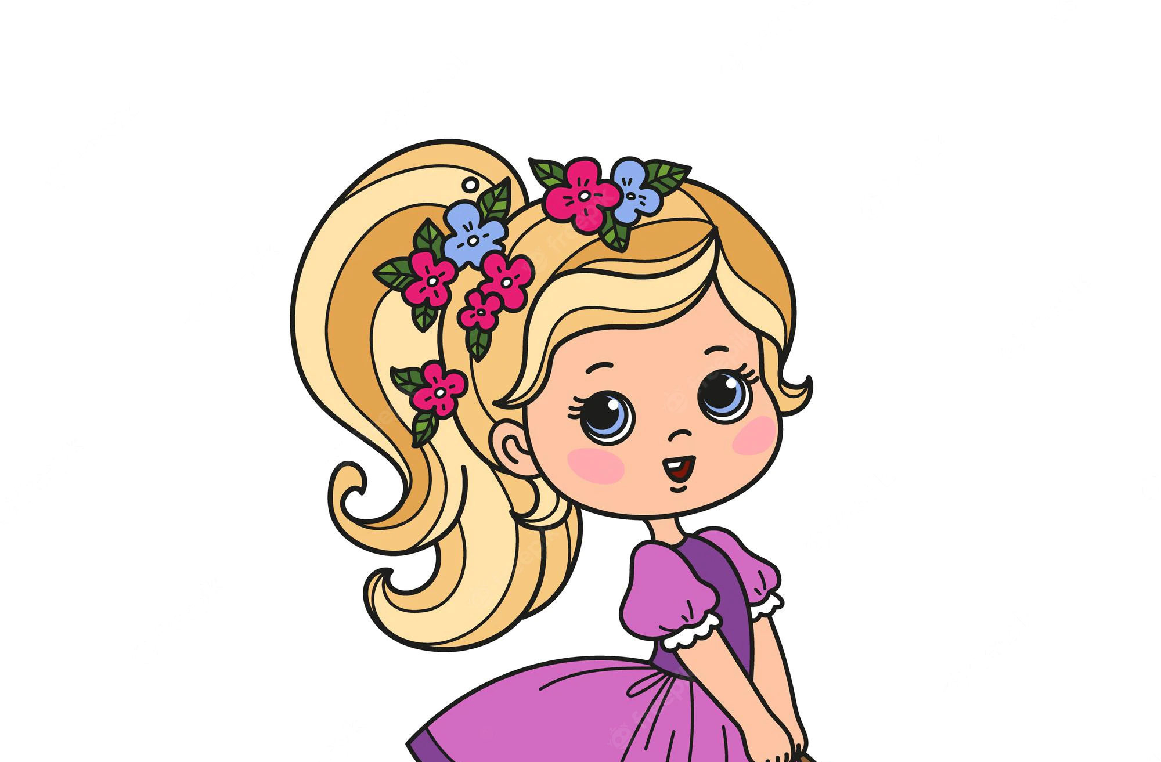

More words
beautiful
handsome

Slide 27
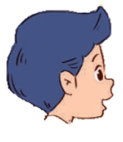
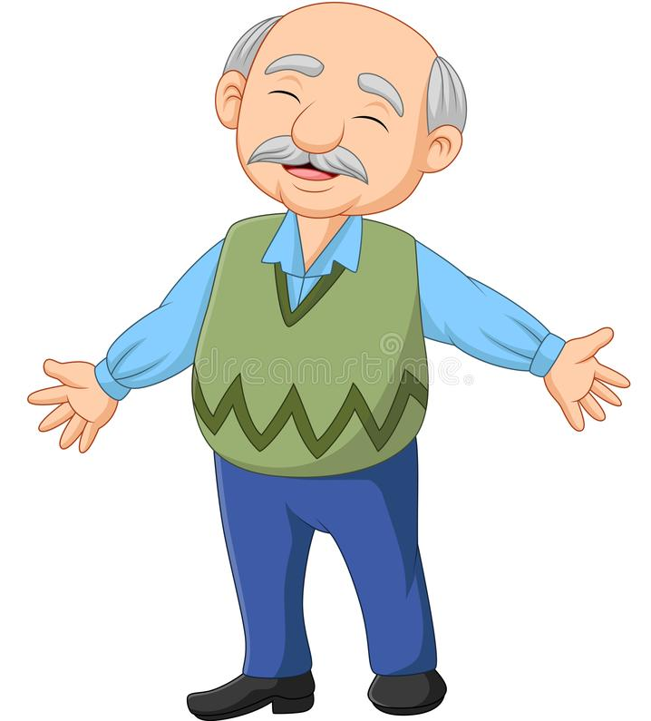

What does your grandpa look like?
He is old and short.

Slide 28

What does your sister look like?
She is slim and beautiful.

Slide 29
What does he/she look like?
He/She is ___ (and ___).

Slide 30


Get the
ANSWER

Slide 31

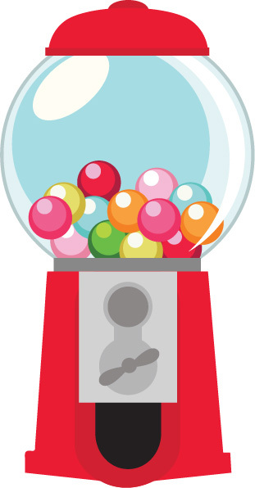



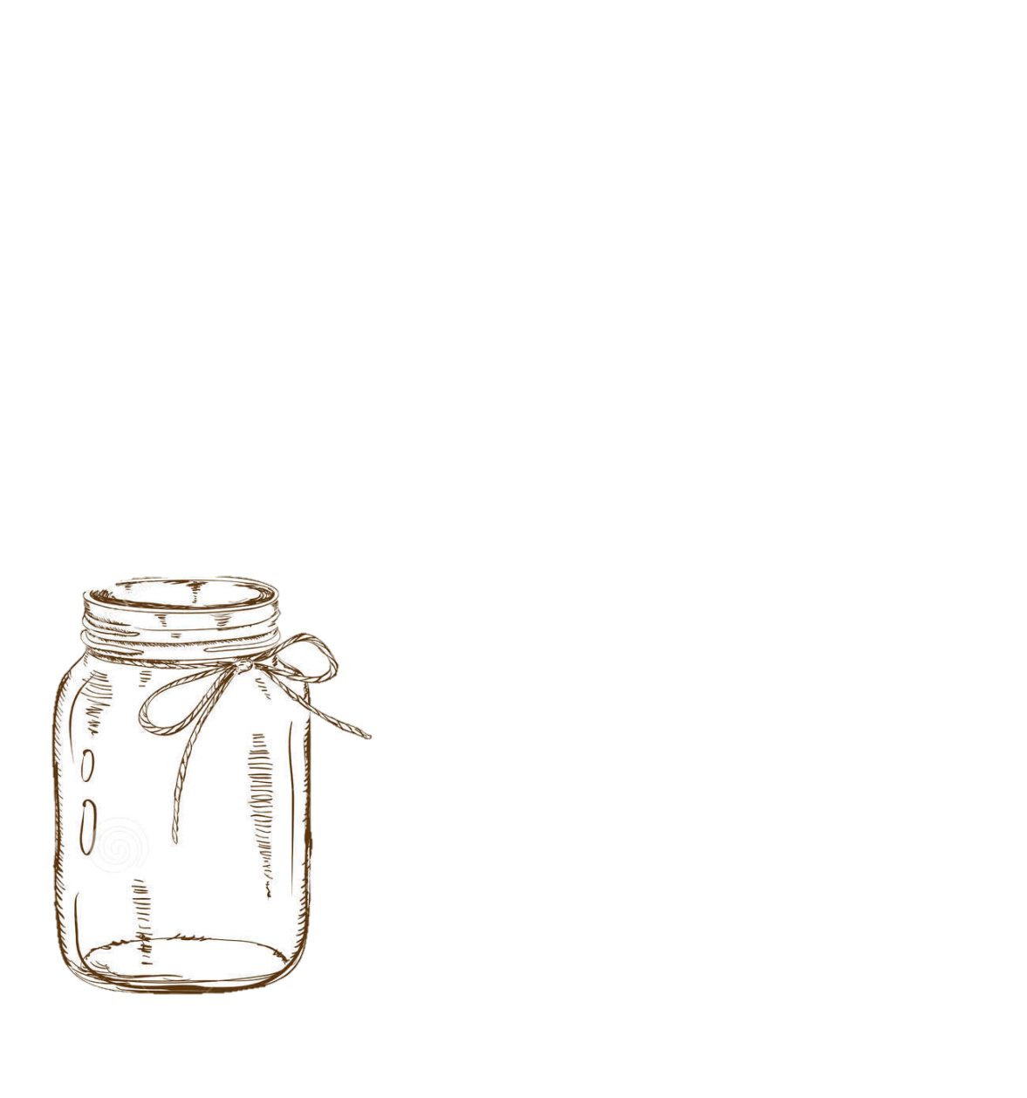
1
2
3
1
2
3
4
4
Notes:
Play in 2 teams
Answer questions to get candies.
Click the number to go to the question.
If right answer, yellow team clicks yellow play button, blue team clicks blue play button to get candies into the jars.

Slide 32

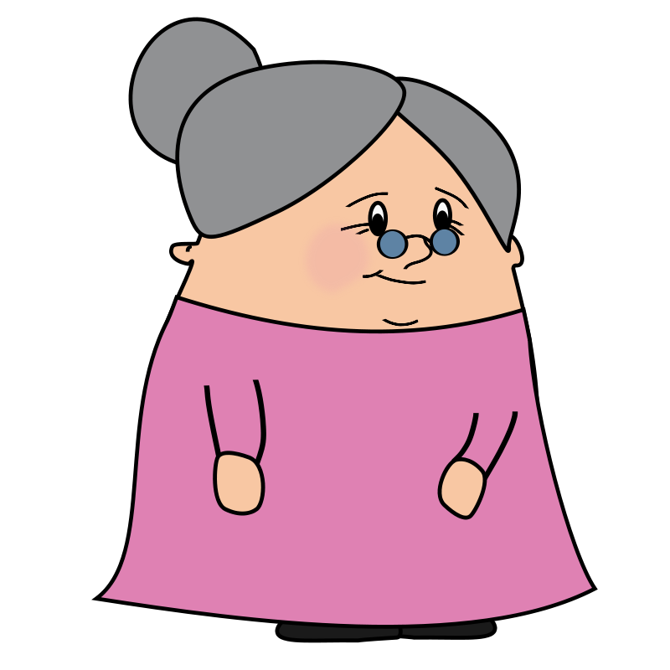
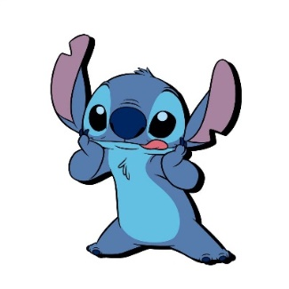

What does she look like?
A.She's old and short.
B.She looks old and short.
A
Notes:
Ask students to answer the questions. Click the candy to go the candy slide.

Slide 33
- ___ does he look like?
- He is tall.
A. What
B. How
A

Slide 34
What does he look like?
A. and short
B. short
He is handsome______.
and short
Notes:
Ask students to answer the questions. Click the candy to go the candy slide.

Slide 35
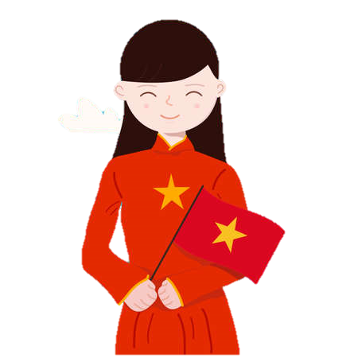
She ___ beautiful.
A. are
B. is
B
Notes:
Ask students to answer the questions. Click the candy to go the candy slide.

Slide 36
What does your father ___ like?
A. look
B. looks
A
Notes:
Ask students to answer the questions. Click the candy to go the candy slide.

Slide 37
My sister __ slim and beautiful.
A. is
B. look
A
Notes:
Ask students to answer the questions. Click the candy to go the candy slide.

Slide 38
My brother ___ _______.
A. handsome is
B. is handsome
B
Notes:
Ask students to write answer on the board. Click the candy to go the candy slide.

Slide 39
What ___ she look ___?
A. is / like
B. does / like
C. does / look
B
Notes:
Ask students to answer the questions. Click the candy to go the candy slide.

