Slide 1



13
My house
LESSON 2 - PERIOD 4

Slide 2
TABLE OF CONTENTS
Warm-up and review
Listen and number.
1
2
3
4
Let’s play.
Look, circle and read.
5
Fun corner and wrap-up

Slide 3
1
Warm-up and review

Slide 4
Slap the board
Game

Slide 5
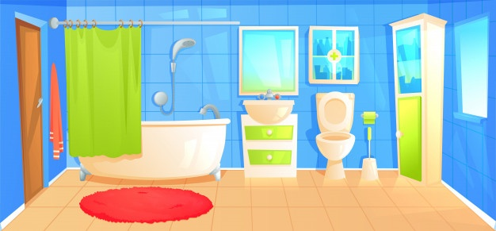
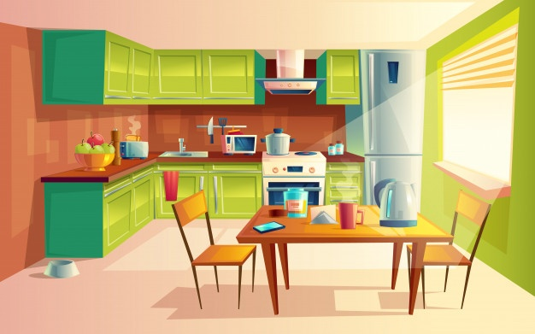
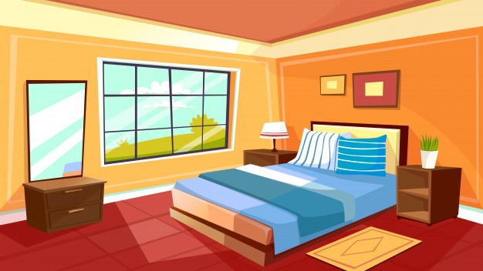


Notes:
Spend a few minutes revising the previous lesson by asking the class to play the game Slap the board

Slide 10
2
Listen and number.

Slide 11
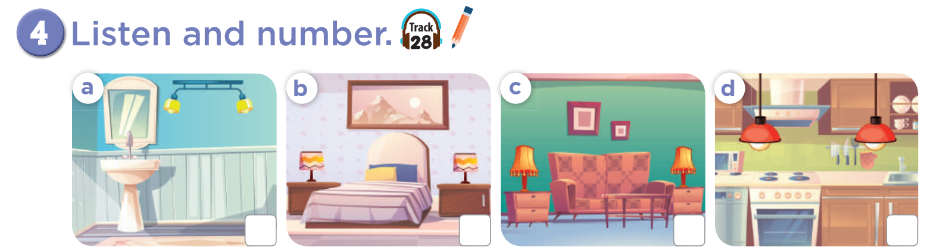

3
4
1
2

Slide 12
3
Look, circle and read. .

Slide 13
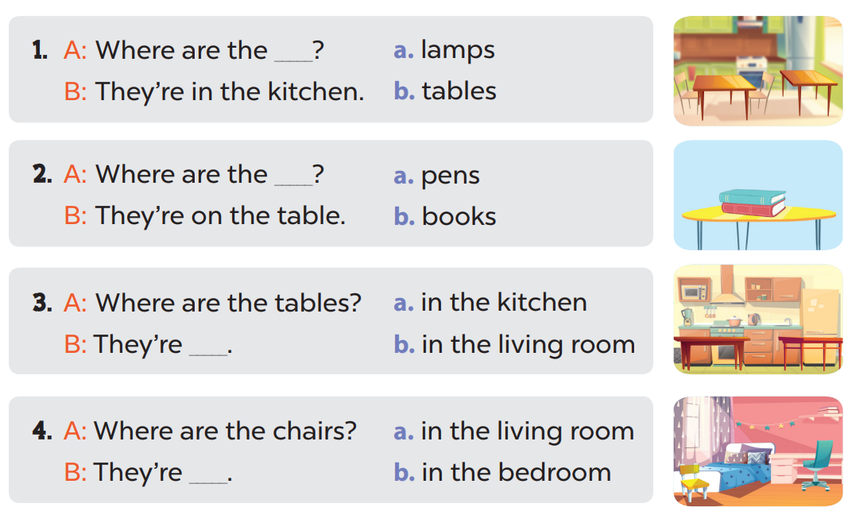

Slide 14
4
Let’s play.

Slide 15
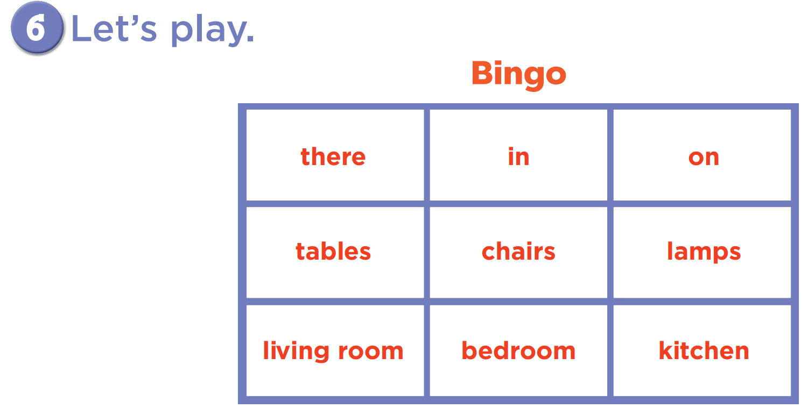

Slide 16
05
Fun corner and wrap-up

Slide 17


5
10
1
7
8
SPIN
-5
3
9
-3
4
6
2
tekhnologic
Notes:
Teacher calls some pairs to the board to practise asking and answering with the sentence models they have learnt.
Pupils/ teachers click the “spin” button to get points.

Slide 18

Website: hoclieu.vn
Fanpage: facebook.com/www.tienganhglobalsuccess.vn

