Slide 2







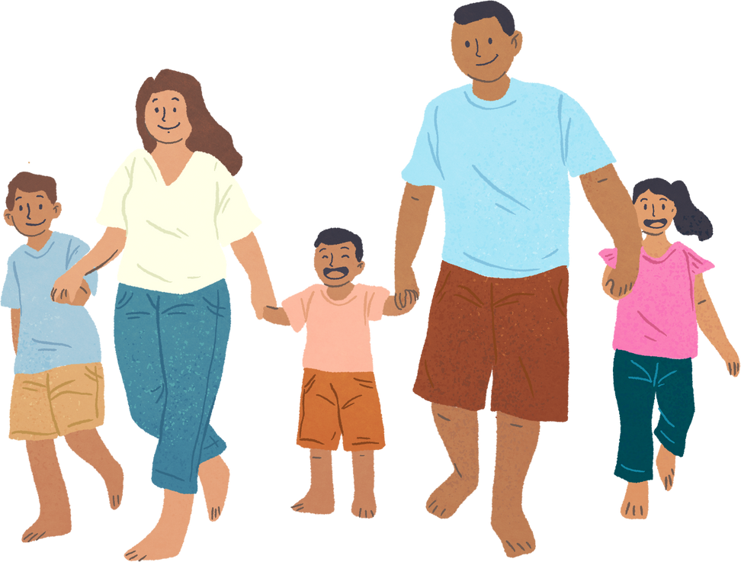

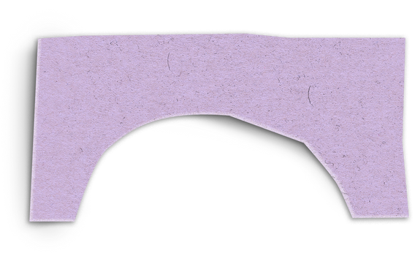
Unit 11: FAMILY TIME
Lesson 1 - Period 2

Slide 3






Table of contents
Warm-up and Review.
Activity 4: Listen and match.
Activity 5: Read and circle.
Activity 6: Listen, complete and sing.
Fun corner and Wrap-up.

Slide 4

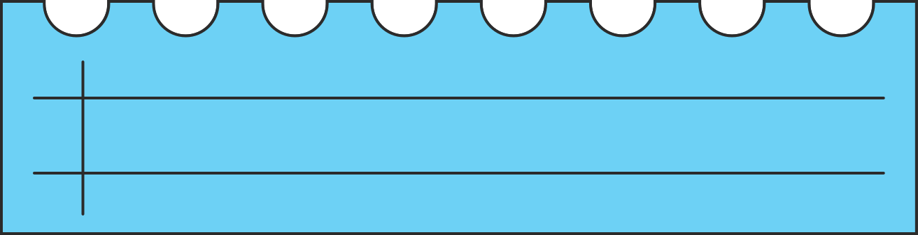






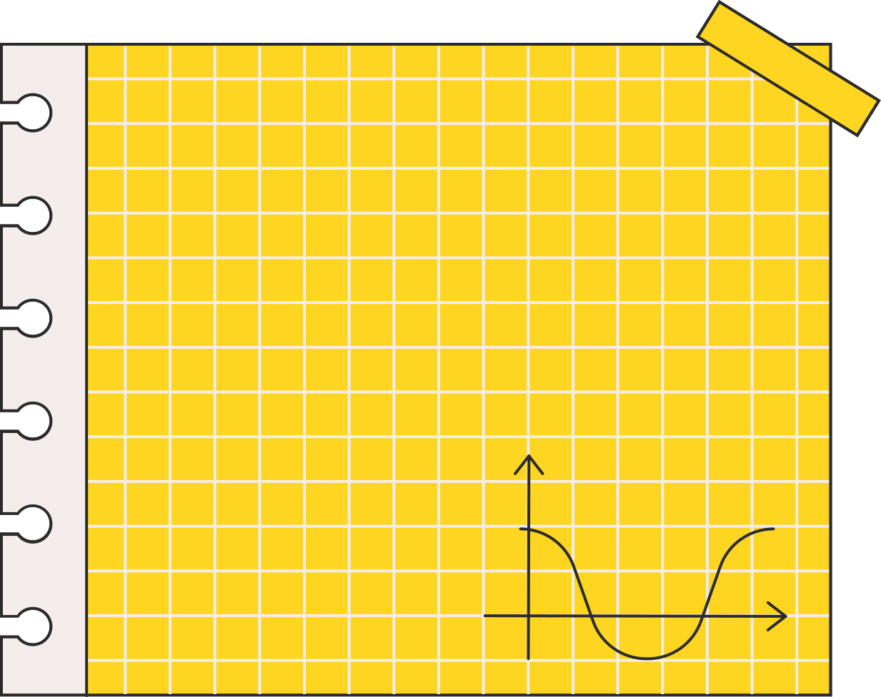



Warm-up and Review.
Let’s play a game.

Slide 5

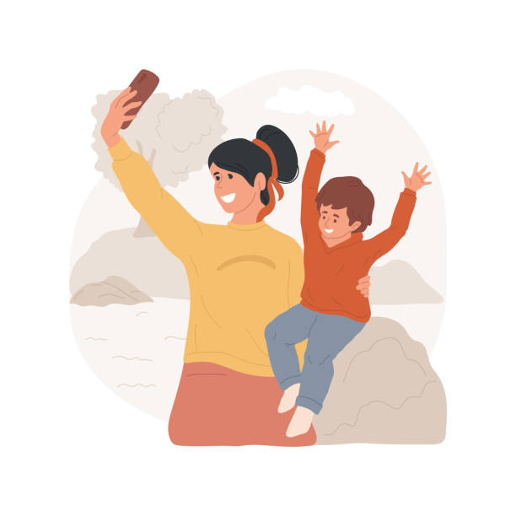
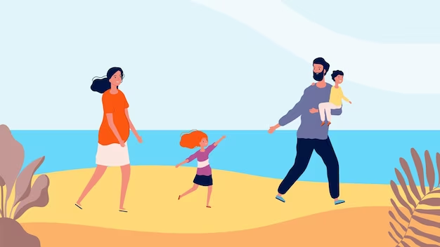
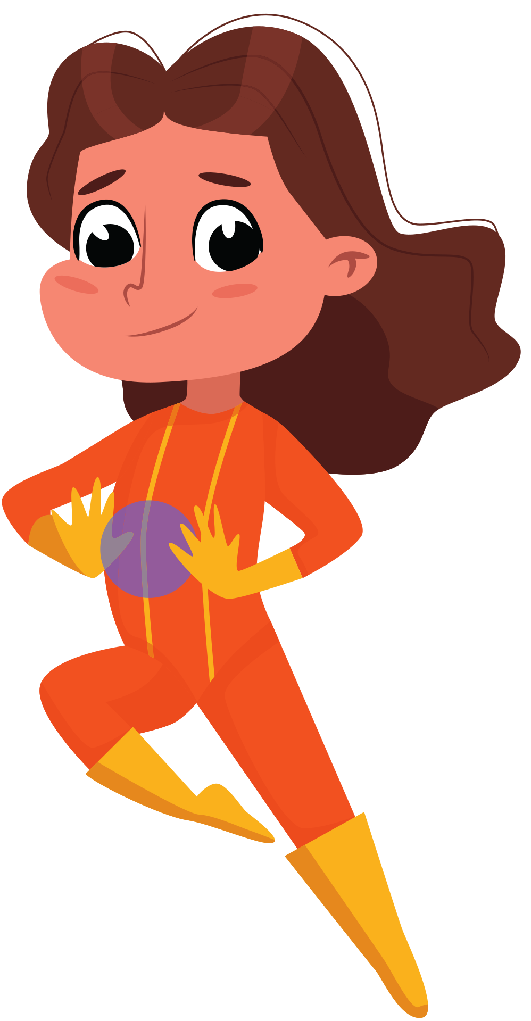
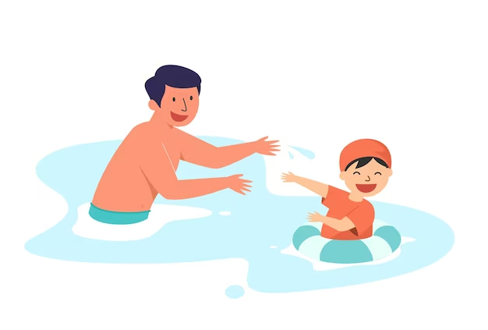
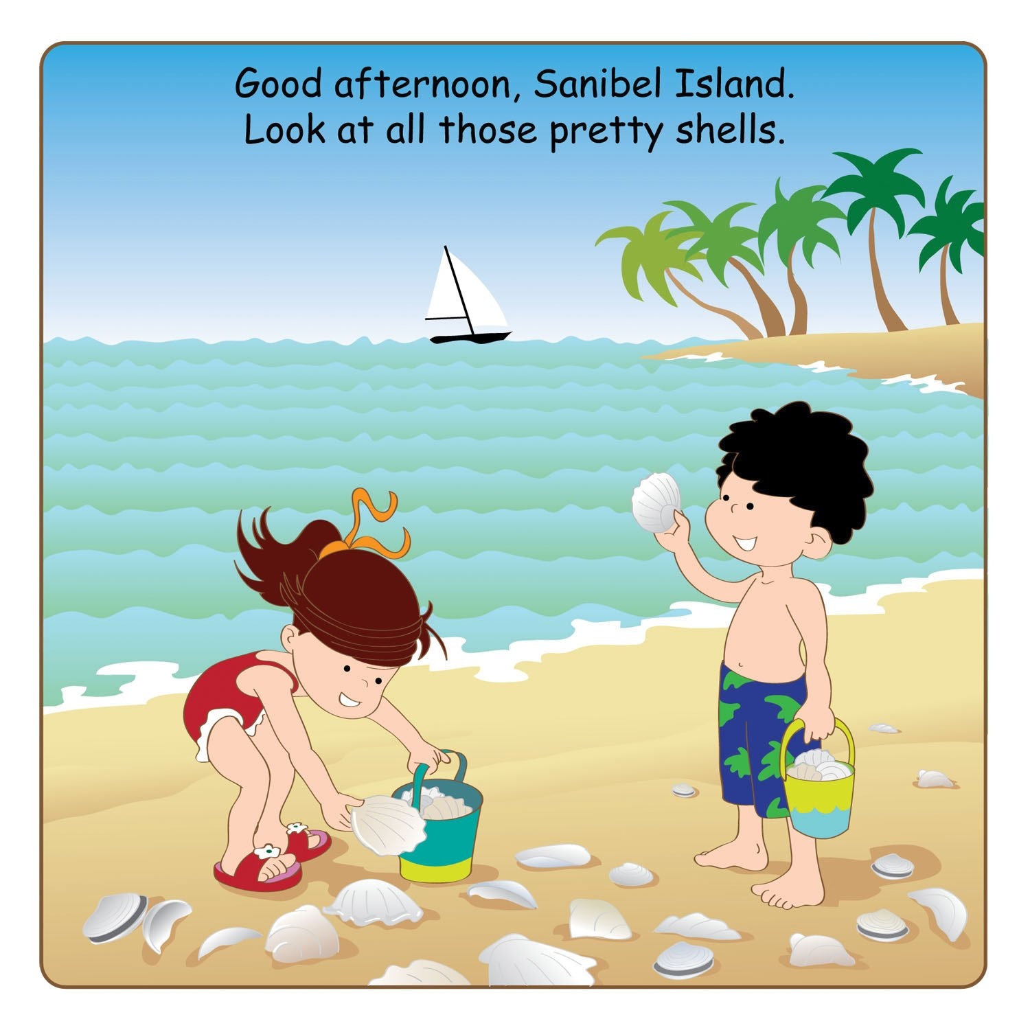
Quiz time!

Slide 6







We ____ on the beach last summer.
are
was
were

Slide 7

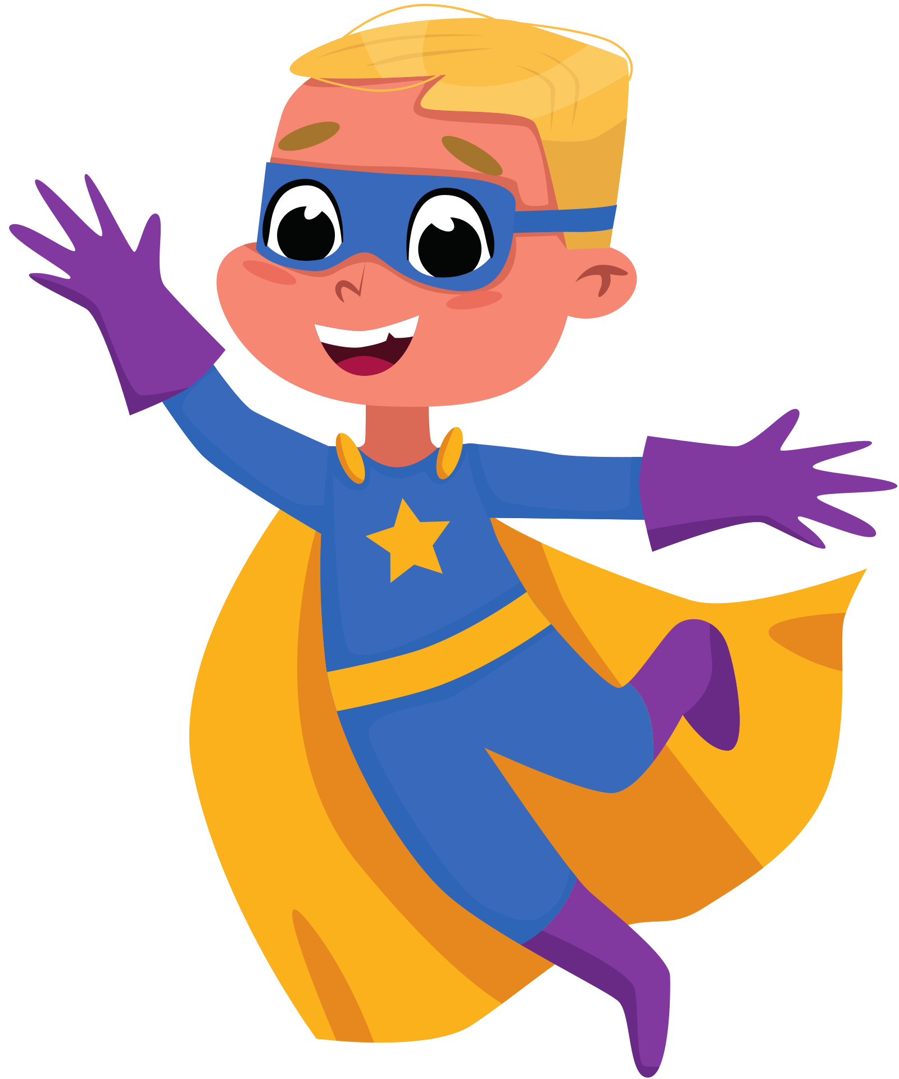
A: Did you take photos?
B: Yes, I did. I _____ photos with my mother.
take
took
taking

Slide 8

A: Did you ____?
B: Yes, I did. I swam with my father.
swim
swam
to swim

Slide 9

A: Did you ____ seashells?
B: Yes, I did. I ____ seashells with my sister.
collect/ collecting
collected/collect
collect/collected

Slide 10

My family walked ____ last Sunday.
in the park
on the beach
in the mountains

Slide 11

Great
job!

Slide 12

01
Activity 4
Listen and match.

Slide 13


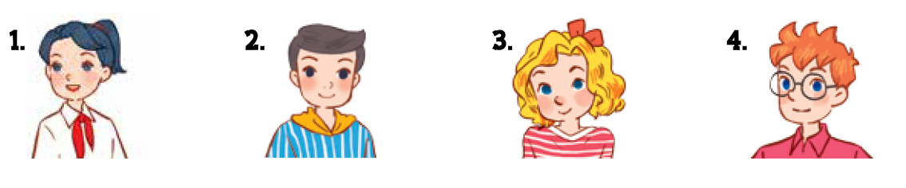

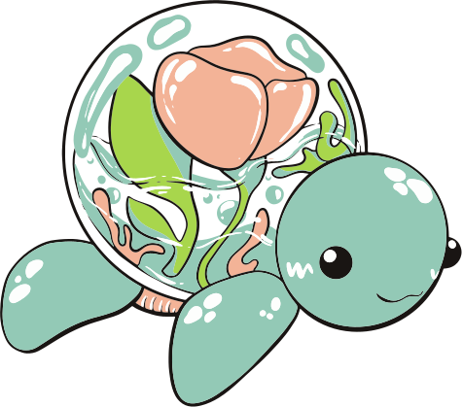
Who are they?
Notes:
Step 1: Draw pupils’ attention to the pictures. Ask questions to help them identify the characters in the pictures and the activities.

Slide 14

What did they do?
Notes:
Step 1: Draw pupils’ attention to the pictures. Ask questions to help them identify the characters in the pictures and the activities.

Slide 15

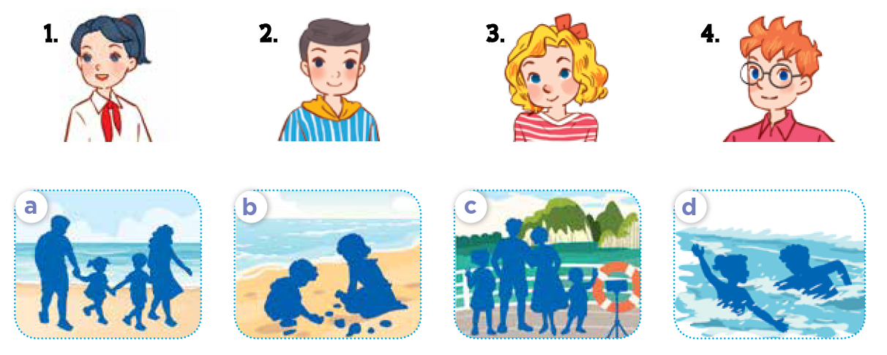
Listen and match.
Notes:
Step 2: Play the recording for pupils to listen. Play the recording again for them to do the task by matching the characters to their activities. Play the recording a third time to give pupils another listening opportunity if necessary.
Step 3: Check answers together as a class. Play the recording again for pupils to double-check their answers.

Slide 16
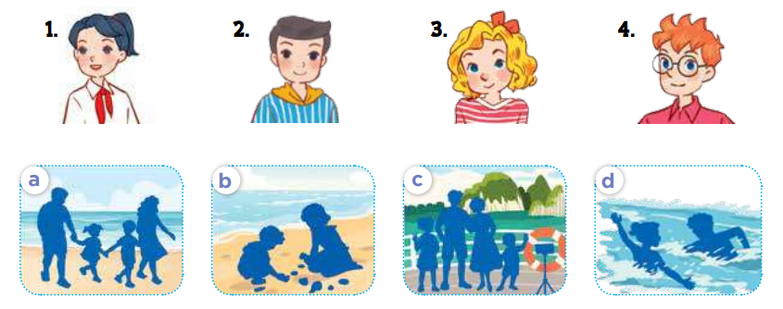
Listen and double-check.
Notes:
Step 3: Check answers together as a class. Play the recording again for pupils to double-check their answers.
Extension: If time allows, play the recording, sentence by sentence, for the class to listen and repeat in chorus. Correct their pronunciation where necessary.

Slide 17
03
Activity 5
Read and circle.

Slide 18



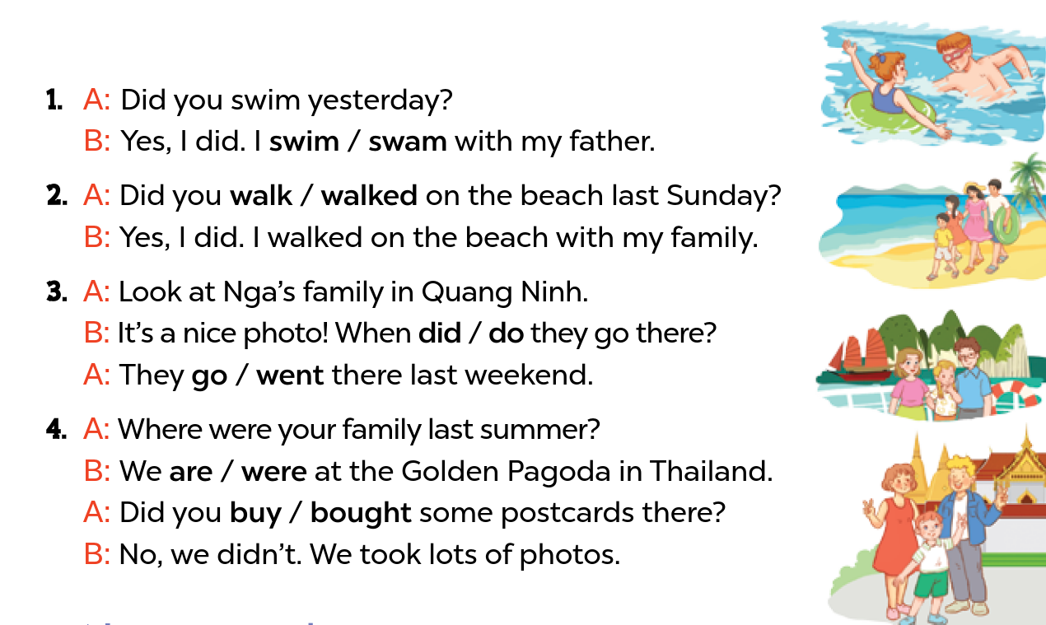


Read and circle.
Notes:
Step 1: Have pupils look at the pictures. Get them to identify the characters and options indicating activities (in the questions and answers) at present or in the past.
Step 2: Have pupils look at the options and choose the correct answers with the help of picture cues.

Slide 19
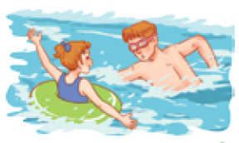
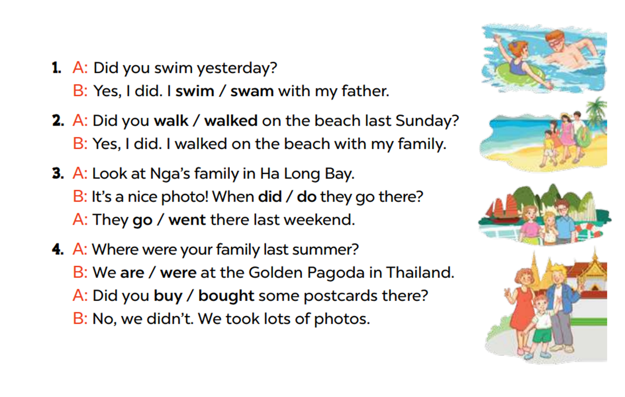
Model with Picture 1.
Notes:
Step 3: Model with Picture 1. Have pupils look at the options. Ask them what the girl did in the sea with her father (swam). Then have pupils circle the correct answer (swam)

Slide 20
Read and circle.
Notes:
Step 4: Follow the same procedure with Pictures 2, 3 and 4. Draw pupils’ attention to the options and choose the correct answers with the help of the picture cues.
Step 5: Have pupils do the task individually and ask a pair to read them aloud.

Slide 21
04
Activity 6
Listen, complete and sing.

Slide 22




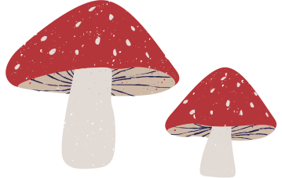

Listen, complete and sing.
Did you swim last Sunday?
Where were you last Sunday?
I was on the (1) ________.
Did you swim?
Yes, I did. I swam with my mum.
beach
Where were you last weekend?
I was in the (2) ________.
Did you walk?
No, I didn't. I (3) ________ photos there.
park
took
Notes:
Step 1: Draw pupils’ attention to the gapped sentences. Encourage pupils to guess the missing words and complete the sentences. Step 2: Play the recording all the way through for pupils to listen to the whole song. Then play the recording again for them to fill in the gaps with missing words. Step 3: Check answers together as a class. Play the recording line by line for pupils to listen and repeat. Correct their pronunciation where necessary. Step 4: Play the recording all the way through for pupils to sing along and clap along with the recording. Extension: Invite some groups to the front of the class to perform while the rest of the class sings and claps along.

Slide 23
05
Wrap-up
Let’s play a game.

Slide 24









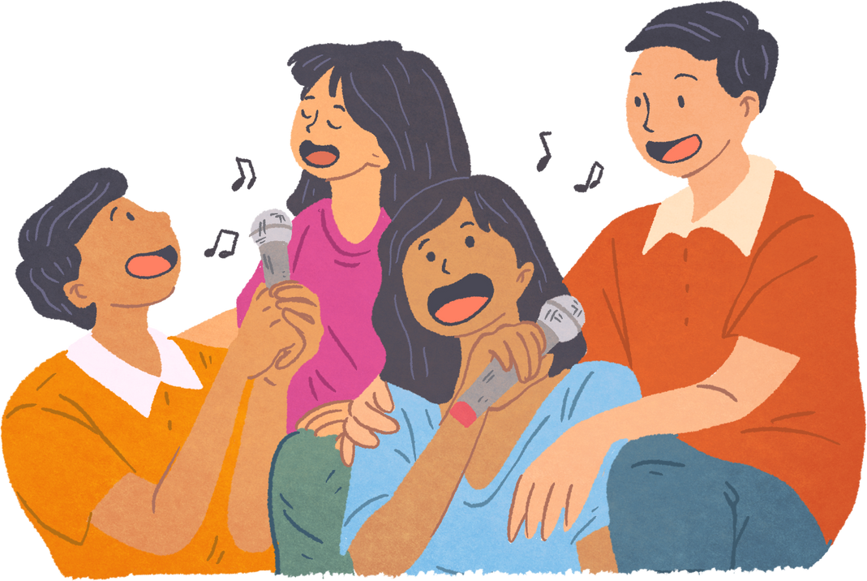
LUCKY STAR GAME
NEXT
Notes:
Click stars

Slide 25



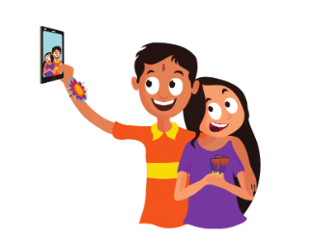

Did you ____________ yesterday?
take a photo
Yes, _____. I _______________________.
BACK
I did
took a photo with my sister

Slide 26
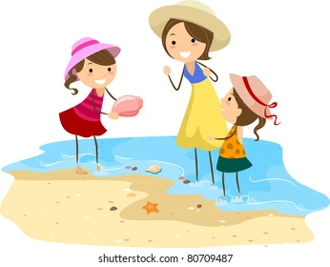
Did you _____________ yesterday?
collect shells
Yes, _____. I ________________________.
BACK
I did
collected shells with my sister

Slide 27
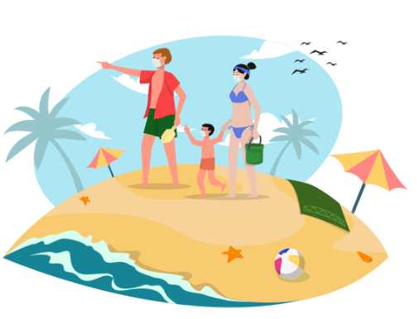
Did you _______________ yesterday?
walk on the beach
Yes, _____. I ____________________________.
BACK
I did
walked on the beach with my family

Slide 28
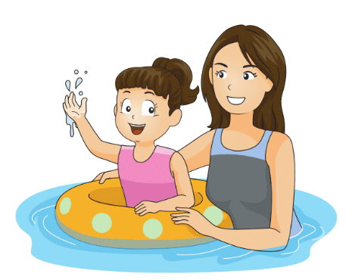
Did you ________ yesterday?
swim
Yes, _____. I ___________________.
BACK
I did
swam with my mother

Slide 29

Congratulations!
BACK

Slide 30

Notes:
Click stars

Slide 31
Website: hoclieu.vn
Fanpage: https://www.facebook.com/tienganhglobalsuccess.vn/

