Slide 2







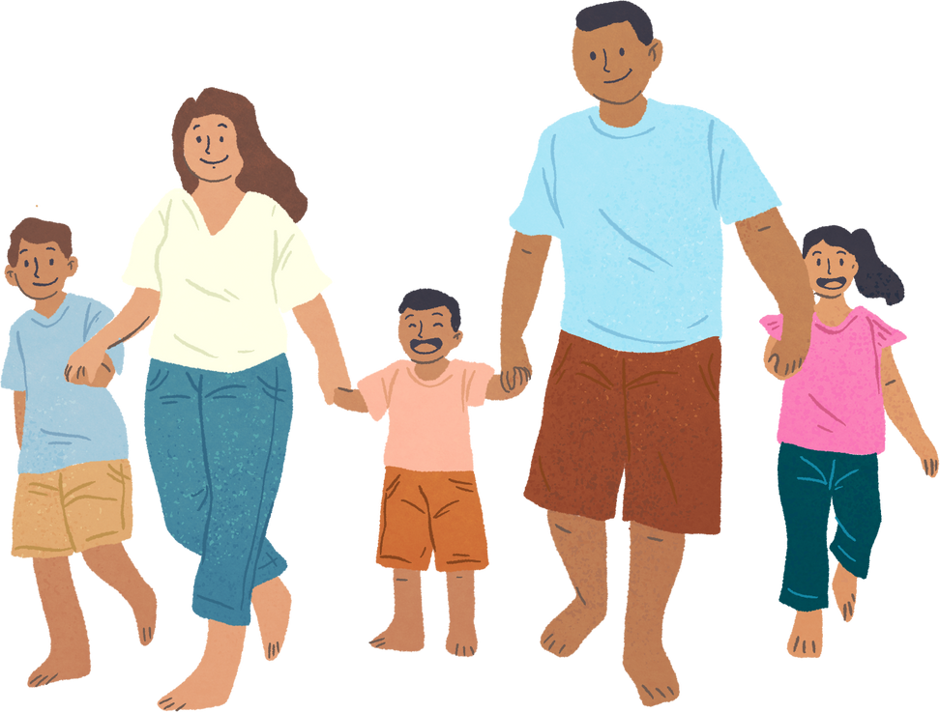


Unit 11: FAMILY TIME
Lesson 2 - Period 4

Slide 3






Table of contents
Warm-up and Review.
Activity 4: Listen and circle.
Activity 5: Read and complete.
Activity 6: Let’s play.
Fun corner and Wrap-up.

Slide 4








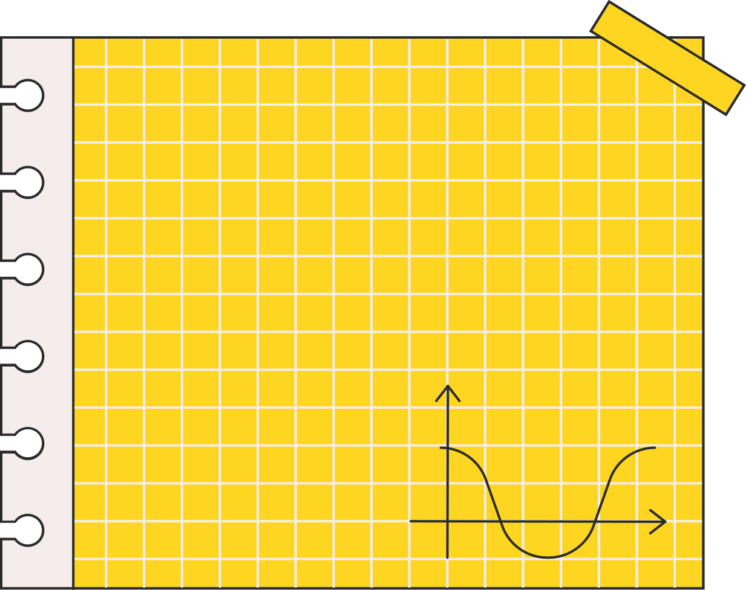



Warm-up and Review.
Let’s play a game.

Slide 5





QUESTIONS AND ANSWERS

Slide 6





What did your family do in Sydney?
We saw some interesting places.

Slide 7
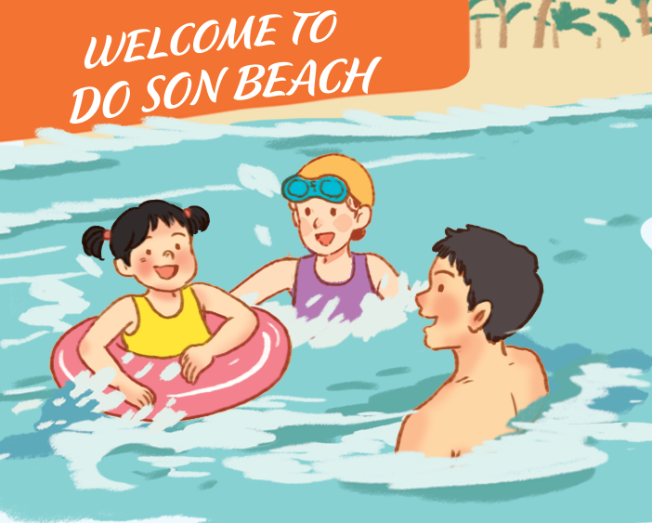


What did your family do in Nha Trang?
We swam in the sea.

Slide 8



What did your family do in Thailand?
We bought souvenirs.

Slide 9

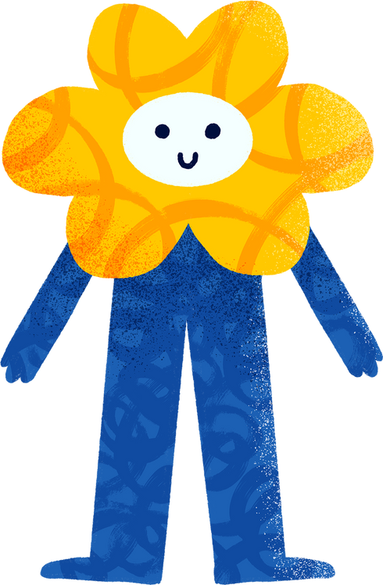

What did your family do in Ha Long Bay?
We took a boat trip around the bay.

Slide 10


Slide 11

01
Activity 4
Listen and circle.

Slide 12


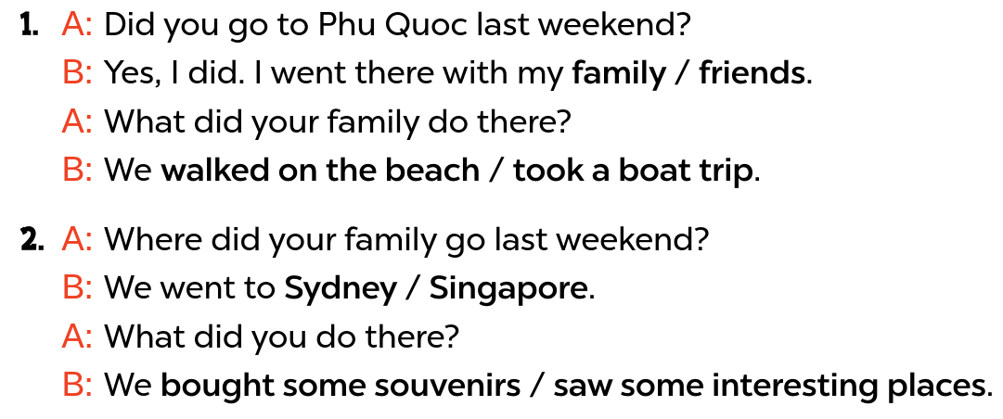


Ask and answer
Notes:
Step 1: Draw pupils’ attention to the questions and the options. Ask questions to help them guess the correct answer.

Slide 13

Listen and circle
Notes:
Step 2: Play the recording all the way through. Then play the recording again for pupils to circle the correct answer.

Slide 14

Swap your book.
Notes:
Step 3: Tell pupils to swap books with a partner, then check answers together as a class. Play the recording again for the pupils to double-check their answers.
Extension (For advanced level): Read conversation 1 aloud but change specific information.

Slide 15
03
Activity 5
Read and complete.

Slide 16



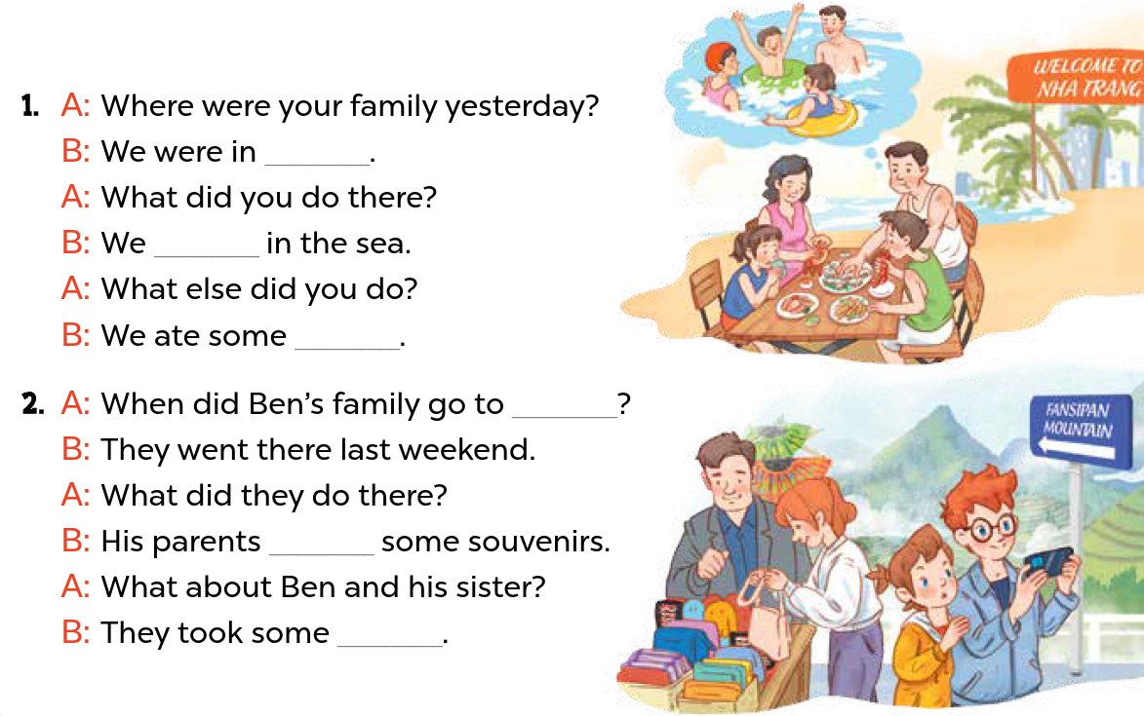


Look and say.
Notes:
Step 1: Have pupils look at the pictures. Get them to identify the places, characters and their activities in the pictures.

Slide 17
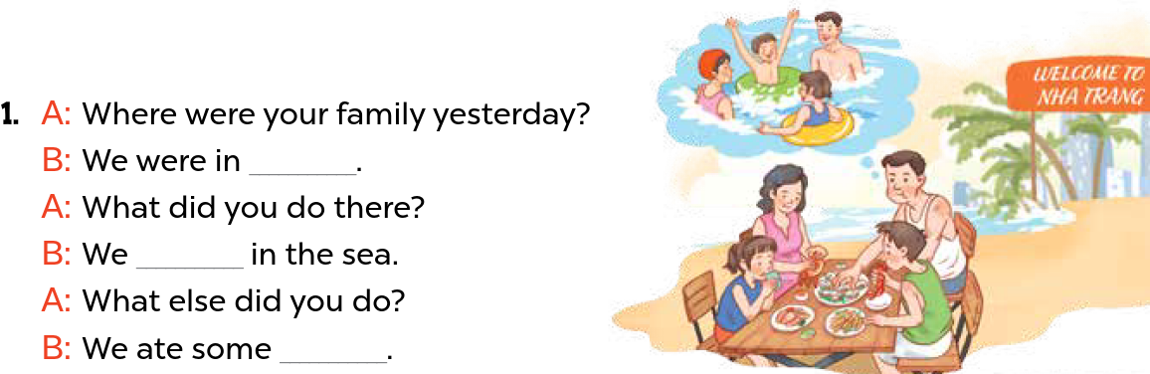
Model with Picture 1.
Nha Trang
swam
seafood
Notes:
Step 2: Model with Picture 1. Have pupils look at the answers. Ask them what words are missing in the answers (Nha Trang; swam; seafood). Then have pupils complete the answers.

Slide 18
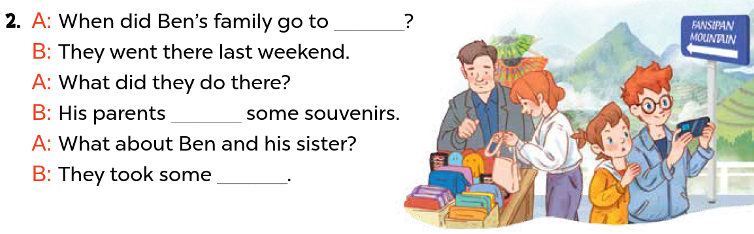
Read and complete.
Sa Pa
bought
photos
Notes:
Step 3: Follow the same procedure with Pictures 2. Draw pupils’ attention to the gaps in the answers in Pictures 2.

Slide 19
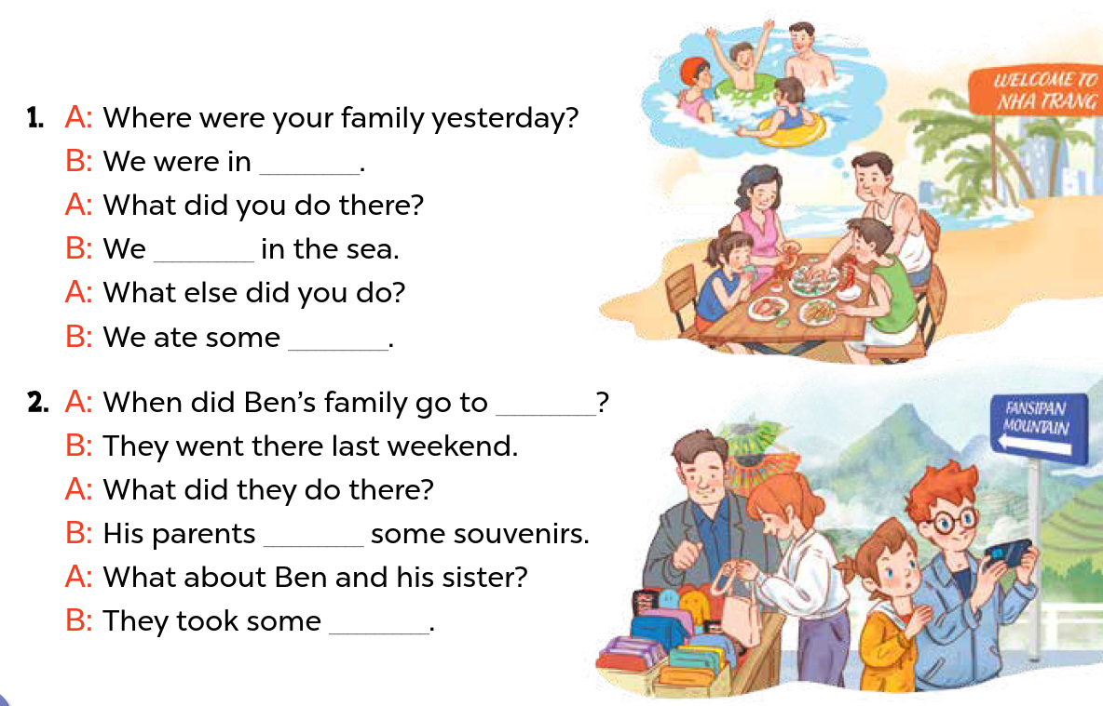
Practice.
Nha Trang
swam
seafood
Sa Pa
bought
photos
Notes:
Step 4: Have pupils complete the gaped exchanges individually. Check the answers, and then ask a few pairs to read them aloud.

Slide 20
04
Activity 6
Let’s play.

Slide 21


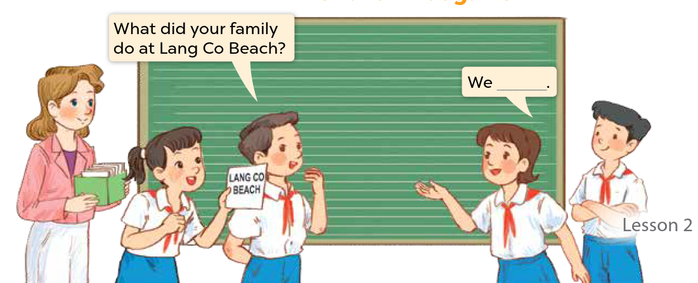



When and What game
Notes:
Step 1: Tell pupils that they are going to play When and What game in groups of four, devided into Team A and Team B. They will review the irregular verbs, such as took photos, ate seafood, bought souvenirs, swam in the sea, went to … Step 2: A pupil from Team A randomly selects a destination paper from the teacher, for example, Nha Trang, and then he / she makes up a question like, When did your family go to Nha Trang? Team B provides one response, such as We went there last summer / weekend / Sunday /etc. (only one response). Then, Team A proceeds to ask another question What did your family do in Nha Trang? Team B offers multiple respones, such as We swam in the sea. / We ate seafood. /We took some photos/ etc. (as many answers as possible). Step 3: Team A and Team B switch roles. A pupil from Team B select a destination paper from the teacher, and create 2 questions using When did your family go to...? and What did your family do in ...?. Team A provides answers (as many as possible). Step 4: Have pupils work in groups and set a time limit for them to play the game. The team that has provided more correct answers is the winner. Step 5: Invite select groups to the front of the class to perform the game.

Slide 22
05
Wrap-up
Let’s play a game.

Slide 23







TRUE
OR FALSE
GAME

Slide 24





We swam in the sea yesterday.
TRUE
FALSE

Slide 25



We took a boat trip last Sunday.
TRUE
FALSE

Slide 26

We bought souvenirs yesterday.
TRUE
FALSE

Slide 27
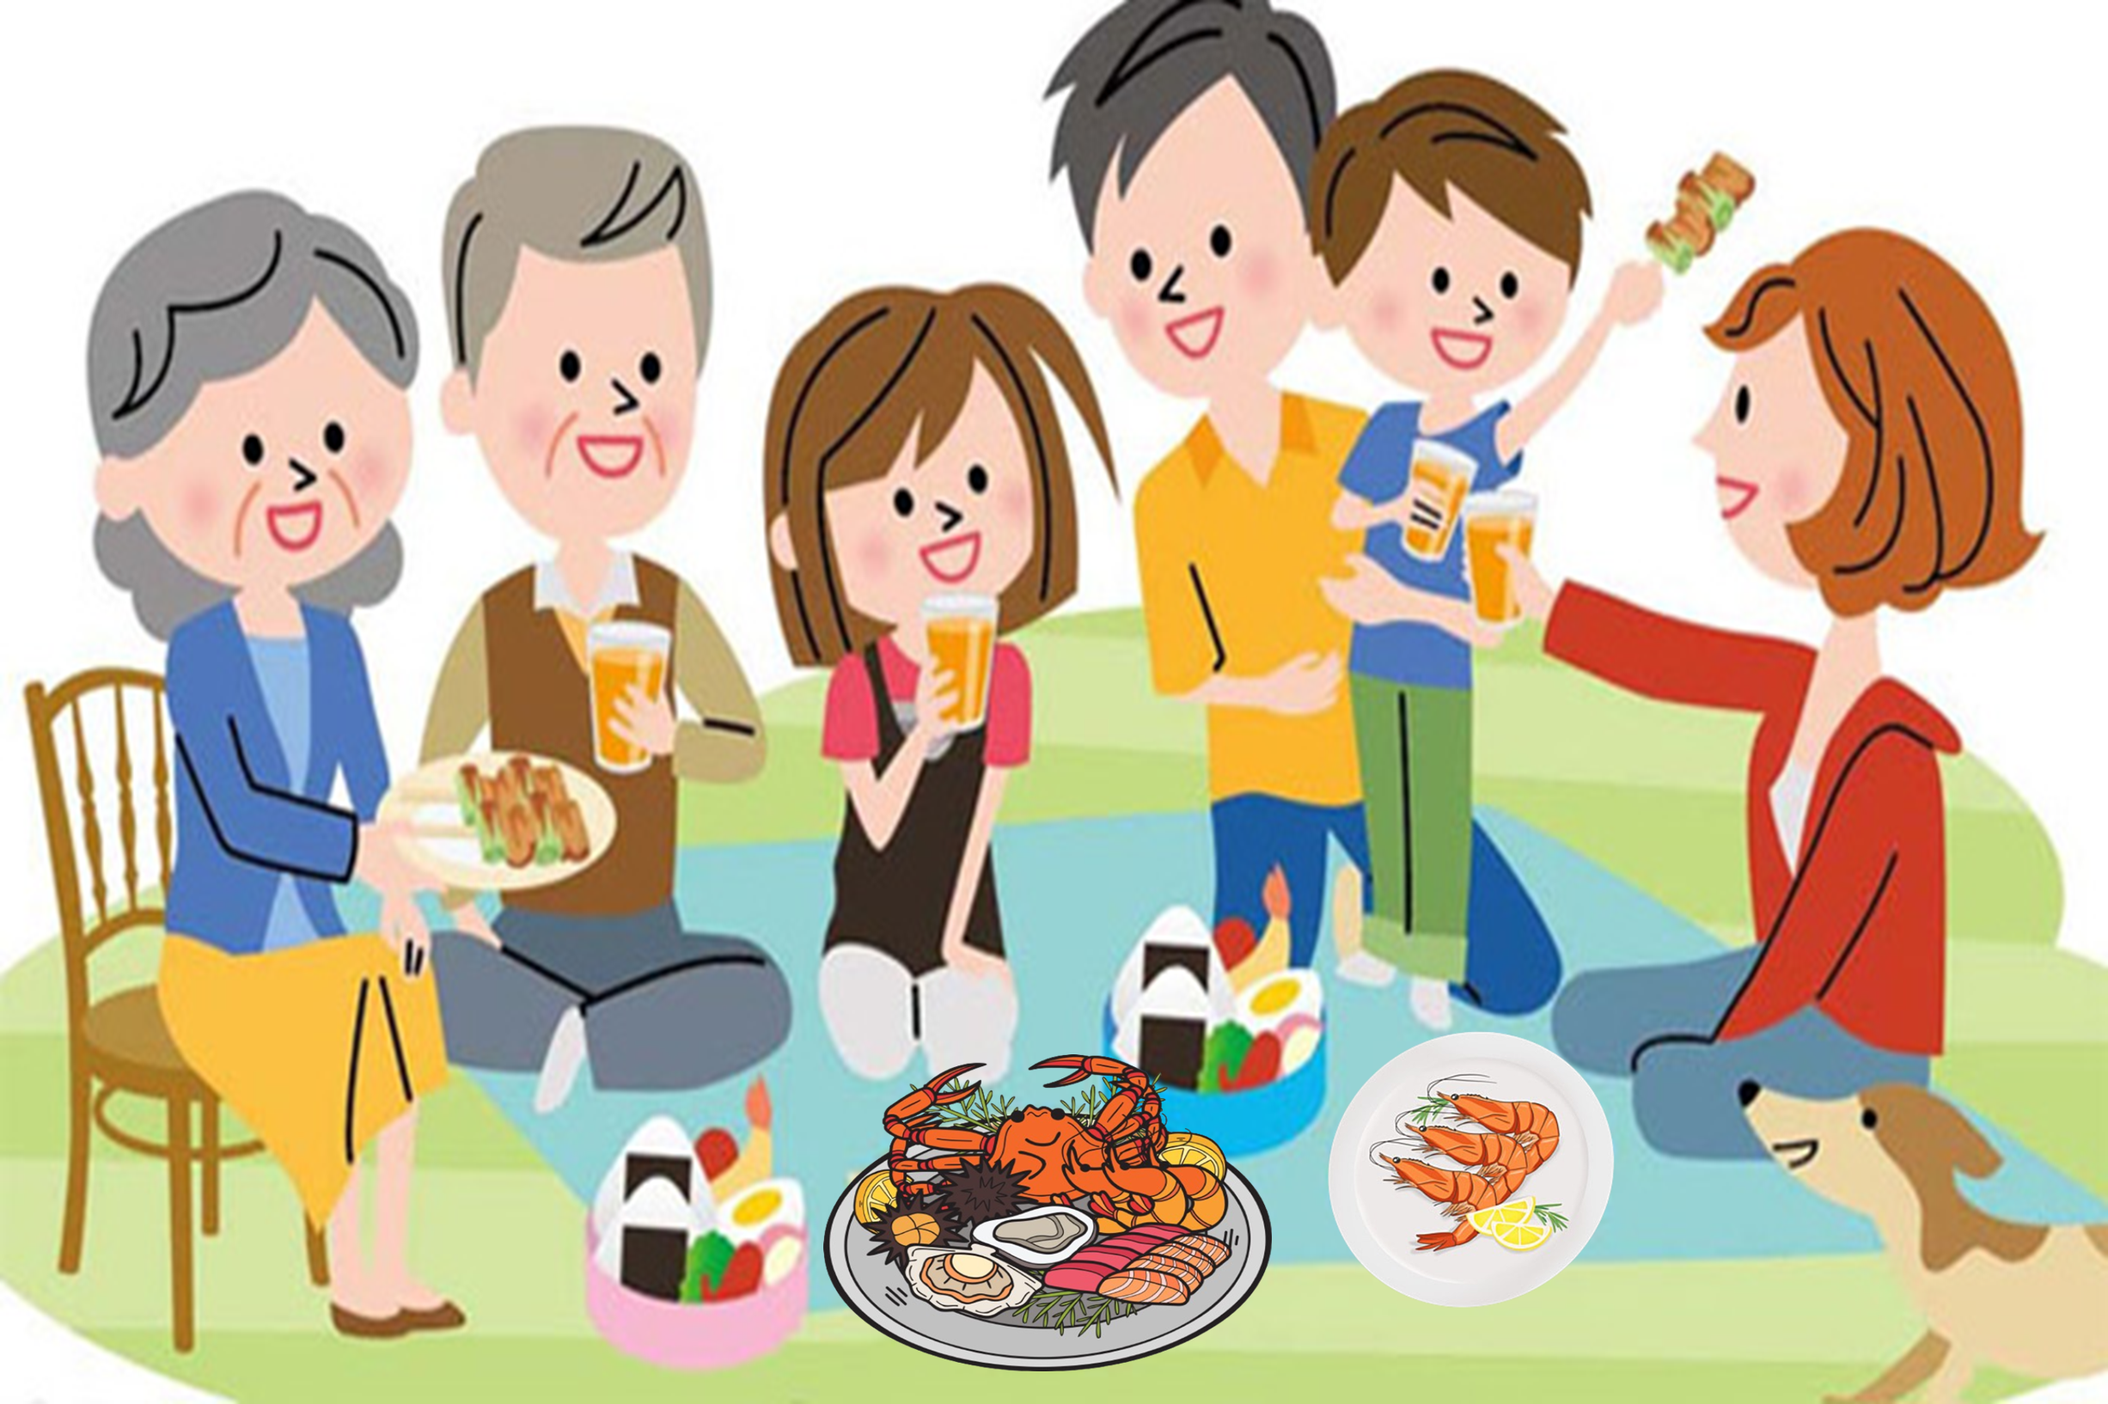
We ate seafood in Nha Trang last summer.
TRUE
FALSE

Slide 28


Slide 29
Website: hoclieu.vn
Fanpage: https://www.facebook.com/tienganhglobalsuccess.vn/

