Slide 1




14
My bedroom
Lesson 2 – Period 3

Slide 2





Lesson 2
Period 3
①
Warm-up and review

Slide 3
Game: Who says fast?
Look and choose A or B
in 15 seconds.
Notes:
- Teacher holds a flashcard and a sentence with a missing word.
- Ask pupils to guess the answer as fast as possible.
- Then have pupils do the same with the rest.
- This can be played in groups to make it more interesting.

Slide 4
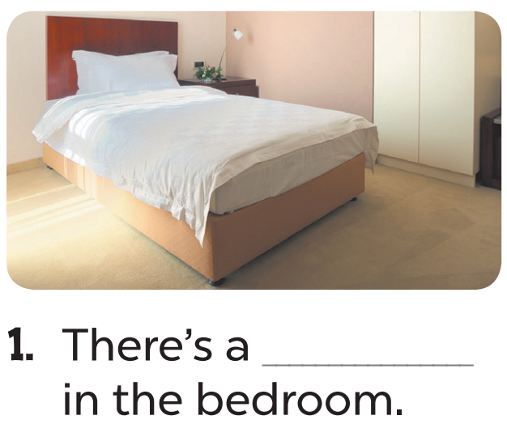
Hết giờ
timing
timing
0
:
0
0
00
59
58
57
56
55
54
53
52
51
50
49
48
47
46
45
44
43
42
41
40
39
38
37
36
35
34
33
32
31
30
29
28
27
26
25
24
23
22
21
20
19
18
17
16
15
14
13
12
11
10
09
08
07
06
05
04
03
02
01
00
+2
A. desk
B. bed

Slide 5
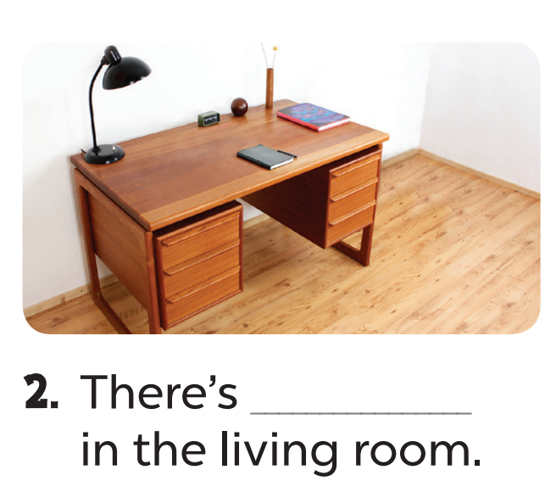
Hết giờ
timing
timing
0
:
0
0
00
59
58
57
56
55
54
53
52
51
50
49
48
47
46
45
44
43
42
41
40
39
38
37
36
35
34
33
32
31
30
29
28
27
26
25
24
23
22
21
20
19
18
17
16
15
14
13
12
11
10
09
08
07
06
05
04
03
02
01
00
+3
A. a desk
B. a bed

Slide 6
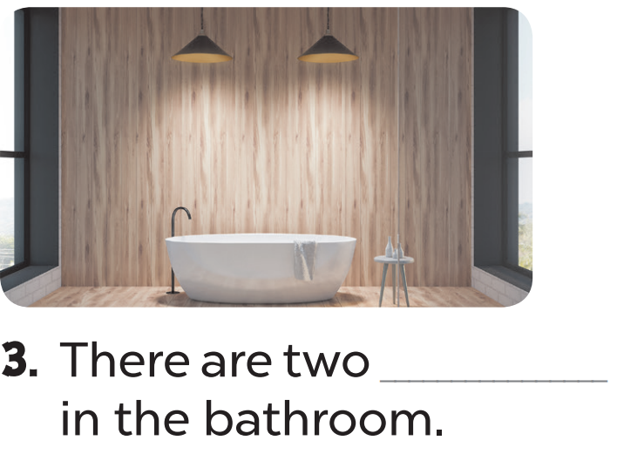
timing
Hết giờ
timing
0
:
0
0
00
59
58
57
56
55
54
53
52
51
50
49
48
47
46
45
44
43
42
41
40
39
38
37
36
35
34
33
32
31
30
29
28
27
26
25
24
23
22
21
20
19
18
17
16
15
14
13
12
11
10
09
08
07
06
05
04
03
02
01
00
+3
A. beds
B. lamps

Slide 7
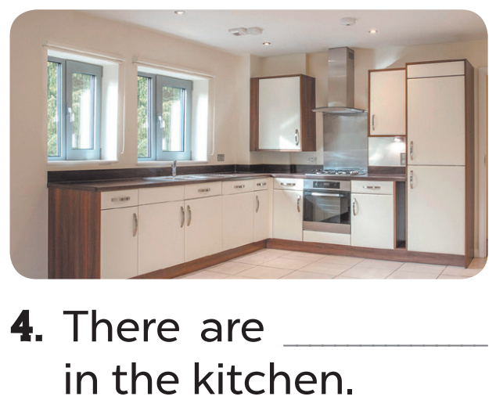
timing
Hết giờ
timing
0
:
0
0
00
59
58
57
56
55
54
53
52
51
50
49
48
47
46
45
44
43
42
41
40
39
38
37
36
35
34
33
32
31
30
29
28
27
26
25
24
23
22
21
20
19
18
17
16
15
14
13
12
11
10
09
08
07
06
05
04
03
02
01
00
+1
A. beds
B. two windows

Slide 8

Hết giờ
timing
timing
0
:
0
0
00
59
58
57
56
55
54
53
52
51
50
49
48
47
46
45
44
43
42
41
40
39
38
37
36
35
34
33
32
31
30
29
28
27
26
25
24
23
22
21
20
19
18
17
16
15
14
13
12
11
10
09
08
07
06
05
04
03
02
01
00
+1
A. two lamps
B. two doors

Slide 9
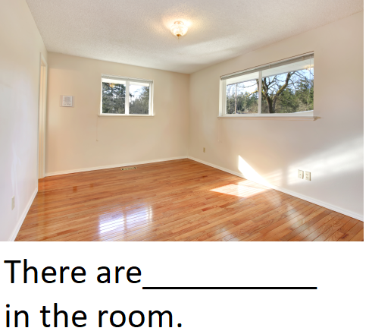
Hết giờ
timing
timing
0
:
0
0
00
59
58
57
56
55
54
53
52
51
50
49
48
47
46
45
44
43
42
41
40
39
38
37
36
35
34
33
32
31
30
29
28
27
26
25
24
23
22
21
20
19
18
17
16
15
14
13
12
11
10
09
08
07
06
05
04
03
02
01
00
+3
A. two doors
B. two windows

Slide 10
Lesson 2
Period 3
②
Look, listen and repeat.

Slide 11

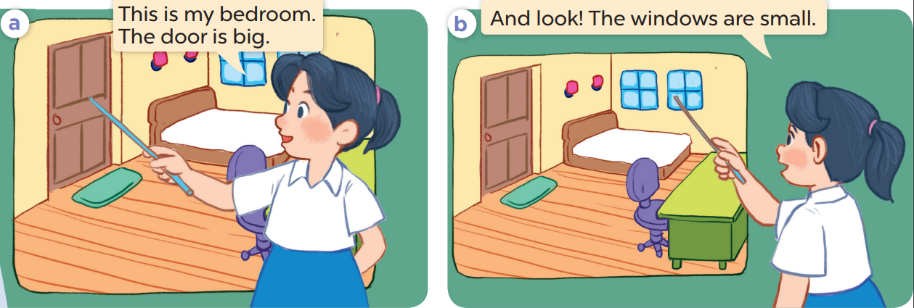

Slide 13
Lesson 2
Period 3
③
Listen, point and say.

Slide 14

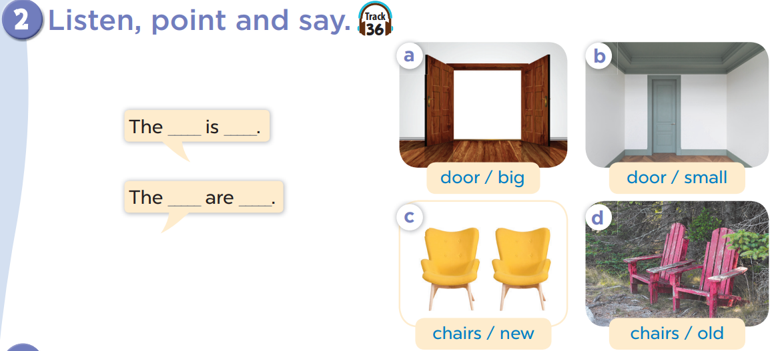

Slide 15




LUCKY WHEEL
3
2
1
2
3
4
10
SPIN
5
8
4
5
6
6
7
7
8
9
Next activity
Notes:
Game: LUCKY WHEEL
- Students choose a number.
- T then asks pupils to make sentences with the words, phrases and pictures given.
- Spin the wheel to get points.

Slide 16


door small.
The………… is………

Slide 17

door big .
The………… is………

Slide 18


chairs new .
The…………… are………

Slide 19

chairs old .
The…………… are………

Slide 20

The door is big.
…………

Slide 21
The door is small.
…………

Slide 22

The chairs are old.
…………

Slide 23
The chairs are new.
…………

Slide 24
+ 5

Slide 25
Lesson 2
Period 3
④
Let’s talk.

Slide 26
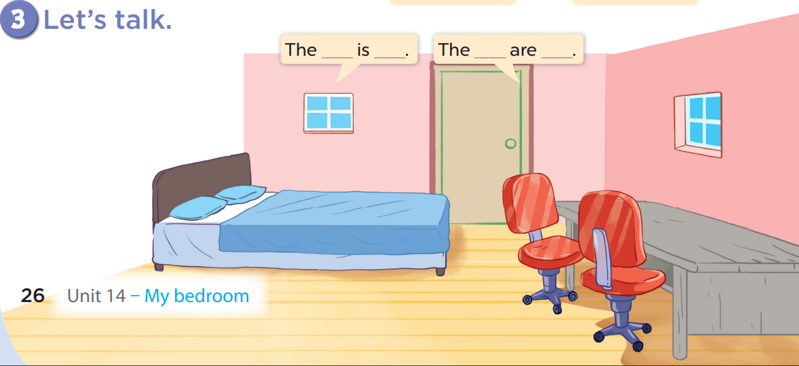

Slide 27
The bed is big.

Slide 28
The desk is old.

Slide 29
The chairs are old.

Slide 30
The windows are small.

Slide 31
Lesson 2
Period 3
⑤
Fun corner and wrap-up

Slide 32


LOOK AND CHOOSE!
Notes:
Game: Look and choose!
- Teacher divides the class into 2 teams: BOYS and GIRLS.
- 1 boy says 1 sentence using the words and structures in the lesson to describe 1 of 4 pictures (A, B, C, D) and 1 girl says out loud the picture the boy is talking about.
- Then the girls team will read and the boys team will guess. Repeat until there are no questions left.

Slide 33

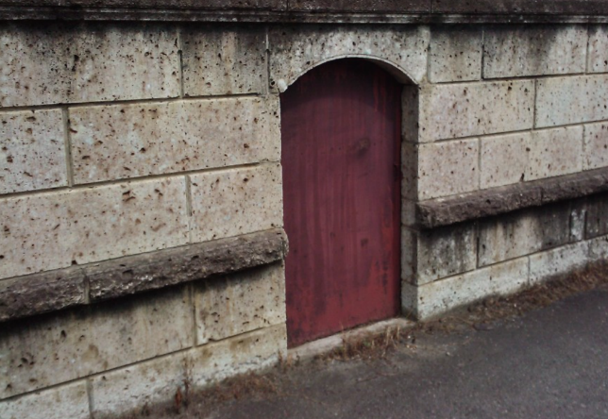
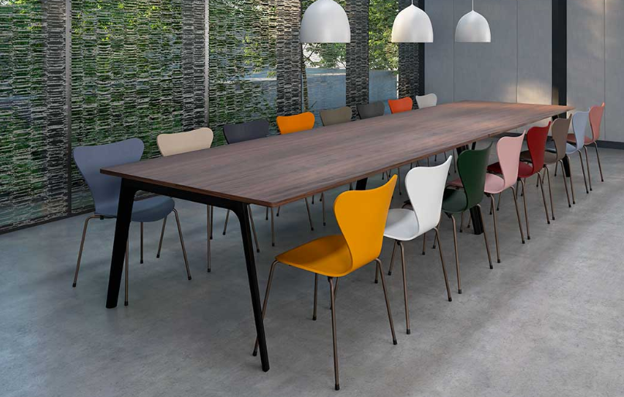
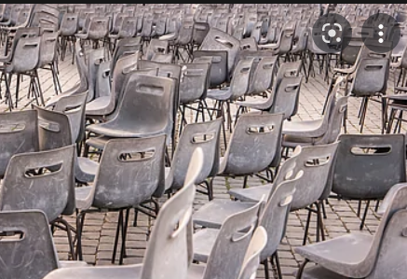

A
B
C
D
Picture D
The door is big.
The door is big.
Notes:
Game: Look and choose!
- Teacher divides the class into 2 teams: BOYS and GIRLS.
- 1 boy says 1 sentence using the words and structures in the lesson to describe 1 of 4 pictures (A, B, C, D) and 1 girl says out loud the picture the boy is talking about.
- Then the girls team will read and the boys team will guess. Repeat until there are no questions left.

Slide 34
A
B
C
D
Picture ………
……………………….
The …… are …….

Slide 35
A
B
C
D
Picture ………..
………………………..
The …….. is ………..

Slide 36
A
B
C
D
Picture ………..
………………………..
The …….. is ………..

Slide 37
A
B
C
D
Picture ………
……………………….
The …… are …….

Slide 38
A
B
C
D
Picture ………..
…………………………….
The ……… is ……..

