Slide 1





Slide 2


Daily activities
14
Lesson 3 – Period 5

Slide 3
Contents
01
Warm-up
04
02
05
Game
03
Let’s chant.
Listen and repeat.
Listen and circle.

Slide 4
01
Warm-up

Slide 5


Pass the Bomb!

Slide 6
Ready?
Start!

Slide 7
16s

Slide 8
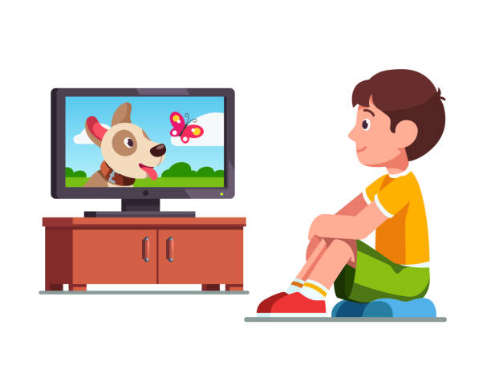
I ______ at home.
watch TV

Slide 9
12s

Slide 10
When do you watch TV?
In the .../ At ...

Slide 11
12s

Slide 12

What do you do in the morning?
I go to school.

Slide 13
12s

Slide 14
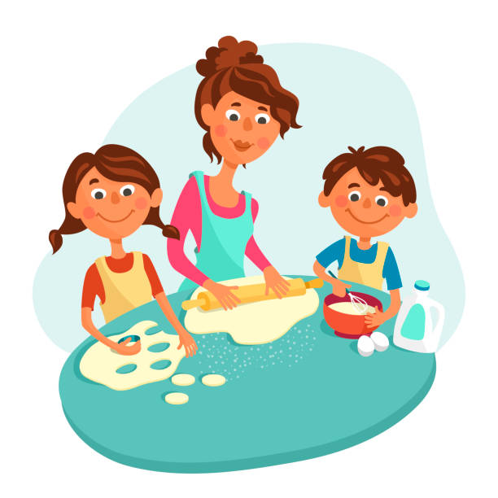
What do you do in the evening?
I help my mum with the cooking.

Slide 15
12s

Slide 16
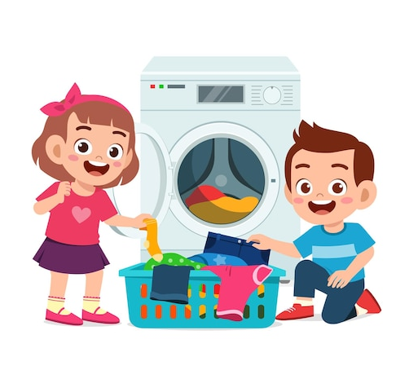
What do you do in the afternoon?
I wash the clothes.

Slide 17
12s

Slide 18
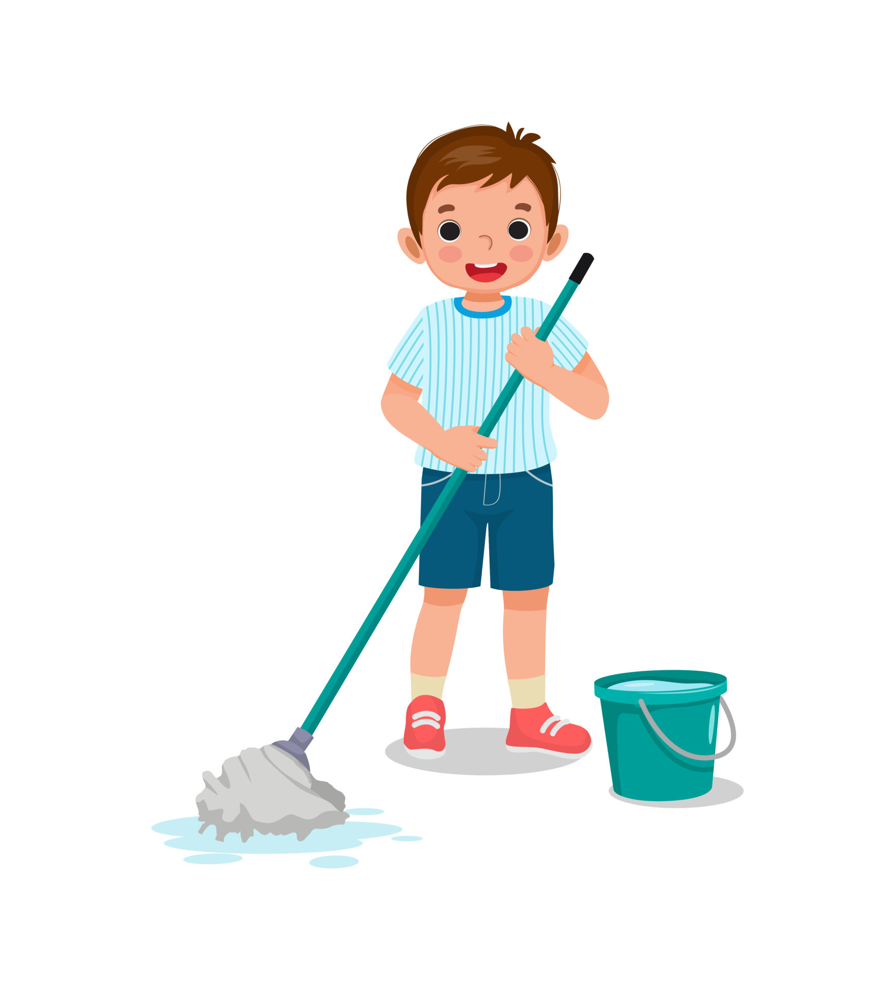
When do you clean the floor?
In the .../ At ...

Slide 19
12s

Slide 20
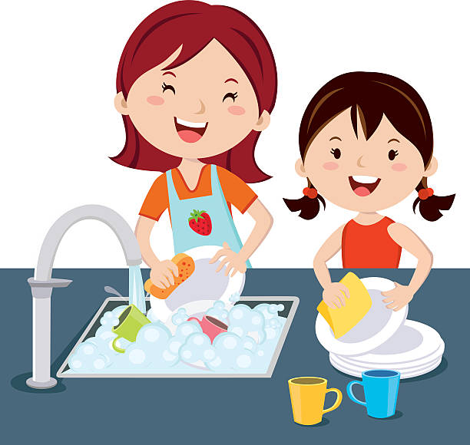

Do they wash the clothes at noon?
No, they don’t.

Slide 21
12s

Slide 22
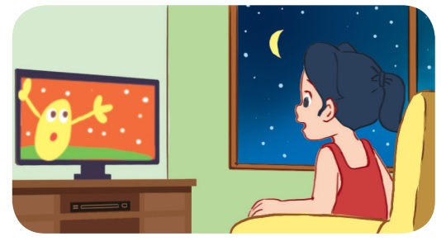
Does she watch TV in the morning?
No, she doesn’t.

Slide 23
17s

Slide 24
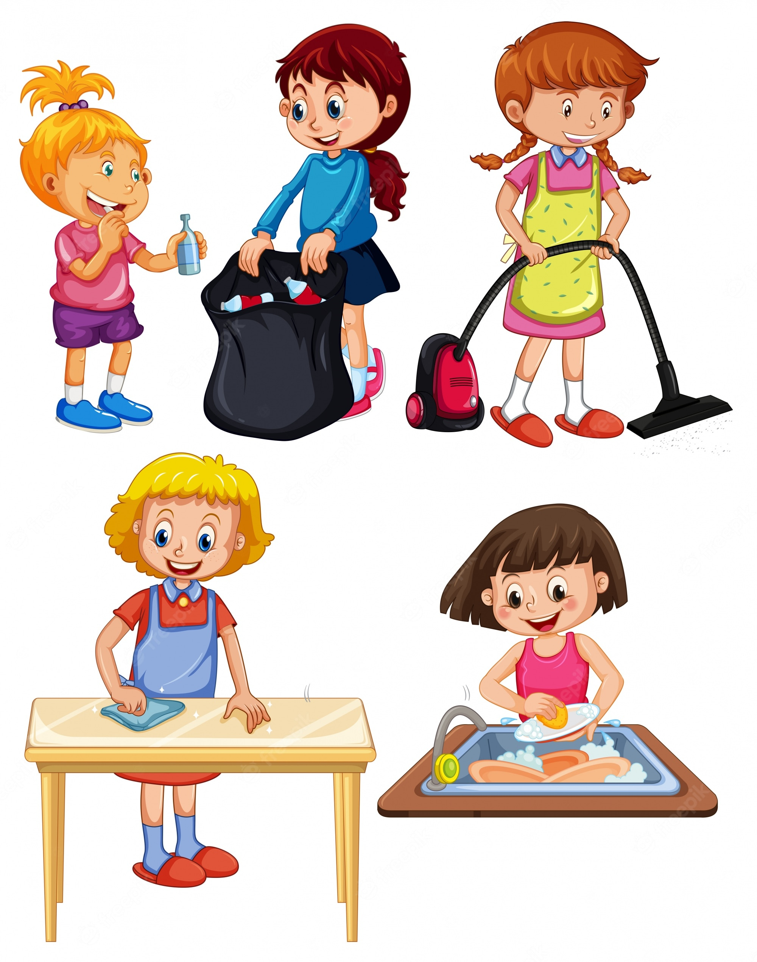
Do you do the housework in the evening?
Yes, I do. / No, I don’t.

Slide 25
10s

Slide 26
What do you do at noon?
I wash the dishes.

Slide 27
02
Listen and repeat.

Slide 28
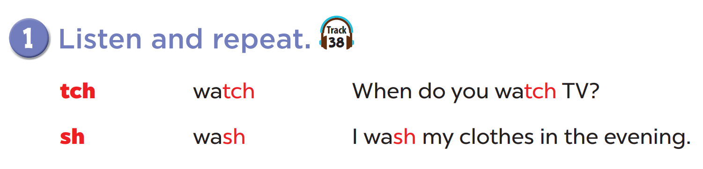


Slide 29
03
Listen and circle.

Slide 30
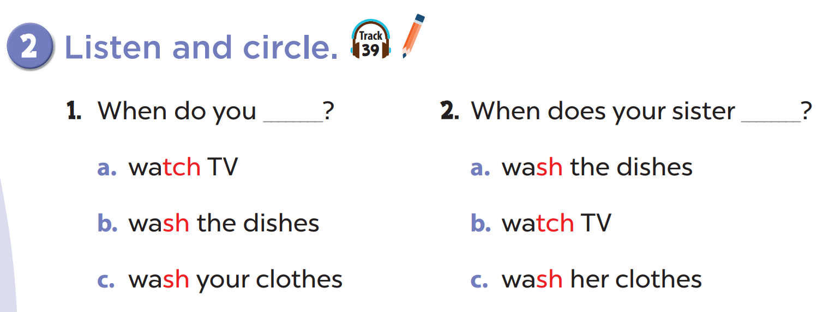

Slide 31
04
Let’s chant.

Slide 32
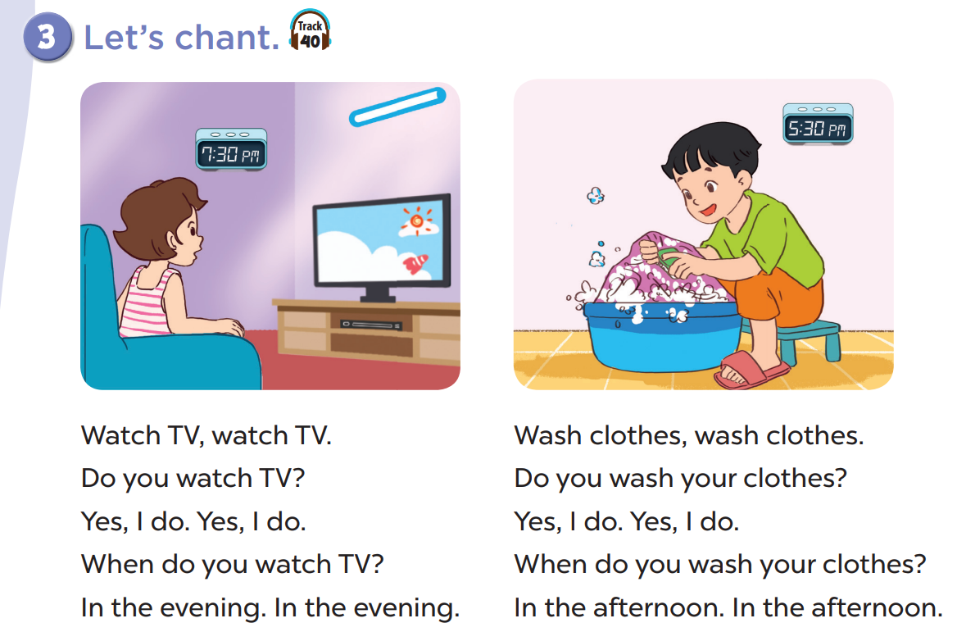

Slide 33
05
Game

Slide 34
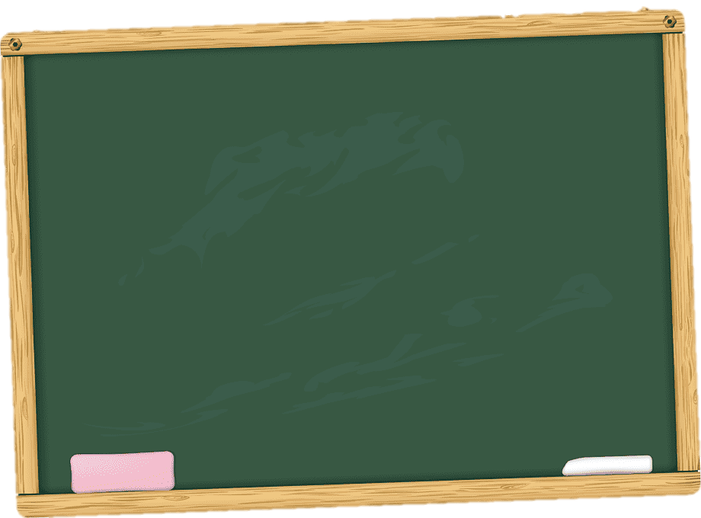
-ch
-sh
watch
March
wash
wish
catch
match
fish
bush
beach
peach
brush
crush
lunch
touch
dish
flash

