Slide 1

In the city
Lesson 2 - Period 3

Slide 2
01
02
Warm-up and review
Look, listen and repeat.
Table of contents
03
Listen, point and say.
04
Let’s talk.
05
Fun corner and wrap-up

Slide 3
Warm-up
01
Look and answer.

Slide 4

What does it say?
It says ‘stop’.

Slide 5

What does it say?
It says ‘turn left’.

Slide 6

What does it say?
It says ‘turn right’.

Slide 7

What does it say?
It says ‘go straight’.

Slide 8
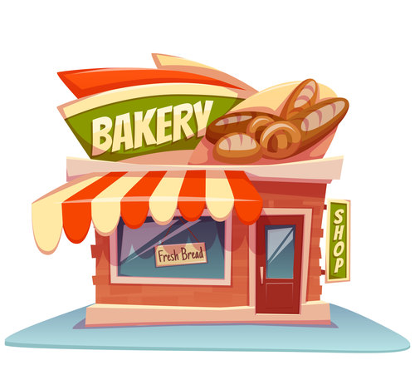
bakery

Slide 9
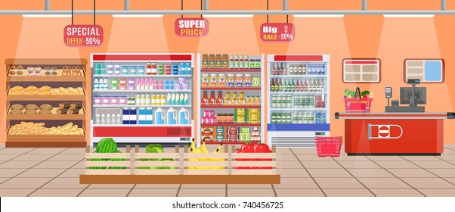
supermarket

Slide 10

cinema

Slide 11

bookshop

Slide 12
Look, listen and repeat.
02
Activity 1

Slide 13

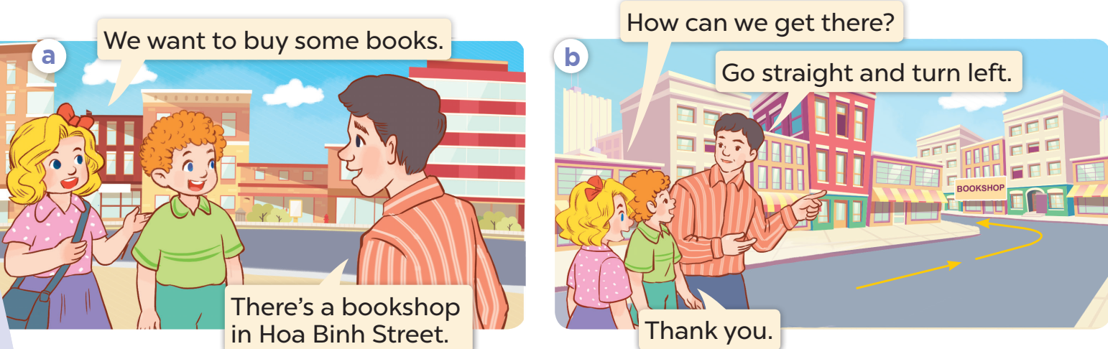
What do they want to buy?
Look and guess.
Where can they buy it?

Slide 14
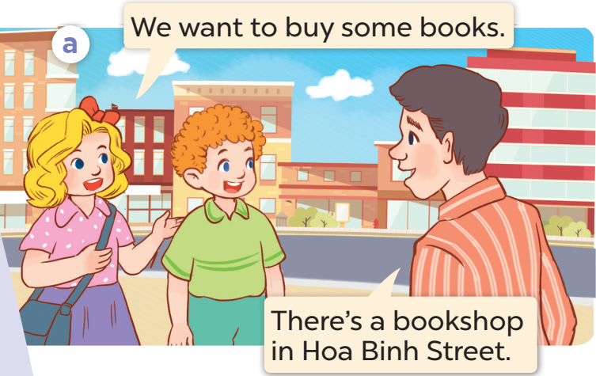
Listen and repeat

Slide 15
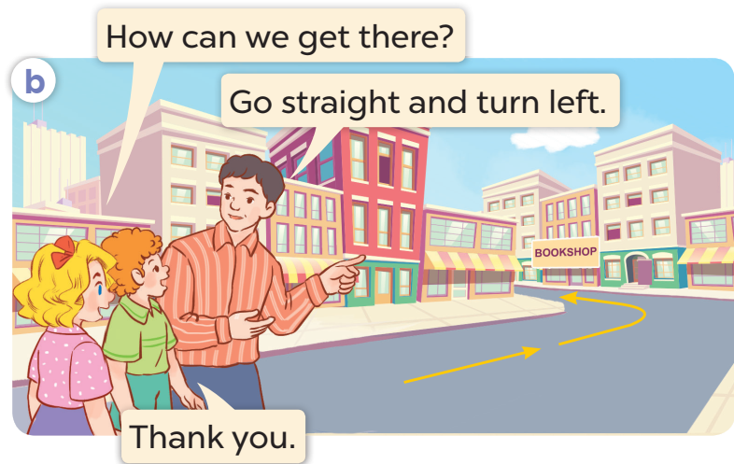
Listen and repeat

Slide 16
Listen, point and say.
03
Activity 2

Slide 17
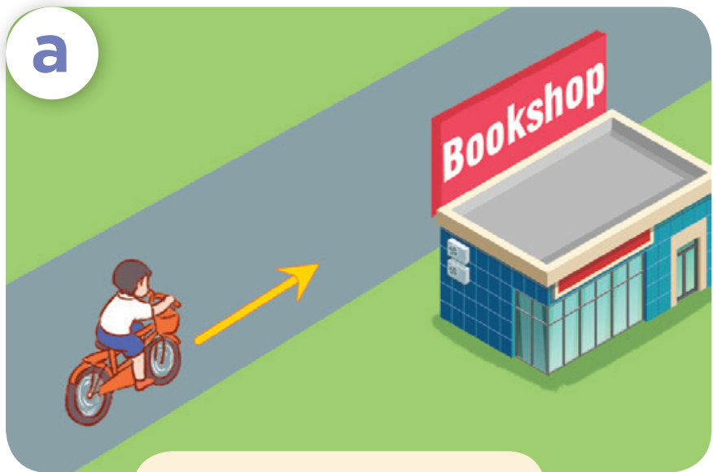
How can I get to the ………………?
bookshop
Go straight.

Slide 18
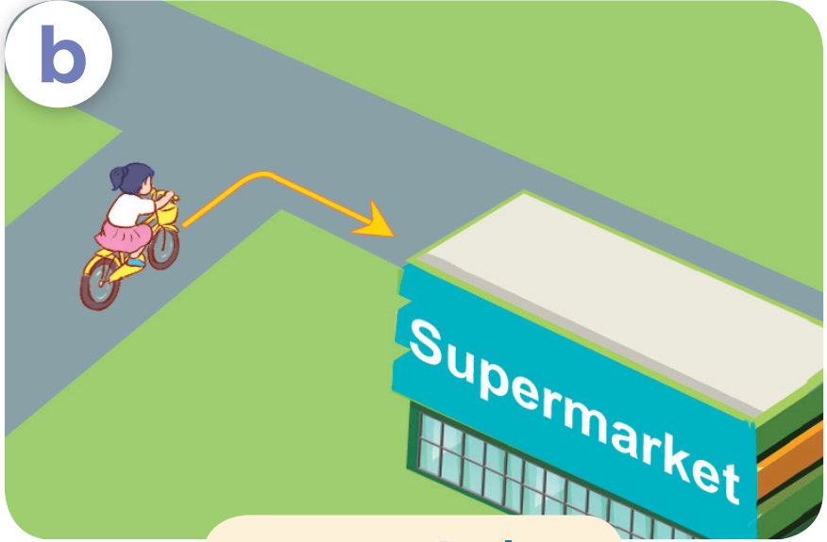
How can I get to the …………………………?
supermarket
Turn right.

Slide 19
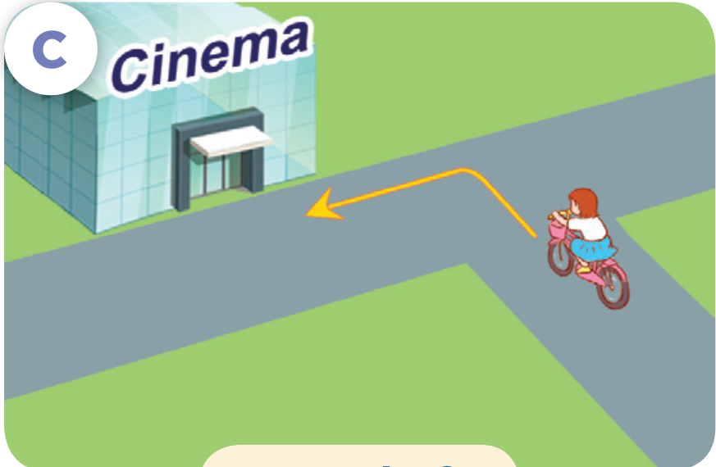
How can I get to the ………………?
cinema
Turn left.

Slide 20
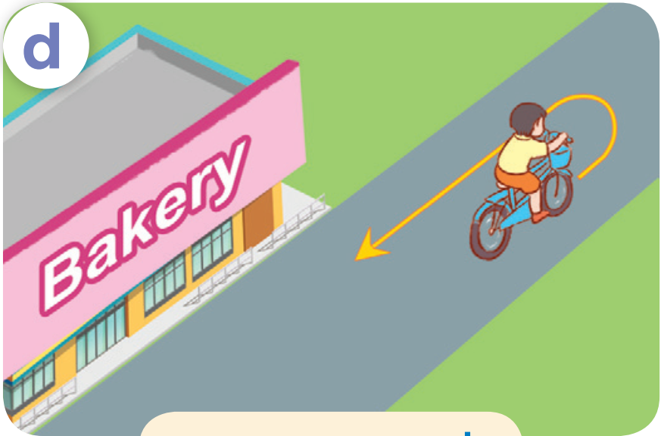
How can I get to the ………………?
bakery
Turn round.

Slide 21
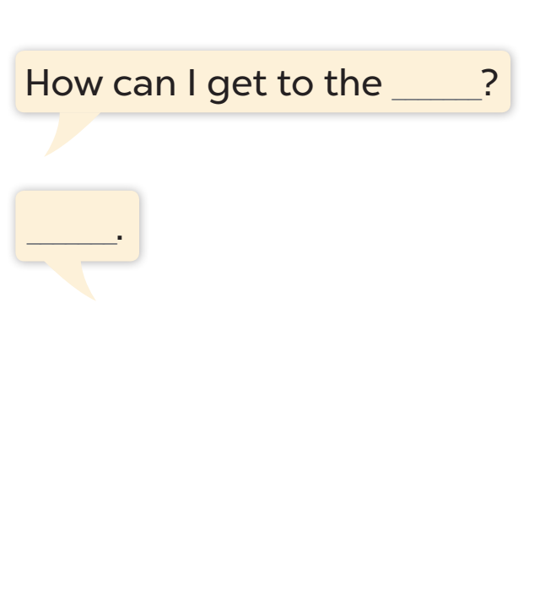
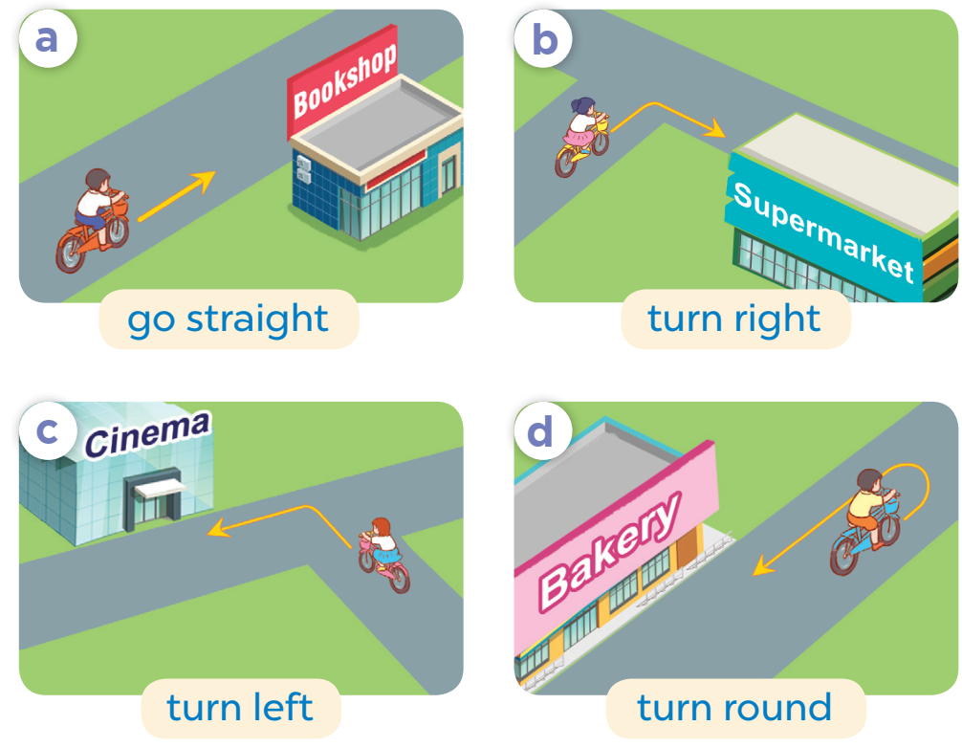
Listen, point and say.

Slide 22
Let’s talk.
04
Activity 3

Slide 23
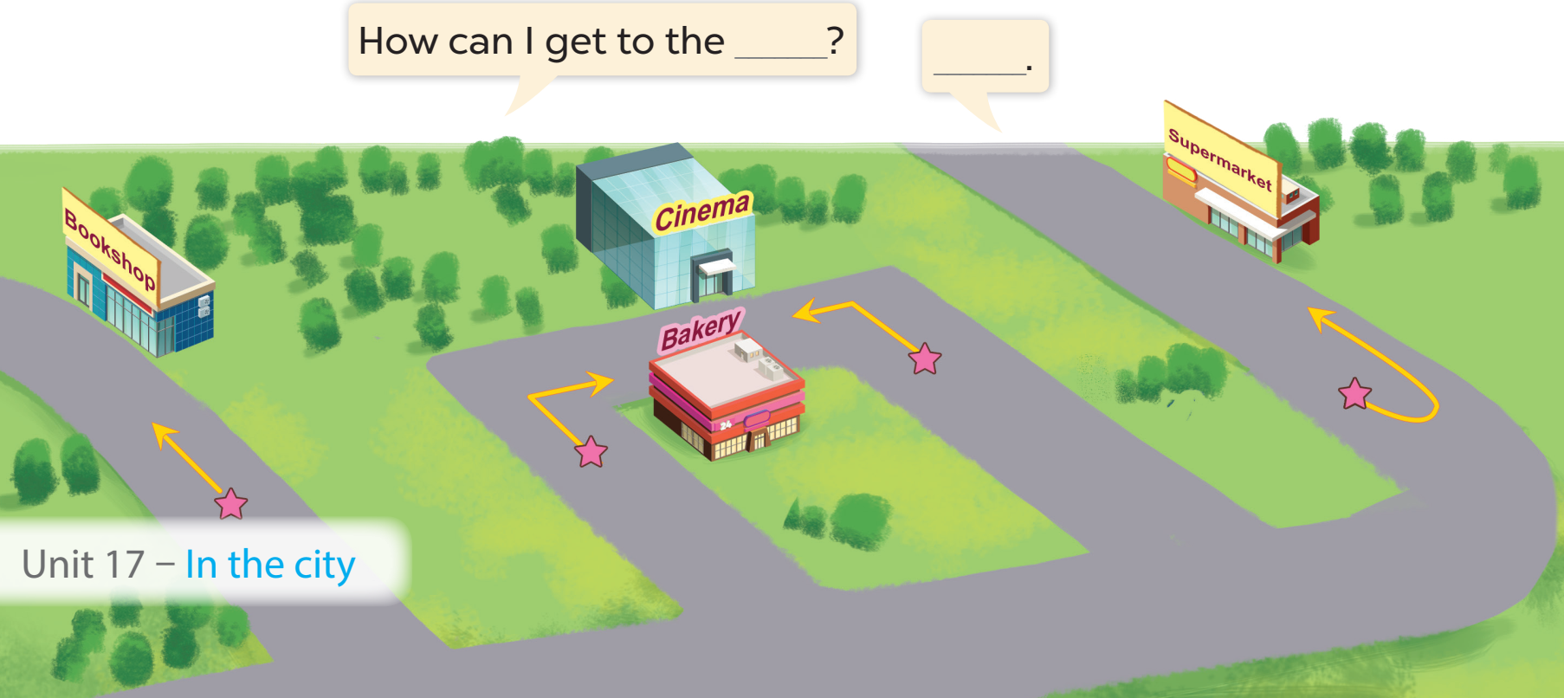
Work in pairs. Ask and answer.

Slide 24
Fun corner
05
Let’s play!

Slide 25
Let’s play

Slide 26




RACING CAR
Questions
Finish line
Notes:
Chọn hình người cầm cờ để trở về slide câu hỏi

Slide 27








Slide 28

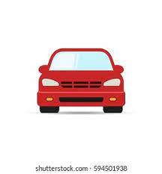

How can I get to the cinema?
Turn left.

Slide 29

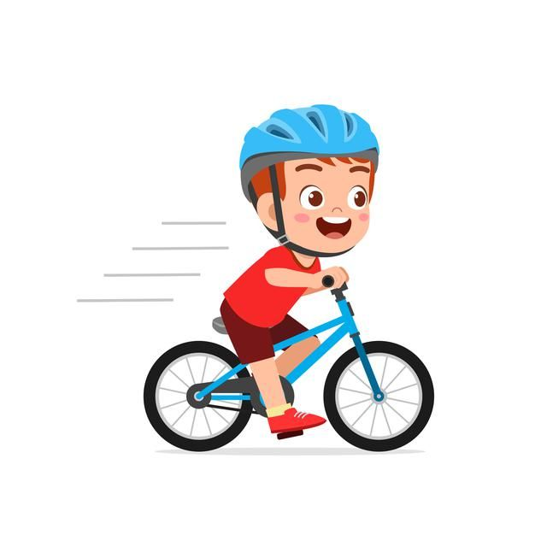
How can I get to the bookshop?
Turn round.

Slide 30
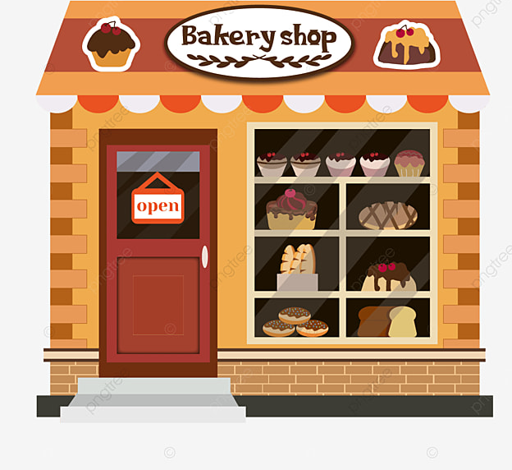
How can I get to the bakery?
Go straight.

Slide 31


How can I get to the supermarket?
Go straight.

Slide 32

How can I get to the bookshop?
Turn round.

Slide 33

How can I get to the supermarket?
Turn left.

Slide 34
How can I get to the bookshop?
Turn right.

Slide 35
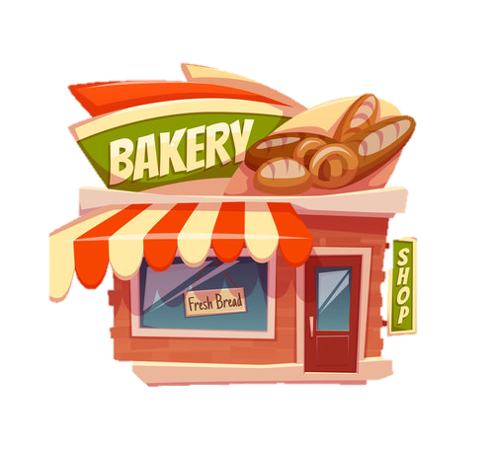
How can I get to the bakery?
Turn right.

Slide 36
How can I get to the cinema?
Turn left.

