Slide 1



19
The animal world
LESSON 1 - PERIOD 1

Slide 2
Table of Contents
01
02
Look, listen and repeat.
Warm-up
03
Listen, point and say.
04
Let’s talk.
05
Game

Slide 3
1
Warm-up

Slide 4
2
Look, listen and repeat.

Slide 5

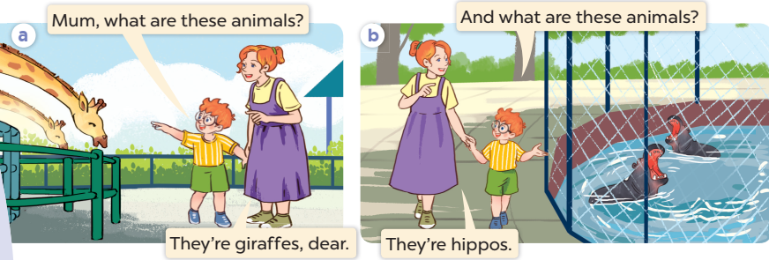
Listen and repeat.

Slide 6
3
Listen, point and say.

Slide 7
New words

Slide 8
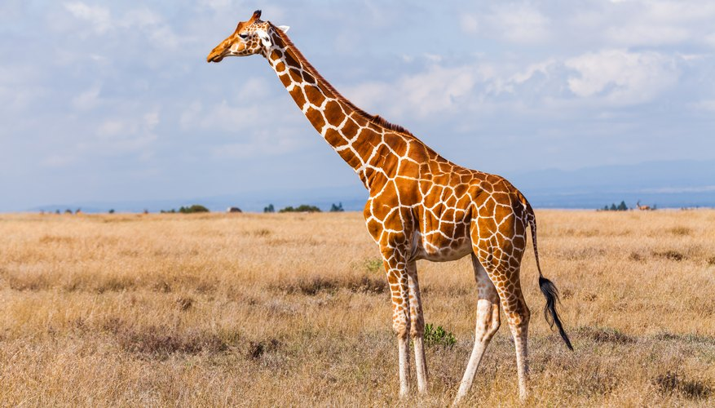
a giraffe

Slide 9
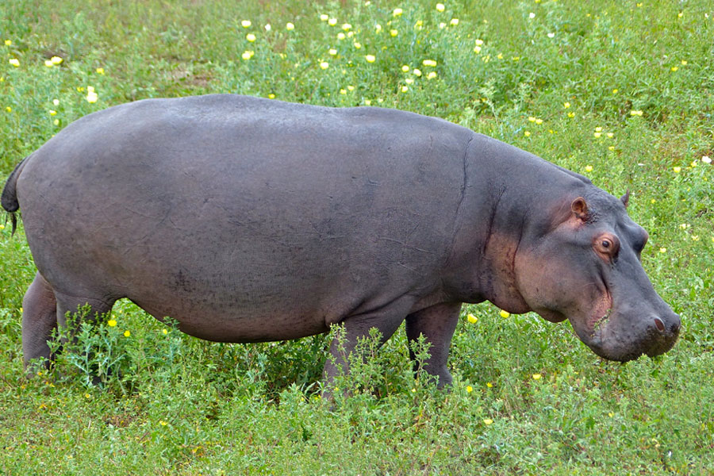
a hippo

Slide 10
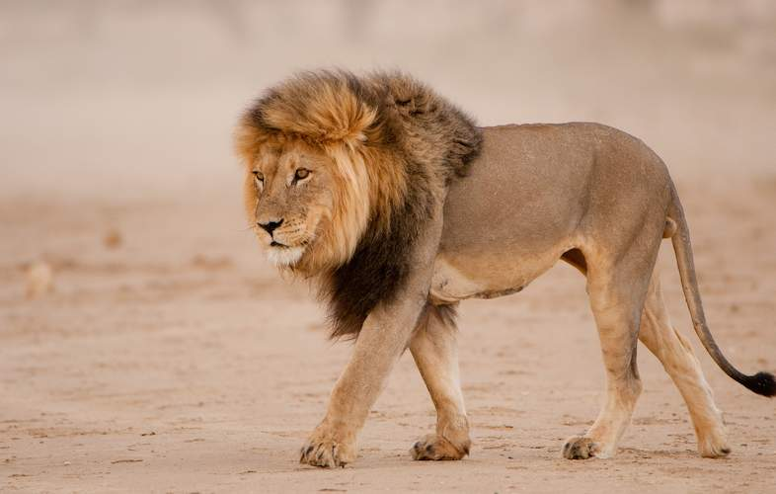
a lion

Slide 11
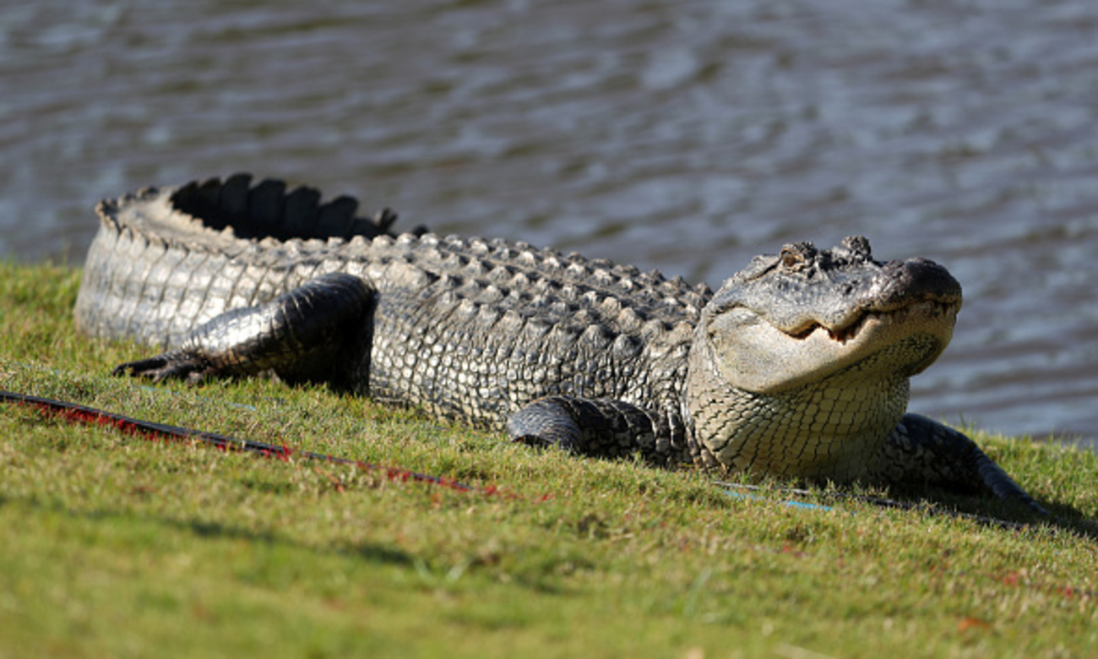
a crocodile

Slide 12
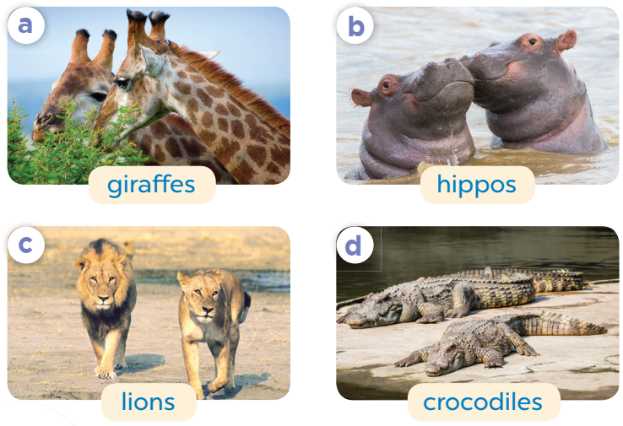
Listen, point and say.
What are these animals?
They’re ___.

Slide 13
What are these animals?
They’re giraffes.

Slide 14
What are these animals?
They’re hippos.

Slide 15
What are these animals?
They’re lions.

Slide 16
What are these animals?
They’re crocodiles.

Slide 17
4
Let’s talk.

Slide 18
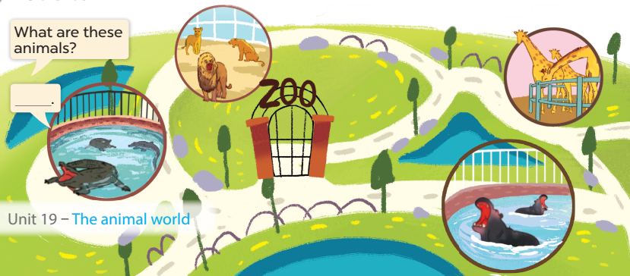
They’re lions.
They’re giraffes.
Look and answer.
They’re crocodiles.
They’re hippos.

Slide 19
5
Game

Slide 20







Collect some cookies.
GIRLS
BOYS
Notes:
- Divide the class into 2 teams (boys & girls)
- Each team takes turns to choose a number and answer the question.
- Click the numbers to choose questions.
- Click Play symbol to give 2 teams the number of cookies they get for each correct answer.

Slide 21
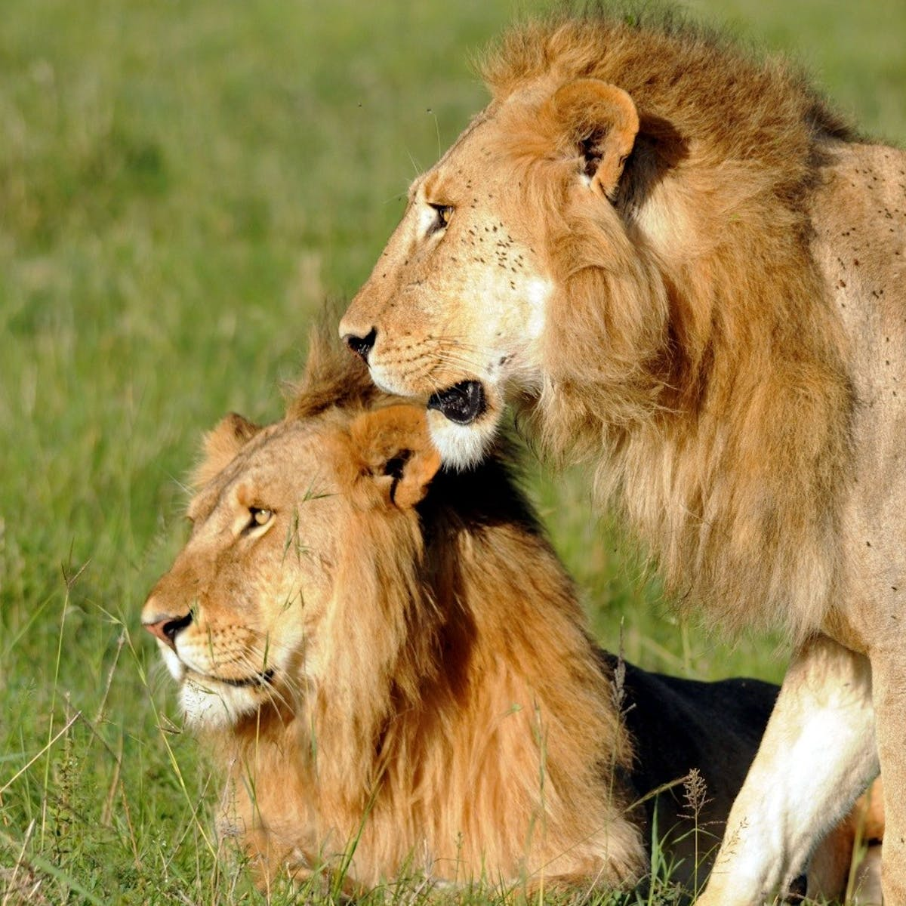

What are these animals?
They’re ………….
lions
Notes:
- Click to show question and answer
- Click again to show the amount of the cookies
- Click Home to get back to the menu

Slide 22
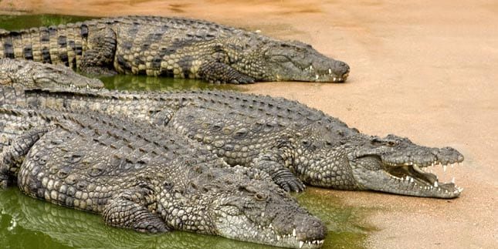
…………………………………………?
What are these animals
They’re crocodiles.

Slide 23
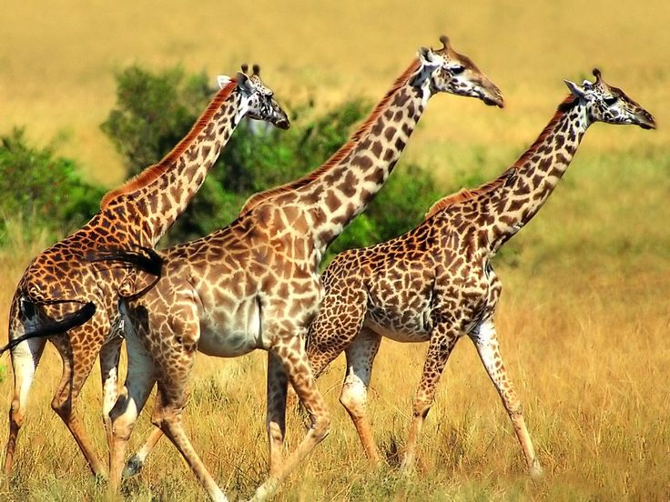
What are these animals?
They’re ……………..... .
giraffes

Slide 24
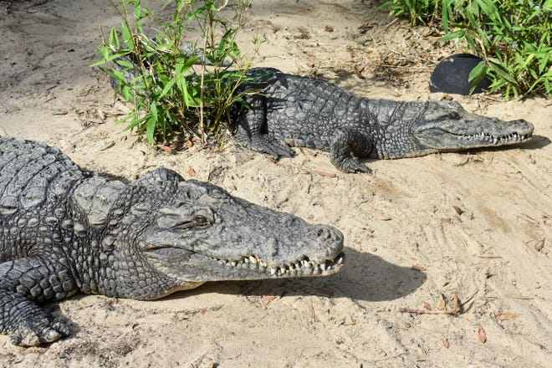
What are these animals?
crocodiles
They’re ……………….. .

Slide 25
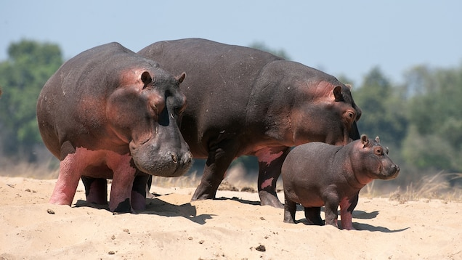
What are these animals?
They’re …………..... .
hippos

Slide 26
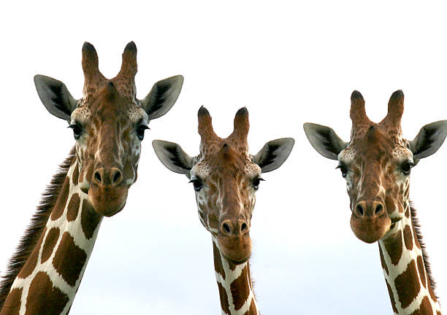
animals
……….… are these ……………..?
What
They’re giraffes.

