Slide 1



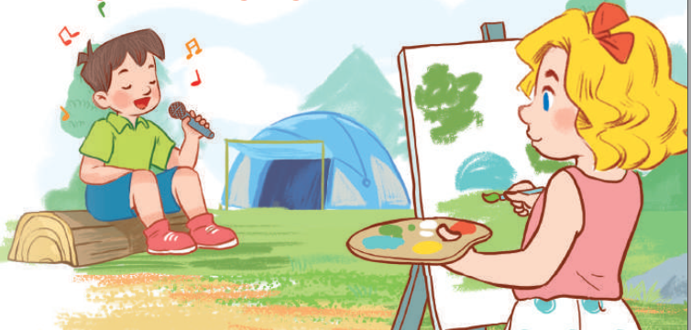
19
Outdoor activities
LESSON 1 – PERIOD 2

Slide 2
Warm-up
& Review
Listen
and tick.
Look,
complete
and read.
Let’s sing.
Fun corner
& wrap-up

Slide 3






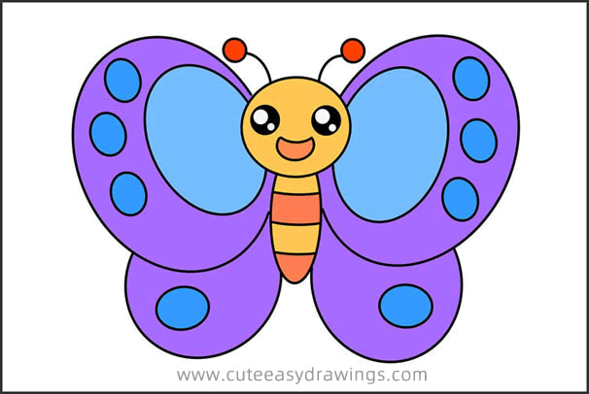




Slide 4

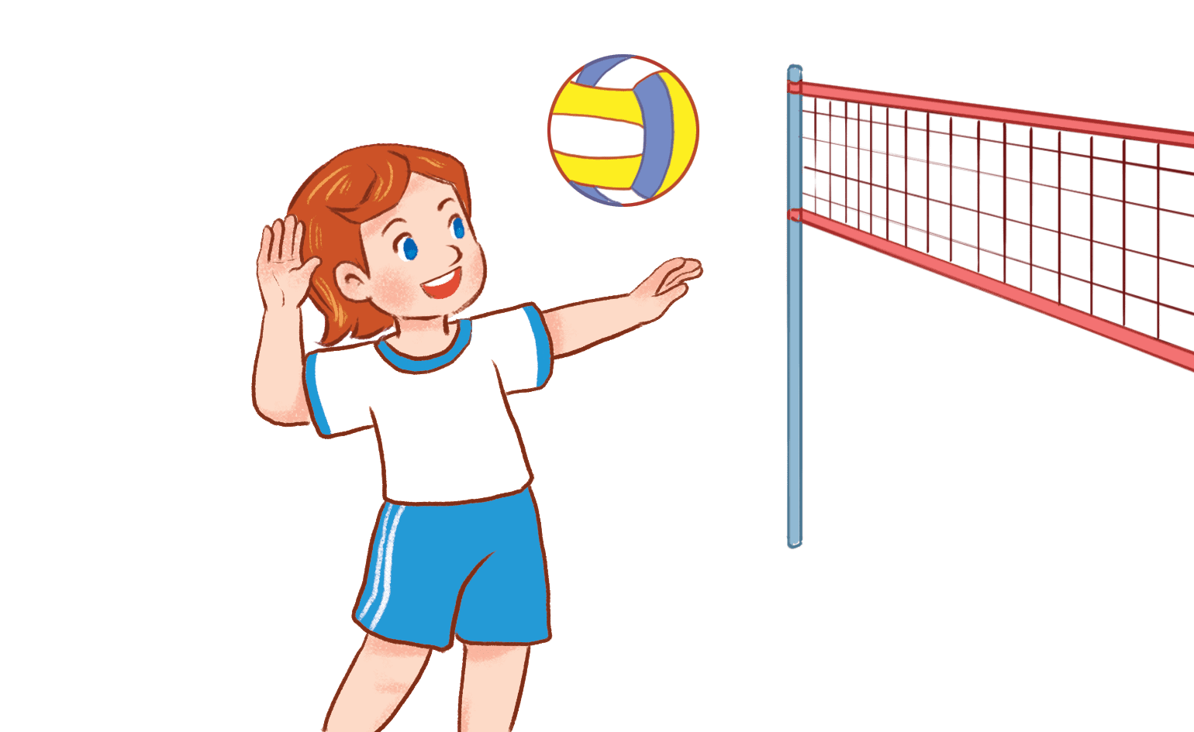


A. She’s playing badminton.
B. She’s playing basketball.
C. She’s playing volleyball.

Slide 5
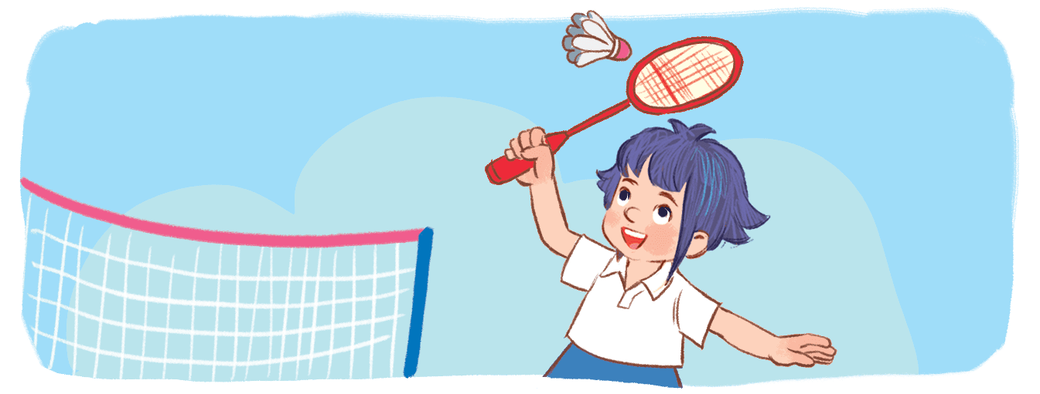
A. She’s playing badminton.
B. She’s playing basketball.
C. She’s playing volleyball.

Slide 6
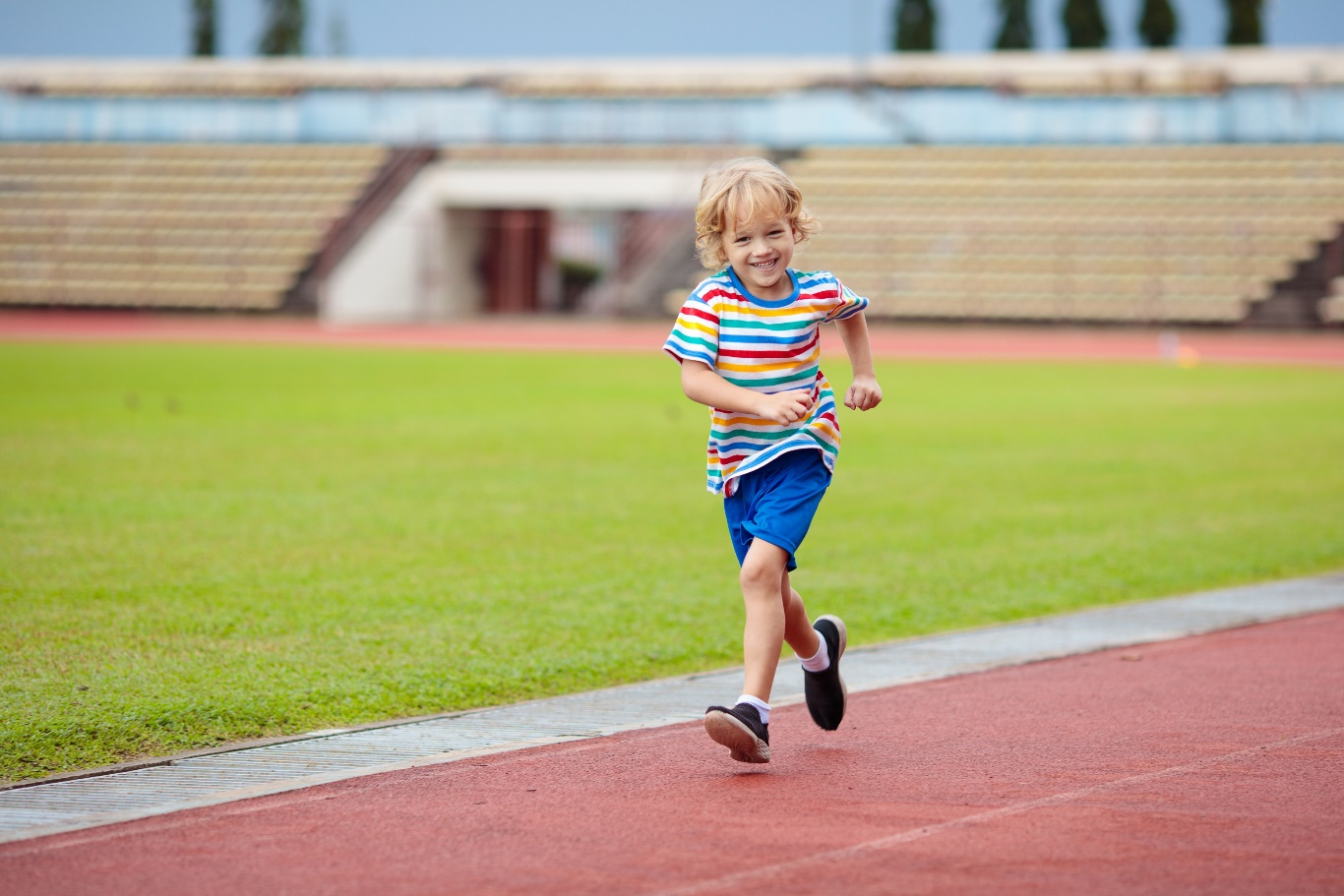
A. He’s walking.
B. He’s running.
C. He’s reading.

Slide 7
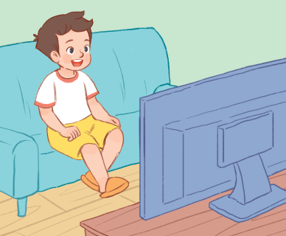
A. He’s listening to music.
B. He’s painting a picture.
C. He’s watching TV.

Slide 8
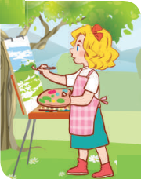
A. She’s painting a picture.
B. She’s listening to music.
C. She’s watching TV.

Slide 9

A. She’s painting a picture.
B. She’s reading a book.
C. She’s watching TV.

Slide 10

A. She’s walking across the street.
B. She’s reading a book.
C. She’s running in the park.

Slide 11

A. He’s listening to music.
B. He’s singing a song.
C. He’s painting a picture.

Slide 12


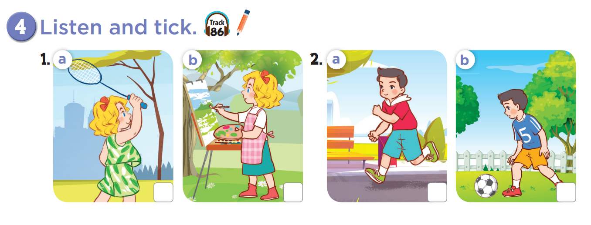
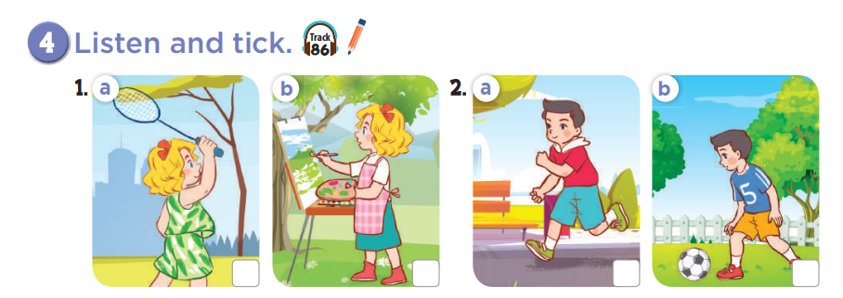


Slide 13
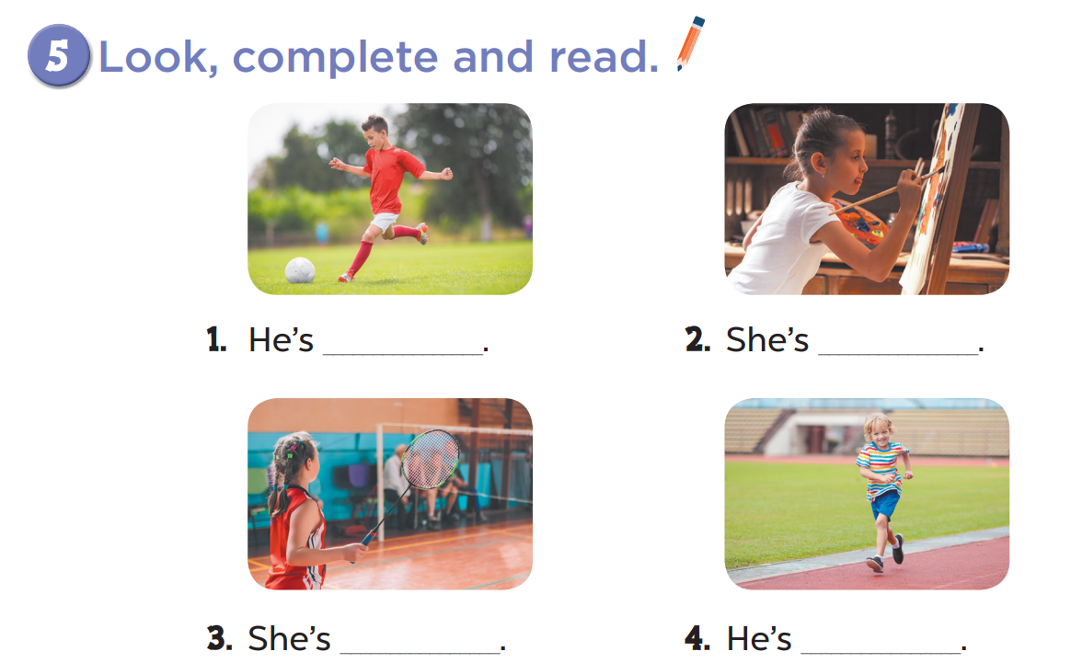
playing football
painting
playing badminton
running

Slide 14
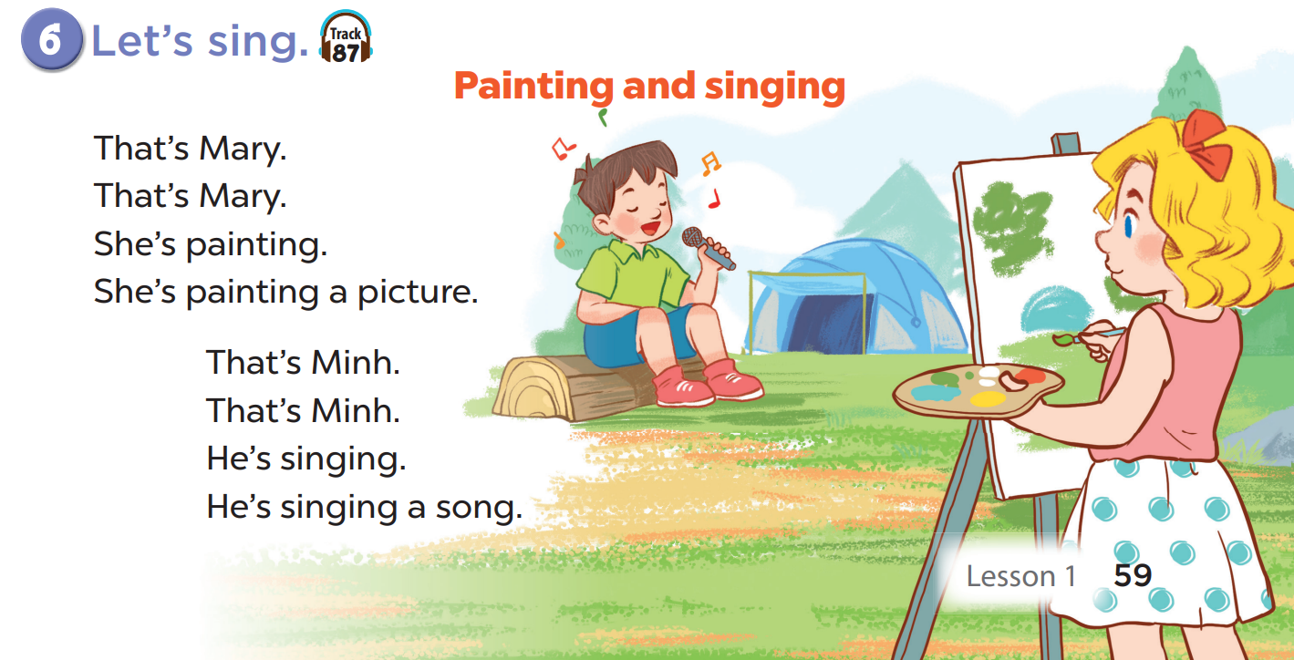

Slide 15










Candy or chilly?
A
B
C
 | A | B | C
1
2
3
+ 50
- 20
Notes:
- Divide the class into 3 teams.
- Each team takes turns picking a square.
- Pupils will get points for each correct question.

Slide 16


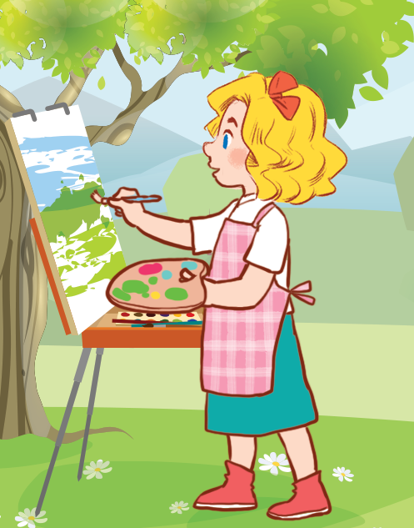
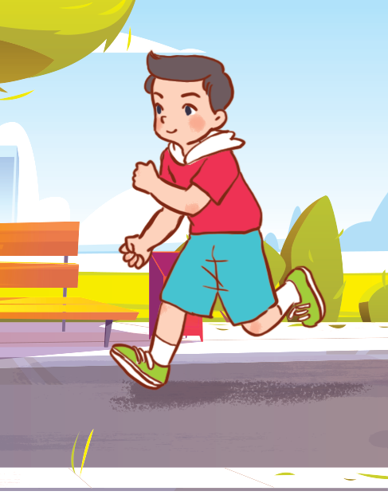
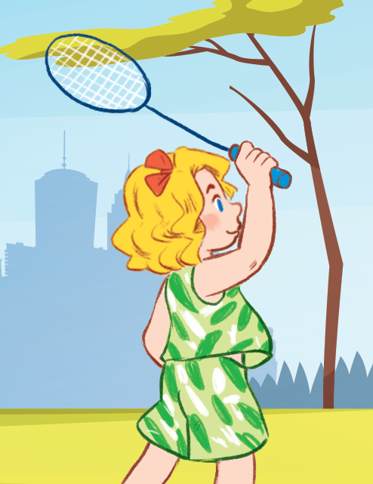
She’s painting.

Slide 17
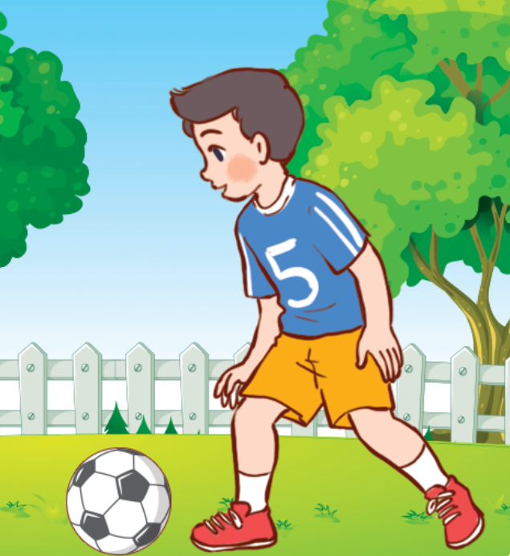

She’s playing badminton.

Slide 18
He’s running.

Slide 19
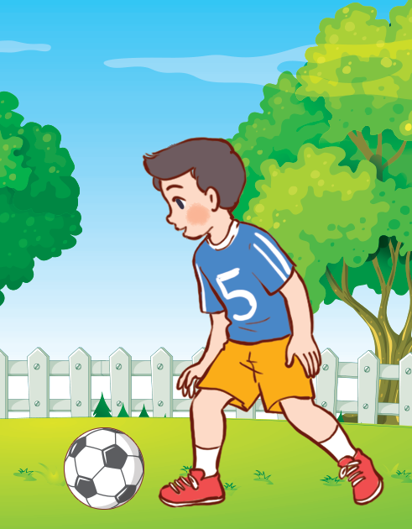
He’s playing football.

Slide 20
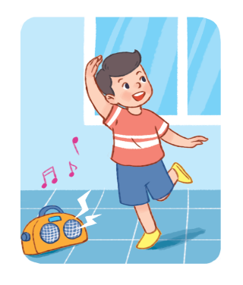
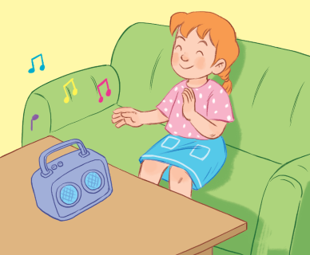
She’s listening to music.

Slide 21
He’s dancing.

Slide 22
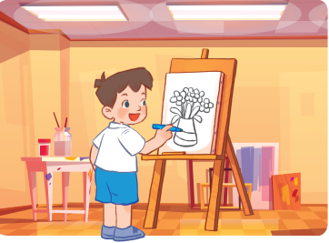
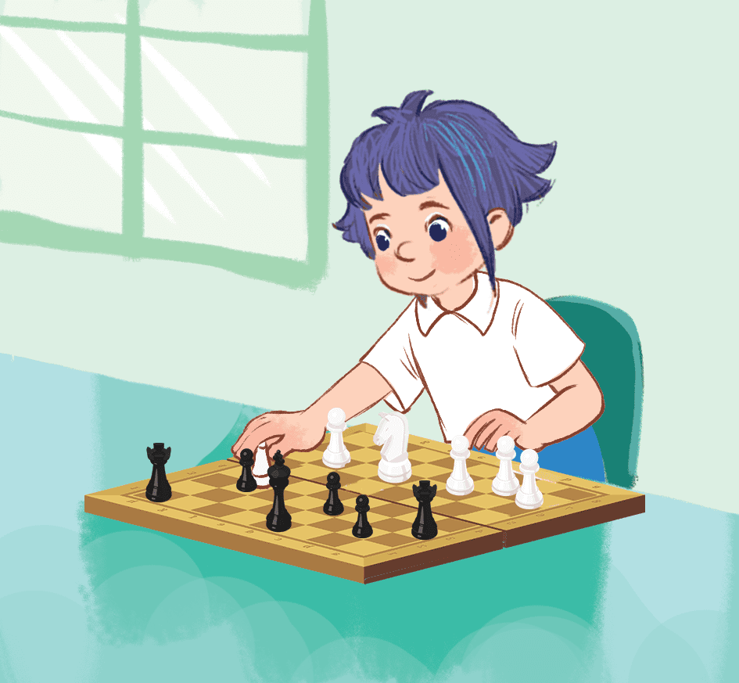
She’s reading a book.

Slide 23
She’s playing chess.

Slide 24
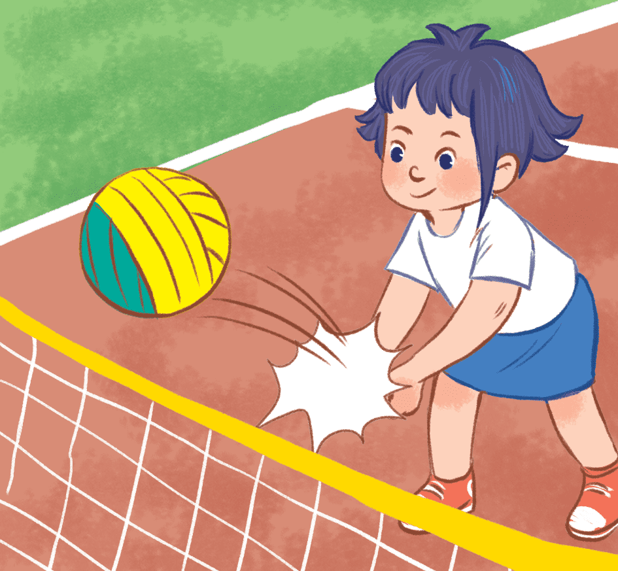
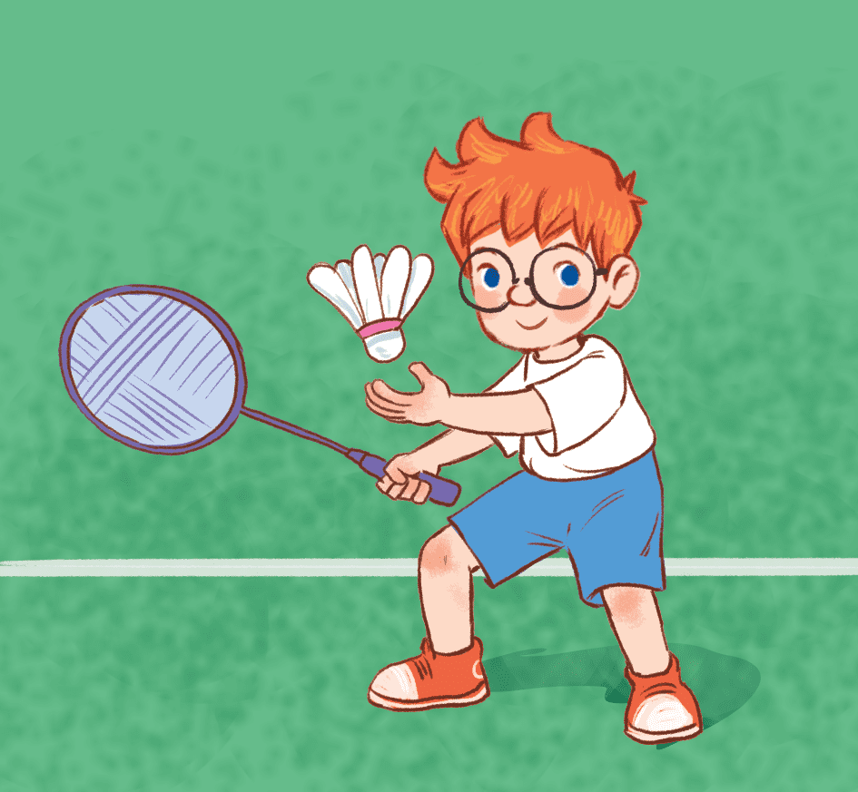
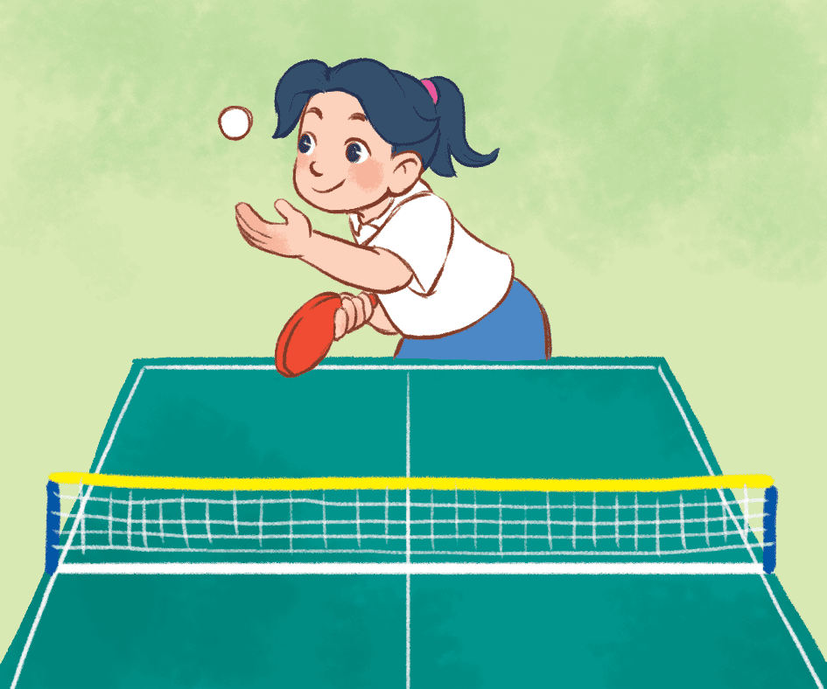
She’s playing volleyball.

Slide 25

Website: hoclieu.vn
Fanpage: https://www.facebook.com/tienganhglobalsuccess.vn/

