Slide 1



19
The animal world
LESSON 2 - PERIOD 3

Slide 2
1
Warm-up

Slide 3
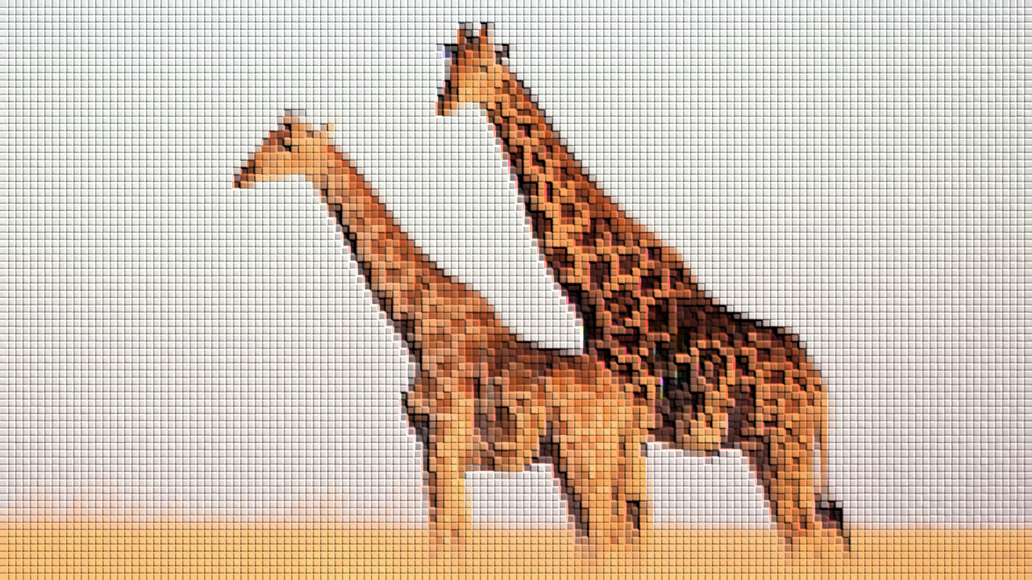
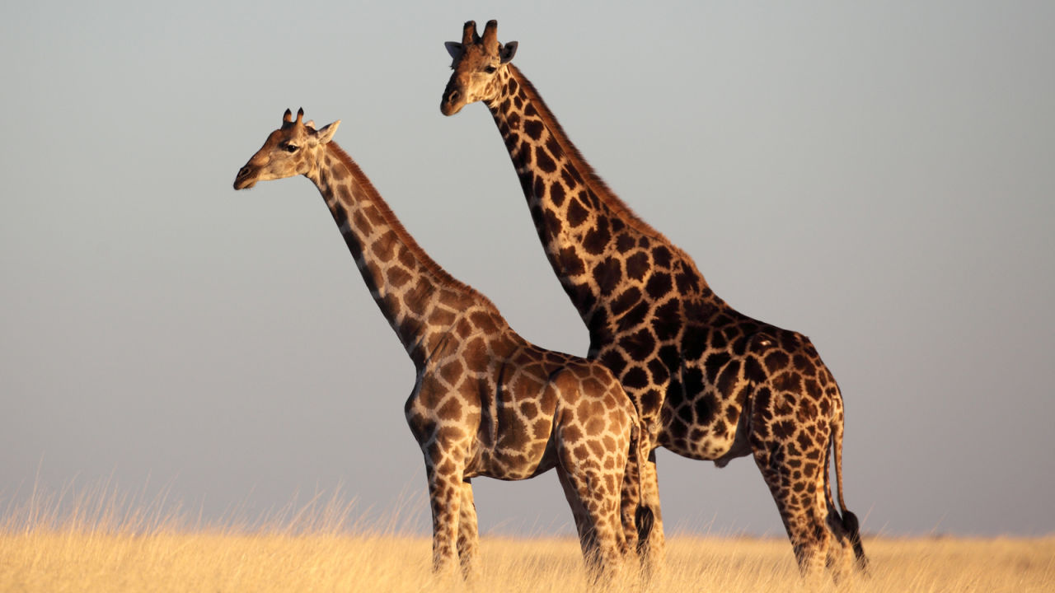
giraffes

Slide 4
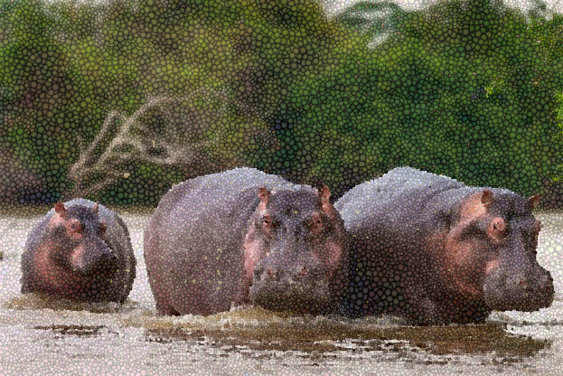
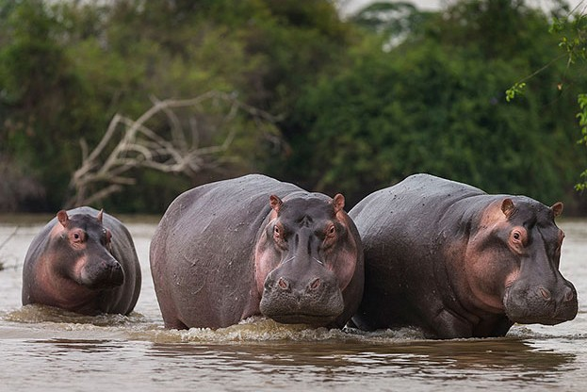
hippos

Slide 5
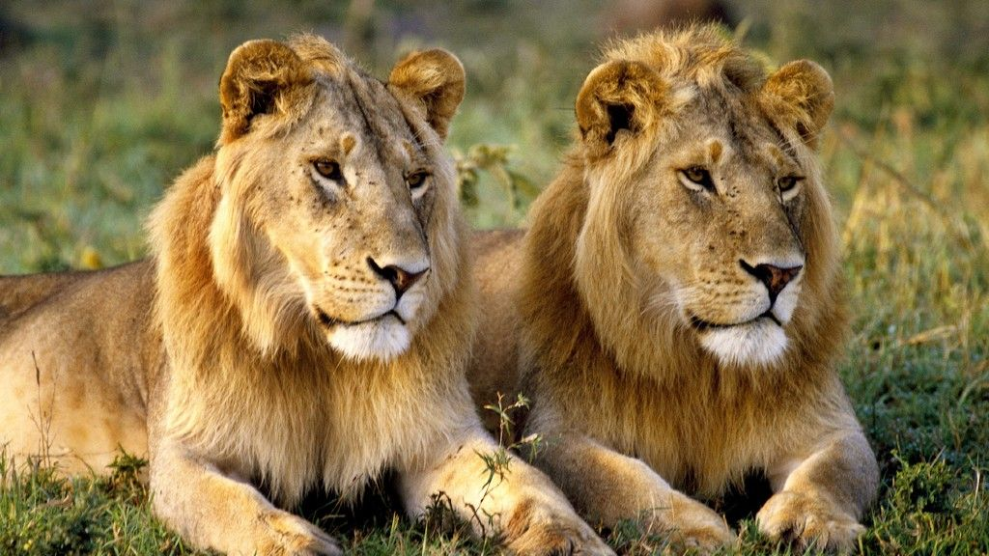
lions

Slide 6
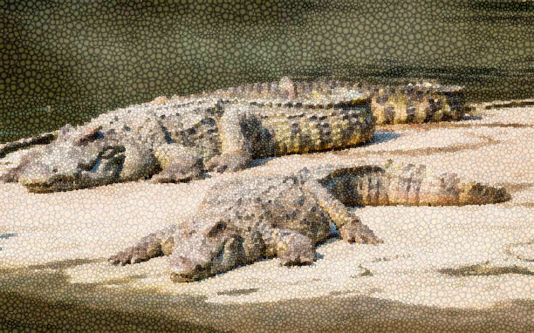
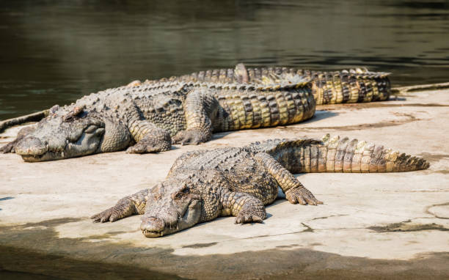
crocodiles

Slide 7
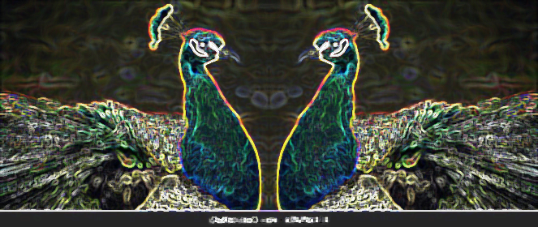
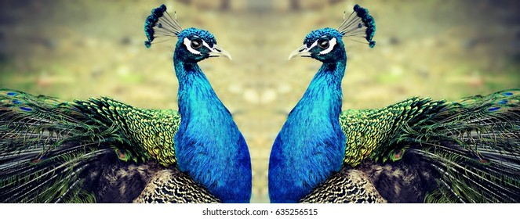
peacocks

Slide 8

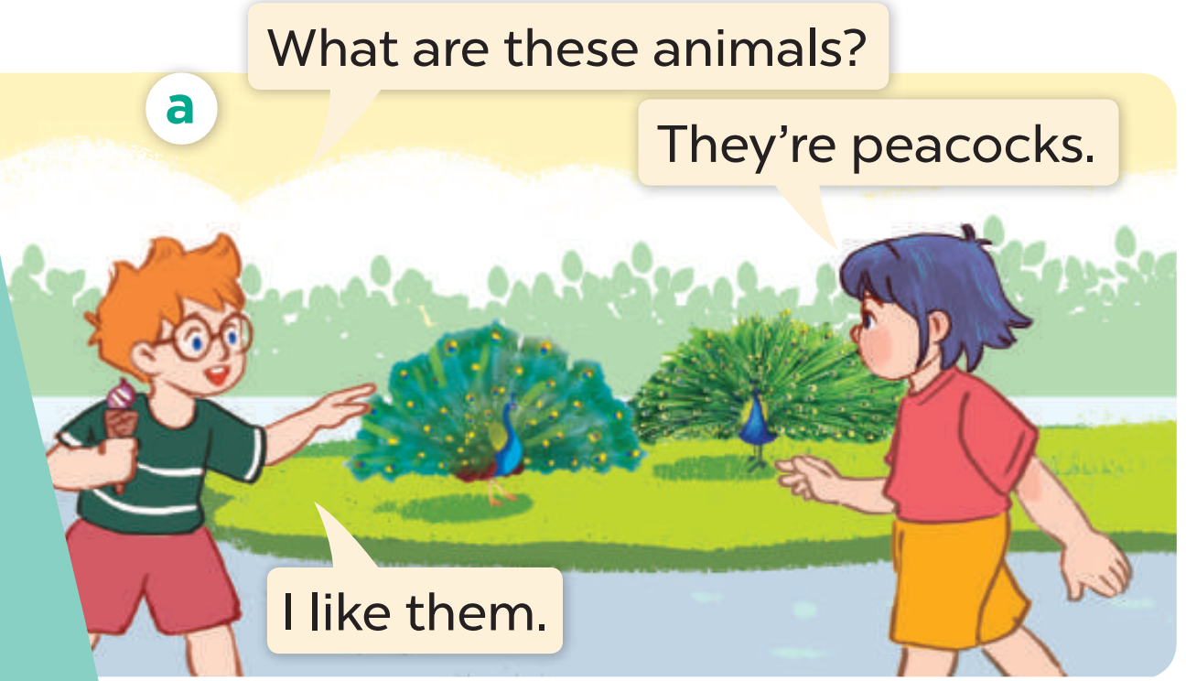
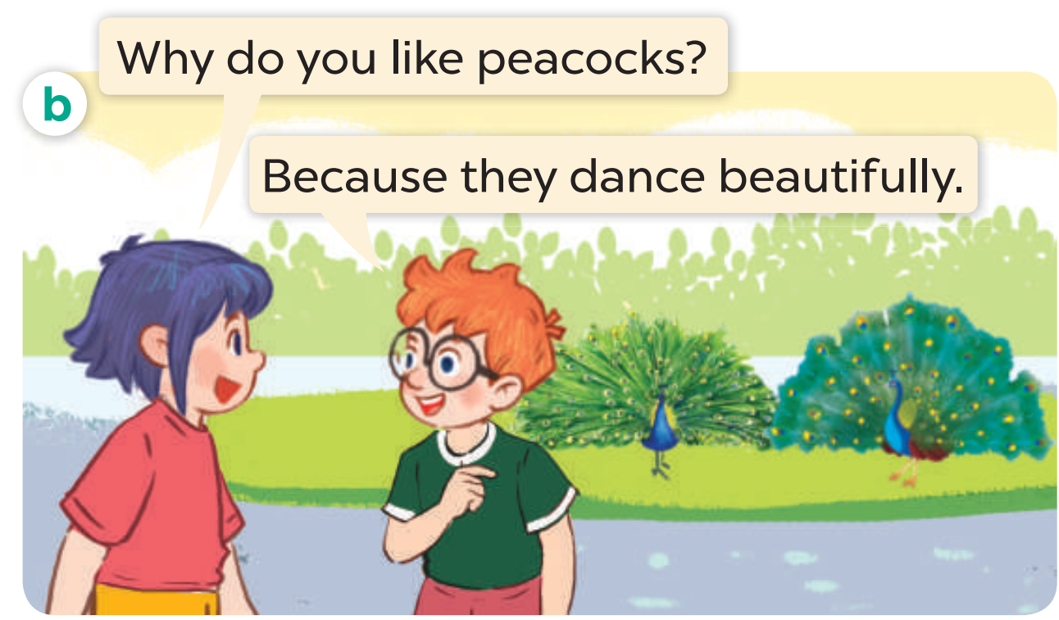
Look, listen and repeat.

Slide 9
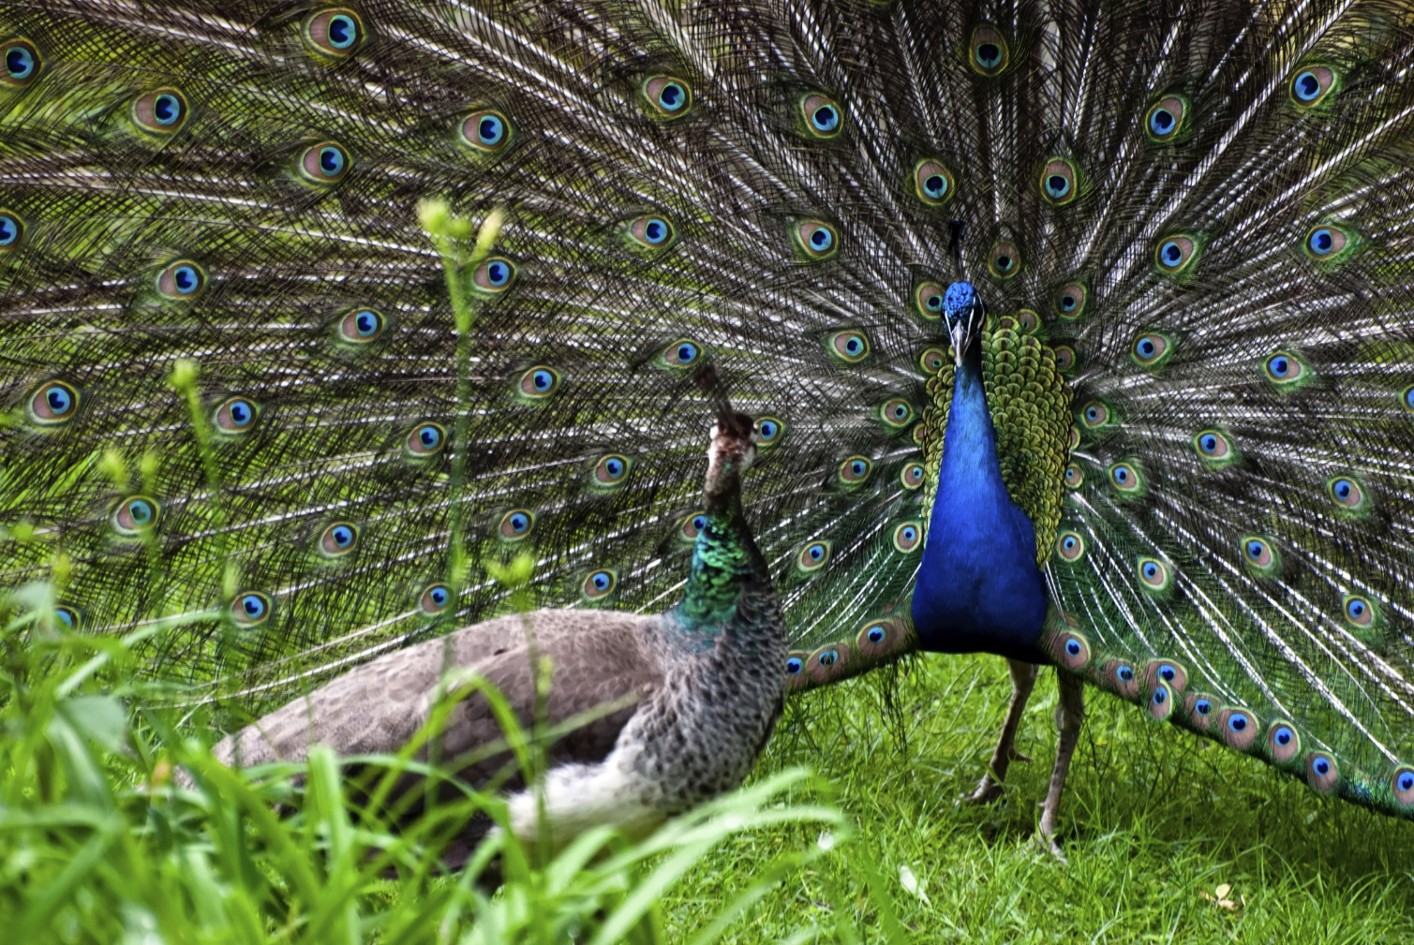
dance beautifully

Slide 10
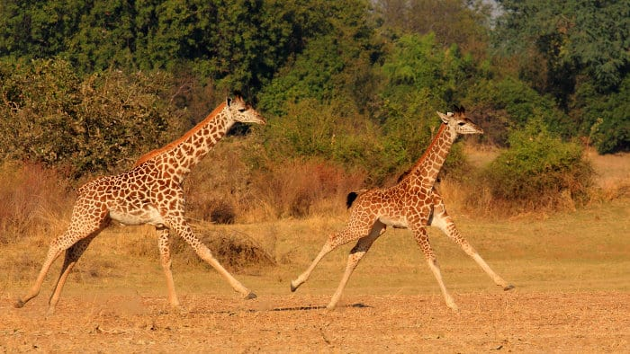
run quickly

Slide 11
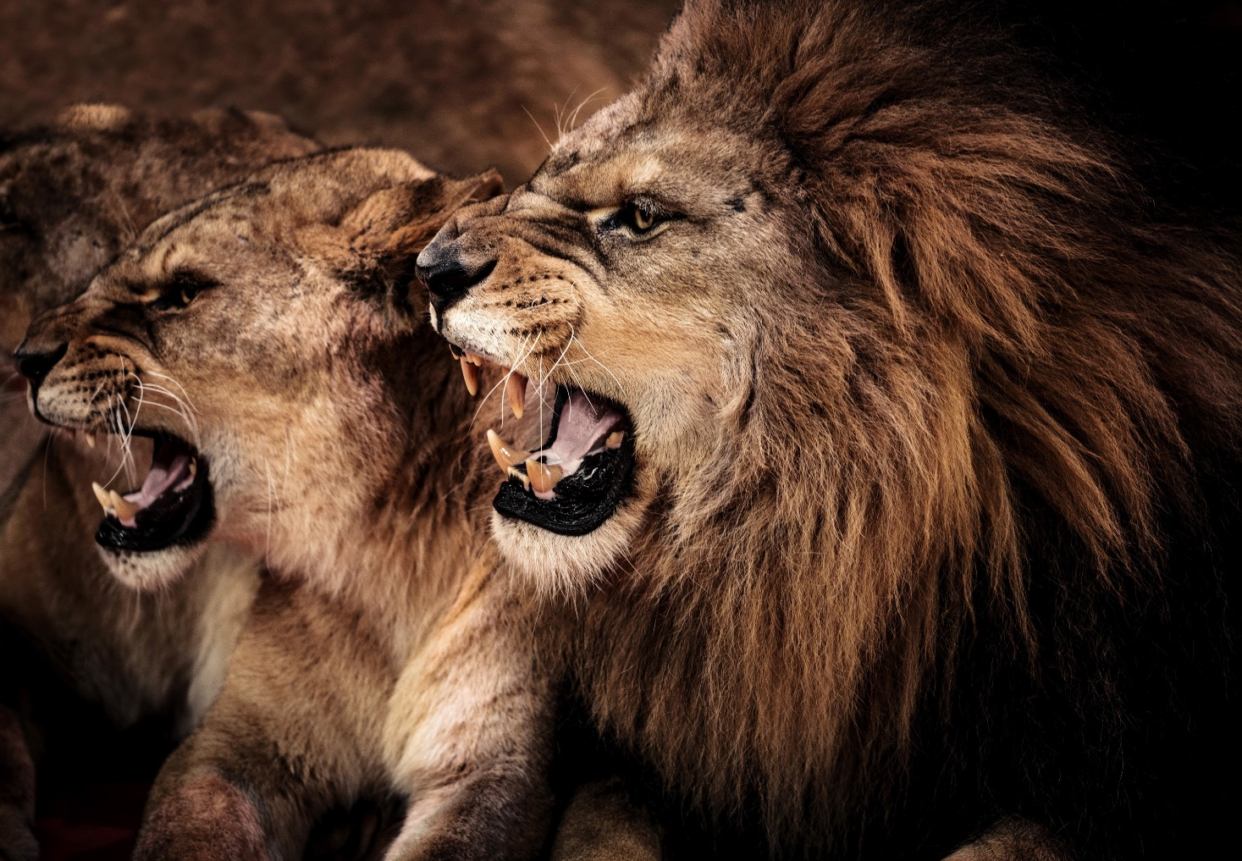
roar loudly

Slide 12
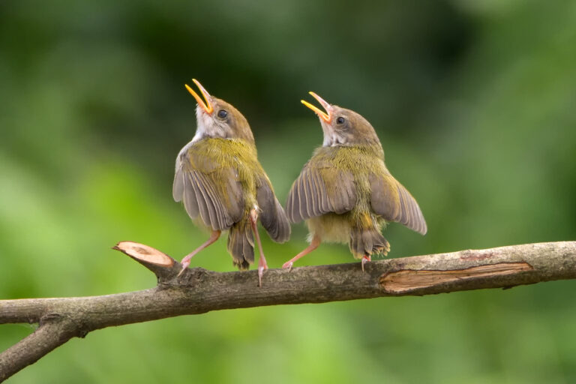
sing merrily

Slide 13
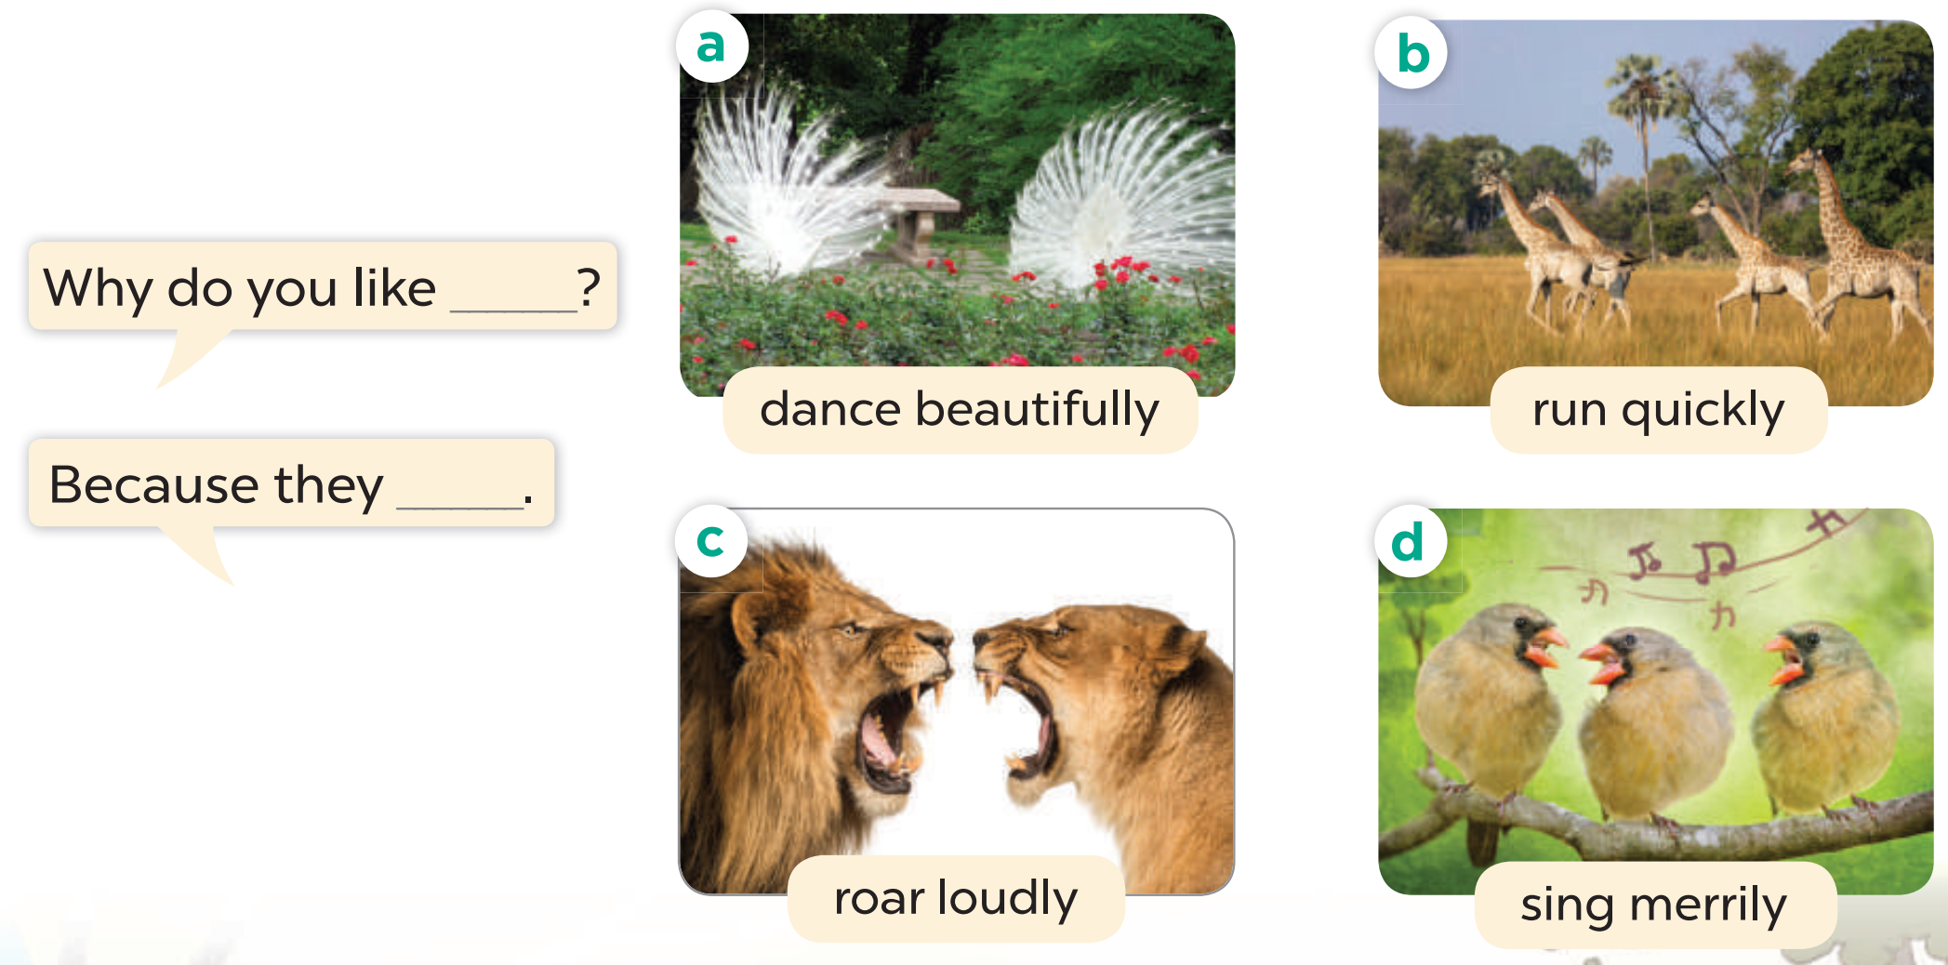
Listen, point and say.

Slide 14
4
Let’s talk.

Slide 15
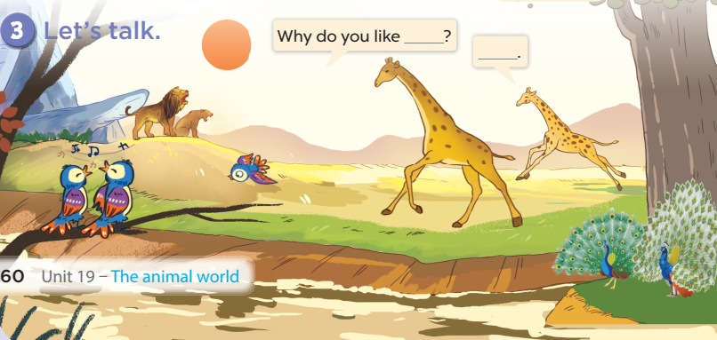

Slide 16
5
Fun corner

Slide 17


Slide 18
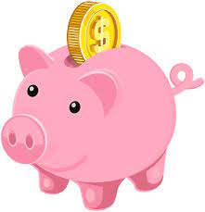
Choose the pig!
1
2
3
4
5
6
7
8

Slide 19
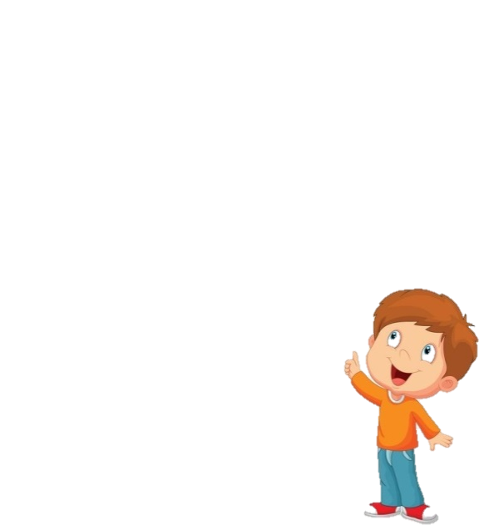


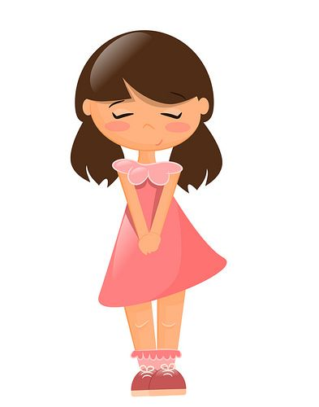
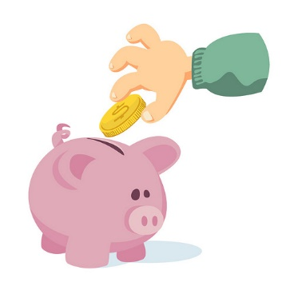

What are these animals?
They’re peacocks.
Notes:
Click once to show the question, twice to show the answer.
Click one last time to show the number of coins they’ll get if the answer is correct.
Click the piggy bank to get back to the menu

Slide 20
Why do you like peacocks?
Because they dance beautifully.
Notes:
Click once to show the question, twice to show the answer.
Click one last time to show the number of coins they’ll get if the answer is correct.
Click the piggy bank to get back to the menu

Slide 21
What are these animals?
They’re giraffes.
Notes:
Click once to show the question, twice to show the answer.
Click one last time to show the number of coins they’ll get if the answer is correct.
Click the piggy bank to get back to the menu

Slide 22
Why do you like giraffes?
Because they run quickly.
Notes:
Click once to show the question, twice to show the answer.
Click one last time to show the number of coins they’ll get if the answer is correct.
Click the piggy bank to get back to the menu

Slide 23

What are these animals?
They’re lions.
Notes:
Click once to show the question, twice to show the answer.
Click one last time to show the number of coins they’ll get if the answer is correct.
Click the piggy bank to get back to the menu

Slide 24
Why do you like lions?
Because they roar loudly.
Notes:
Click once to show the question, twice to show the answer.
Click one last time to show the number of coins they’ll get if the answer is correct.
Click the piggy bank to get back to the menu

Slide 25
What are these animals?
They’re birds.
Notes:
Click once to show the question, twice to show the answer.
Click one last time to show the number of coins they’ll get if the answer is correct.
Click the piggy bank to get back to the menu

Slide 26
Why do you like birds?
Because they sing merrily.
Notes:
Click once to show the question, twice to show the answer.
Click one last time to show the number of coins they’ll get if the answer is correct.
Click the piggy bank to get back to the menu

