Slide 1

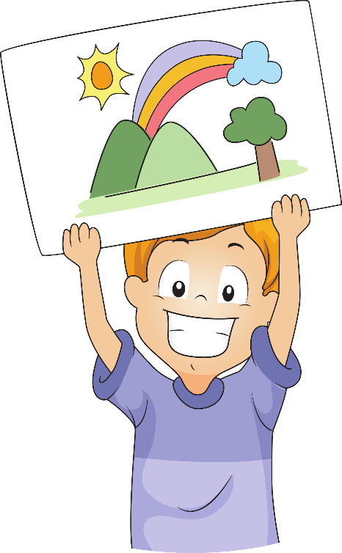





Unit 3
My week
Lesson 1
MsPham
0936082789

Slide 2

Warm up

Slide 3
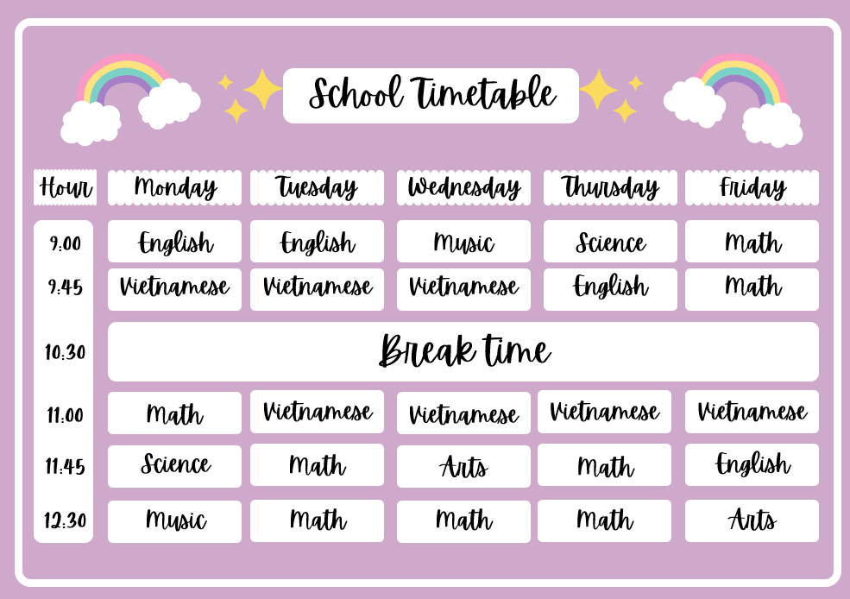
Look and answer the question
1. What is it?
It is a timetable.
2. What is the line called?
Days of the week

Slide 4

Vocabulary

Slide 5

Sunday
/ˈsʌndeɪ/
Chủ nhật

Slide 6
Monday
/ˈmʌndeɪ/
Thứ hai

Slide 7
Tuesday
/ˈtuːzdeɪ/
Thứ ba

Slide 8
Wednesday
/ˈwenzdeɪ/
Thứ tư

Slide 9
Thursday
/ˈθɜːzdeɪ/
Thứ năm

Slide 10
Friday
/ˈfraɪdeɪ/
Thứ sáu

Slide 11
Saturday
/ˈsætədeɪ/
Thứ 7

Slide 12
Days of a week
Sunday
Monday
Tuesday
Wednesday
Thursday
Friday
Saturday

Slide 13
MsPham
0936082789
Vocabulary
Sunday
: Chủ nhật
Monday
: Thứ hai
Tuesday
: Thứ ba
Wednesday
: Thứ tư
Thursday
: Thứ năm
Friday
: Thứ sáu
Saturday
: Thứ bảy

Slide 14
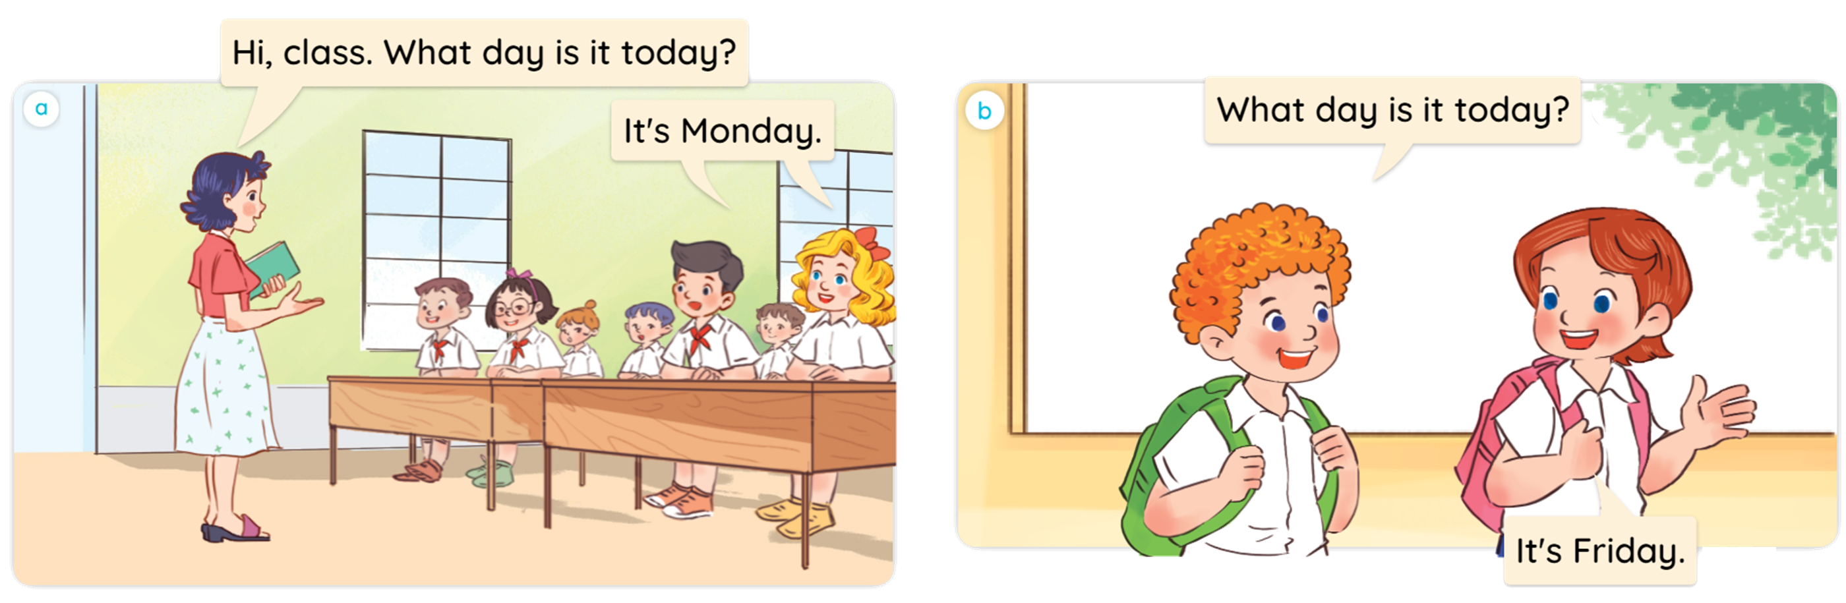


1
Look, listen and read.
MsPham
0936082789

Slide 15
Structure

Slide 16
1
Cách hỏi hôm nay là thứ mấy:
What day is it today?
(Hôm nay là thứ mấy?)
It’s _________.
(Hôm nay thứ _____.)
(+ thứ)
Ex:
What day is it today?
Sunday
MsPham
0936082789
It’s Sunday.

Slide 17
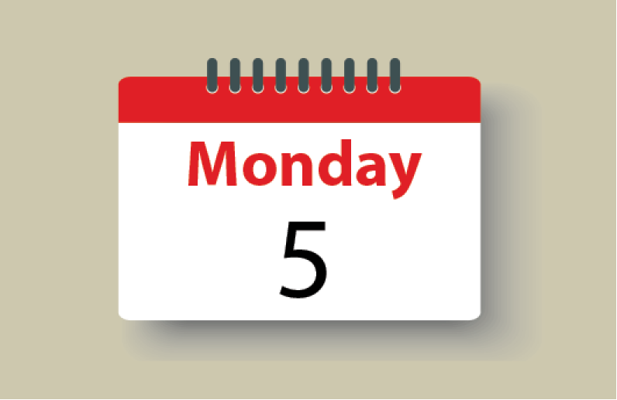
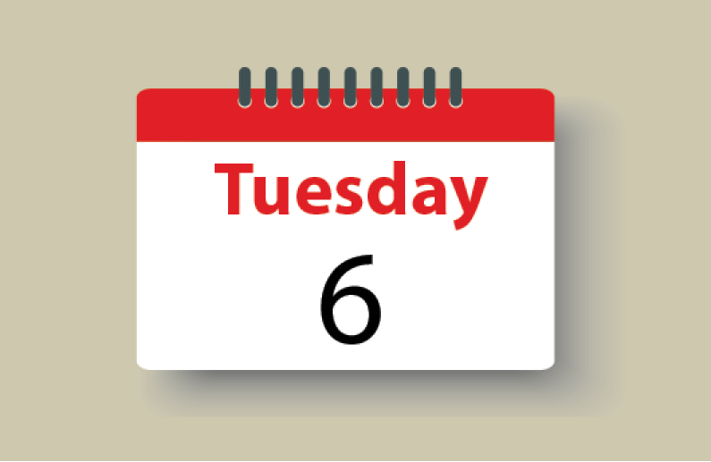
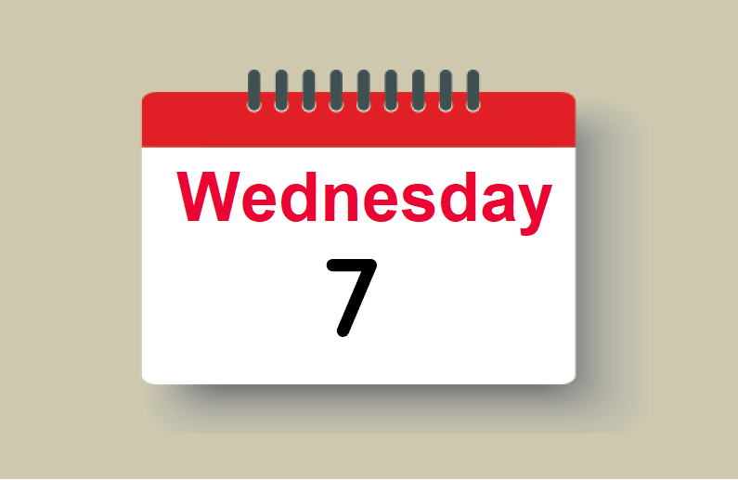
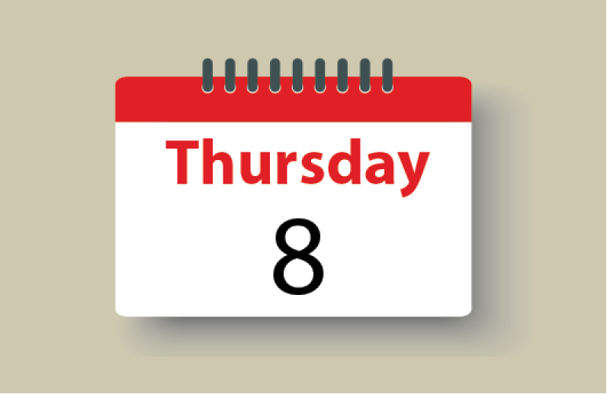
2
Listen, point and say.
What day is it today?
It’s _________.
a
b
MsPham
0936082789
Monday
Tuesday
c
d
Wednesday
Thursday

Slide 18

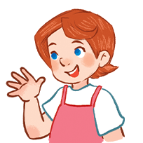
2
Listen, point and say.
a
MsPham
0936082789
Monday
What day is it today?
It’s Monday.

Slide 19
2
Listen, point and say.
b
MsPham
0936082789
Tuesday
What day is it today?
It’s Tuesday.

Slide 20
2
Listen, point and say.
c
MsPham
0936082789
Wednesday
What day is it today?
It’s Wednesday.

Slide 21
2
Listen, point and say.
d
MsPham
0936082789
Thursday
What day is it today?
It’s Thursday.

Slide 22
2
Listen, point and say.
What day is it today?
It’s _________.
a
b
MsPham
0936082789
Monday
Tuesday
c
d
Wednesday
Thursday

Slide 23
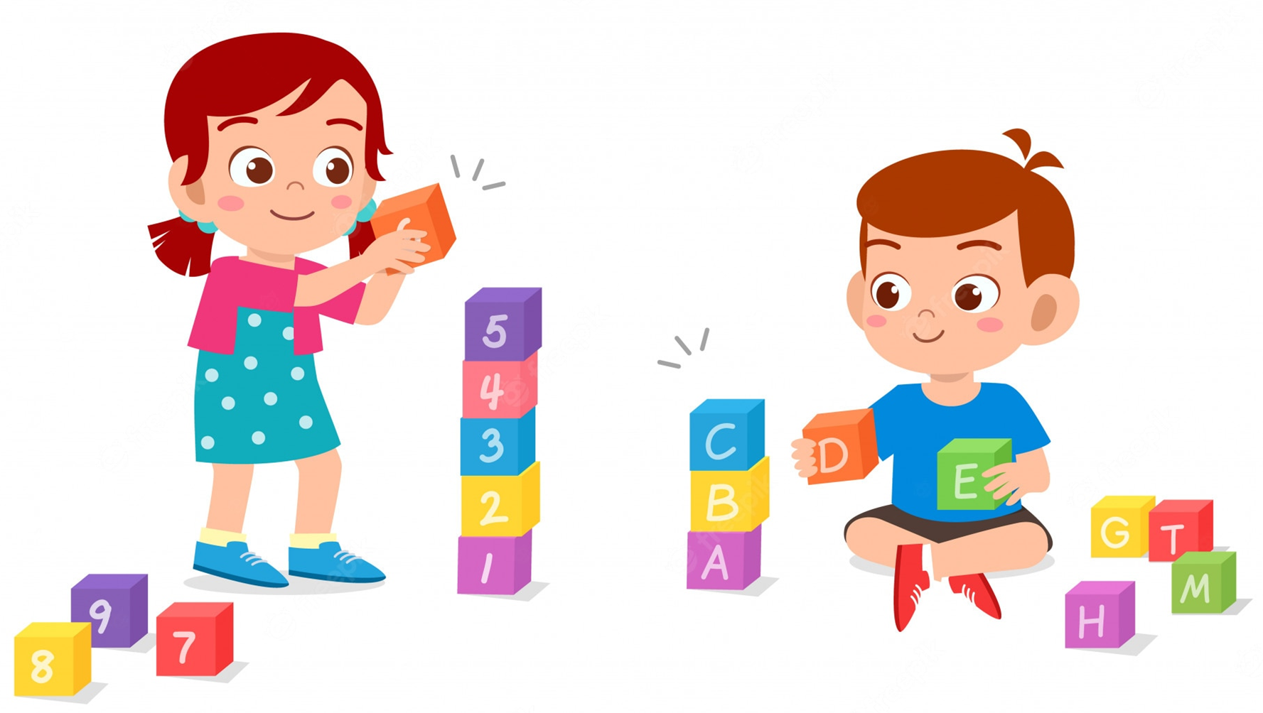
L
C
S
B
O
K

Slide 24
What day is it today?
It’s ___________________________.
M
a
n
d
y
o
Check

Slide 25
What day is it today?
It’s ___________________________.
Next
M
o
n
d
a
y
g

Slide 26
What day is it today?
It’s ___________________________.
s
h
u
T
a
y
r
d
Check

Slide 27
What day is it today?
It’s ___________________________.
Next
T
h
u
r
s
d
a
y

Slide 28
What day is it today?
It’s ___________________________.
a
e
y
T
d
s
u
Check

Slide 29
What day is it today?
It’s ___________________________.
Next
T
u
e
s
d
a
y

Slide 30
What day is it today?
It’s ___________________________.
y
e
s
d
a
e
d
n
W
Check

Slide 31
What day is it today?
It’s ___________________________.
Next
W
e
d
n
e
s
d
a
y

Slide 32
What day is it today?
It’s ___________________________.
a
r
y
d
a
S
u
t
Check

Slide 33
What day is it today?
It’s _________________________.
Next
S
a
t
u
r
d
a
y

Slide 34
What day is it today?
It’s ___________________________.
i
d
r
y
a
F
Check

Slide 35
What day is it today?
It’s ___________________________.
Next
F
r
i
d
a
y

Slide 36
What day is it today?
It’s ___________________________.
u
a
n
y
d
S
Check

Slide 37
What day is it today?
It’s ___________________________.
Next
S
u
n
d
a
y

Slide 38
G
O
O
D
J
O
B

Slide 39
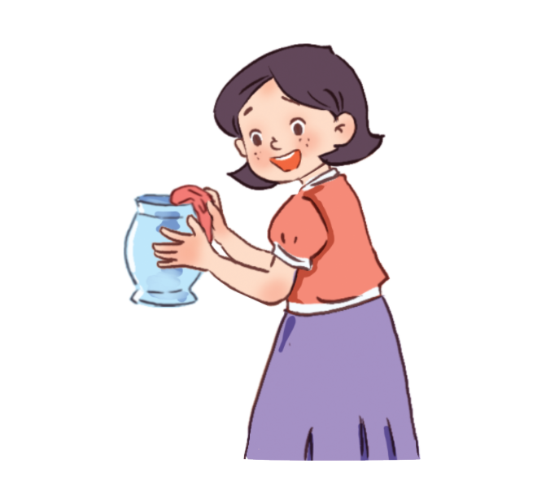
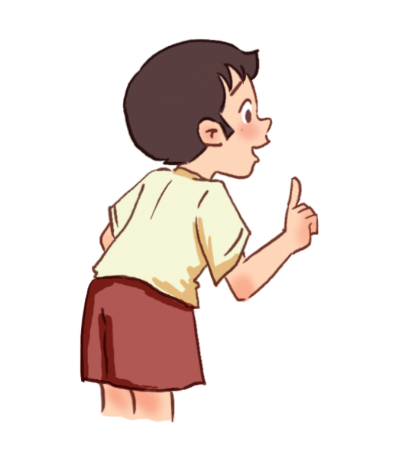
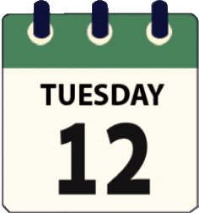
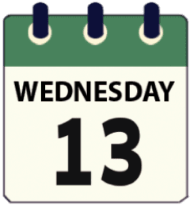
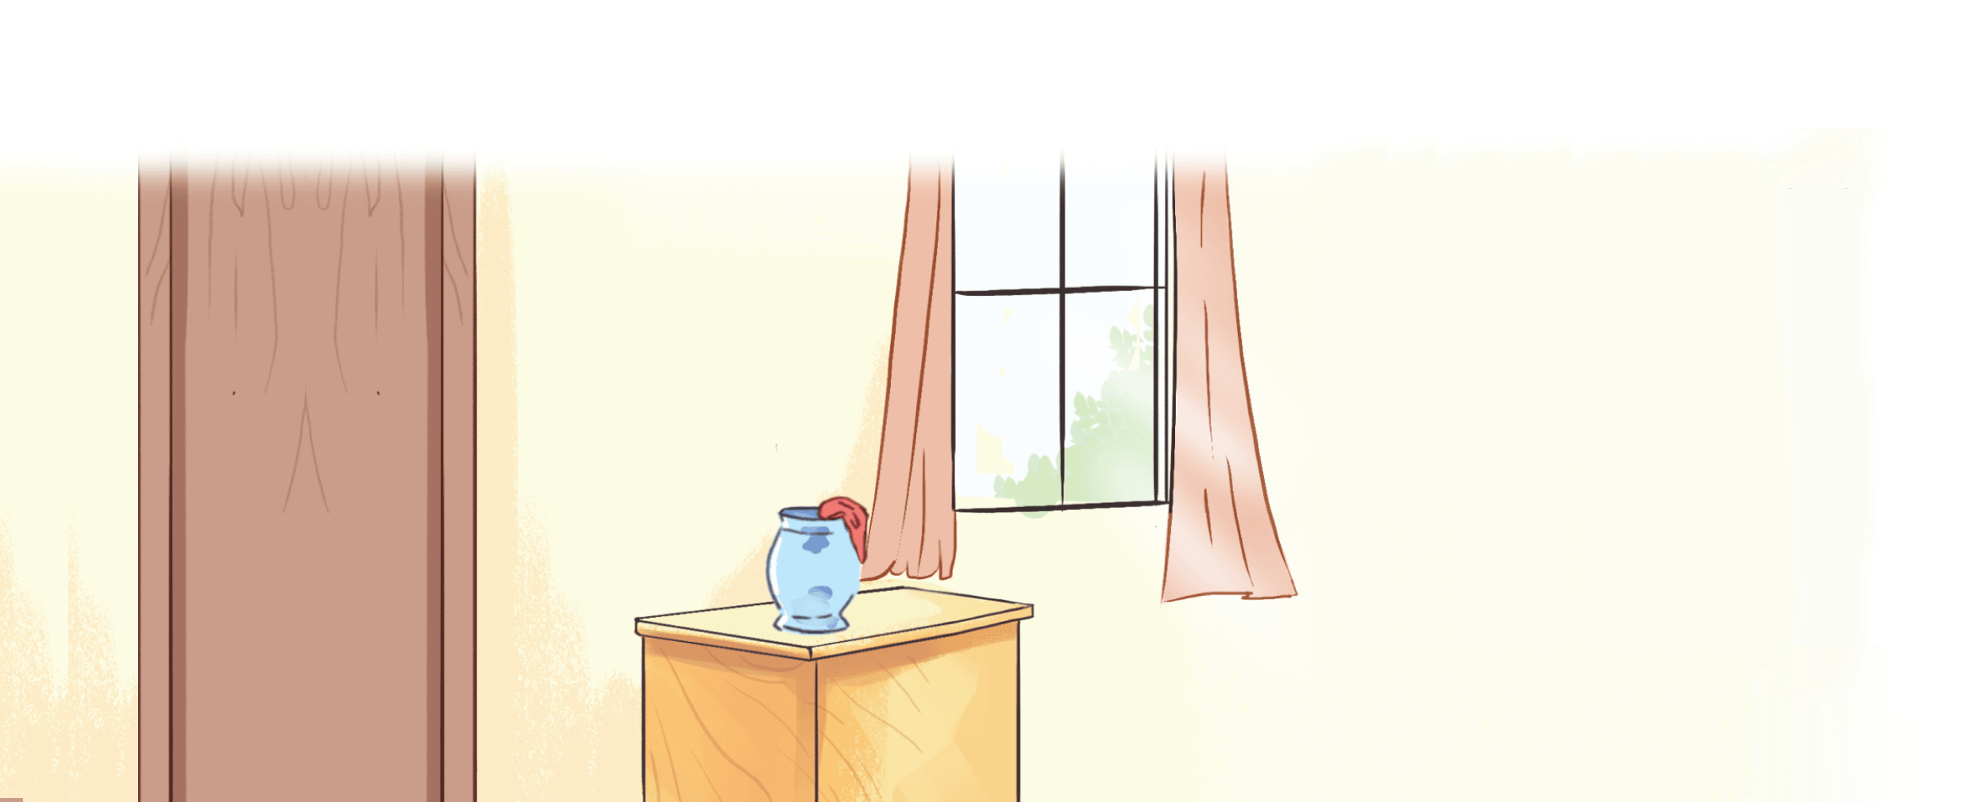
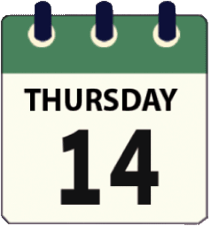
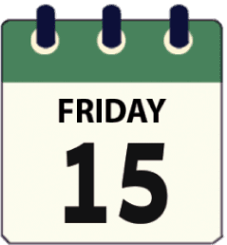
2
Let’s talk.
What day is it today?
It’s _________.

Slide 40
Review

Slide 41
Monday
Tuesday
Wednesday
Sunday
MsPham
0936082789
What day is it today?
It’s _________.
MsPham
0936082789
Thursday
Saturday
Friday

Slide 42
Thank you!

