Slide 2

Review 2
Period 1

Slide 3

Table of contents
01
Warm-up and Review
02
Activity 1. Listen and tick.
03
Activity 2. Answer the questions.
04
Fun corner and Wrap-up

Slide 4


01
Warm-up and Review

Slide 5
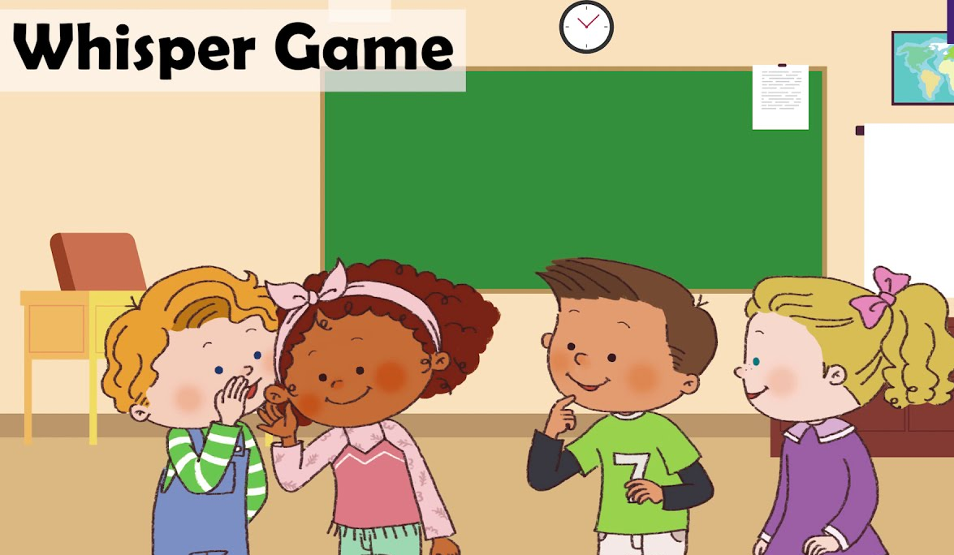

Slide 6

Whisper Game
Team 1
Team 2

Slide 7

Team 1
Whisper Game
Team 2
The music room is on the first floor.
The music room is on the second floor.
Round 1
He likes solving maths problems.
He likes reading English short stories.
Round 2
His notebooks are in the desk.
Her books are on the desk.
Round 3
They danced around the campfire.
They listened to music.
Round 4
Notes:
GV ghi điểm cho HS bằng cách nháy vào tên team. Mỗi lần nháy 1 ngôi sao xuất hiện.

Slide 8


Slide 9
02
Activity 1. Listen and tick.

Slide 10

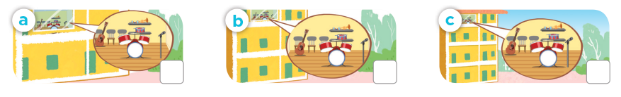
Listen and tick.
1. Where’s the music room?
✓

Slide 11
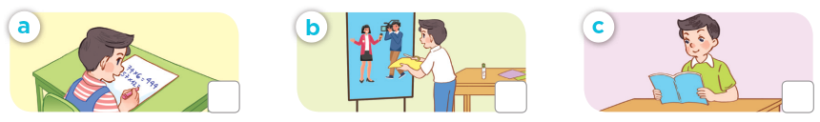
Listen and tick.
2. What school activity does Nam like?
✓

Slide 12
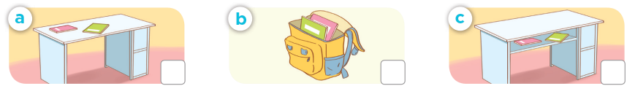
Listen and tick.
  3. Where are Mary’s notebooks?
✓

Slide 13
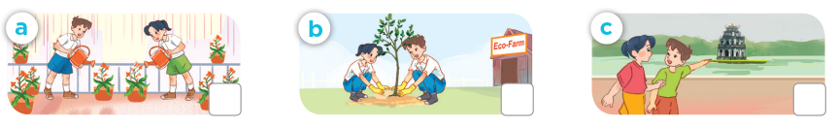
Listen and tick.
  4. What did Minh and Mai do last Sunday?
✓

Slide 14
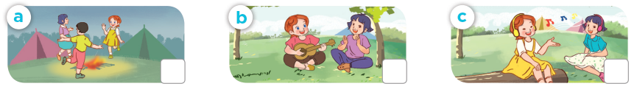
Listen and tick.
  5. What did Lucy and Linh do last weekend?
✓

Slide 15
03
Activity 2.
Answer the questions.

Slide 16
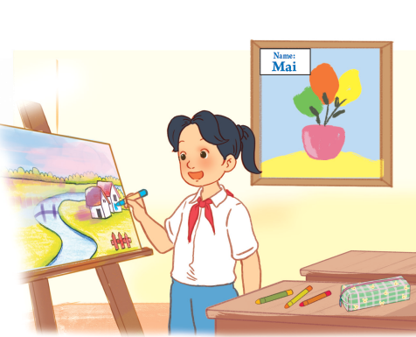
Answer the questions.
1. What school activity does Mai like?
She likes drawing pictures.

Slide 17
Answer the questions.
2. Where are the crayons?
They’re on the desk.

Slide 18
Answer the questions.
3. Whose picture is on the wall?
It’s Mai’s.

Slide 19
Answer the questions.
4. Do you like drawing pictures? Why?
Yes, I do. Because I think it’s interesting.

Slide 20
04
Fun corner and Wrap-up

Slide 21



Slide 22
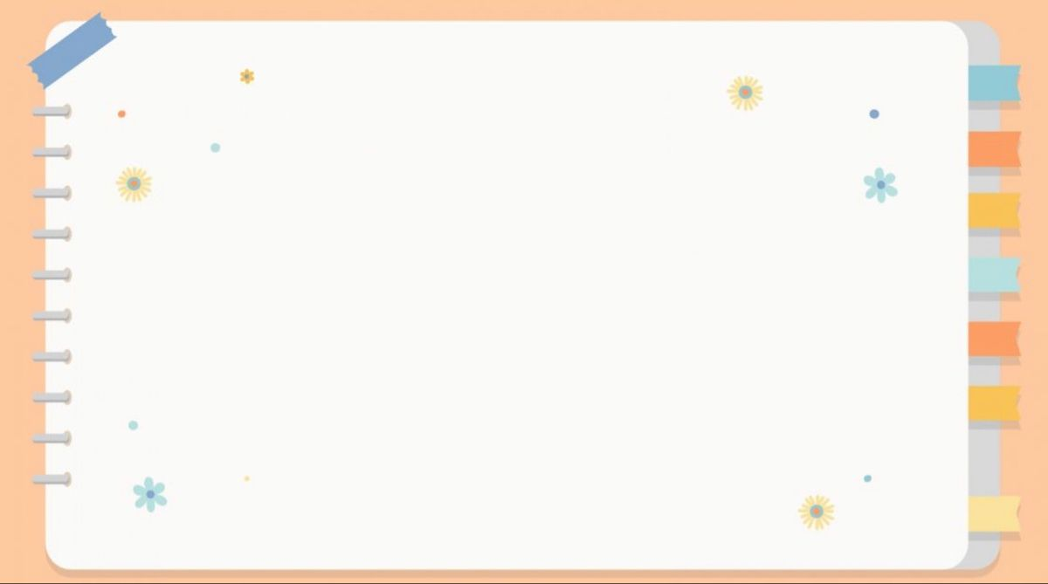
listen to music
play the guitar
listen to music
play the guitar
dance around the campfire
draw pictures
dance around the campfire
draw pictures
crayon
water the flowers
crayon
water the flowers
plant trees
read books
plant trees
read books
clever
friendly
clever
friendly
active
glue stick
active
glue stick
clever
set square
clever
set square
visit the old buildings
pencil sharpener
visit the old buildings
pencil sharpener

Slide 23


Slide 24
draw pictures
play the guitar
dance around the campfire
listen to music
read books
water the flowers
plant trees
crayon
glue stick
friendly
active
clever
pencil sharpener
set square
visit the old buildings
clever

Slide 25


Very Good!

Slide 26
Website: hoclieu.vn
Fanpage: https://www.facebook.com/tienganhglobalsuccess.vn/

