Slide 2

Review 2
Extension Activities – Period 3

Slide 3

Table of contents
01
Warm-up and Review
Activity 1: Write the activities in the correct places.
02
Activity 2: Answer the questions about your last holiday.
03
04
Activity 3: Board game. Roll a dice. Listen and answer.
05
Fun corner and Wrap-up

Slide 4


01
Warm-up and Review

Slide 5


GUESSING
GAME
Multiple Choice

Slide 6

Multiple Choice
1. Where did you go last Sunday?
a. I watched TV.
b. I went to Hoan Kiem lake.
c. It was fun.

Slide 7
Multiple Choice
2. What did you do there in the morning?
a. I walked around the lake.
b. I walk around the lake.
c. I’m walking around the lake.

Slide 8
Multiple Choice
3. What did you do in the afternoon?
a. They played games.
b. I drew a picture.
c. I draw a picture.

Slide 9
Multiple Choice
4. How was your trip?
a. We went home late.
b. We was in a restaurant.
c. It was a lot of fun.

Slide 10


Very Good!

Slide 11
02
Activity 1. Write the activities in the correct places.

Slide 12
Write the activities in the correct places.
ice skating
horse riding
mountain biking
swimming in the sea
skiing
taking photos
visiting a museum
playing beach volleyball
Adventure holiday
hiking
Beach holiday
- going on a boat tour
Sightseeing holiday
shopping
Winter holiday
- building a snowman

Slide 13



Slide 14
Write the activities in the correct places.
ice skating
horse riding
mountain biking
swimming in the sea
skiing
taking photos
visiting a museum
playing beach volleyball
Adventure holiday
hiking
Beach holiday
going on a
boat tour
Sightseeing holiday
shopping
Winter holiday
- building a snowman
-
Notes:
Click vào các chữ từ phía trên để điền vào nhóm thích hợp.

Slide 15
03
Activity 2.
Answer the questions about your last holiday.

Slide 16

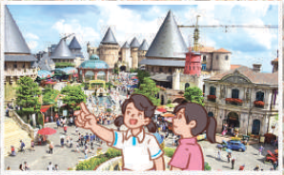
Answer the questions about your last holiday.
1. Where did you go?
___________________________________________________
2. What kind of holiday was it?
___________________________________________________
3. Who did you go with?
___________________________________________________
4. What did you do?
___________________________________________________
5. Did you enjoy the holiday? Why (not)?
______________________________________________________________________
Notes:
Giáo viên cho HS đọc câu hỏi. Đưa hình ảnh để HS thể hỏi và trả lời về hình ảnh đó.

Slide 17


Slide 18
04
Activity 3. Board game.
Roll a dice. Listen and answer.

Slide 19

Roll a dice
Game

Slide 20



05
Fun corner and Wrap-up
LET'S START!

Slide 21


05
Fun corner and Wrap-up

Slide 22
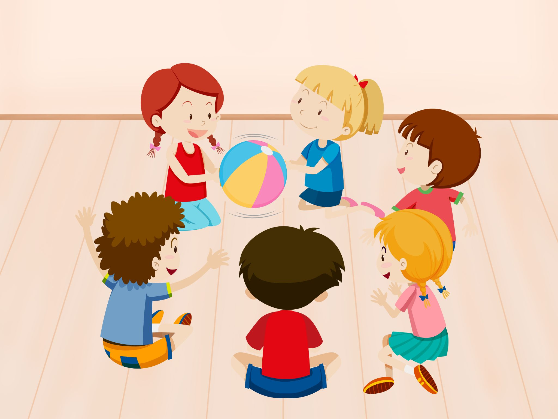
PASS THE BALLS
Notes:
Giáo viên nháy choột để bật nhạc và dừng nhạc. Dừng nhạc bạn nào cầm bóng thì trả lời câu hỏi.

Slide 23

Answer the questions.
Where did you go?
I went to Ba Na Hills.
Notes:
Giáo viên đưa ra câu trả lời gợi ý để chữa bài.

Slide 24
PASS THE BALLS
Notes:
Giáo viên nháy choột để bật nhạc và dừng nhạc. Dừng nhạc bạn nào cầm bóng thì trả lời câu hỏi.

Slide 25
Answer the questions.
What kind of holiday was it?
It was summer holiday.
Notes:
Giáo viên đưa ra câu trả lời gợi ý để chữa bài.

Slide 26
PASS THE BALLS
Notes:
Giáo viên nháy choột để bật nhạc và dừng nhạc. Dừng nhạc bạn nào cầm bóng thì trả lời câu hỏi.

Slide 27
Answer the questions.
Who did you go with?
I went there with my friend.
Notes:
Giáo viên đưa ra câu trả lời gợi ý để chữa bài.

Slide 28
PASS THE BALLS
Notes:
Giáo viên nháy choột để bật nhạc và dừng nhạc. Dừng nhạc bạn nào cầm bóng thì trả lời câu hỏi.

Slide 29
Answer the questions.
What did you do?
We visited the old buildings.
Notes:
Giáo viên đưa ra câu trả lời gợi ý để chữa bài.

Slide 30
PASS THE BALLS
Notes:
Giáo viên nháy choột để bật nhạc và dừng nhạc. Dừng nhạc bạn nào cầm bóng thì trả lời câu hỏi.

Slide 31
Answer the questions.
Did you enjoy the holiday? Why (not)?
Yes. Because it was a lot of fun.
Notes:
Giáo viên đưa ra câu trả lời gợi ý để chữa bài.

Slide 32

Very Good!

Slide 33
Website: hoclieu.vn
Fanpage: https://www.facebook.com/tienganhglobalsuccess.vn/

