Slide 1





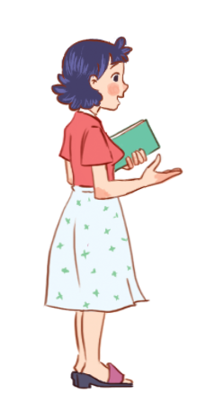
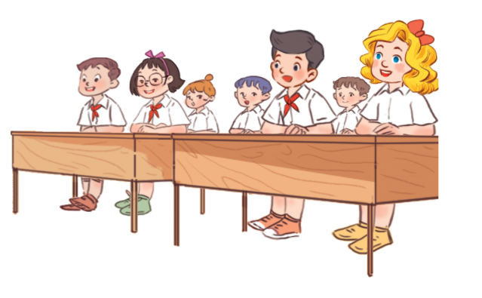


Mến gửi quý thầy cô!
Bộ bài giảng Tiếng Anh 1 - 4 Global này được biên soạn bởi MsPham, là công sức lao động và là tâm huyết của MsPham. Vì vậy, khi đăng kí nhận bài giảng, quý thầy cô được tùy ý chỉnh sửa cho phù hợp mục đích giảng dạy của mình.
Tuy nhiên, mọi hình thức chia sẻ, trao đổi, mua bán, cho tặng bộ bài giảng này đều vi phạm và là ăn cắp.
Kính mong thầy cô cùng mình giữ gìn sự cao quý của nghề giáo và cùng nhau tôn trọng công sức của đồng nghiệp.
Trân trọng!
MsPham – 0936082789
Review 2
MsPham
0936092789
Period 1
Teacher:
Ms. Huyen Pham
MsPham
0936092789

Slide 2

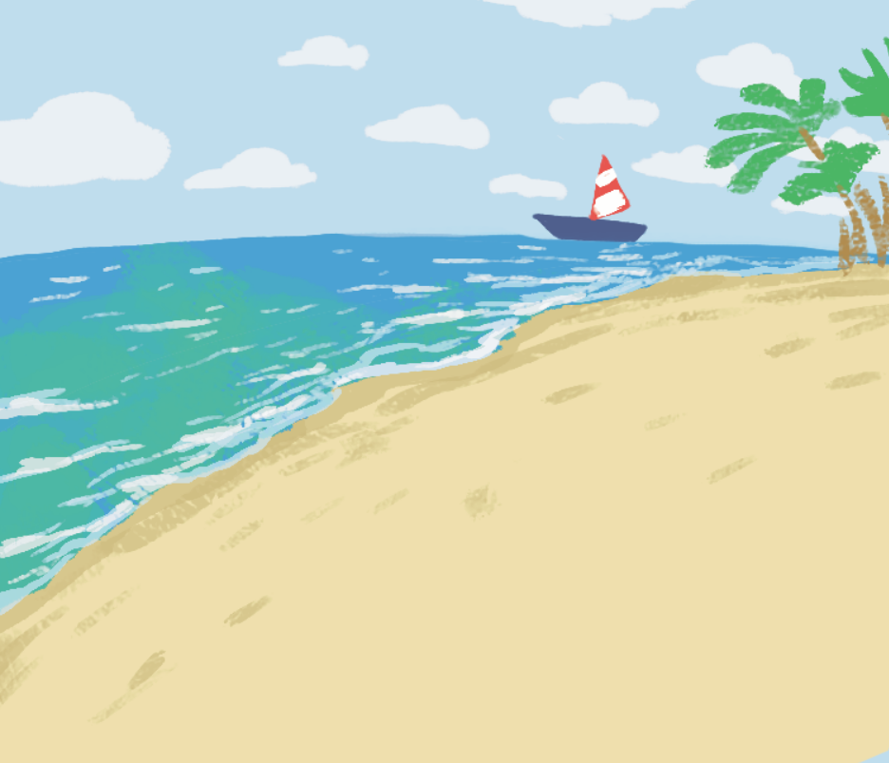

Look and say
I do
Were you on the beach last weekend? - Yes, _______.
Answer
Notes:
Ms Huyền Phạm - 0936.082.789

Slide 3
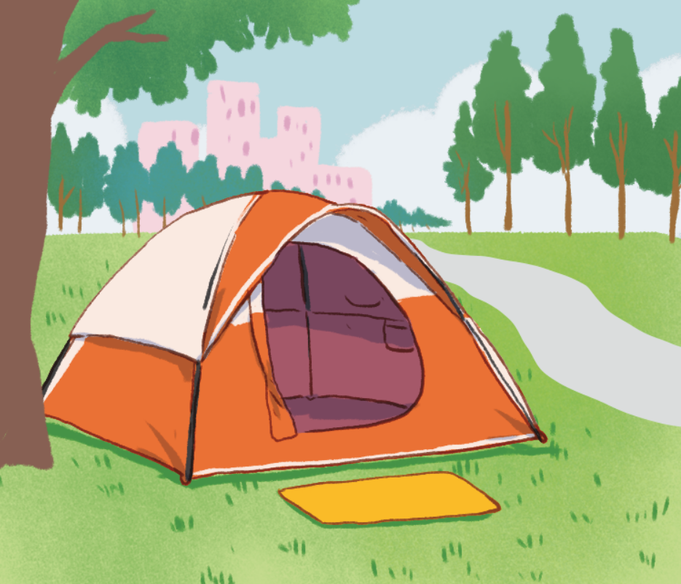
Look and say
at the campsite
Were you __________ last weekend?
No, I don’t.
Answer
Notes:
Ms Huyền Phạm - 0936.082.789

Slide 4

Look and say
moutain
Where’s your school?
It’s in the ______.
Answer
Notes:
Ms Huyền Phạm - 0936.082.789

Slide 5
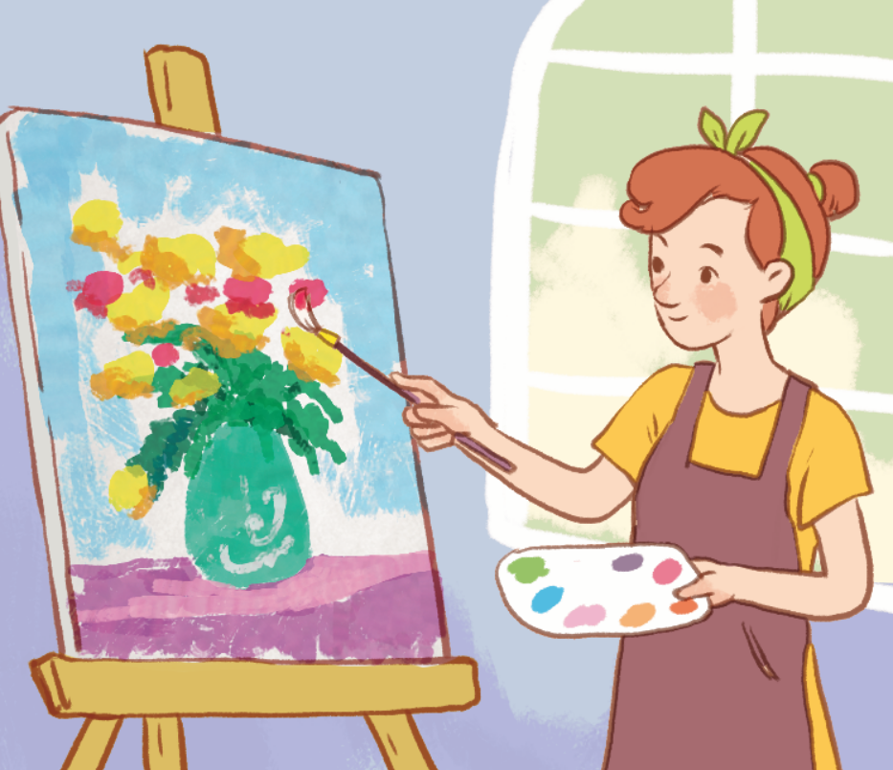
Look and say
art
Why do you like _____?
Because I want to be a painter.
Answer
Notes:
Ms Huyền Phạm - 0936.082.789

Slide 6
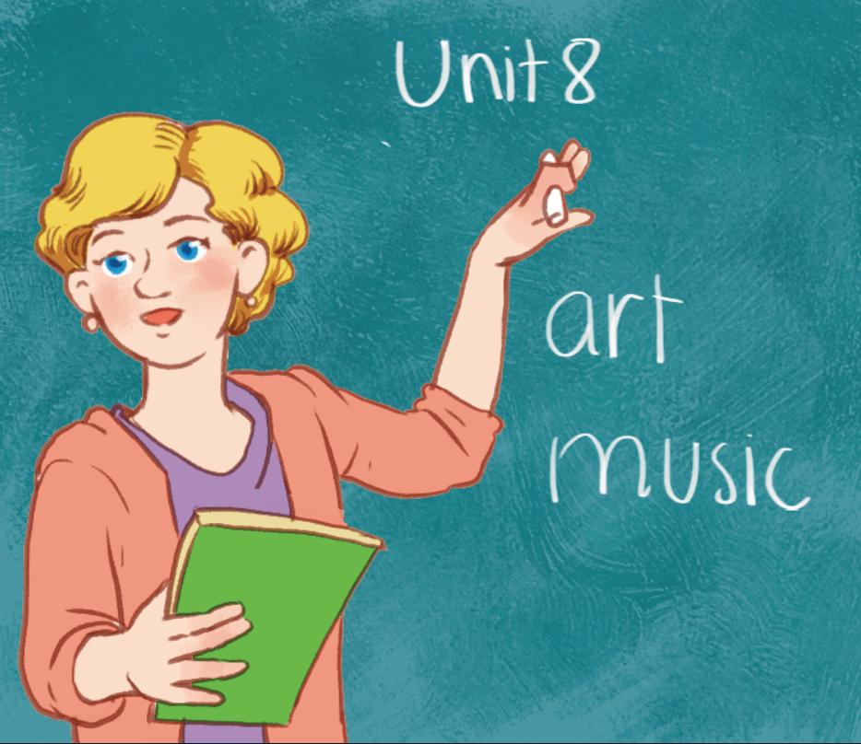
Look and say
a notebook
Answer
Notes:
Ms Huyền Phạm - 0936.082.789

Slide 7
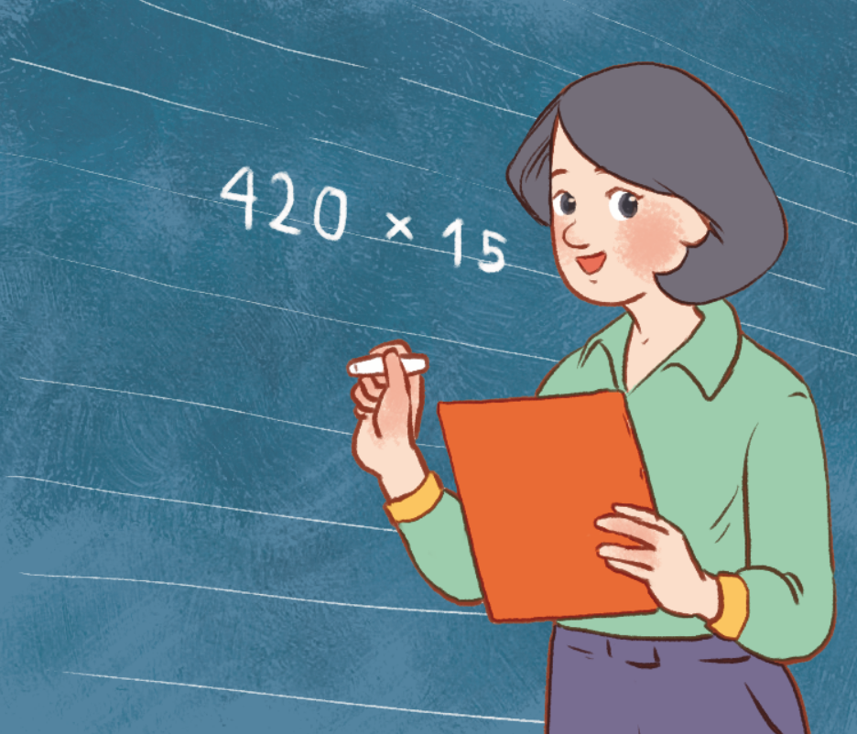
Look and say
Thursday
When do you have maths?
I have it on _____.
Thứ 5 , ngày … tháng … năm ….
Answer
Notes:
Ms Huyền Phạm - 0936.082.789 –

Slide 8
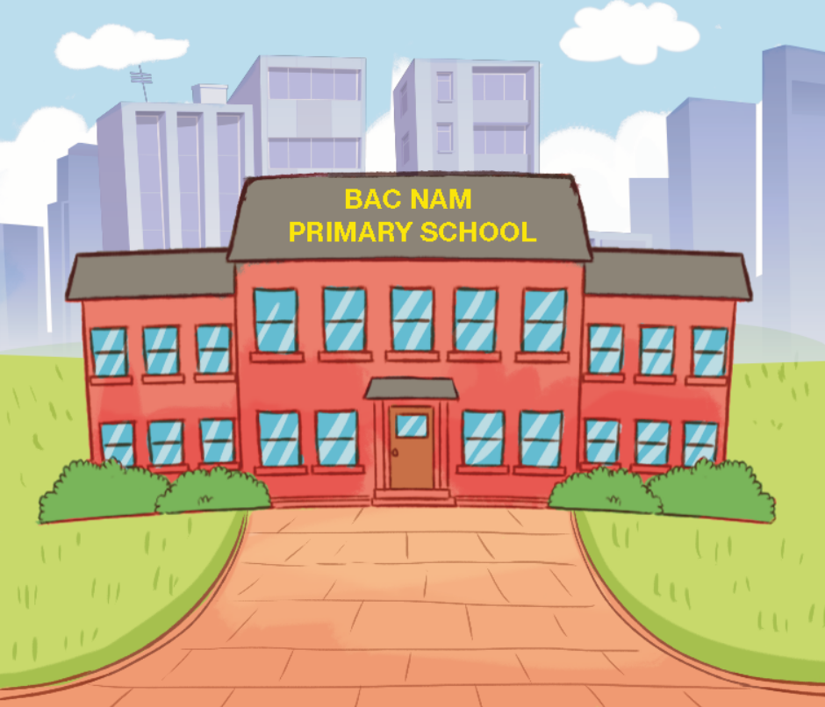
Look and say
one
How many buildings are there at your school?
There is ______.
Answer
Notes:
Ms Huyền Phạm - 0936.082.789

Slide 9
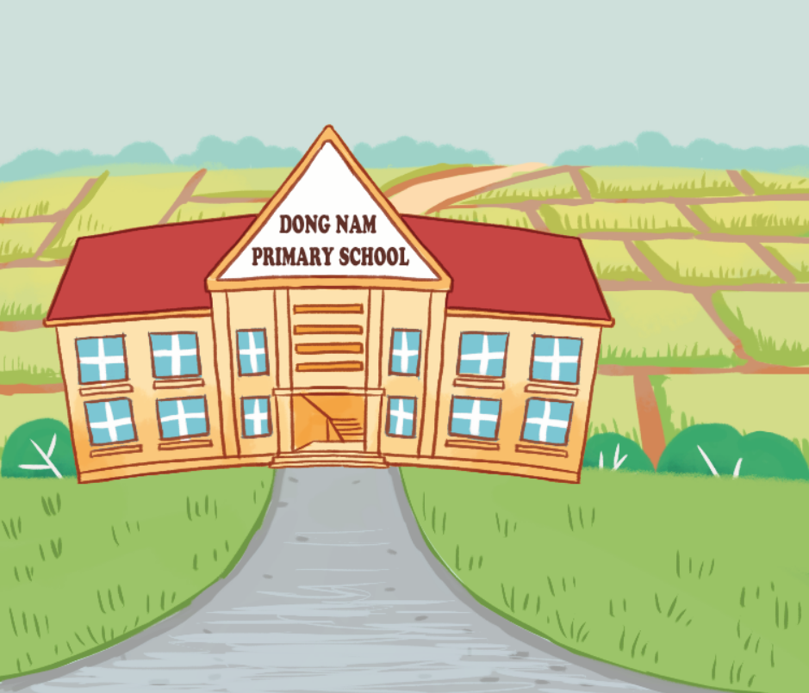
Look and say
countryside
Where’s your school?
It’s in the ______.
Answer
Notes:
Ms Huyền Phạm - 0936.082.789 –

Slide 10
Practice
MsPham
0936092789

Slide 11
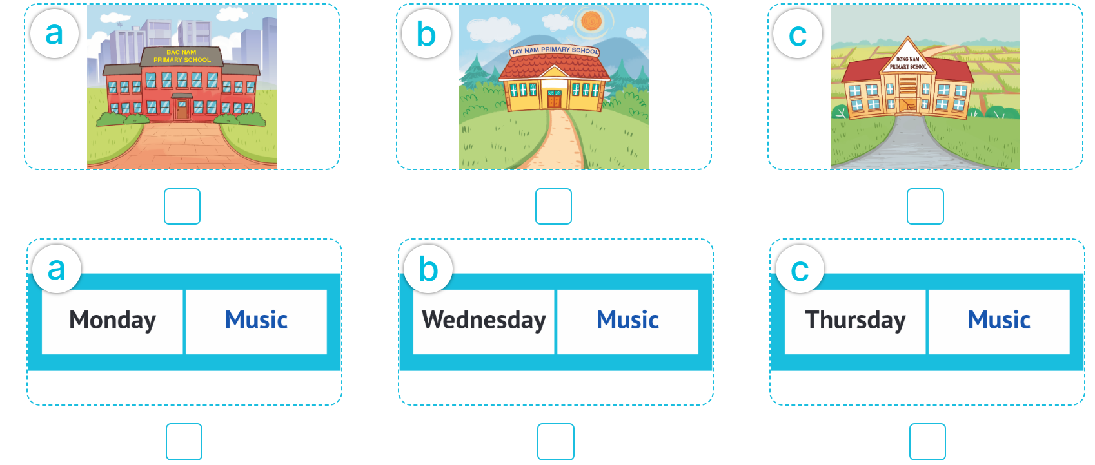
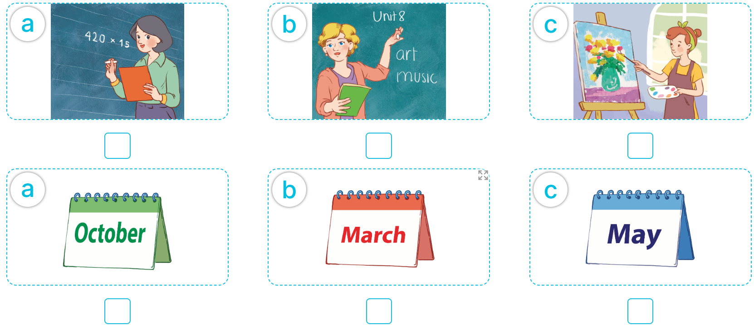
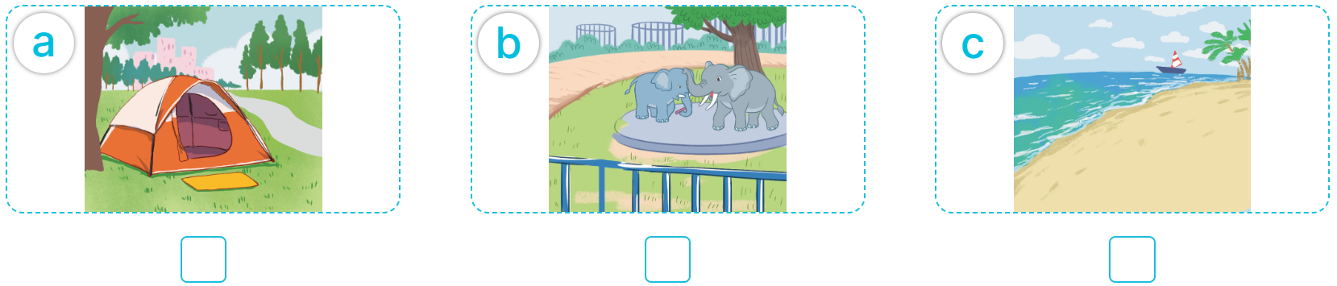

1
Listen and tick.
MsPham
0936092789

Slide 12

1
Listen and tick.
MsPham
0936092789

Slide 13
1
Listen and tick.
MsPham
0936092789

Slide 14
1
Listen and tick.
MsPham
0936092789

Slide 15
1
Listen and tick.
MsPham
0936092789

Slide 16
1
Listen and tick.
MsPham
0936092789

Slide 17
1
Listen and tick.
Answer key
MsPham
0936092789

Slide 18
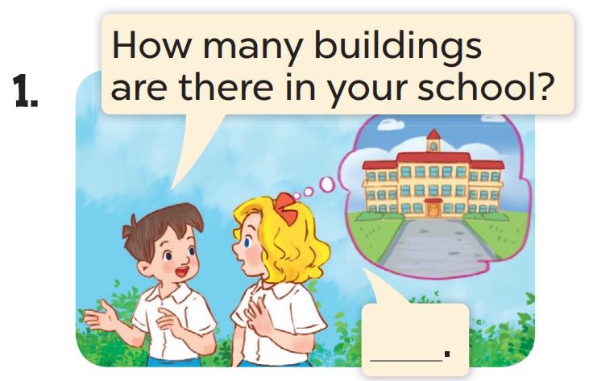
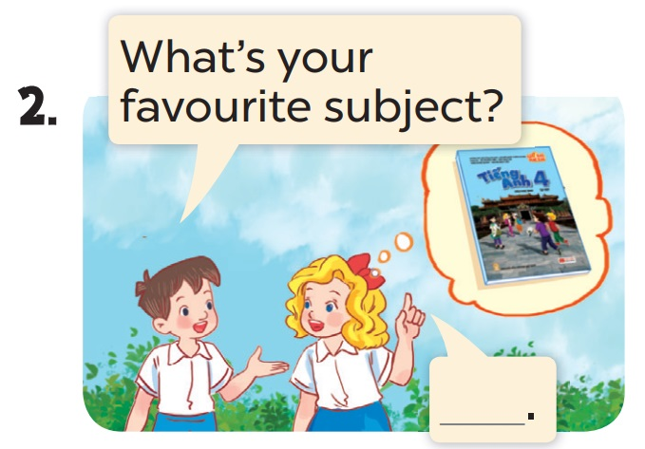
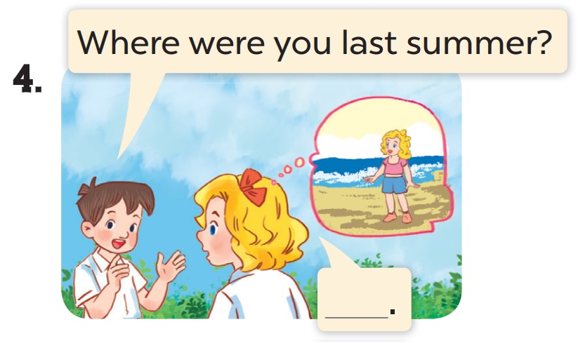
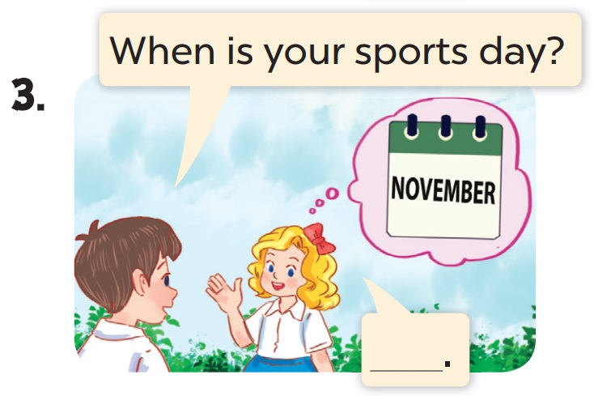
2
Ask and answer.
MsPham
0936092789
There is one.
It’s English.
I was on the beach.
It’s in November.

Slide 19
Speaking
test
MsPham
0936092789

Slide 20
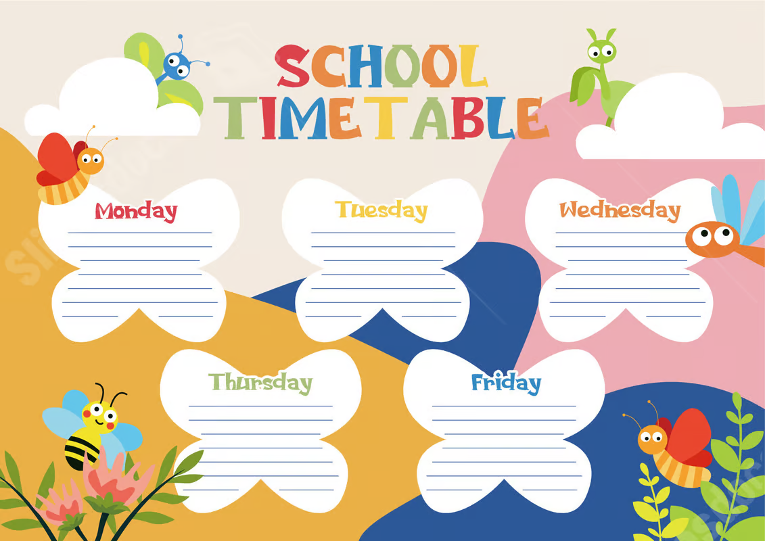
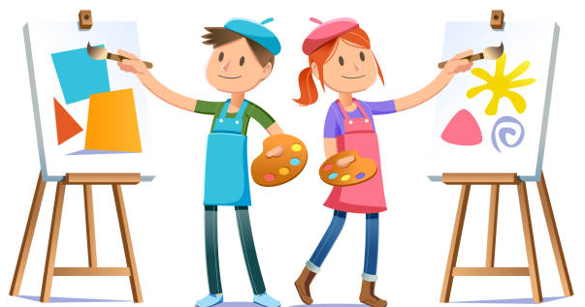
Do you have art on Tuesdays?
Yes, I do. / No, I don’t.

Slide 21
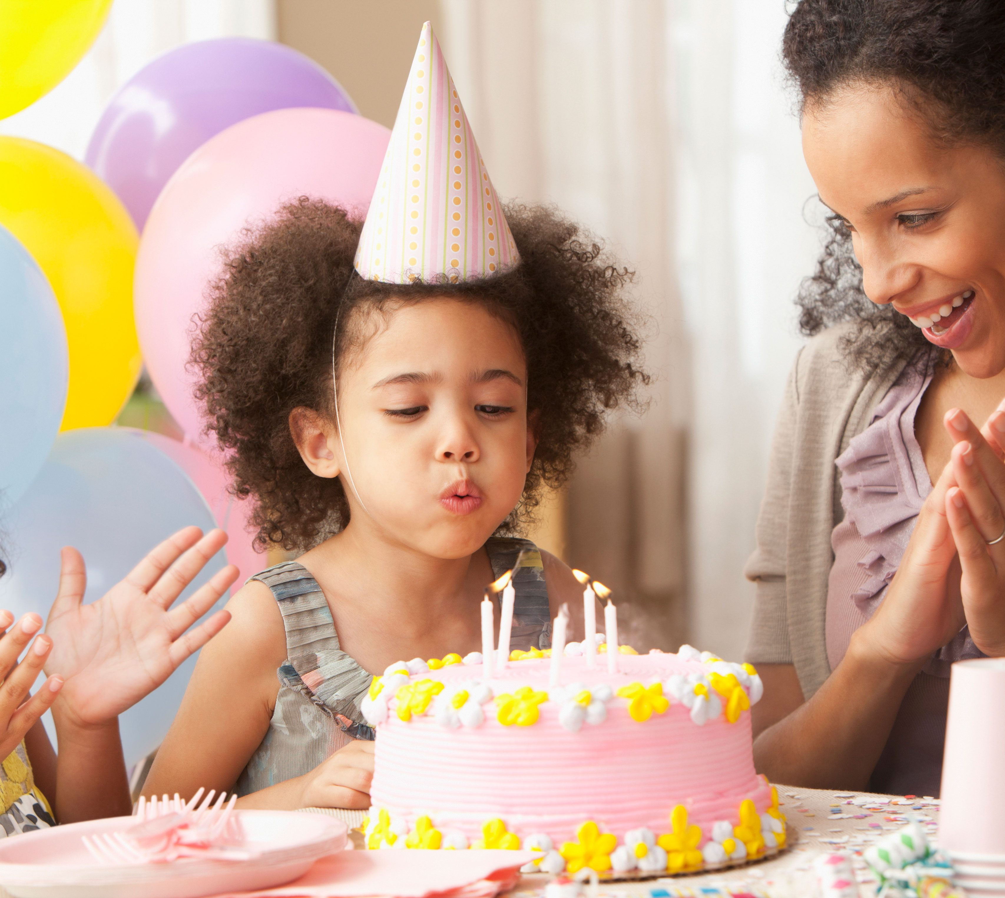
When’s your birthday?
It’s in ________.

Slide 22

How many buildings are there at your school?
There is/ are ________.

Slide 23
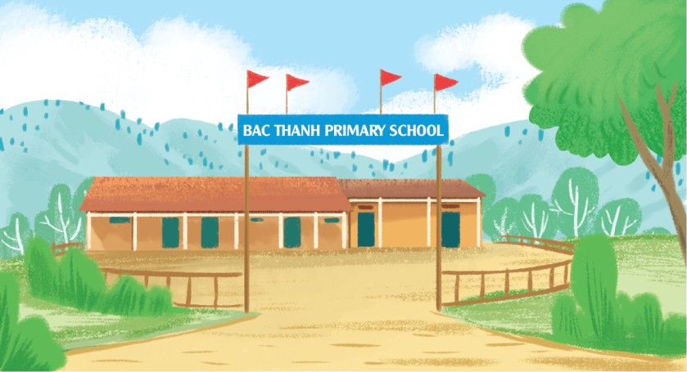
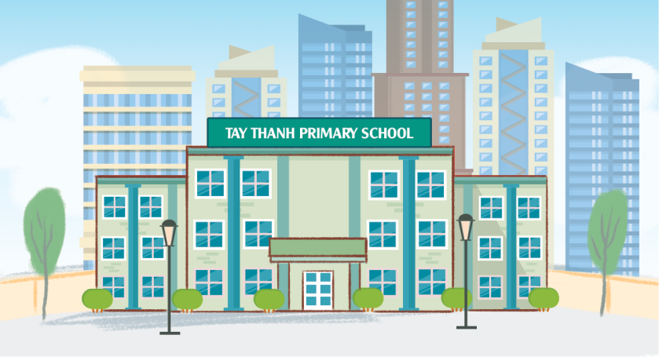
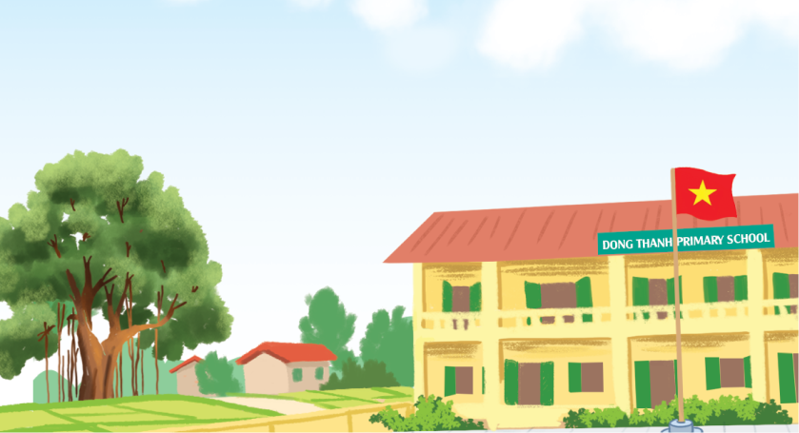
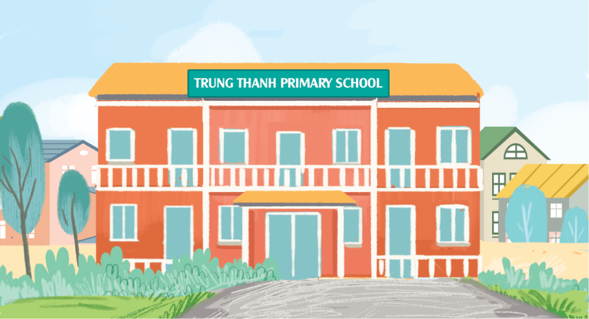
Where’s your school?
It’s in the _____.

Slide 24
What subjects do you have on Mondays?
I have __________.

Slide 25
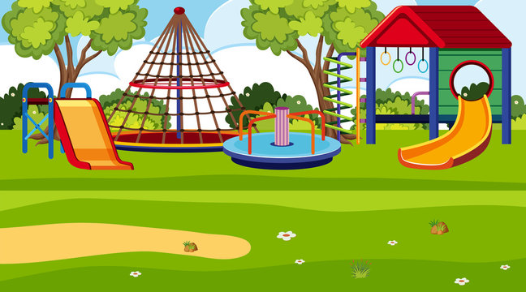
Is there a playground at your school?
Yes, there is. / No, there isn’t.

Slide 26
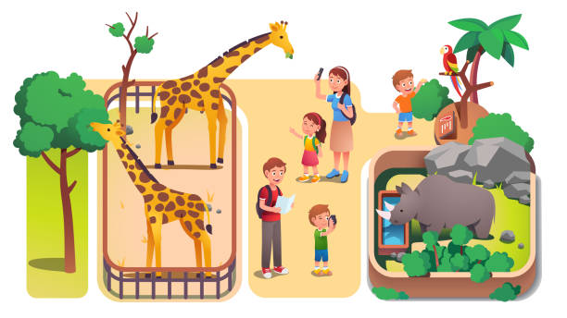
Were you at the zoo yesterday?
Yes, I was./ No, I wasn’t.

Slide 27

What’s your favourite subject?
It’s ___________________.

Slide 28
Why do you like it?
Because I want to be a/ an __________.

Slide 29
Where were you last summer?
I was in/ at / on _________.

