Slide 1
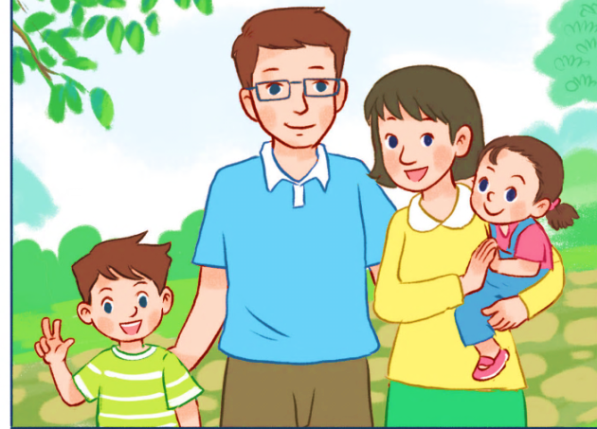
My family
Unit 11
Lesson 1 (1+2+3)

Slide 2

Warm-up

Slide 3

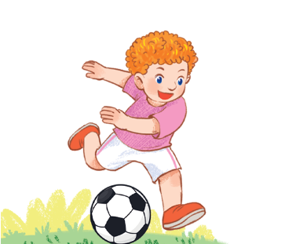

Let’s chant.
What do you do at break time?
Football.
Football.
I play football.
I play football.
What do you do at break time?
Volleyball.
Volleyball.
I play volleyball.
I play volleyball.

Slide 4



Facebook : Bùi Liễu
0968142780
Contents
Look, listen and repeat.
Listen, point and say.
Let’s talk.

Slide 5

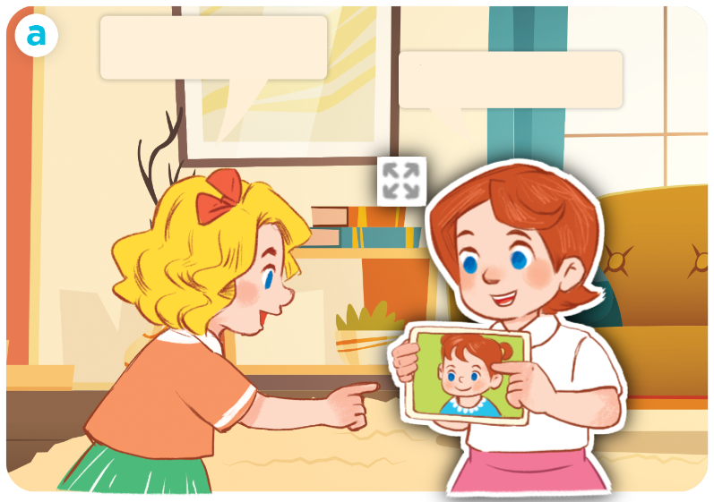
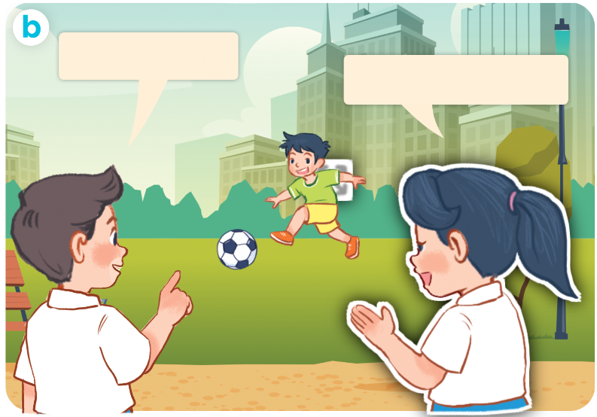
1. Look, listen and repeat.
Click on the speaker / sentences to listen again.
Who’s this?
Who’s that?
It’s my sister.
It’s my brother.
Who are they?
Where are they?
What are they doing?
Click on the screen to show 3 questions.

Slide 6
Vocabulary

Slide 7
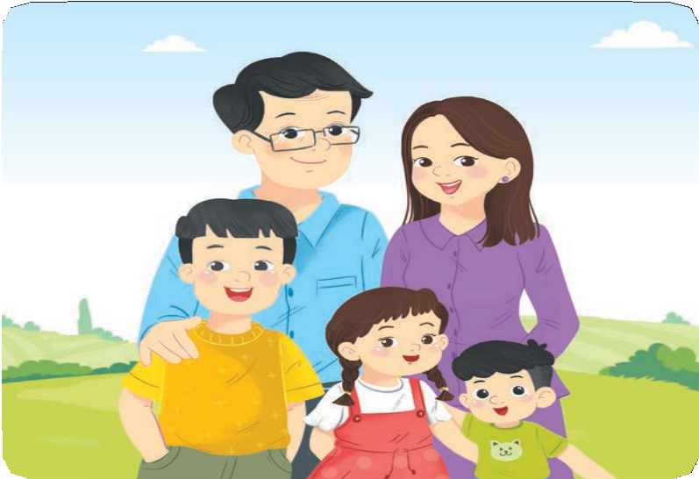
Vocabulary
family
/ˈfæmɪli/
gia đình
Click on the words to listen again.

Slide 8

mother
/ˈmʌðə/
mẹ

Slide 9
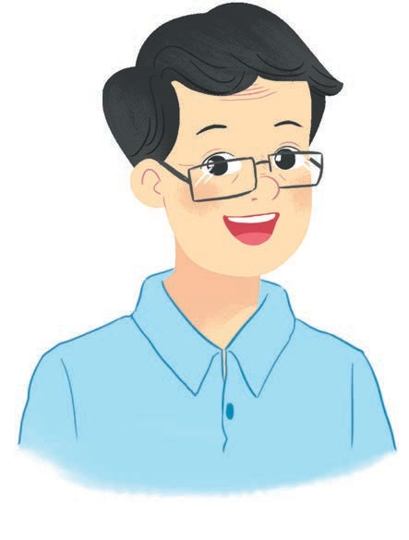
father
/ˈfɑːðə/
bố

Slide 10
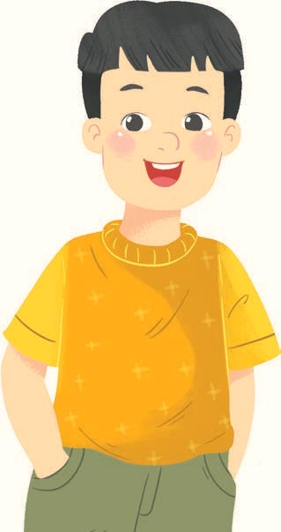
brother
/ˈbrʌðə/
anh / em trai

Slide 11
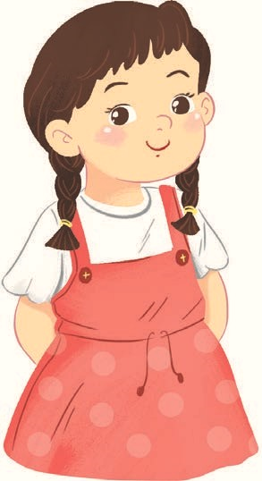
sister
/ˈsɪstə/
chị / em gái

Slide 12




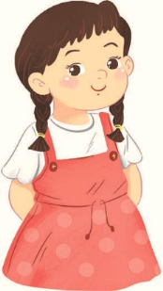
Review
family
mother
father
brother
sister
Click on the words to listen again.

Slide 13





Vocabulary
1. family
: gia đình
2. mother
: mẹ
3. father
: bố
4. brother
: anh / em trai
5. sister
: chị / em gái
Click on the words to listen again.

Slide 14




Checking vocabulary
1
3
a. mother
b. brother
2
c. father
4
d. sister

Slide 15
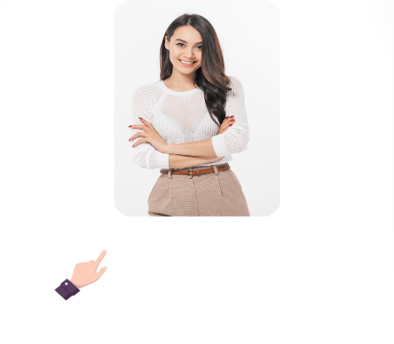


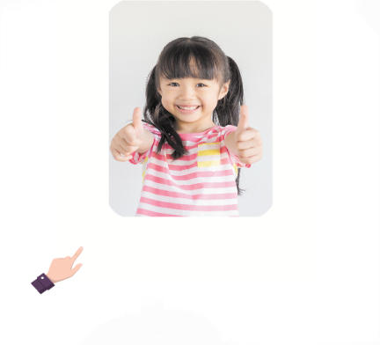
2. Listen, point and say.
a
b
Who’s this / that?
mother
It’s my _____.
father
c
d
who’s = who is it’s = it is
brother
sister

Slide 16



2. Listen, point and say.
a
Who’s this / that?
It’s my _______.
mother
Who’s that?
It’s my mother.
Click on the sentences to listen again.

Slide 17


2. Listen, point and say.
b
Who’s this / that?
It’s my _______.
father
Who’s this?
It’s my father.

Slide 18

2. Listen, point and say.
c
Who’s this / that?
It’s my _______.
brother
Who’s this?
It’s my brother.

Slide 19
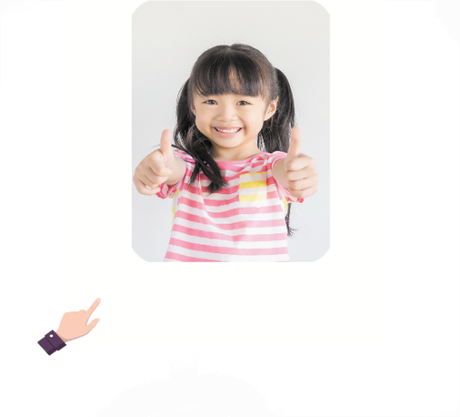
2. Listen, point and say.
d
Who’s this / that?
It’s my _______.
sister
Who’s that?
It’s my sister.

Slide 20
Structures

Slide 21


Structures
Hỏi và trả lời “đây / kia là ai”
- Who’s this / that?
(Đây / kia là ai?)
- It’s my _______. (Đó là …. tớ)
who’s = who is it’s = it is
Example:
Mary: Who’s this?
Linh: It’s my mother.

Slide 22

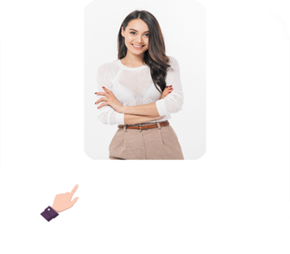



Unit 11 lesson 1 (1+2+3)
Who’s this / that?
who’s = who is
It’s = it is
It’s my______.
mother
sister
father
brother

Slide 23
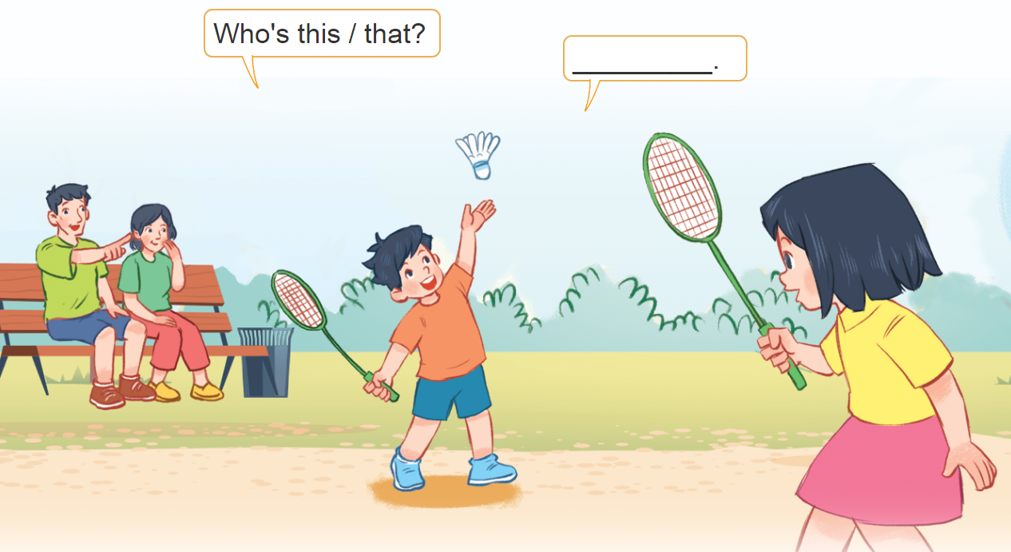
3. Let’s talk.
Who’s this / that?
____________.

Slide 24
3. Let’s talk.
It’s my father
Who’s _____?
____________.
that

Slide 25
3. Let’s talk.
It’s my mother
____________.
Who’s _____?
that

Slide 26
3. Let’s talk.
It’s my brother
____________.
Who’s _____?
this

Slide 27
3. Let’s talk.
It’s my sister
____________.
Who’s _____?
this

Slide 28


Facebook : Bùi Liễu
0968142780
Let’s play!

Slide 29















Slide 30





Slide 31






Slide 32








Slide 33
family

Slide 34
- Who’s this? - It’s my sister.

Slide 35
- Who’s this? - It’s my mother.

Slide 36



- Who’s that? - It’s my brother.

Slide 37




sister
family
mother

Slide 38


Facebook : Bùi Liễu
0968142780
Mary: _____________? Nam: It’s my father.
Who is that
Who’s this
Who is this

Slide 39

Facebook : Bùi Liễu
0968142780
Mary: _____________? Nam: It’s my brother.
Who is that?
Who is this?
Who’s that

Slide 40

Mary: Who is that?
Nam: ______ my mother.
It’s
They are
They’re

Slide 41
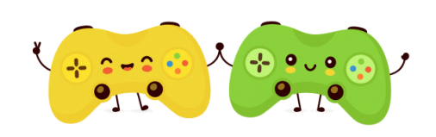
Facebook : Bùi Liễu
0968142780
WELL DONE!

Slide 42
Wrap up

Slide 43
Review
Who’s this / that?
who’s = who is
It’s = it is
It’s my______.
mother
sister
father
brother

Slide 44

Thank you!

