Slide 1
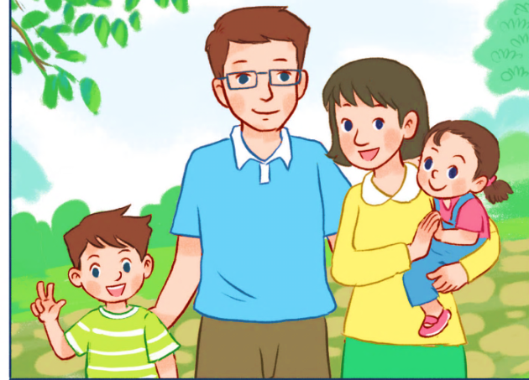
My family
Unit 11
Lesson 1 (4+5+6)

Slide 2

Warm-up

Slide 3

Let’s play!

Slide 4

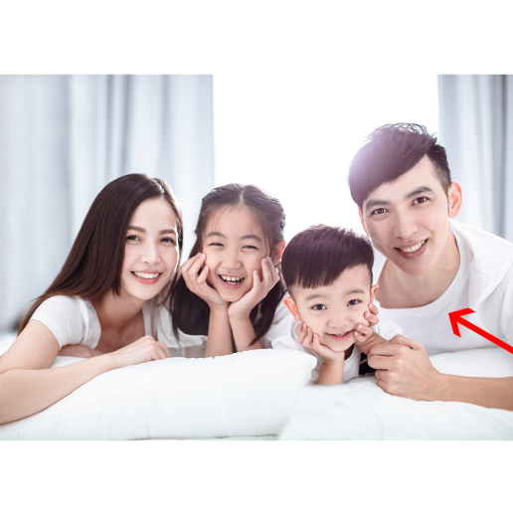






father
mother
brother

Slide 5

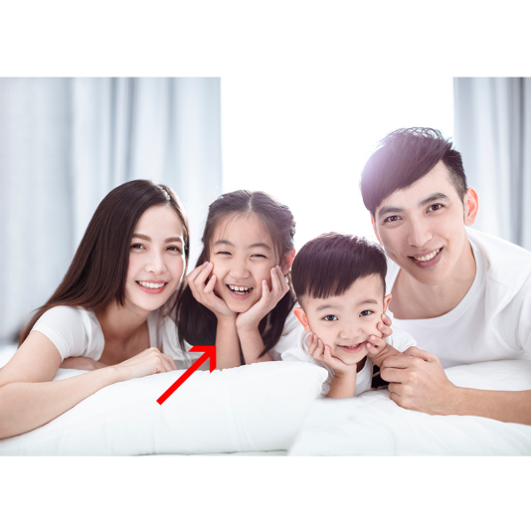

mother
sister
brother

Slide 6

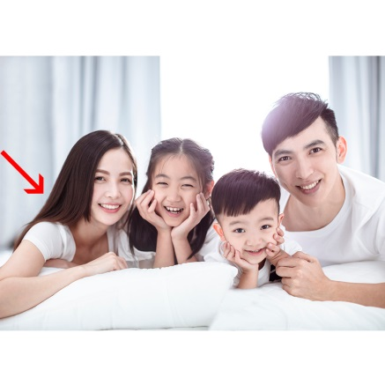
sister
mother
brother

Slide 7

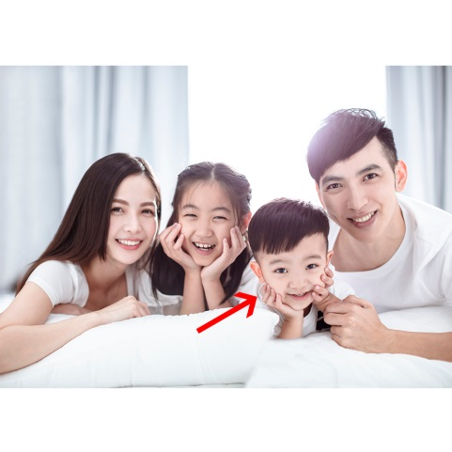
mother
father
brother

Slide 8
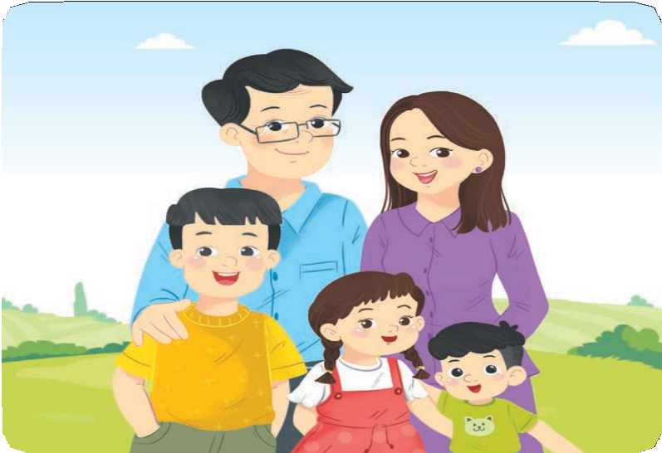
sister
family
father

Slide 9

Who’s ____?
It’s my mother.
it
this
that

Slide 10

Who’s that?
It’s my sister.
sister → mother
True
Fasle

Slide 11


Who’s ____?
It’s my father.
this
that
there

Slide 12


Facebook : Bùi Liễu
0968142780
____ this?
It’s my brother.
Where’s
What’s
Who’s

Slide 13
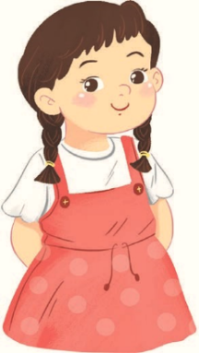


False
True

Slide 14

Facebook : Bùi Liễu
0968142780
Well done!

Slide 15



Facebook : Bùi Liễu
0968142780
Contents
Listen and tick.
Look, complete and read.
Let’s sing.

Slide 16







4. Listen and tick.
1
a
b
2
a
b
Click on the speaker /pots to listen.

Slide 17
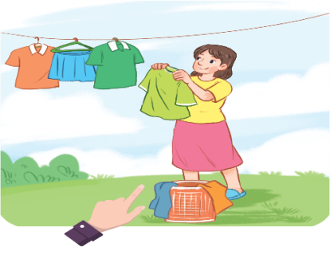
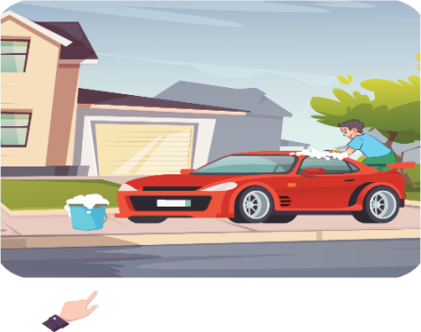
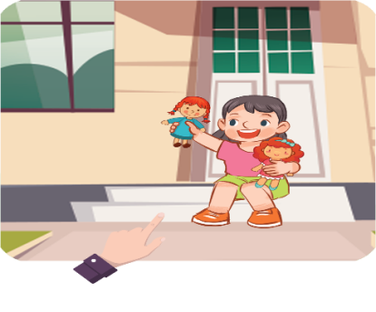
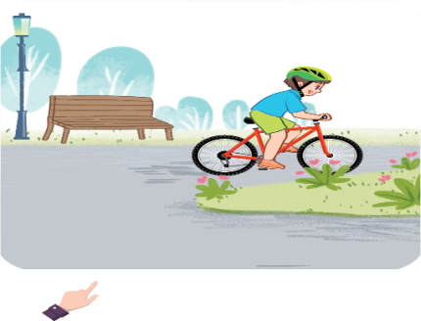
5. Look, complete and read.
1. A: Who’s this?
B: It’s my ______.
2. A: Who’s that?
B: It’s my ______.
mother
father
3. A: Who’s this?
B: It’s my ______.
4. A: Who’s that?
B: It’s my ______.
sister
brother

Slide 18


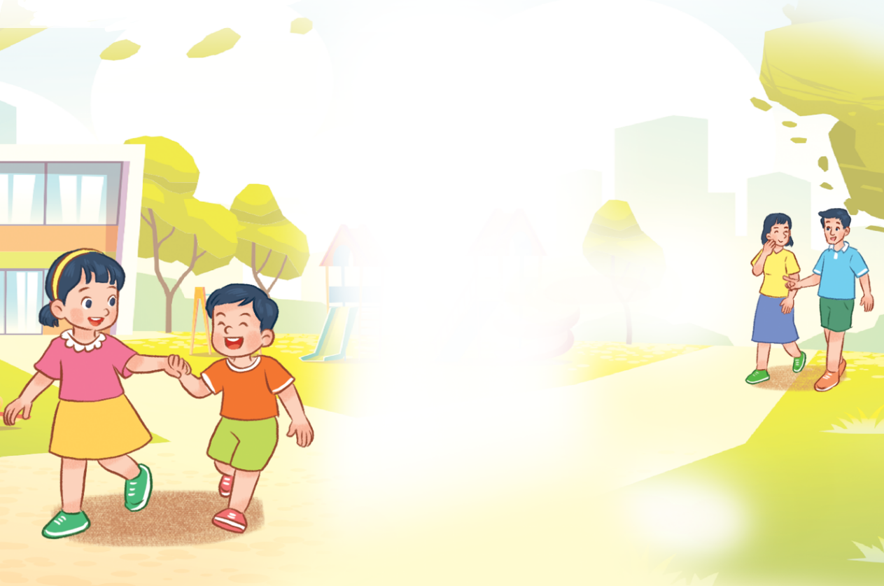








6. Let’s sing.
Who’s this?
It’s my brother.
Who’s this?
It’s my sister.
My brother and my sister.
Who’s that?
It’s my mother.
Who’s that?
It’s my father.
My mother and my father.
Click on the leaves to listen again.

Slide 19

6. Let’s sing.

Slide 20

6. Let’s sing.
Who’s this?
It’s my brother.
Who’s this?
It’s my sister.
My brother and my sister.
Who’s that?
It’s my mother.
Who’s that?
It’s my father.
My mother and my father.
Click on the “karaoke” symbol to listen.

Slide 21
Wrap up

Slide 22




Review
Who’s this / that?
who’s = who is
It’s = it is
It’s my______.
mother
sister
father
brother

Slide 23

Thank you!

