Slide 1
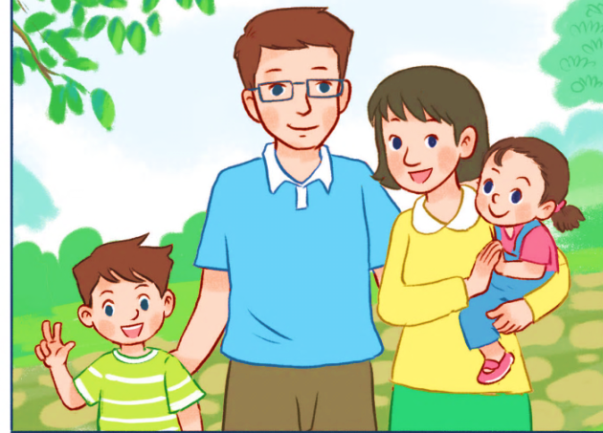
My family
Unit 11
Lesson 2 (1+2+3)

Slide 2
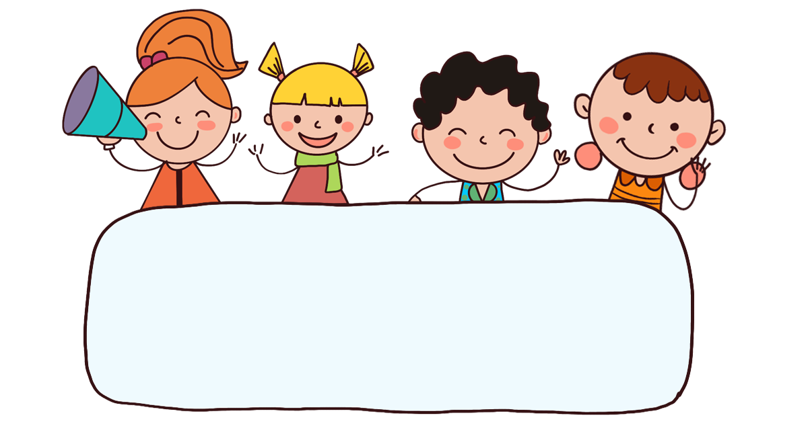
Warm-up

Slide 3

















Picking
apples
END
Chia lớp thành 3 nhóm, mỗi nhóm được 1 giỏ. Đội nào trả lời đúng thì click vào giỏ để hái 1 trái táo vào giỏ.

Slide 4


It’s my father.
A: Who’s that?
B: ___________
A
It’s my mother.
B
It’s my brother.
C

Slide 5
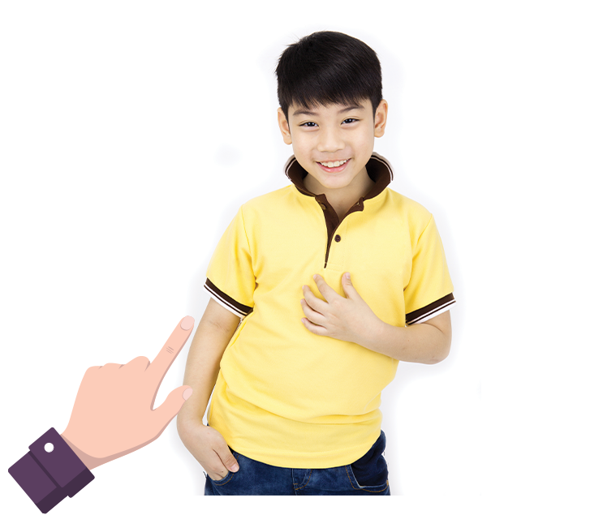
It’s my brother.
A: Who’s this?
B: ___________.
A
It’s my father.
B
It’s my sister.
C

Slide 6
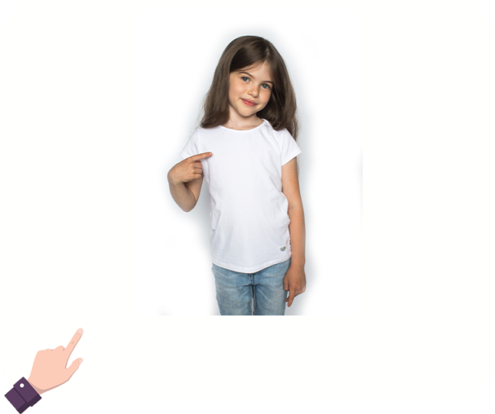
It’s my family.
A: Who’s that?
B: ____________.
A
It’s my mother.
B
It’s my sister.
C

Slide 7

It’s my mother.
A: Who’s this?
B: ____________.
A
It’s my father.
B
It’s my family.
C

Slide 8
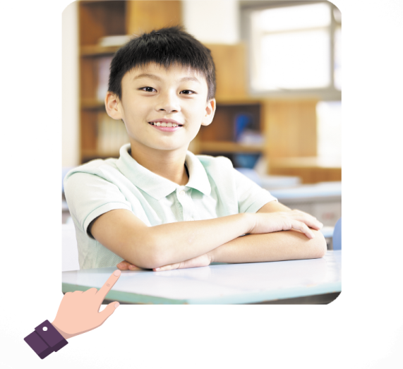
A: Who’s that?
B: ____ is my brother.
She
A
It
B

Slide 9
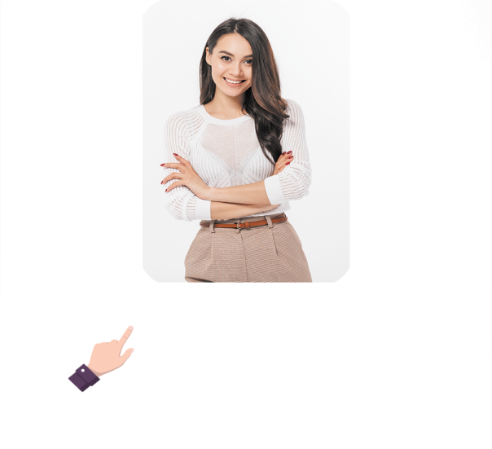
A: Who’s _____?
B: It is my mother.
this
A
that
B

Slide 10
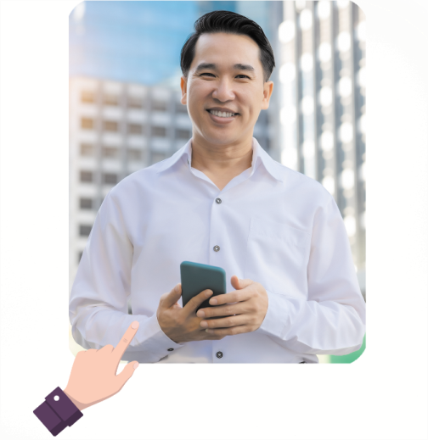
A: Who’s _____?
B: It is my father.
that
A
this
B

Slide 11
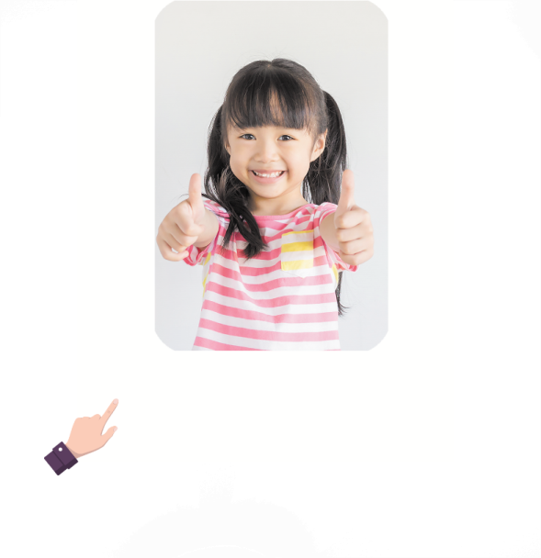
______ that?
What is
A
Who is
B

Slide 12
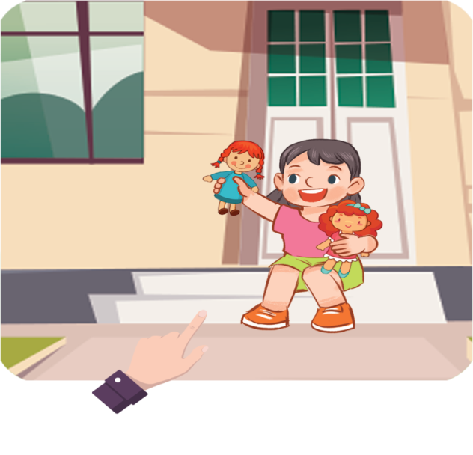
A: _____ that?
B: It is my sister.
Who is
A
Who are
B

Slide 13
Thank you!

Slide 14



Facebook : Bùi Liễu
0968142780
Contents
Look, listen and repeat.
Listen, point and say.
Let’s talk.

Slide 15

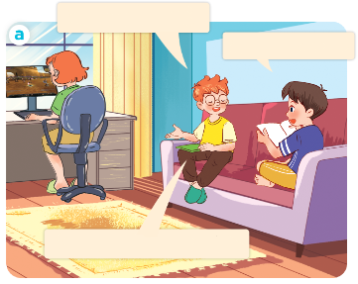
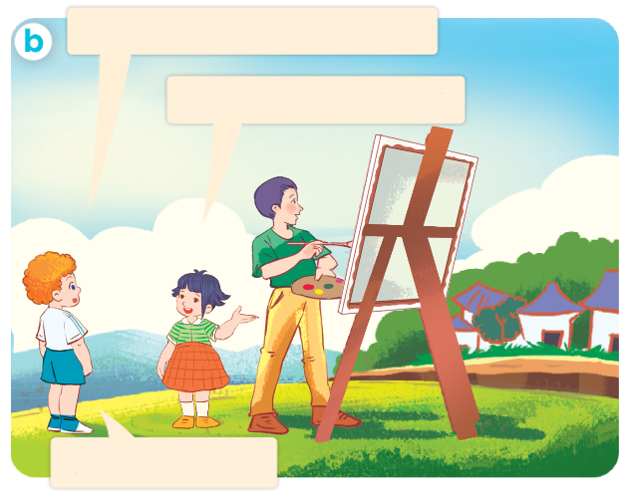
1. Look, listen and repeat.
This is my sister.
How old
is she?
How old is your brother?
He’s twenty years old.
She’s thirteen years old.
Are you sure?
Who are they?
Where are they?
What are they doing?
Click on the speaker / sentences to listen.

Slide 16
Vocabulary
Notes:
Facebook : Bùi Liễu
Mobile phone: 0968142780

Slide 17









Numbers
eleven
twelve
thirteen
fourteen
fifteen
/ɪˈlevən/
/twelv/
/ˌθɜːˈtiːn/
/ˌfɔːˈtiːn/
/ˌfɪfˈtiːn/
sixteen
seventeen
eighteen
nineteen
/ˌsɪksˈtiːn/
/ˌsevənˈtiːn/
/ˌeɪˈtiːn/
/ˌnaɪnˈtiːn/
Click on the words to listen again.

Slide 18









twenty
thirty
forty
fifty
sixty
/ˈtwentɪ/
/ˈθɜːtɪ/
/ˈfɔːtɪ/
/ˈfɪftɪ/
/ˈsɪkstɪ/
seventy
eighty
ninety
one hundred
/ˈsevəntɪ/
/ˈeɪtɪ/
/ˈnaɪntɪ/
/wʌn ˈhʌndrəd/

Slide 19
22
=
20
+
2
twenty - two
twenty
two
45
40
+
5
=
forty - five
forty
five
78
=
70
+
8
seventy - eight
seventy
eight

Slide 20

Let’s watch a video!

Slide 21
Look and say
12
twelve
a
14
fourteen
b
18
eighteen
c
19
nineteen
d

Slide 22
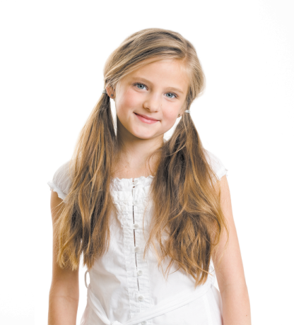
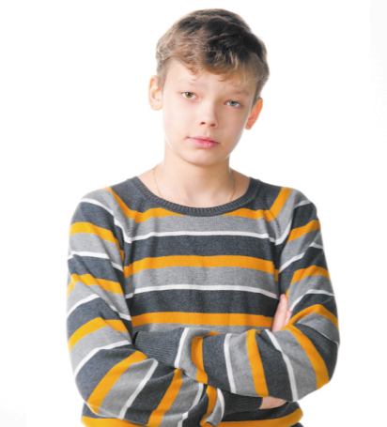
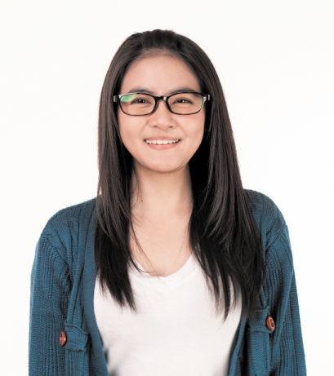
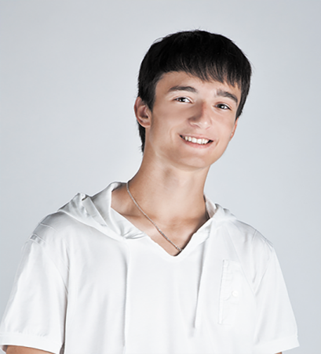
2. Listen, point and say.
How old is he / she?
he’s = he is
she’s = she is
He’s / She’s _____.
a
b
c
d
twelve
fourteen
eighteen
nineteen

Slide 23
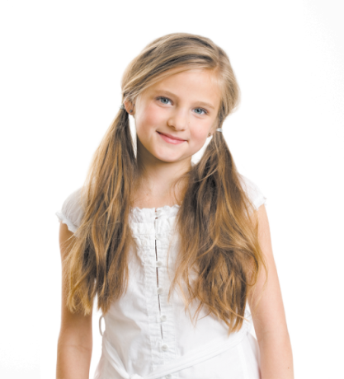


2. Listen, point and say.
a
How old is he / she?
He’s / She’s _____.
twelve
How old is she?
She’s twelve.
Click on the sentences to listen again.
Notes:
Facebook : Bùi Liễu
Mobile phone: 0968142780

Slide 24


2. Listen, point and say.
b
How old is he / she?
He’s / She’s _____.
fourteen
How old is he?
He’s fourteen.
Notes:
Facebook : Bùi Liễu
Mobile phone: 0968142780

Slide 25

2. Listen, point and say.
c
How old is he / she?
He’s / She’s _____.
eighteen
How old is she?
She’s eighteen.
Notes:
Facebook : Bùi Liễu
Mobile phone: 0968142780

Slide 26
2. Listen, point and say.
d
How old is he / she?
He’s / She’s _____.
nineteen
How old is he?
He’s nineteen.
Notes:
Facebook : Bùi Liễu
Mobile phone: 0968142780

Slide 27
Structures

Slide 28

Structures
Hỏi và trả lời về tuổi của ai đó.
How old is he / she?
(Anh ấy / cô ấy bao nhiêu tuổi?)
He’s / She’s ______. (Anh ấy / cô ấy ........... tuổi)
he’s = he is
she’s = she is
Example :
eighteen
Mary: How old is she?
Linh:She’s eighteen.

Slide 29






Unit 11 lesson 2 (1+2+3)
he’s = he is
she’s = she is
How old is he / she?
He’s / She’s _____.
twelve
nineteen
fourteen
eighteen

Slide 30
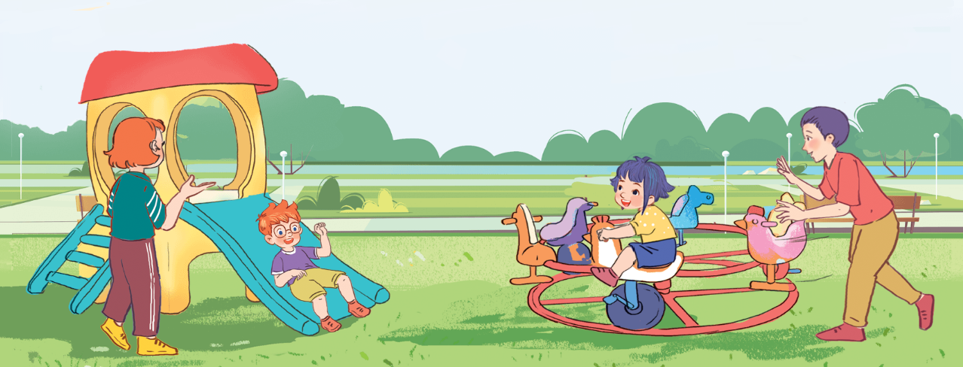
3. Let’s talk.
How old ______?
___________________.
20
13
8
8

Slide 31
3. Let’s talk.
How old ______?
is she
___________________.
She’s thirteen years old
13

Slide 32
3. Let’s talk.
How old ______?
is he
________________.
He’s eight years old
8

Slide 33
3. Let’s talk.
How old ______?
is she
__________________.
She’s eight years old
8

Slide 34
3. Let’s talk.
is he
How old ______?
__________________.
He’s twenty years old
20

Slide 35
Wrap up

Slide 36
Review
he’s = he is
she’s = she is
How old is he / she?
He’s / She’s _____.
twelve
nineteen
fourteen
eighteen

Slide 37

Thank you!

